Slide 1
Machine Learning methods for
NEWSdm data
Artem Golovatiuk
University of Kyiv (Ukraine)
Giovanni De Lellis, Andrey Ustyuzhanin
Universita di Napoli (Italy), Yandex (Russia)

Slide 2
Why do we need ML?
Our goal:
  Reducing the number of background events in potentially signal data
Statistical approach:
  limited by our physical understanding of the system
Machine Learning approach:
  can discover complex correlations between features, can be robust to insignificant variations in case of high input dimensions.

Slide 3
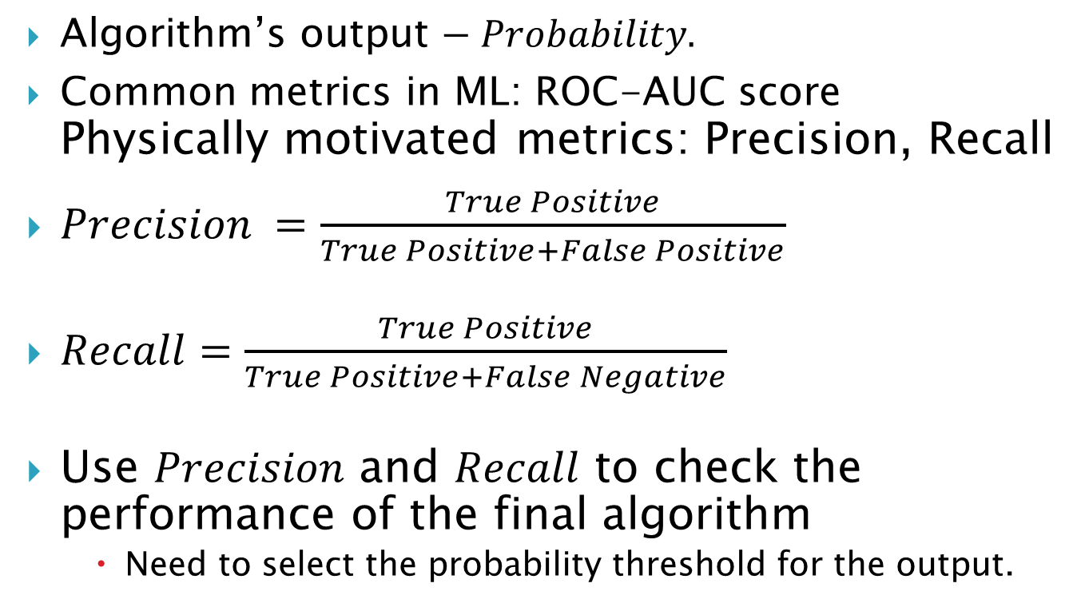
Algorithms performance metrics
Algorithm’s output $− Probability.$
Common metrics in ML: ROC-AUC score Physically motivated metrics: Precision, Recall
$Precision =\frac{True Positive}{True Positive+False Positive}$
$Recall=\frac{True Positive}{True Positive+False Negative}$
Use $Precision$ and $Recall$ to check the performance of the final algorithm
    Need to select the probability threshold for the output.

Slide 4
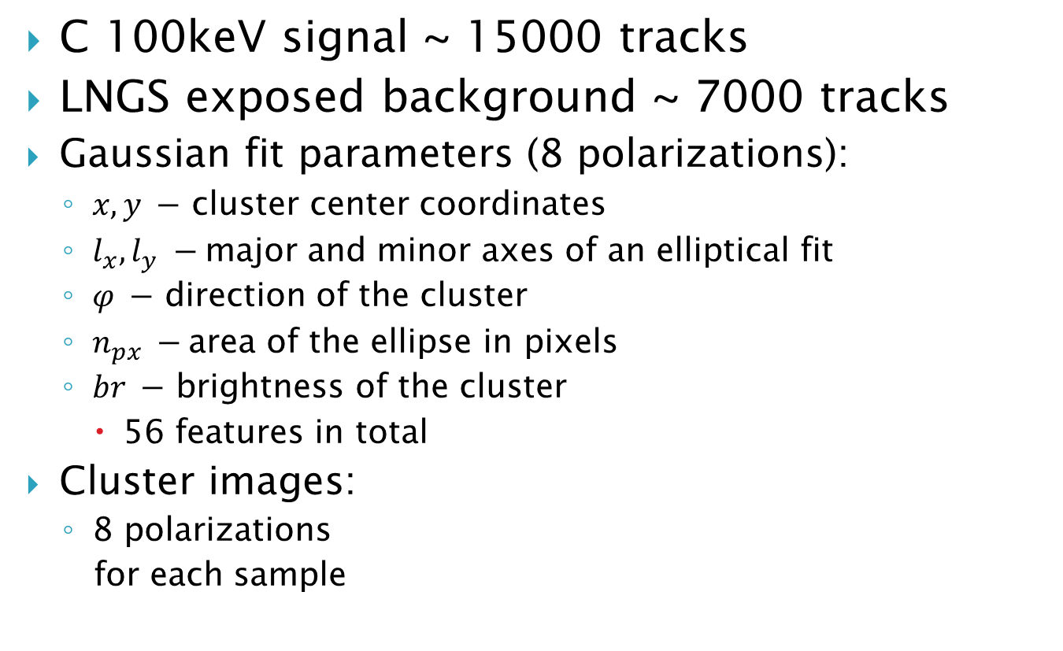
Training data
C 100keV signal ~ 15000 tracks
LNGS exposed background ~ 7000 tracks
Gaussian fit parameters (8 polarizations):
  $x, y −$ cluster center coordinates
  $l_{x}, l_{y} −$major and minor axes of an elliptical fit
  $φ −$ direction of the cluster
  $n_{px} −$area of the ellipse in pixels
  $br −$ brightness of the cluster
    56 features in total
Cluster images:
  8 polarizations
  for each sample

Slide 5
Tested approaches
Boosted Decision Trees:
  Composition of small decision trees, next one improves result of the previous one.
  Limited possibility to parallelize
Random Forest:
  Composition of very deep trees, each one makes its own decision, result is the average of probabilities.
  Highly parallelizable on CPUs
Trees weakness:
  Performance strongly depends on the features choice.

Slide 6
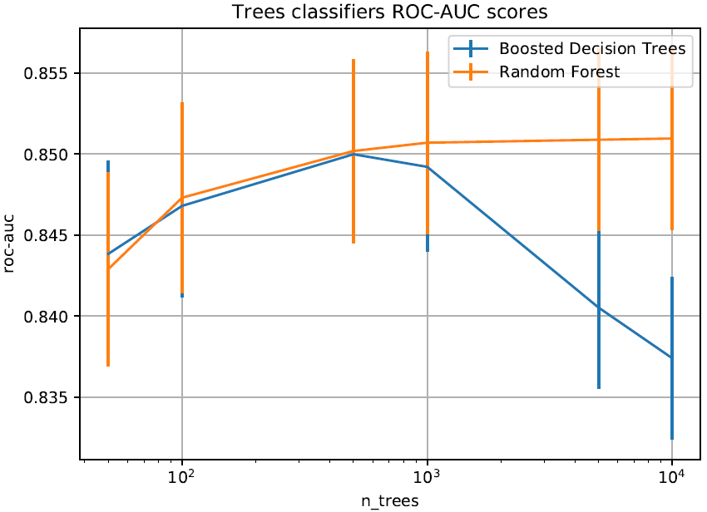
Preliminary results (Trees)

Slide 7
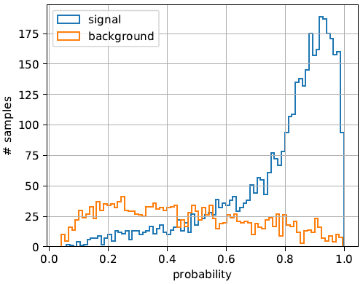
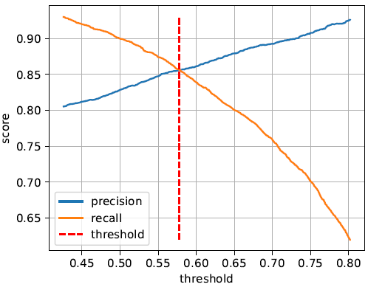
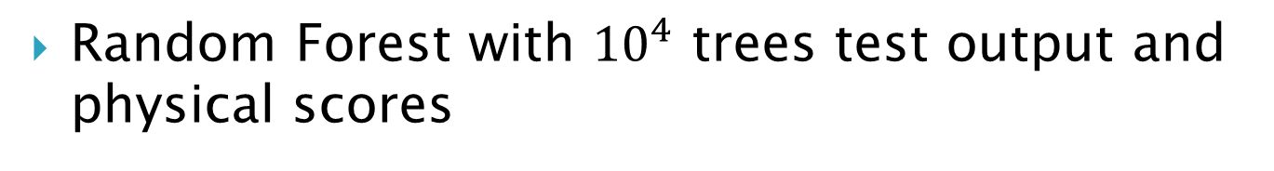
Preliminary results (Trees)
Random Forest with ${10}^{4}$ trees test output and physical scores

Slide 8
Tested approaches
Convolutional Neural Networks:
    Compared 2D and 3D architectures
    Compared Deep and Shallow Networks
  Working directly with the cluster images
  Requires large computational power (e.g. GPU)
  Larger datasets can be highly profitable for performance

Slide 9
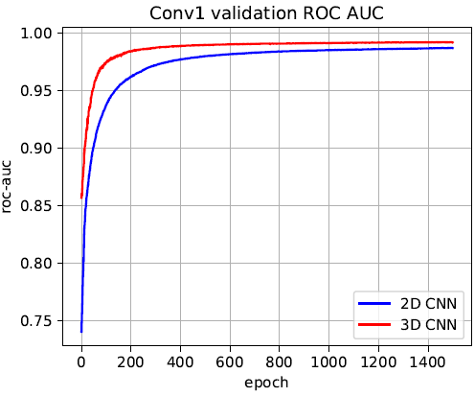
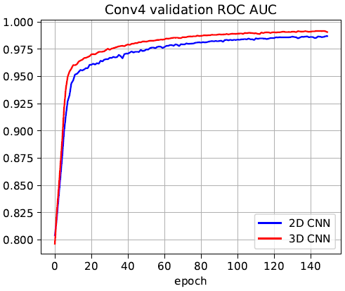
Preliminary results (CNNs)
Performance of Conv1 and Conv4 Networks
(named by the number of convolutional layers)

Slide 10
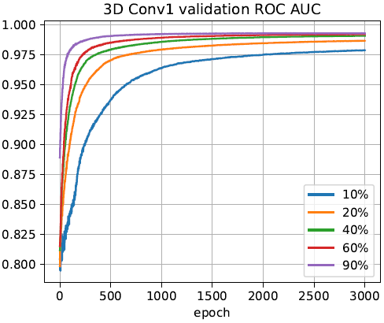
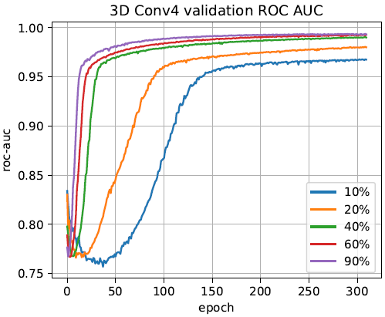
Preliminary results (CNNs)
Training size dependence of 3D Conv1 and Conv4 Networks
(named by the number of convolutional layers)

Slide 11
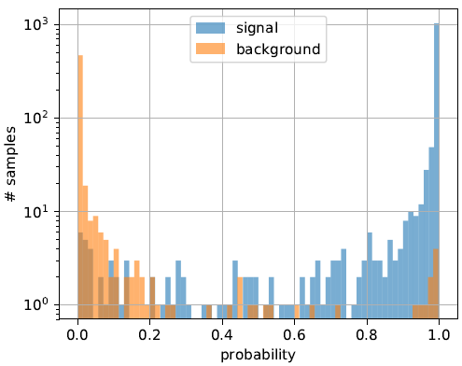
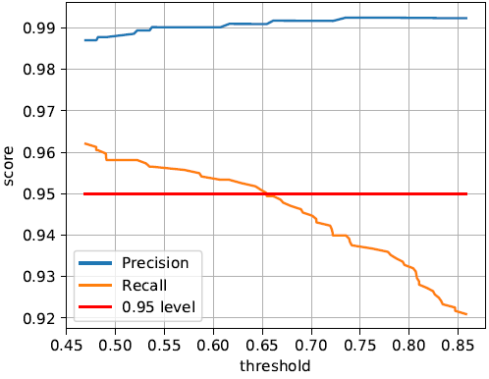
Preliminary results (CNNs)
3D Conv4 validation output and physical scores

Slide 12
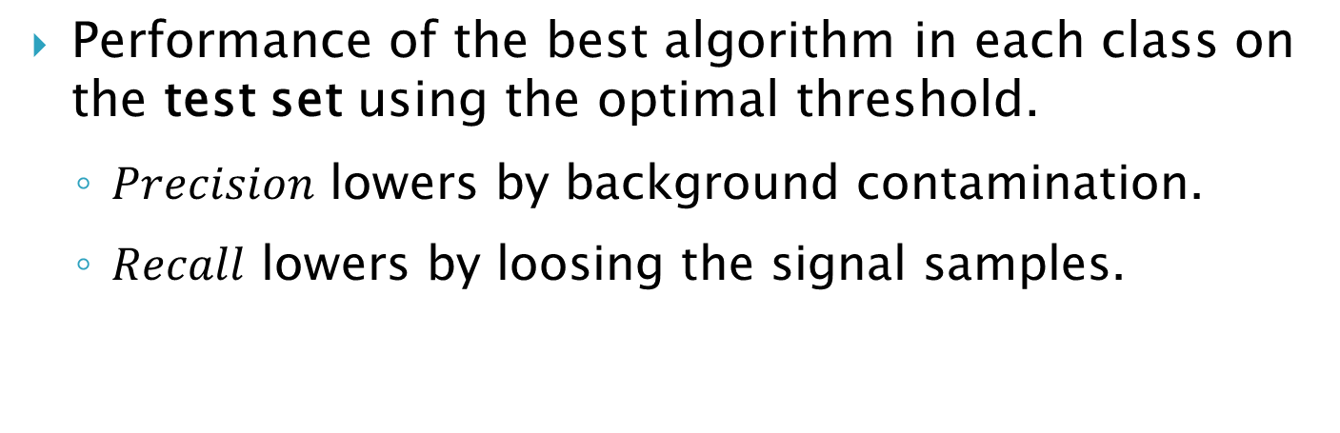
Physical results
Score | Random Forest | 3D Conv4 network
Precision | 85.62% | 99.01%
Recall | 85.62% | 95.41%
Performance of the best algorithm in each class on the test set using the optimal threshold.
  $Precision$ lowers by background contamination.
  $Recall$ lowers by loosing the signal samples.

Slide 13
Conclusions and further plans
Machine Learning can decrees background contamination by orders of magnitude without loosing any significant portion of signal.
The physical motivation in the selection of network architecture can give considerable improvement of it’s performance.
Enlarging the training set improves the networks’ performance.
Further plans:
  Enlarge and diversify the dataset.
  Rotate the emulsions during scanning for isotropic signal.
  Try getting the direction of the track as a physical feature.
  Use images from color camera.

