Slide 1
30 May 2018
Kimio Niwa
丹羽 公雄
befor OPERA after OPERA

Slide 2
PHOTOGRAPHIC EMULSION in the physics research
1896 A Beｃquerel found radioactivity
by photograpfic plate , naked eye.
1910 S Kinoshita 木下季吉 studied
the darkness by micro scope.
darkness made by tracks
“discovery of alpha particle”

Slide 3
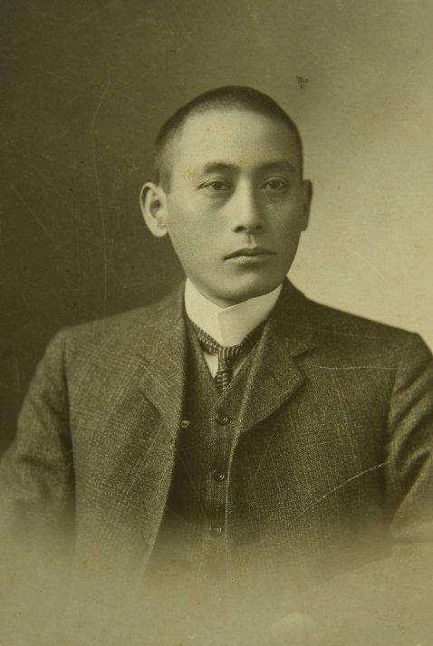
S KINOSHITA

Slide 4
1935 Powell developped electron sensitive gel G5 with ilford Co. Kodak Co. 1947 pai/ μ/e detected in cosmic ray ,thick gel [pericle]
1970 both side coated emulsion plate introduced by Japanease physisists Niu, Koshiba,Fuji Co.
Both side coated plate is 3D tracking device(x,y,tx,ty and D) with high resolution.
BB

Slide 5
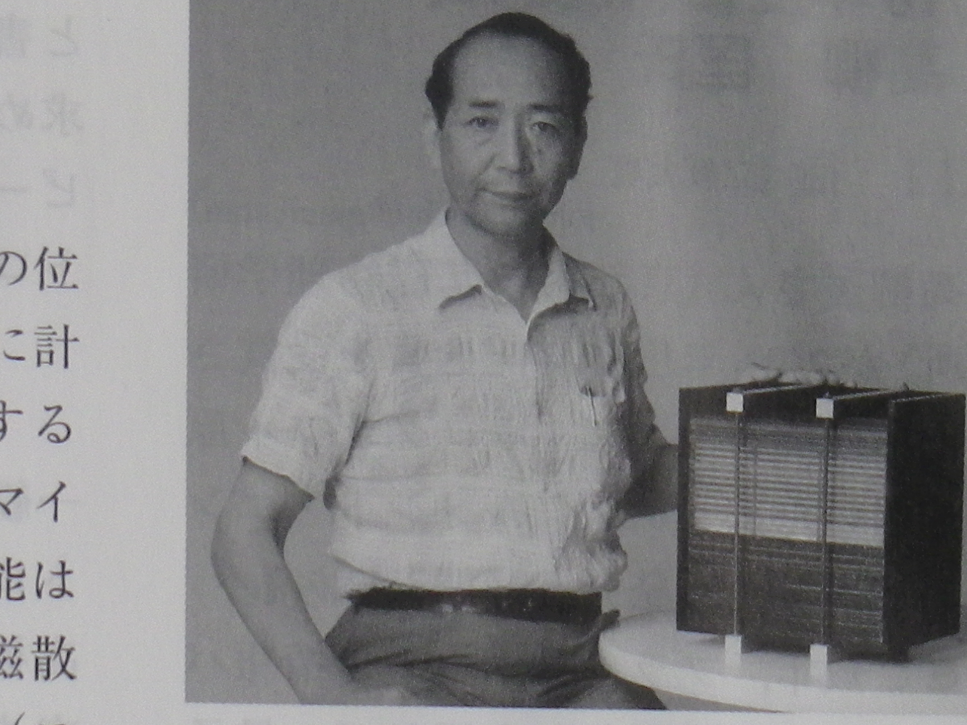
K. 1971 Niu discovered charm ptl. in cosmic ray by ECC

Slide 6
ECC
Sandwich structure by
emulsion plate and absorber
Absorber: iron and or lead etc.
Emulsion plate: double side gel coated
Emulsion Cloud Chamber
Multiple layer of Spark chamber was used in Comic ray study. In 1950-1970 and Ue Uμ identification EXP.

Slide 7
After
J/Ψ discovery 1974
Beuty particle found
Tau lepton found
Interest changed!
From quark to neutrino

Slide 8
1990 KAMIOKANDE obtained atomospheric neutrino. Ue/Uμ separated
up going neutrino number is missing compare to down going neutrino!
Neutrino oscillate ? or sterile ?
Neutrino oscillation was introduced 1962 by NKAGAWA et al.
If oscillate, Neutrino is not massless !!
tau neutrino is dark matter!! Harari 1998
Our interest changed from quark to neutrino world!
CHORUS 1990 started at CERN
DONUT at FNAL tau neutrino search

Slide 9
DONUT
Beam dump of FNAL TEVATRON
800GeV proton
Detecter is ECC+muon spectrometer
Hand made both side em coated plate
Absorber is iron with thickness 1mm
Size 50cm by 50 cm
Automatic scanning and NET-SCAN was applied
Track density ~10⁷/cm²

Slide 10
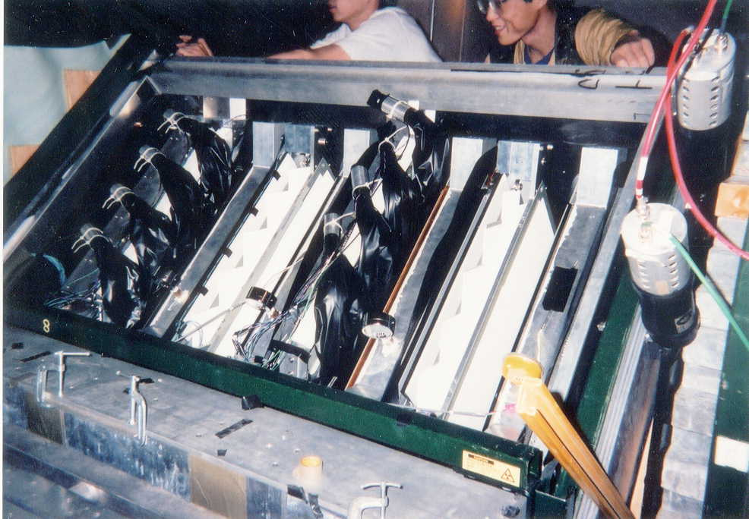
DONUT detecter
50kg ECC 4 units total 250kg
Sandwich structure,emulsion plate and iron plate

Slide 11
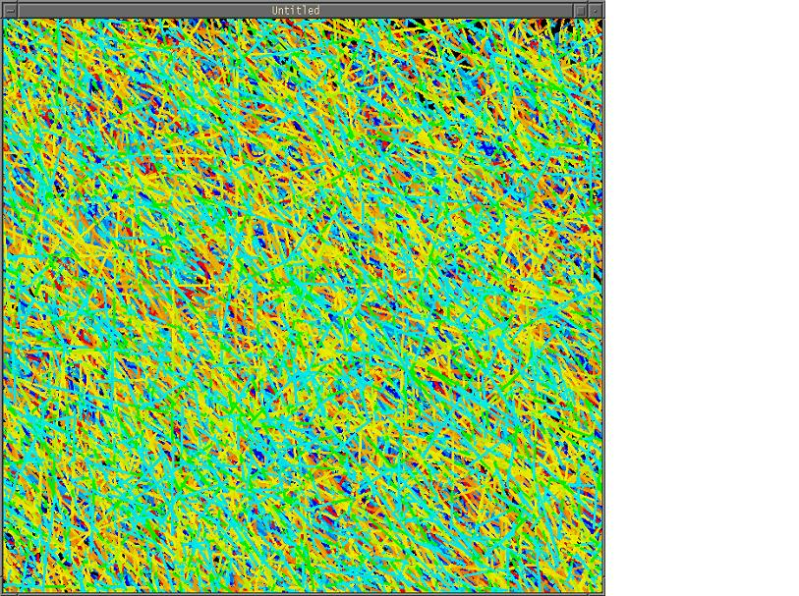

Slide 12
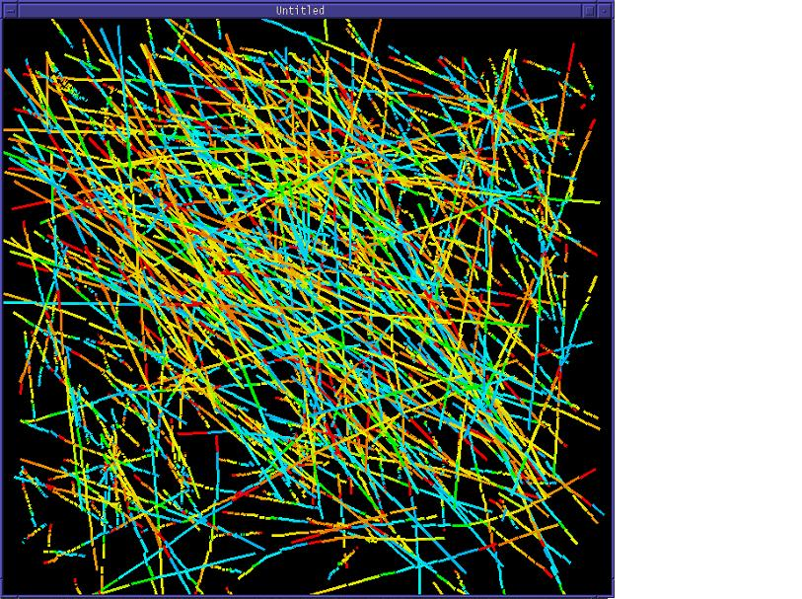

Slide 13
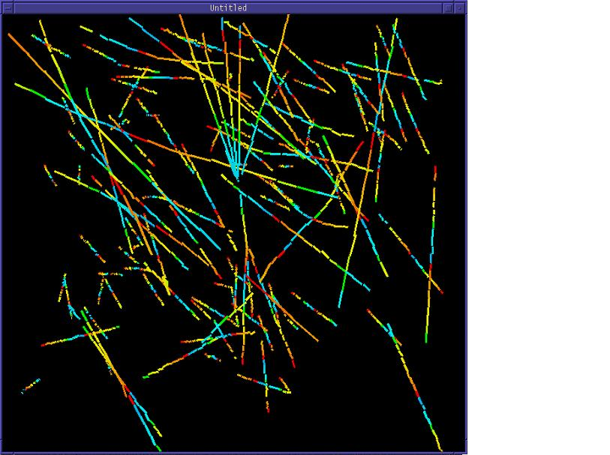

Slide 14
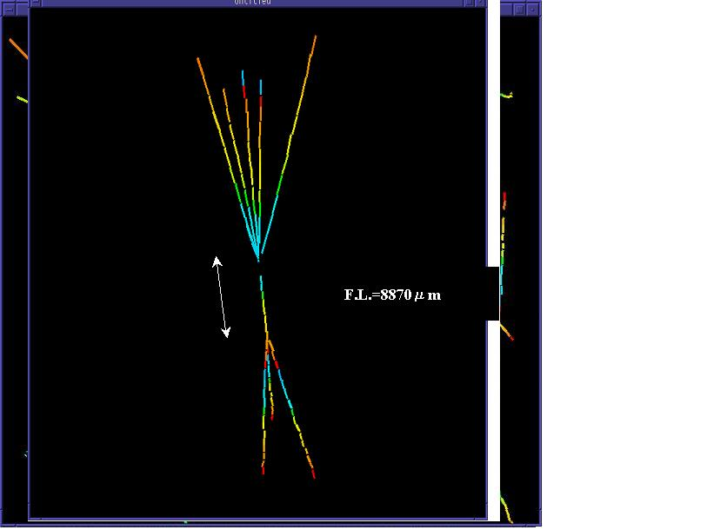

Slide 15
From Quark to neutrino
1996 KAMIOKANDE new data mean
atomospheric neutrino is misterius !!
Looks like, neutrino is oscillating...
Mixing angle is big, mass difference is small

Slide 16
1995 at FNAL I(Niwa) introduced the idea of
long base line υμ-uτ appearance EXP by
DONUT like100tonECC.start of opera
assumed mixing angle 10 ⁻²
using KAMIOKANDE(before SK)data
Neutrino mass may be not heavy,
Ut dose not a candidate of darkmatter.
Uμ-Ut dose not osc. in short distance.
CHRUS should be no solution! Long base line shold be done, with big target mass

Slide 17
Summary 1947 to 2005
1947 C.F.Powell Π/μ/e [emulsion thickgel: pericle]
electron sensitive gel G5
1971 K Niu Charm ptl by ECC Emulsion cloud chamber
both side coated film : track position(x,y) and angle(tx,ty)
manually scanning
1998(200) DONUT tau neutrino by ECC
handmade emulsionfilm
automatic scanning

Slide 18
1995 Ｉ（丹羽）introduced the idea of long base line
υμ-uτ appearance EXP at FNAL by
DONUT like100tonECC 700km fromFNAL.
assumed mixing angle 10 ⁻²
using KAMIOKANDE before SK
Neutrino shold not be heavy,
Ut dose not a candidate of darkmatter.
myu-neutrino dose not osc. in short distance.
CHRUS should be no solution!
Long base line should be done!!

Slide 19
Who intersted to Niwa talk ?
FNAL adam para
MINOS leader S.Wojiki?
ECC 100 ton ! Emulsion ?
At CERN： discussed with chorus p
K.Winter, Dore, Roberta
Next suporter!
L.Fore, Ａｎｔｏｎｉｏ , P strolin
Seminar at rome univ. etc.

Slide 20
まとめ From chorus to opera proposal
1998 TAKAYAMA neutrino conference.
SK group (Totsuka and Kajita) presented
the beutiful result on atmospheric neutrinos
Up going neutrino missing compare to down
going neutrino. Mu neutrino disappeared !
Strongly sugestted neutrino oscillation
Sterile?
DONUT presented one neutau event detected
In ECC.

Slide 21
LOI : ANTONIO E assembled !
[Appearans] is indispensable to confirm
the neutrino oscillation.
Tau neurino detection is possible by ECC
Big ECC detector construction is possible !
Fuji Co. can make big volume emulsion film.
Scanning is possible! 20cm²/h/sys

Slide 22
1999 OPERA proposed
DG Maiani suported
2000 approved at CERN
1.5kton ECC sensitive to 3·10⁻³ mixing
Maiani pushed OPERA
Machine made emulsion film by FUJI Co.
BAM, Lead plate,packing, Target tracker,
Muon spectrometer, 1.5kton mounting.
Brick handring(exchange) system,
Automatic develop, CS, CS to Brick, etc.
By international collaboration work.

Slide 23
Opera progress after approval
2007 OPERA detector constructed at Grnsasso
CNGS(neutrino beam from CERN)constructed
Neutrino exposure 2008-2014
2008/5 The first event (first light) detected in ECC
under microscop
20010 the first tau neutrino candidate
20012 clear tau neutrino (leptonic tau) detected
20015 5 tau neutrino events
20018 final analysis 6 sigma

Slide 24
Opera summary
1995 idea at fnal (DONUT meeting)
OPERA detecter constructed in Gransasso.
OPERA/CNGS construction 2000-2007
Exposure 2008-2014
2008 dec. first neutrino event is located.
Nμ-Nt 5 events 6-sigma
Technological out put, useful for future
Big volume emulsion film handling
High speed scanning machine with 1m²/h

Slide 25
教訓
Thanks INFN for monay short of “japan”
to organize international collabolation
Trouble: over light velocity
Good lesson to scientist
It is important to open OPERA data
Big data handling, application soft.
for out side researcher and education .

Slide 26
教訓
Thanks INFN for monay short of “japan”
to organize international collabolation
Trouble: over light velocity
Good lesson to scientist
It is important to open OPERA data
Big data handling, application soft.
for out side researcher and education .

Slide 27
Trouble : Neutrino velocity
Ｍoｎｅｙ short friends passed away
G Romano
Giacomelli
Tolun(ankara)
Niu(japan)
Kanazawa Fuji co.
Guy Vanbeek(burussel)
合掌

Slide 28
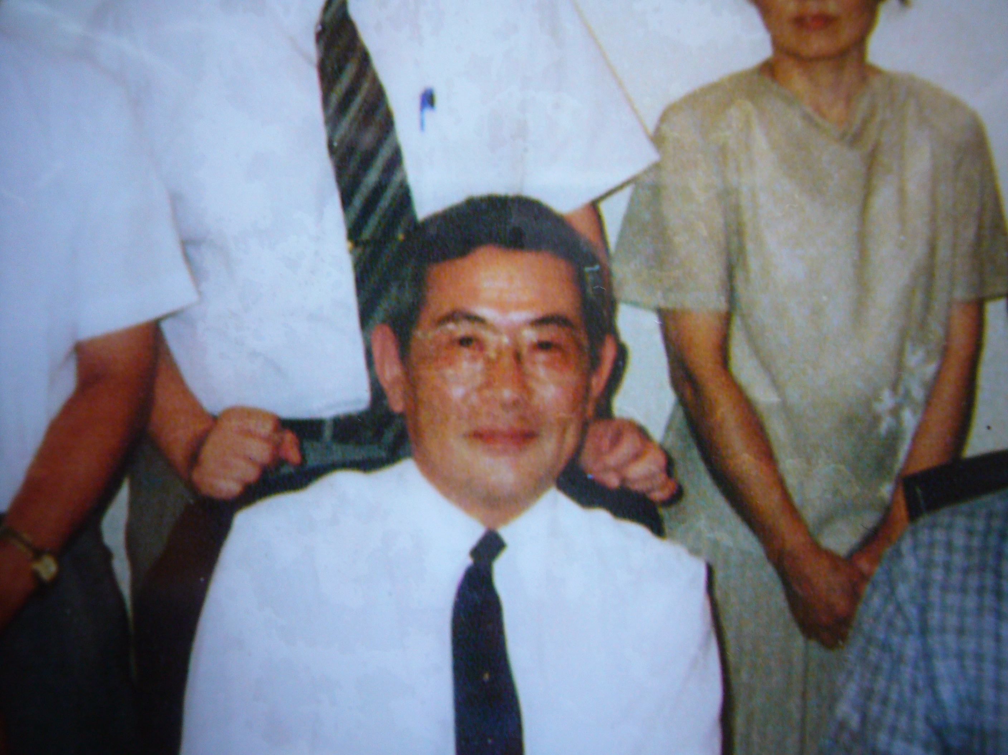

Slide 29
HTS scanning speed 1m2/h
HTS の写真

Slide 30
After opera [future]
We maneged big volume emulsion film
by low cost 1m² 100 ER(big volume only)
Other device are more expensive.
We have big scanning power
1m²/h or more ~10m²/h in future

Slide 31
Emulsion future
Emulsion is the long life detecter in physics
Start 1896 ,
Used in research and business..
Very good interaction with industrial technology.
Emulsion is not behind the times,
rather ahead of the times.

Slide 32
OPERA else
Gamma ray star AOKI
balloon , 1m², 10 m² Eγ>10MeV,,,1GeV
Monopol, antiproton ,quark,
Under ground ,airple,balloon,
μon radiography
blast furnace / pyramid /etc
check the status without distroy
WIMPS search ?, super fine AgBr crystal
Double hyper nuclus analyzed ΛΛ force, important for neutron star study. NAKAZAWA

Slide 33
Nuclear reacter
F.Reines νe detecter:liquid scintillater+PMTs
BNL 14/28 GeV beam dump Lederman Vµ detecter:multilayer spark chambers
FNAL 800GeV beam dump DONUT Vt detecter:ECC

Slide 34
4th Neutrino
e μ τ x4 ?
νe νμ ντ ν4 ?
rejected Mass (ν4) ≤ 50GeV LRP exp Mass () ≤ 100GeV LHC
try mass 100GeV≤ .. ≤ 7TeV

Slide 35
Search for very heavy neutrino V4
One of dark matter WIMP candidate
LEP killed leight neutrino U4 mass<50GeV
LHC no signal on heavy mass neutrino
DAMA result is not killed
mass~50GeV??

Slide 36
LHC
7TeV Х 7TeV
On the ground above CMS/ATLAS
Collision point to the surface≈ 100m
Detecter area 100m Х 100m
Detect the muon position and impact parameter and momentum

Slide 37
LHC ポンチ絵

Slide 38
Beam dump emulsion exp
name Target mass physics date year
DONUT 100kg ντ discover 2000
FNAL tevatron
OPERA 1000 ton νμ → ντ 2017
SPS appearance
New 1 Mega ton ν4 ?
LHC

Slide 39
Experiment Numbr of proton int Target mass Energy cross section
DONUT 10¹⁸ 250kg 20Gev tau neutrino (800GeV)
LHC 100MHz · 3·10⁷s=3·10¹⁵int/y 1M ton 14TeV
V4 search (10⁸ GeV) present situation LHC is wonderfull !

Slide 40
LHC beam colliding position is under ground depth 100m
Put the detecter on the ground above ATLAS and/or CMS detecter size 100m*100m

Slide 41
ECC muon detecter
Posion and angle of muon
impact parameter analysis
Momentum measurement
multiple scattering
Iron plate and emulsion film ~50 layers
muon momentum (Tev muon)
iron plate thickness ~0.5cm 40kg
Unit ECC weightis ~2 ton

Slide 42
possible ? SCANNING
Opera new
unit size 10*cm*10cm*0.6cm 100*100*50 layer
mag spectrometer +scat. Scatterng only
Unit number 100000 units 10000 units
scanning power 100cm²/h 10000cm²/h
Only selected all

Slide 43
コスト how mach??
Ecc 10000 units cost
Ecc cost film 2万/m² 100万円10⁴ euro/unit
Total detecter cost 10⁸ euro 100億円
仲間 中国？
(HP Kamioka:: korea chaina)
宇宙線研究 高エネルギーμフラックス

