Slide 1
QUICK SCANNING SYSTEM NEWS
QSS HARDWARE
QSS SOFTWARE
APPLICATIONS AND OUTLOOK
C. Bozza – University of Salerno – Anacapri, 31/5/2018

Slide 2
QSS HARDWARE
  The hardware design of the Quick Scanning System is based on five principles
  1) KISS = Keep It Super Simple
  2) Commercial
  3) Easy to replicate
  4) Modular (easy to adapt to different possibilities)
  5) Sustainable with minimum funding
  At the moment we don’t have specific funding for hardware development
  Upgrades are incremental and dictated by workload requirements
  The system hardware is split into
  Emulsion readout part
  Postprocessing (mostly tracking) part
QUICK SCANNING SYSTEM NEWS
C. Bozza – University of Salerno – Anacapri, 31/5/2018

Slide 3
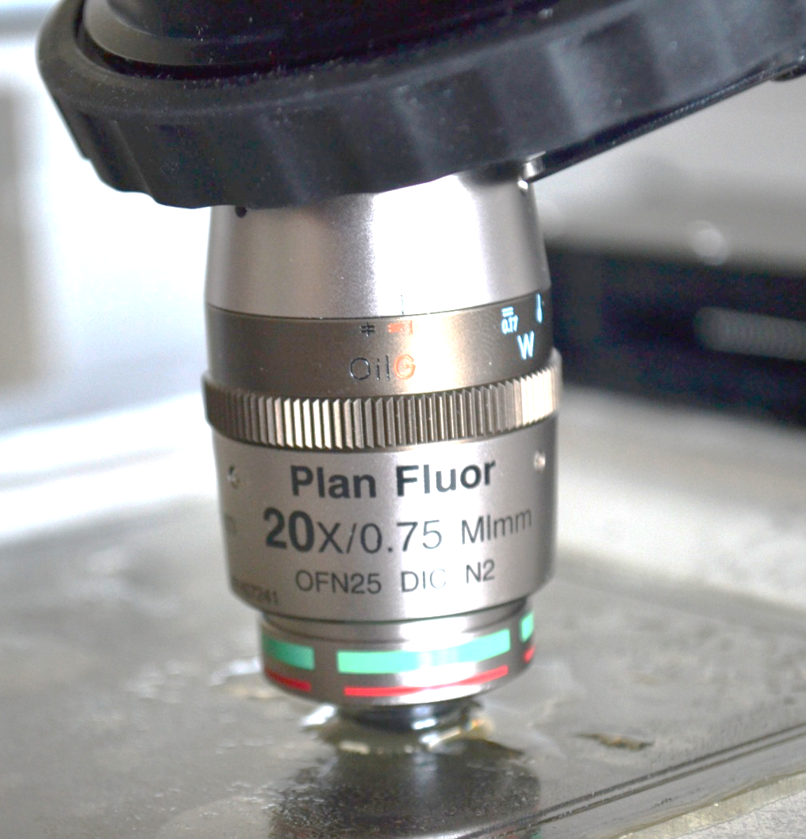
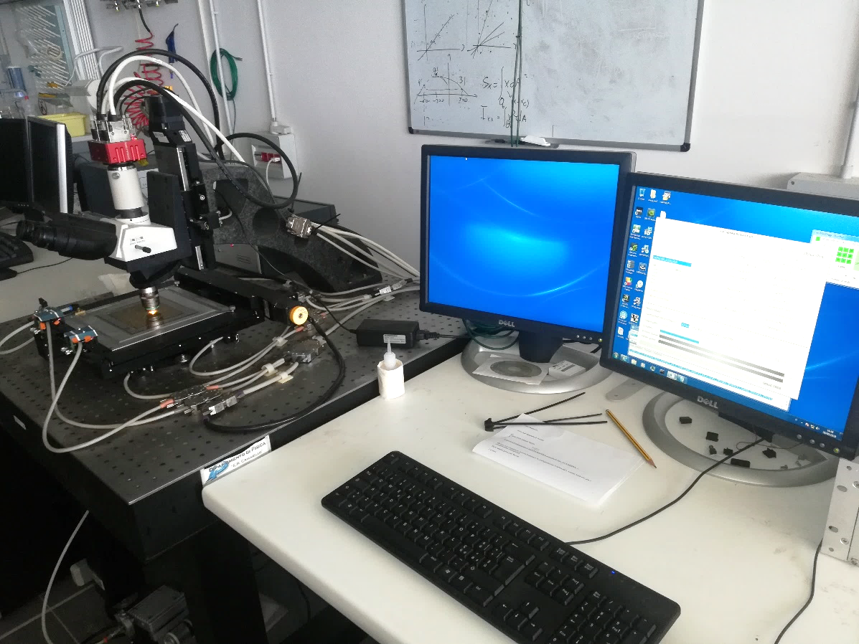
QSS HARDWARE
  Standard setup
  ESS XY stage
  ESS Nikon trinocular
  Modified MICOS box
  Nikon 20× (NA 0.75)
  CMC 4000 (4 Mpix, 385 fps)
  Radient DFCL
  1 Dell Precision Workstation
  ProDex MAXk 4000/5000
  nVidia GTX 690 or better
  (currently 980 ti)
  Obtained ~95% microtracking
  efficiency on OPERA-like
  emulsions
QUICK SCANNING SYSTEM NEWS
C. Bozza – University of Salerno – Anacapri, 31/5/2018

Slide 4
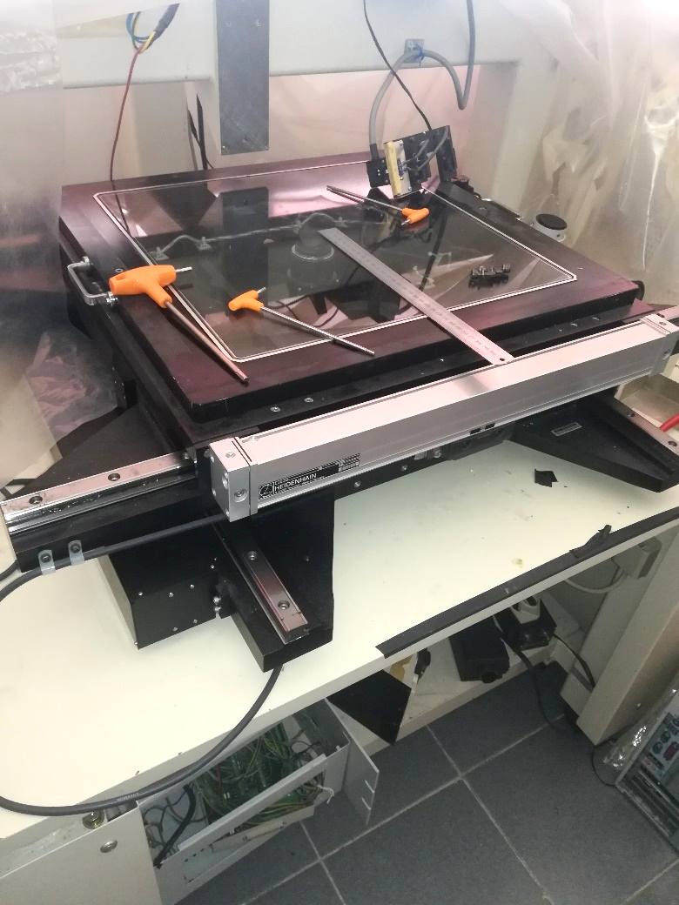
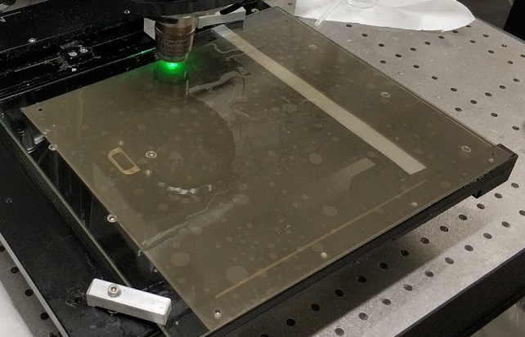
QSS HARDWARE
  Alternate setup for large area emulsion films
  Nikon large area stage (∼36×36 cm²)
  Nikon trinocular
  Same motor box, different gearing ratio of motor power output
Scanning such films is hardly sustainable for us:
No dedicated
manpower for scanning
Film setup once or twice
per day (9:00-14:00)
Courtesy V. Tioukov
QUICK SCANNING SYSTEM NEWS
C. Bozza – University of Salerno – Anacapri, 31/5/2018

Slide 5
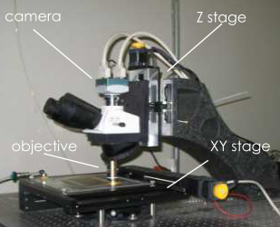
QSS HARDWARE
GTX 980ti
  Post-Processing HW
  1 distribution server
  (64 GB RAM buffer)
  6 GTX 690 (hosted on various servers)
  1 Gbps network connection
RAMDisk 64 GB
GTX 690
GTX 690
GTX 690
GTX 690
GTX 690
GTX 690
This HW could sustain 120 cm²/h on
OPERA-like emulsion
Speed 2÷3 times lower with new films
(90 µm thickness, higher background)
Not a problem as long as load is small (not many films to scan)
Incremental upgrade foreseen (no funding for scanning system, using University funds)
Final storage
QUICK SCANNING SYSTEM NEWS
C. Bozza – University of Salerno – Anacapri, 31/5/2018

Slide 6
QSS SOFTWARE
  SySal.NET now evolved to run on 4.5 NET Framework (or Mono 5.x for offline tasks)
  Fully back-compatible (including Oracle connectivity, now using Managed ODP.NET)
  Python libraries for RWD and TLG files (run analysis on Windows/MacOS/Linux)
  Windows 7 64 bit for data acquisition (NExTScanner)
  (Windows 10 64 bit might work, driver incompatibilities to be checked)
  Windows Server 2003 or better for Post-Processing Manager (RAM buffer manager)
  Porting to Linux Debian 9 or CentOS 7 scheduled (1 year from now)
  Windows 7 or better (currently using Windows 10) for GPU Tracking Servers, running on CUDA 8.0 or higher
  Porting to Linux Debian 9 or CentOS 7 envisaged (1 year from now)
QUICK SCANNING SYSTEM NEWS
C. Bozza – University of Salerno – Anacapri, 31/5/2018

Slide 7
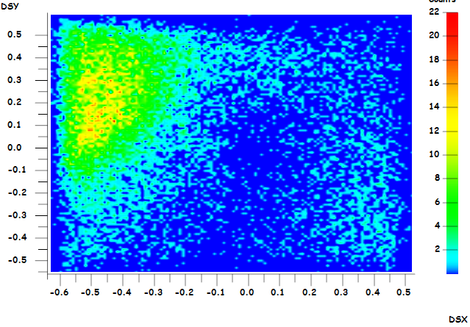
APPLICATIONS AND OUTLOOK
  Currently focusing on muography applications
  Need specific funding for major upgrades
  QSS evolution will continue in incremental
  mode according to needs and usage
  SW is general and can accommodate
  different hardware
  Areas for improvement (in order):
  Computing power for tracking
  Camera speed
  Field of view
  Frame grabber
Preview from La Palma fault exposure
  The system is very modular, but fund allocation must be optimized (upgrades/human resources)
QUICK SCANNING SYSTEM NEWS
C. Bozza – University of Salerno – Anacapri, 31/5/2018

