Slide 1
High Radiation to Materials
Project Report
Outline
The HiRadMat facility – what is it?
Project overview
Status
  WG1 - Beam line
  WG2 - TNC and T1 dismantling
  WG3 - New irradiation area
Schedule
Operation & user’s support
Summary
On behalf of the project team
S. Evrard – EN/MEF
EDMS No: 1061203
IEFC Workshop, session 4
CERN, February 11, 2010

Slide 2
The HiRadMat Facility – What is it ?
Essential purpose
Study the impact of intense pulsed beams on materials
  Thermal management (heating)
    material damage even below melting point
    material vaporization (extreme conditions)
  Radiation damage to materials – change of properties
  Thermal shock - beam induced pressure waves
Test bed, important for the design validation of LHC near-beam components before installation in the machine
Requires LHC-type SPS beam (450 GeV/c) from pilot to 288 nominal bunches
Foreseen clients : LHC collimators, protection devices, machine components, material studies (bulk, superconductors), high-power targetry, irradiation tests of electronics

Slide 3
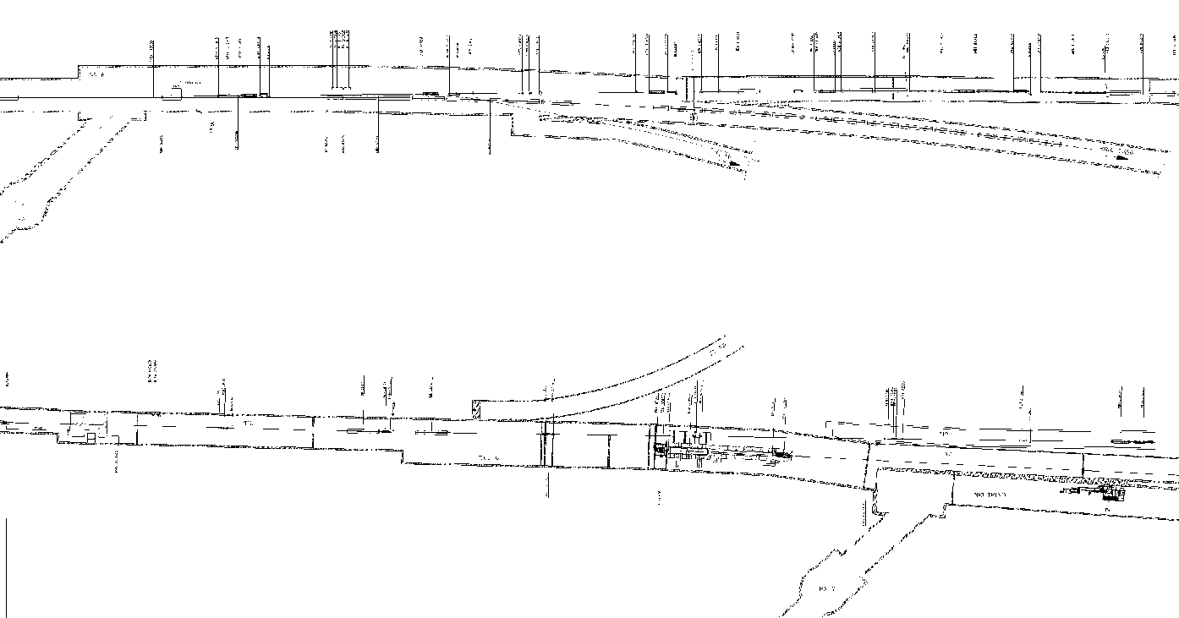
The HiRadMat Facility – What is it ?
Location
TT60
Beam
SPS
TI 2
Beam
End of common part
with TI 2 transfer line
50 m
T9 target area / TNC
C. Hessler, 26/01/09

Slide 4
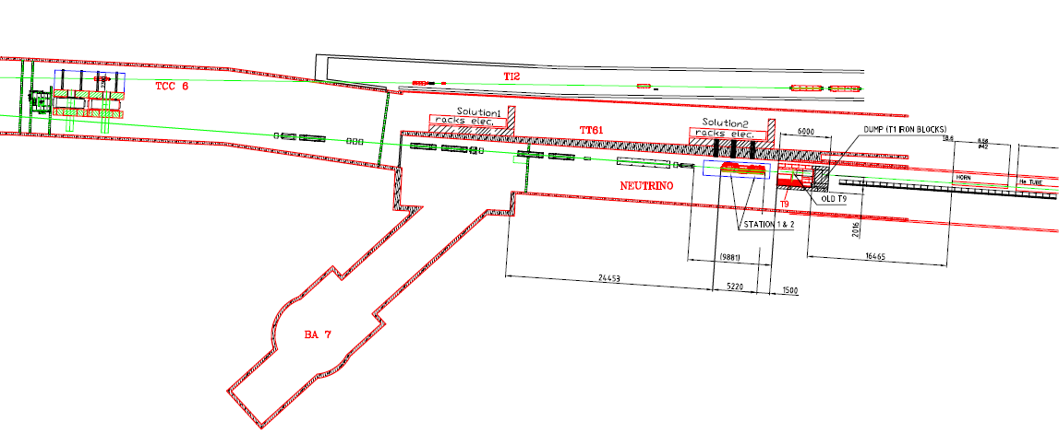
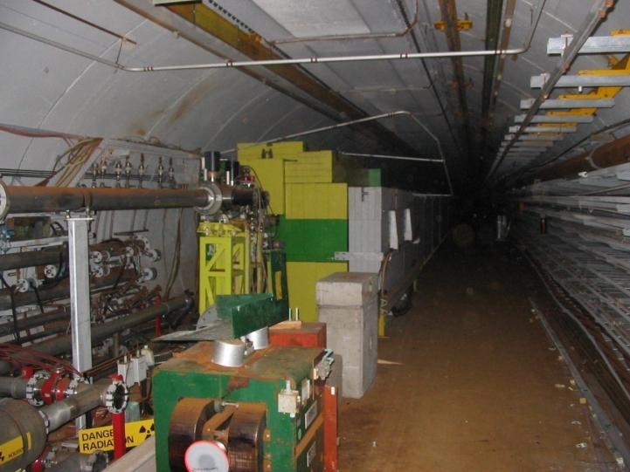
The HiRadMat Facility– What is it ?
Irradiation area layout in the TCC6-TNC tunnels
Test area upstream the T9 target
Convert T9 target to a beam dump
Cleanup the TNC tunnel
Dismantle/condition WANF equipment
Maintain escape passage from tunnel end

Slide 5
Project Overview
Project structure
A & T Sector Mgmt
HiRadMat Facility Project
Project Leader : I. Efthymiopoulos
Deputy PL : S. Evrard
IEFC Committee
Project Team
Operation
User Selection Panel
Primary beam WG1
M. Meddahi, C. Hessler
Beam Commissioning
M. Meddahi
SPS & LHC Physics coordinators & scientific committees
TNC Dismantling WG2
S. Evrard, Hel. Vincke
Operation & Maintenance
CCC, M. Lazzaroni (superintendent)
Irradiation area WG3
A. Pardons, S. Evrard
User support Team
EN/MEF
Safety experts: Y. Algoet, L. Ulrici, L. Bruno,
E. Paulat, N. Conan, C. Theis
Planning : H. Gaillard, N. Gilbert
External collaborators : SLAC team
Users : invited/informed (R. Assmann, B.Goddard, R. Schmidt, …)

Slide 6
Project Overview
Project budget
The HiRadMat project is important for LHC.
A&T sector based project :
  BE: ABP, ASR, BI, CO, OP
  EN: CV, EL, HE, MEF, MME, STI
  TE: ABT, EPC, MPE, MSC, VSC
  And DG/SCR, DG/SCG, GS/ASE, GS/SEM, IT/CS
Work packages defined in each WG’s in close collaboration with equipment groups.
Thanks to all groups for providing feedback to update the budget and manpower estimate for the project !
6.9 MCHF and 26 FTE’s over 2010, 2011 and 2012

Slide 7
WG1 – Beam line: status
Primary proton/ion beam parameters
Parameter | Protons | Ions
Beam energy | 450 [GeV] | 177.4 [AGeV]
Bunch intensity | 5×10⁹ to 1.7×10¹¹ [protons] | 5×10⁹ to 4.1×10¹⁰ [ions]
Number of bunches | 1 to 288 | 52
Bunch spacing | 25 [ns] | ≥25 [ns]
RMS bunch length | 11.24 [cm] | 11.24 [cm]
Pulse length | 7.2 [μs] | 7.2 [μs]
Transverse norm. emittance (1σ) | 3.5 [μm rad] | 1.4 [μm rad]
RMS beam spot at focal point | 1.0 [mm²] - nominal 0.25 – 4.0 [mm²] – range | 1.0 [mm²] - nominal 0.25 – 4.0 [mm²] – range
RMS beam divergence at focal point | 0.2 [mrad] | 0.2 [mrad]
RMS shot-to-shot stability | < 0.2 [mm] | < 0.2 [mm]
Transverse beam steering at focal point | +/- 4 [mm] | +/- 4 [mm]
Integrated beam intensity(protons) | 10¹⁶ protons/year 10 exp.×10¹⁵ protons/exp. ~30÷100 extractions/exp
Beam in shared mode during SPS operations

Slide 8
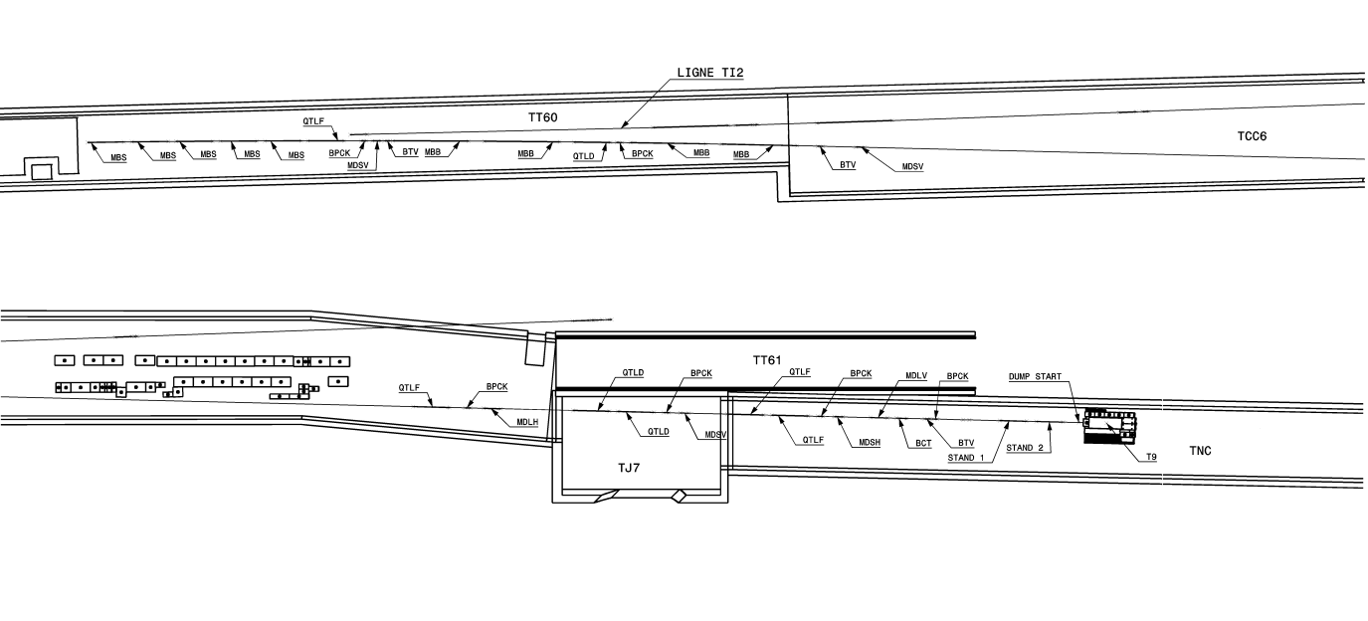
WG1 – Beam line: status
Beam line Geometry
Beam
25 m

Slide 9

WG1 – Beam line: status
Beam line layout
MBS switching magnets
QTL
Beam
SPS extraction point
End of common part with TT60
MBB
Exp. area
50 m
Flexible optics to provide beam radii of σ = 0.1 to
2.0 mm at the focal point
Focal point movable to starting points of the three test stands

Slide 10
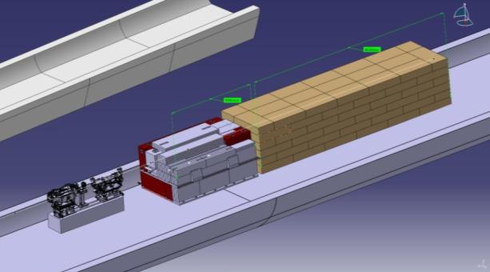
WG1 – Beam line: status
Focal point – Layout requirements

Slide 11
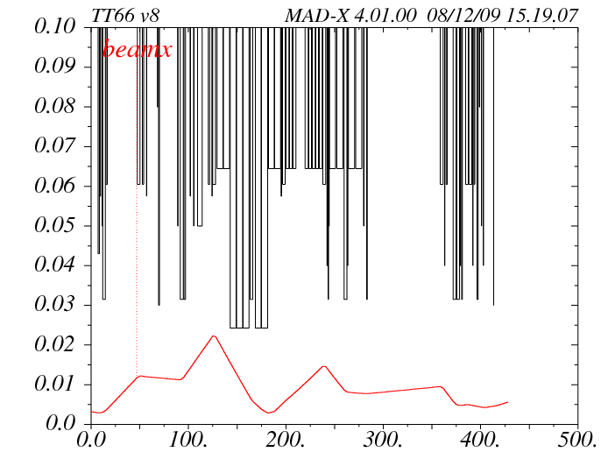
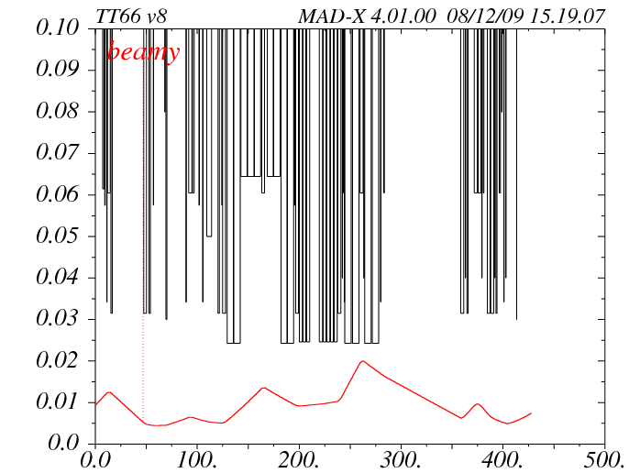
WG1 – Beam line: status
Beam Envelope Calculation
beam envelope x (m)
beam envelope y (m)
s (m)
s (m)
Focal point position: start of large test stand
Beam radius at focal point: σ = 0.5 mm
6σ beam radius and 5 mm max. trajectory deviation for beam envelope calculation assumed

Slide 12
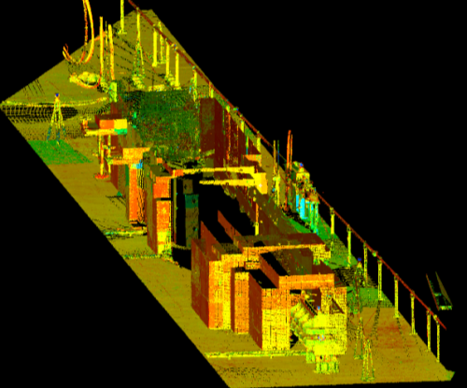
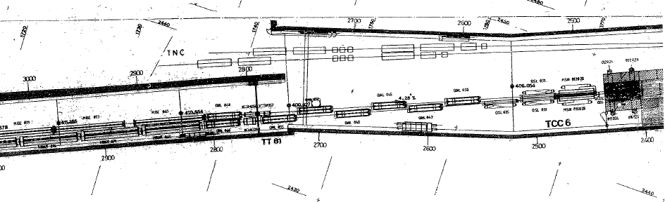
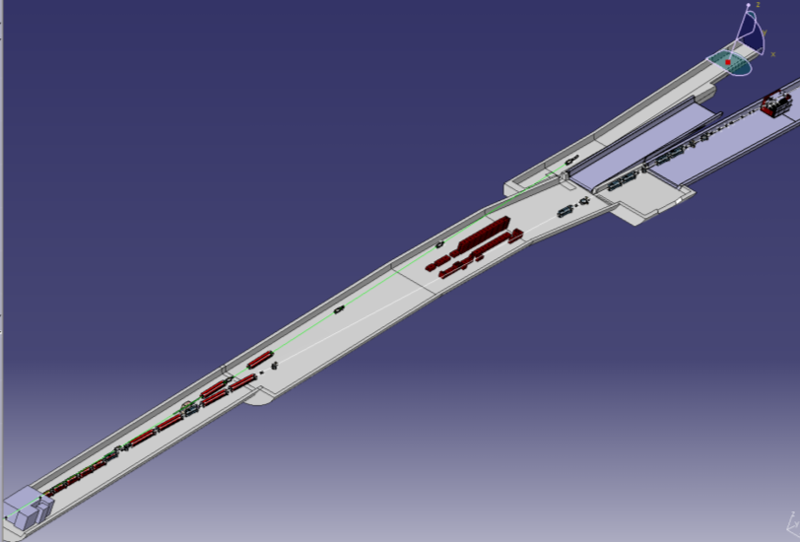
WG1 – Beam line: status
Integration issues
Paper drawing from early 80’s
Laser scanning of the whole area (TNC + TCC6) achieved just before LHC startup
Migration to Catia → 3D model now available
Valuable for future projects
Weekly integration meetings

Slide 13
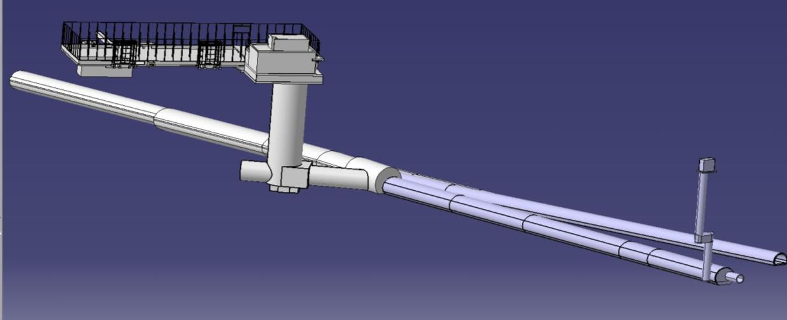
WG2 – TNC and T1 dismantling: status
Preparatory works
Radiation survey
  Dose rate + contamination (→ EDMS 1053964)
Escape path → B.846
General safety systems (AUG, red telephones, RIA,…)
BA7
TCC6
B.846
TT61
TNC

Slide 14
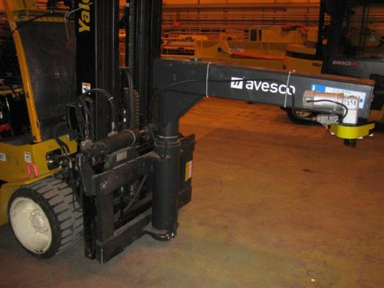
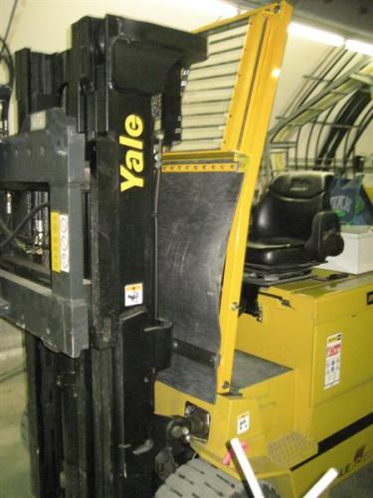
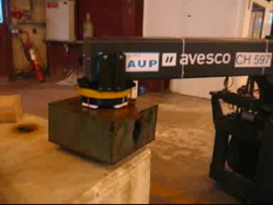
WG2 – TNC and T1 dismantling: status
Dedicated handling means
Click on the movie
Forklift shielded with lead glass and lead sheet (attenuation factor = 5)
Automatic hook developed by EN-HE (J-L Grenard and C. Bertone)
Dose rate attenuation due to operator remoteness
Already tested successfully in TCX blocks removal

Slide 15
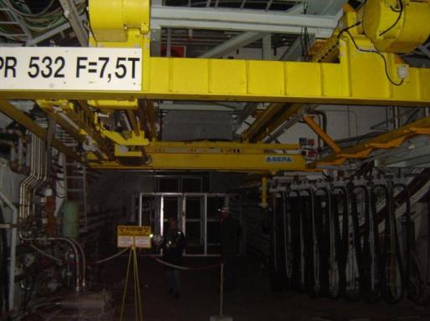
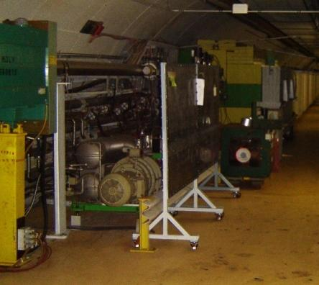
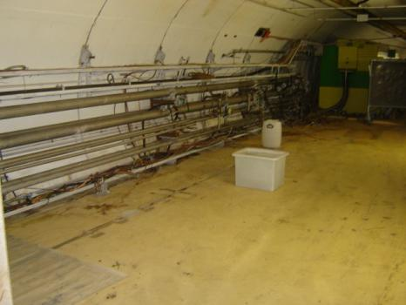
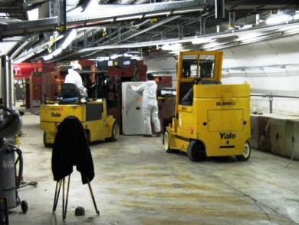
WG2 – TNC and T1 dismantling: status
First activities carried out
PR 532 refurbishment
TNC cleaning
Beam line removal up to T9 target
TCX blocks dismantling

Slide 16
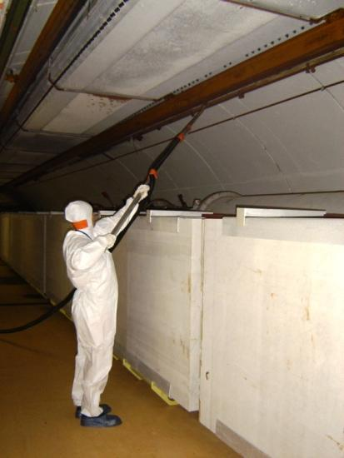
WG2 – TNC and T1 dismantling: status
Focus on TNC cleaning
Specific price enquiry won by ENDEL Nucleaire (F)
Smear tests taken where contamination was the highest: reduction by a 10 factor (all smear tests < 1Bq/cm² = contamination level)
Dosimetry below estimates (collective dose 2.2 mSv where 2.8 was estimated in DIMR)

Slide 17
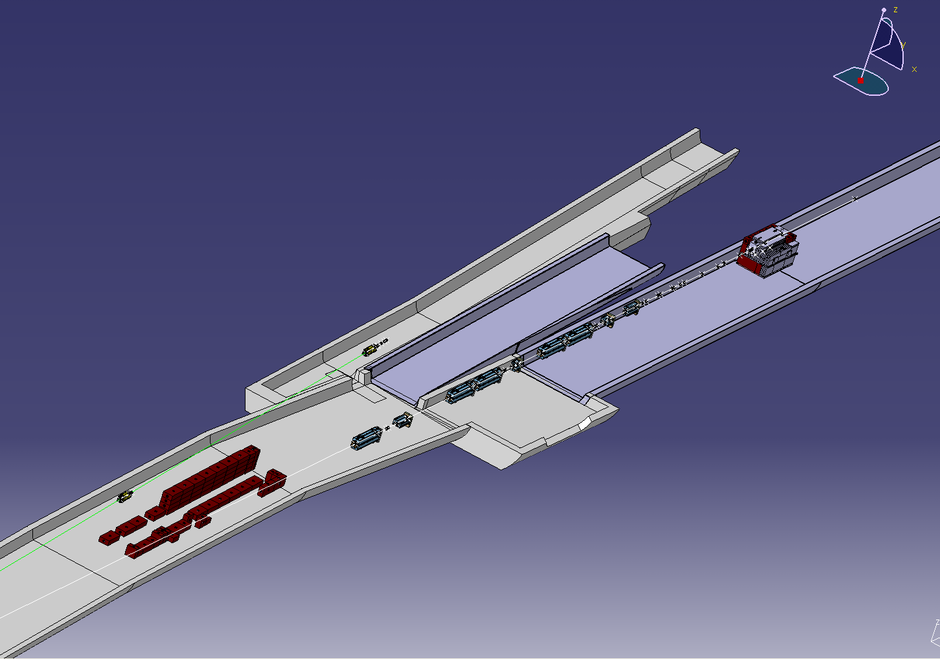
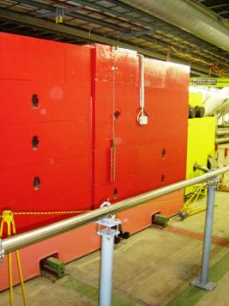
WG2 – TNC and T1 dismantling: status
T1 dismantling: our plan
Complete dismantling of T1 target complex
Removal step by step during LHC technical shutdown
MTR magnet removal requires TI2 vacuum dismantling
Shielding blocks will be re-used for HiRadMat dump.

Slide 18
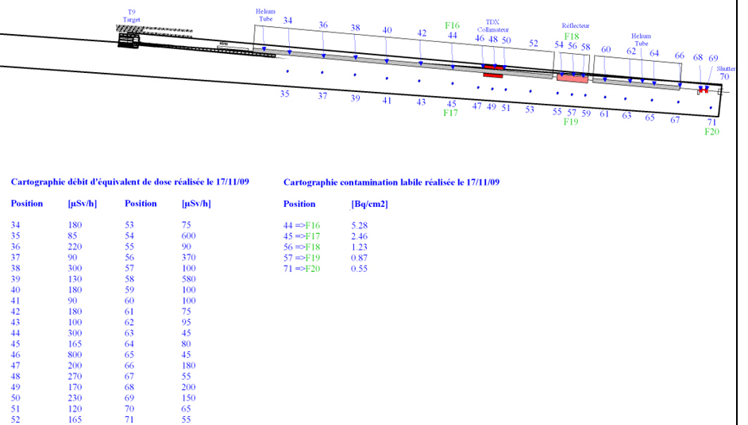
WG2 – TNC and T1 dismantling: status
TNC dismantling: our plan
EDMS 1053964

Slide 19
WG2 – TNC and T1 dismantling: status
TNC dismantling: our plan
Consultancy study with TUEV Nord (D) in progress regarding the planning of the dismantling
Optimization of interventions w.r.t. dose, waste conditioning, measurement procedures, storage & disposal possibilities
Risk management and documentation (DIMR and ALARA committee)
Interim storage set-up (for conditioning and treatment)
Dismantling in TNC
Packaging 3 options: cleaning, plastic bags, box sarcophagus
Shipment internal transport is preferred than public roads
Conditioning and treatment Volume reduction in interim storage
interim storage at CERN prior to final disposal

Slide 20
WG3 – New irradiation area: status
Design parameters for the experimental area
Specification document
Parameter | Value
Experiments per year | 10
Maximum intensity per experiment | 1×10¹⁵ protons <30 full intensity pulses
Waiting time after experiment for de-installation | ≥ 2 weeks
Access during experiment (except urgent interventions) | no
Control of experiment and data taking | remote
Maximum intensity per year | 1×10¹⁶ protons
Parameter | Value
Installed experiments | 1
Material exposed to beam | C, CFC, Cu, W, hBN, Al, Be, …, advanced composite materials
Volume of exposed material | ≤ 16,800 cm³
Equipment size Length (flange-to-flange) Width Height below beam line Height above beam line | ≤ 7.0 m ≤ 1.0 m 1.1 m ≤ 0.8 m
Weight | ≤ 4,000 kg
Handling zone (L × W × H) | 15 × 2.0 × 2.2 m³
Equipment support | comes with experiment – quick installation interface required
Cool-down space | see equipment size
Crane support | mobile cranes sufficient
Handling | prepare fast handling and remote installation with crane
Additional requirements for the exp. area will depend on the type of equipment and test planned
Safety and RP constraints should come in addition

Slide 21

WG3 – New irradiation area: status
Test stands and beam dump
Water-cooled core dump based on TED technology (core graphite bloc)
Secondary dump made of cast iron blocks
2 stands for collimator (or other equipment) to be tested

Slide 22
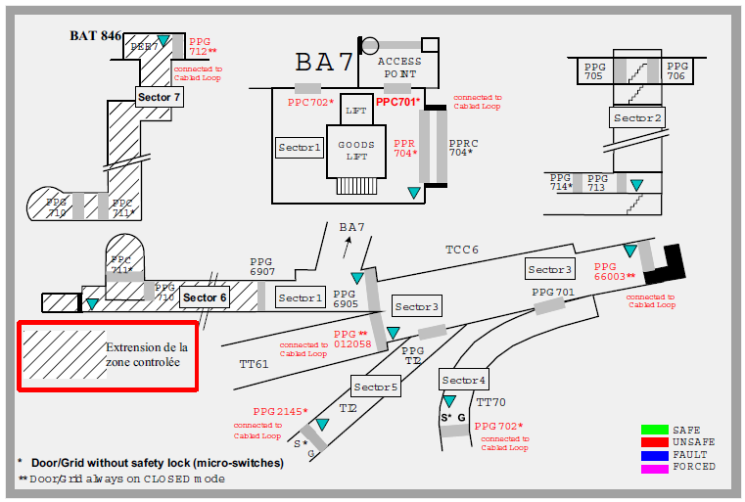
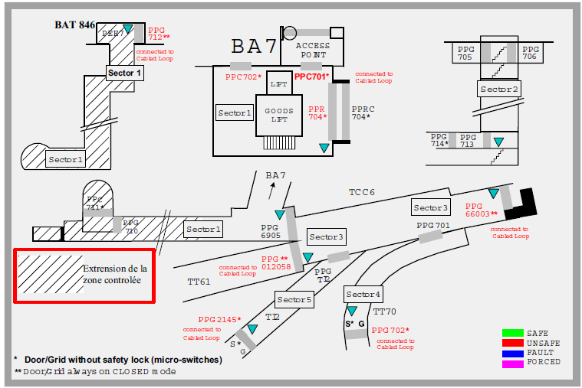
WG3 – New irradiation area: status
Access

Slide 23
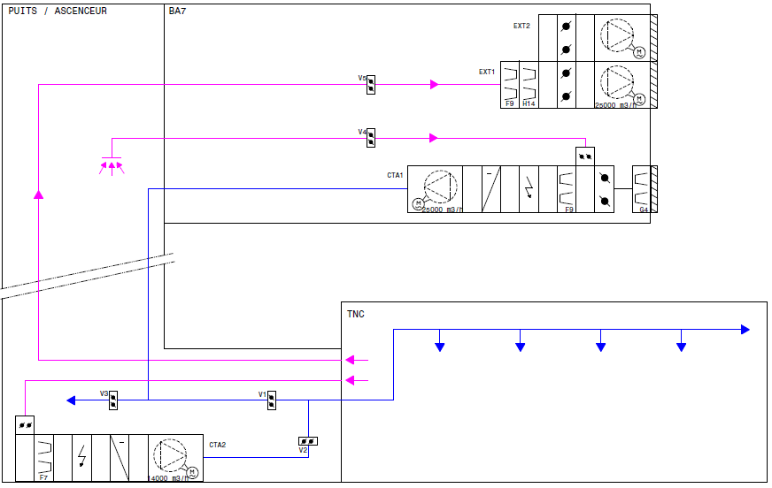
WG3 – New irradiation area: status
Cooling & Ventilation
1- Run mode
2- Flushing mode
3- Access mode
4- Smoke extraction mode
TNC

Slide 24
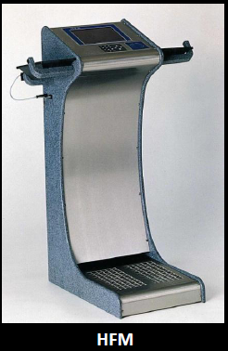
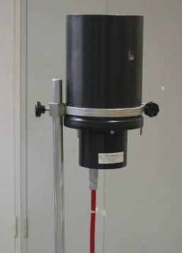
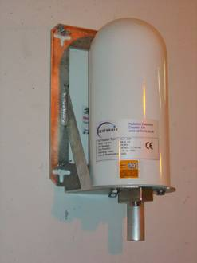
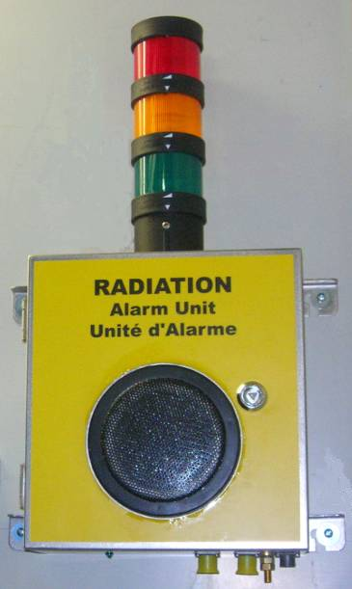
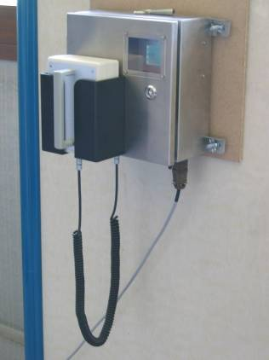
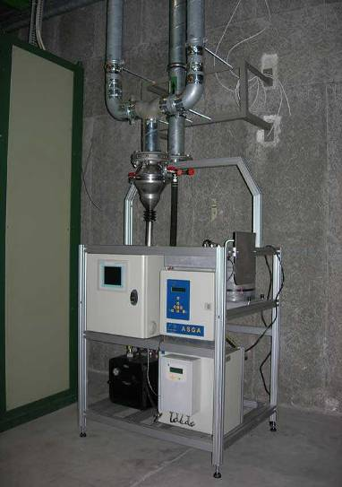
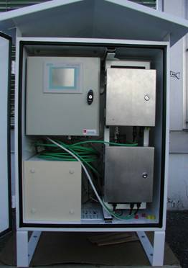
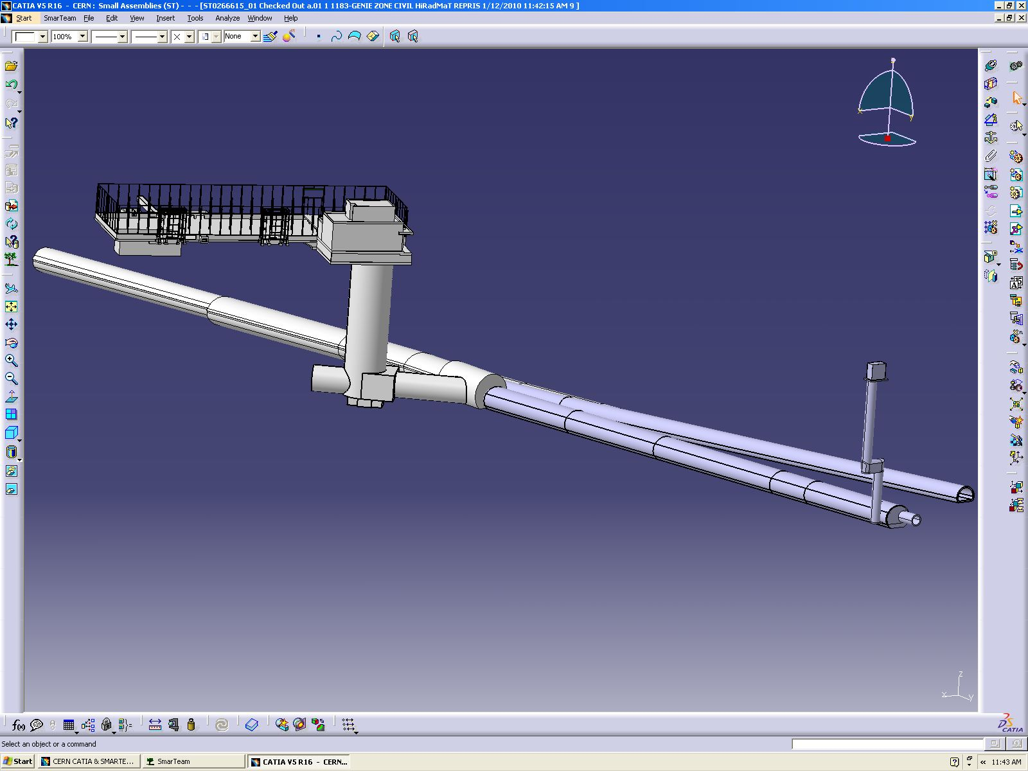
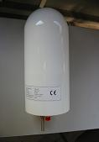
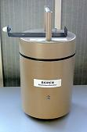
WG3 – New irradiation area: status
Radiation monitoring
1 x stray rad. Station (includes cabin + infrastructure)
Ventilation station
8 x PMI monitors (for the HIRADMAT area and the neighbouring tunnel, accurate position to be defined)
2 x IG5 monitors (hydrogen type), 1 x IG5 monitors (argon type)
3 Alarm Units (UA)
1 x hand foot monitor
1 x material control monitor
Ventilation
Monitoring
Stray radiation
Monitoring
IG5
PMI
  PCM
VGM - VAS
BA7
TCC6
EPIC
ERC
B.846
TT61
TNC

Slide 25
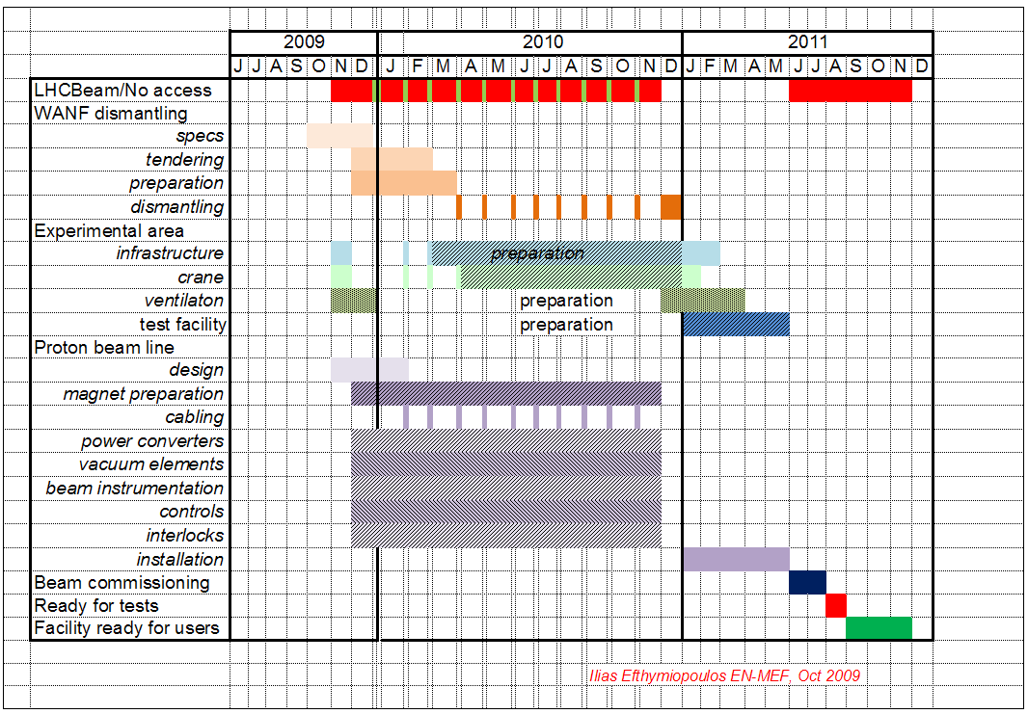
Schedule: first version
Major deadlines
LHC extended run → even more challenging to meet final deadline

Slide 26
Schedule: revised version
Major deadlines
 |  | 2009 |  |  |  |  |  |  |  |  |  | 2010 |  |  |  |  |  |  |  |  |  |  |  |  |  |  |  |  |  |  |  |  | 2011
 |  | J | J | A | S | O | N | D |  |  | J |  | F |  | M |  | A |  | M |  | J |  | J |  | A |  | S |  | O |  | N | D | J |  | F |  | M |  | A |  | M |  | J |  | J |  | A | S | O | N | D
 | LHCBeam/No access
 | WANF dismantling
 | specs
 | tendering
 | preparation
 | dismantling
 | Experimental area
 | infrastructure |  |  |  |  |  |  |  |  |  |  |  |  |  |  |  |  |  | preparation
 | crane
 | ventilaton |  |  |  |  |  |  |  |  |  |  |  |  |  | preparation
 | test facility |  |  |  |  |  |  |  |  |  |  |  |  |  |  |  |  |  |  |  | preparation
 | Primary beam line
 | design
 | magnet preparation
 | cabling
 | power converters
 | vacuum elements
 | beam instrumentation
 | controls
 | interlocks
 | installation
 | Beam commissioning
 | Ready for tests
 | Facility ready for users
Very challenging !!!

Slide 27
Schedule
Most critical items
Crit. | Item | Comments
 | Water-cooled cables | Could become critical → Inspection planned W12
 | DC cables | New cables to be pulled → limit co-activities
 | Signal cables | Needs are being collected→ cabling campaigns
 | Power converters | Long delivery time
 | Ventilation units | Procurement procedure (FC,…)
 | Core dump | Re-use of existing one.
 | Vacuum equipments | No major concern
 | TBSE | Installation time slot to be carefully defined (TI2 line)
 | Radiation monitors | Available on the shelf
 | Beam instrumentation and control | Monitors of the TI beam line standards
 | Magnets | No new magnet to be built, 2 being refurbished
 | Survey equipment | Reference points already set-up and surveyed
 | Machine Interlocks | Beam Interlock and Magnet Interlock (no major concern on both systems)

Slide 28
Operation
General lines
Guidelines
  10 users/year
  (up to) 10^15 protons/user
  (up to) 100 high intensity pulses: 100x3.0E11 p/pulse
  Several pilot pulses/user during setup
Pilot pulses (setup) can be done in an almost transparent way to present operations
High-intensity pulses will be done in dedicated HiRadMat cycles – no other physics for SPS
HiRadMat cycle parameters under study
  Impact on magnets/power supplies
  Impact on physics schedule for SPS users

Slide 29
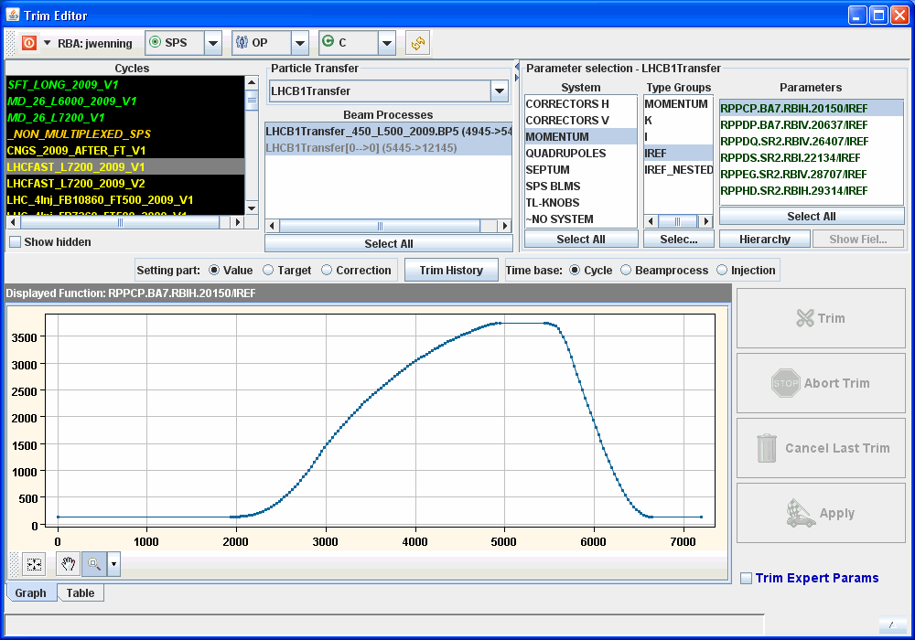
Operation
Power Converter Cycle for Beam Setup

Slide 30
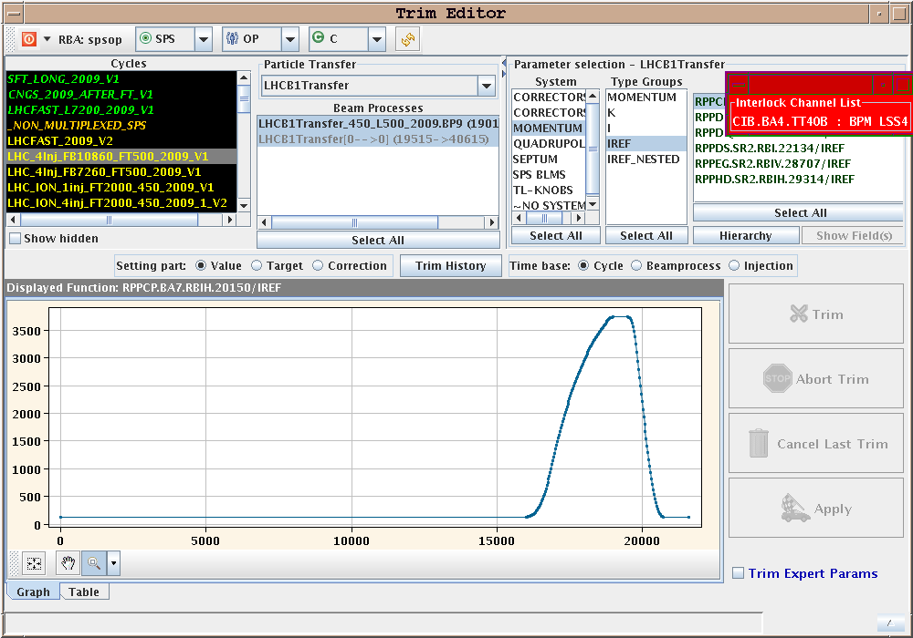
Operation
Power Converter Cycle for HiRadMat Operation

Slide 31
User’s support
Future users already interested in using HiRadMat
  Collimator phase 2 (prototyping work)
  LHC beam dump entrance window robustness
  Studies of protection devices and windows (TE-ABT)
  Vacuum chamber coatings for electron cloud mitigation
  R2E teams - irradiation facility – radiation damage
  BLM developments
  LARP Rotatable Collimator Robustness Test (SLAC)
  Radiation tolerance tests (EN-STI)
  ISOLDE – Target and Ion Source Development
Infrastructure needed for users
  Racks/space for electronics and readout in BA7
  Lab space nearby
  Office space
  Training and access procedure

Slide 32
Summary
Project well on tracks
  Organization, work packages, budget defined
  Safety file in progress
  Design stage almost completed
  First activities on site achieved
Schedule very tight
  LHC driven planning
  Make full use of monthly technical stops and 2010 Xmas shutdown
Radiation risk mitigation strategy
The whole TT60/TCC6/BA6,BA7 areas will be largely renovated.
Operation issues under study
Wide range of future users
Further info at : http://cern.ch/hiradmat

Slide 33
Thanks for your attention
Acknowledgments :
Nadine Conan, Helmut Vincke, Chris Theis, Luisa Ulrici, Yvon Algoet, Daniel Perrin, Malika Meddahi, Christoph Hessler, Brennan Goddard, B. Puccio, Ilias Efthymiopoulos, Catherine Magnier, Serge Pelletier, Caterina Bertone, Dino de Paoli, Hubert Gaillard, Michael Lazzaroni, Thijs Wijnands.

Slide 34
Spares

Slide 35
WG1 – Beam line: status
Focal point studies
2.5 m
3 m
Layout:
Focal point achievable at all 3 positions for
σ = 0.1 to 2.0 mm
Focal point @ 1st small test stand:
large test stand
1st small test stand
2nd small test stand
Beam radius (1 σ) at
large test stand | 1st small test stand | 2nd small test stand
~2.00 mm | 2.00 mm | ~2.00 mm
~0.52 mm | 0.50 mm | ~0.53 mm
~0.40 mm | 0.10 mm | ~0.47 mm

Slide 36
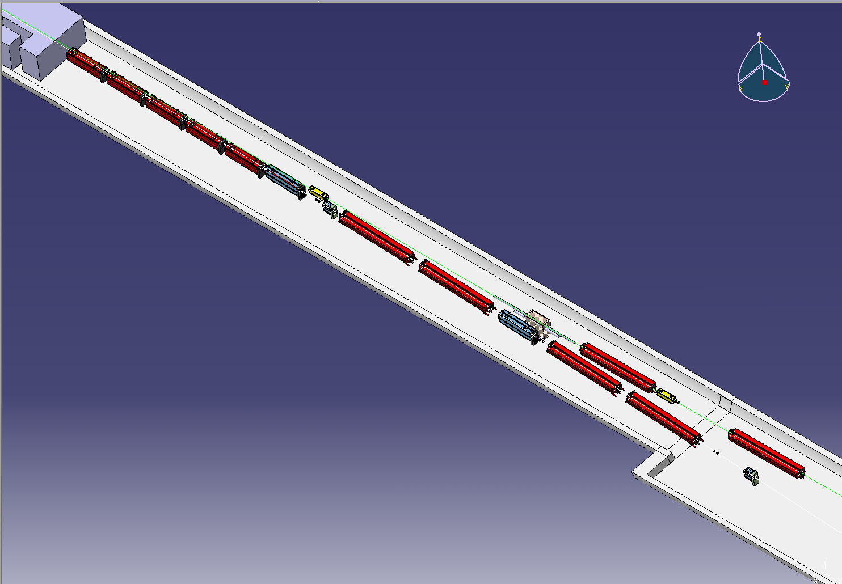
WG1 – Beam line: status
TBSE location
This new TBSE will allow HiRadMat operation while accessing the LHC tunnel

Slide 37
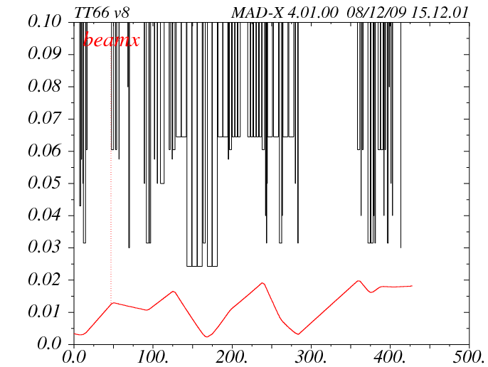
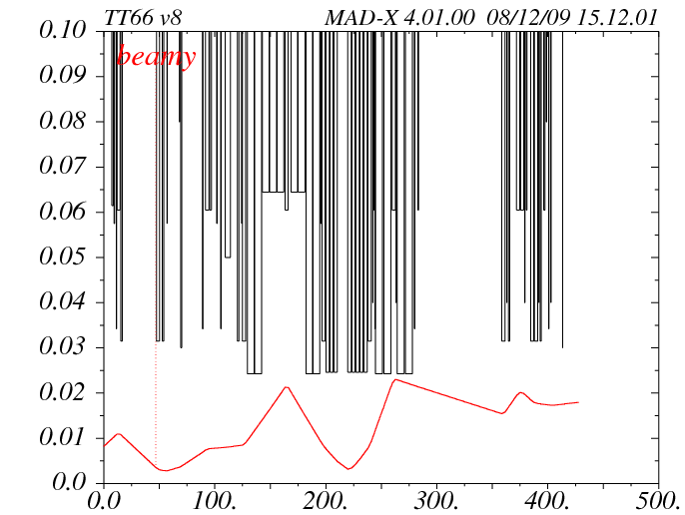
WG1 – Beam line: status
Beam Envelope Calculation
beam envelope x (m)
beam envelope y (m)
s (m)
s (m)
Focal point position: start of large test stand
Beam radius at focal point: σ = 2 mm
6σ beam radius and 5 mm max. trajectory deviation for beam envelope calculation assumed

Slide 38
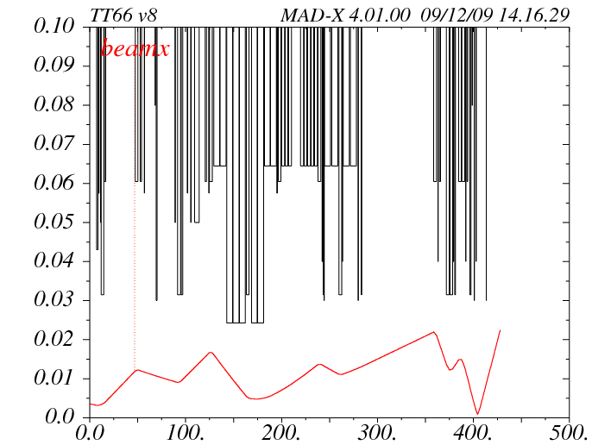
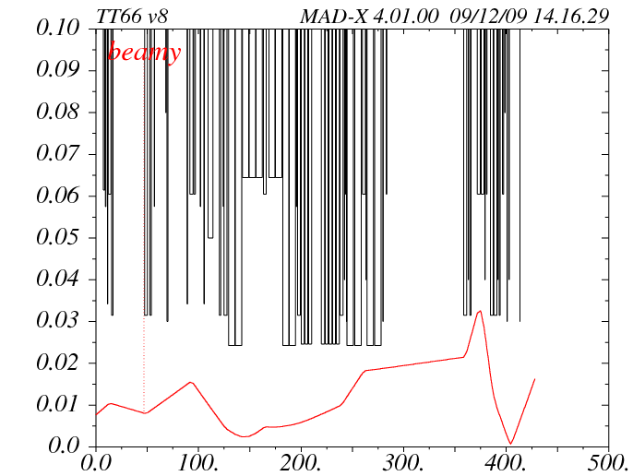
WG1 – Beam line: status
Beam Envelope Calculation
beam envelope x (m)
beam envelope y (m)
s (m)
s (m)
Focal point position: start of large test stand
Beam radius at focal point: σ = 0.1 mm
6σ beam radius and 5 mm max. trajectory deviation for beam envelope calculation assumed

