Slide 1
AD
Outlook for 2010

Slide 2
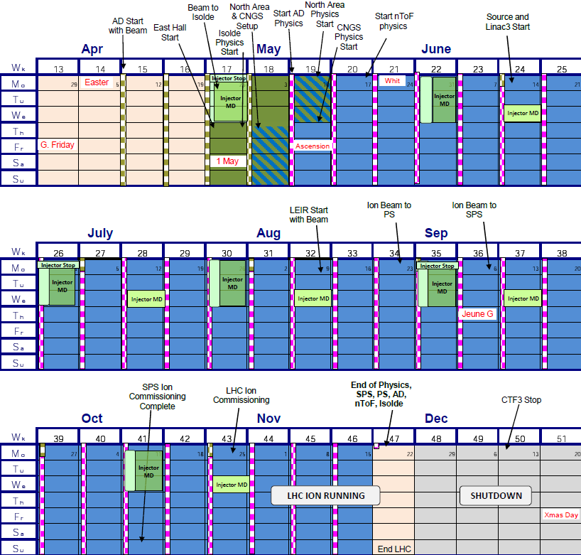
Key dates for 2010 run:
22/3 start of HW-tests
12/4 start s-u with beam
10/5 Start of physics
=>
28 weeks of physics scheduled (4600 h)

Slide 3
Experimental requirements for 2010:
ACE:
  2-3 * 24h periods mid-June
  1 week 24h/24 in October
  Single bunch ejection at 500 MeV/c (no e-cooling)
ALPHA, ATRAP: Single bunch ejection at 100 MeV/c
ASACUSA: Single and 6:ple ejection at 100 MeV/c
3*8 h shifts
AEGIS: No beam required in 2010

Slide 4
AEGIS (AD-6)
Gravitational studies of Hbars produced in flight
Sharing of the DEM-zone with ACE (cell irradiation)
Fully approved in 2009
Installation and commissioning in 2010
First Pbar beams in 2011
=> one more user to share the available Pbars

Slide 5
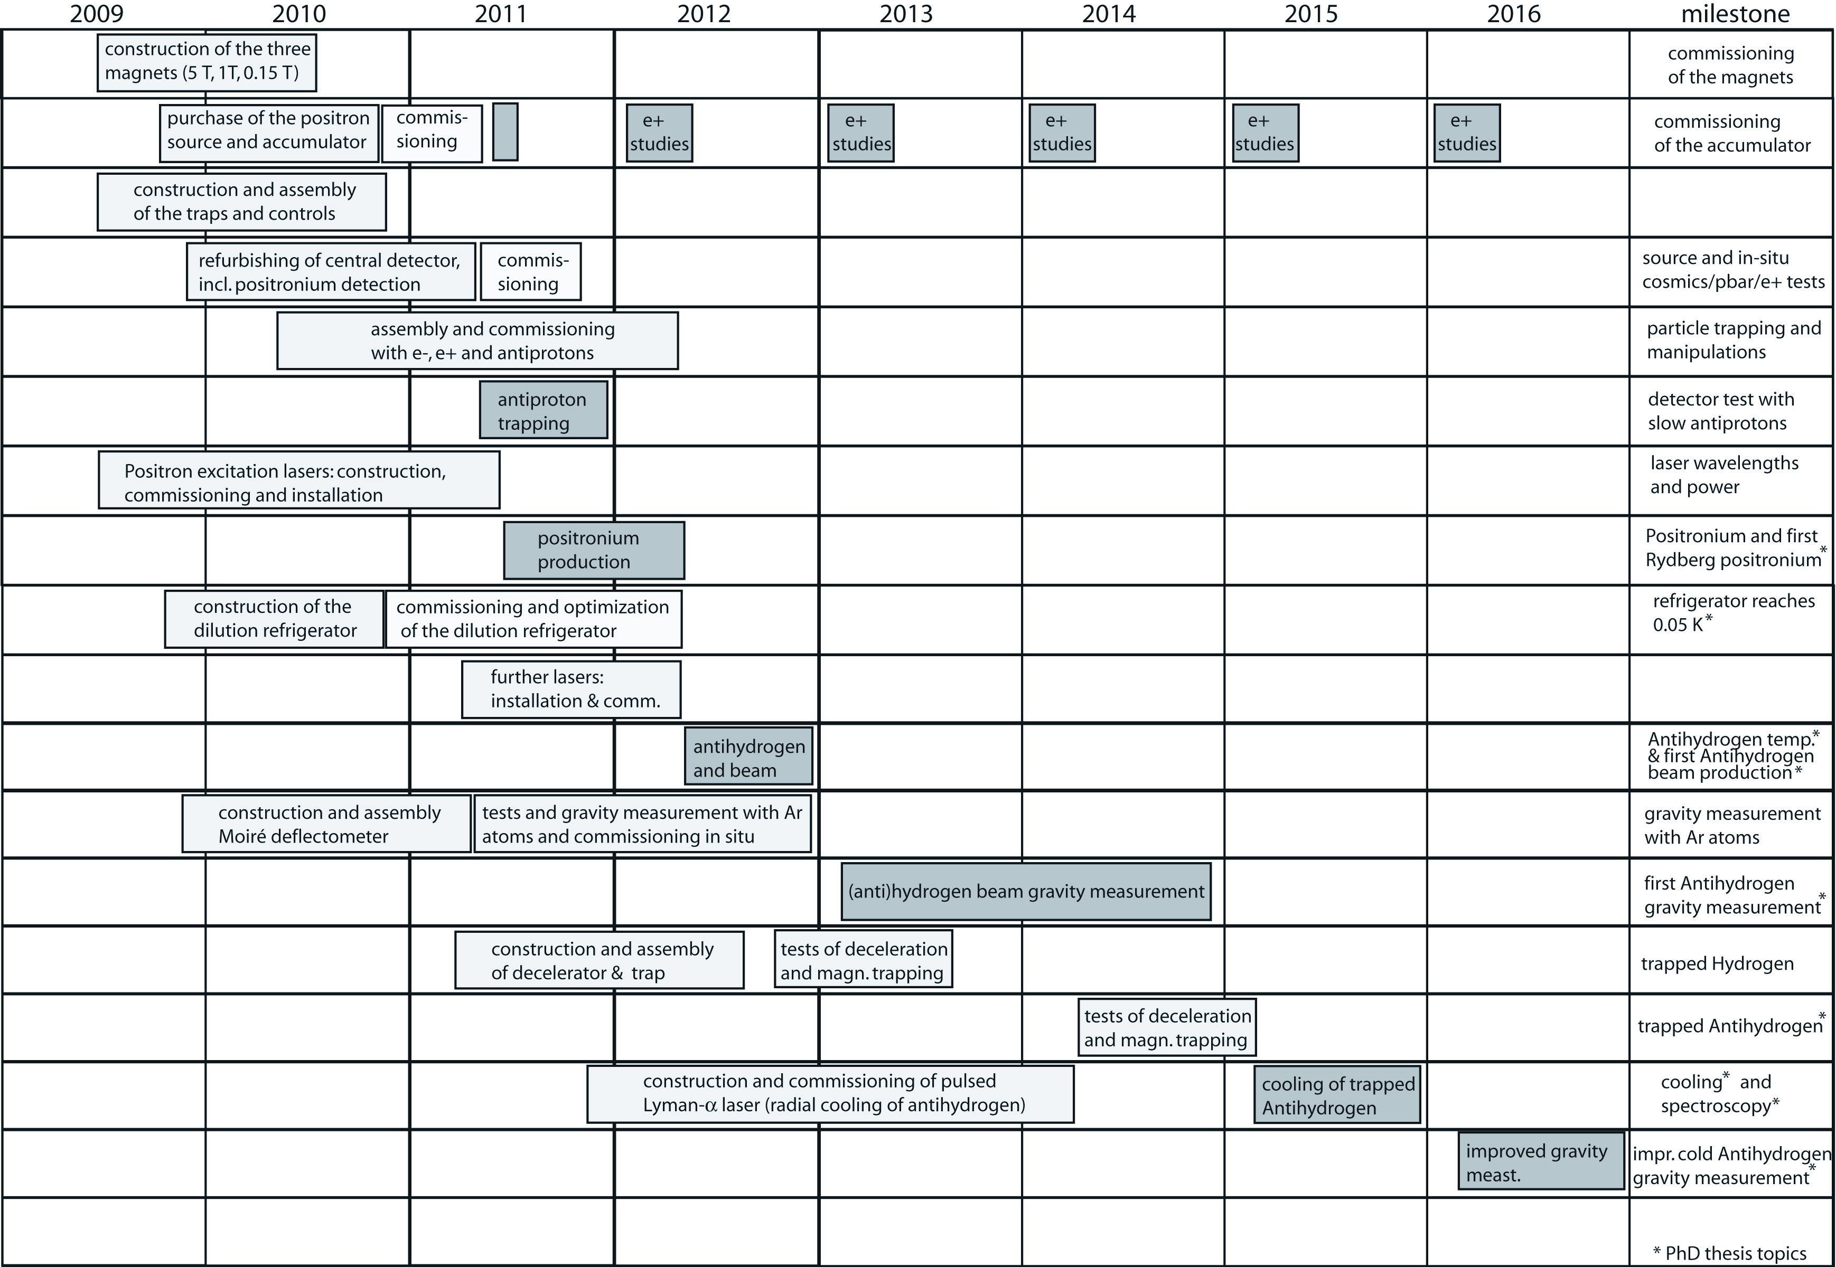
AEGIS schedule

Slide 6
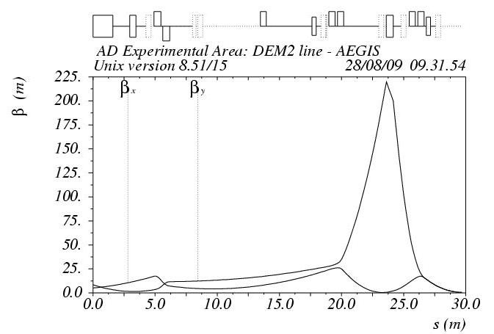
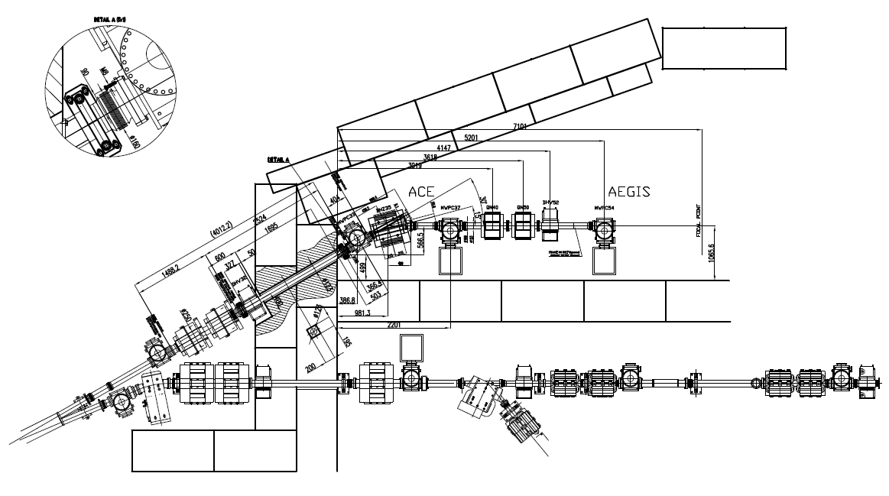
AEGIS beamline in AD and DEM zones

Slide 7
Magnets
Element | Type | Bl [Tm] | I [A] | Imax
DEM.DHV32 | PSB Type 1 | 0.0081/0.0079 | +-10 | 10
DEM.BHZ35 | MEA43 | 0.175 | 73 | 80
DEM.DHV52 | PSB Type 1 | 0.0081/0.0079 | +-10 | 10
Element | Type | K1 [m-2] | GL [T] | I[A] | Imax
DEM.QN40 | QTR | 0.2548 | 0.091 | 8.9 | 50
DEM.QN50 | QTR | 0.5550 | 0.1981 | 19.4 | 50
Power | converters
Element | Type | I nominal [A] | Imax [A]
DEM.DHZ32 | LPSS 35V 24A | 0 | +-24
DEM.DVT32 | LPSS 35V 24A | 0 | +-24
DEM.BHZ35 | 2*60V/100A | 73 | +-100
DEM.QN40 | LPSS 18V 50A | 8.9 | +-50
DEM.QN50 | LPSS 18V 50A | 19.4 | +-50
DEM.DHZ52 | LPSS 35V 24A | 0 | +-24
DEM.DVT52 | LPSS 35V 24A | 0 | +-24
MWPC/GEM | detectors
DEM.MWPC33
DEM.MWPC37
DEM.MWPC54
Vacuum | equipment
AEGIS beamline equipment:
Extension of beamline in DEM-zone used by ACE
Upgrade of MWPC:s in all ejection lines: GEM detectors + new electronics

Slide 8
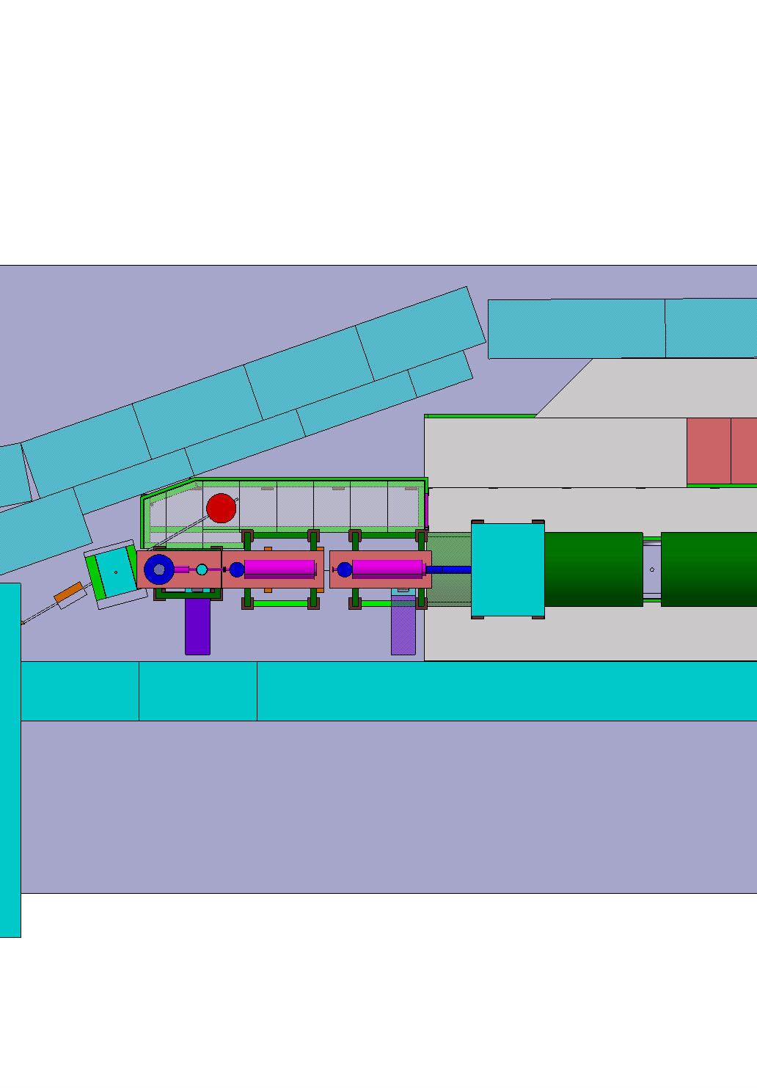

Slide 9
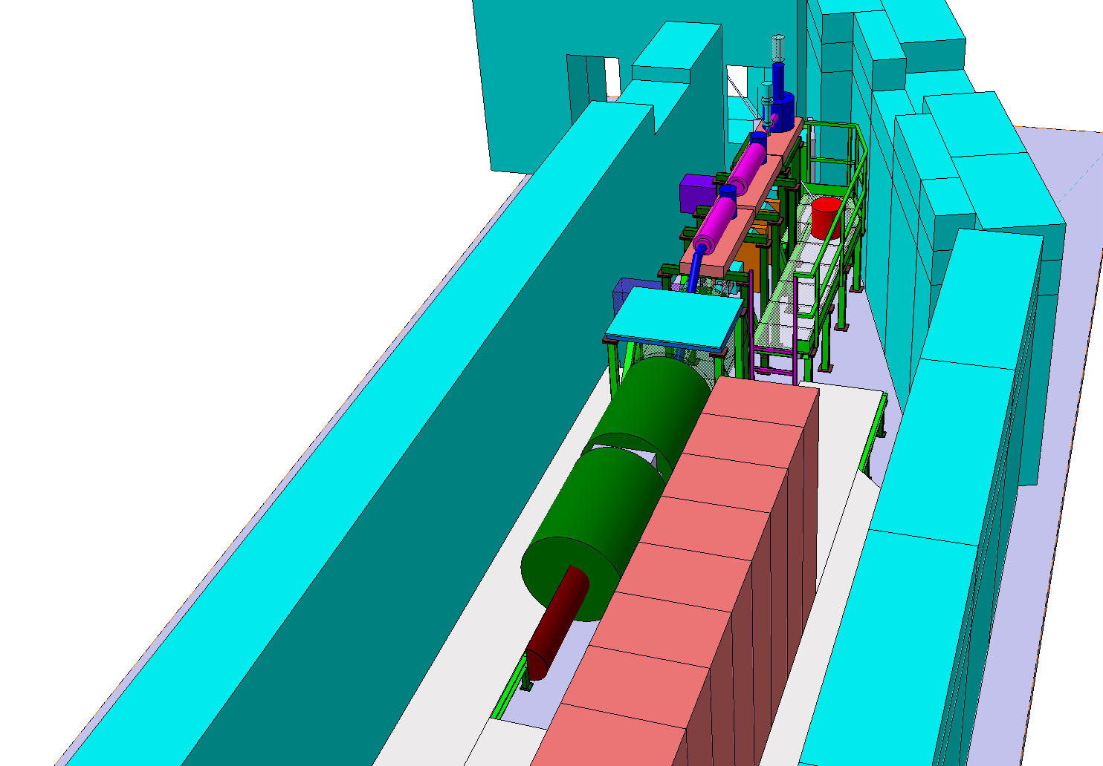

Slide 10
Beamline schedule
Final layout/optics 1 Sept 09
Final mechanical design + drawings 1 Nov 09
Vacuum chamber fabrication 1/11/2009 -1/3/2010
Magnet refurbishing/tests =>1/3/2010
Power converter refurbish/purchase 2009/2010
MWPC/GEM tests =>1/11/2009
Installation: shutdown 09/10
  MWPC electronics (started Aug .09) + during 2010 run
  MWPC chambers
  Vacuum chambers/equipment
  Magnets
  Power converters/cabling/controls

Slide 11
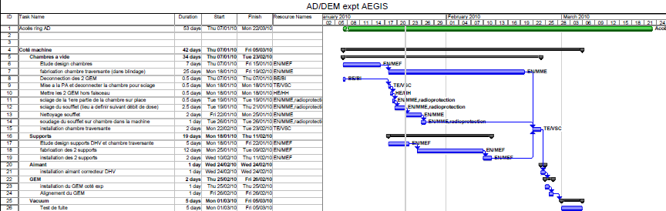
Progress:
Shutdown 2010, phase 1:
  Finish all installation work inside AD ring enclosure before startup
During 2010 run, phase 2:
  Installation in DEM-zone (access ok)
  Equipment tests

Slide 12
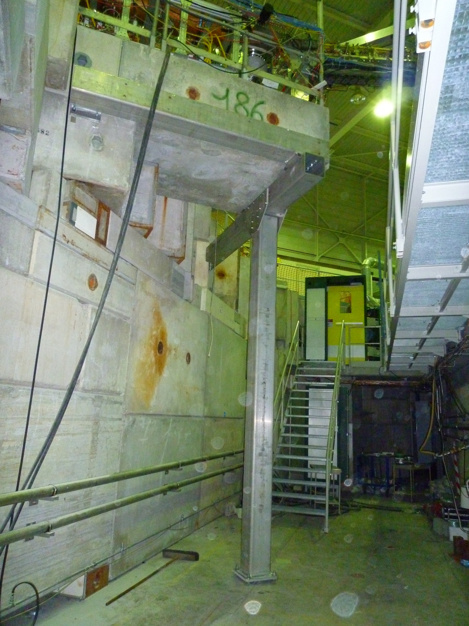
Removal of 20T concrete pillar supporting ATRAP2 positron accumulator zone
Replaced by metallic structure to make space for AEGIS equipment
It went well…….

Slide 13
ELENA
SPSC request:
We have already identified 2 points which will require some attention, namely:
- a better quantification of the gains for the experiments, with some real practical examples for each of them ;
- the implications of an improved AD on the experimental area in order to be able to host more experiments.

Slide 14
ELENA location
  Building 193
  Building 181
  New building
  Conclusion

Slide 15
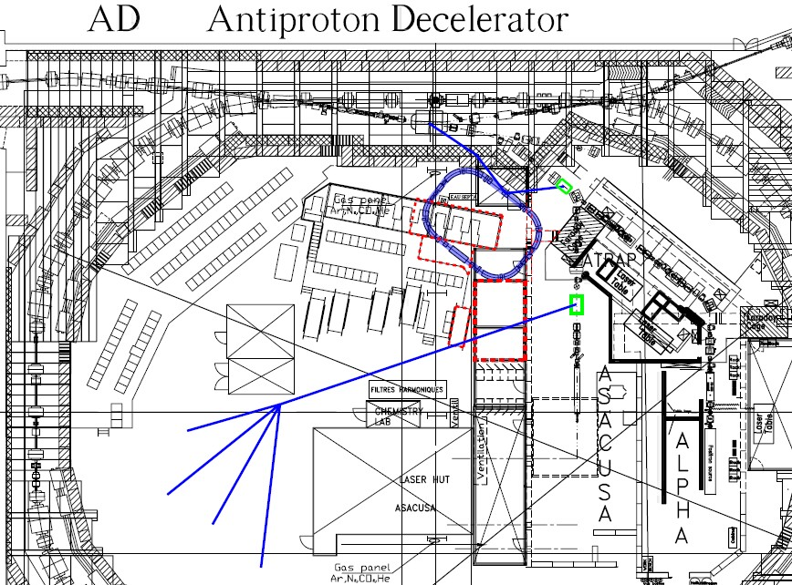
ELENA location 1: Initial place

Slide 16
ELENA location 1: Initial place
+ Short transfer lines
+ Few new magnets
+ Lowest cost
+ No AD ring modifications
+ No change for the present experimental zone (low and high energies possible)
+ New experimental zone at low energy obtained with some difficulty (transfer line + shielding under user barrack, access)
o Modification of ASACUSA experimental zone
- Tight space (no upgrade possible, difficulties for ELENA installation and access)
- 4 kicker modules instead of 2 to move
- Difficult to modify shielding
- Perturbations to 4 users during installation

Slide 17
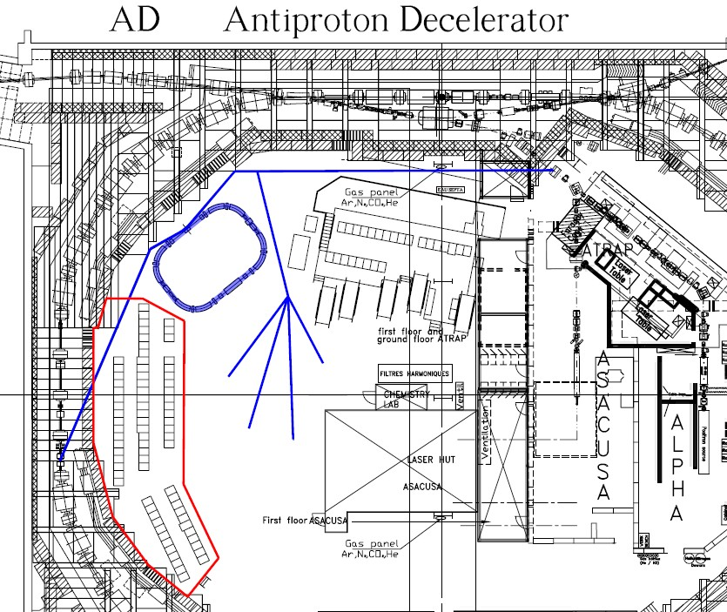
ELENA location 2: New place in Bldg193

Slide 18
ELENA location 2: New place in Bldg193
+ Plenty of space (future upgrade possible)
+ Easy access (no particular re-arrangement in AD hall needed)
+ No perturbation to existing ejection lines and shielding
+ New experimental zone at low energy possible
+ No change for the present experimental zone (low and high energies possible)
+ Simple transfer line to new zone
- Move racks, new cabling – cost?
- New low energy septum magnet (+kicker?)
- Long 100keV transfer line (stability?)

Slide 19
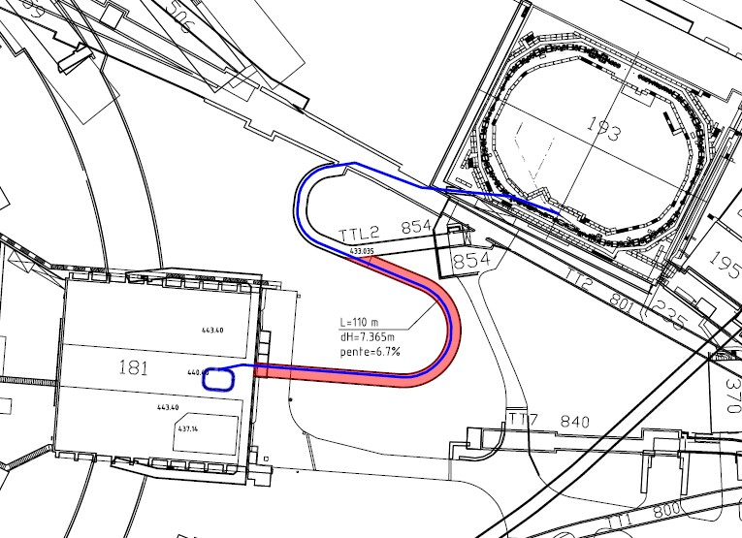
ELENA location 3: Building 181

Slide 20
ELENA location 3: Building 181
+ Space for future upgrade and a new e+ source (1000m2 or more, max. 2600m2)
+ Keep high energy experiments in Bldg 193 and low energy experiments in new location
+ No modifications in AD ring
+ Several new experimental zones at low energy possible
+ No perturbation to existing experiments during ELENA construction and commissioning
- Very long 5MeV beam line, expensive
- Civil engineering work (>100m long new tunnel, max. 10% slope) – expensive (cost of about 8-10 MCHF)
- Long downtime for moving and restarting experiments (+6 months?)
- Bldg 181 presently used for other activities (LHC magnet assembly press, workshops, clean room)

Slide 21
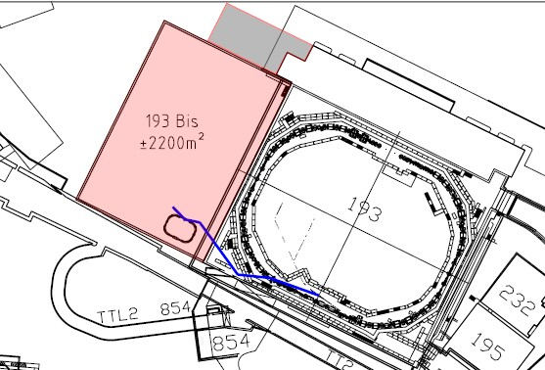
ELENA location 4: New Building

Slide 22
ELENA location 4: New Building
+ Plenty of space for future upgrade and for a new e+ source (better layout, 2200 m2)
+ Keep high energy experiments in Bldg 193 and low energy experiments in new location
+ Short new 5MeV extraction beam line
+ No modifications in AD ring
+ Several new experimental zones at low energy possible
+ No perturbation to existing experiments during ELENA construction and commissioning
- New expensive building (cost of about 15-20 MCHF and delay of the project by about 1.5 years)
- Long downtime for moving and restarting experiments (+6 months?)

Slide 23
Conclusion
+ Plenty of space (future upgrade possible)
+ New experimental zone at low energy possible with a very simple transfer line
+ Easy access (no particular re-arrangement in AD hall needed)
+ No perturbation to existing ejection lines and shielding
+ No change of the present experimental zone (low and high energies possible)
Many advantages, small number of disadvantages show that location 2 is very attractive and very elegant place to put ELENA.

Slide 24
ELENA location 2: New place in Bldg193

