Slide 1
Towards smooth operations for the SPS North Area that remains as popular as ever
Masi, EN/STI
thanks to inputs from: O. Aberle (EN/STI); Jean-Paul Burnet (TE/EPC); S. Deleval (EN/CV); M. Dumas (TE/MSC); S. Girod (EN/MEF); M. Pezzetti (TE/CRG); E. Sallaz (IT/CS); J. Spanggaard (BE/BI); D. Vaxelaire (GS/ASE);
Contents
SPS North area- Status of consolidation programs for:
    Power Supplies
    Beam Instrumentation
    Access System
    Beam Obstacles Controls
    Beam Obstacles Mechanics
    Cooling and Ventilation
    Cryogenics
    Magnets
    Networking in the experimental hall
    Budget-resources estimates and possible timeline

Slide 2
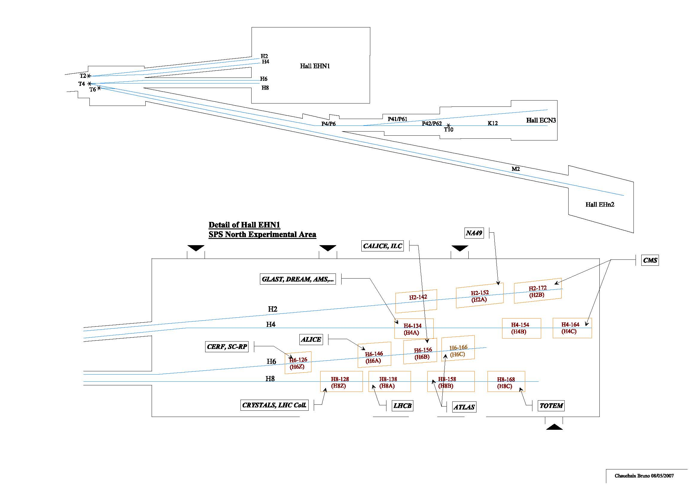
North Area

Slide 3
North area status
    Power Supplies inputs from Jean-Paul Burnet (TE/EPC)
    Beam Instrumentation inputs from J. Spangaard (BE/BI)
    Access System inputs from D. Vaxelaire (GS/ASE)
    Beam Obstacles Controls inputs from A. Masi(EN/STI), A. Bland(BE/CO)
    Beam Obstacles Mechanics inputs from O. Aberle(EN/STI), S. Girod(EN/MEF)
    Cooling and Ventilation inputs from S. Deleval ( EN/CV)
    Magnets inputs from M. Dumas (TE/MSC)
    Cryogenics inputs from M.Pezzetti (TE/CRG)
    Networking in the inputs from E. Sallaz (IT/CS) experimental hall

Slide 4
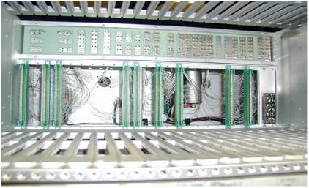
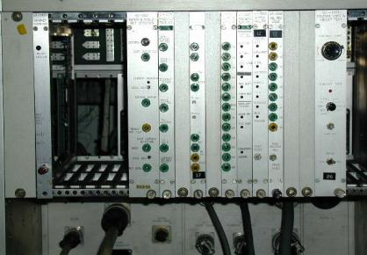
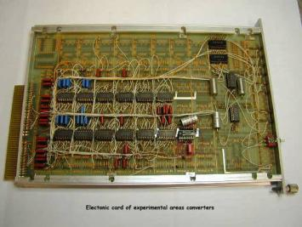
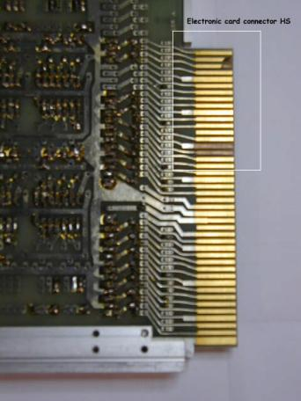
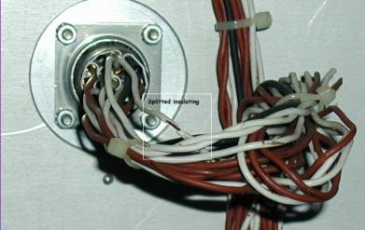
Power supplies: main issues that presently affect operation
Wire wrap
Obsolete components
Power converters in operation since 1976
Original analog & digital electronics
Wire wrap technology
Old control system (Databus)
Power converter MTBF very low: ≈7000H
167 interventions by the first line team in 2009
100 electronic cards repaired each year
~ 6600 electronic
modules of this type
are in operation
Cabling ageing
330 power converters in operation
50 spares
Split insulation
Damaged gilded contacts

Slide 5
Power supplies- Solutions: Full consolidation plan
TECHNICAL SOLUTIONS
Replace 180 power converters (≤500A) by new switch-mode power converters.
  C11 250A / 100V
  R11 500A / 150V
  R12 500A / 300V
Renovate 150 thyristor converters.
  R21 1000A / 300V
  R22 1500A / 250V
  R31 2500A / 255V
  R41 6000A / 600V
  D21 1500A / 200V
  D31 2500A / 285V
New electronic control (FGC3 + Worlfip)
CONSOLIDATION PLANS
Provisional schedule: 6 years
  2 years studies and contracts
  4 shutdowns for implementation
Budget : 20 MCHF
Manpower: 19 FTE

Slide 6
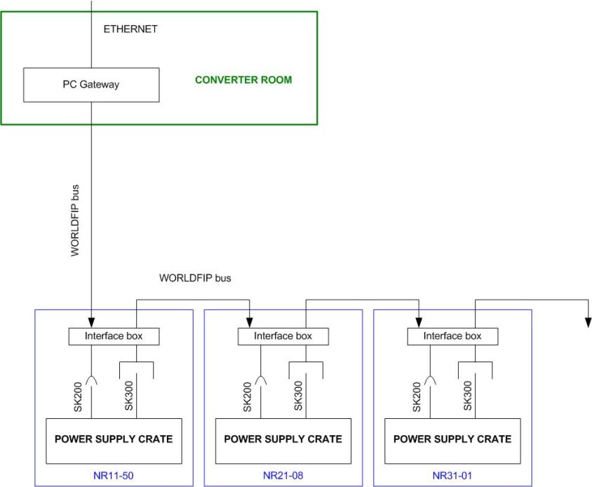
Power supplies- Solutions: Partial consolidation plan
Second proposal: Deploy WORLDFIP up to the power converters
Keep Power Supply crate
Install an interface box inside all power converters
No more databus faults
No more Converter crate faults
Fault reduction: at least by 60% on bending magnets
power supplies (less than 50%)!!!
Interface box:
ADC, DAC, current & voltage regulators, command & status
Interface box will include FGC3
New DCCT can be easily installed
Next step:
  Renovate power part
  Replace Power supply crate

Slide 7
Power supplies- Solutions: Partial consolidation plan
Advantages
Use WORLDFIP => CERN standard data bus for power converters
  As already planed in the consolidation
  Anticipate the data bus deployment
Use FGC3 control system => CERN standard control system for power converters
  As already planed in the consolidation project
  Anticipate the FGC3 deployment
  FGC3 hardware will be reused after the power converters renovation
  FGC3 project is already in progress => Synergy & Convergence
Manpower => Save at least 0.5 FTE / year
  Reduce the number of piquet interventions
  Reduce the maintenance works for electronic cards
Operation => Improve reliability
  Reduce the number of faults
  Improve the quality of the power converter data
  Improve the magnet current control (replacement of DAC and ADC)
  Some DCCT can be easily replaced by new ones (for Bends)

Slide 8
Power supplies- Solutions: Partial consolidation plan
Improvement proposal before starting a global consolidation project
Deploy WORLDFIP on “high” power converters (R21, R22, R31), 150 units / 330
Use FGC3 to control the power converters (3 kCHF / PC)
New DCCT in bending converters
Budget allocated : 300kCHF (2010), 300kCHF (2011)
Provisional schedule:
  2010 purchasing of material+ FGC3 production
  2011 WORLDFIP cabling + Software development
  2012 start with new converter control
Manpower: 2 FTE
Fault reduction: 60% on upgraded converters (30% in total)

Slide 9
North area status
    Power Supplies inputs from Jean-Paul Burnet (TE/EPC)
    Beam Instrumentation inputs from J. Spanggaard (BE/BI)
    Access System inputs from D. Vaxelaire (GS/ASE)
    Beam Obstacles Controls inputs from A. Masi(EN/STI), A. Bland(BE/CO)
    Beam Obstacles Mechanics inputs from O. Aberle(EN/STI), S. Girod(EN/MEF)
    Cooling and Ventilation inputs from S. Deleval ( EN/CV)
    Magnets inputs from M. Dumas (TE/MSC)
    Cryogenics inputs from M.Pezzetti (TE/CRG)
    Networking in the inputs from E. Sallaz (IT/CS) experimental hall

Slide 10
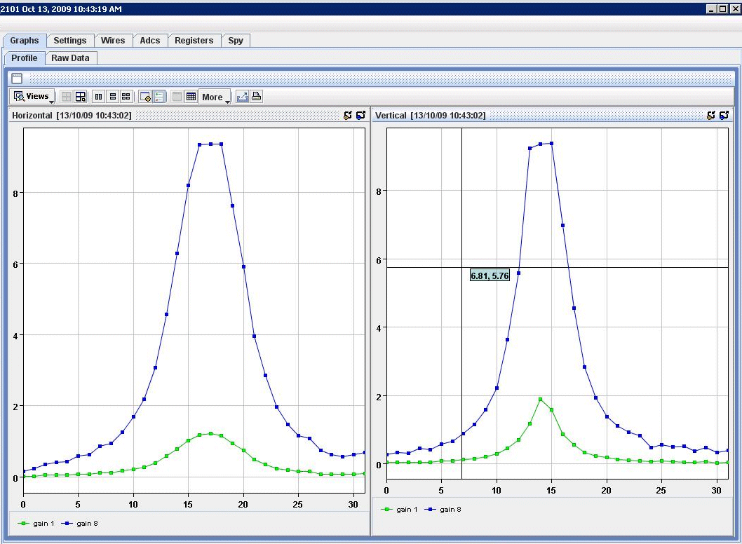
Beam Instrumentation: main issues that presently affect operation
MWPC consolidation in the North EA
(In-house EquipmentBus replaced by VME)
(Data Modules replaced by FESA)
(NODAL replaced by JAVA applications)

Slide 11
Beam Instrumentation: consolidation plan
Area | Device | State | Consolidation plans & comments
EAN | EXSCAL: Experimental Scaler | Operational | Consolidated in 2003
EAN | MWPC: Multi Wire Proportional Chambers | Operational | Consolidated in 2009
EAN | XCED: Cerenkov Differential counter with Achromatic Ring focus (CEDAR) | Operational | Consolidated in 2008
EAN | XCET: Cerenkov Threshold Counter | Operational | Consolidated in 2007
EAN | XDWC: Delay Wire Chambers / Spectrometer | Operational | Consolidated in 2006
EAN | XEMC: Electromagnetic Calorimeter | Commissioning | Consolidated in 2007 (upgrade application)
EAN | XFFV/XFFH: Filament Scintilator (Fast FISC) | Operational | Consolidated in 2005/2006
EAN | - XFFN: Normalisation Counter (using Fast FISC hardware) | Operational | Consolidated in 2005/2006
EAN | - XPHA: Pulse Height Analysis (Add-on for Fast FISC hardware) | Prototype | New development being terminated in 2010

Slide 12
Beam Instrumentation: consolidation plan
Area | Device | State | Consolidation plans & comments
EAN | XION: Ionisation Counters (Argonion) | Operational | Consolidated in 2003
EAN | XSCI: Scintillation Counters (Scintillator) | Operational | Consolidated in 2003
EAW | HiRad: Instrumentation for Mat. irradiation | Project 2010/2011
EAD | MWPC: Multi Wires Proportional Chambers | Dying | Detector: Replace by Gas Electron Multipliers
EAD | XGEM: Gas Electron Multipliers |  | Installation of new detectors, local electronics,VME acquisition system, FESA and Java application during the 2010/1011 shutdown.
EAE | XDWC: Delay Wire Chambers | Operational | Installed in 2007, commissioned in 2008.
EAE | XSCI: Scintillation Counters (Scintillators) | Operational | Installed and commissioned in 2007
EAE | XSEC: Secondary Emission Counters | CAMAC ACQ Dying | Suppress CAMAC and install new VME hardware. Consolidation foreseen during the 2011/2012 shutdown.
EAE | XTEL: Telescope Intensity/Spill monitors | CAMAC ACQ Dying | Suppress CAMAC and install new VME hardware. Consolidation foreseen during the 2011/2012 shutdown.

Slide 13
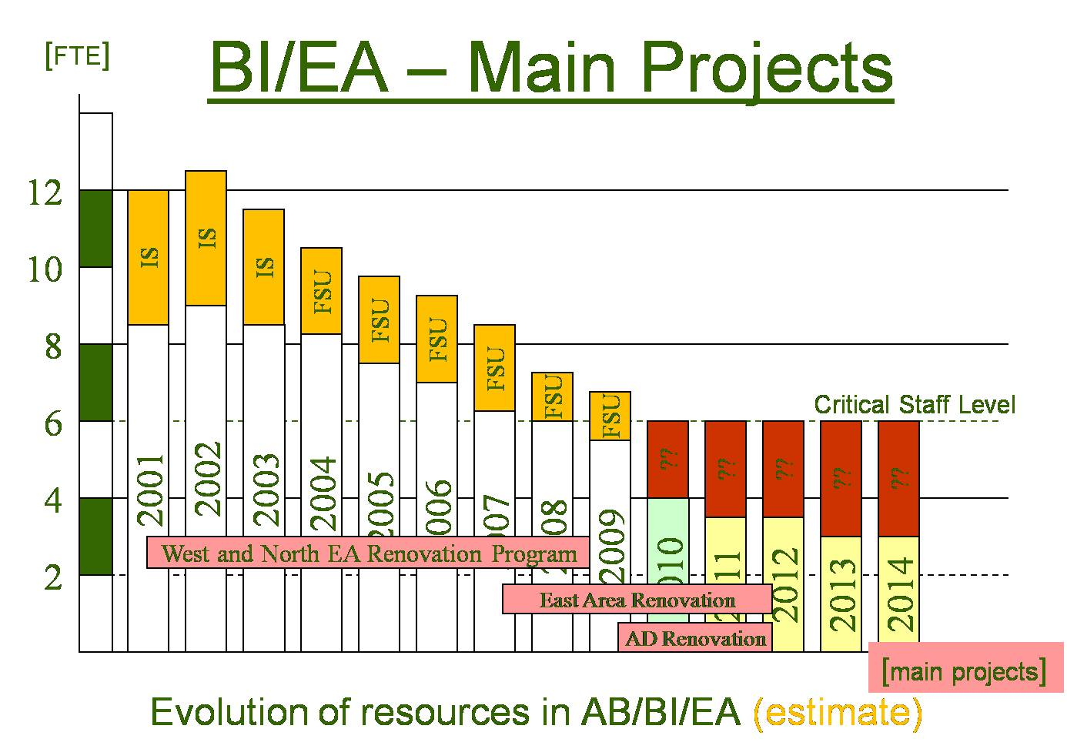
Beam Instrumentation: budget and resources estimate

Slide 14
Beam Instrumentation: budget, resources estimate and timeline
North Areas: Consolidation terminated last year.
  Equipment Bus Master maintained for Motors only (See Masi’s slides).
  Multi Wire Proportional Chambers could still be upgraded to Gas Electron Multipliers like in the AD (profit from the needed upgrade in the AD).
East Hall: Consolidation is ongoing.
  Old CAMAC electronics to be upgraded.
  Remote control of Telescope, SEC and Cerenkov still missing.
AD Areas: Consolidation is being studied.
  Multi Wire Proportional Chambers have artifacts at low energy that can be overcome with Gas Electron Multipliers.
  Funded via AEGIS, but no qualified manpower.
Know-how disappearing from the BI group.
  Present manpower for the experimental areas will have left by 2011!
  BI should consolidate expertise in the fields of MWPC, GEM and Cerenkov.

Slide 15
North area status
    Power Supplies inputs from Jean-Paul Burnet (TE/EPC)
    Beam Instrumentation inputs from J. Spangaard (BE/BI)
    Access System inputs from D. Vaxelaire (GS/ASE)
    Beam Obstacles Controls inputs from A. Masi(EN/STI), A. Bland(BE/CO)
    Beam Obstacles Mechanics inputs from O. Aberle(EN/STI), S. Girod(EN/MEF)
    Cooling and Ventilation inputs from S. Deleval ( EN/CV)
    Magnets inputs from M. Dumas (TE/MSC)
    Cryogenics inputs from M.Pezzetti (TE/CRG)
    Networking in the inputs from E. Sallaz (IT/CS) experimental hall

Slide 16
Access system: main issues that presently affect operation
Low reliability of the system:
communication problems affects the operation due to the large number of software layers kept in place for historical reasons and to allow the interfacing with newer devices
Maintenance problems:
- Very old system
- Difficult to integrate the system in the new infrastructure

Slide 17
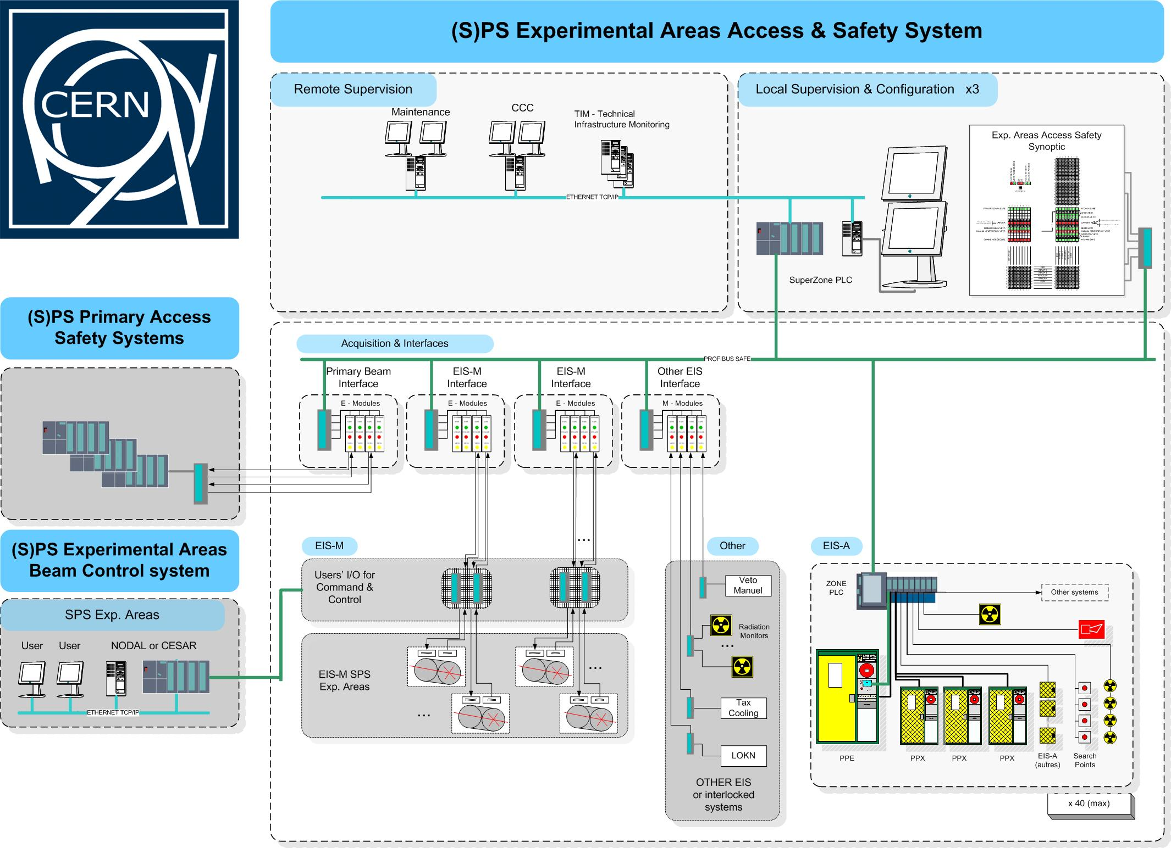
Access system: consolidation plan
Installation of a new access system as the one installed in the PS experimental areas (i.e. PS AD and East Hall)

Slide 18
Access system: budget, resources estimate and timeline
Consolidation project already approved and funded
Hardware already produced and test, software test in progress
Complete upgrade foreseen in 3 shutdowns (by 2011/2012)

Slide 19
North area status
    Power Supplies inputs from Jean-Paul Burnet (TE/EPC)
    Beam Instrumentation inputs from J. Spangaard (BE/BI)
    Access System inputs from D. Vaxelaire (GS/ASE)
    Beam Obstacles Controls inputs from A. Masi(EN/STI), A. Bland(BE/CO)
    Beam Obstacles Mechanics inputs from O. Aberle(EN/STI), S. Girod(EN/MEF)
    Cooling and Ventilation inputs from S. Deleval ( EN/CV)
    Magnets inputs from M. Dumas (TE/MSC)
    Cryogenics inputs from M.Pezzetti (TE/CRG)
    Networking in the inputs from E. Sallaz (IT/CS) experimental hall

Slide 20
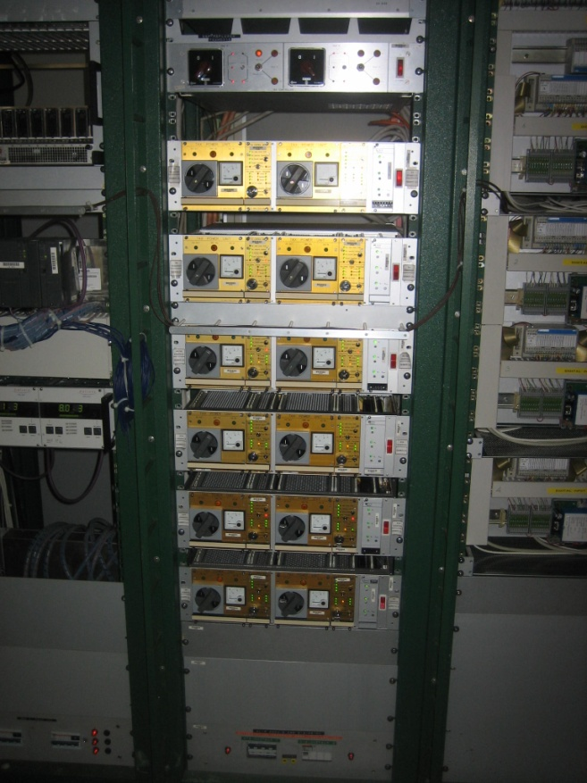
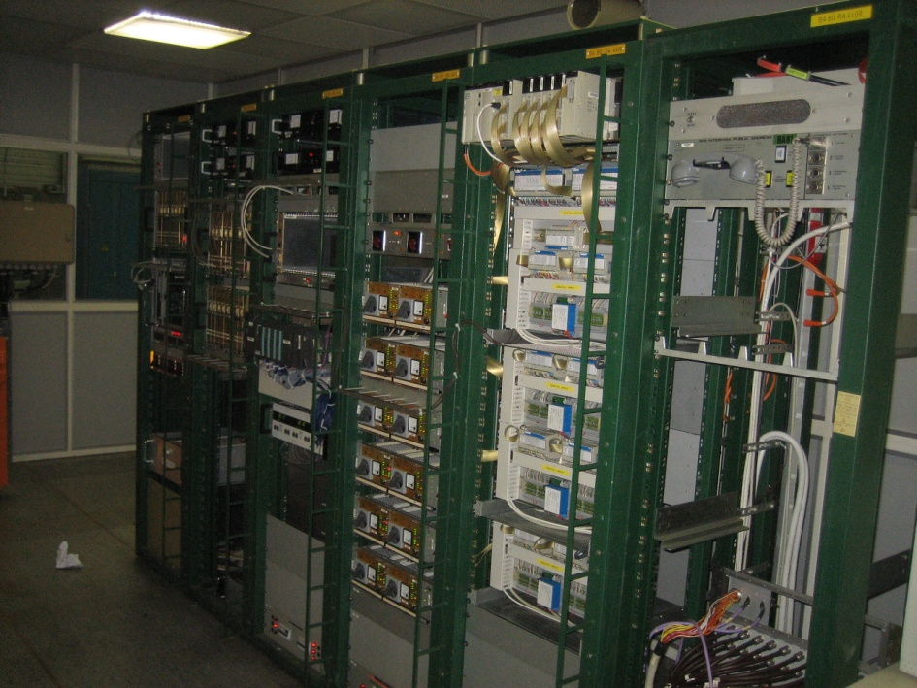
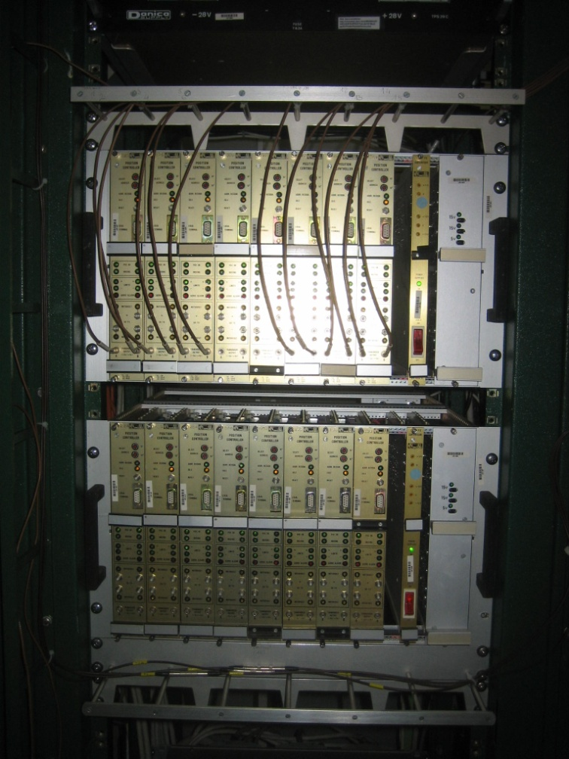
Obstacles controls: main issues that presently affect operation
Maintenance is becoming difficult to sustain: Failure rate very high due to ageing of cables and hardware. In average we had this year more than 7 interventions per month of 2h hours each
Few spare parts still available

Slide 21
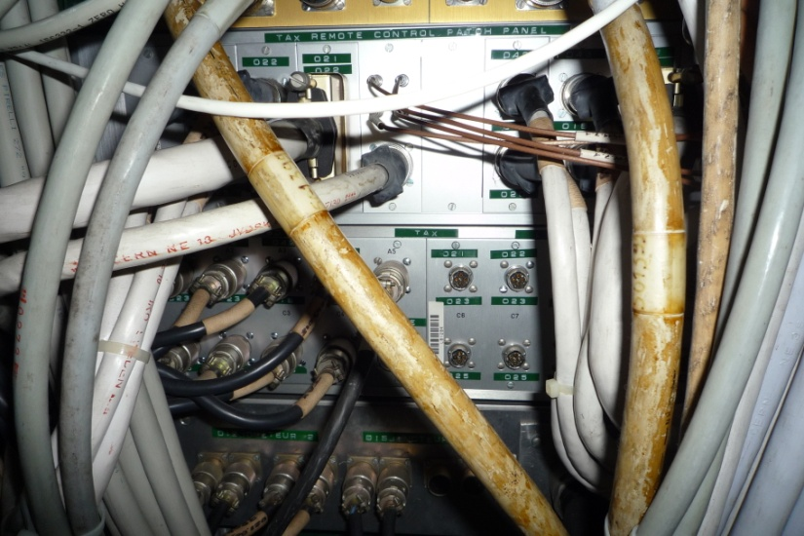
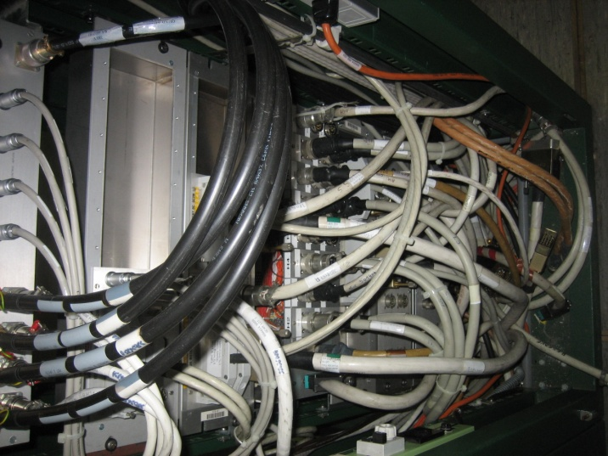
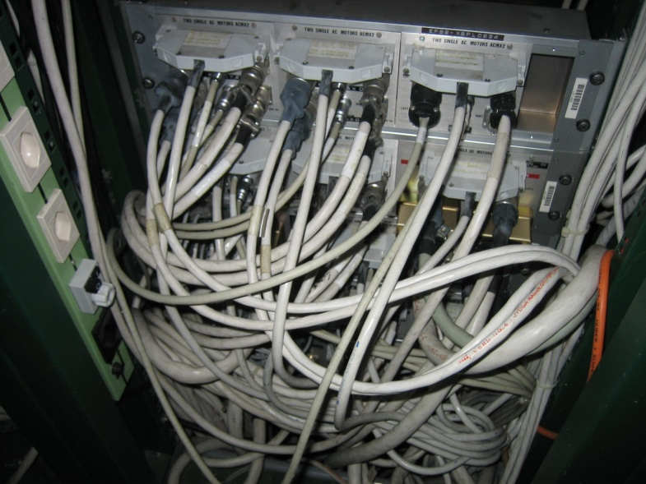
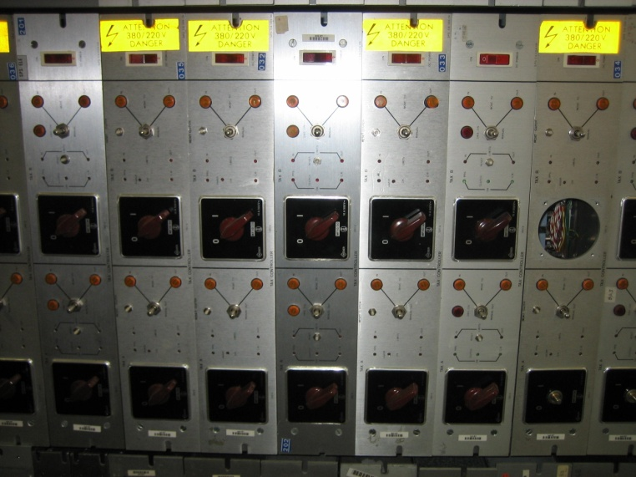
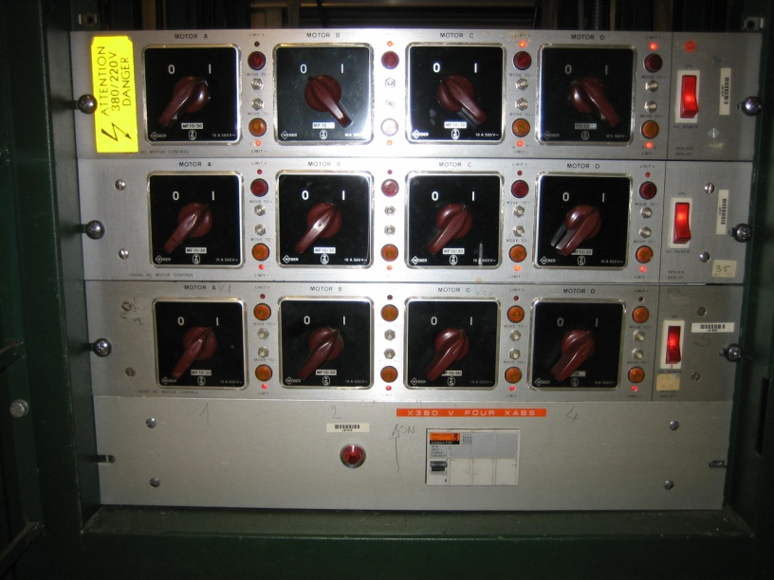
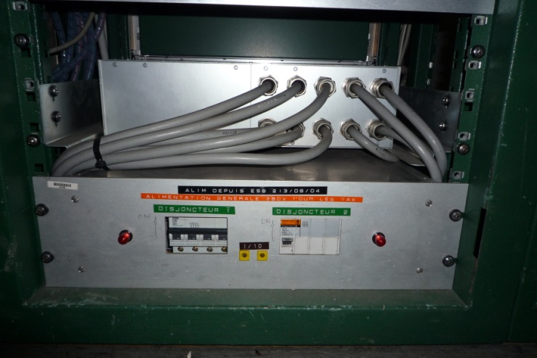
Obstacles controls: main issues that presently affect operation
Cables aging
High failure rate of power supplies and controller box

Slide 22
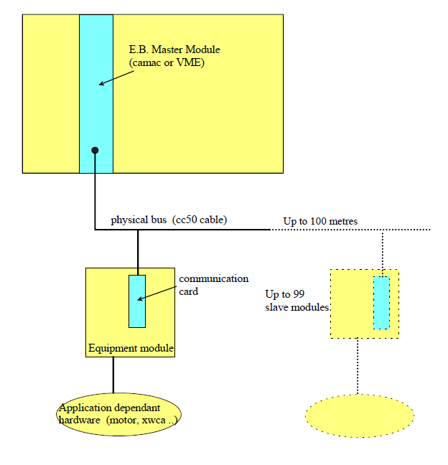
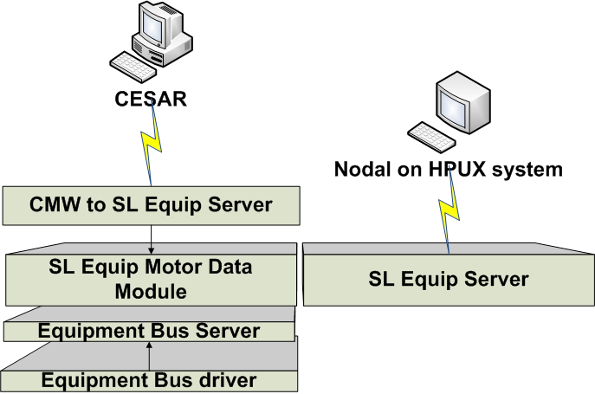
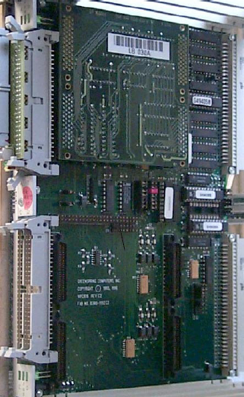

Obstacles controls: main issues that presently affect operation
Known communication problems:
Equipment Bus is not reliable, in particular when other software on same machine uses a lot of CPU or memory
Known bug may cause data requested from one Position Controller to be returned as a request for another (out of sync)
YELLOW CARD:
The communication infrastructure is not supported anymore by BE/CO
A. Bland is kindly still ensuring the support for the operation but until when????!!!!!
10 operational Equipment Bus Master LynxOS Front Ends:
V1n201, v1n351, v1n394, v1n403, v1n438, v1n472, v1n494, v1nb80, v1nx80, v2n117
E. Bus Master communication Card

Slide 23
Obstacles Controls: consolidation plan
Objectives: Replace the old controls with a new solution based on PLC and FESA gateway fully supported by CO starting from 2009/10 shutdown till 2011/12 shutdown
Phoenix modules on Profibus will be used to control DC motors and Siemens AC motor starters will be used for the AC motors
The present VME crate that control motors of different obstacles will replaced by a PLC
New control software as well as new FESA classes to be developed
New control chassis will replace the old position controller and power box in the racks
In the meantime
Installation in this shutdown of 9 VME crates to isolate the Equipment bus master by BI applications. This should slightly improve the reliability of the communication and make easier the rebooting in case of failure

Slide 24
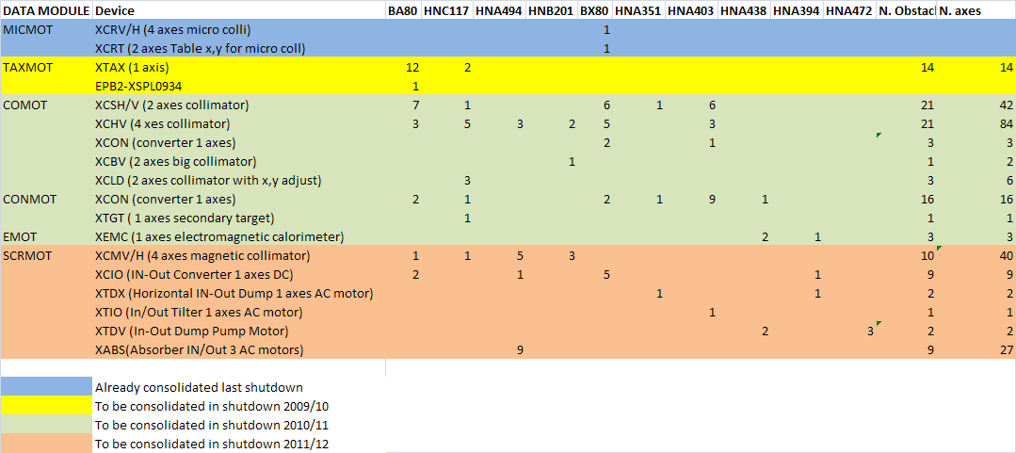
Obstacles Controls: budget, resources estimate and timeline
The renovation should proceed by DATAMODULE to avoid conflicts in Cesar between old and new middleware
Consolidating one shot all the devices concerning the same motorization type produce a considerable costs saving
(i.e. materials discount and series production of the control chassis)
It would be preferable to perform the entire renovation of a barrack

Slide 25
Obstacles Controls: budget, resources estimate and timeline
Shutdown | Data Module t.b.c. | Mot. Type | Devices t.b.c. | N. Devices, N. Axes | Barracks involved | Budget Required
2009/10 | TAXMOT | AC | XTAX | 14,14 | BA80, HNC117 | 120 KCHF (allocated)
2010/11 | COMOT, CONMOT,EMOT | DC | XCSH/V, XCHV, XCON, XCBV, XCLD, XCON, XTGT, XEMC | 69,157 | BA80, HNC117, HNA494, HNB201, BX80, HNA351, HNA403, HNA438, HNA 394 | 500 KCHF
2011/12 | SCRMOT | AC | XCMV/H | 10,40 | BA80, HCN117, HNA494,HNB201 | 350 KCHF
 |  | AC,DC | XCIO, XTDX, XTIO,XTDV,XABS | 21, 39 | BA80, HNA494, BX80, HNA351, HNA403, HNA438, HNA394, HNA472

Slide 26
North area status
    Power Supplies inputs from Jean-Paul Burnet (TE/EPC)
    Beam Instrumentation inputs from J. Spangaard (BE/BI)
    Access System inputs from D. Vaxelaire (GS/ASE)
    Beam Obstacles Controls inputs from A. Masi(EN/STI), A. Bland(BE/CO)
    Beam Obstacles Mechanics inputs from O. Aberle(EN/STI), S. Girod(EN/MEF)
    Cooling and Ventilation inputs from S. Deleval ( EN/CV)
    Magnets inputs from M. Dumas (TE/MSC)
    Cryogenics inputs from M.Pezzetti (TE/CRG)
    Networking in the inputs from E. Sallaz (IT/CS) experimental hall

Slide 27
Obstacles mechanics: main issues that presently affect operation
The movable obstacles mechanics is in good shape. Yearly maintanance performed and covered by operational budget
BUT
Target stations in the North (T2,T4,T6,T10) are in bad shape
-Difficult to intervene
-Regular maintenance very limited
Operation of targets for more than some years (5?) would need a complete renovation (means new target mechanisms)

Slide 28
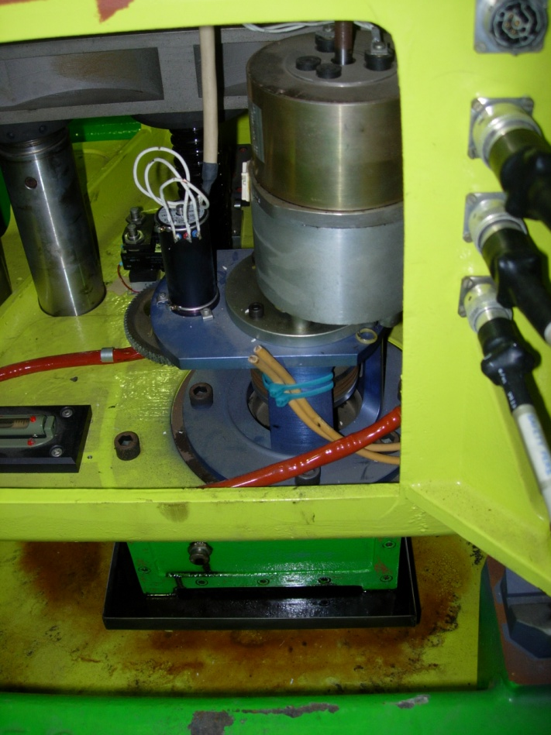
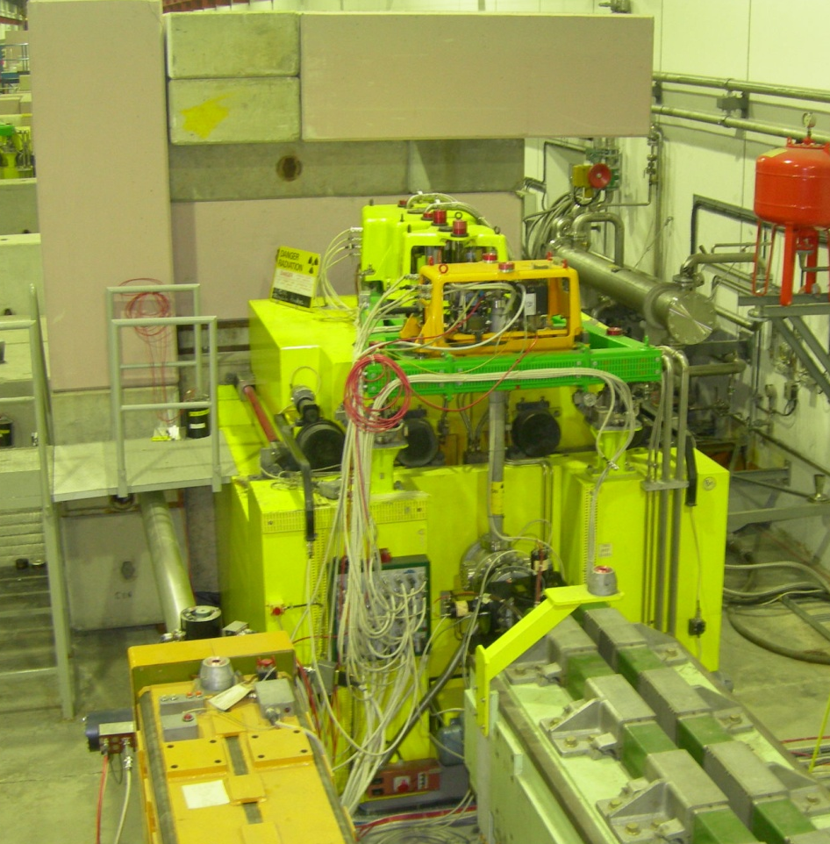
Obstacles mechanics: main issues that presently affect operation
Strong aging due to radiation
-rust
-loss of oil
-cable
breakage
-switches
fails
-Mobile shielding of T6 doesn‘t open anymore

Slide 29
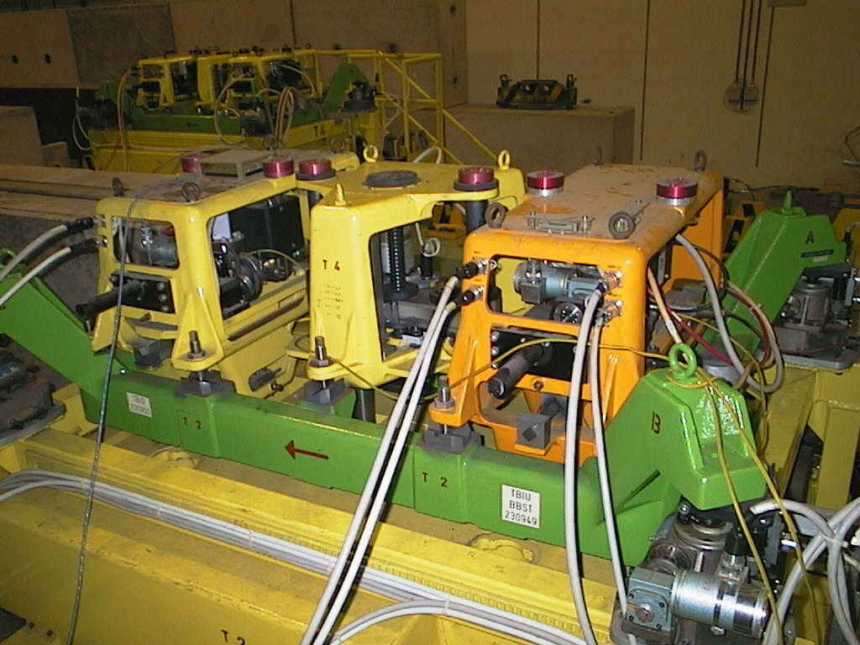
Obstacles mechanics: budget , resources estimate and timeline
Target stations in the North area will not be able to run reliably for another 5-10 years
Some radioactive spare parts are available
Renewal of the drivers for the monitors, the target boxes and the collimator plus two new spare chassis
Consolidation budget for mechanics renewal of 750 kCHF over 5 years needed

Slide 30
North area status
    Power Supplies inputs from Jean-Paul Burnet (TE/EPC)
    Beam Instrumentation inputs from J. Spangaard (BE/BI)
    Access System inputs from D. Vaxelaire (GS/ASE)
    Beam Obstacles Controls inputs from A. Masi(EN/STI), A. Bland(BE/CO)
    Beam Obstacles Mechanics inputs from O. Aberle(EN/STI), S. Girod(EN/MEF)
    Cooling and Ventilation inputs from S. Deleval ( EN/CV)
    Magnets inputs from M. Dumas (TE/MSC)
    Cryogenics inputs from M.Pezzetti (TE/CRG)
    Networking in the inputs from E. Sallaz (IT/CS) experimental hall

Slide 31
Cooling and ventilation: main issues that presently affect operation
  Important leak for the chilled water circuit
  Ventilation of the EHN1 Barracks : lack of spare parts.
  Ventilation of the EHN1 Barracks regulation not compatible with the user needs.
→ Pipe in very bad state (+asbestos insulation)
→ incl. in the CV consolidation plan but not foreseen for the next 2 years
→ no spare part for ventilation controller Modification of the control cubicle
→ incl. in the CV consolidation plan but not for foreseen for the next 2 years
→ the ventilation is not adapted anymore for the present need of the user
→ study and modification

Slide 32
North area status
    Power Supplies inputs from Jean-Paul Burnet (TE/EPC)
    Beam Instrumentation inputs from J. Spangaard (BE/BI)
    Access System inputs from D. Vaxelaire (GS/ASE)
    Beam Obstacles Controls inputs from A. Masi(EN/STI), A. Bland(BE/CO)
    Beam Obstacles Mechanics inputs from O. Aberle(EN/STI), S. Girod(EN/MEF)
    Cooling and Ventilation inputs from S. Deleval ( EN/CV)
    Magnets inputs from M. Dumas (TE/MSC)
    Cryogenics inputs from M.Pezzetti (TE/CRG)
    Networking in the inputs from E. Sallaz (IT/CS) experimental hall

Slide 33
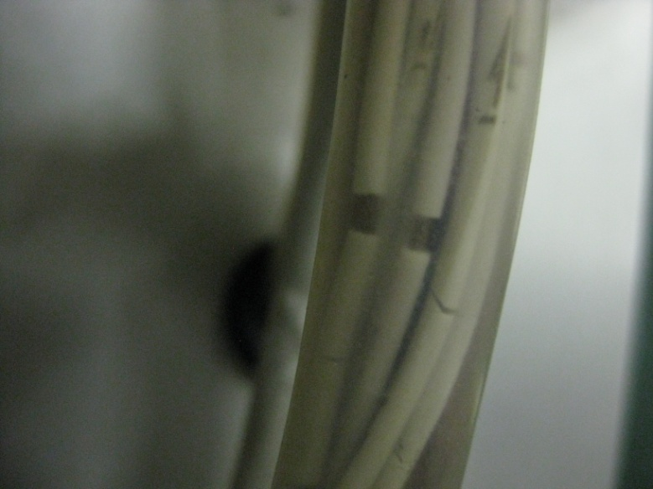
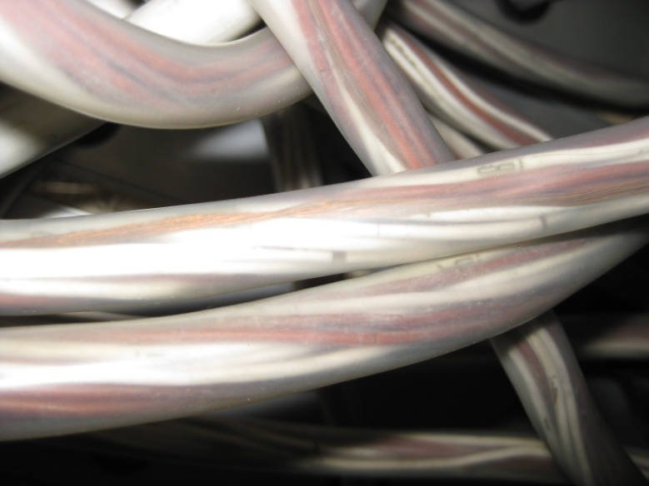
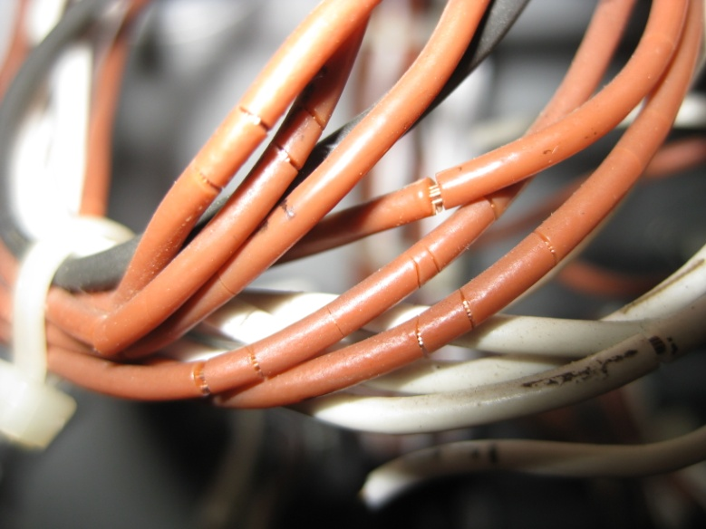
Magnets: problems that presently affect operation
Current situation:
No major issue identified at the moment for the magnets in operation
Cracked insulation on interlock cables.
-> Risk of short circuit on the interlock electronic rack.
-> Risk of "shunting" magnet securities.

Slide 34
Magnets: consolidation plan
Strategy:
Careful monitoring of the magnet, notably during each technical stop, during the run. Magnet piquet is available in any case 24/24 h.
Spare policy:
Global program of certification of the magnet in storage currently ongoing. Following results, additional spare magnets and/or coils could have to be built. (E.g. MSN)
Auxiliary equipment:
Interlock: Thermometer and Manometer contacts get corroded, triggering inconsistent machine stops;
Insulation of cables is cracked in the patch panels, securities of the magnet could be shunted.
  Interlock systems will need consolidation in the future. A more modern system should be defined and implemented in the same time.
-Cooling: Global replacement of EPDM/Kevlar water hoses and gaskets in TDC2 / TCC2
Will be implemented during shutdown 2010/11 (if sufficiently long)
Project:
K12 beam line to NA62. Certification of the magnets that will be reused, in progress.

Slide 35
North area status
    Power Supplies inputs from Jean-Paul Burnet (TE/EPC)
    Beam Instrumentation inputs from J. Spangaard (BE/BI)
    Access System inputs from D. Vaxelaire (GS/ASE)
    Beam Obstacles Controls inputs from A. Masi(EN/STI), A. Bland(BE/CO)
    Beam Obstacles Mechanics inputs from O. Aberle(EN/STI), S. Girod(EN/MEF)
    Cooling and Ventilation inputs from S. Deleval ( EN/CV)
    Magnets inputs from M. Dumas (TE/MSC)
    Cryogenics inputs from M.Pezzetti (TE/CRG)
    Networking in the inputs from E. Sallaz (IT/CS) experimental hall

Slide 36
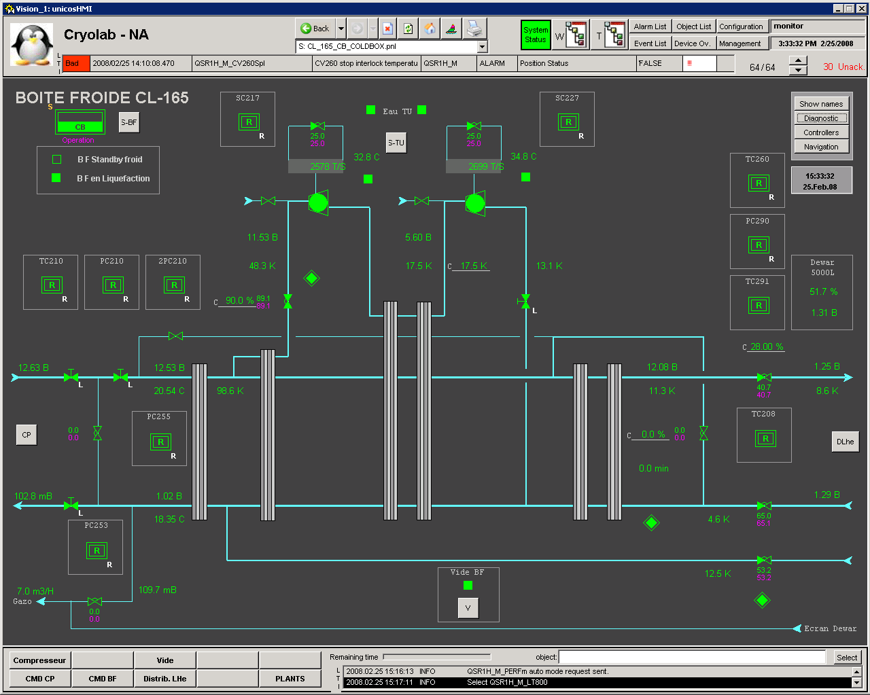
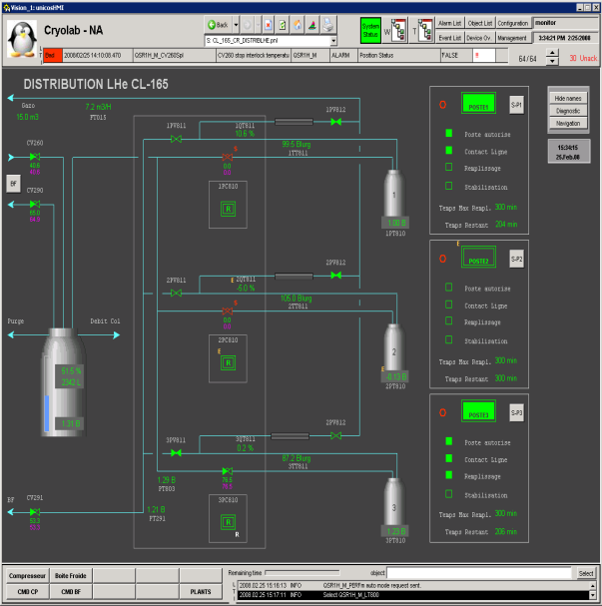

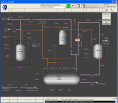

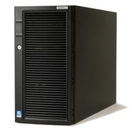
Cryogenics: main issues that presently affect operation
Cryogenics: consolidation plan
Upgrade of the cryogenic process control system (ABB to CERN/UNICOS) coupled to the Detectors He superconducting magnets for ATLAS H8, NA61 (1-2) and RD5 (in total 4 cryoplants).
To be realized by TE/CRG/CE.
Cost estimation 300 KCHF.
Planning 2010/2011 included.
Operating
Workstation
with PVSS
Operating
Workstation
without PVSS
Terminal
Service
Ethernet Technical Network
Ethernet GPN
Operation line
Eng. Workstation
PLC Premium
Data Server PVSS

Slide 37
North area status
    Power Supplies inputs from Jean-Paul Burnet (TE/EPC)
    Beam Instrumentation inputs from J. Spangaard (BE/BI)
    Access System inputs from D. Vaxelaire (GS/ASE)
    Beam Obstacles Controls inputs from A. Masi(EN/STI), A. Bland(BE/CO)
    Beam Obstacles Mechanics inputs from O. Aberle(EN/STI), S. Girod(EN/MEF)
    Cooling and Ventilation inputs from S. Deleval ( EN/CV)
    Magnets inputs from M. Dumas (TE/MSC)
    Cryogenics inputs from M.Pezzetti (TE/CRG)
    Networking in the inputs from E. Sallaz (IT/CS) experimental hall

Slide 38
Networking in the experimental area: consolidation plan
Networking infrastructure renovation in the North area halls HCN1, HCN2 and ECN3 completed in a couple of weeks
10 new star points installed to replace the old coax outlets with new UTP ones and cover new requests
New UTP outlets are going to be installed in proximity of the old ones
Users are invited to move their devices on the new outlets and/or send request to IT/CS in case a new outlet is not made available close to an old one

Slide 39
Conclusions: consolidation plans summary (not exhaustive )
 | Shutdown 2009/10 | Shutdown 2010/11 | Shutdown 2011/12 | Shutdown 2012/13 | Shutdown 2012/13 | Remarks
Obstacles Controls | upgrade of 14 TAX | upgrade collimators (COMOT, CONMOT,EMOT) | Renewal absorbers and IN/OUT (SCRMOT) |  |  | Provided that budget will be made available
Target mechanics |  | upgrade target mechanics T6 | upgrade target mechanics T4 | upgrade target mechanics T2 | upgrade target mechanics T10 | Provided that budget will be made available
Power Supply |  |  | upgrade bending magnets power supply |  |  | Partial consolidation plan (faults reduction 30%)
Beam Instrumentation | entire renovation of the instrumentations on equipment bus (now VME and FESA) |  |  |  |  | Manpower risk: no overlap between staff retired and new hired
Access System | upgrade access system H2-H4 | upgrade access system H6-H8 | upgrade access system M2-EHN2
Cryogenics |  | upgrade control systems cryoplants for ATLAS H8, NA61 (1-2) and RD5
Networking | Infrastructure renovation in north experimental halls |  |  |  |  | Installation of 10 new star points
Magnets |  | Global replacement of EPDM/Kevlar water hoses and gaskets in TDC2 / TCC2
Cooling and V. |  |  |  | ???? | ???? | consolidation foreseen but not before 2 years

