Slide 1
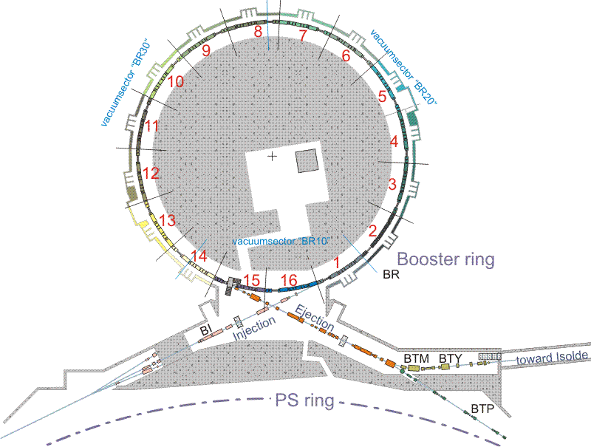
How to ensure reliable PSB operation for the next 25 years

Slide 2
History of Booster
The accelerator was built in 1972.
The Proton Synchrotron Booster is the first, in the accelerator chain, and smallest proton circular accelerator in the LHC injection complex.
It has four superimposed rings with a radius of 25 meters.
It takes 50 MeV protons from the Linac2 and accelerates them up to 1.4 GeV, ready to be injected into the PS.

Slide 3
Areas covered
Electrical power converters
Septum / kickers
Magnets
Interlocks
RF (Low level / High level)
Cabling
Cooling and ventilation
Instrumentation
Vacuum
Source targets and interactions
General Infrastructure
Final thoughts

Slide 4
Electrical Power Converters
(TE/EPC)
Model | Quantity | Designation | Last upgrade | Unit Cost (kCHF) 2009 ESTIMATION | Next upgrade | Consolidation Cost (kCHF) 2009 ESTIMATION
A1/IP | 16 | InverPower 15kW | 1998 | 80 | 2018 | 1280
A2/IP | 10 | InverPower 31.5kW | 1998 | 80 | 2018 | 800
A3/IP | 4 | InverPower 35kW | 1998 | 80 | 2018 | 320
B1/IEP-REC | 3 | IEP avec récupération 100kW | 1998 | 150 | 2018 | 450
BEN-250KW | 2 | IEP 250kW | 1998 | 250 | 2018 | 500
BI_QNO | 3 | Power Converter : BI.QNO [±40A, ±35V] | 1995 | 10 | 2015 | 30
BIX_QNO | 8 | Power Converter : BIX.QNO [±100A, ±30V] | 1995 | 10 | 2015 | 80
BR_MPS | 1 | Power Converter : PS01 [±4100A, ±3900V] - POWER | 1982 | 900 | 2015 | 900
SVC MEYRIN FILTER | 1 | SVC : MEYRIN FILTER [-22.7Mvar] | 1976 | 700 | 2014 | 700
SVC TCR BOOSTER | 1 | SVC : TCR BOOSTER [+17Mvar] | 1997 | 2000 | 2020 | 2000
Total |  |  |  |  |  | 7060
    50% of all existing power converters will need to be replaced by 2020 = 7 MCHf

Slide 5
Septum / Kickers (TE/ABT)
System | Type | Subsystem | Action | Comment
BE.BSW | Kicker | Magnets | Build spare magnets
 |  | Transmission lines | Change HV cables
 |  | Electronics & Controls | Renew controls & electronics equipment
BT.KFA10 | Kicker | Magnets | Build spare magnet modules
 |  | Transmission lines |  | HV gas cables not manufactured anymore
 |  | PFLs & HV switches |  | HV gas PFL not manufactured anymore
 |  | Electronics & Controls | Renew controls & electronics equipment
BT.KFA20 | Kicker | Magnets | Refurbish spare vacuum tank (radioactive) | 1 full spare exists but vacuum tank has leaks
 |  | Transmission lines |  | HV gas cables not manufactured anymore
 |  | PFLs & HV switches |  | HV gas PFL not manufactured anymore
 |  | Electronics & Controls | Renew controls & electronics equipment
BE.KFA 14L1 | Kicker | Magnets | Refurbish spare magnet modules
 |  | Transmission lines |  | HV gas cables not manufactured anymore
 |  | PFLs & HV switches |  | HV gas PFL not manufactured anymore
 |  | Electronics & Controls | Renew controls & electronics equipment
oil/gas | Kicker | Hydraulic | Renew equipment and change insulation fluid
 |  | Electronics & Controls | Renew controls & electronics equipment | Partially part of approved consolidation program
Thyratron | Kicker | Thyratron | Buy and store thyratrons for 20-25 years | Single source supplier - could disappear

Slide 6
Magnets
(TE/MSC)
It is believed that the PSB magnets can operate during the next 25 years with very high levels of reliability provided that:
  the present maintenance plan is pursued;
  Procure one spare multiple corrector per type (about 300 kCHF in total)
All magnets of the PSB transfer lines are covered by spares with the exception of -TBH (PXMBHFBWWP) -BHZ20 (PXMBHEACWP) The manufacture of a spare unit of each has been recently approved in a frame of the consolidation budget.
  The new spare units shall be available by mid-2011.
Note that we cannot increase energy, some magnets are already in saturation. If there is an energy upgrade of the PSB, it will not be possible with the present setup.

Slide 7
Magnet Interlock
(TE/MPE)
Protection of magnets covered by new interlock system (i.e. WIC):
  Based on Safety PLC (F series from Siemens)
  Solution used in LHC, SPS transfer lines , LEIR and LINAC3.
  Will protect all Booster circuits.
Note: deployment initially foreseen during shutdown 2010-2011. Due to new LHC schedule, the installation should be postponed to next shutdown.
Notes:
So large WIC system (254 circuits) cannot be installed and commissioned in a short period. At least 6 to 8 weeks will be required.

Slide 8
RF (Low level)
(BE/RF)
* The figures below are in addition to the usual annual budget for maintenance activities.
Requirements to keep the PSB RF System running for 25 years
Renewal of the pick-up head amplifiers for the phase loop, 1 plus 1 spare per ring or 8 amplifiers in total including power supply, estimated delivery 2013, cost approximately 25kCHF.
The cabling may need to be renewed due to the increased radiation with the higher beam intensities from LINAC 4, i.e. probably 16 coax cables or 8 twisted pairs and 8 power cables from the head amplifiers to the BOR.
The renewal of PSB beam control (including spares), is a project that is underway and estimated to be delivered in 2013 for 450kCHF from the currently agreed consolidation budget. This will not include control of the cavity tuning or voltage loops, so if this is required due to cavity changes, additional money and manpower would need to be added.
It would be estimated that a further consolidation of the PSB beam control would be required after 12-15 years of operation, with a cost estimation of 500kCHF.
Requirements to keep the PSB Transverse Damper System running for 25 years
Renewal of the pick-up head amplifiers and power supplies for the H&V systems in each ring, i.e. 16 amplifiers plus 8 spares, delivery for 2013 at a cost of approximately 25kCHF, unless a similar amplifier to that used for the phase loop above is suitable, when this cost could be reduced.
Renewal of the PSB Transverse Damper System:
4 VME crates : 32 kCHF, 4 Power PCs : 40 kCHF, 8 mother boards + 2 spares = 10 boards: 20 kCHF
Design office: 15 kCHF (shared with all 1TFBs, and TFBs for other machines)
8 new power amplifier + power loads + PLC control + renewal of the water cooling system = 380 kCHF
Total: 500 kCHF
It would be estimated that a further consolidation of PSB Transverse Damper would be required after 12-15 years of operation, with a cost estimation of 500kCHF.

Slide 9
RF (High level)
(BE/RF)
Reconstruction of the C04 RF system going from air cooled to water cooled system and including new HV power supplies, tuning supplies, interlocks and servos: 7 MCHF
Partial reconstruction of the C02 system, including HV power supplies, tuning supplies, interlocks and servos: 2.4 MCHF
Partial reconstruction of the C16 system, including HV power supplies, tuning supplies, interlocks and servos: 2.4 MCHF
Cabling renewal due to radiation damage (?): 1 MCHF

Slide 10
Cabling
On top of existing Consolidation (44MCHf)
PSB & PS
  Replace all cabling (48 MCHF)
  Replace low voltage switchboards, UPS, safety lighting etc. (14MCHf)
  Renovate HV substations ME16, ME49 & M76 (2MChF)

Slide 11
Cooling & Ventilation
(EN/CV)
Replacement of the Booster ventilation systems (including the problem of the asbestos)
For the cooling stations:
  Replacement of the cooling towers,
  Replacement of the valves,
  Replacement of the control and electrical part,
  possibly replace several heat exchanger.
Compressed air production needs to be fully refurbished.
Renovate production for dematerialized water

Slide 12
Instrumentation
(BE/BI)
System | Replacement of detector |  | Replacement of acquisition system |  | Comments
 | Price [CHF] | Man power [MM] | Price [CHF] | Man power [MM]
Booster orbit | 0 | 0 | 250k | 18 | 192 ADC ch+ new cables
Booster half turn | 0 | 0 | 50k | 6
Booster BCTDC | 40k | 4 | 100k | 8 | Monitor modif. + new electronics
Booster BCTFR | 50k | 12 | 80k | 8 | Monitor ? + new electronics
Booster WCM | 0 | 0 | 20k | 1 | Connection to OASIS?
Booster extraction PU's | 0 | 0 | 150k | 12
Booster extraction BCTF's | 200k | 12 | 50k | 10 | Cabling BTMTRA, ISO transformers + Acq. chains
Total | 1300kCHF | 85MM | 1830kCHF | 135MM

Slide 13
Vacuum
(TE/VSC)
First “estimate”
  Operation to 2022 replace 50-70% of system hardware
  Operation to 2035 replace 100%
Any major consolidation campaign (ABT, MSC, RF etc…) would involve a lot of vacuum activity

Slide 14
Source Targets & Interactions
(EN/STI)
No major modifications or upgrades are forseen
Need to verify that all the objects (dumps, collimators etc..) can sustain the eventually increased intensity (from Linac 4) and build spares.
Booster dump: the present dump has no spare, nobody knows any details about it and it is unclear how it will behave when we increase the beam intensity (with Linac 4).

Slide 15
General Infrastructure
Money would need to be allocated to the maintaining of the Booster buildings. They are already quite old and various areas would need to be renovated if they are to be used for a further 25 years.
Cranes, lifts, handling equipment are in the existing Consolidation plan.

Slide 16
Final Thoughts
No upgrade in performance considered (treated elsewhere)
Maintain current beam performance and availability for LHC lifetime
Major modifications to the injection line and other areas will be done under the LINAC 4 project and therefore are not covered under this topic.
Consideration has to be made to that fact that the Booster is a labour intensive machine and most works will be done in radioactive zones and will have to be scheduled during shutdowns.

