Slide 1
Status and Plans for InCA
S. Deghaye
IEFC Workshop 2010
Notes:
Introduction to the renovation project of the high level control system of the CERN PS complex

Slide 2
Agenda
What is InCA?
What happened in 2009?
  MDs’ results
  Deployment in LEIR
What will happen in 2010?
  PS deployment
    Setup & planning
    Preparation (MD, OP applications)
    Support Organisation
    Advantages (e.g. increase number of contexts)

Slide 3
Agenda
What is InCA?
What happened in 2009?
  MDs’ results
  Deployment in LEIR
What will happen in 2010?
  PS deployment
    Setup & planning
    Preparation (MD, OP applications)
    Support Organisation
    Advantages (e.g. increase number of contexts)

Slide 4
What is InCA?
InCA: Injector Controls Architecture
Presented in details at the ATC/ABOC Days’08
Renovation of the high-level controls aiming at:
  Reduce effort duplication
  Reduce maintenance cost (XMotif)
  Improve control system performance
Notes:
* Reduce effort duplication: Homogenise the solutions deployed across the accelerator complex. Reduce the number of specific applications needed by providing high-level services.
* Reduce maintenance cost: Suppress remaining 30+ X-Motif applications. Renovate & redefine some (obscure) PS specific parts.
* Improve Controls system performance: Tackle the performance, scalability and reliability problems experienced in the PS complex. Provide sound technical solutions to common problems badly handle due to architecture limitations.

Slide 5
What is InCA?

Slide 6
Agenda
What is InCA?
What happened in 2009?
  MDs’ results
  Deployment in LEIR
What will happen in 2010?
  PS deployment
    Setup & planning
    Preparation (MD, OP applications)
    Support Organisation
    Advantages (e.g. increase number of contexts)

Slide 7
MDs’ results
Original planning approach with regular MD sessions
2009 InCA MD Program:
  2-day MD after Easter,
  Many parasitic MDs for the beam steering (YASP),
  Few smaller MDs during parallel MD sessions (6 hours).
Very fruitful ➔ We want more!!
  Feedback on performance & scalability → bottlenecks found & removed
  User feedback on new tools (FunctionEditor)
  Main corrections on the PS validated → YASP@PS ready!
  Need for an InCA test stand identified (2000 devices avail.)

Slide 8
Deployment in LEIR – Why?
OP/ABP point of view:
  LEIR control system was hybrid → more difficult to operate (e.g. Archive incomplete & not coherent)
  InCA could bring a homogenous view of the machine
  Favourite operational tools would remain unchanged
  Old XMotif generic tools would be replaced
CO point of view:
  Opportunity to have a first partial deployment
  Proof of concept on a longer period
  Gather experience

Slide 9
Deployment in LEIR – What?
Database

Slide 10
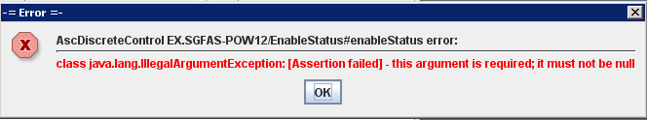
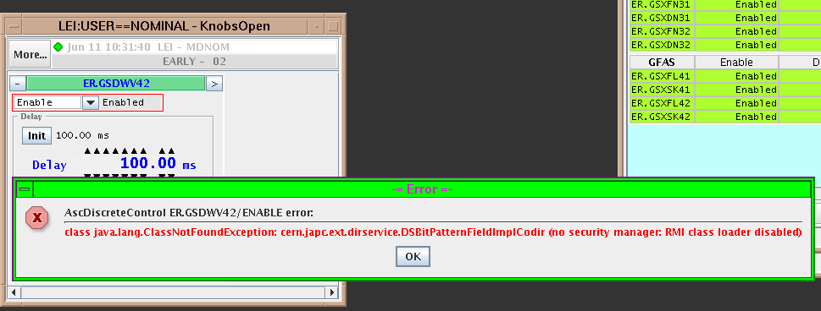
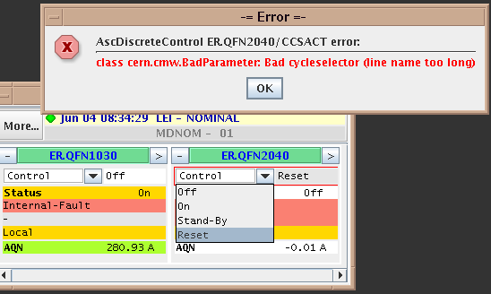
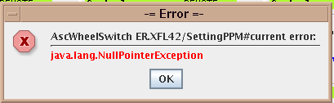
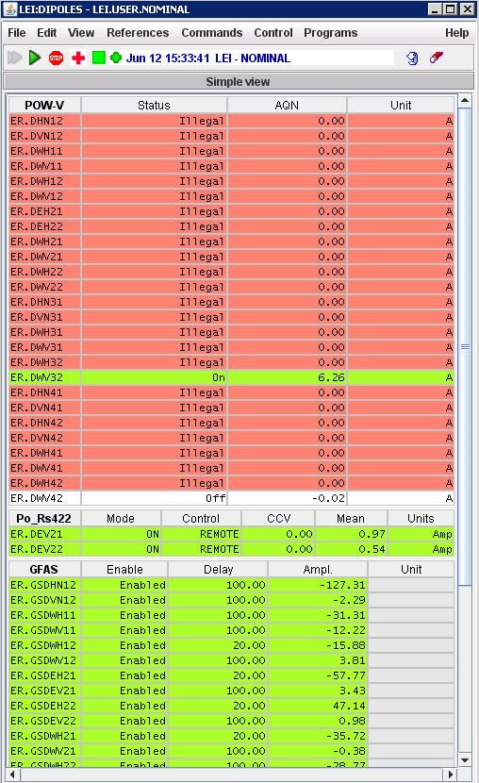
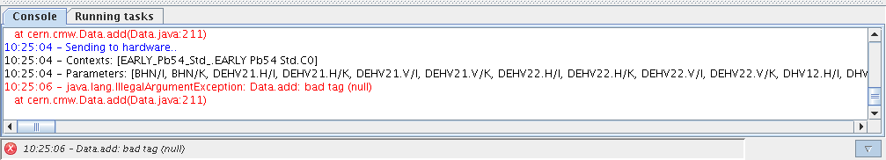
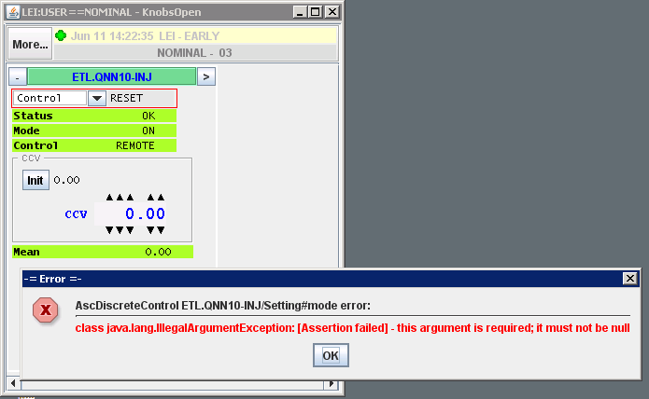
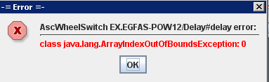
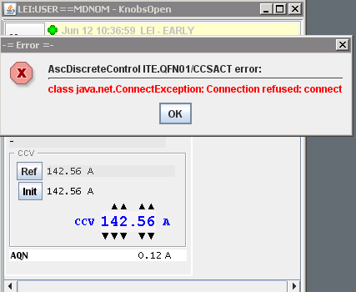
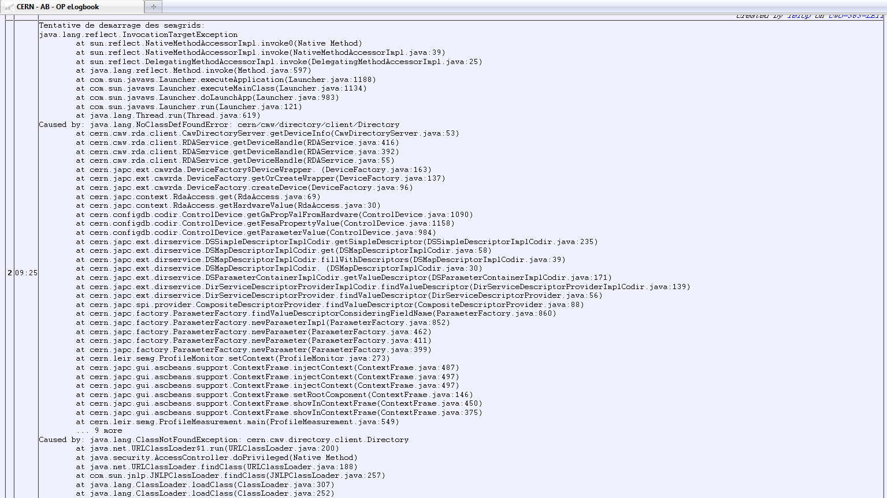
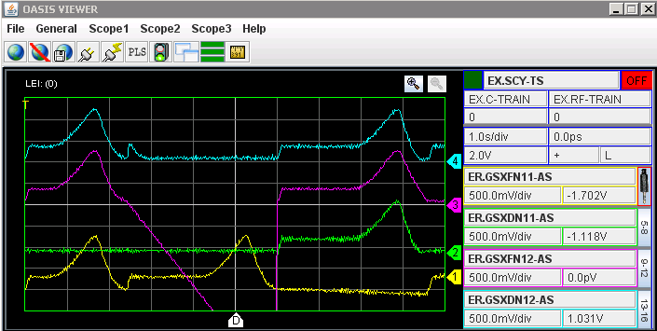
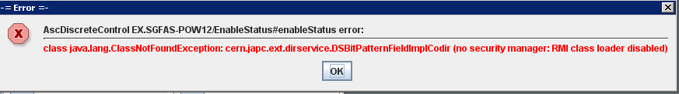
Deployment in LEIR – Results?
Preparation from May
Ready to operate in July
Good feedback from OP/ABP
Know where to improve
Quote from OP representative during the InCA day’09:
“LEIR Controls in good shape. Thank you to the INCA team for its availability and its reactivity”

Slide 11
Agenda
What is InCA?
What happened in 2009?
  MDs’ results
  Deployment in LEIR
What will happen in 2010?
  PS deployment
    Setup & planning
    Preparation (MD, OP applications)
    Support Organisation
    Advantages (e.g. increase number of contexts)

Slide 12
PS deployment: Setup & Planning
Same setup as in LEIR + YASP for beam steering
  Acquisitions done in 2-tier
  Old status algorithm used on the workstation
  Direct DB access
Three tentative dates (LHC technical stop):
  Week 26 (28-06-2010)
  Week 30 (26-07-2010)
  Week 35 (30-08-2010)
2-day MD (week 17) to assess the readiness and decide on the release date

Slide 13
PS deployment - Preparation
Before the MD in April:
  DB preparation (cycles, parameters) - 90% to be done
  Solution for XMotif applications in place
  InCAification of the Java applications - 80% to be done
Before the release date:
  OP Training to the new concepts (YASP, resident cycles, Settings DB...)
  Support team operational
  Expert/OP training in InCA troubleshooting
  InCAified environment i.e. InCA applications in CCM...
  Monitoring infrastructure (DIAMON)

Slide 14
PS deployment - Support
Very important topic.
3-step response:
  Troubleshooting guide for OP
  Expert support team reachable 24/7 on a fix phone no
  Fall-back solution ready in case of big troubles
Presence in the CCC during working hours for the 1st weeks

Slide 15
PS deployment - Advantages
Immediately:
  Quite transparent as seen in LEIR
  Settings history
  Much faster archiving
  YASP for beam steering + optics for other applications
  New FunctionEditor
  More contexts than users
Later:
  Less load on the FECs, the CCC workstations and the DB
  Quicker start-up for popular working sets
  Virtual parameters in control & acquisition
  ...

Slide 16
Limitation of the number of users
Limited number of users – 24 in the PS Complex
More is needed as more beams are produced on a regular basis
At a given moment, there are never 24 users programmed in the central timing sequences
Two solutions:
  Increase the number of users in the FECs
    ➔Not realistic in the short term.
  InCA solution
    ➔ Available in the PS in 2010, in the PSB in 2011

Slide 17
Solution at low-level – Why not?
Some pieces of hardware have the 24 in hard
  Need to renovate the installations ➔ need a long shutdown + money.
GM classes: Difficult to asses how tight to 24 they are
  Effort with little future as GM is replaced by FESA
  Memory problem in some FECs
XMotif applications: how many times 24 has been hard-coded?
  Effort with little future as XMotif is replaced by Java
For both cases, tricky to find all the occurrences → High risk of failure (always at the wrong time)
Notes:
(no 25% free RAM)

Slide 18
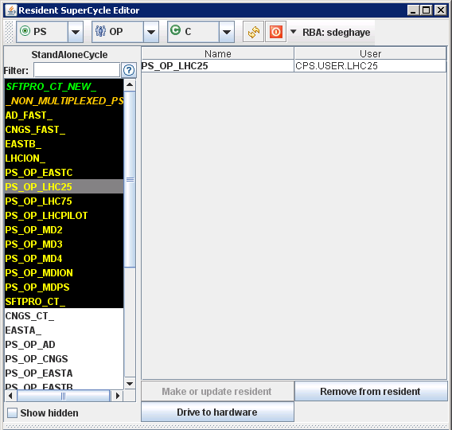
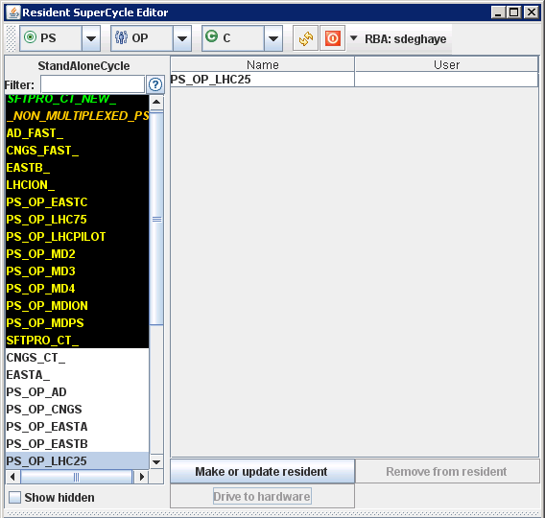
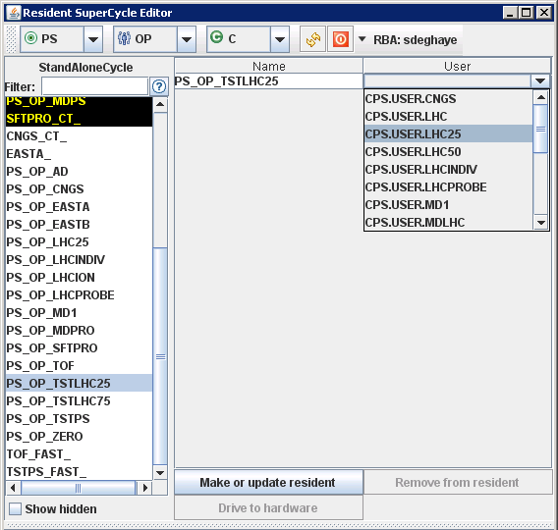
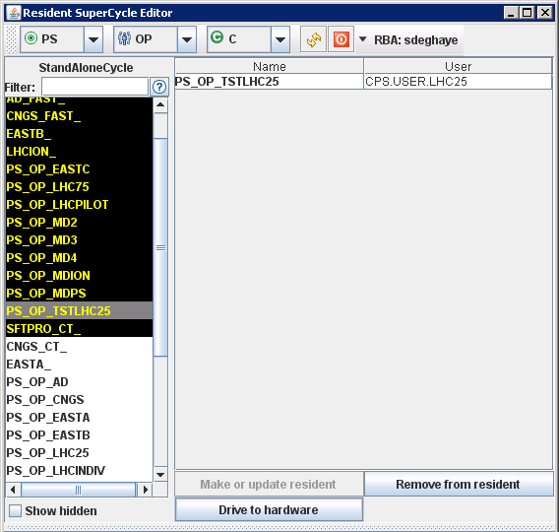
InCA Solution
Introduction of Context – Cycle for the PS.
The Context:
  are always in the DB
  can be made resident i.e. linked to a timing user
  can be made non-resident in no time

Slide 19
Conclusions
2009 = Very good year for InCA:
  Fruitful MDs
  Successful deployment in LEIR
2010 = Challenging year for InCA:
  Decisive MD in April
  First PS deployment in June (or July/August)

Slide 20
Questions ?!?
Thank you for your attention!

