Slide 1
Critical overview of
RF equipment in the
LHC injector chain
IEFC Workshop
Prepared by colleagues from BE-RF
presented by Erk Jensen
10th Feb. 2010

Slide 2
RF Issues overview
Machine | Short term | Medium term | Long term
Linac2 | Vac. leak coupler – spare available | Linac 2 to be replaced by Linac 4 | NA
Linac 3 | Plasma source upgrade 18 GHz ongoing |  | Bertronix, LLRF upgrade, energy ramping/debunching
PSB | Lifetime RS 2012, C16 power supply, tomoscope, LLRF upgrade underway | C04 at the limit, transverse damper power upgrade, RF bypasses?, upgrade to 2 GeV: T.B.D, (new LLRF ...), outer rings already behave strangely ... | C02, C04, C16 to be renewed, upgrade LLRF all systems, upgrade transverse damper, all cables, ... → David McFarlane
LEIR | None | None | Lifetime Finemet® cores?
PS | RF bypasses, C10 tuning supply (Kempower), C10 control electronics, tomoscope, automated tuning C40 | 1-turn feedback (in the pipeline), renewal LLRF, C200 upgrade to be finished, transverse FB power upgrade, C40, C80: complete servo tuning (also for ions/protons) | Renew C10 drivers (and PA?), RF bypasses redesign, renewal LLRF, coupled bunch FB, all cables, ... → Ray Brown
SPS | 800 MHz upgrade (power and LLRF) underway, BQM upgrade underway | SPS upgrade: review sectorization of TWC’s, TWC impedance? new power station 200 MHz, ... | All power couplers, tetrodes long term supply, cables, ... → Nicolas Gilbert

Slide 3
PSB RF systems (for each ring)
Name | harmonic h | f range [MHz] | peak voltage | remarks:
C02 | 1 | 0.6 … 1.8 | 8 kV | acceleration
C04 | 2 | 1.2 … 3.9 | 8 kV | acceleration, bunch shaping
C16 | 8, 9 | 6 … 17 | 6 kV | controlled long. BU
+ transverse damper
Krusche, Paoluzzi: http://cern.ch/AccelConf/e98/PAPERS/TUP03H.PDF

Slide 4
Lifetime RS 2012 CL
A total of 12 RS2012 are used in the PSB, 8 in the C04, 4 in the C16.
We have a stock of (old) Siemens tubes, but for a number of years, Thales rebuilds them.
The first two tubes by Thales showed a lifetime of only 15 kh, whereas the typical lifetime before was 30 kh.
It is too early to call this an issue (not enough statistics), but we survey it and are in touch with Thales to straighten this out. M. Haase is reviving the PSB tubes test-stand. I expect this to become a non-issue.
excerpt of PSB-C04 RS2012 inventory from last year:
Tube Nr. | Delivery date | Installed | Working Hours | Prospective removal | est. remaining lifetime
2912 | 17/10/1995 | 06/11/2001 | 29434 | removed
2913 | 17/10/1995 | 12/01/1996 | 36725 | removed
2940 | 17/04/1996 | 11/09/2000 | 29052 | removed
2941 | 17/04/1996 | 11/09/2000 | 29052 | removed
2952 | 05/06/1996 | 11/04/1997 | 36299 | removed
2953 | 05/06/1996 | 06/11/2001 | 29434 | removed
2955 | 05/06/1996 | 06/03/2005 | 30559 | removed
3143 | 07/09/1999 | 02/12/2004 | 25977 | 2010/2011 | 27.84%
3144 | 07/09/1999 | 02/12/2004 | 25977 | 2010/2011 | 27.84%
3193 | 25/09/2002 | 07/03/2006 | 13653 | 2012/2013 | 62.08%
3199 | 25/09/2002 | 07/03/2006 | 13653 | 2012/2013 | 62.08%
547827 | 20/12/2005 | 28/9/2006 | 12207 | 2013/2014 | 66.09%
547826 | 20/12/2005 | 03/07/2007 | 10315 | 2013/2014 | 71.35%
3209 | 04/02/2002 | 03/07/2007 | 10313 | 2013/2014 | 71.35%
3211 | 25/09/2002 | 03/07/2007 | 10313 | 2013/2014 | 71.35%
Thales tubes,
fail after 15000 h

Slide 5
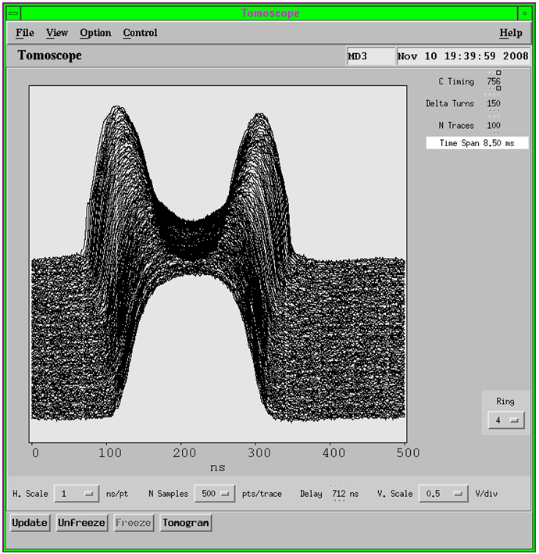
Tomoscope
The issue:
  The Tomoscope is an important
  operational tool.
  The present Tomoscope is based
  on special hw (scope), which is
  ageing – some channels started
  to drop out.
Status:
  Since PSB needs all 4 channels,
  a quick temporary fix was to swap
  the PS and PSB scopes.
  We have now purchased a suitable
  (reconditioned) scope for a short-term solution.
  RF, CO & FNAL^{*)} (Hancock, Deghaye & McCrory) are looking at possible solutions to modernize the software (Java). OASIS scopes, as used in AD & LEIR, cannot be directly adopted due to lack of dynamic range.
  To assure operation in the medium term, a second-hand scope of the old type will be purchased.
  ^{*)}: https://wikis.cern.ch/display/LAFS/Tomoscope

Slide 6
PSB C04 water cooling study
The issue:
  If the PSB is to pulse with 900 ms, the C04 becomes marginal – 600 ms is impossible without upgrade.
  The conclusion was that even for 900 ms – for reliable operation – an upgrade to water cooling would become necessary
Status:
  This was not a priority and no study has been started.
  The upgrade will however become necessary also in view of
    the long-term consolidation and
    the upgrade to 2 GeV extraction energy.

Slide 7
PSB C02 upgrade necessary?
The issue:
  Beam loading: The current limitation of the C02 system ... would indicate an intensity limit of 1.65 E13 per ring;
  or 6.6 E13 total.
Status: LLRF renovation progresses according to roadmap:
  2009^{*)}: Operational beams on ring 4 with current h/w + s/w.
  2010-11^{*)}: Ring 4 equipped with new h/w + s/w
  2012: All rings equipped with new h/w + s/w.
  2012-13: System commissioned for PSB-Linac2 operation.
  2014+: System re-commissioned with Linac4.
^{*)} Issue: P resource problem signalled by MEA; reasons:
  LEIR took more resources than foreseen,
  some fundamental work had to be redone and couldn’t be based 2003 BNL prototypes.
The original question, whether PSB C02 needs upgrade for Linac4 or whether new digital LLRF system would suffice, will be addressed once the full potential of the new LLRF system can be evaluated.
See also: http://indico.cern.ch/materialDisplay.py?contribId=2&materialId=slides&confId=59488

Slide 8
PSB damper upgrade
Τ
The issue:
  The transverse damper power is not sufficient for operation with Linac 4; roughly it should be quadrupled.
  First MD’s showed that 1E13 per ring is the limit of the transverse damper.
Status:
  MD’s last year were not yet conclusive – it remains to determine the necessary bandwidth – MD’s are scheduled in April ’10.

Slide 9
PS RF systems
Name | harmonic h | count | f range [MHz] | peak voltage | remarks:
C10 | 7, 10, …, 21 | 10+1 | 2.7 … 10.01 | 1 … 20 kV | acceleration, RF “gymnastics”
C20 | 28, 42 | 1+1 | 13 or 20 | 15 kV | LHC 75 ns & 50 ns bunching
C40 | 84 | 1+1 | 40 | 3 … 350 kV | LHC bunching, bunch compression
C80 | 168 | 2+1 | 80 | 350 kV | LHC bunch compression
C200 | 420, 433 | 4+2 | 200 | 30 kV | re-bunching, controlled long. BU
+ transverse damper (2 x 6 kW)

Slide 10
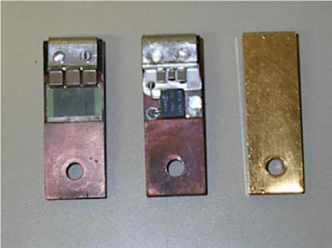
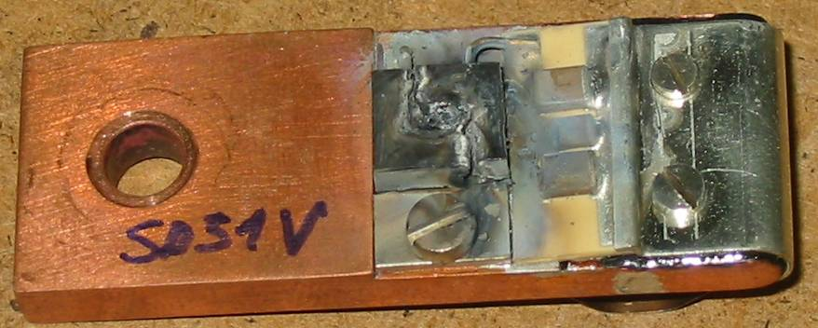
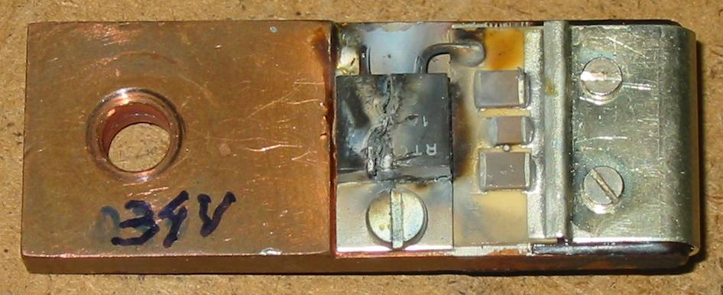
PS RF Bypasses
The issue:
  On June 10th 2009, a vacuum leak developed
  in SS52, a 1 Ω resistor was found to be
  open, traces of arcing.
  Question: was the RF bypass damage
  cause or consequence?
Status:
  peak power on n-TOF 27 W peak, < 10 W average
  The power/voltage specifications of the 1 Ω resistor are 50 W/300 V.
  40 % of the RF bypasses were measured and found OK. It looked OK!
  However, during the shutdown, 3 more broken RF bypasses were found.
  They were all of the “new” type.
  Short term solution: all 24 “new” were replaced by “old” type bypasses.
  It will be studied, what the problem with “new” type is.
“old”
“new”
“short”
H. Damerau, J. Ferreira-Bento

Slide 11
PS 40 MHz: Automated tuning
The issue:
  The tuning of the 40 MHz cavity slowly drifts, also depending on # of LHC cycles and the beam current.
  Automatic (slow) tuning was foreseen from the beginning, but never implemented.
  The slow drift required frequent specialist interventions – just for the re-tuning.
Status:
  For one of the two cavities (78), a prototype solution has been implemented in June 09 and has since been running smoothly.
  A missing module to adopt the same solution for cavity 77 was shipped from Naples. Both cavities should now be running with automated tuning.
  This is a short-term solution; a long-term solution, which will be standard across different machines, will be studied by RF-CS. It will notably include the C80 and should solve the problem of different frequencies for ions and protons.

Slide 12
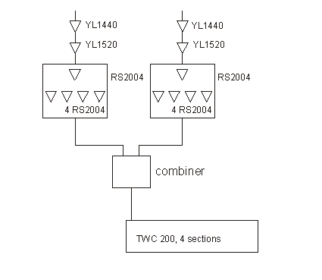
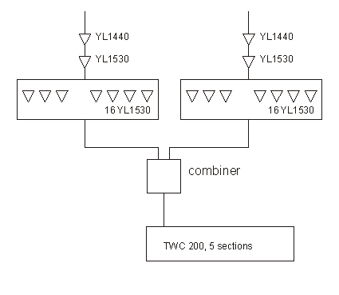
SPS RF systems – TWC 200 lines
Siemens, 2 TX per line, 2 lines
Philips, 2 TX per line, 2 lines
…
…
1 line sketched
1 line sketched
Total voltage (2 cavities): 4.1 MV w/o BL,
≈ 3.3 MV with nominal BL (1.15 10¹¹ ppb).
With new tubes: 350 kW/TX
Total voltage (2 cavities): 5.5 MV w/o BL,
≈ 4.2 MV with nominal BL (1.15 10¹¹ ppb).
With new tubes: 400 kW/TX

Slide 13
Stock of SPS high power tetrodes
The issue(s):
  Tubes are consumables!
  Of some tubes (YL1530), we had a relatively large (but very old, hence of unknown value) stock of tubes.
  This fact together with severe budget limitations had forced us over many years to buy less tubes per year than we consume.
  Now the tube stock situation has become critical, just when CNGS (which is very demanding) started in full swing.
  If we don’t buy the correct number of tubes regularly, tube manufacturers may decide to stop making them!
  For the RS2004, e.g., the lead time for the first 2 tubes is 6 months, then 1 additional month for every batch of 2 tubes.
  We have frame contracts with the 2 tube manufacturers (Thales and Richardson) – negotiations for the extension/renewal have started.

Slide 14
Stock of SPS high power tetrodes
Status:
  Careful statistics done: With 6.25 kh yearly operation, we would need yearly column E, i.e. a budget of column K:
  deviations from this to slowly approach I to J (NB: YL1530!)
  These numbers (notably column D) are revised regularly.
 |  |  |  |  |  | Orders over the last years:
A | B | C | D | E |  | F | G | H | I | J | K
type | 2009 price [kCHF] | # of sockets | average lifetime [kh] | yearly consumption |  | 2007 | 2008 | 2009 | stock Jan 2010 | ideal stock | yearly need [kCHF]
RS2004 | 60.6 | 20 | 19 | 7 |  | 4 | 7 | 7 | 25 | 26 | 424
YL1530 | 11.1 | 68 | 27 | 16 *) |  | 4 | 16 | 3 | 105 | 63 | 178
RS2048 | 11.9 | 36 | 12.5**) | 18 |  | 8 | 8 | 12 | 60 | 72 | 214
YL1520 | 12.5 | 10 | 15.9 | 4 |  | 2 | 2 | 2 | 20 | 16 | 50
YL1440 | 5.1 | 14 | 15.8 | 6 |  | 2 | 3 | 8 | 27 | 22 | 31
TH561 | 10.9 | 4 | 11.1 | 2 |  | 1 | 2 | 2 | 8 | 9 | 22
 |  |  | budget [kCHF]: |  |  | 426 | 779 | 659 |  |  | 919
 |  |  |  |  | =ROUND(C*6.25/D,0) |  |  |  |  | =ROUND(C*25/D,0) | =B*E, 2009 prices
*) before 2013: 5 per year, from 2013: 21 per year.
**) LHC ADT: no valid statistics yet.

Slide 15
The need for correct yearly maintenance
Update of transparency shown at last year’s ATOP days
# of interventions
per week outside
normal working hours
CNGS
CNGS
CNGS
From 2005, limited resources forced us to reduce some maintenance work.
CNGS type beams result in more wear and thus reduce tube-lifetime (16! tubes broken in 2008!)
Early 2009: memory effect – looked bad at first … BUT eventually – once the problems with HV supplies of TX3 and TX1 were fixed, 2009 was an excellent run – even with ions and CNGS …
But beware: remember the effect of reduced maintenance! 2009/10 and 2010/11 will be minimum shutdowns ... expect some impact on the failure statistics!

Slide 16
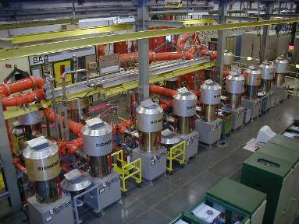
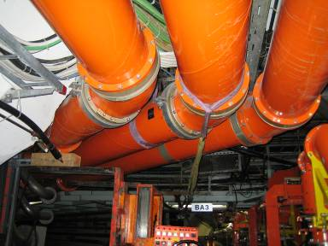
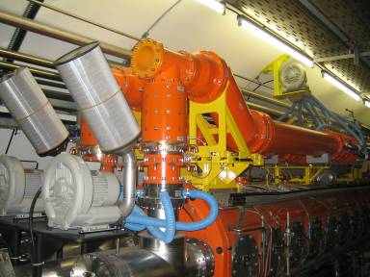
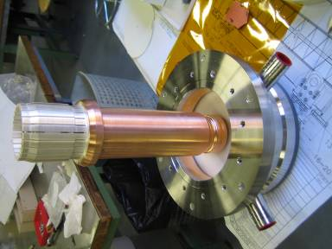
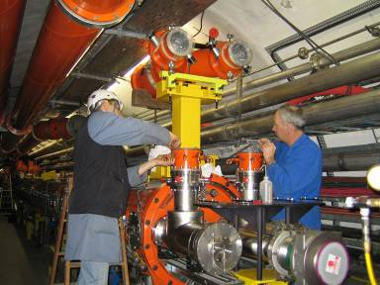
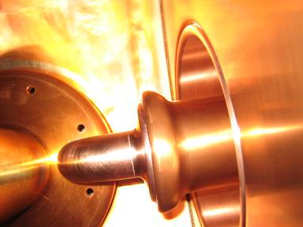
SPS Power couplers
Limits (cw, per line):
  Amplifier: 750 kW (after combiner),
  limited by tubes & BW,
  BW-power-product & phase linearity
  recently upgraded (driver stages).
  Coaxial line: 750 kW
  Spinner expansion lines: 750 kW
  Windows: 800 kW,
  1.1 MW, tested “in series”.
  Couplers (upgraded 2000...2004)
  limit: >1.1 MW, tested “in series”.
  Connection coupler/cavity:
  750 kW, tested 1 MW
  during only 10 minutes.
  Geometry not suitable
  for higher powers.
The issues:
  One possible conceptually easy upgrade would consist in connecting two lines to one cavity. In this case, the expansion lines, the windows and the connection coupler/cavity would become the bottlenecks.
  The connection coupler-cavity is most critical, since in cannot be lab-tested but requires a test-cavity!
Status:
  ... not progressed due to other priorities

Slide 17
Beam loading in TWC200
local gradient
special cases
no beam loading
full beam loading
total voltage = 0
Why more, shorter TW cavities help:
Total voltage of cavities or total length :
Total impedance: (the same!!)
Beam current at which voltage is (full beam loading):
the price to pay:
Total power required:

Slide 18
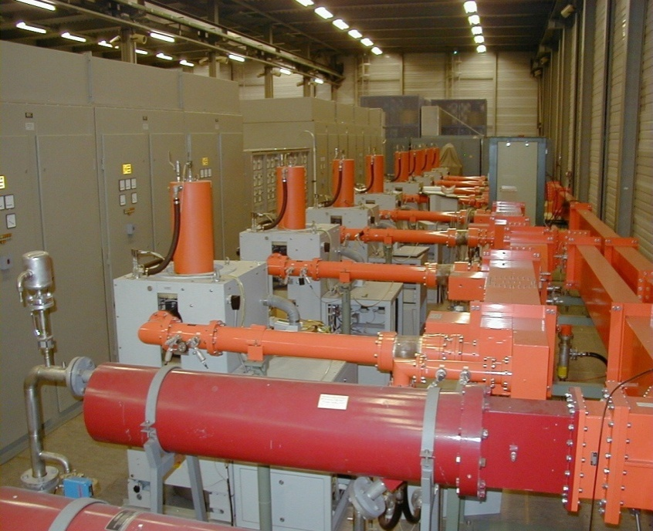
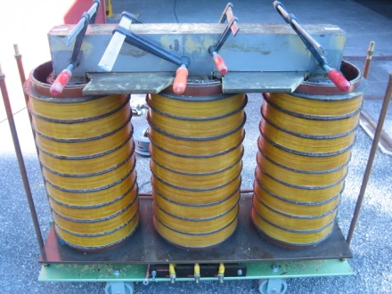
SPS RF systems – TWC 800
System is essential at high intensity to cope with the dominant coupled bunch instability!
This system is dying!
“Valvo” klystrons (YK1198) are very old. These klystrons have not been built any more for decades! Of 16 existing tubes, 10 are broken, 6 are operational.
Equally the transformers in their power supplies are at the end of their lifetime. The cavities are OK.
We managed “just” (with a lot of personal commitment of some people) to supply the necessary 800 MHz voltage (700 kV) thru 2008 and 2009.

Slide 19
Renovation SPS 800 MHz system I (LL)
The issue:
  The 800 MHz system in the SPS is essential for maintaining stability above 1/5 of nominal intensity,
  The existing beam control for the 800 MHz only controls the mean amplitude and phase of the voltage. However, it does not cater for changes along the batches for the voltage seen by the beam due to beam loading. An upgrade is required.
  Needed to improve reliability and ease operation:
    1-turn feedback for induced voltage reduction at f_{rev} components,
    feed-forward to deal with the fast leading edge.
Status:
  Work on feedback (-forward) systems has started as “White Paper” activity,
  In addition to the original proposal, also the analog beam control for the 800 MHz will also be improved, using digital techniques where possible and useful.

Slide 20
Renovation SPS 800 MHz system II (HP)
The issue:
  System is necessary, but HP old & dying (10/16 klystrons broken)!
Status:
  Consolidation of existing system:
    Power supplies fixed - now 2 systems running, 2 “hot spare” (waveguide switch).
    Efforts with industry to repair the Valvo klystrons (CPI).
  Tendering for new IOT-based 800 MHz systems:
    IT-3624/BE: tenders received, company selected, peer review: 11/2/10
15th March
FC: Order placed
15th October
CERN Site Acceptance Tests
of the first Pre-series
PA(#1)
02nd October
IT closed
30^{0h} April
Decision for the Series order
31th March
CERN Site Acceptance Tests of the last Series
PA (#9)
2010
30th April
Design Report Review
2011
2012
21st August
IT sent
15th January
Company selected
every two weeks
Progress report
15th September
Factory
Acceptance Test
Of the 1st PA (#1)
15th September
Factory
Acceptance Test
of the 2nd PA (#2)
New IOT power plant
Draft time table

Slide 21
Summary RF equipment review
The status of the RF equipment in the LHC injector chain has been reviewed.
No “major” risks were identified.
Main issues presently known and addressed:
  PSB C04 power limit, RS2012CL lifetime, tomoscope, PS RF bypasses, C10 tuning supply & control electronics, SPS TWC800 LL & HP upgrade.
Upgrade scenarios have to be studied in more detail (PSB→ 2 GeV, SPS # of TWC200 cavities, power upgrade ...).
After two “short” shutdowns in a row, expect larger failure rates!

