Slide 1

EOS to Castor transfers evaluation: gridftp vs xroot
Maria Arsuaga Rios
Collaborative work with:
Herve Rousseau (EOS)
Giuseppe Lo Presti (CASTOR)

Slide 2
GridFTP vs Xroot
Is it worthy to migrate from gridftp to xroot for moving data EOS -> Castor?
Currently, Atlas and other VOs are using gridftp for transferring data EOS->Castor
However,
gridftp transfers are limited by the gridftp gateway model in EOS (limiting the throughput)
A FTS stress test is used in order to evaluate how much it affects.

Slide 3
Stress testing
Transfers EOS -> Castor
200 process
1M of submission per process
100MB filesize
Min actives = 200
Max actives = 500
Protocols: gridftp and xroot
1 gridftp gateway dedicated

Slide 4
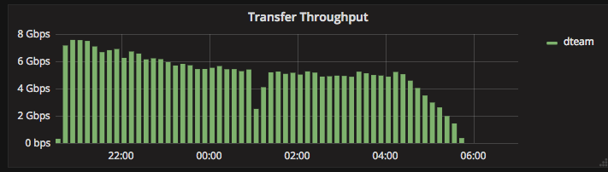
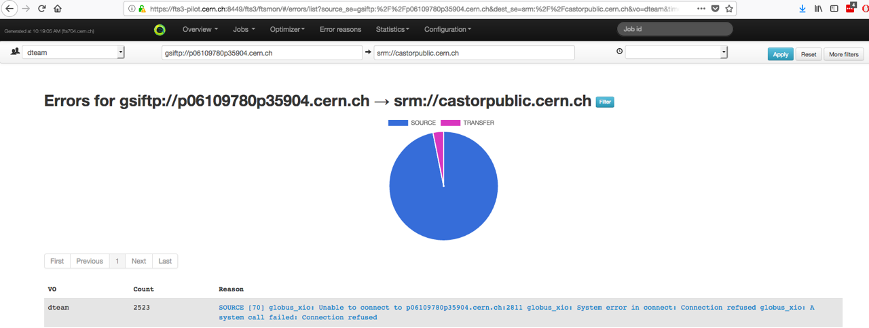
GridFTP
The gateway was saturated

Slide 5
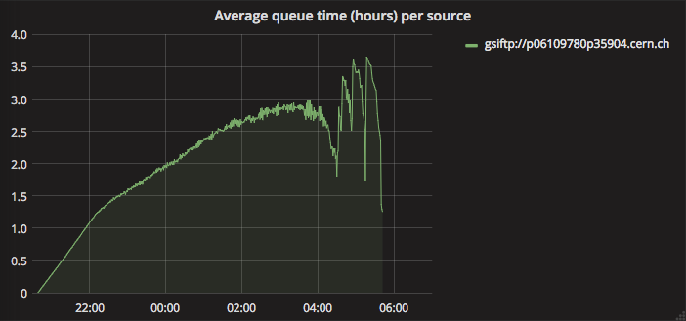
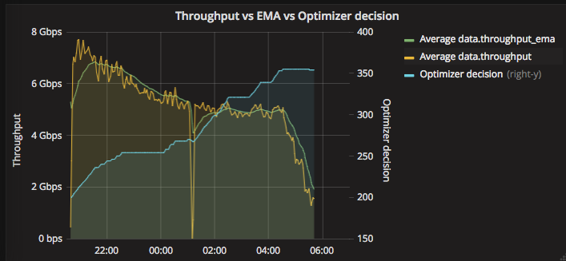
GridFTP
High average queue time
3.5 hours peak
FTS optimizer pushing according to the throughput

Slide 6
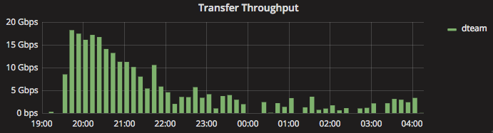
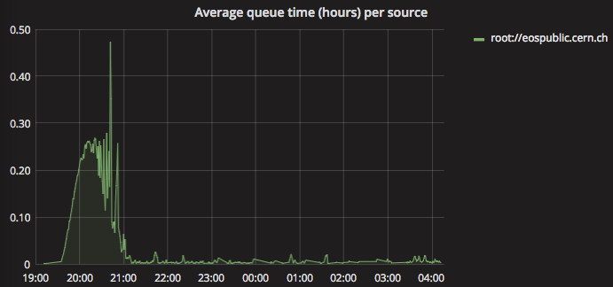
Xroot
Higher throughput -> empty queue faster
0.47 hours peak (remember the 3.5 peak in gridftp)

Slide 7
GridFTP vs Xroot
We could conclude that using Xroot for EOS to Castor transfers ensure:
better throughput
less risk of saturation ( as the errors caused by the gridftp gateway)
less queue time
srm free! (at least for internal transfers – EOS/CTA evolution)

