Slide 1
CMS
Database Strategy moving from development to operation
Vincenzo Innocente
CERN PH/SFT

Slide 2
DataBases in CMS
Relational Databases are pervasive in CMS software applications
  Used as strategic and tactical storage in many distributed application for logging, workflow management, configuration management, document storage etc
  Applications are rather independent of each other
    no central authority
    small development teams
    limited scope
  Notable exception: Condition Database

Slide 3
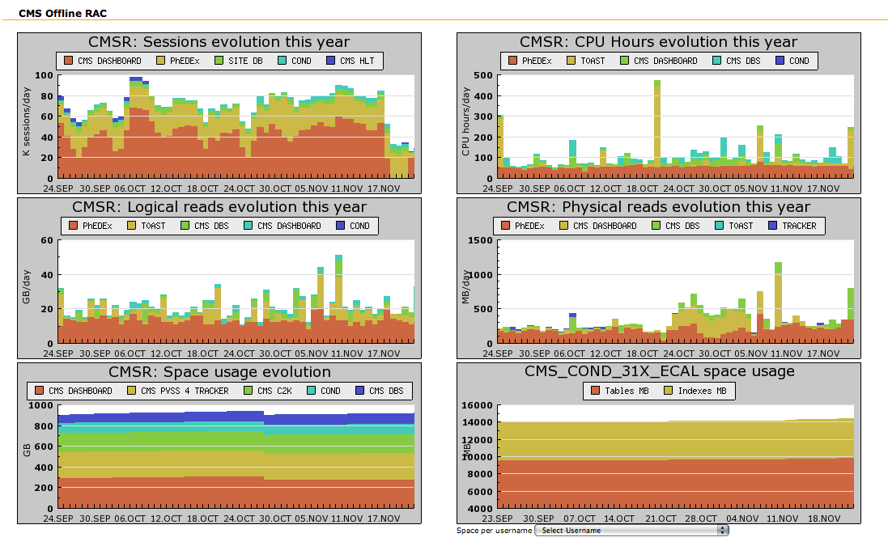
Offline RAC Usage

Slide 4
Condition DB Design

Slide 5
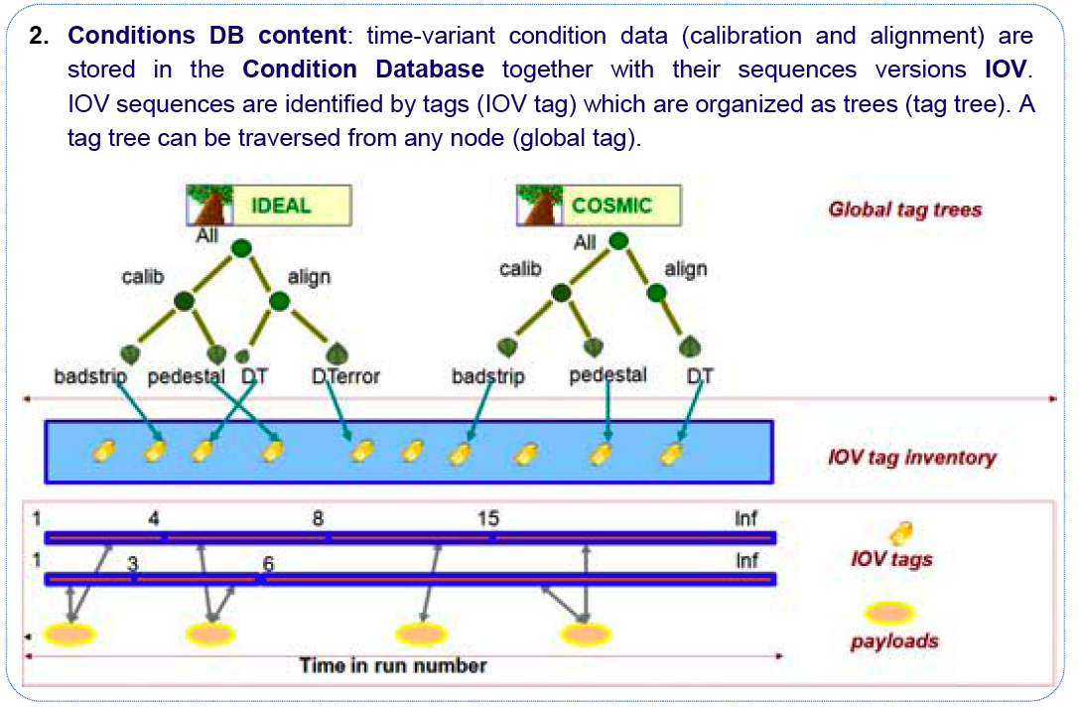
Condition DB Structure
~150 conditions
In each global tag

Slide 6
Relations in conditions
All relations in conditions DB are purely logical and application specific
  No RDBMS consistency enforced
  Full flexibility in copying (deep and shallow) at all level of the structure
  Simple policy: NO DELETE, NO UPDATE
    Only the current IOV-Sequence can be extended
  Payloads implemented as POOL/ORA objects
  Management through application specific tools

Slide 7
Population Strategy

Slide 8





Condition DataBase Population
PopCon (Populator of Condition Objects tool):
  is an application package fully integrated in the overall CMS framework intended to transfer, store, and retrieve condition data in the Offline Databases;
  Assigns metadata information (tag and IOV).
CMS relies on three ORACLE databases for the condition data.
PopCon
P5
    OMDS
    (Online Master Database System)
    ORCOFF
    (Offline Reconstruction Condition
    Database Offline System)
Streaming
PVSS
…
other
IT
CMS
Compact Muon Solenoid
    ORCON
    (Offline Reconstruction Condition DB Online System)
PopCon

Slide 9
Centralized Population of Condition Databases
Two possibilities for each sub-detector:
  Run automatically the so-called O2O application that reads from any online source, assigns tag and IOV and uploads data in the dedicated ORCON account (condition data);
  Dropbox (calibration data): users copy data in SQLite format into a dedicated folder, then these data are automatically exported to the sub-detector’s ORCON account.
PopCon transfers data into the DB accounts:
  Creates log information stored in a DB account.
Watchdog to monitor automatic jobs’ status:
  Monitoring information stored in the DB.

Slide 10

Web Monitoring from different users’ perspectives
Personal reports, and the trend of self-monitoring to check the status of his own jobs
Overview and full report of sub-detector to check all transaction done in a dedicated account
  The CMS sub-detector manager
End - users
The ORACLE DB
Administrator and PopCon Developer
Overview and full report for all detectors’ subsystems
The central CMS detector manager
Log Inspection for deep scan, security checks, performance issues

Slide 11
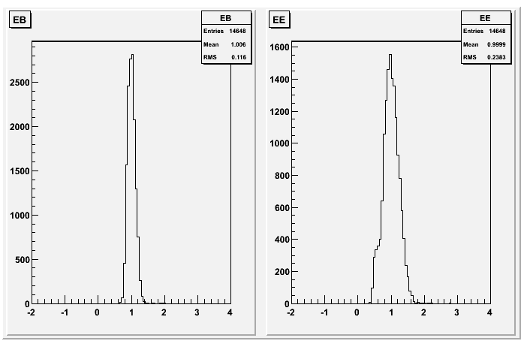
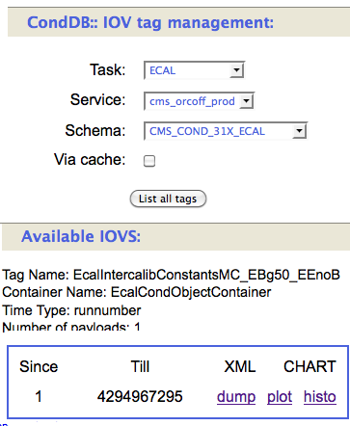
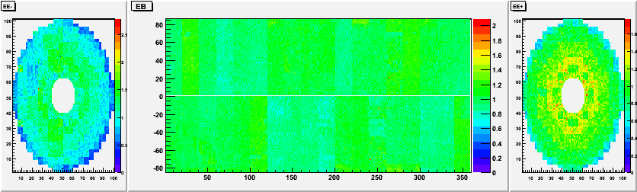
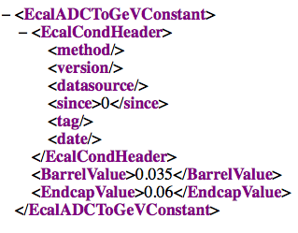
CondDB web server – GUI prototype

Slide 12
Access Strategy

Slide 13
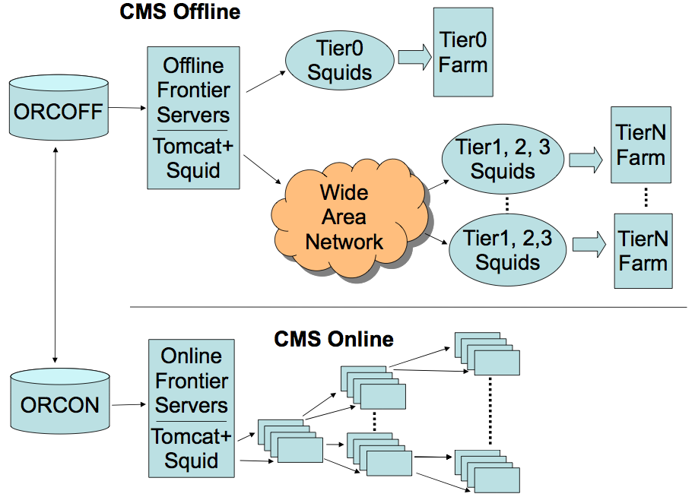
Data Access using web caches
(FronTier)

Slide 14
Physical Layout

Slide 15
“Partitioning Strategy”
Till now the database has been “partitioned” into accounts following development and deployment criteria
  Keep separated areas of independent development
    By sub-detectors, by software release
Move to “partitioning” by use-cases
  Keep separated independent use-workflow
    MonteCarlo: copy all relevant data into a dedicated account
      Even a single sqlite file!
    Re-processing at remote Tiers: make a read-only snapshot of the whole condition DB and use that (through FronTier)
    Prompt processing (reconstruction, calibration, analysis at T0 and CAF) keeps using the master DB (updated in real time)

Slide 16
Open issues
As the Database grows and applications evolve more “partitioning” issues will show up
  Manage “schema evolution”
  Use of oracle partitions
  Archive and pruning
  Snapshot frequency
Add new “dimensions” and/or “abstractions” at the application level

Slide 17
Summary
CMS has in production a large number of applications critically relying on DB backends
Condition Database adds complexity challenges due to its close connection to “physics” applications
Stable LHC operation will add new challenges and new dimensions to the project
  Balance between development and production
  Performance issues
  Robustness and flexibility issues

