Slide 1
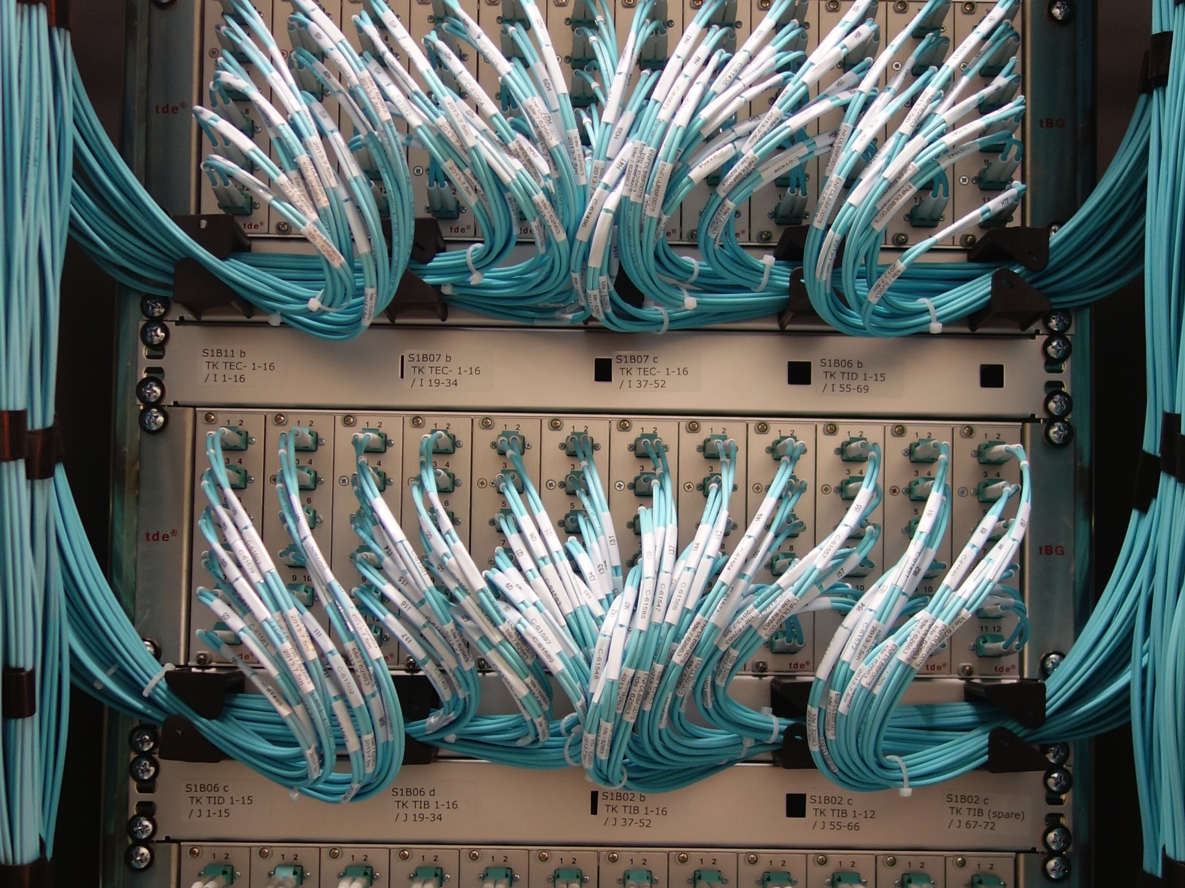
CMS DAQ-2 Shifter Tutorial
Hannes Sakulin, CERN/EP-CMD
On behalf of the CMS DAQ group

Slide 2
DAQ2 Tutorial Outline
Part 1: Your tasks as a DAQ shifter
Part 2: Overview of the DAQ-2 system
  Change from DAQ-1 to DAQ-2
  DAQ-2 hardware and data flow from the detector to storage / Tier 0
  Flow control
  Software
Part 3: Controlling data taking through Run Control
Part 4: DAQ monitoring tools

Slide 3
Part 1: Your tasks as a DAQ shifter

Slide 4
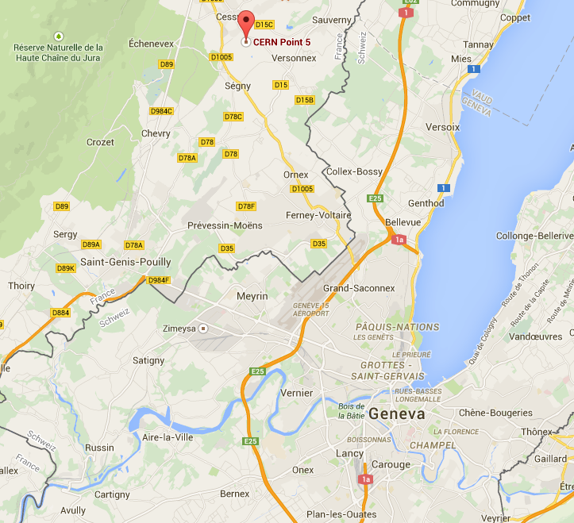
Context
DAQ shifts take place at the
CMS Control Room at Point 5
of the LHC in Cessy, France
Three shifts: 7-15, 15-23, 23-7
Five shifters
  Shift leader: manage operations in line with daily plan, monitor data taking, communicate with LHC, safety
  DCS shifter: slow control, access, safety
  DAQ shifter: control, monitor & troubleshoot data taking
  Trigger shifter: monitoring of the L1 trigger
  DQM shifter: monitoring of data quality
  (the latter three shifts may get cancelled under certain circumstances)

Slide 5
Your responsibilities as a DAQ Shifter
Main DAQ responsibilities:
  Monitor the DAQ
    Make sure the DAQ is running smoothly and that CMS is collecting high quality data!
    This means:
      Monitoring all stages of the DAQ from FEDs -> data sent to Tier 0.
        Data rate, dead time, back-pressure, CPU usage, problems
      Interfacing with the shift crew
  Control data taking as the Shift Leader requests
    Start / stop runs
    Take in / out sub-detectors, FEDs
    Manual re-syncs, hard resets, control random rate
  Troubleshoot the DAQ in case of problems
    But don’t hesitate to call the DAQ DOC (x76600) when you are stuck!
  Document your shift: use the ELOG!

Slide 6
Your responsibilities as a DAQ Shifter
You are the main responsible for efficient data taking of CMS
  The CMS efficiency will depend to a high degree on your abilities
  As a consequence you need to
    Read and learn the necessary procedures
    Keep yourself up-to-date
      The run environment will evolve in time
      Procedures will change
      Monitoring systems will change
    This means you have to dedicate some time outside of your shift period to study the online DAQ system and how to operate it.

Slide 7
Your responsibilities as a DAQ Shifter
During your shift you have to communicate continuously with the shift leader and other shifters/DOCs in order to keep running efficiently
  You are needed since the job CANNOT be done by a computer program or a robot !
  Since you are the key person which starts and stops the run, you also should be the key person to overcome or work around problems. This means:
    You should be able to localize where the problem is
      In the central DAQ, or in a subsystem, or in the computing infrastructure
    You must communicate efficiently to the relevant experts and the shift leader in the control room
    You are involved in suggesting workarounds where you can
    You are co-responsible to solve problems in the DAQ and online system
      This often means to efficiently communicate to the expert on call
      You must be precise & concise when reporting problems on the phone

Slide 8
Your responsibilities as a DAQ Shifter
Be active! Do not just wait for instructions
  This will increase the data taking efficiency.
  If you think time is being wasted, talk to the shift-leader.
  If you think a specific sub-system is blocking for too long the data taking talk to the shift leader.
    You as a cDAQ shifter probably have the best feeling which subsystem is blocking data-taking.
  When you are active, you learn more about the other systems, too. This makes shifting much more fun, and is a good thing for CMS!
But always: Do nothing without informing the shift leader
  In particular when subsystem experts contact you directly:
  Always involve the shift leader that he/she knows what is going on!
  Always make sure that either you or the shift leader have contacted the relevant sub-system expert (DOC) before deciding to remove subsystems or FEDs from the run

Slide 9
E-Log
Document your shift in the e-log
  Your entries are essential to make CMS run efficiently. The e-log is a primary source of information for improving the system. With your entries in the e-log you are part of the team which tries to improve the online system to achieve “smooth operation”.
There should be an e-log window already open. Logout the old shifter and log in yourself as soon as you start your shift
  Use the Subsystems>DAQ>DAQ area – there is a link to it in the shifters guide
Please “submit” comments in a timely manner
  That way people offsite can monitor what’s going on
    Many short entries are preferable to one long log entry at the end of your shift!
Document any issues that come up or observations you have about the DAQ, e.g.
  If you have to constantly restart or resync a subdetector, If the DAQ goes into error at any time, anything that seems funny or you don’t understand
  Make sure to copy / paste any error messages that are relevant
    From hotspot / RCMS / handsaw / etc.
  Add context information to the errors
Give a meaningful & correct subject to your log message
    E.g.: “Run blocked due to HCAL FED 1122 sending events out of sequence”
    (instead of “DAQ crashed”)

Slide 10
Shift Bulletin Board
Before each shift check the Shift Bulletin Board
  This Twiki page contains
    Procedures
    Settings (e.g. sub-system RUN Keys, FEDs that are out for a period of time)
    Known problems (and workarounds)
    (temporary) instructions
  If you do not fully understand, check with the previous shifter or the DAQ on-call at the beginning of your shift
You must keep the Shift Bulletin Board up-to-date
  The next shifter will rely on it

Slide 11
General Rules and Policies
Security (computing):
  Never write down passwords in public places where other people have access to (files in your home account, paper on your desk, etc)
  Do not give the passwords to other people
    It is the on-call experts which give the relevant information to the shifters

Slide 12
General Rules and Policies
Take your work seriously:
  If you have time (during a long smooth run in the night):
    Of course you may check your email on your portable
    Of course you may write an email
    You SHOULD eat and drink something during your shift...
  BUT : You must continuously watch the screens to check that the data taking proceeds as it should.
It is unacceptable that the run stops due to some problem and you do not realize this for 5 minutes.
Shifting is real work, and unfortunately not always exciting or breath-taking...
If you manage to do efficiently other work during your shift, then you do not take the shifting seriously !

Slide 13
General Rules and Policies
In case you are in trouble:
  FIRST INFORM THE SHIFT LEADER
    Tell him/her what you suggest to do next. (Sometimes he/she does not know what to do...)
You cannot get a run going and beam is there or imminent
  You have serious doubts that the data is taken correctly and/or there is a problem in the central DAQ
  CALL THE DAQ ON-CALL EXPERT AT ANY TIME
  The experts are there to help you at any time. (This is why they do not need to do other shifts)
If you have a problem or question which you are sure is NOT critical to efficient data taking
  Document your problem in e-log
  Call the expert at any time during the day/morning/evening.
  The experts are also there in order to make you more expert!!

Slide 14
Your shift outline
Arrive 15 minutes early!
  Discuss with previous shifter any problems / issues / requests
  Read through the shift bulletin board and make sure you understand it
  Log into the Elog and begin documenting your shift
If a run is ongoing, check all the monitoring screens
  Is the data flowing ok?
  Do you understand the trigger rate? Is the trigger correct?
Follow any requests from the shift leader
  Never include / remove subdetectors or FEDs without talking to the shift leader
When you have time, take a tour of both the central control room and the subdetector room
  Introduce yourself to your fellow shifters!
If questions/problems do not hesitate to call the DAQ DOC (x76600)

Slide 15
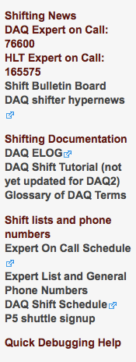
Documentation and Resources
DAQ2 shifters guide twiki page
  https://twiki.cern.ch/twiki/bin/view/CMS/ShiftPourNuls2014
The leftbar of the DAQ2 shifters guide has many valuable links:
Shifter bookmarks : http://cmsdaqweb/daqpro/ShifterBookmarks.html
Questions about shifts: cms-daqshift-office@cern.ch
DAQ shifter bulletin board: read before every shift.
DAQ shifter hypernews: subscribe to this! All DAQ shift related announcements are sent here
DAQ ELOG: Link to DAQ area of the ELOG
DAQ Shift Tutorial: link to slides from shift tutorial
Glossary of DAQ Terms: definition of all the DAQ acroynyms.
Expert on call: link to DAQ DOC area of shift tool
Expert List: link to list of DAQ and HLT experts
DAQ shift schedule: link to DAQ shifters area of shift tool
P5 shuttle: link to shuttle schedule

Slide 16
Part 2: The central DAQ system

Slide 17
The Central DAQ during Run-1
DAQ-1

Slide 18
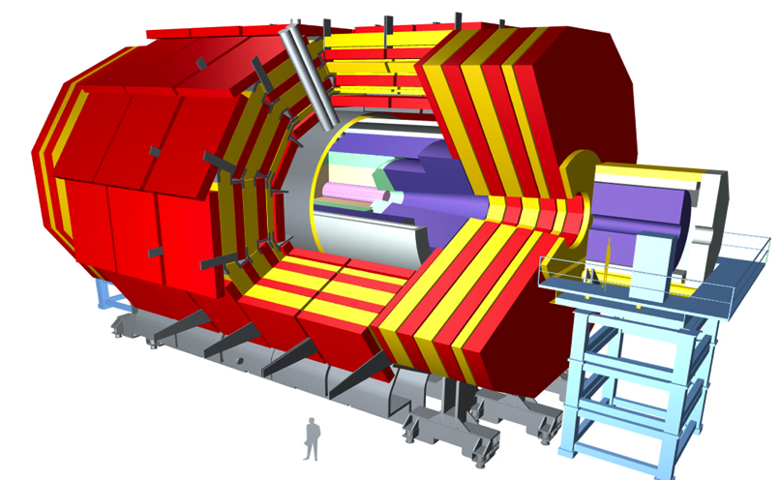
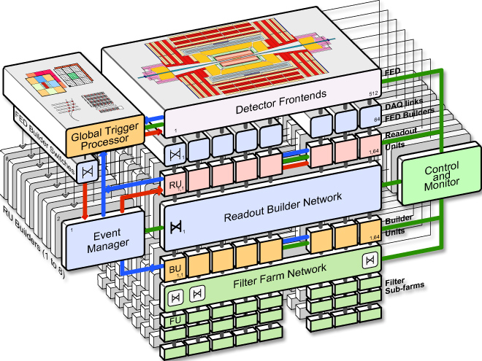
CMS DAQ for
LHC Run-1
Bunch crossing rate
40 MHz nominal
Only 2 trigger
levels in CMS
Event size up to 1MB
Level-1 Trigger
accepting 100 kHz
Custom electronics
DAQ: 100 GB/s
bandwidth
Myrinet
2-stage event builder
Myrinet
Gigabit Ethernet
1 Gb/s Ethernet
High-Level Trigger
working on full events
13000 cores
~500 Hz accept rate
99.6 % cDAQ availability
(2010-2013 physics runs)
up to 1.2 GB/s
to storage

Slide 19
Why build a new DAQ?

Slide 20
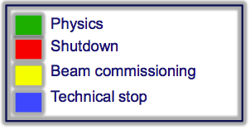
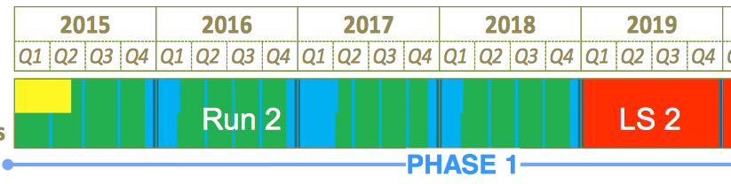
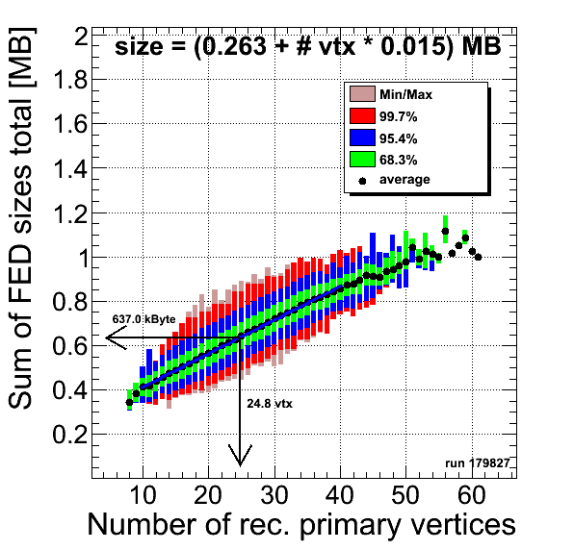
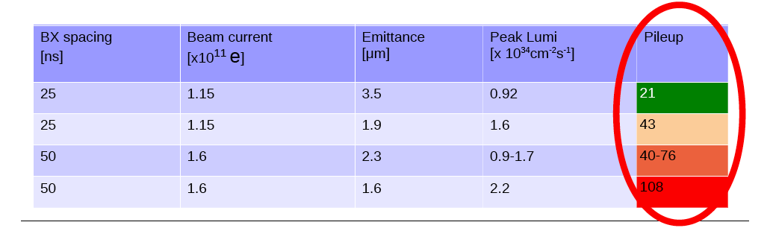
LHC plans
13 TeV center-of-mass energy
40 MHz (25 ns ) operation
targeting 40 fb⁻¹ / year
higher pile-up
Plan for startup
after LS1
(2015)
(*)
(*)
LHC run-2 pile-up scenarios
(*) LHC will perform luminosity leveling to limit pile-up to 50
n_{vtx} = PU * 0.7
CMS event size
(Run-1 subsystems)

Slide 21
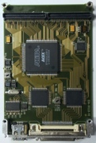
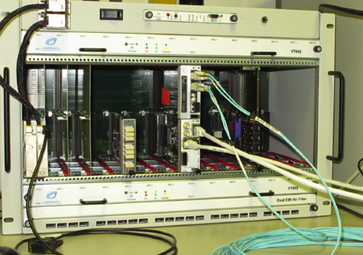
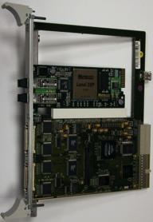
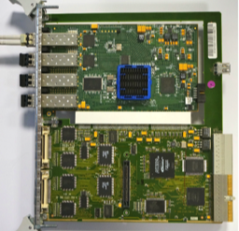
New or upgraded detectors in CMS
Several detectors / online-systems being
upgraded to cope with higher luminosity
Increase of event size
Readout electronics of upgraded systems
based on µTCA
2014: New Trigger Control and Distribution System
2014: Stage-1 calorimeter trigger upgrade
2014/15: new HCAL readout electronics
2016: Full trigger upgrade
2017: New pixel detector and readout electronics
SLINK sender mezzanine
plugged onto
VME electronics
SLINK express
sender = IP-core
µTCA electronics
“AMC-13” card used
by many subsystems
Fragment size 1..4 kB
Fragment size 2..8 kB
SLINK-64 copper cable
400 MB/s
Optical SLINK-express
4 Gb/s or 10 Gb/s
- retransmit
Myrinet NIC
Frontend-
Readout
Link
Frontend-
Readout
Optical
Link
640 Legacy Links: SLINK-64
(600 after pixel upgrade)
+ 50 new Links: SLINK-express
(170 after pixel upgrade)

Slide 22
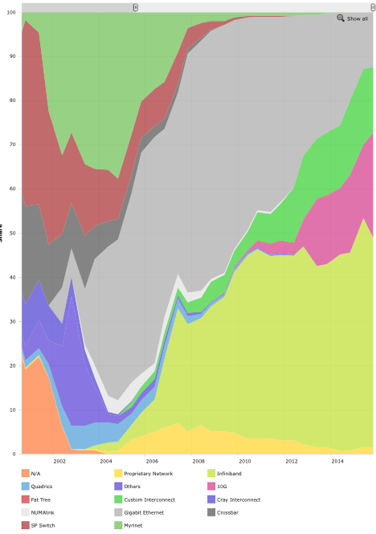
Other reasons to upgrade
Ageing hardware
  Most PCs of Run-1 system
  at end of life cycle
  NICs of Run-1 based on PCI-X
New technologies
  Myrinet widely used when
  DAQ-1 was designed
  Today Ethernet and Infiniband
  dominate the Top-500
  supercomputers
DAQ1 TDR (2002)
Myrinet
1 Gb/s
Ethernet
10 Gb/s
Ethernet
Infiniband
2014
Top500.org share by Interconnect family

Slide 23
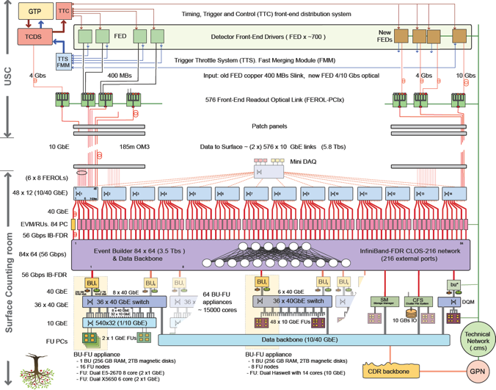
Event size up to 1MB
Event size up to 2MB
(large margin)
100 kHz
L1 rate
100 kHz
L1 rate
Myrinet
10/40 Gb/s Ethernet
1 Gb/s Ethernet
56 Gb/s Infiniband
100
GB/s
200
GB/s
13000 core
filter farm
16000+ core
filter farm
CMS DAQ 1
CMS DAQ 2
max. 1.2 GB/s to storage
~ 3 GB/s to storage

Slide 24
The Central DAQ during Run-2
DAQ-2

Slide 25
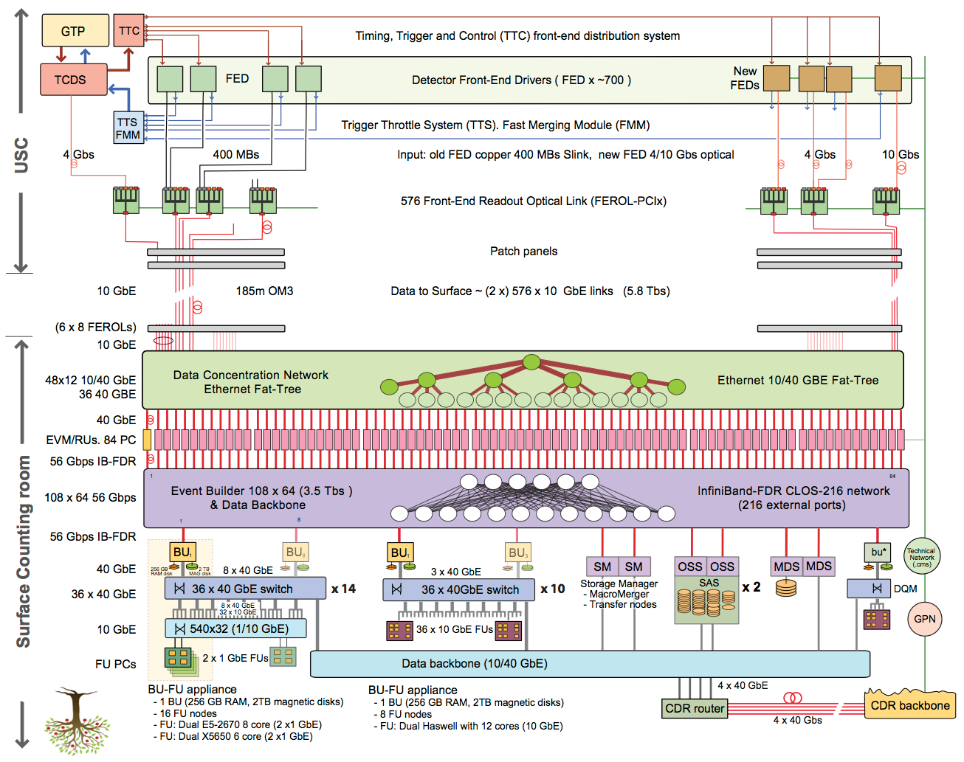
Legacy readout link
SLINK-64
Optical readout link
SLINK express
Frontend Readout Optical Links
10 Gb/s TCP/IP links from FPGA
Data Concentrator:
Individual 10/40 Gb/s
Ethernet switches
fat tree: can route
to other switches
Core Event Builder:
56 Gb/s FDR Infiniband
Clos network
Event Filter
attached by
1/10/40 Gb/s
Ethernet
Storage:
Cluster file system

Slide 26
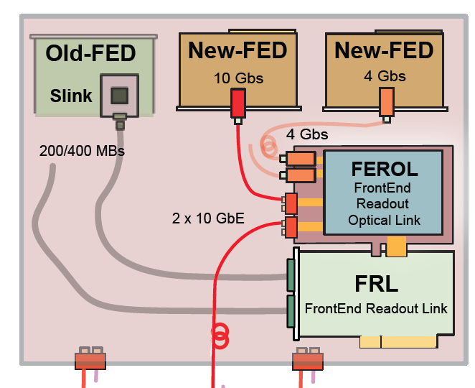
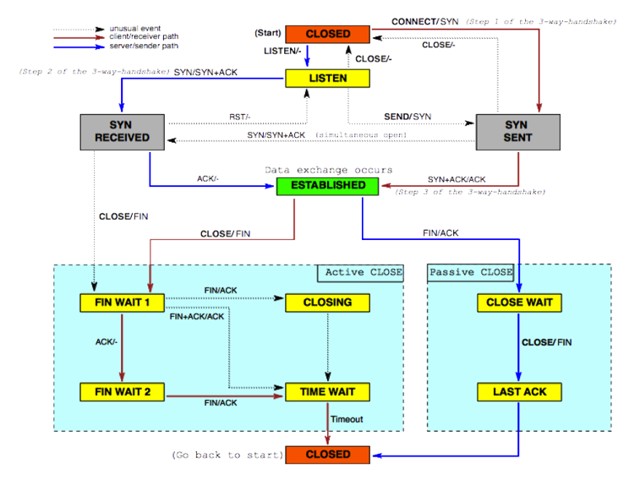
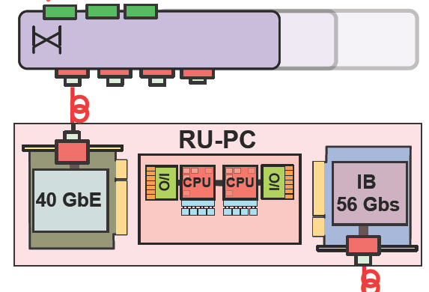
Frontend-Readout Optical Link
PCI-x
TCP/IP in principle difficult to
implement in an FPGA …
10 Gb/s simplified TCP/IP
from an FPGA
switch
PC running standard
TCP/IP Linux stack
10 GbE

Slide 27
Frontend-Readout Optical Link
x
x
x
x
x
x
x
x
PCI-x
x
Simplified unidirectional TCP/IP
only needs 3 states
10 Gb/s simplified TCP/IP
from an FPGA
switch
PC running standard
TCP/IP Linux stack
10 GbE

Slide 28
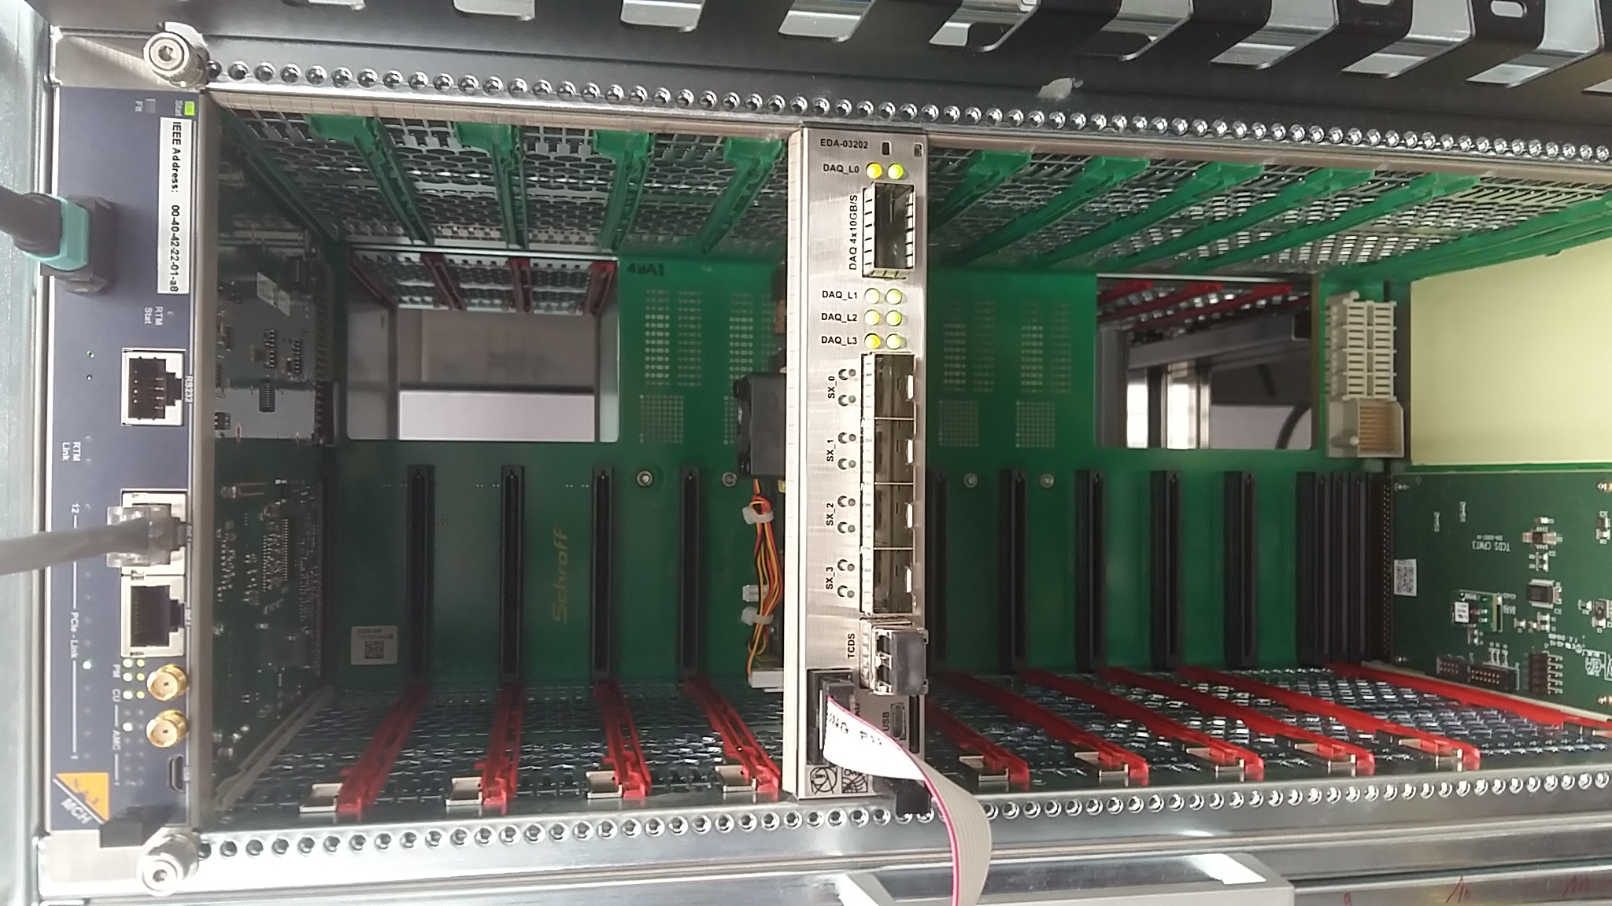
New in 2017: FEROL 40 board
4x 10 Gb/s SLINK Express in
40 Gb/s (4x 10 Gb/s) TCP/IP to DAQ
uTCA standard
Used to read out Pixel Upgrade

Slide 29
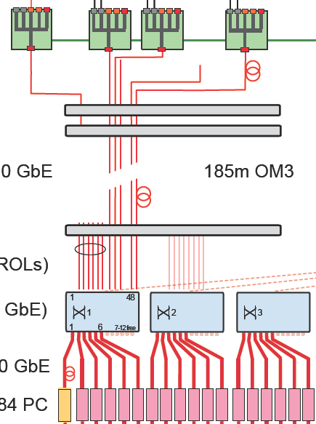
Data concentrator
48 Frontend Readout Optical Links (FEROLs)
per data concentrator switch
patch panels
48 x 10 Gb/s in
links to fat tree
Individual 10/40 Gb/s
Ethernet switches
Mellanox MSX1024
6 x 40 Gb/s out
Readout Unit (RU) PCs

Slide 30
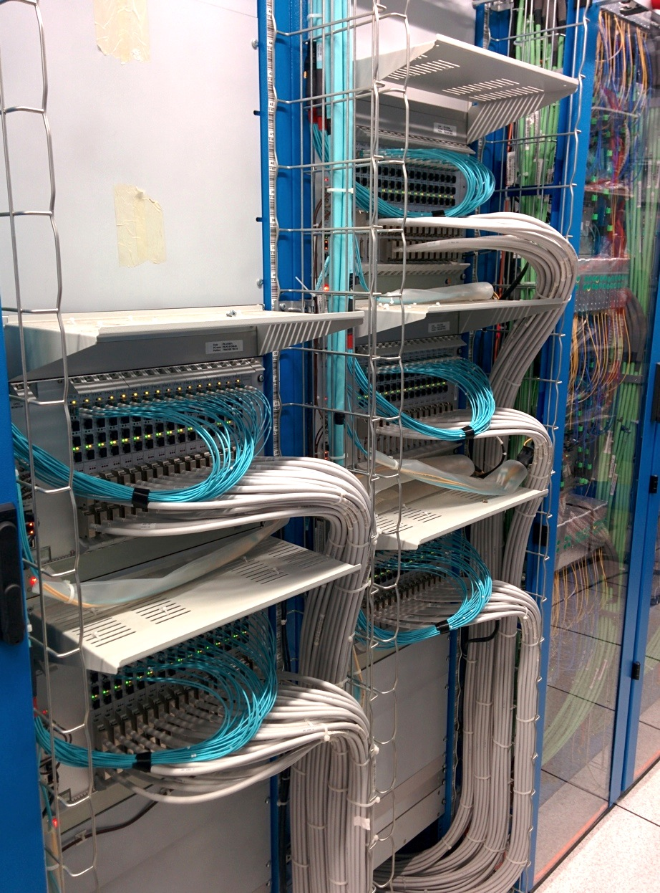
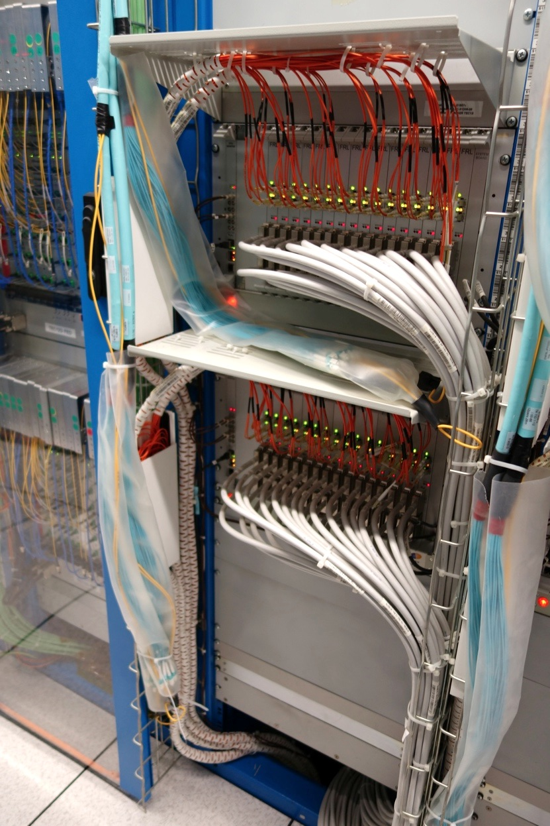
DAQ-1: FRL/Myrinet
DAQ-2: FRL/FEROL 10 Gb/s Ethernet
Switchover completed

Slide 31
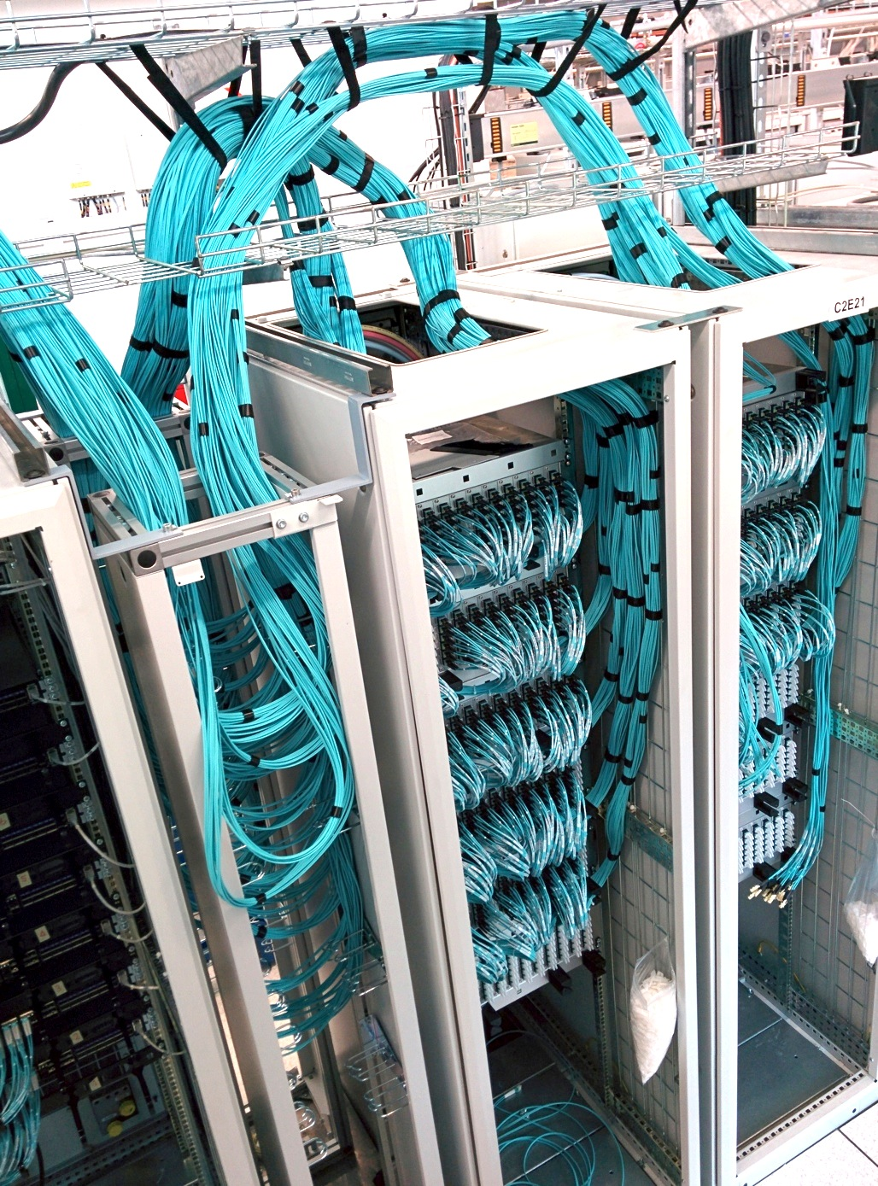
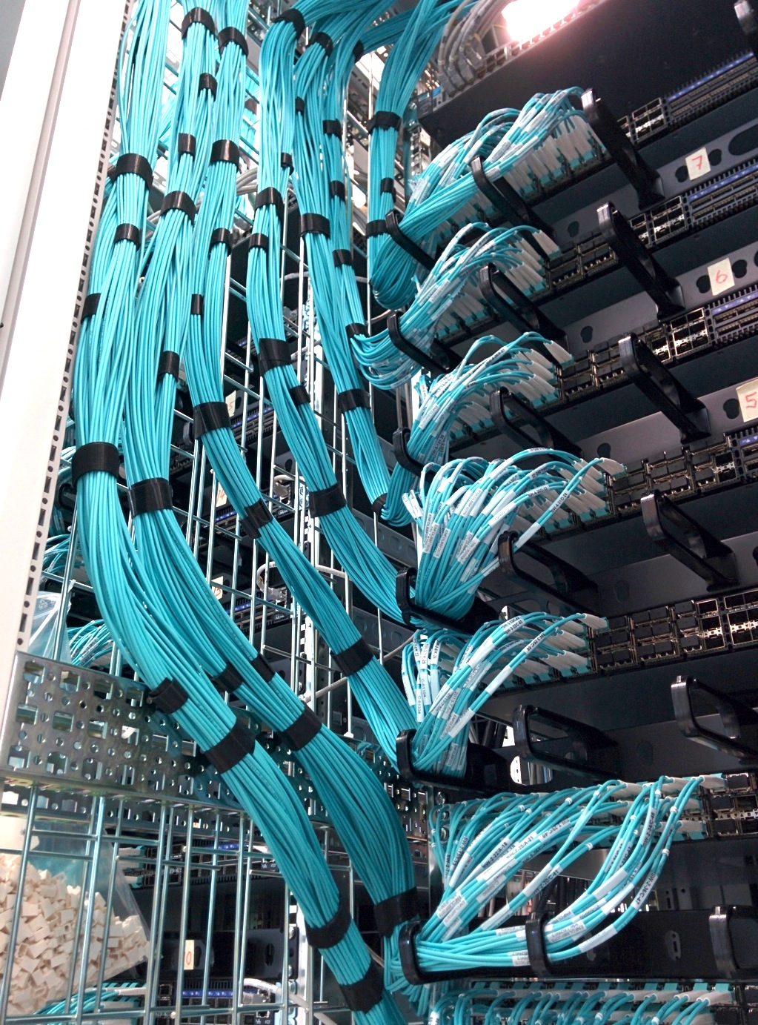
Data concentrator patch panels
and switches

Slide 32
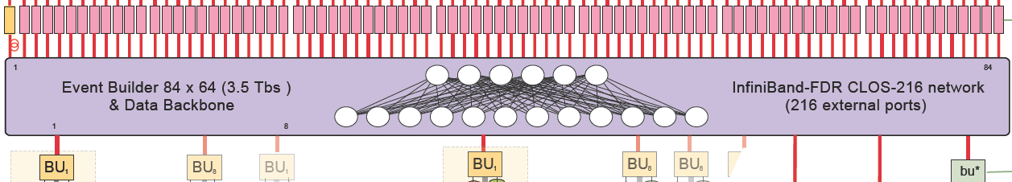
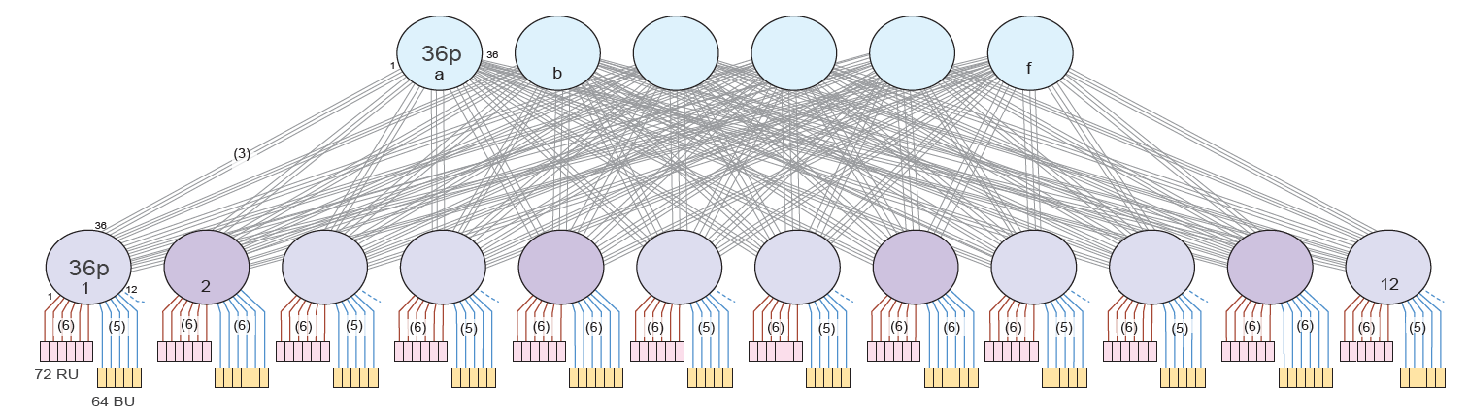
Core Event Builder
108x72 Event Builder – 56 Gb/s FDR Infiniband Clos network (108x108 IOs)
3.5 Tb/s
Infiniband
reliable in hardware at link level (no heavy software stack needed)
supports credit-based flow control
switches do not need to buffer
can construct large network from smaller switches
cost effective
6 spine switches
6 Tb/s per direction
12 leaf
switches
Inputs and outputs mixed on leafs to better utilize leaf-to-spine connections

Slide 33
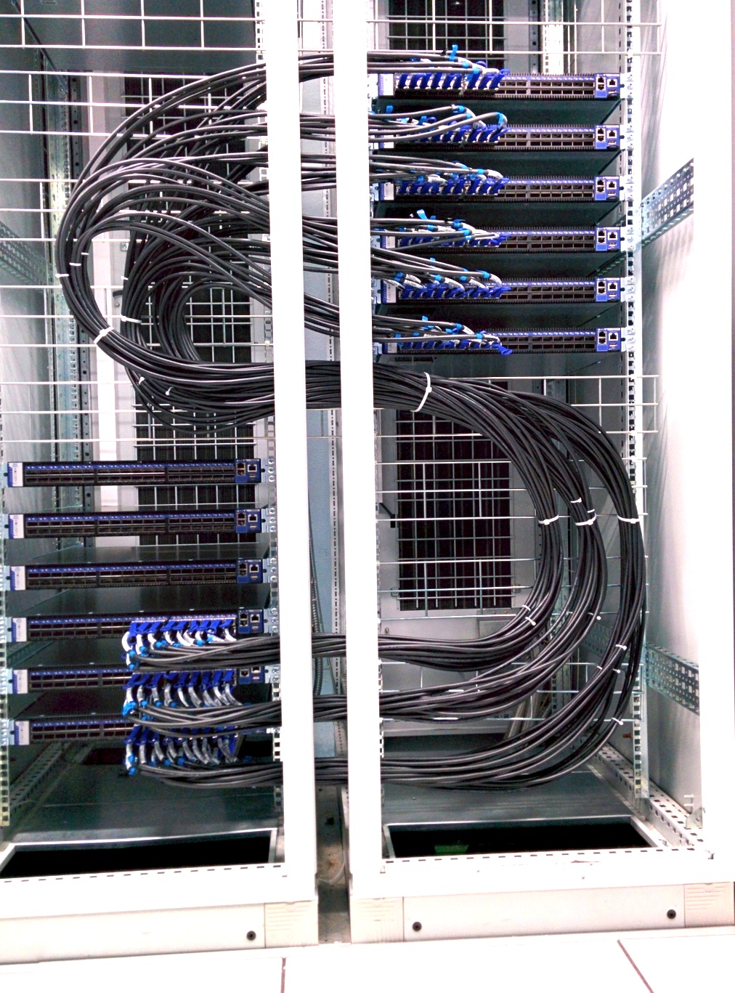
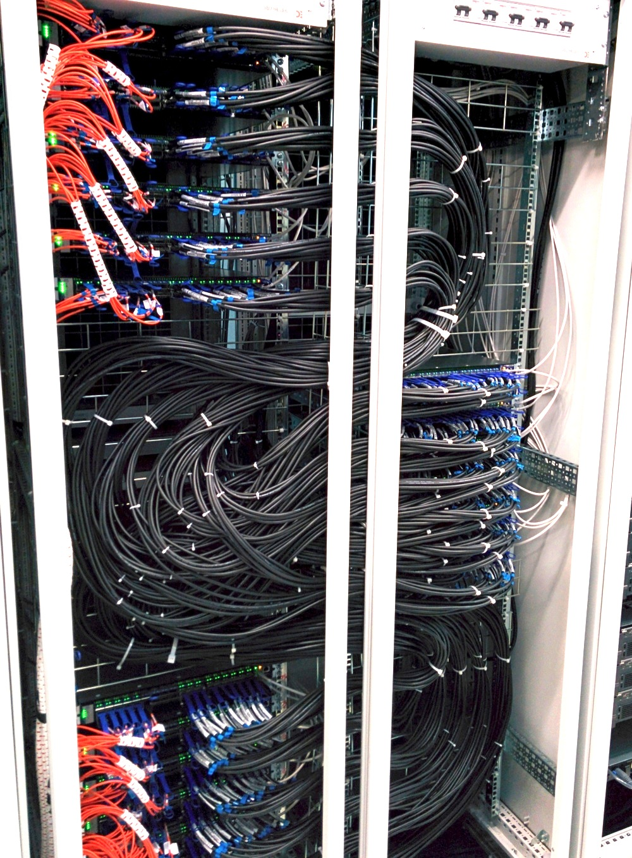
Infiniband Clos network

Slide 34
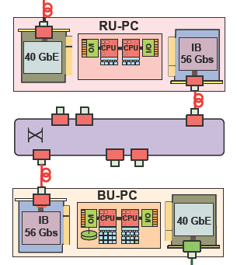
Core event builder performance tuning
40 Gb/s Ethernet
  Linux stack with performance tuning
56 Gb/s Infiniband
  Software based on
  Infiniband Verbs API
  All data transport by RDMA
In both cases:
  Multiple threads for data reception and writing
  CPU affinities tuned
    threads
    memory pools
    interrupts
dual 8-core
E5 2670
dual 8-core
E5 2670
Non-Uniform Memory Access (NUMA)

Slide 35
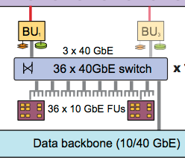
Filter Farm
Infiniband
Appliance
(=BU and
its FUs)

Slide 36
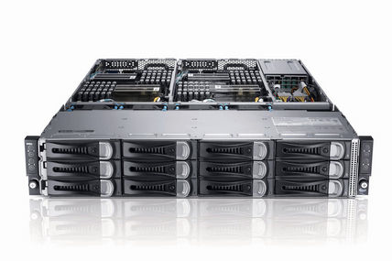
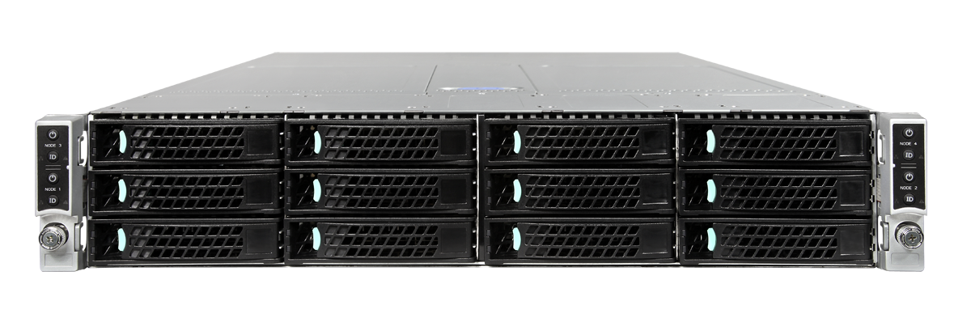
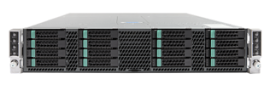
HLT farm, DAQ2
2012
64x
2015
90x
2016
81x
2018
100 x
 | 2012 extension of DAQ-1 Dell Power Edge c6220 | HLT PC 2015 Megware S2600KP | HLT PC 2016 Action S2600KP | HLT PC 2018 Maguay
Form factor | 4 motherboards in 2U box | 4 motherboards in 2U box | 4 motherboards in 2U box | 4 motherboards in 2U box
CPUs per mother-board | 2x 8-core Intel Xeon E5-2670 Sandy Bridge, 2.6 GHz, hyper threading, 32 GB RAM | 2x 12-core Intel Xeon E5-2680v3 Haswell, 2.6 GHz, hyper threading, 64 GB RAM | 2x 14-core Intel Xeon E5-2680v4 Broadwell, 2.5 GHz, hyperthreading, 64 GB RAM | 2x 16-core Intel Xeon Gold 6130 Skylake, 2.1 GHz, hyperthreading, 92 GB RAM
#boxes | 64 (=256 motherboards) | 90 (=360 motherboards) | 81 (=324 montherboards) | 100 (=400 motherboards)
#cores | 4096 | 8640 | 9072 | 12800
Data link | 2x 1Gb/s | 1x 10 Gb/s, 1x 1Gb/s | 1x 10 Gb/s, 1x 1Gb/s | 1x 10 Gb/s, 1x 1Gb/s
Cloud / Spare
Total 2018: 31k cores on 1100 motherboards

Slide 37
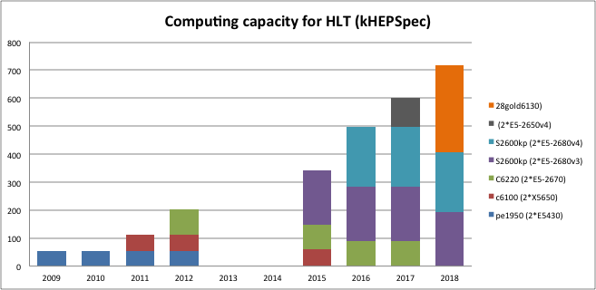
HLT farm, DAQ2
Total 2018: 31k cores on 1100 motherboards

Slide 38
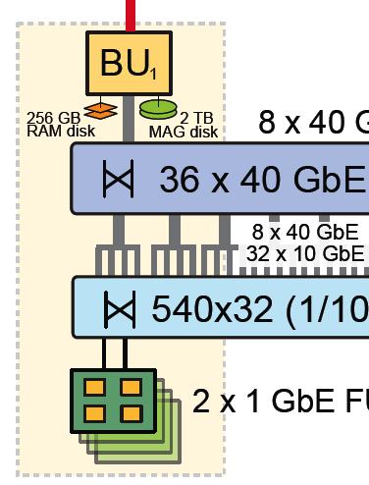
File based Filter Farm Data Flow
BUs build full events and write them to
RAM disk
Several FU machines per BU run CMSSW processes to reconstruct / filter the events
  CMSSW input/output is file based
  BU-FU data transfer uses file systems as a protocol
  8-16 FUs mount ram disk via NFSv4 over the BU-FU network :
    40 to 10 Gbit Ethernet
    (1 Gbit on legacy FU)
The output files of the CMSSW processes are merged by the Micro-Merger on the FU and written back to a hard disk on the BU over NFS.
BU-FU
Appliance
FUs
Notes:
13:00

Slide 39
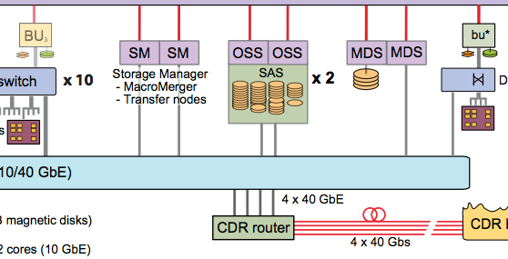
Merging
Lustre
File-Based Filter Farm
produces output files
  After micro-merging on FU:
  1100 files x 10 streams per
  lumi section (23s)
  scattered over hard disks on
  72 BUs
  To be merged to 1 file per
  stream and lumi section
  in a central place
Merging is done by a Global File System (Lustre)
  Micro-merging on FU
  Mini-Merging on BU
  Macro-merging on dedicated merger nodes
DQM
BU
~ 4.5 GB/s write
+ ~ 4.5 GB/s read
Notes:
15:00

Slide 40
Mini-Merge step
BU1
BU2
…
BU64
merger
One file per
event filter PC
on hard disk
of Builder Unit
2 TB
hard disk
Single output file in the cluster file system
Mini-Merge step
  Merger process on BU reads data from all FUs in the appliance
  Data are written directly from the BUs to a single output file per stream in the global file system
    Exception: DQM streams: One file per BU in the global file system

Slide 41
Macro-Merge step and Transfer System
Lustre
DQM
BU
~ 4.5 GB/s write
+ ~ 4.5 GB/s read
Macro-Merge step
  Single output file in Lustre is checked and resized
  Exception: DQM streams
    Output files per BU are read from Lustre and written to single output
      Cut on size (2 GB) and timeout of 15s to ensure DQM data gets to DQM in time
    Histograms are added
Transfer
  Merged data are then transferred from Lustre to Tier 0 or to consumers
  (e.g. DQM/Event Display) at pt.5

Slide 42
Legacy readout link
SLINK-64
Optical readout link
SLINK express
Frontend Readout Optical Links
10 Gb/s TCP/IP links from FPGA
Data Concentrator:
Individual 10/40 Gb/s
Ethernet switches
fat tree: can route
to other switches
Core Event Builder:
56 Gb/s FDR Infiniband
Clos network
Event Filter
attached by
1/10/40 Gb/s
Ethernet
Storage:
Cluster file system

Slide 43
Flow control
The entire DAQ from detector to storage is loss-less
If cDAQ cannot handle the data throughput, back-pressure is propagated all the way back to the FED
  Bandwidth limitation in any part of CDAQ
  CPU limitation in the filter farm
  A failure / crash
Buffers in the FED may fill up
  If too much data is coming from the detector
    Backgrounds, noise, high trigger rate, wrong settings
  Or if the FED is back-pressured by CDAQ
In this case the FED throttles the trigger
  Through the Trigger Throttling System (TTS)
  A tree of Fast Merging Modules (FMMs)

Slide 44
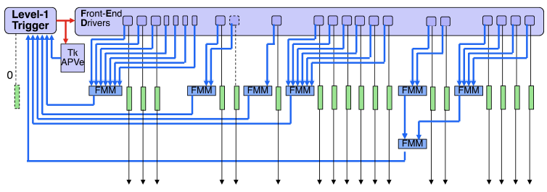
Trigger, TCDS + flow control
Global
Trigger
TCDS
Physics
triggers
Physics
+calibration
+random
triggers
DAQ
back-
pressure
FRL/
FEROL
Each FED sends a TTS signal
    Possible sTTS signals: Busy, Warning, OutOfSync, Error, Disconnected, Ready
FEDs are grouped into partitions
FMMs (Fast Merging Modules) merge sTTS signals from FEDs in each partition
Merged signals sent to TCDS (Trigger Control and Distribution System) which reacts according to the signal
  i.e. blocks triggers from Global Trigger for all states except Ready
Special cases of TTS signals that are only seen by TCDS (not by the FMMs):
  For tracker partitions also the emulated APV state is an input to the partition controller
  New uTCA FEDs send their TTS status through the TTC Partition Interface to TCDS

Slide 45
Software

Slide 46

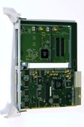
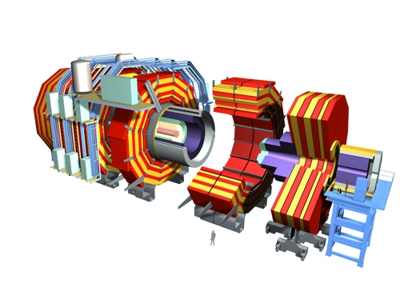
The online software
XDAQ Framework – C++, XML, SOAP
XDAQ applications control hardware and data flow
XDAQ is the framework of CMS online software
It provides Hardware Access, Transport Protocols, Services etc.
data
XDAQ Application
XDAQ Online
Software
…
data
data
control
Low voltage
High voltage
Gas, Magnet
L1 trigger
electronics
Sub-det DAQ
electronics
Central DAQ
electronics
Central DAQ
Event Builder
High Level Trigger Farm
& Storage
Front-end
Electronics

Slide 47

The online software
Run Control System – Java, Web Technologies
Defines the control structure
GUI in a web browser
HTML, CSS, JavaScript, AJAX
Run Control System
Run Control Web Application
Apache Tomcat Servlet Container
Java Server Pages, Tag Libraries,
Web Services (WSDL, Axis, SOAP)
Level-0
DCS
Trigger
Tracker
…
…
ECAL
DAQ
DQM
Function Manager
Node in the Run Control Tree
defines a State Machine & parameters
User function managers dynamically loaded into the web application
Trigger
Supervisor
…
XDAQ Online
Software
…
HLTD
CMSSW
merger
transfer
CMSSW
CMSSW
data
data
control
Low voltage
High voltage
Gas, Magnet
L1 trigger
electronics
Sub-det DAQ
electronics
Central DAQ
electronics
Central DAQ
Event Builder
High Level Trigger Farm
& Storage
Front-end
Electronics

Slide 48


The online software
DCS
Shifter
YOU
(as DAQ shifter)
errors
alarms
monitor
clients
F3 mon
Detector
Control
System
Run Control System
Level-0
…
ES
TRG
DAQ
ES
Live Access
Servers
DCS
Trigger
Tracker
…
ECAL
DAQ
DQM
Tracker
…
ECAL
Trigger
Supervisor
tribe
…
…
Monitor collectors
Elastic search
XDAQ Online
Software
XDAQ monitoring
& alarming
WinCC OA
(Siemens ETM)
SMI++ (CERN)
…
HLTD
CMSSW
merger
transfer
CMSSW
CMSSW
data
data
control
Low voltage
High voltage
Gas, Magnet
L1 trigger
electronics
Sub-det DAQ
electronics
Central DAQ
electronics
Central DAQ
Event Builder
High Level Trigger Farm
& Storage
Front-end
Electronics

Slide 49
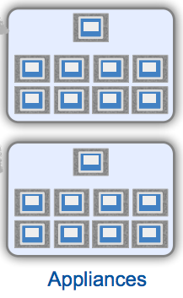
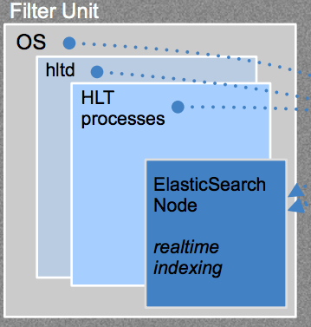
File-based Filter Farm Software
FFF on appliances is controlled by a service (hltd), asynchronous to Run Control
hltd is running on BUs and FUs and responsible for:
  Detecting a new run (run directory in ramdisk appears)
  CMSSW runs as standard cmsRun jobs, process input files
  Output bookkeeping and copying merged data files to BU
Monitoring
  Using elasticsearch (a search engine)
  Data is indexed, searching for specific information is available in near-realtime
  Running on central ES server clusters
  Insertion of information by hltd or merger services
    CPU usage, event processing statistics, merging completion, logs (more details later in F3Mon description)
injection
Notes:
13:00

Slide 50

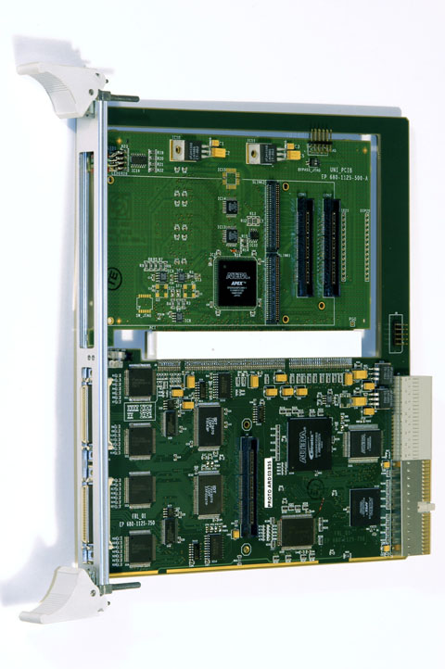
How Run Control starts up a sub-system:
Run Control + XDAQ system structure configurable
High-level tools
Store
configuration
Resource
Service
API
XML
XML
configurations
Load configuration
Run Control
Resource Service
Database
start
& configure
applications
Control structure
  Function Managers to load (URL)
  Parameters
  Child nodes
Configuration of XDAQ Executives (XML)
  libraries to be loaded
  applications (e.g. builder unit, filter unit)
  & parameters
  network connections
  collaborating applications
Job Control
Service

Slide 51

Level-0 interaction
DAQ shifter
Control room
On-Call
Expert
Detector Control
Level-0
Online
Monitoring
LHC
LHC + HV state
GCM
Run Mode
Run Info
Resource
Service
Configuration DBs
Session
L1 Trg
Logs
…
Equipment
HLT
L1-Trigger
PIX
TRK
ECAL
…
CSC
Central
DAQ
DQM
sub-detectors
Data Quality
Monitoring
FEC
FED
FB
EVB
FED Builder
Event Builder

Slide 52
RCMS: Registration and Keys
Sub-system configurations need to be “registered” with the Global Configuration Map Database. This is done by the DAQ on-call expert or sub-system experts
The Level-0 Function Manager queries the DB
  to know what configuration to start for a subsystem
    Important: when a new configuration is registered you need to destroy (red recycle) the corresponding FM
  to know what RUN KEYS are available for a subsystem
    You can parameterize a subsystem’s configuration by selecting a run key (unless the key is are selected by a CMS Run Mode)

Slide 53
Part 3: Controlling data taking through Run Control

Slide 54
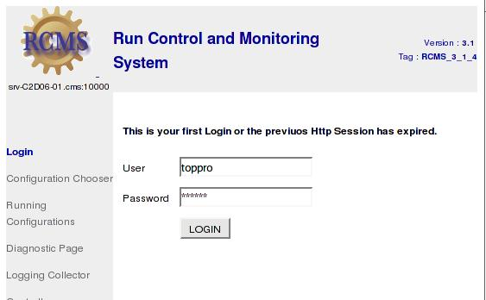
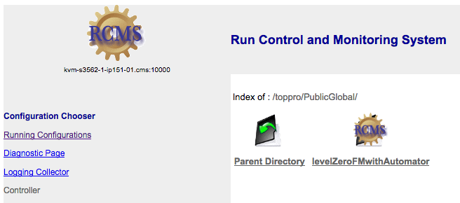
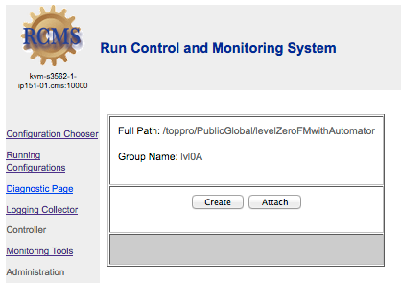
Create FM Level Zero
RCMS workflow to create the FM Level Zero
  Log into RCMS as toppro (http://cmsrc-top.cms:10000/rcms)
  Configuration Chooser: Path: PublicGlobal/LevelZeroFMwithAutomator
  Press on “Create”
    At this point the Level 0 Function Manager is created in the tomcat.

Slide 55
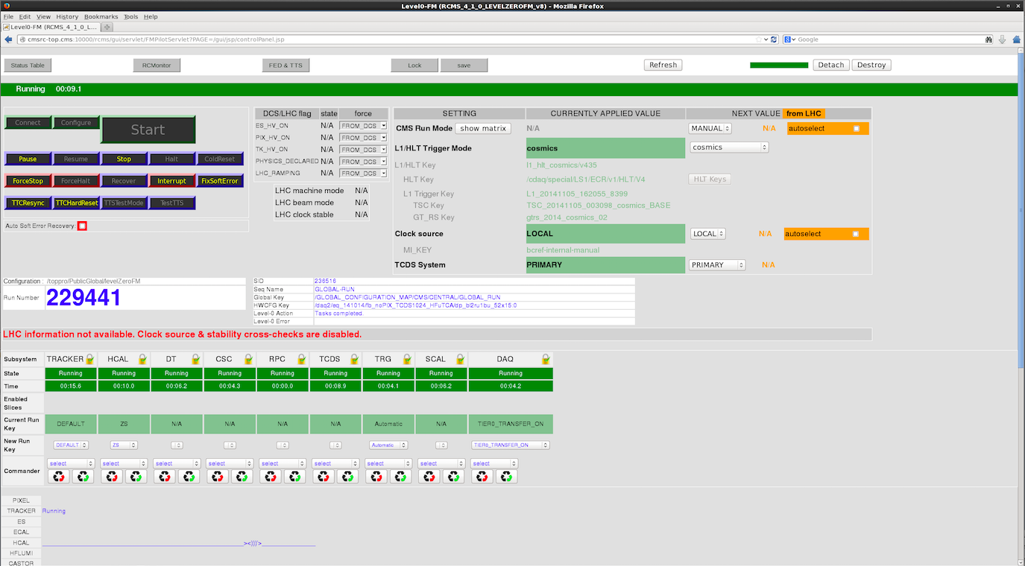
1. RCMS interface
    This is your main interface to DAQ management. This is the window where you will configure the CMS running mode, start / stop runs, remove / add subdetectors and FEDs, and look for errors.

Slide 56
1. RCMS interface
Main activity (start / stop / TTCResync etc)
Subdetector status (Running, Configured, Error, etc)
Subdetector Configuration Keys
Subdetector recycle/reconfigure & commander buttons
Additional info from subdetectors (could be errors)

Slide 57
1. RCMS interface
Slow Control (DCS / LHC) information (when available)
Information (and settings) for Trigger keys, Clock source, TCDS

Slide 58
Managing the run: start / stop runs
Main activity (start / stop / TTCResync etc)
Subdetector status (Running, Configured, Error, etc)
Subdetector Configuration Keys
Subdetector recycle/commander buttons
Additional info from subdetectors (could be errors)

Slide 59
Simplified state diagram for run control
In green are commands, in black are states reached after command is executed
Note that “Error” state can happen during any step
Only valid commands in each state are enabled in the Run Control screen
reConfigure
Configure
Start
Halted
Configured
Running
Halt
Stop
Initialize
Resume
Pause
Faulty/Error
Paused
Error
Destroy
Re-configure = (Halt) + Configure
Re-cycle = Destroy + Initialize

Slide 60
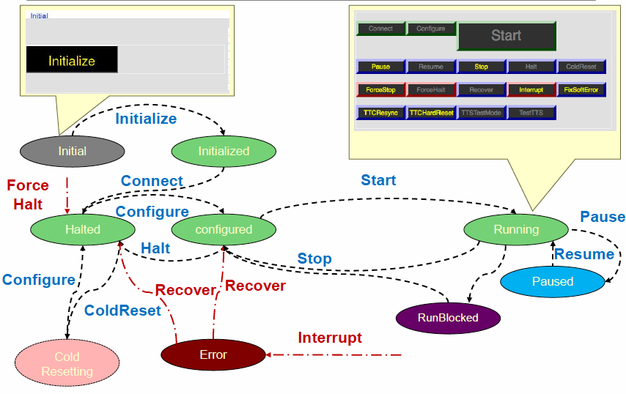
Full state diagram for run control
In green are commands, in black are states reached after command is executed
Note that “Error” state can happen during any step

Slide 61
Starting / Stopping runs
In general, you will use the buttons in the main activity area
  Here the initialize / configure / start / stop buttons will address all subdetectors in the run
    There is an order in which the commands must be sent to subdetectors, and the order is built into the L0 function manager
It is possible also to use the “commander” and / or “recycle” buttons below the subdetector
  Sends commands only to one subdetector
  If this command requires subsequent action on another subdetector, then there will be a flashing message next to the subdetector that requires action
    E.g. if you add a subdetector into the run when the TCDS or DAQ (or both) is already configured, a flashing message next to the TCDS / DAQ will tell you to reconfigure it
  Recycle/Reconfigure buttons
    There are two: “red” recycle and “green” reconfigure
    Red recycle destroys the subdetector function manager and restarts it, ending in the “halted” state. You can do this from any state, you must do this from the “error” state
    Green reconfigure reconfigures the subdetector only. You can do this either from the “halted” or “configured” state

Slide 62
Adding / removing subsystems and/or FEDs
To add / remove FEDs or subsystems, click on the FED & TTS button
The window on the next slide will pop up
FED & TTS button
Subdetector recycle/commander buttons
To remove an entire subsystem, you can also choose the “Destroy and Out” command from the commander pull down menu

Slide 63
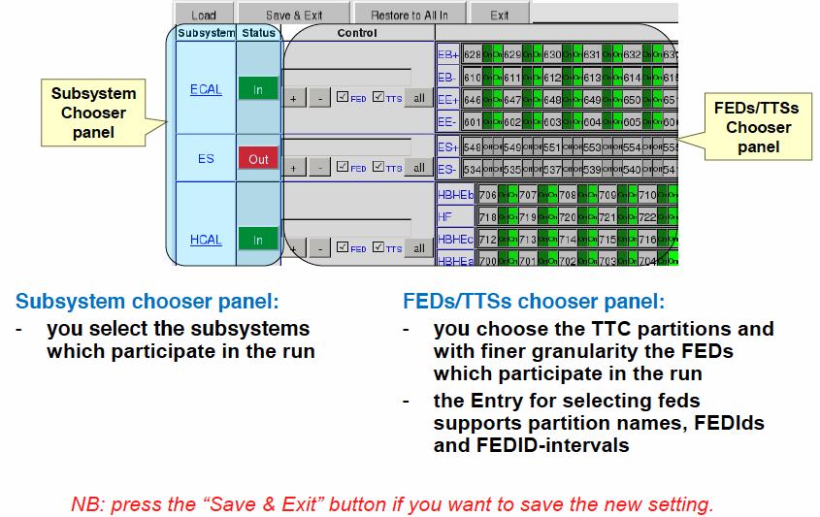
Adding / removing subsystems and/or FEDs
Following is pictures / more in depth information

Slide 64
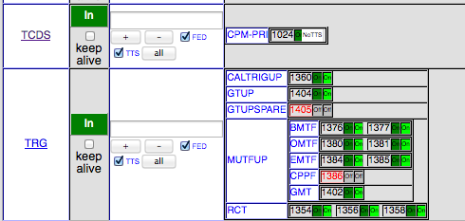
Adding / removing subsystems and/or FEDs
FED groups help to
differentiate between
subsystems within
a partition

Slide 65

Sub-Systems Control Panel
The Sub-Systems panel contains:
  All the subsystems included in the Global Run
  State of each subsystem
  Applied Run Key for each subsystem
  Run Key selector
  Commander for each subsystem:
    The pull down menu allows to send command directly to the subsystem
    Red re-cycle button allows to destroy the subsystem software and bring it to halted state.
    Green re-cycle button allows to (re-)configure the subsystem software.

Slide 66

FM L0 built-in cross-checks
  Indicate sub-systems to re-configure if :
    A parameter is changed in the GUI
    A sub-system / FED is added/removed
    External parameters change
  Enforce correct order of re-configuration
  Enforce procedure to follow if LHC clock stability changes

Slide 67




Access Control
Subsystems are created by the Level-0 in a locked state and the subsystem RCMS GUIs may be attached for read access but may not command the subsystem or set parameters.
If a subsystem-expert needs to access the sub-system through their RCMS GUI, you may unlock the subsystem by clicking on the lock icon. You should lock the subsystem again after the intervention is finished.
If a subsystem was created by a GUI or by a different Level-0, the central Level-0 may not be able to command this subsystem. In order to control the subsystem from the central Level-0, the subsystem must be destroyed from where it was created.
Destroy Backdoor (this applies for any Function Manager, whether it belongs to a subsystem or it is the Level-0 itself): If things went wrong and you cannot destroy a Function Manager in any regular way.

Slide 68

Run and Trigger mode selection
Select CMS Run Mode other than MANUAL
Tick to auto-select
CMS Run Mode
Based on LHC mode
(Only available if
connection to DCS
is working)
All keys defined by CMS Run Mode
including (some) sub-system RUN KEYs

Slide 69

You may sometimes need: Manual RUN MODE
Select CMS Run Mode is MANUAL
Select L1/HLT Mode
L1 and HLT keys defined by
L1/HLT mode
Select clock source
( Select primary/secondary
TCDS system – not yet available)
Attention: You also need to select sub-system run keys manually

Slide 70

You may rarely need: Manual L1/HLT MODE
Select CMS Run Mode is MANUAL
L1/HLT Mode is MANUAL
Choose HLT key and
HLT SW Architecture
L1 Keys defined by trigger shifter
Select clock source
( Select primary/secondary
TCDS system – not yet available)
Attention: You also need to select sub-system run keys manually

Slide 71




Automator
DCS
Operator
DAQ
Operator
DAQ Expert
monitor
clients
errors
alarms
Automator Function Manager
LHC
Level-0 Function
Manager
HV status,
LHC state
DCS
SE
Gd
Ind.
SM
Conf
Config
DBs
…
Run Control System
Subs 1
…
Subs n
…
Detector Control System
Monitoring Services
XDAQ Online
Software
HLT, merge &
transfer
control
data
data
control
Low voltage
High voltage
Gas, Magnet
Trigger
Control and
Distribution
System
File based Filter Farm
& Storage
Front-end
Electronics
L1 trigger
electronics
Sub-det DAQ
electronics
Central DAQ
electronics
Central DAQ
Event Builder

Slide 72

Level-0 Automator
Start a run from any state
Taking into account all cross-checks (except sanity checks)
Taking into account scheduled actions
Attempting to recover from failures (2 retries, currently)
Stop a run then re-start
Schedule
“at-fault” is for future
automatic down-time splitting

Slide 73
Level-0 Automator
When to use what button
  If we are not “Running”
    “Start Run” will start a new run ( “Recover Run” will do the same thing)
  If we are “Running”
    “Recover Run” will stop, then start a new run (“Start Run” has no effect)
When to use the automator
  To start a run
    First set all settings (Subsystems & FEDs in/out, run mode etc. )
    Then let the automator re-configure / re-cycle subsystems as necessary and start a new run
  To recover from a problem (if you know the appropriate recovery action)
    Select the recovery action in the Schedule
    Let the automator stop the run, re-configure / re-cycle subsystems as necessary and start a new run
  To apply changed settings such as a new run mode or trigger key
    Just click “Recover Run” while a run is going
    The automator stops the run, recycles/ reconfigures subsystems as requested by indicators and starts again

Slide 74

Level-0 timeline
Shows history of subsystem states and all manual and automatic actions taken

Slide 75

Level-0 timeline
Tool tips give information about the reasons for action

Slide 76

Level-0 timeline
Tool tips give information about the reasons for action … and their outcome

Slide 77


Tooltips for errors

Slide 78

Going back to analyze problems

Slide 79



FM L0 Links Panel
Save
Save the configuration parameters of the Level Zero GUI.
Refresh
Refresh the Level Zero page.
Detach
Disconnect the Level Zero GUI from the Level Zero FM.
Destroy
Kill all Function Managers
and XDAQs started by them

Slide 80
Automation:
Automatic reaction to
LHC beam/machine mode and
DCS high voltage state

Slide 81
Automator
DCS
Operator
DAQ
Operator
DAQ Expert
monitor
clients
errors
alarms
Automator Function Manager
LHC
Level-0 Function
Manager
HV status,
LHC state
DCS
SE
Gd
Ind.
SM
Conf
Config
DBs
…
Run Control System
Subs 1
…
Subs n
…
Detector Control System
Monitoring Services
XDAQ Online
Software
HLT, merge &
transfer
control
data
data
control
Low voltage
High voltage
Gas, Magnet
Trigger
Control and
Distribution
System
File based Filter Farm
& Storage
Front-end
Electronics
L1 trigger
electronics
Sub-det DAQ
electronics
Central DAQ
electronics
Central DAQ
Event Builder

Slide 82
DAQ actions on LHC and DCS state changes
Extensive automation in the Detector Control System (DCS)
  Automatic handshake with the LHC
  Automatic ramping of high voltages (HV) driven by LHC machine and beam mode
Some DAQ settings depend on the LHC and DCS states
  Suppress tracker payload while HV is off (noise)
  Reduce pixel gain while HV is off
  Mask sensitive channels while LHC ramps …
Automatic new run sections driven by asynchronous state notifications from
DCS/LHC
Detector Control System
Run Control System
DCS
PVSS
SOAP
eXchange
Level-0
LHC
Tracker
…
ECAL
PSX
DCS
Tracker
…
DAQ
XDAQ
service

Slide 83


Automatic actions driven by the LHC …
…
STABLE BEAMS
ADJUST
STABLE BEAMS
section 1
LHC dipole current
DCS ramps up
tracker HV
DCS ramps down
tracker HV
Start run at FLAT TOP.
The rest is automatic.
DCS ramps up
pixelHV
DCS ramps down
pixelHV
section 1
section 2
section 1
2
3
…
Special run with circulating beam
Collisions run
Automatic actions in DAQ (“PerformingDCSPauseResume” state)
ramp start
Mask
sensitive
trigger
channels
ramp done
Unmask
sensitive
trigger
channels
Tracker HV on
Enable payload (Tk)
raise gains (Pixel)
Tracker HV off
Disable payload (Tk)
reduce gains (Pixel)

Slide 84
Automatic recovery
from Soft Errors

Slide 85

Automatic soft error recovery
With higher instantaneous
luminosity in 2011 more and more frequent “soft errors” causing the run to get stuck
  Proportional to integrated luminosity
  Believed to be due to single event upsets
Recovery procedure
  Stop run (30 sec)
  Re-configure a sub-
  detector (2-3 min)
  Start new run (20 sec)
One Single Event Upset
(needing recovery) every 73 pb⁻¹
Single-event upsets in the electronics of the Si-Pixel
detector. Proportional to integrated luminosity.
  3-10 min down-time

Slide 86

Automatic soft error recovery
From 2012, new automatic recovery procedure in top-level control node
  Sub-system detects soft error and signals by changing its state to RunningSoftErrorDetected
  Top-level control node invokes recovery procedure
    Pause Triggers (TCDS)
    Invoke newly defined selective recovery transition on requesting detector (FixSoftError)
    In parallel perform preventive recovery of other detectors
    Resynchronize
    Resume
…
Function
Manager
  12 seconds down-time
At least 46 hours of down-time avoided in 2012

Slide 87
Other special states
RunningDegraded
  Subsystems may change into RunningDegraded state
  if data taking is still continuing, but there is a problem requiring the attention of the shift crew
  The subsystem message panel should contain a message describing the problem
  Discuss with the shift leader how to proceed and check with the corresponding DOC if the message is not 100% clear.
RunBlocked
  The DAQ and Level-0 may change into the RunBlocked state if the DAQ received corrupted data from a subdetector
    It is possible to (Force-)Stop the run from RunBlocked state.

Slide 88
Part 4: Monitoring tools

