Slide 1
Monitoring of the DAQ2 system
  Remi Mommsen, FNAL
  Andre Holzner, UCSD

Slide 2
Monitoring tools
RCMS/LVL0 interface
  Has been covered by Hannes
aDAQMon
  Overview screen to see at a glance the CMS running configuration and rates.
DAQView
  Most comprehensive monitoring tool for issues with data flow. Here you can monitor the data from FEDs to BUs.
DAQ Expert application
  automatic detection of error conditions and displaying of instructions how to get the run going again
  replacement of the DAQ doctor
Elastic Search / Filter Farm monitoring (HLT, File Merging & Transfers)
  Shows state of HLT processing. Important monitor of file-based filter farm (FFF).
CPM controller
  Central Partition Manager for the TCDS system. Good place to see rates, state of detector inputs, etc.
HotSpot
  Central display for sentinel messages for errors from all processes.
Handsaw
  Scrolling display of error messages

Slide 3
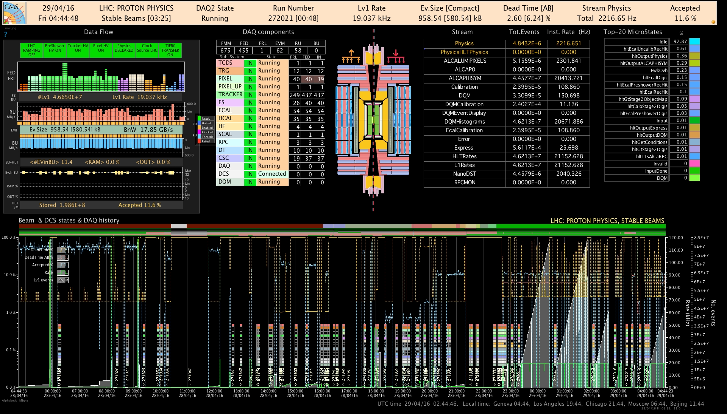
aDAQmon – DAQ Status Display
Status bar gives a quick overview of the DAQ
  http://cmsonline.cern.ch/daqStatusSCX/DAQstatusGre.html
HLT Output Streams
DAQ flow
HLT activity
DAQ sub-system configuration
Data taking history

Slide 4
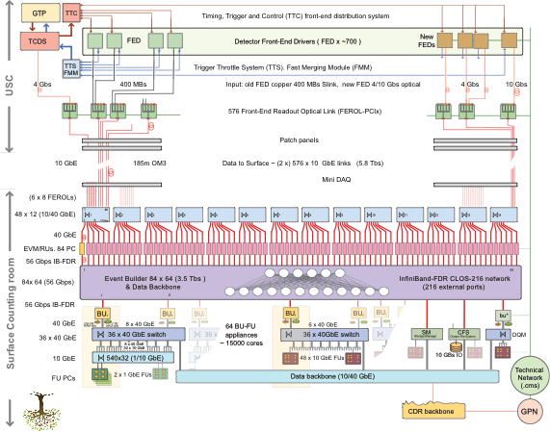

FED-RU data stream
DAQ Sub-Sys configuration
Main systems (LHC, DCS,...) status
Box color:
Sub-Sys ID
FED IN
FED OUT
FED RU configuration
RU bandwidth plot
RU/BU box color:
Application state
BU bandwidth plot
# Ev. in BU
RU/BU box RED frame:
flash data not updated
BU RAM disk %
BU OUT disk %
Event storage summary

Slide 5
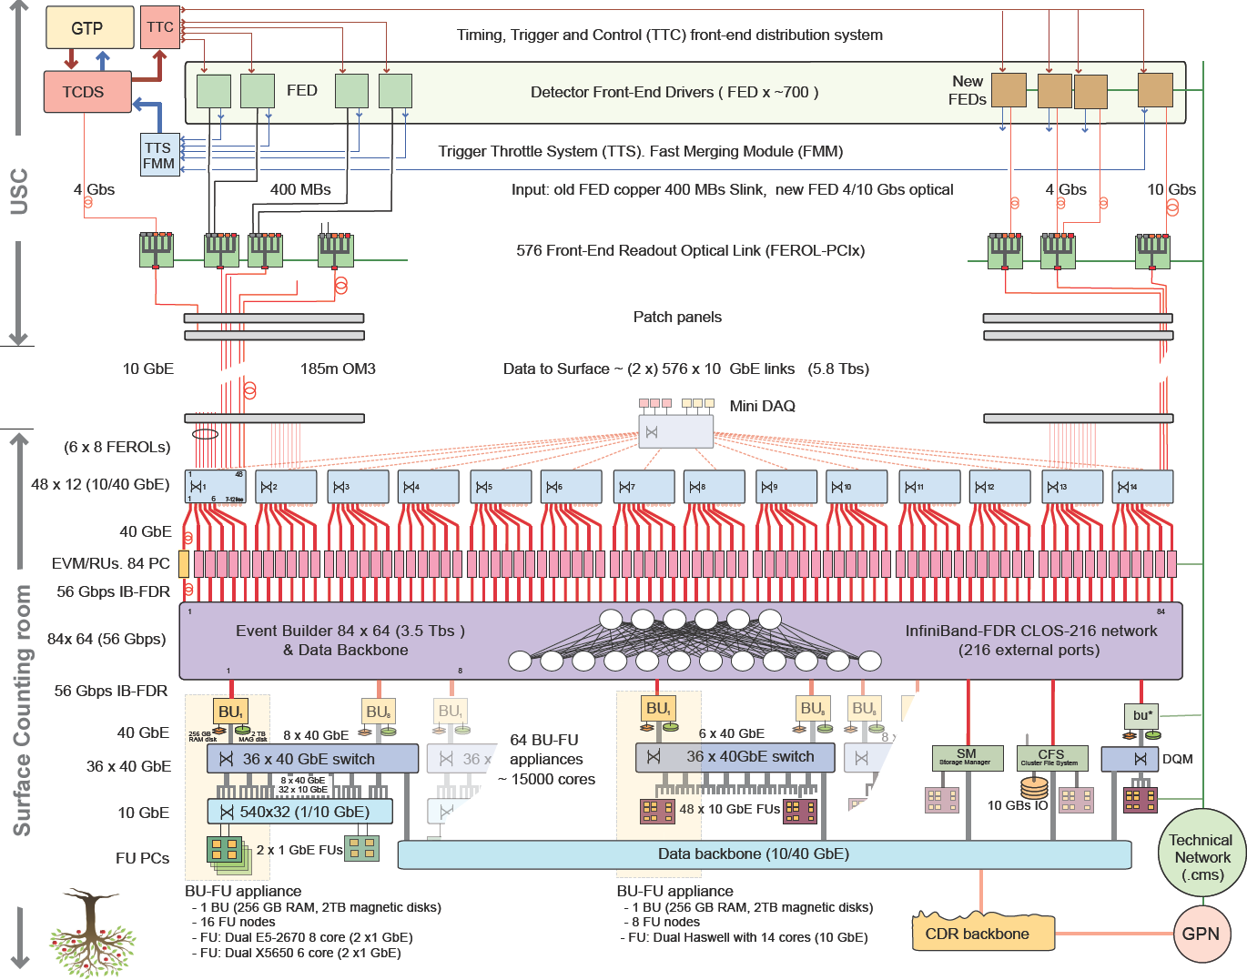
DAQView

Slide 6
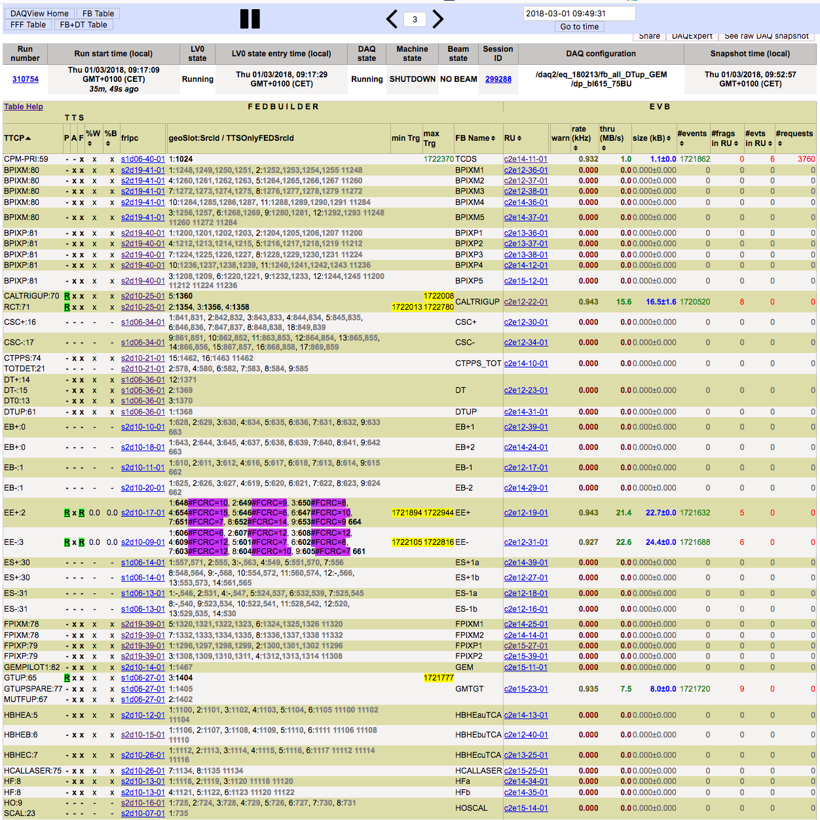
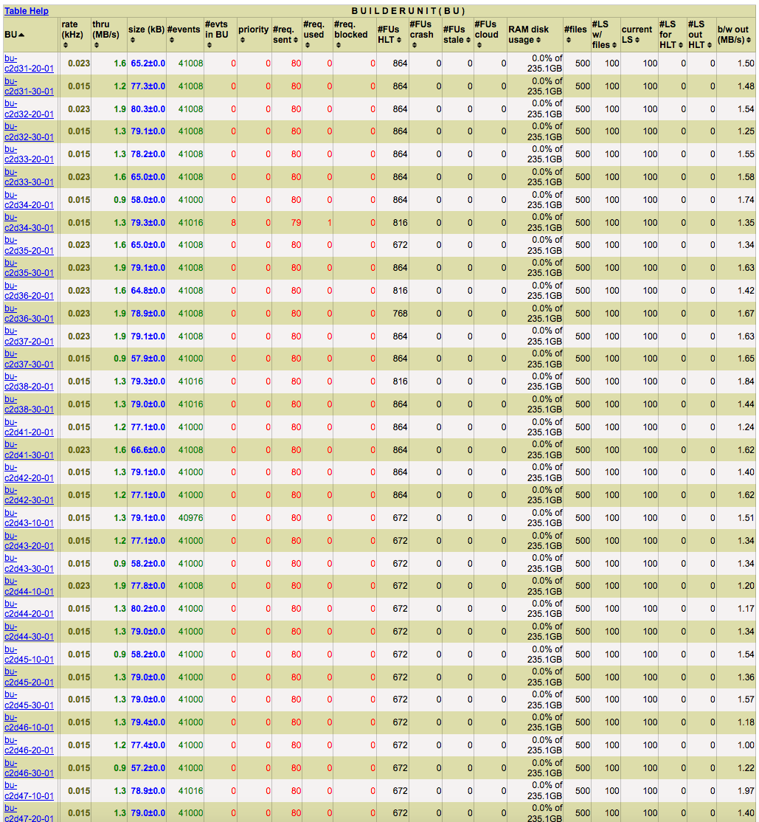
DAQView http://daq-expert.cms/daq2view-react/
Status & navigation
FFF Appliances
BU & FU
FED Builder
FEROL/FMM
Event Builder
RU/EVM
Background turns red
when EvB is Enabled &
no data is flowing

Slide 7
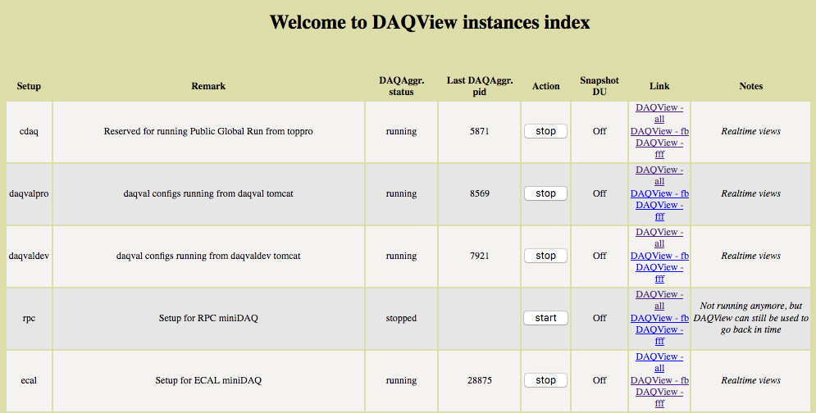
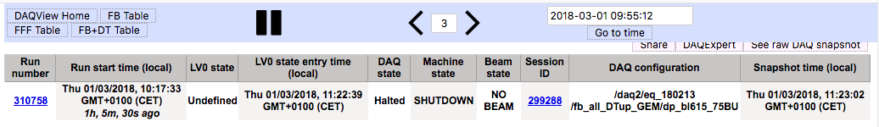
DAQView - Navigation
get a link for current view (useful to paste to ELOG)
switch to DAQExpert for this point in time
go back/forth in time
Switch pages between
FEDbuilder, FFF, and all
Stop refreshing page
go to a specific point in time
Current run
current Level0 FM state and time
when state was reached
DAQ configuration
(blacklist version etc.)
Duration and start time of run
LHC states
DAQ subsystem state
Last update of page must be current!
If this is stale, call the oncall expert

Slide 8
DAQView – Global TTS
in ‘FB+DT Table’ view
Trigger throttling system (dead time from subsystems)
resonant trigger veto
(e.g. 11 kHz zero bias triggers)
triggers lost due to calibration
sequence
dead time in all clock cycles
dead time in clock cycles with actual bunch crossings
total dead time in %
backpressure from DAQ
dead time from trigger rules
(can come from trigger microbursts)

Slide 9
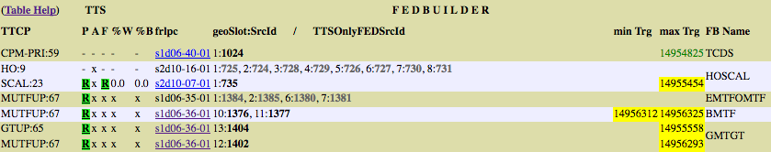
DAQView – FED builder
Confused? Try the table help button!
%warning, %busy
in TTS partition
FED builder name
FEROL PC
(link to hyperdaq page)
TTC partition name & no.
Current TTS state of partition
P: TTS state from TCDS
F: TTS state from FMM
A: APVE emulator TTS state
FED information (see next page)
min/max # fragments received by FEROL. Highlighted in yellow if different to trigger.
Min is only displayed if not equal to max.
screenshot still from classic DAQView, appearance is slightly different in current DAQ2View
DAQ2View allows sorting columns

Slide 10
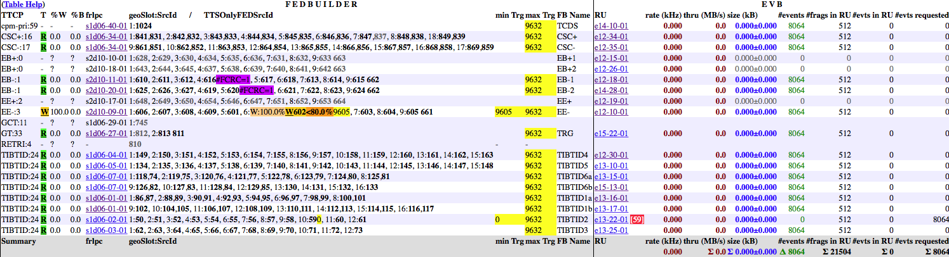
DAQView – FEROL and FMM
Entries are of form
  FRL_geoslot: FEDSourceID or
  FRL_geoslot: FEDSourceID1, FEDSourceID2 or
  FEDSourceID
    For a pseudo-FED (=TTS link only, but no data is read out by DAQ)
Additional info may be displayed next to the FEDSourceID
(from left to right)
  Percentage of time during which FED was in Warning ( ) or Busy ( ) during the last 3 seconds (if non-zero)
  Current state of TTS if other than Ready
  FEDSourceID (expected) 601
    Grey if FRL input not enabled (FMM not enabled in case of pseudo-FED)
    Highlighted in color of current TTS state if other than Ready
  Percentage of time with DAQ backpressure
  during last update interval (5s) if non-zero
    < is meant to be an arrow, not an inequality
  Warnings
    Received source ID different to expected
    FED or SLINK CRC errors
    Number of fragments received by FRL if no data is flowing and this FRL is lagging “behind”
uTCA FEDs (FED id >= 1024) do not have an FMM
  Busy/warning in column ‘P’ DAQView
W:9.9%
B:0.2%
W
<6.9%
Use this to judge whether a FED is creating dead-time because of a FED problem or because of DAQ-backpressure
#FCRC=69
9605

Slide 11
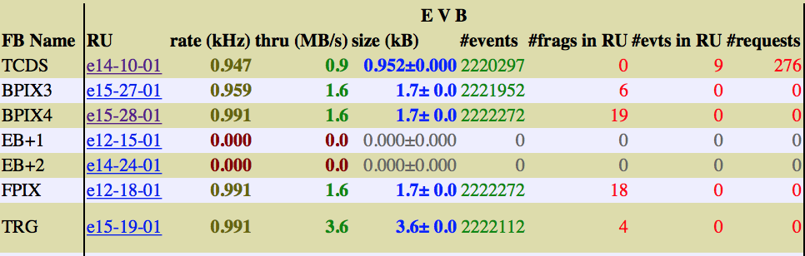
DAQView – RU/EVM Information
Throughput (MB/s)
Rate (kHz)
Super-fragment size (kB)
# requests by BU
normal EVM >> 1 && RUs < 10
First row is TCDS / EVM
Shaded values
mean FEDbuilder
is not in readout
Each row is one FEDbuilder
EVM/RU host
(link to hyperdaq page)
# incomplete fragments
>> 1 indicates a problem on the RU
# events currently in RU
>>1 indicates problem in IB
# fragments built by RU/EVM since start of run
screenshot still from classic DAQView, appearance is slightly different in current DAQ2View
DAQ2View allows sorting columns

Slide 12
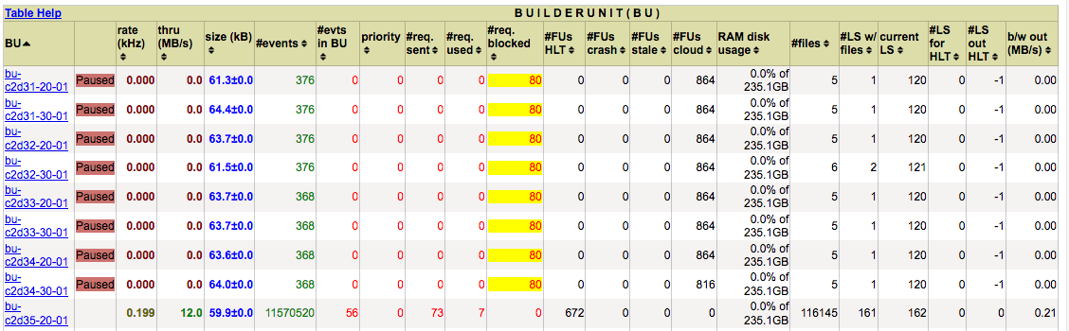
DAQView – FFF/BU
Current LS number
Confused? Try the table help button!
# LS queued on output disk on FUs
BU host
(link to hyperdaq page)
Event size (kB)
Events built since start of run
# LS queued for FUs
each line is one appliance
Throughput (MB/s)
Resource information
(see next page)
# LS for which
there is a file
Rate per BU (kHz)
output
bandwidth
BU state
# events being built
in this moment
# files written

Slide 13
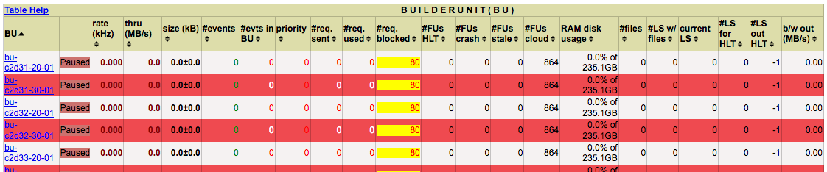
DAQView – BU Resources
BUs have use a fixed number of requests (20 in the current configuration)
  Each request corresponds to multiple events (32 in the current configuration)
The number of active requests may vary during a run
  Load balancing between independent appliances
  Backpressure mechanism if FFF/HLT cannot keep up
A request is sent to the EVM (#req. sent) when all events of the request have been handled
  If #req sent > 0, the BU is able to accept new events
When the BU got at least one fragment for the request, the request is ‘used’ (#req. used)
  The more request are used, the busier is the BU (either building events or waiting for data)
Resources can be blocked (#req. blocked)
  RAM disk becomes full
  Not enough FU CPU cores are available to process data
  FU processing lags behind
Requests have a priority depending on the load of the BU appliance
  BUs with lower priority number get events first

Slide 14
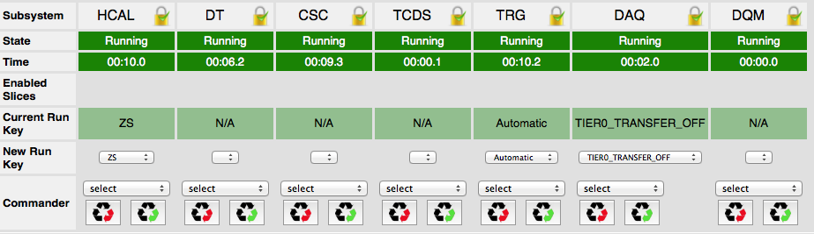
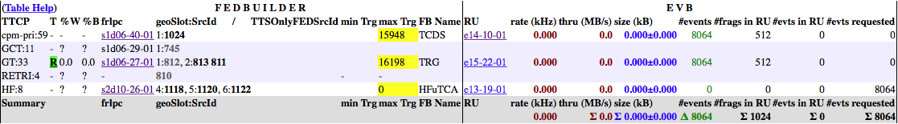
DAQView – Running, or not?
LVL0:
DAQ is running
No, rate is 0 kHz
None of the HF FEDs
has sent any events
No fragments in RU
Many events requested
No data flow as HF has not sent any data ➔ Talk to HCAL expert
screenshot still from classic DAQView, appearance is slightly different in current DAQ2View

Slide 15
DAQView – Who Blocks the Run?
ECAL is 100%
in Warning
Rate is 0 kHz
FED 602 is in warning
and last event is 9605
There’s backpressure
from DAQ
RU waits for data from FED 59
FED 59 has not sent any data
FED 59 is the culprit ➔ Talk to Tracker expert
screenshot still from classic DAQView, appearance is slightly different in current DAQ2View

Slide 16
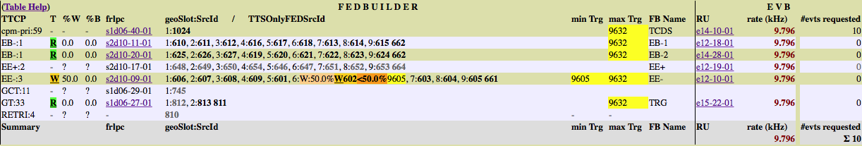
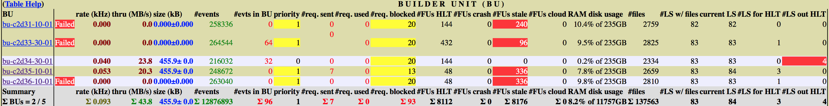
DAQView – DAQ backpressure
ECAL is 50%
in Warning
There’s backpressure
from DAQ
Very few events
requested by BUs
The rate is 10 kHz
Some BUs have Failed
Resources blocked
Many FUs are stale
Data queued on HLT output
Data queued for HLT
FFF output bandwidth is too high ➔ HLT is accepting too many events
➔ Check with trigger shifter for high L1 rates or call HLT DOC
DAQ FM goes into ‘Running Degraded’ when BUs fail
After massive failures on the FFF/HLT, DAQ oncall has to be called
screenshot still from classic DAQView, appearance is slightly different in current DAQ2View

Slide 17
DAQ Expert
Automatic detection of problems in the event builder
  and instructions to fix the problem
Web application
Two main components:
  Dashboard
    current status/problem and instructions how to fix it
    recent problems
    recent sound messages and state changes
  Browser
    timeline of error conditions and other information
    mainly for DAQ DOC
Replaces the Run I DAQ Doctor
Core logic: classic ‘flow chart’ (see backup slides)
  https://twiki.cern.ch/twiki/pub/CMS/ShiftNews/DAQStuck5.pdf
  however not maintained anymore, conditions and solutions were and will be added to the DAQExpert
DAQExpert has been used throughout 2017, your feedback is welcome !
the first place to look at when
triggers stop unexpectedly !

Slide 18

DAQ expert
introduction/documentation at: http://daq-expert.cern.ch/

Slide 19
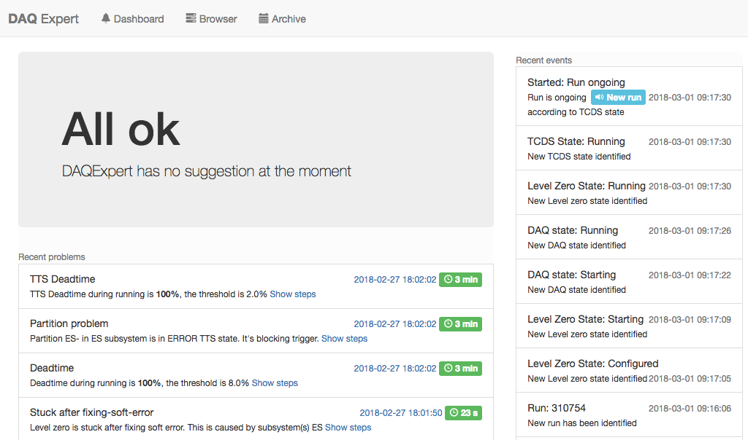
DAQ Expert dashboard
http://daq-expert.cms/nm/dashboard.jsp
overall status
(nothing to worry about at the moment)
all recent events
(includes state changes and sound messages)
recent problems
and proposed solutions

Slide 20
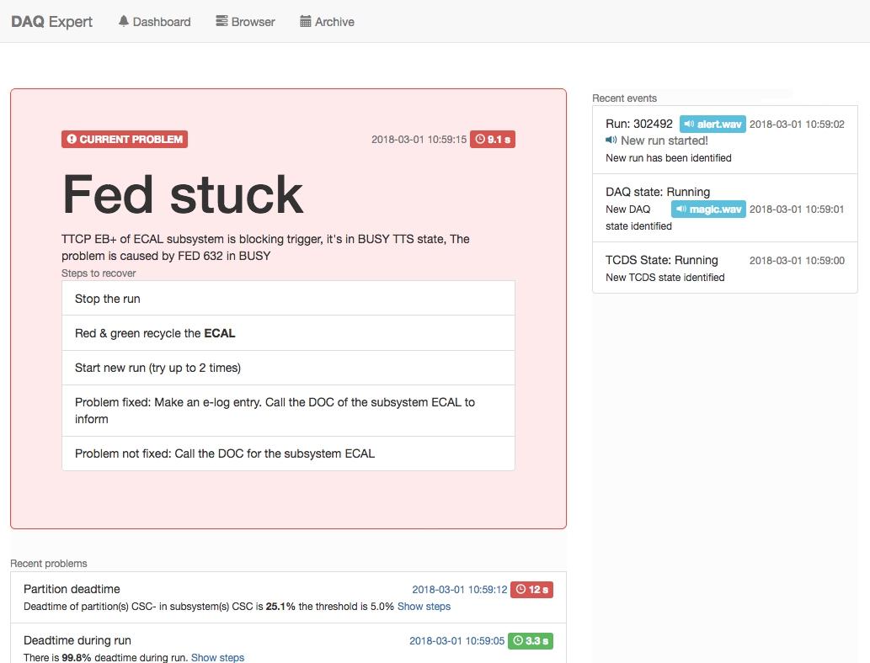
DAQ Expert dashboard
problem is currently active
overall status: there is a problem now which you need to solve !
symptoms
follow these steps to fix the problem

Slide 21
DAQ Expert dashboard demo
Example walkthrough: http://daq-expert.cern.ch/dashboard-demo.html
shows:
  normal (‘happy’) state
  an event that generates a sound in the control room
  an event that generates spoken text in the control room
  a problem without known solution (i.e. no recovery suggestions)
  a new problem which is considered more important than the currently active problem (problems overlapping in time)
have a look at this in your browser after the tutorial !

Slide 22
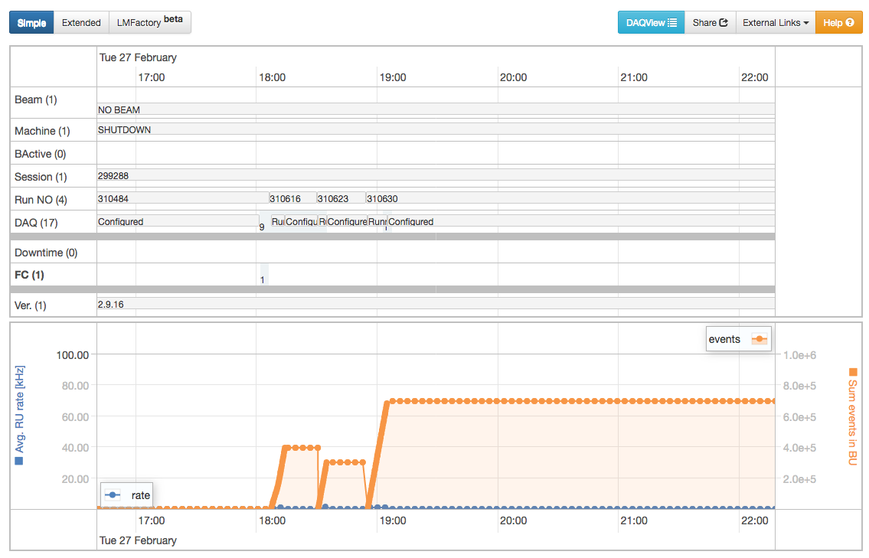
DAQ Expert browser
Confused? Try the help button!
time axis
(scroll to zoom in/out, pan to move)
LHC and CMS DAQ
state changes etc.
downtime / problems
FC = flow chart case
1 event in the time range shown
readout rate
total events collected in run

Slide 23
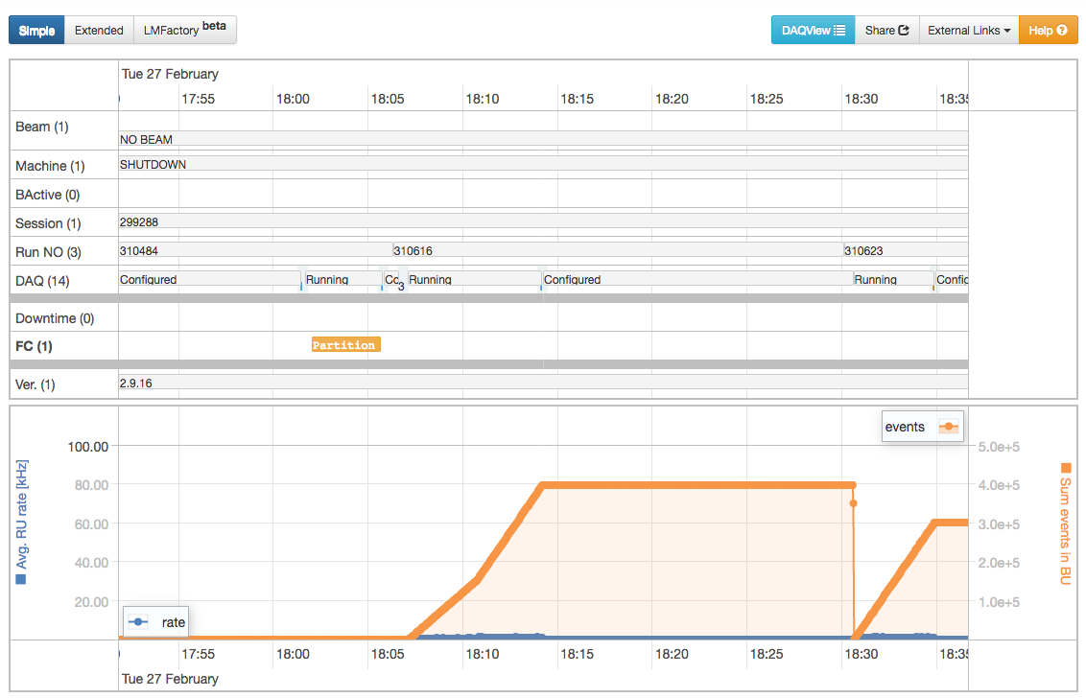
DAQ Expert browser
click on it for further details

Slide 24
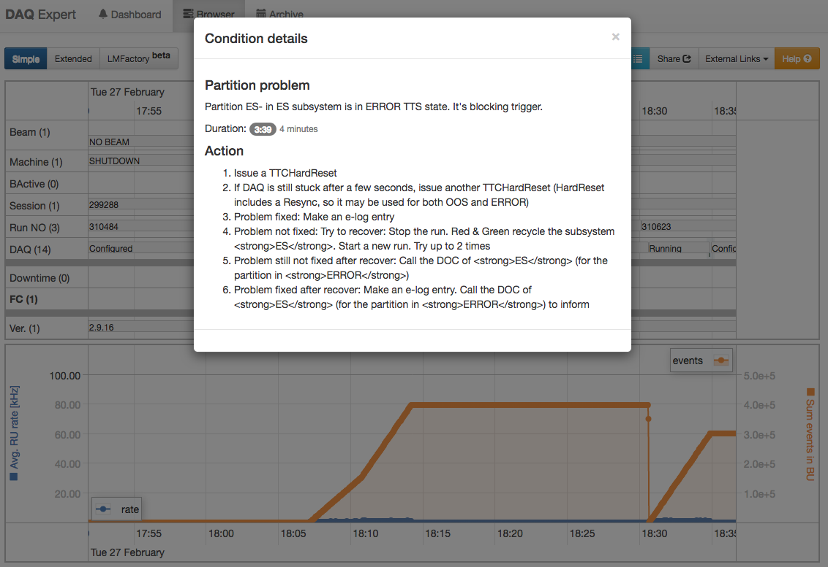
DAQ Expert browser

Slide 25
F3 Mon

Slide 26
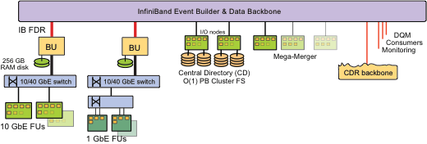
File-based Filter Farm (FFF/F3)
Filter Units (FUs) run the CMSSW processes selecting events for permanent storage
  Each FU runs multiple, multi-threaded CMSSW instances
  Accepted events are written to the local disk
The Storage and Transfer System aggregates files (event data, DQM histograms & metadata)
  Micro-merger on each FU aggregates the data from all processes on the FU
  Mini-merger on the BU aggregates the data from all FUs
  Macro-merger(s) aggregate the data from all BUs
  Data are aggregated per stream and luminosity section
  DQM data might suffer delays when merging is lagging behind
Error stream contains events which crashed the CMSSW process
  Backtrace is available from F3 mon (see next slide)
  CMSSW processes are restarted after a crash a few times, after that they are “quarantined”
    DAQ oncall needs to clean up the FFF when this happens
  If there is a low rate of crashes, the HLT DOC should be notified

Slide 27
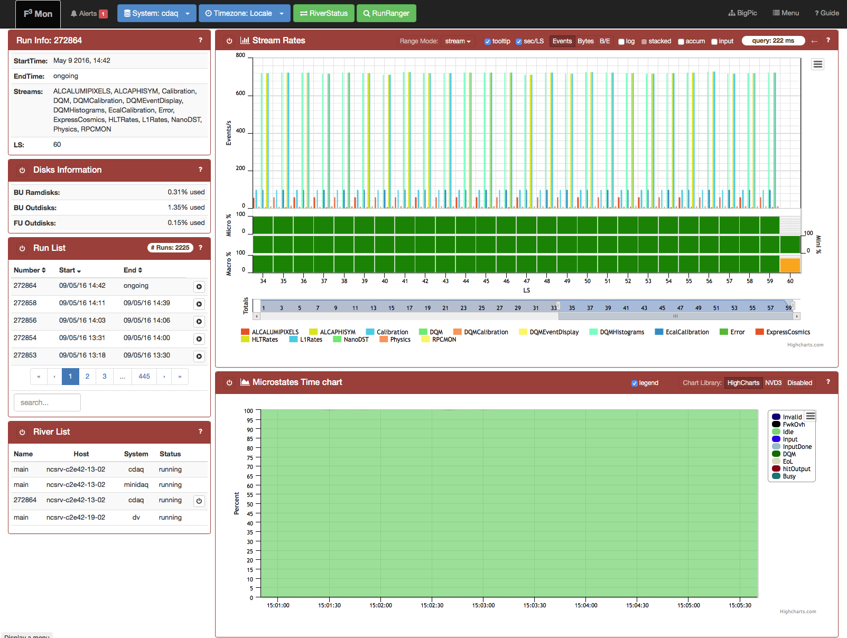
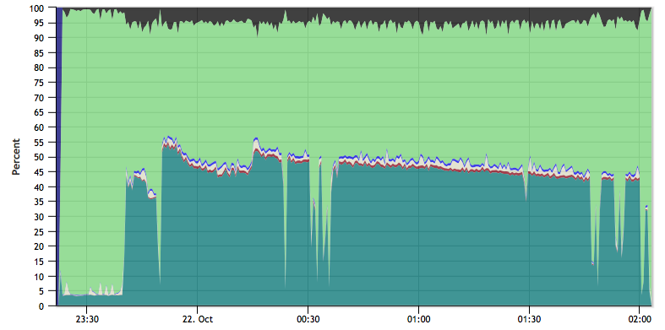
  F3 Mon http://es-cdaq.cms/f3mon
Errors from HLT
Both boxes must be green
Confused? Try the guide!
Active run
Stream rates vs LS
Completeness of data
Error events!
List of recent runs
Stream names
(click to hide them)
Access old runs
Time chart of HLT activity
  Animated introduction available at http://cmsdaqfff/prod/doc/presentation/

Slide 28
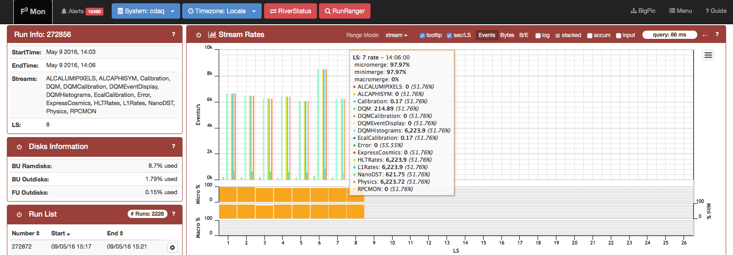
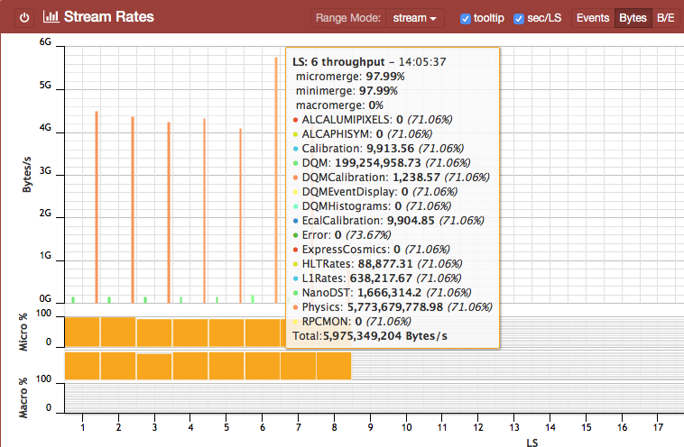
F3 Mon – Bad Situation
Many alerts
Huge rate
Merging incomplete
(color is not green)
>5GB/s output
FFF output bandwidth is too high
➔ HLT is accepting too many events
➔ Check with trigger shifter for high
L1 rates or call HLT DOC

Slide 29
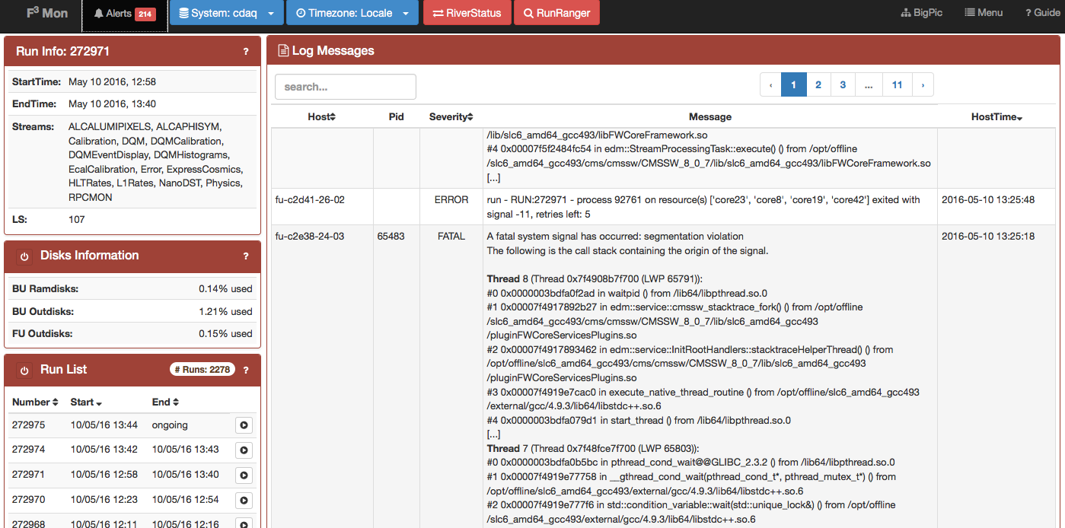
F3 Mon – Alerts Panel
Click here to open alerts panel

Slide 30
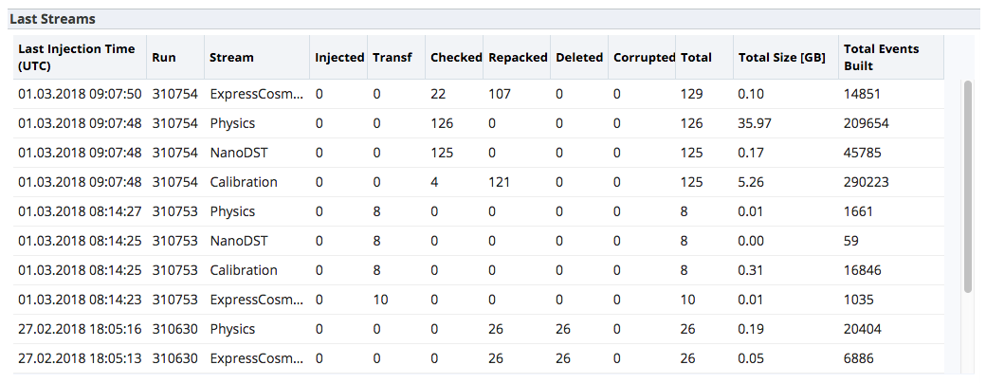
Storage Manager Page 1 https://cmsonline.cern.ch/webcenter/portal/cmsonline/pages_common/storagemanager
Gives an overview of the data transfer to tier 0 for recent runs
  Number of files, sizes and event rates per stream
  Totals per run
Check that files are injected, transferred and checked
  Suspicious values are color coded
  in case of problems: make an elog entry and send an email to cms-storagemanager-alerting@cern.ch

Slide 31
Central
Partition
Manager

Slide 32
TCDS
Combines the pre-LS1:
  Trigger Control System (TCS)
  The conductor of all CMS triggering and data-taking
  Trigger Timing and Control (TTC)
  The distributor of clock, L1As, and synchronisation signals
  Trigger Throttling System (TTS)
  The feedback of readiness states from FEDs to TCS
Many-legged creature:
  The ‘head’ is the Central Partition Manager (controlled by central DAQ)
  Many different legs (i.e., partitions) across the different subsystems (controlled by the subsystems)

Slide 33
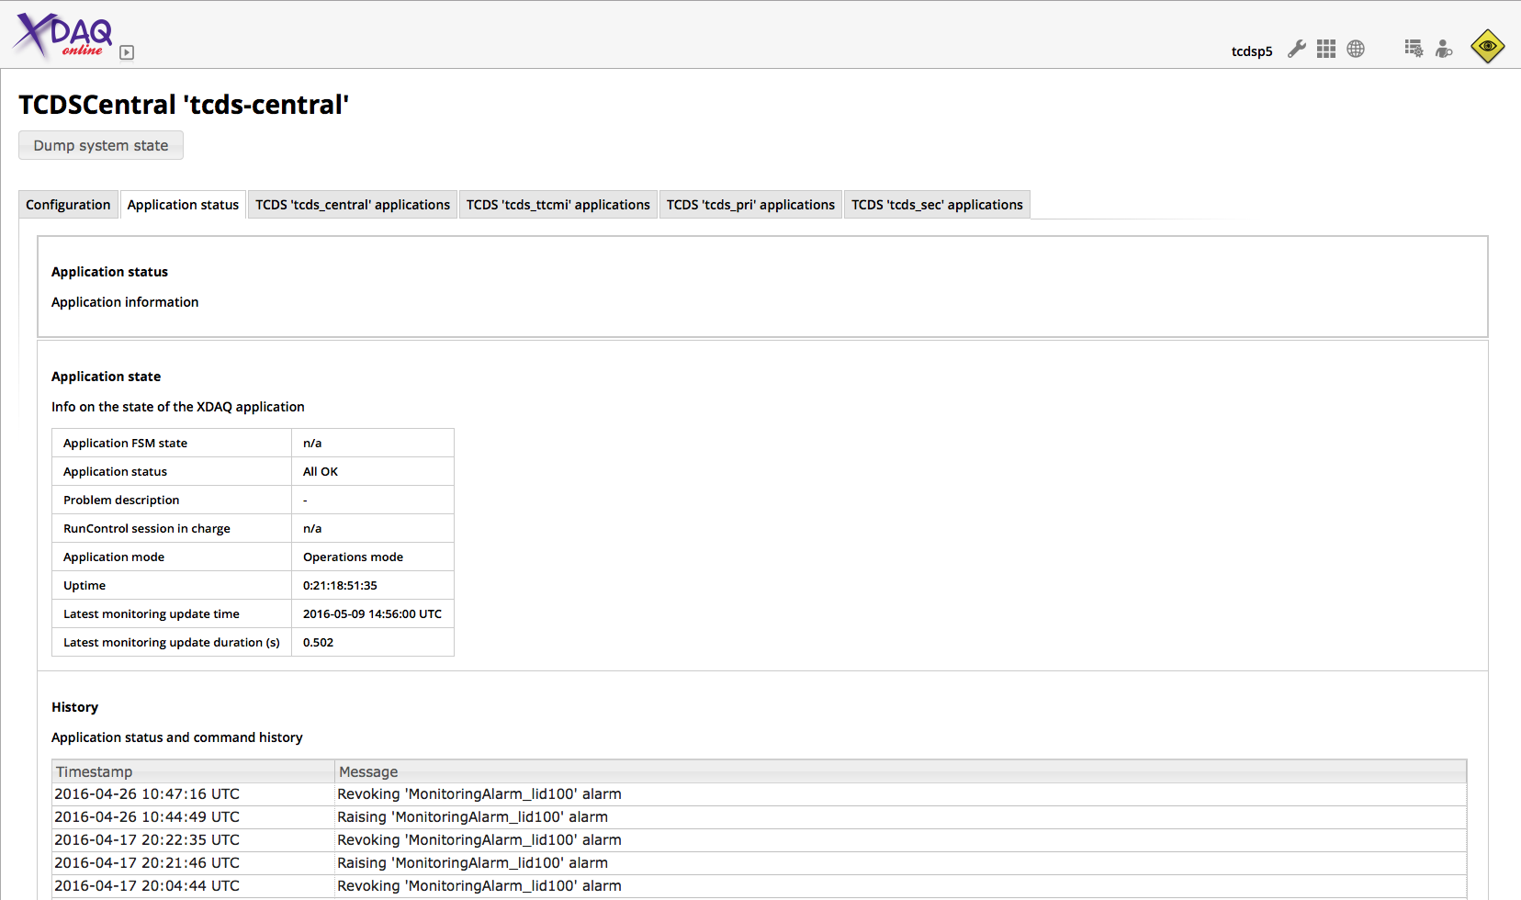

TCDSCentral http://tcds-control-central.cms:2000/urn:xdaq-application:lid=100

Slide 34
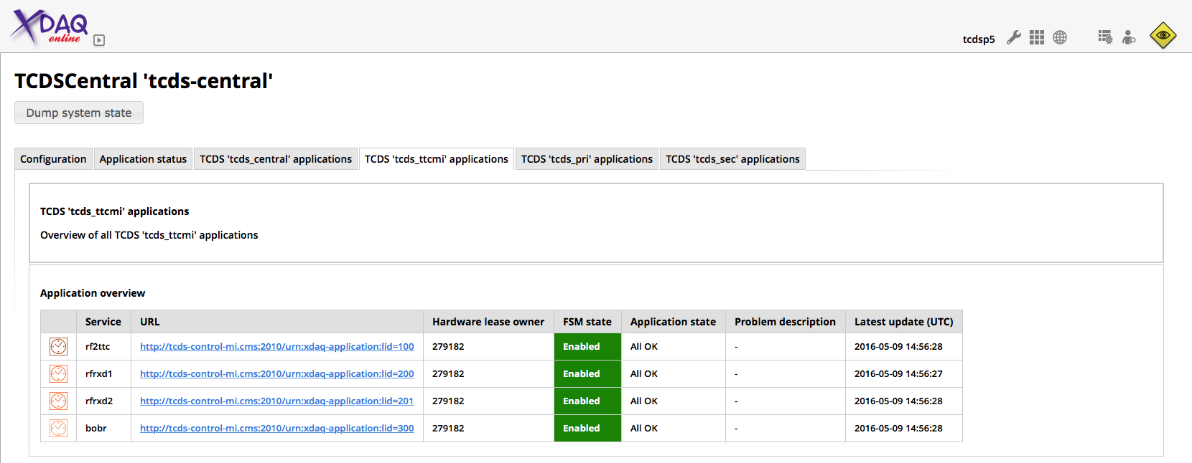
TCDSCentral http://tcds-control-central.cms:2000/urn:xdaq-application:lid=100
TTC machine interface applications
Provide the connection between the LHC RF and timing signals and CMS.

Slide 35
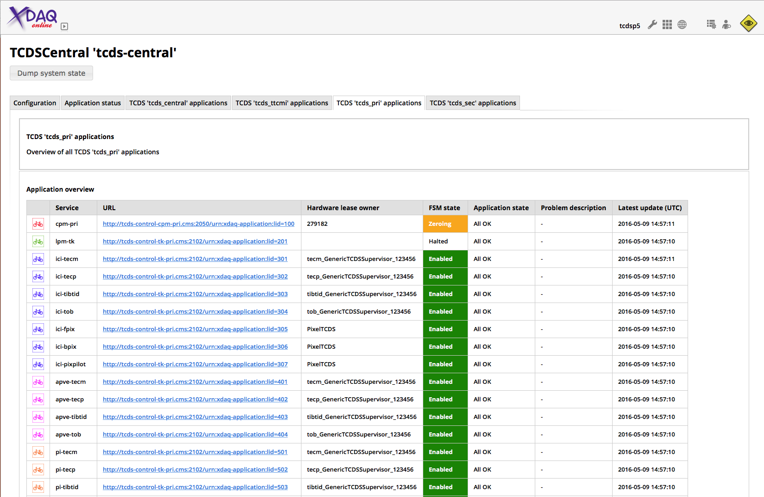
TCDSCentral http://tcds-control-central.cms:2000/urn:xdaq-application:lid=100
Central Partition Manager (CPM)
Drives CMS. Controls triggers, calibration sequence, timing and synchronisation, …
This application should tell you what and how many triggers are flowing,
or why not.

Slide 36
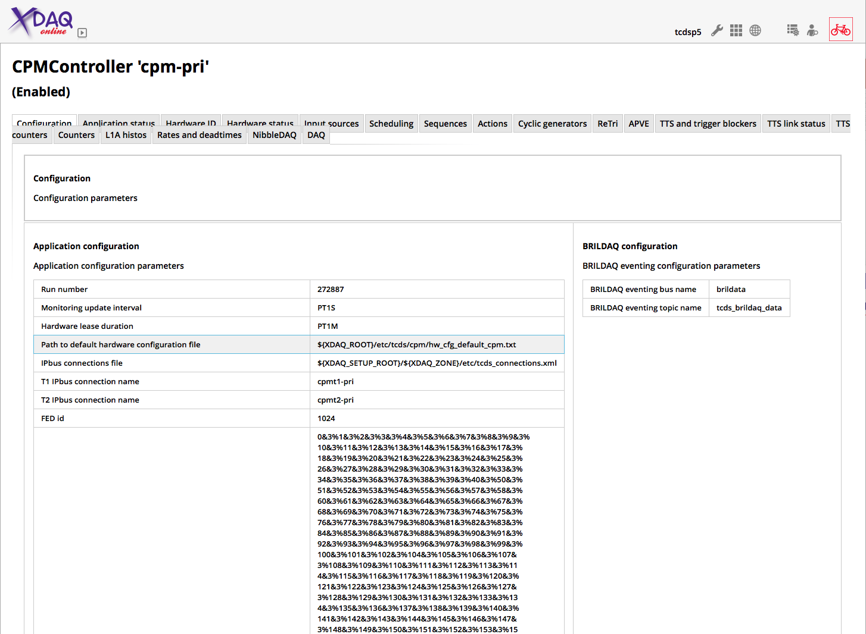
CPMController http://tcds-control-cpm-pri.cms:2050/urn:xdaq-application:lid=100

Slide 37
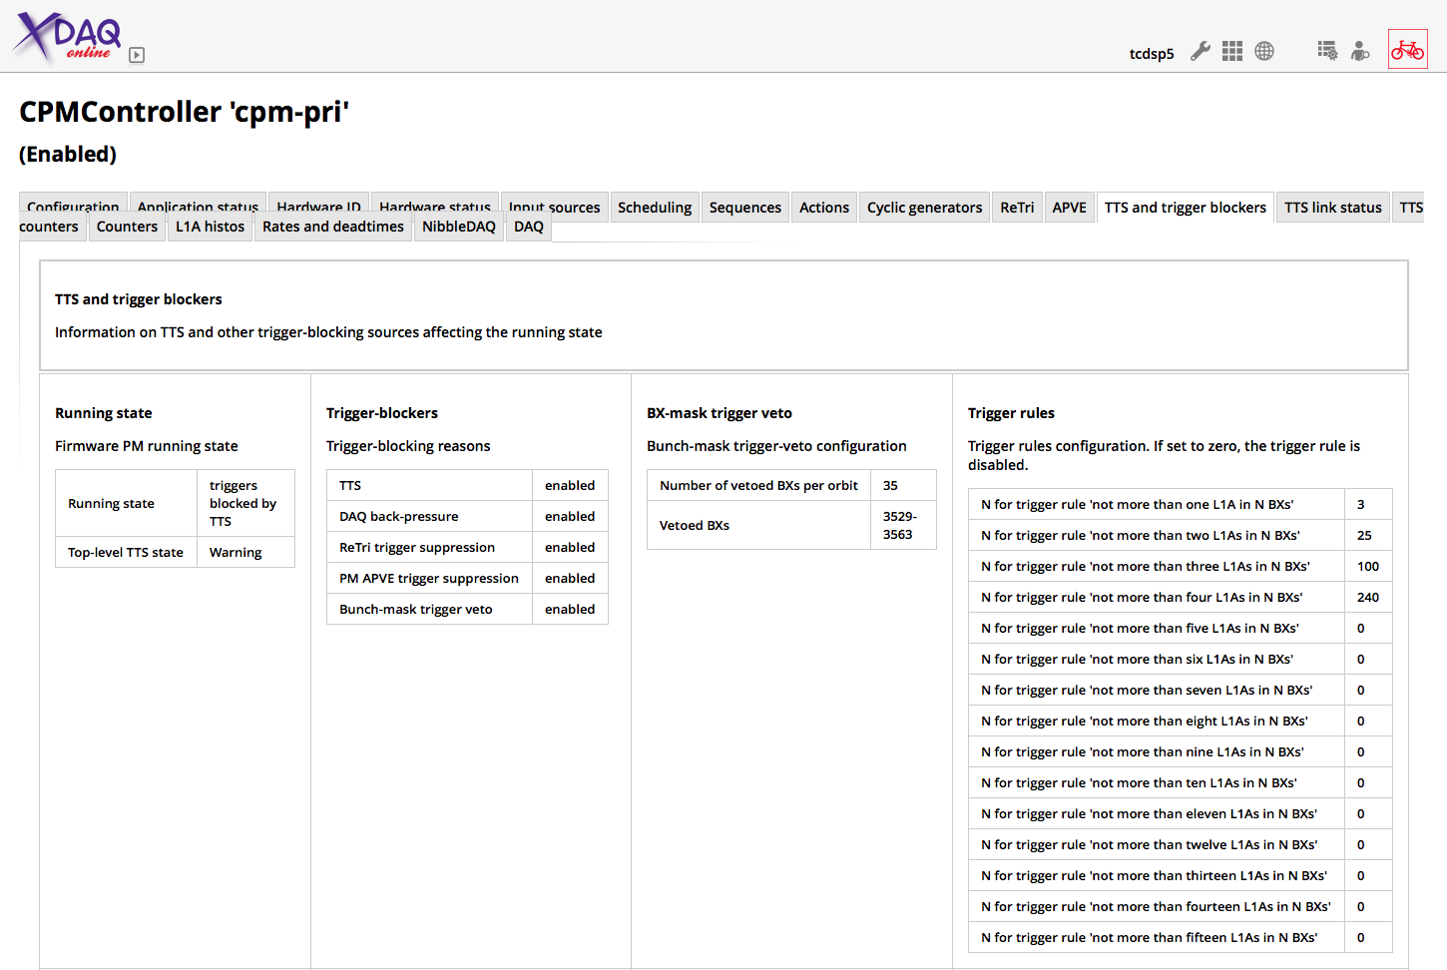
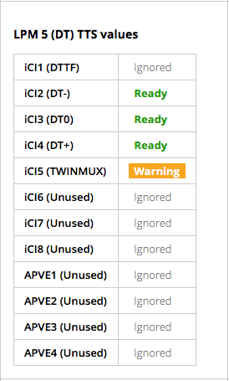
CPMController http://tcds-control-cpm-pri.cms:2050/urn:xdaq-application:lid=100
TTS and trigger blockers tab
Running state shows if triggers are flowing or why not:
Stopped
Running
Blocked by TTS
Blocked by DAQ backpressure
etc.

Slide 38
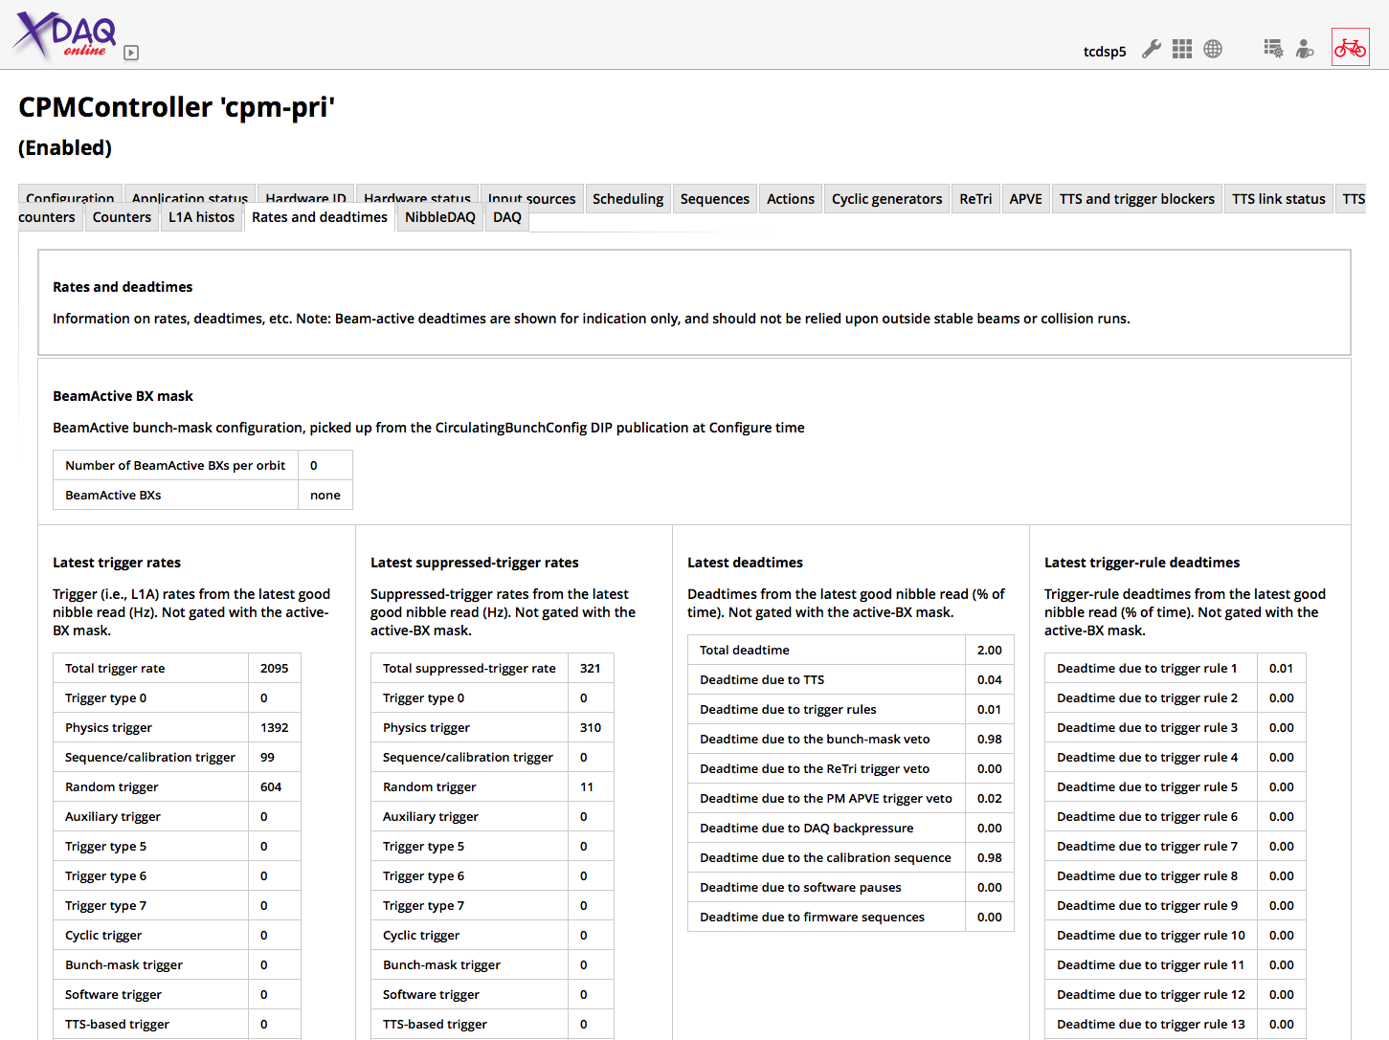
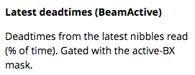
CPMController http://tcds-control-cpm-pri.cms:2050/urn:xdaq-application:lid=100
Rates and deadtimes tab
This tab shows:
What rate of triggers are flowing, per type
What rate of triggers are being suppressed, per type
What the deadtime is, per source
How much time each partition spends in TTS not-READY (at the bottom)
Dead times are shown twice
Averaged over all bunch crossings
Averaged over bunch crossings where collisions happen
(BeamActive)

Slide 39
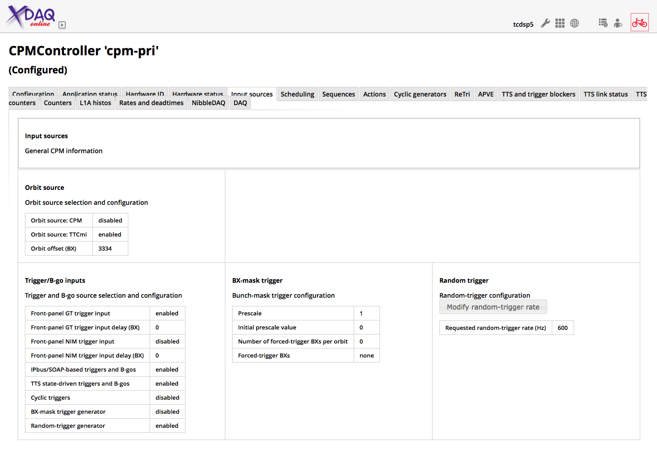
CPMController http://tcds-control-cpm-pri.cms:2050/urn:xdaq-application:lid=100
Input Sources
Click here to change the random trigger rate

Slide 40
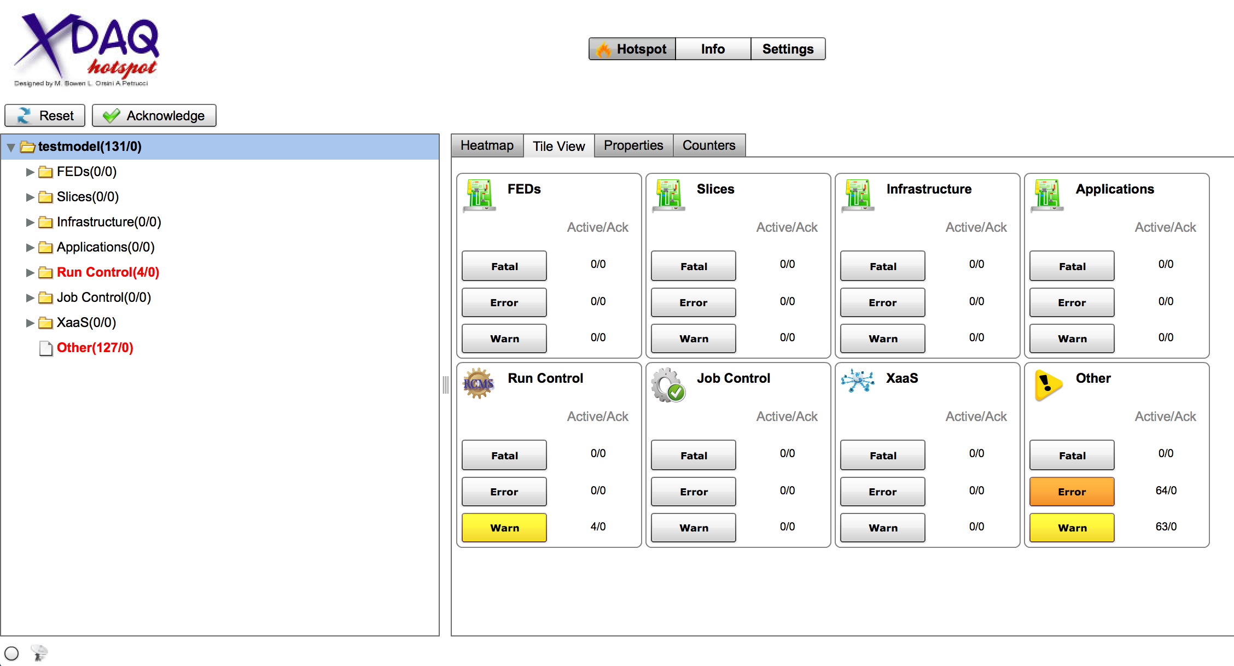
HotSpot https://xdaq.web.cern.ch/xdaq/xmas/14/hotspot/hotspot.swf
Check regularly for Errors or Fatal by clicking on corresponding button
Make sure that it updates (pulsates)

Slide 41
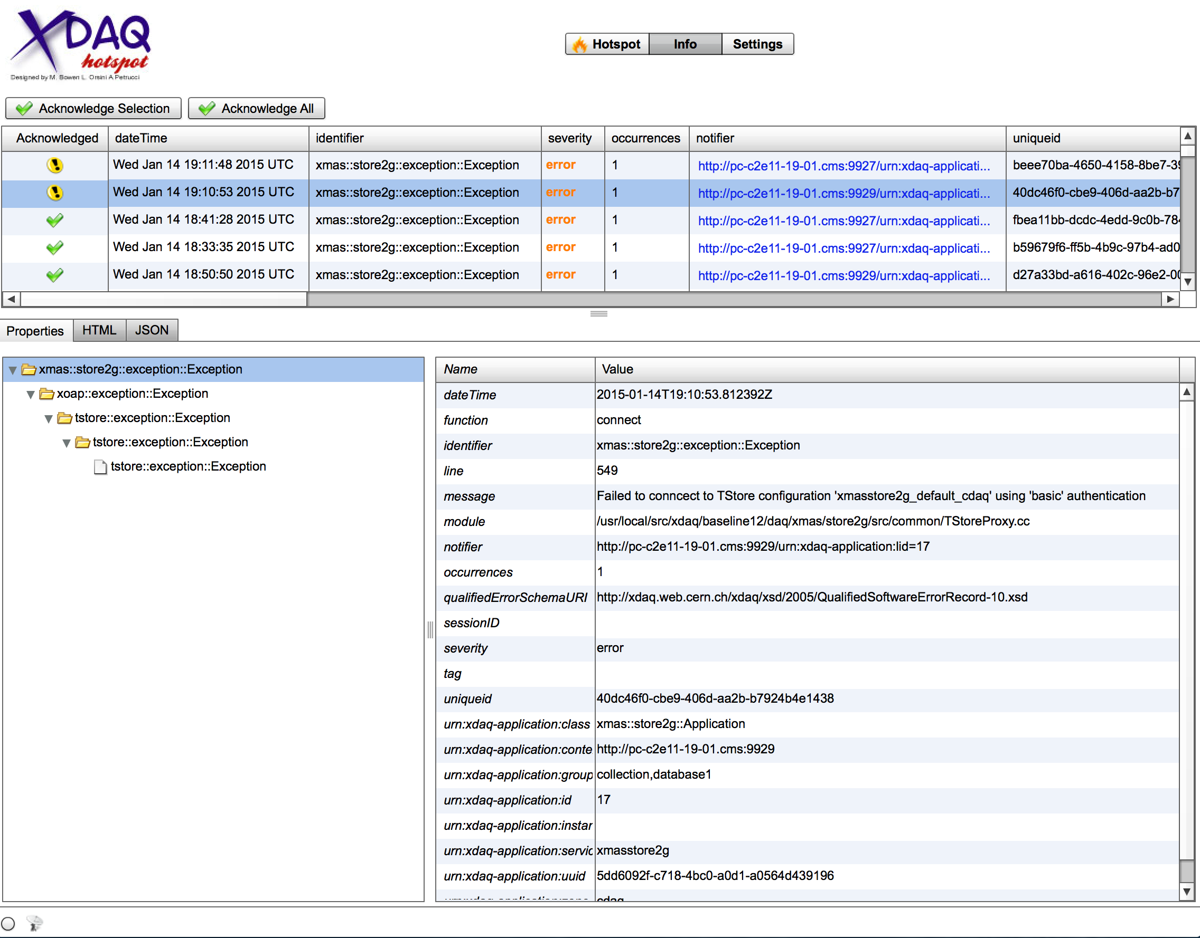
HotSpot
Click on error
Acknowledge understood errors
You can use HTML to copy it into the elog
Analyze the error and take appropriate action

Slide 42
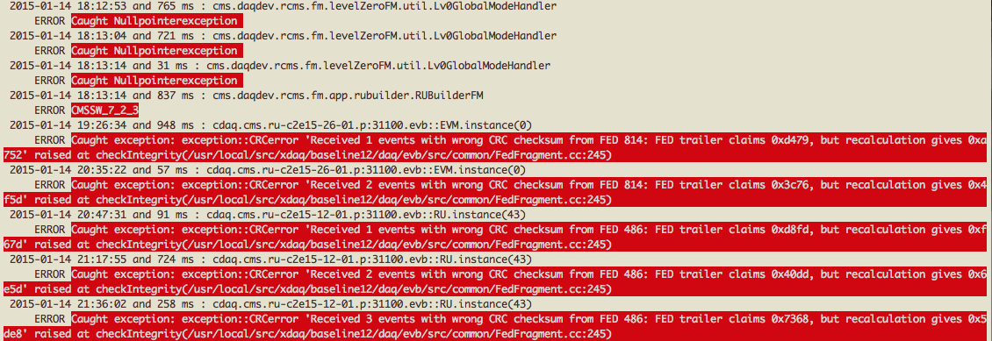
Handsaw
Running in a terminal on the shifter console
  You need an account in the online cluster to start it
Scrolling display of error messages from DAQ
  All messages (and more) are in HotSpot or LVL0
  Handsaw is often quicker to find the most relevant message

Slide 43
What to do if it does not work
Don’t panic! Keep cool.
  Not always easy, especially during stable beams
  Think before clicking!
  GUIs are sometimes slow in reacting. Be patient…
Look at what the DAQ expert application suggests
  suggestions are a superset of the ‘DAQ stuck’ flow chart
Look for error messages (LVL0, HotSpot, Handsaw)
Look at DAQView for anything suspicious
  Figure out what subsystem is causing problems
  Be aware that one subsystem might get backpressure from DAQ due to other issues
Talk to the shift leader and other shifters
  They might be aware of problems affecting DAQ
  E.g. if a subsystem lost power, DAQ will go into error
  (you might be the first to realize it!)
If you are unsure or stuck, do not hesitate to call the DAQ oncall anytime (76600)

Slide 44
Happy Shifting…
Thank you for your attention

