Slide 1
ARIES TASK 15.4
Progress report 16.3.2018
Oliver Kugeler

Slide 2
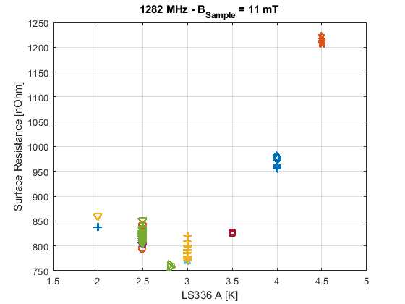
QPR development
Discrepancy between values obtained in pulsed and CW operation
Reason for this behavior is presently analyzed by S. Keckert and will be published in his thesis
CW
Pulsed op.

Slide 3
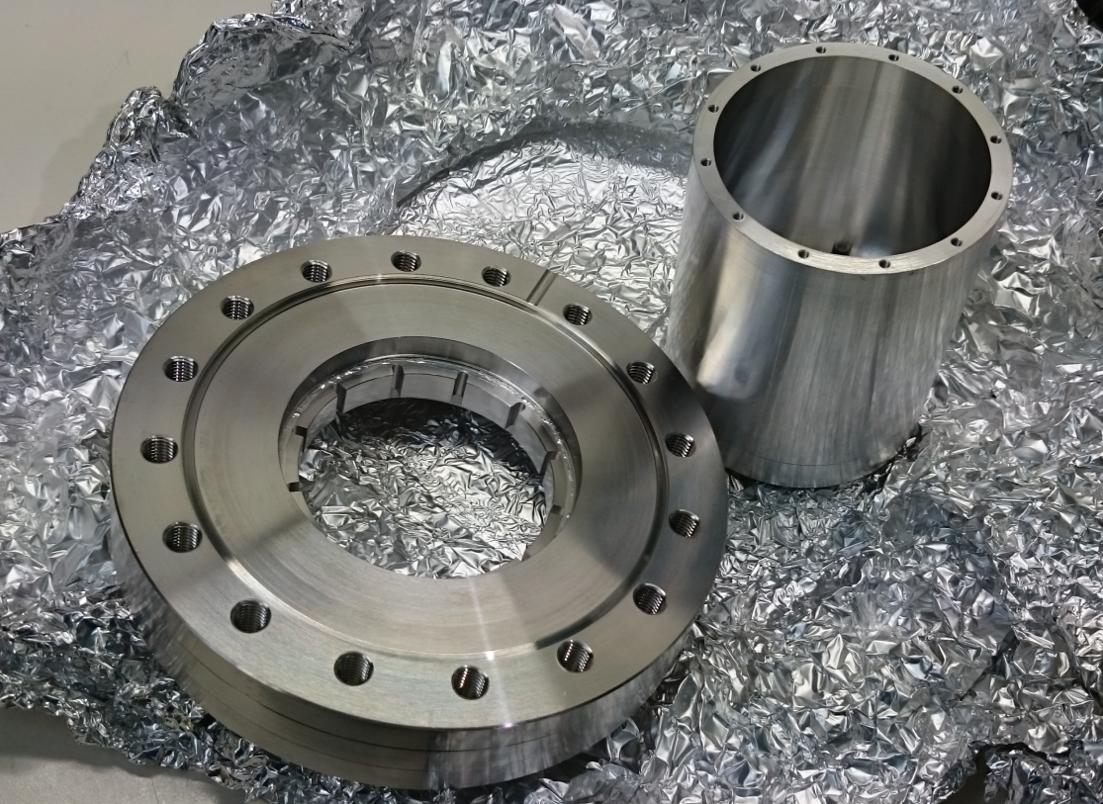
QPR development
sample mount
Problem:
RF penetrates down
to flange and heats up
stainless steel parts
sample cylinder
Base flange

Slide 4
Solutions
sample mount
Problem:
RF penetrates down
to flange and heats up
stainless steel parts
Solution1:
Coat exposed SS areas
with copper
(Workshop)
sample cylinder
Solution2:
Coat exposed SS areas
with niobium
(Jlab)
Base flange
Solution3:
Make flange from NbTi
(ordered at Heraeeuss,
fabricated in-house)

Slide 5
Personnel
Sebastian Keckert finishing up his PhD thesis
Tobias Junginger helping with debugging QPR -> left HZB for STFC
Marie-Curie EASITRAIN ESR fellow Dmitry Tikhonov started working on QPR on March 1st
Knowledge transfer Keckert - > Tikhonov initiated
Tikhonov to reactivate the development of detachable samples

Slide 6
Collaborative activities
Meeting on 14.3.2017 with CERN QPR group (Walter Venturini and Marco Arzeo) to discuss QPR performance issues
Comparison of baseline performance:
Both resonators exhibit poor performance at the 3rd harmonic
R_res baseline too high (100 nOhm instead of ~5 nOhm)
temperature dependence unphysical
Decision to intensify collaboration and mutually take part in each other‘s measurement run
CERN commissioning of 2nd QPR in April envisioned

Slide 7
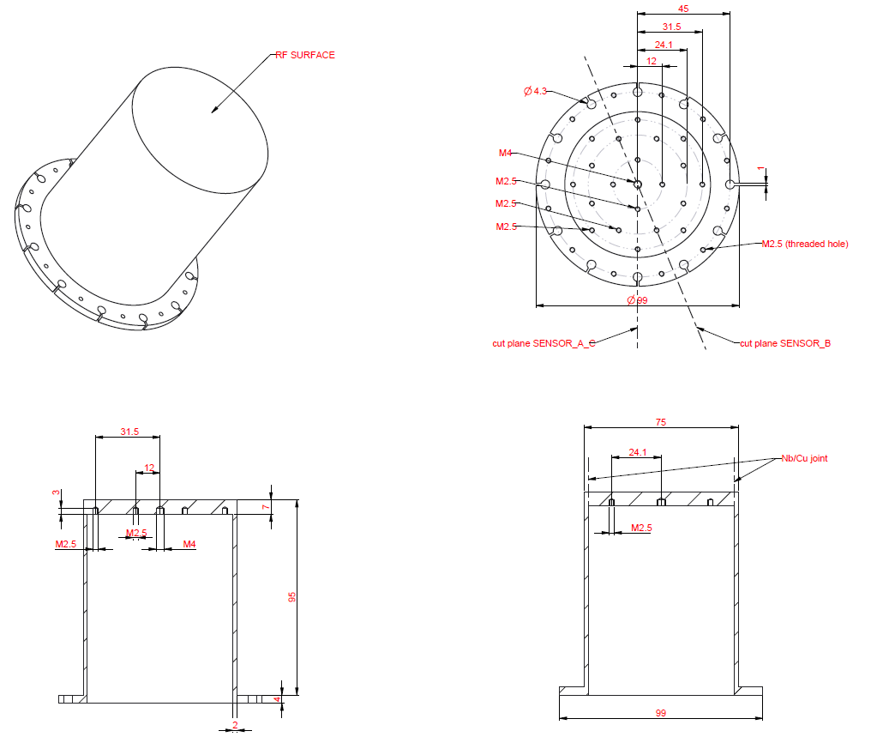
Sample procurement
Position 1: Nb high RRR sample
Quantity: 1, optional 5
Material: Niobium, RRR 300, fine-grain
Optional surface treatment: 150 µm bulk-BCP, 800 °C bake-out, flash-BCP
BCP may be replaced (even partially) by EP
Position 2: Nb/Cu sample
Quantity: 1, optional 5
Material:
- bottom part and cylindrical part (full height): Niobium, RRR 300, fine-grain
- inner part of sample disk (diameter 71 mm): OFHC copper, optional 5N-Cu
The joint between niobium and copper is also marked in the drawing.
Optional surface treatment: 150 µm bulk-BCP, 800 °C bake-out, flash-BCP
BCP may be replaced (even partially) by EP

Slide 8
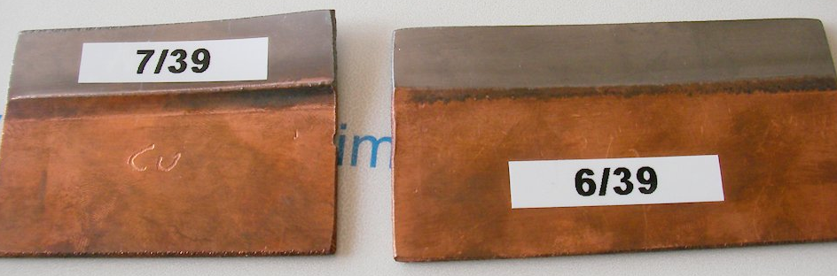
Sample procurement - Offers
16 | Zanon | Niowave | Research Instruments
1 Nb sample |  | $ 14000
5 Nb samples |  | $ 42000
1 Cu/Nb sample |  | $ 14000
5 Cu/Nb samples |  | $ 42000
1+1 | 17200 € | $ 28000 | 16900 €
5+5 | 47600 € | $ 84000 | 46100 €
winner
Dmitry Tikhonov will supervise the
Manufacture as part of his EASITRAIN
related industry secondment at RI
Copper/Nb welds by Zanon

