Slide 1
Interfacing Geant4/Garfield++ and Geant4/Degrad
A step by step introduction
RD51 collaboration meeting Munich
19.06.2018
Carlos Azevedo, I3N - Physics Department, University of Aveiro
Lennert de Keukeleere, IKS KU Leuven
Dorothea Pfeiffer, European Spallation Source ERIC

Slide 2
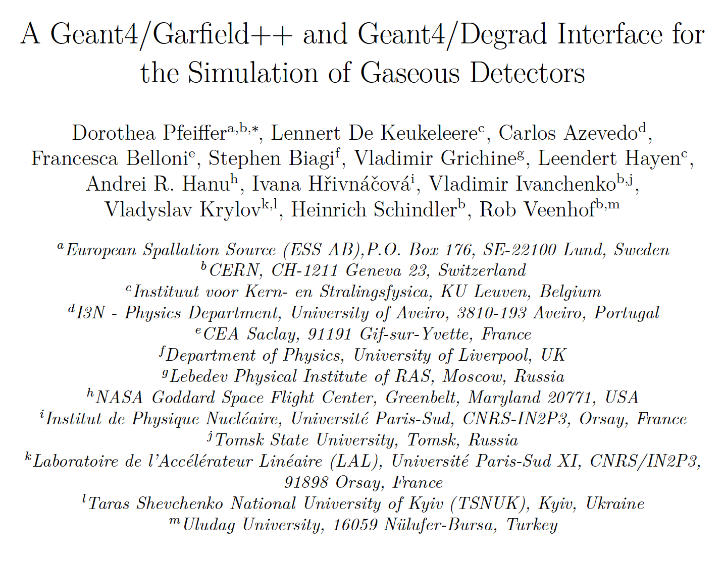
Interface paper
Contains model verification and source examples,
submitted to NIM A: https://arxiv.org/abs/1806.05880

Slide 3
Task division between Geant4 and Garfield++/Degrad

Slide 4
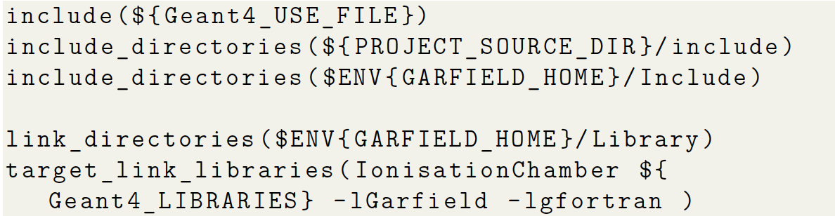
Geant4/Garfield++ interface
Geant4 and Garfield++ are used in the same user C++ program
Garfield++ includes are added to the CMakeList.txt file
User program is linked against Geant4 and Garfield++ libraries

Slide 5
Geant4 parameters: Lower production cut and lowest electron energy
Lowest electron energy limit:
Energy threshold below which an electron
is not tracked anymore. If the kinetic energy
of an electron falls below the lowest electron
energy limit value during a step, the full
energy deposition independently of
material is enforced.
PAI model: Mean number of
electron-ion pairs produced by
10 keV electron in a very large
volume of He/isoButane 70/30.
Variance of electron-ion pair
distribution
Lower production cut:
Minimum energy transfer required to produce
a new particle. If the transferred
energy is lower than the lower production cut,
the energy is merely recorded as being deposited
in the step.

Slide 6
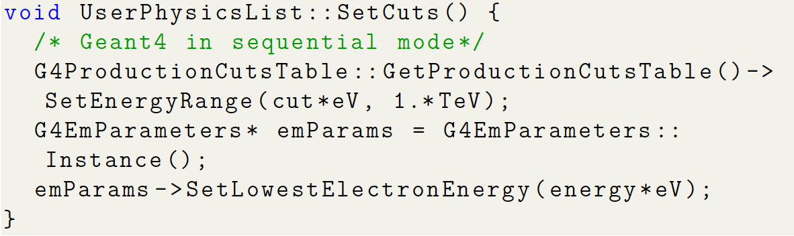
Physics list: SetCuts()
Lower production cut and lowest electron energy have to be set in SetCut() method of physics list
If PAI model is used, parameters are of crucial importance to create enough electron-ion pairs
Deposited energy is not influenced!
Correct values depend on the gas mixture
Paper gives guidelines how to determine the correct values

Slide 7
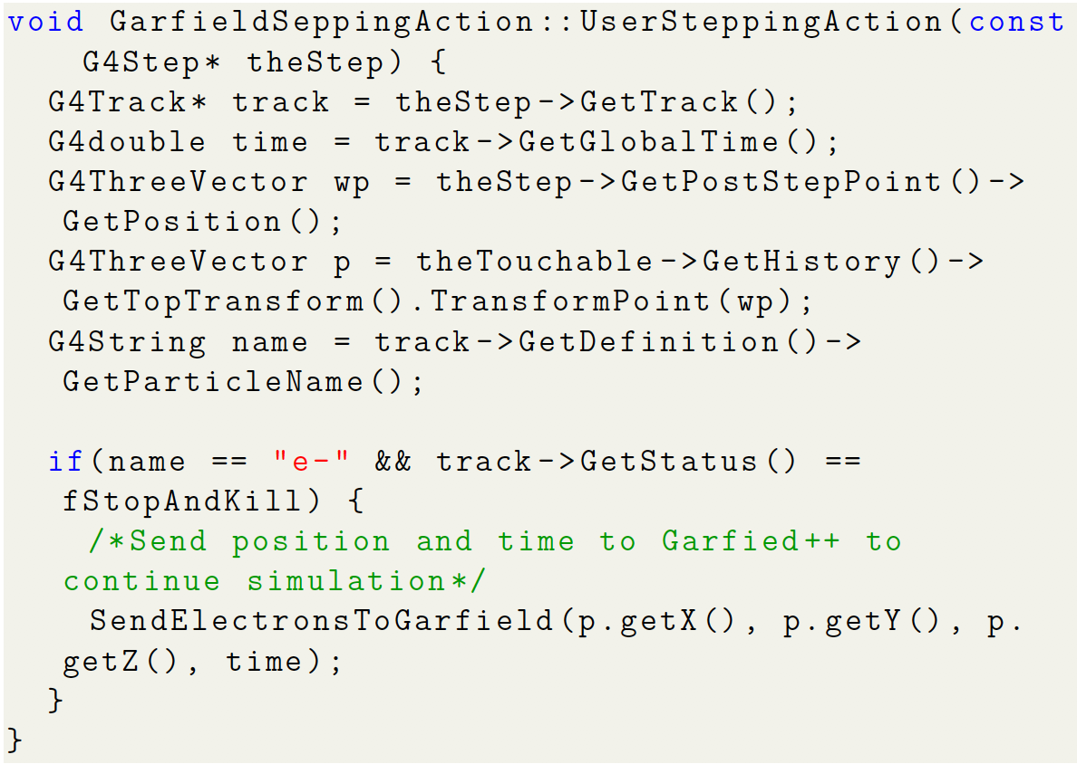
Case A: Geant4 only for creation of electron-ion pairs

Slide 8
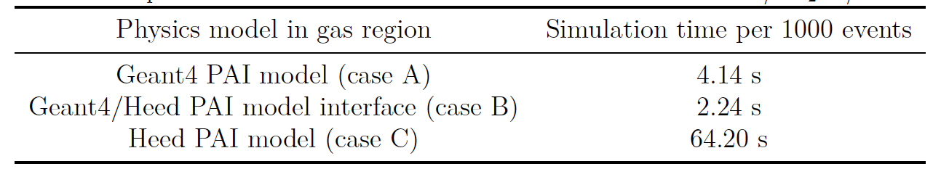
Performance of different options for creation of electron-ion pairs
Comparison of simulation times for 10⁵ 1 GeV electrons in 1 cm of Ar/CO2 70/30
Most efficient way of interfacing is to use Geant4 PAI model in conjunction with the Heed PAI model

Slide 9
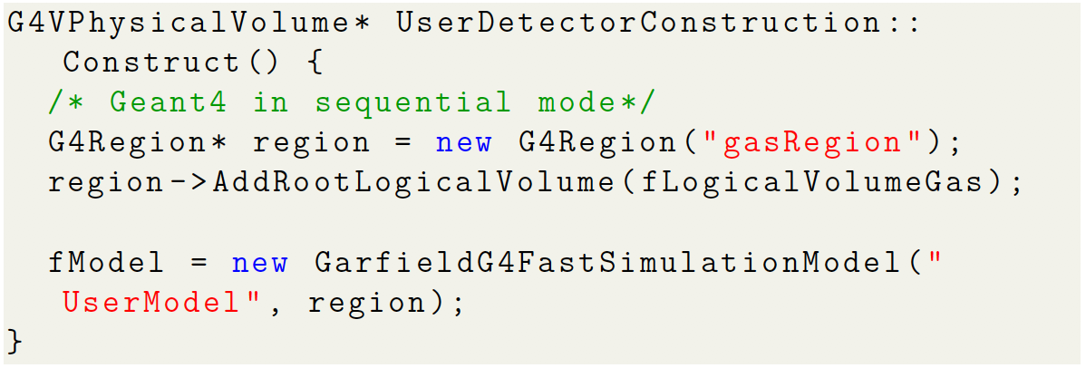
Case B – D: Heed responsible for creation of electron-ion pairs
Geant4 has parametrization feature
G4VFastSimulationModels can be used as alternative to the Geant4 physics
Definition of a gas region in which the Garfield FastSimulationModel is used

Slide 10
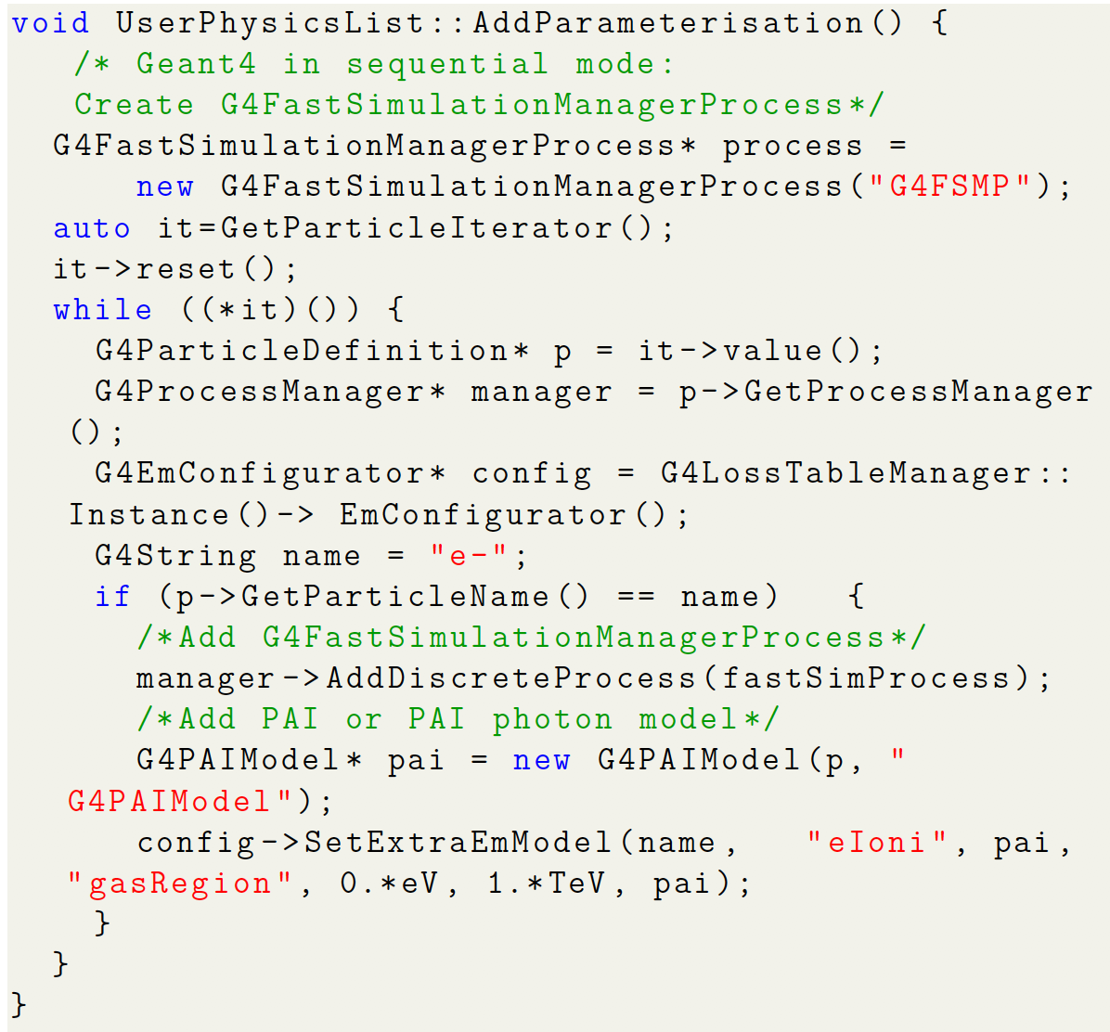
Case B – D: Heed responsible for creation of electron-ion pairs
Parameterisation has to be added to physics list
G4VFastSimulation-ManagerProcess has to be defined to trigger the FastSimulationModel
For charged particles, PAI model has to be activated as extra EM model

Slide 11
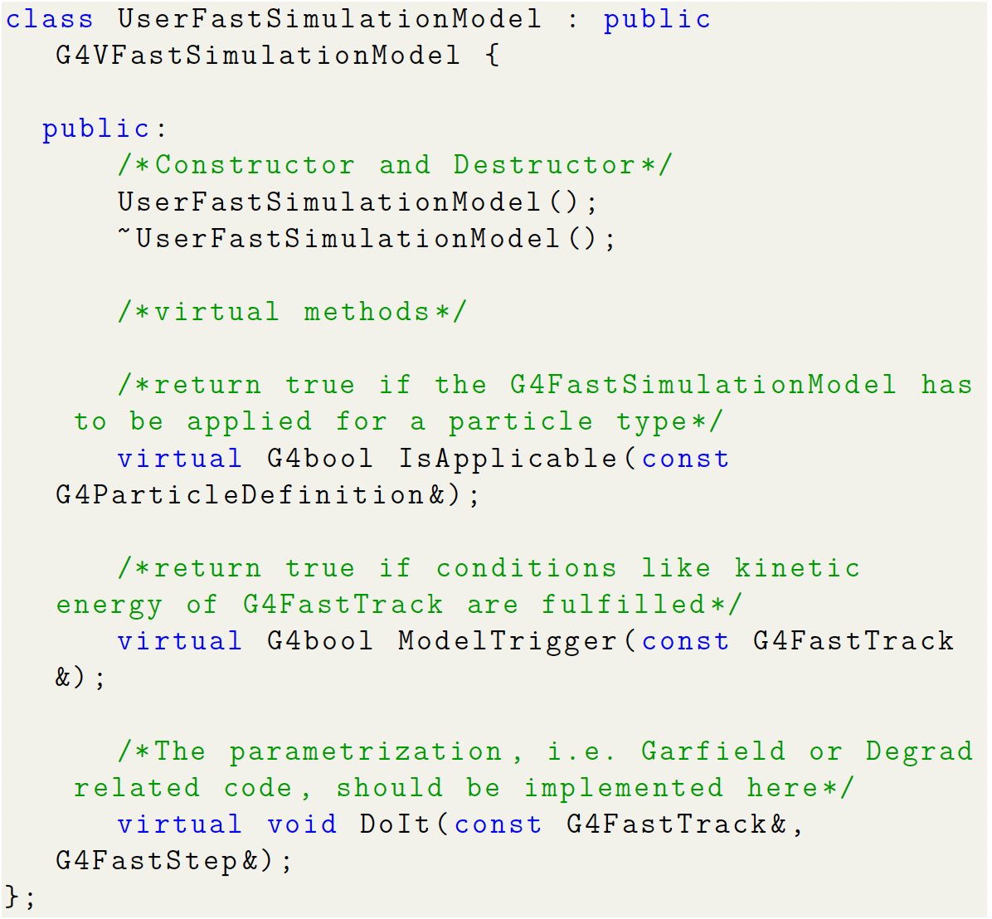
Definition of FastSimulationModel

Slide 12
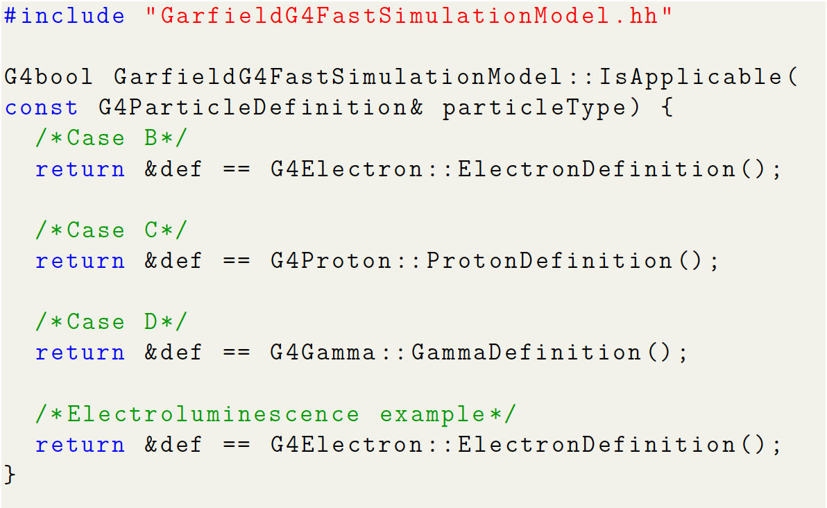
Definition of FastSimulationModel:
IsApplicable()
The FastSimulationModel is applicable for certain particle types

Slide 13
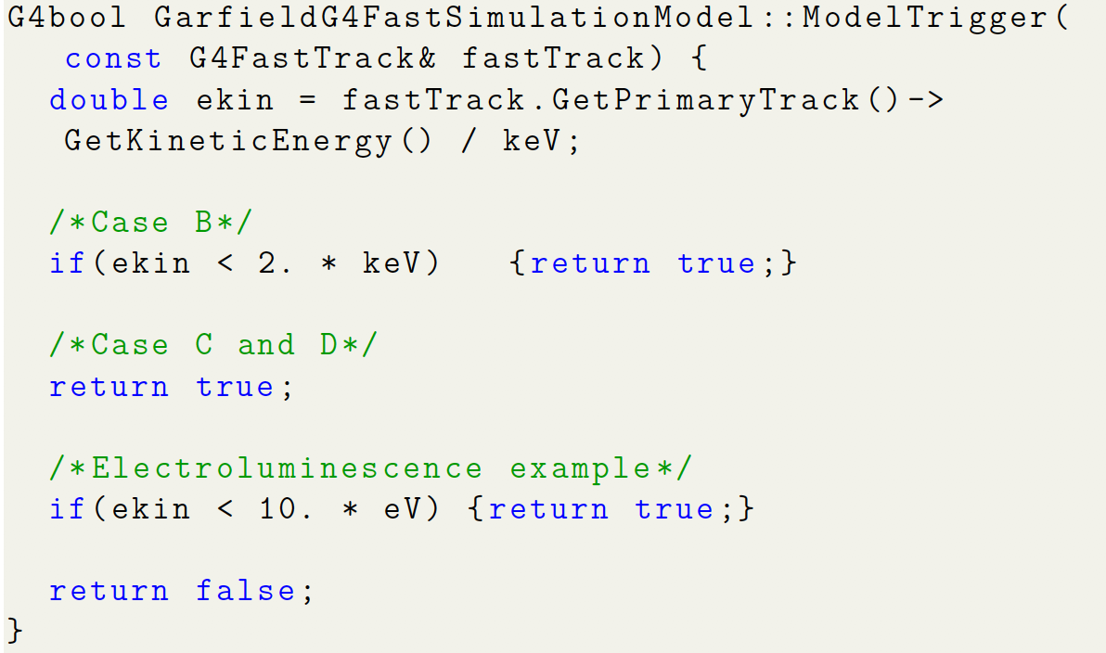
Definition of FastSimulationModel:
ModelTrigger()
The FastSimulationModel is triggered at each step for certain particle energies

Slide 14
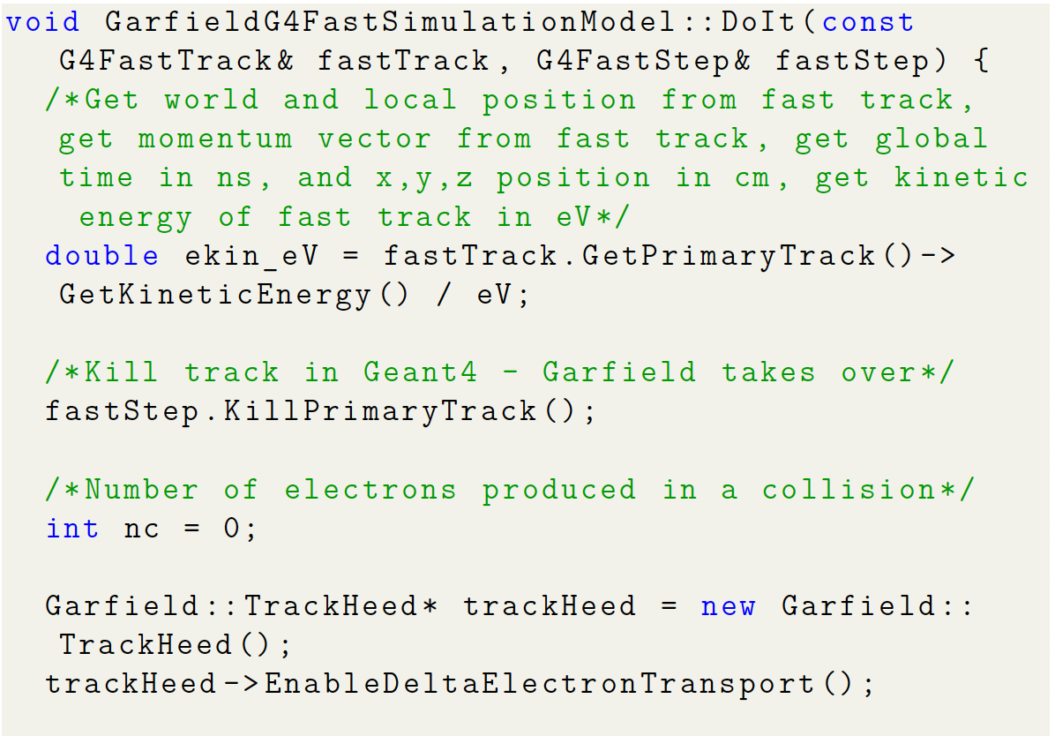
Definition of FastSimulationModel:
DoIt()
The primary particle in Geant4 is killed
Heed track is created

Slide 15
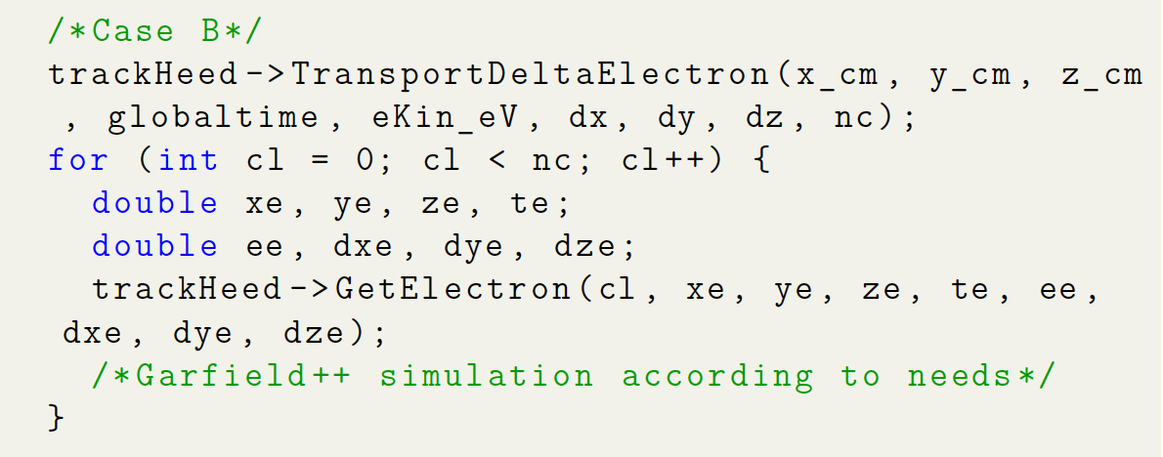
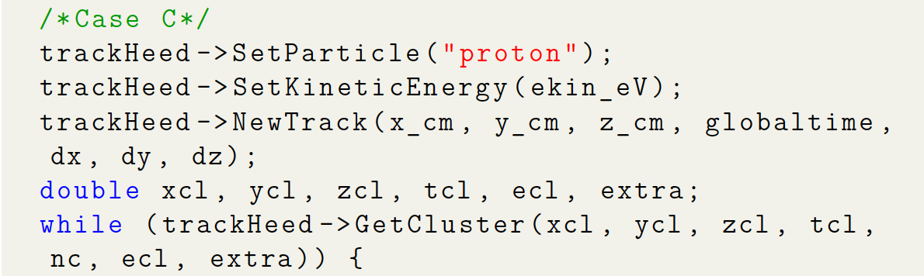
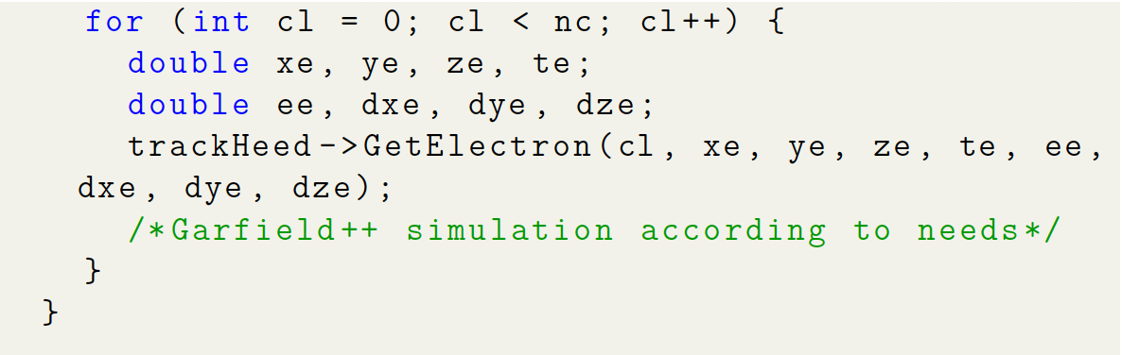
Definition of FastSimulationModel:
DoIt()
For electrons, Heed TransportDeltaElectron is used
The produced conduction electrons are retrieved
For charged particles, Heed NewTrack is used
First the clusters, and then the conduction electrons are retrieved

Slide 16
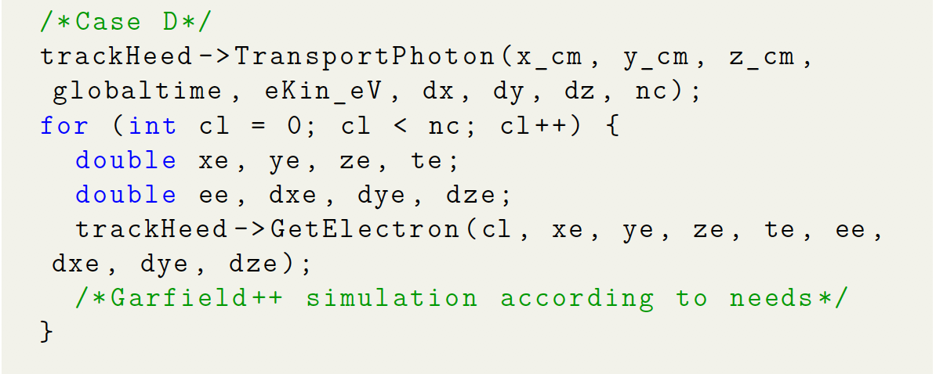
Definition of FastSimulationModel:
DoIt()
For photons, Heed TransportPhoton() is used
The produced conduction electrons are retrieved
With the conduction electrons, the Garfield++ simulation (drift, avalanches, signal creation) is continued as needed

Slide 17
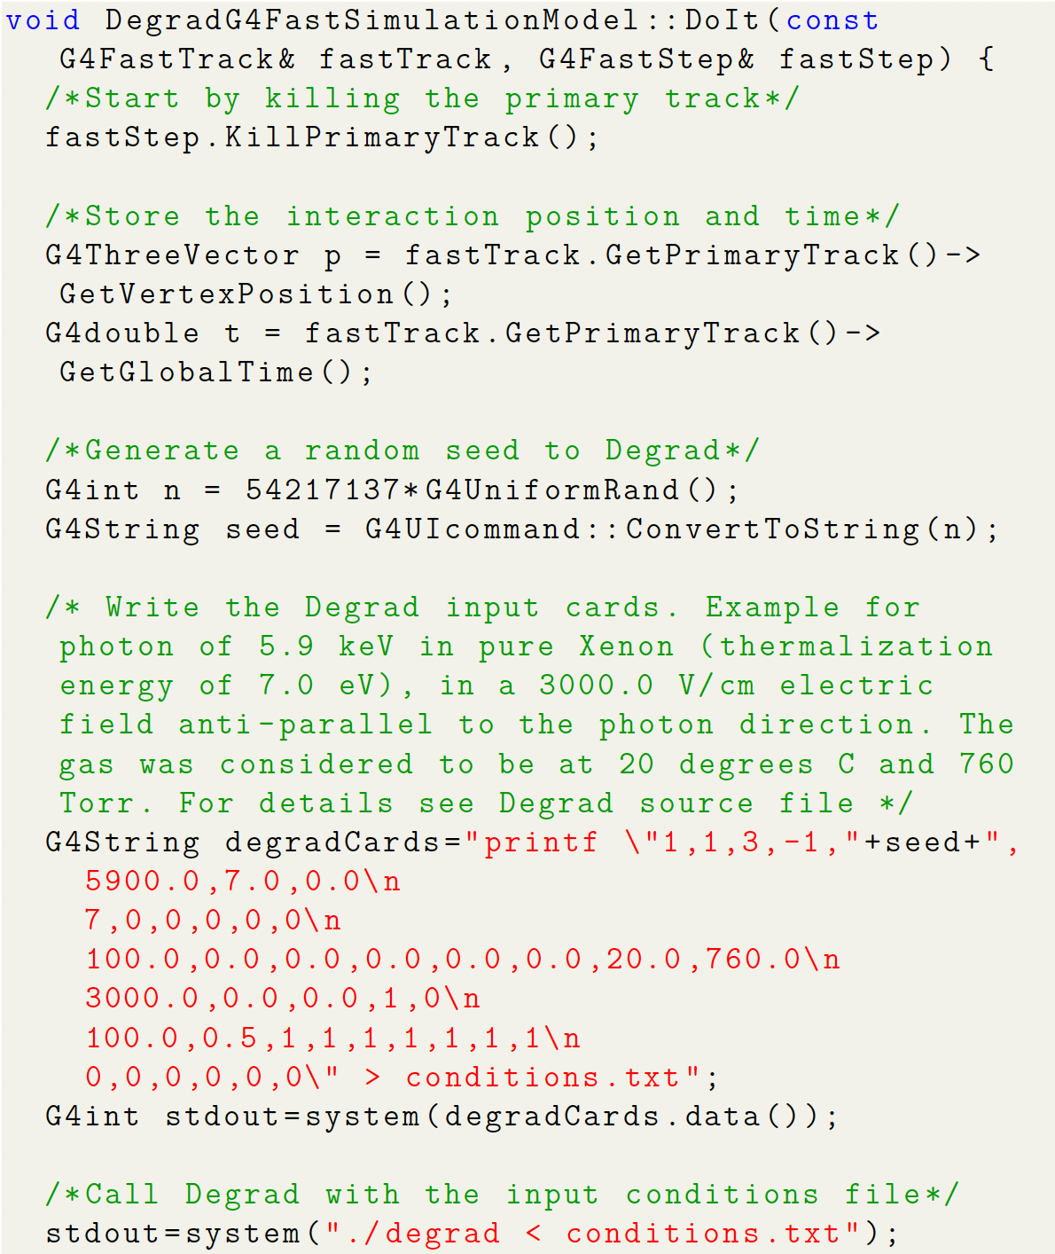
Geant4/Degrad interface:
Electroluminescence example
As before, a FastSimulationModel is defined and attached to a gas region
The model is applicable for electrons with Ekin > 7 eV, produced via the photo-electric effect in Geant4
Degrad is a Fortran program, the easiest way to execute it is to just run it using the system function
The Degrad input cards are fed to Degrad using a pipe

Slide 18
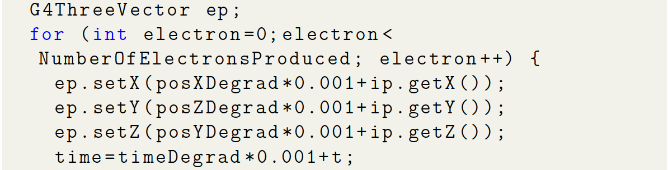
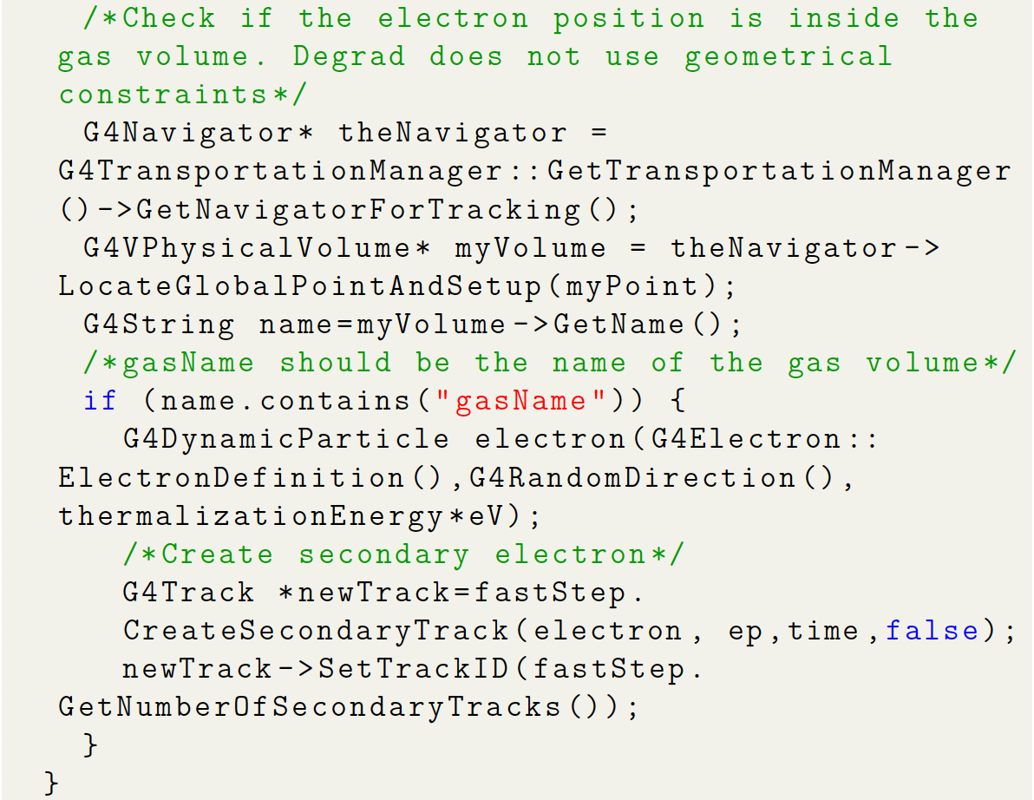
Geant4/Degrad interface:
Electroluminescence example
Degrad write the position and time of the thermalized electrons to a text file
Text file is looped through in Geant4
If position of electron is inside the gas volume (in Degrad the volume is indefinite, hence the check), new secondary electrons are created in Geant4

Slide 19
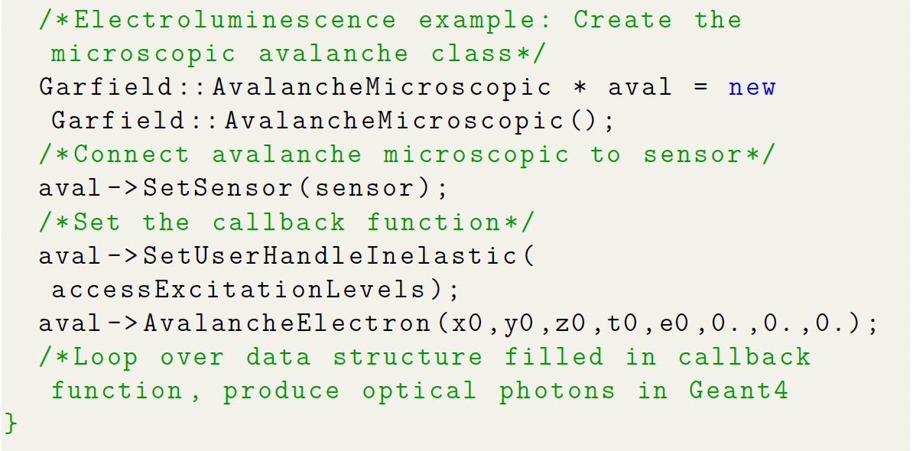
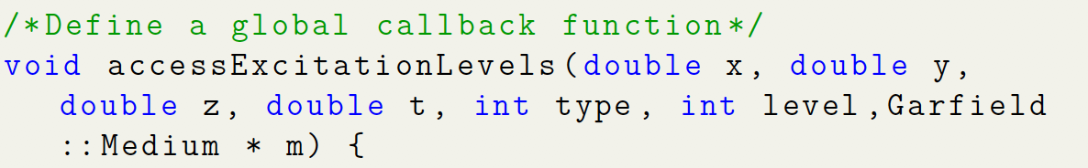
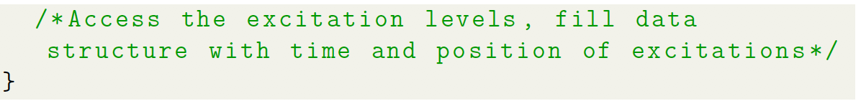
Garfield++ FastSimulationModel: Electroluminescence example
Garfield++ FastSimulationModel is valid for electrons with Ekin < 7 eV (these electrons were just created in the Degrad FastSimulationModel)
AvalancheMicroscopic is used to create an electron avalanche
Callback function is written to access the excitation levels
Time and position of excitations are stored

Slide 20
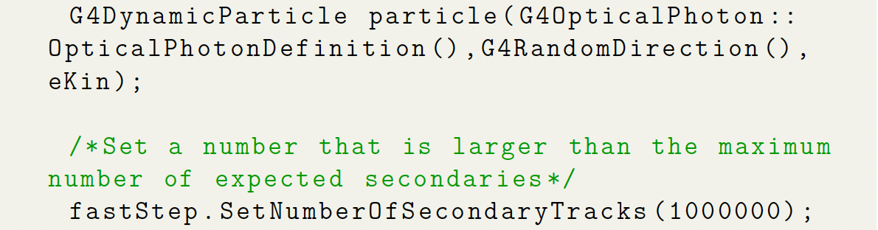
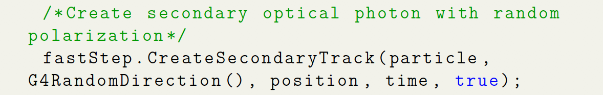
Garfield++ FastSimulationModel: Electroluminescence example
At the stored excitation positions, optical photons are produced in Geant4 as secondary particles in the DoIt() method of the FastSimulationModel

Slide 21
Conclusions
Geant4/Garfield++ and Geant4/Degrad interface works
Depending on the use case, different ways exist to interface the Monte Carlo programs
Paper under review at NIM A
During work on paper, bugs in Heed C++ implementation detected and corrected
Possibility to create a Heed like physics process in Geant4 should be investigated Geant4 collaboration to further facilitate the simulations

