Slide 1
Modification of the shielded beam screen design & misalignment analysis
M. Morrone, C. Garion
TE/VSC
HL-LHC TCC, 8th March 2018

Slide 2
Outline
Concept
Behaviour during quench
Main modifications of the beam screens due to CLIQ
Misalignment effects of the beam screen in the cold bore
Conclusions

Slide 3
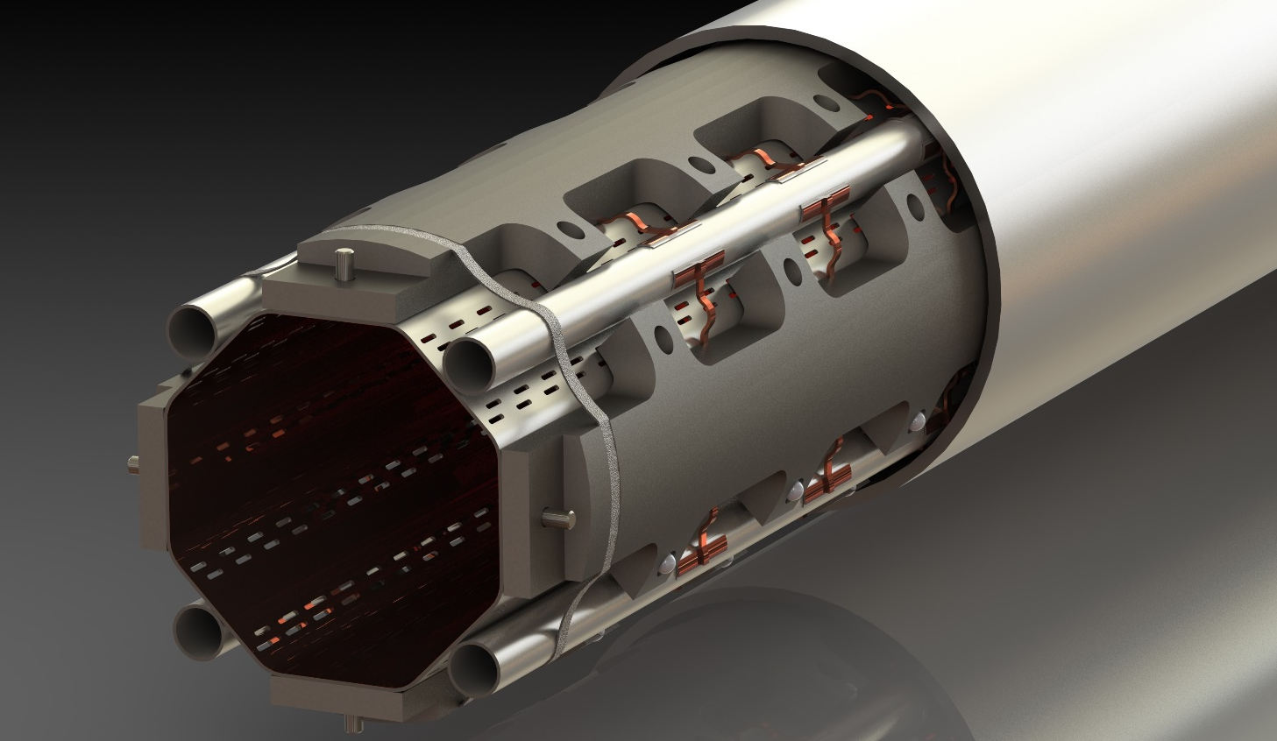
Concept
Beam screen tube (BS) at 60-75 K:
Perforated tube (~2%) in High Mn High N stainless steel (1740 l/s/m (H2 at 50K))
Internal copper layer (75 μm) for impedance
a-C coating (as a baseline) for e- cloud mitigation
Laser treatments under investigation
Thermal links:
In copper
Connected to the absorbers and the cooling tubes or beam screen tube
Cold bore (CB) at 1.9 K:
4 mm thick tube in 316LN
Elastic supporting system:
Low heat leak to the cold bore
tube at 1.9K. Ceramic ball with
titanium spring
Tungsten alloy blocks:
Chemical composition: 95% W, ~3.5% Ni, ~ 1.5% Cu
Mechanically connected to the beam screen tube: positioned with pins and titanium elastic rings
Heat load: 15-25 W/m
40 cm long
Cooling tube:
Outer Diameter: 10 or 16 mm
Laser welded on the beam screen tube

Slide 4
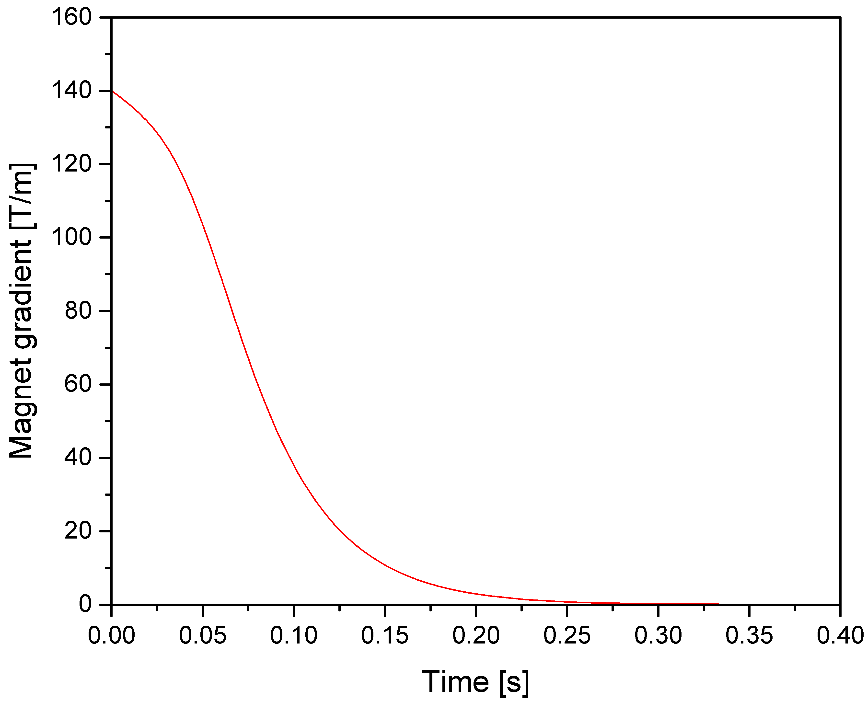
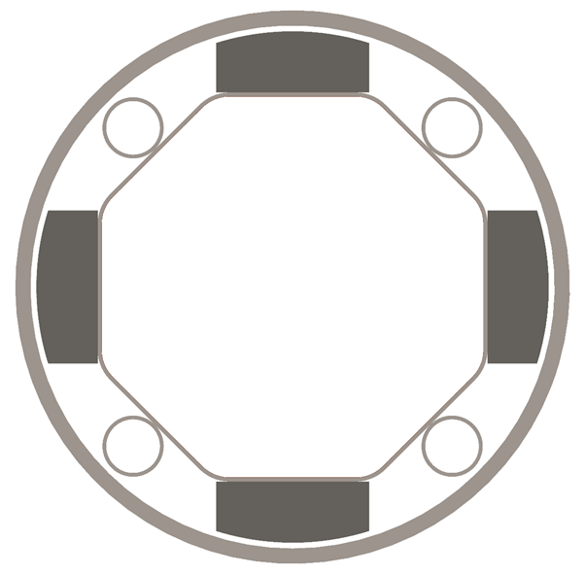
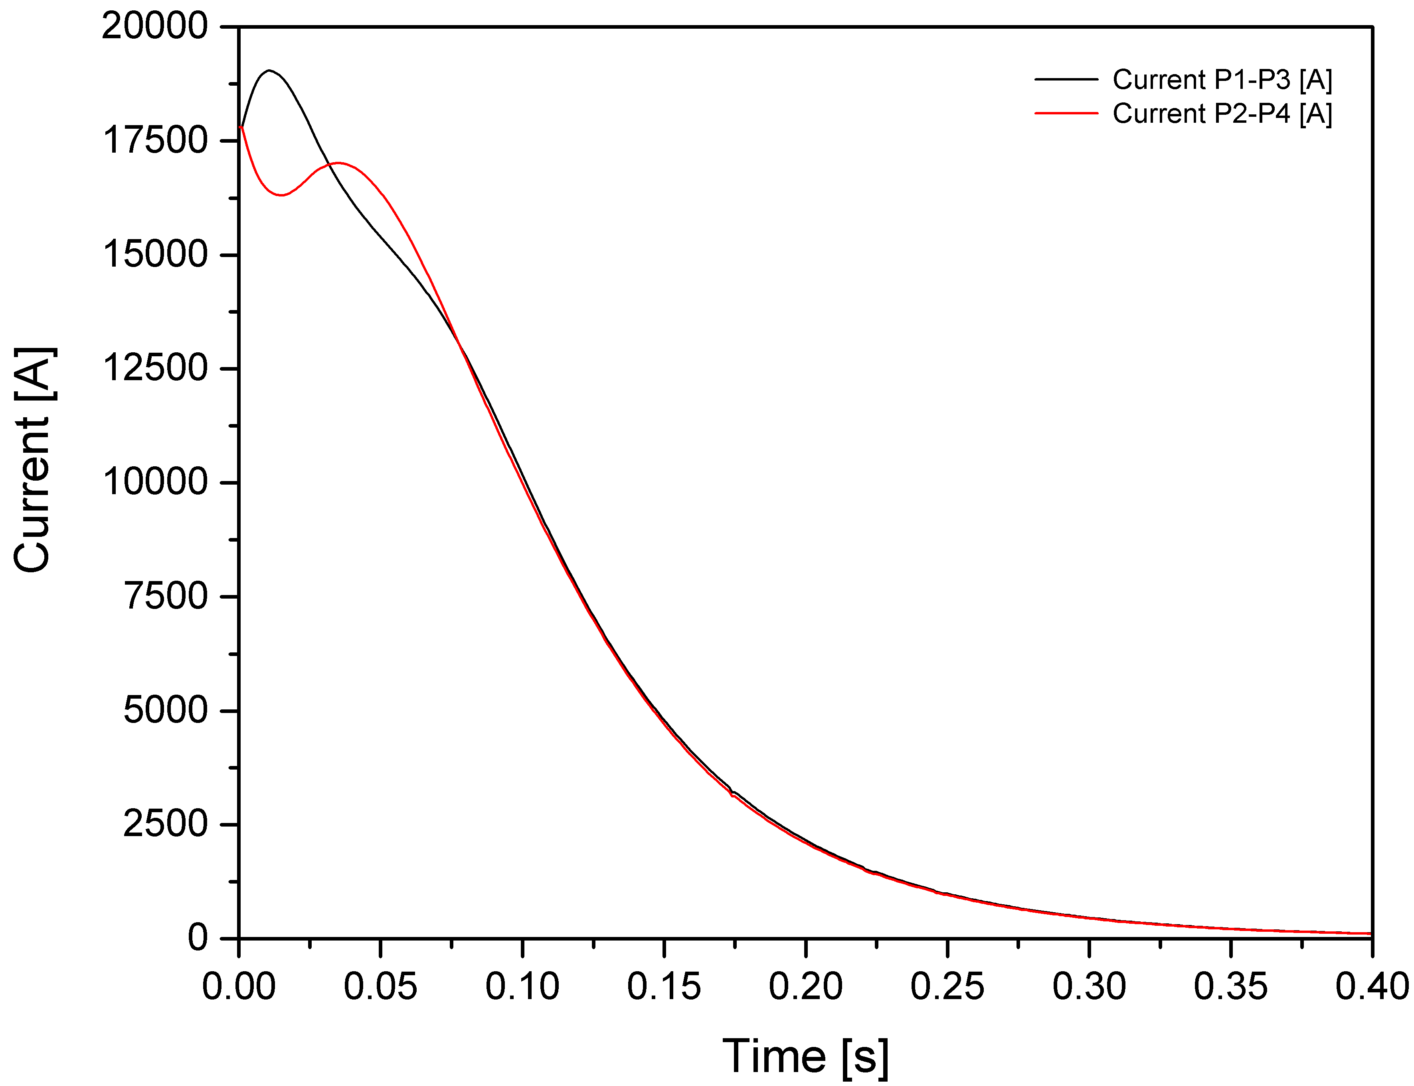
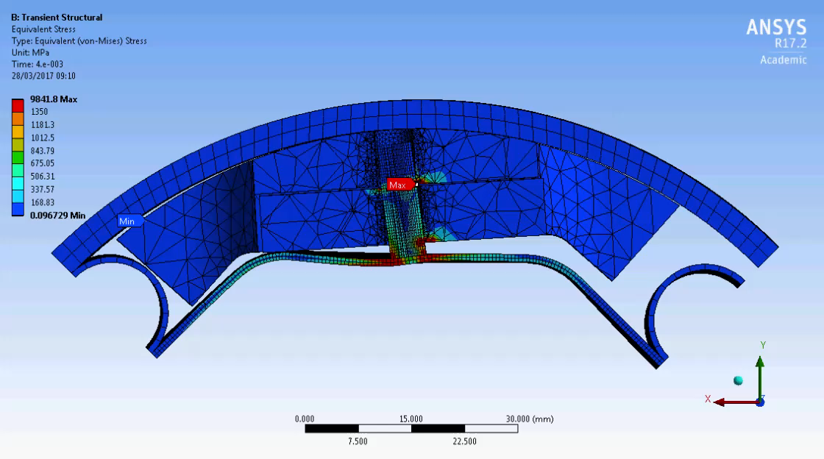
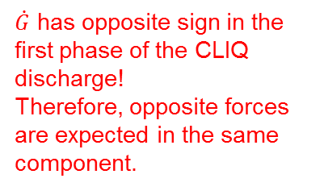

Behaviour during a magnet quench
Quench heaters vs CLIQ
Specific Lorentz forces reads:
P2
P1
$$f∝\frac{G\dot{G}}{ρ}r^{3}$$
Lorentz forces driven by GG’ product
Lorentz forces acting on the beam screen are pointing toward the cold bore
Lorentz forces are maximum after 50 ÷ 60 ms.
Courtesy of E. Todesco
P3
P4
Magnet gradient decay with quench heaters
Expected forces in red
P2
P1
$\dot{G}$ has opposite sign in the first phase of the CLIQ discharge!
Therefore, opposite forces are expected in the same component.
Courtesy of S. Izquierdo Bermudez & E. Ravaioli
P3
P4
Current decay with CLIQ discharge
The study has been presented in the TE-TM dated 31.8.2017 (https://indico.cern.ch/event/659350/).

Slide 5
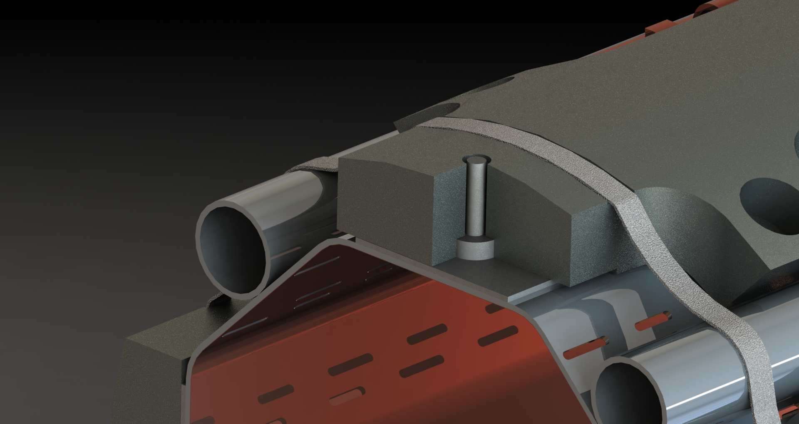
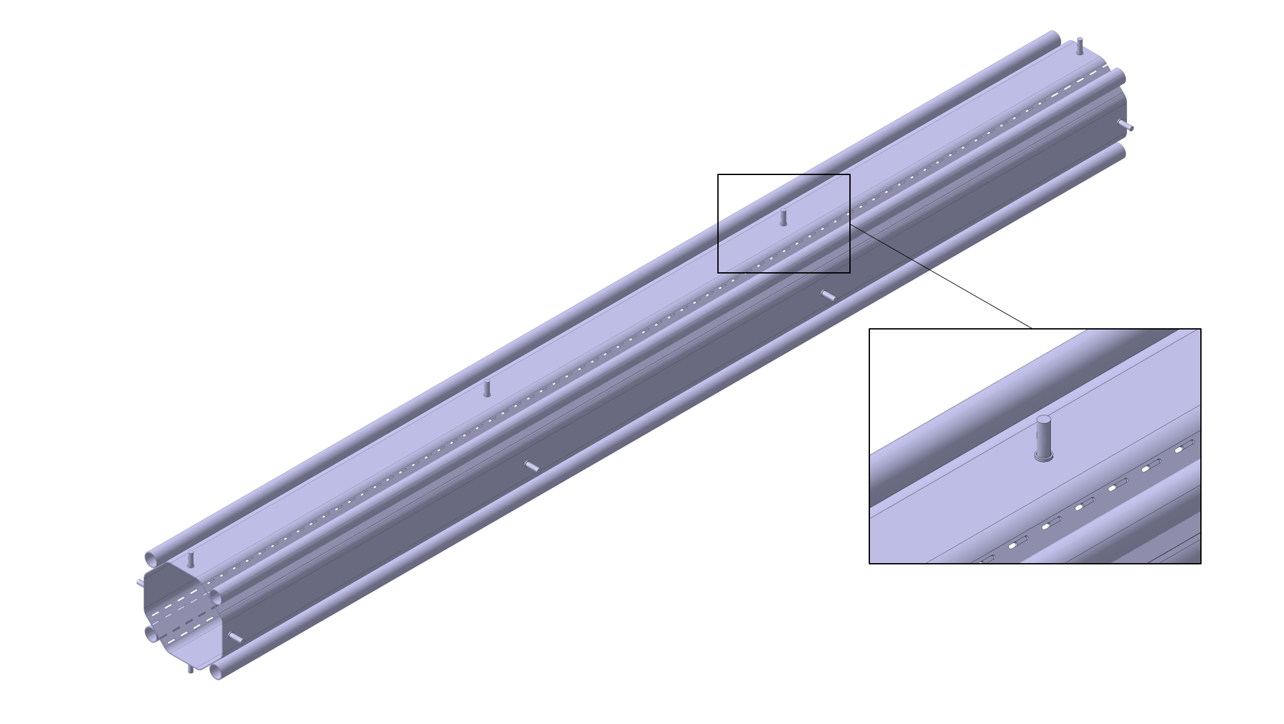
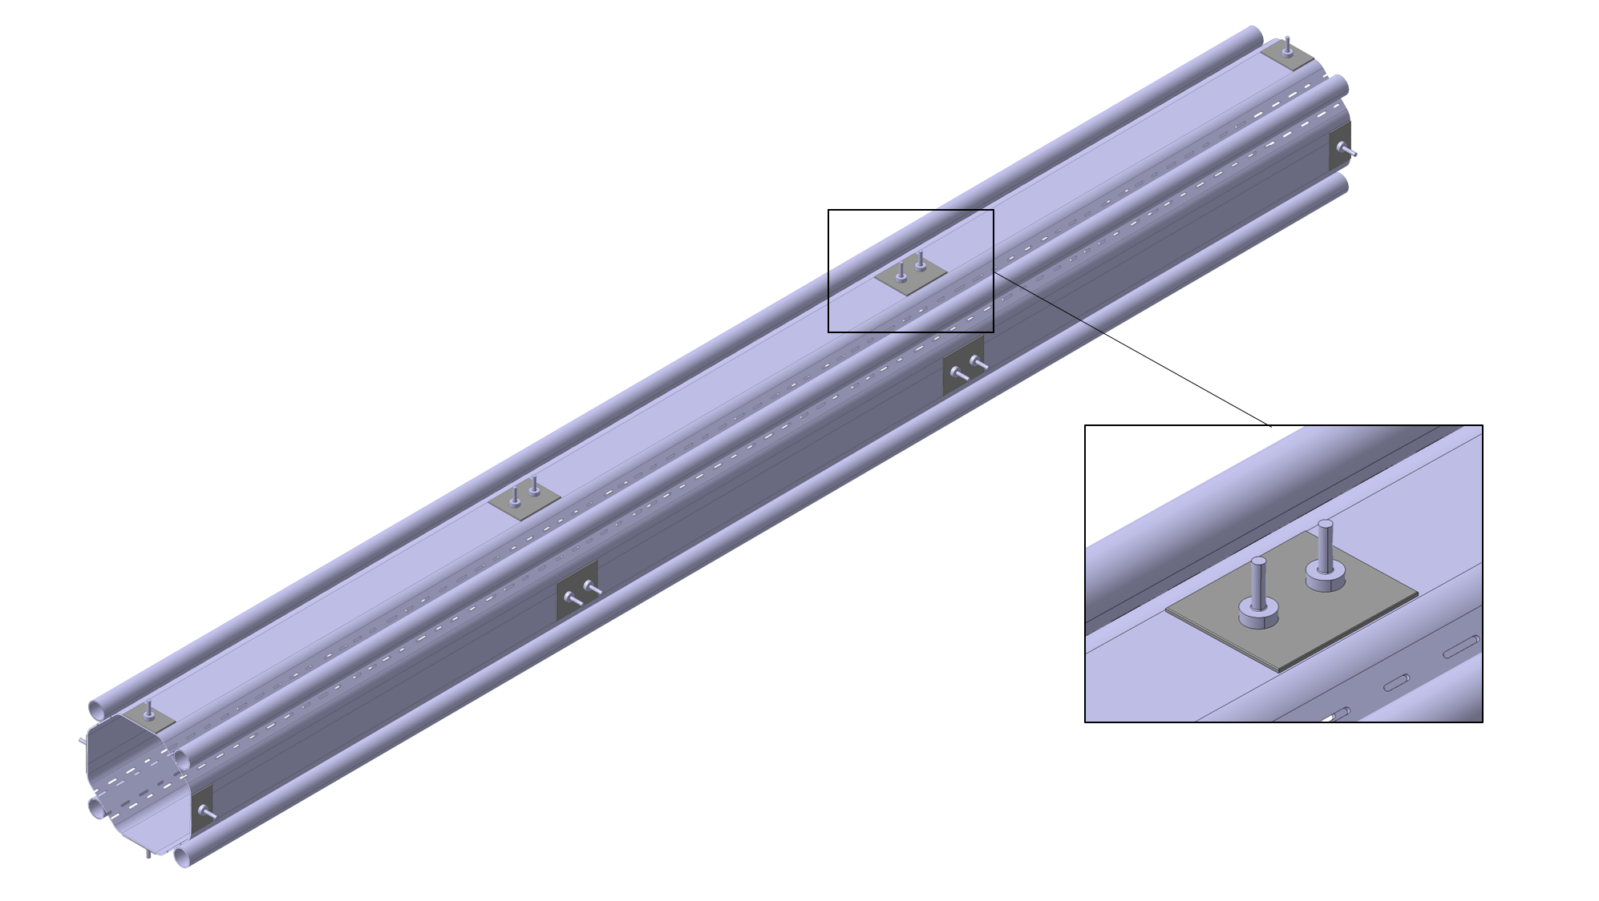
Main modifications of the Q1 beam screen
Old design
New design
New pin (2 per W block) + reinforcement plates

Slide 6
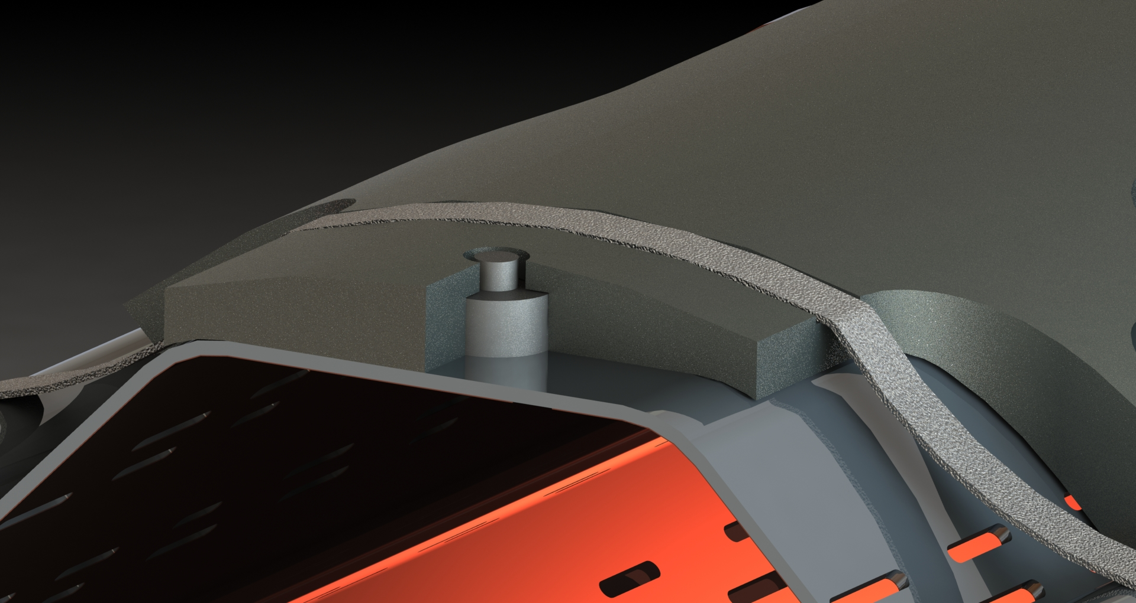
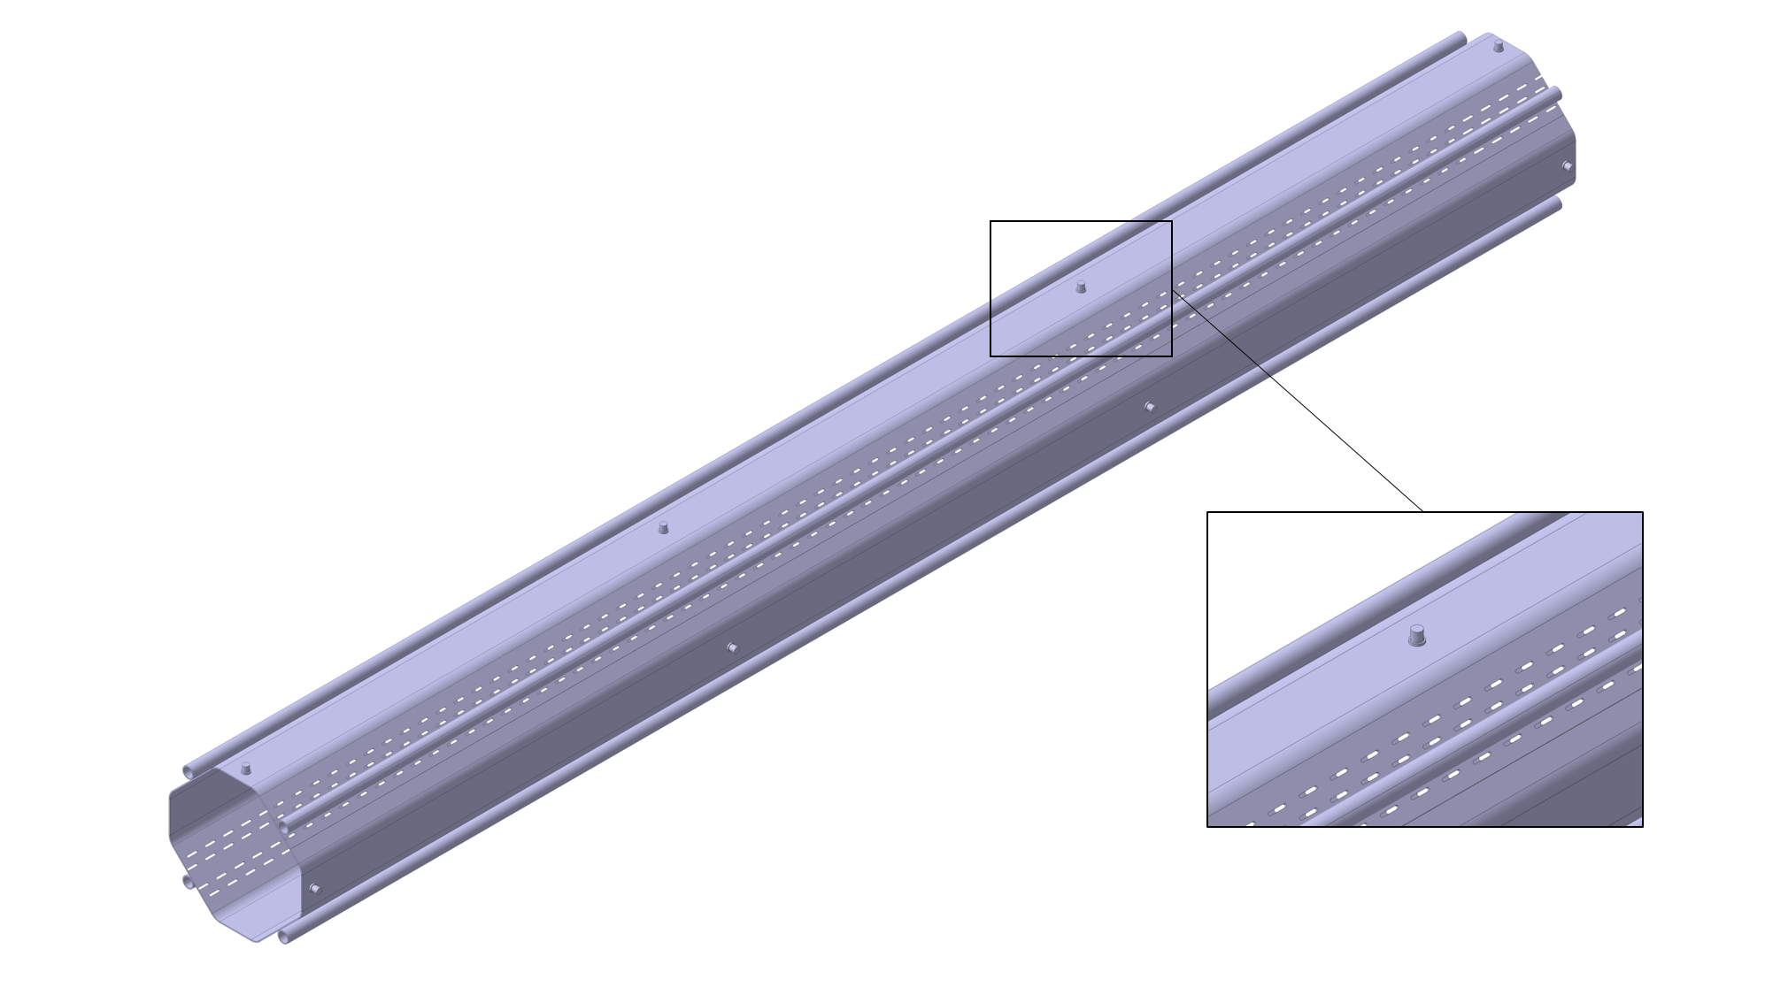
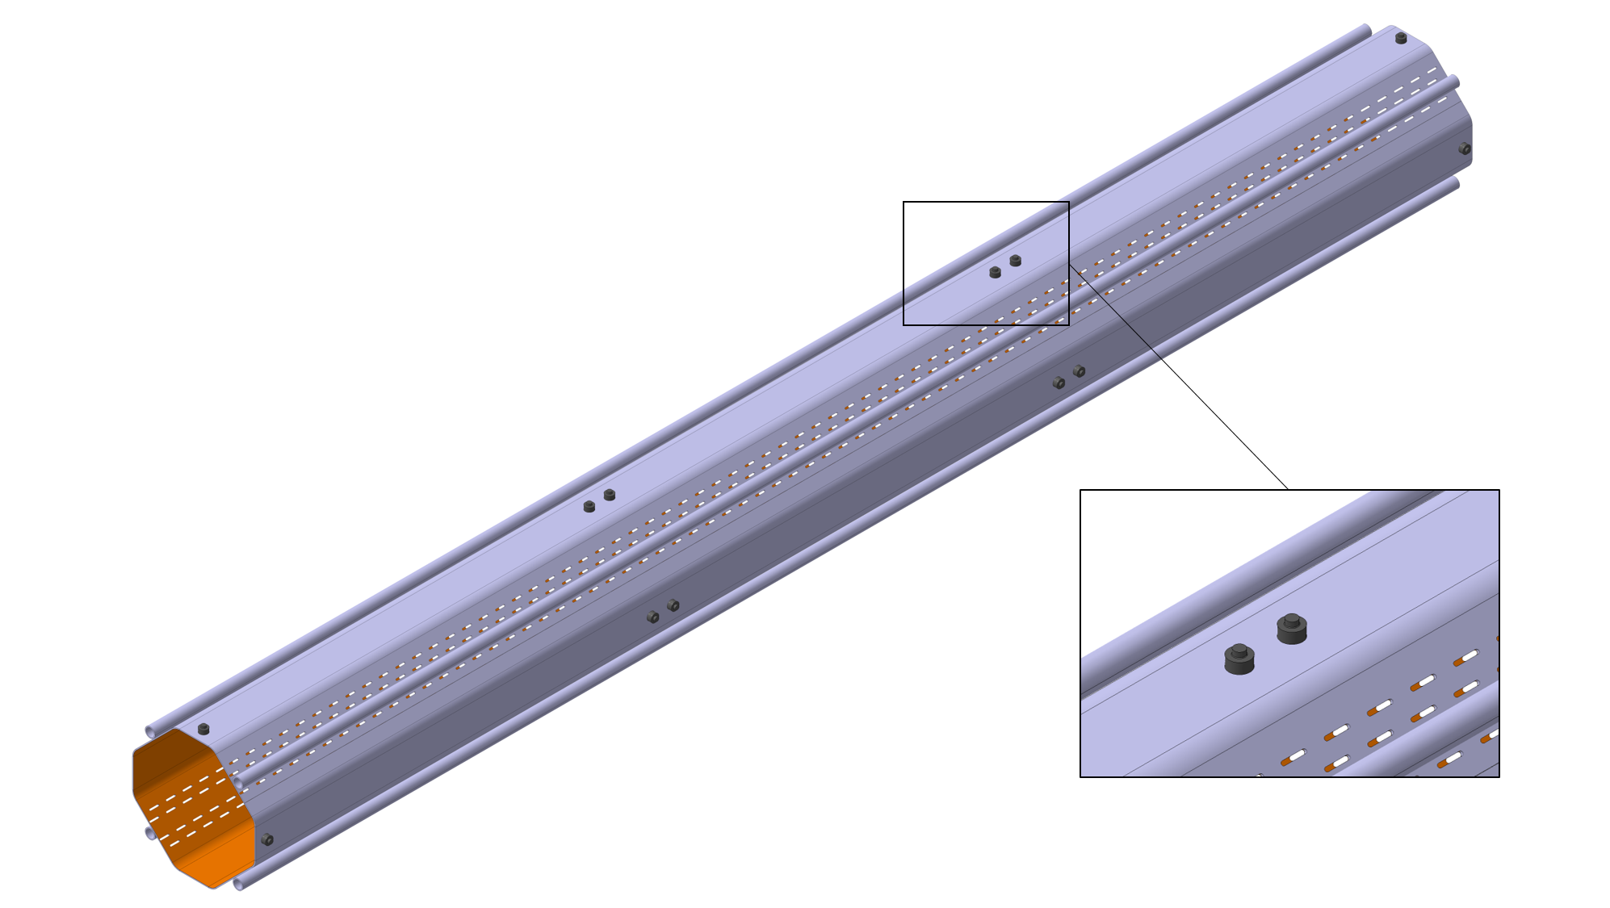
Main modifications of the Q2x-Q3-D1 beam screens
Old design
New design
New pin (2 per W block)

Slide 7
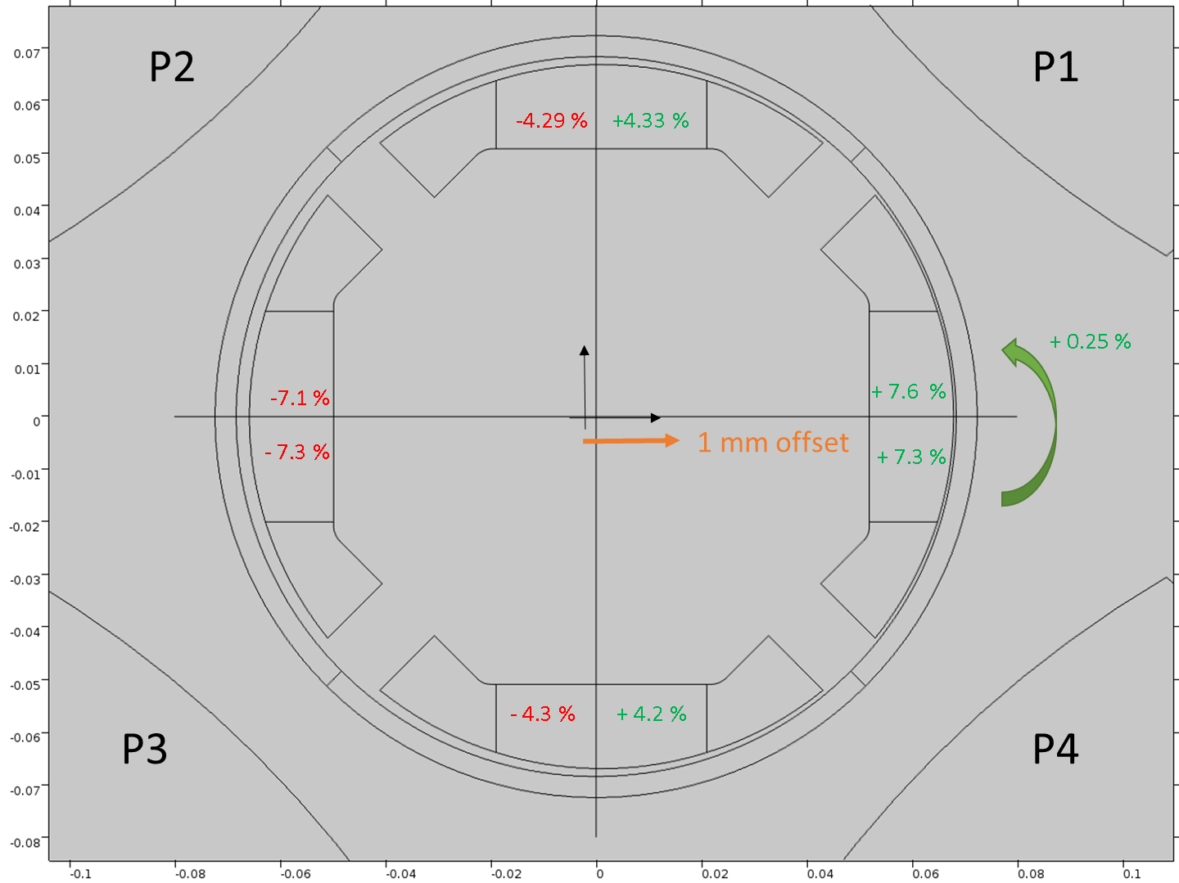
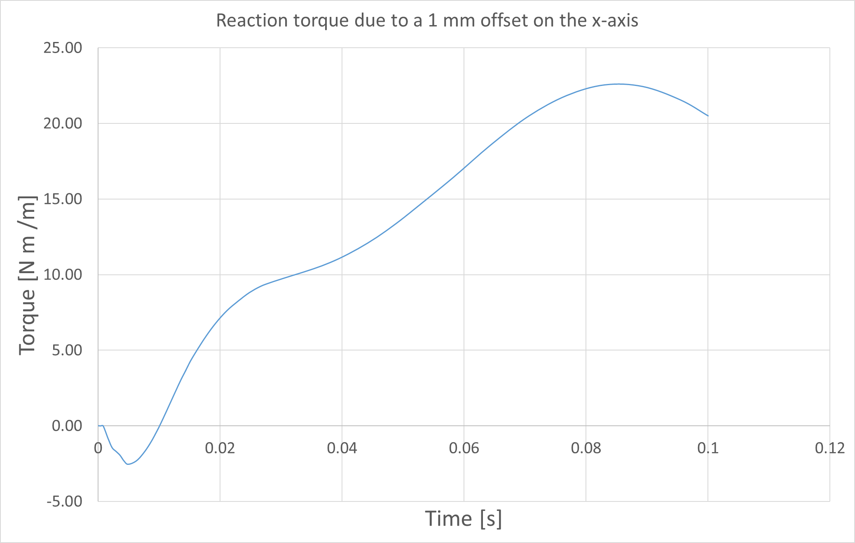
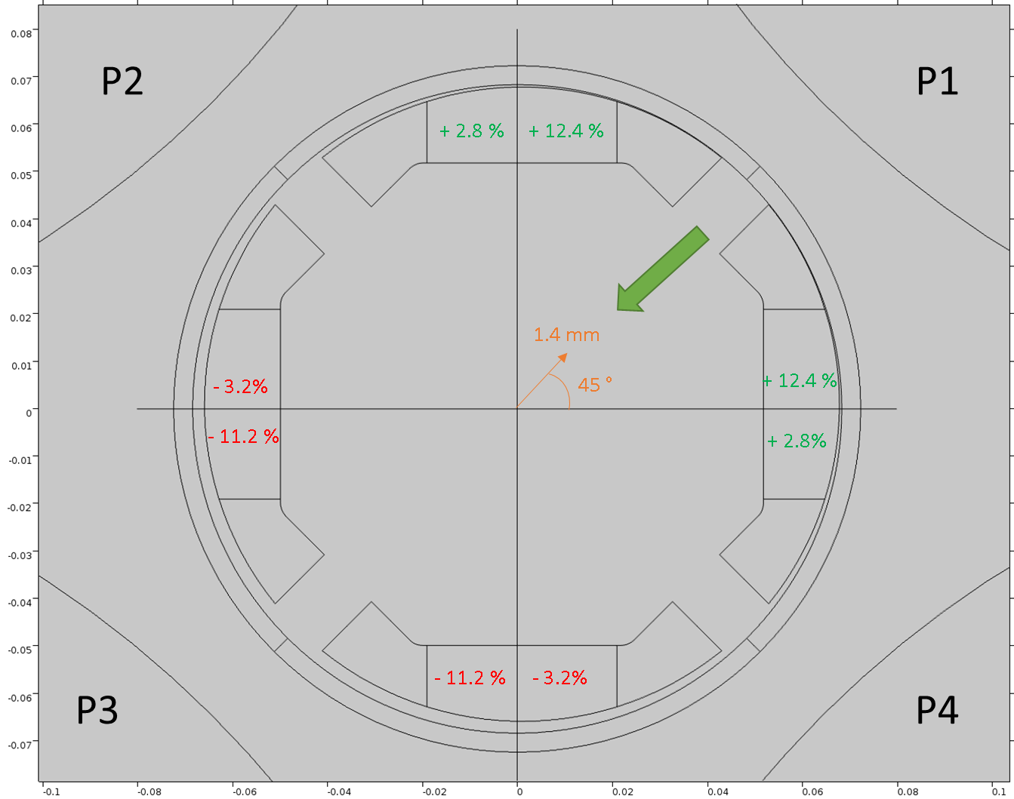
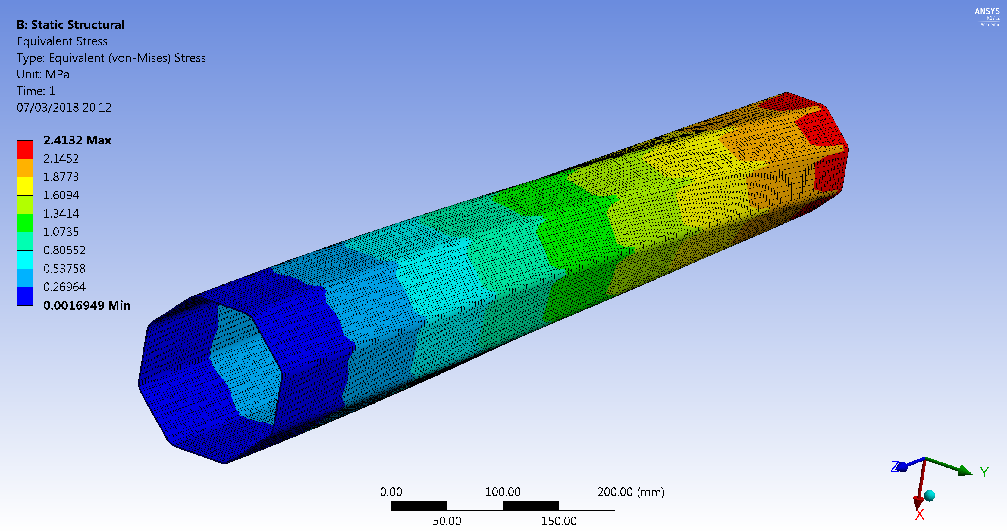
Misalignment effects of the beam screen in the cold bore
@ 5 ms
y
0
x
Variation of the forces in the W blocks due to 1 mm offset on the x-axis of the BS
in comparison with the nominal case at 5 ms.
Reaction torque of the BS fixed at one end during the CLIQ discharge
@ 85 ms
y
0
x
1 m
Twist angle: 0.01°
magnification
x 6000
Maximum V.M. stress on the fixed end of the BS due to the 1 mm offset .
Variation of the forces in the W blocks due to 1.4 mm offset at 45 ° of the BS
in comparison with the nominal case at 5 ms.
The misalignment effects are negligible
at the fixed point of the beam screen.

Slide 8

Conclusions
The cost estimate for the beam screen
modification is 250 kCHF, which includes:
  raw material;
  machining and assembly of additional pins;
  reinforcement plates;
  elastic rings;
  drawing updates.
No impact neither on schedule
nor on the performance is expected:
  no impact on aperture;
  no impact on field quality;
  non significant impact on shielding efficiency.
No impact on the beam screen fixed point
due to a misalignment of the beam screen
in the cold bore.

Slide 9
Thank you for your attention

Slide 10
Backup slides

Slide 11
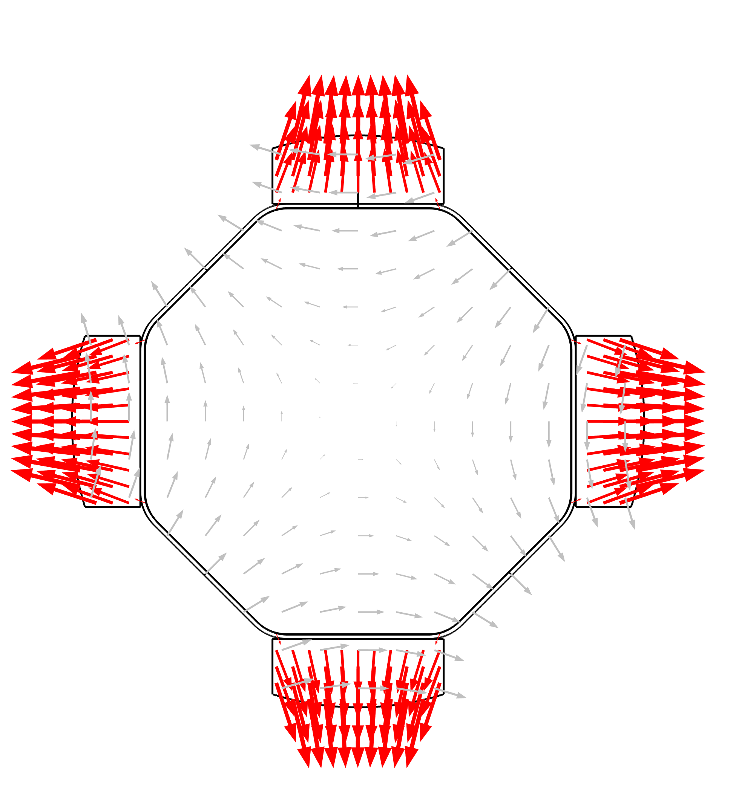
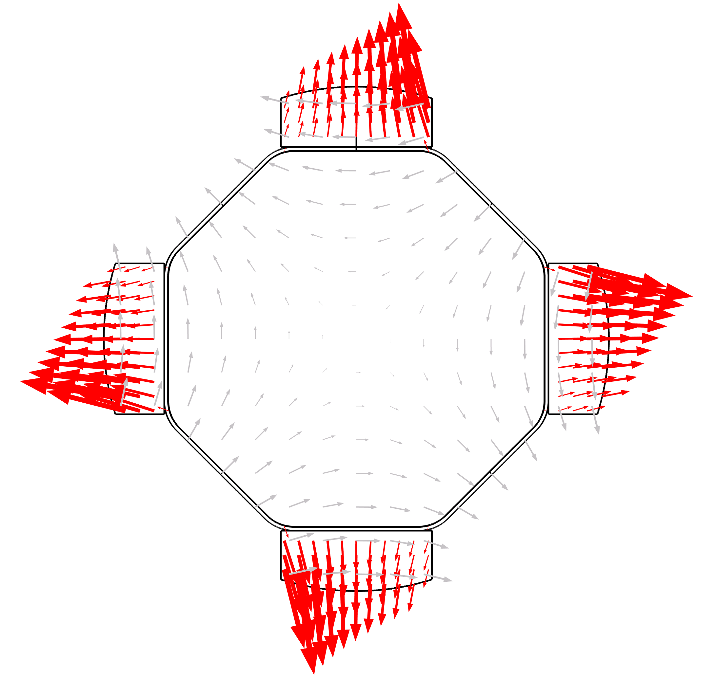
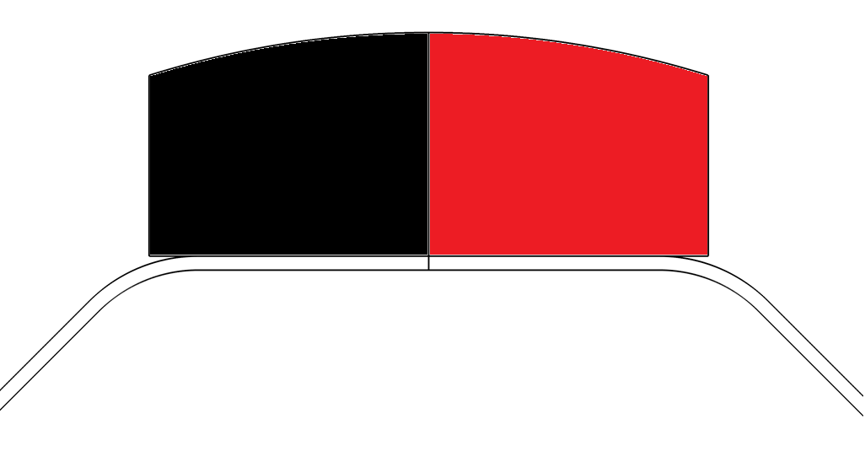
Behaviour during a magnet quench
Impact of CLIQ
1
2
3
4
Torque
Tangential force
Force distribution
Deformation during the first phase
Phase 1: Most critical!!
1
2
3
4
component | Q1 |  | Q2
 | Torque [N m/W block] | Tangential force [N/W block] | Torque [N m/W block] | Tangential force [N/ W block]
Cold bore | 250 | 3400 | 250 | 3400
Heat absorber | 280 | 4200 | 150 | 2200
Octagonal pipe | 80 | 1600 | 230 | 3800
Phase 2: Less severe than phase 1
Integrated forces induced in half W block
Phase 4: Less severe than without CLIQ
Integrated forces induced in half W block
E.g. Fy for the tungsten block: Q1_{NO CLIQ} ~230 [N/mm] > Q1_{CLIQ} ~200 [N/mm]

Slide 12
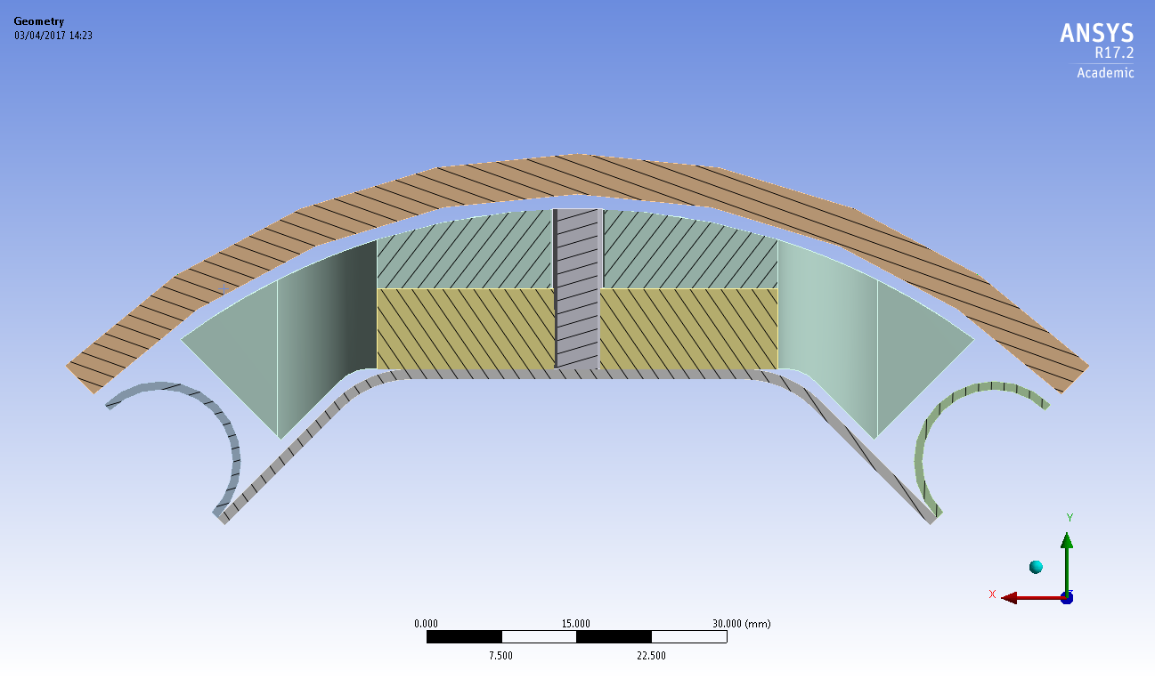
Impact of CLIQ
CLIQ
NO CLIQ
The pin becomes a structural component!
→ New solution needs to be found!

Slide 13
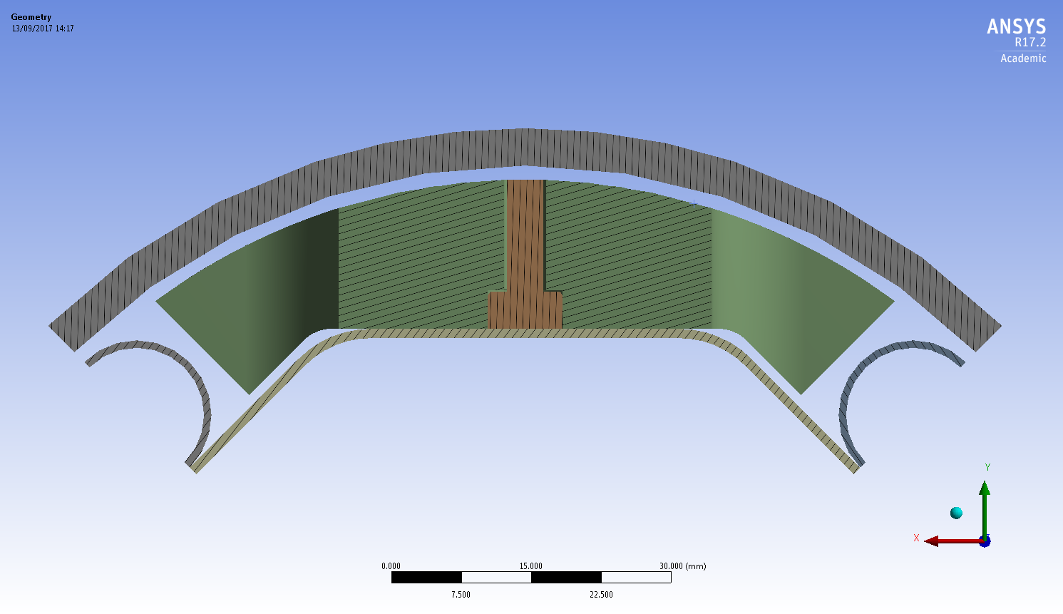
Proposed solution
16 mm
4 mm

Slide 14
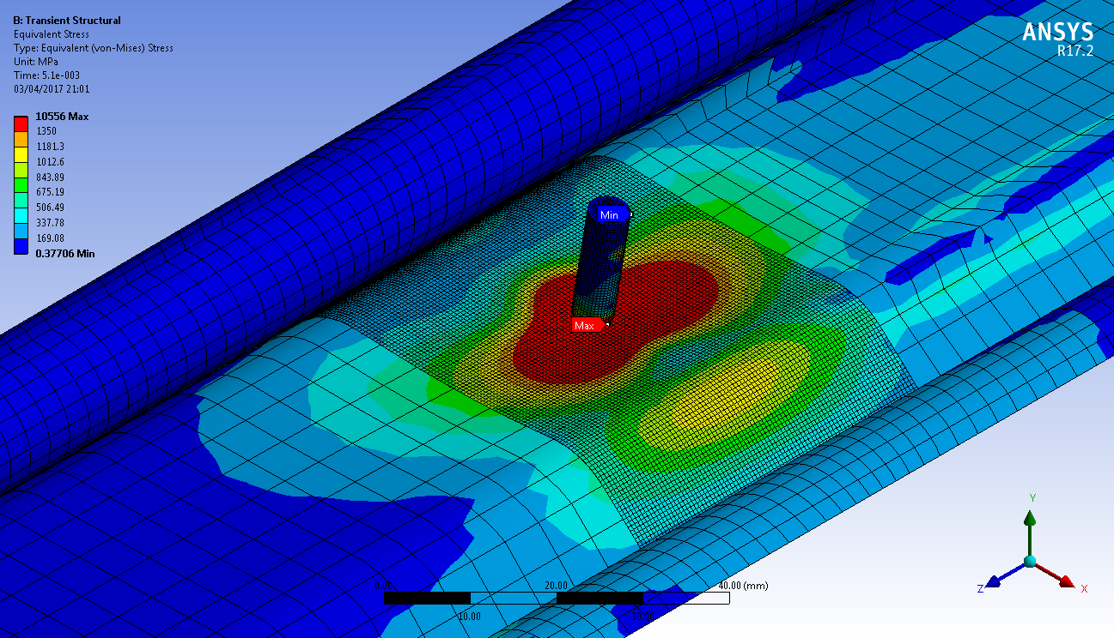
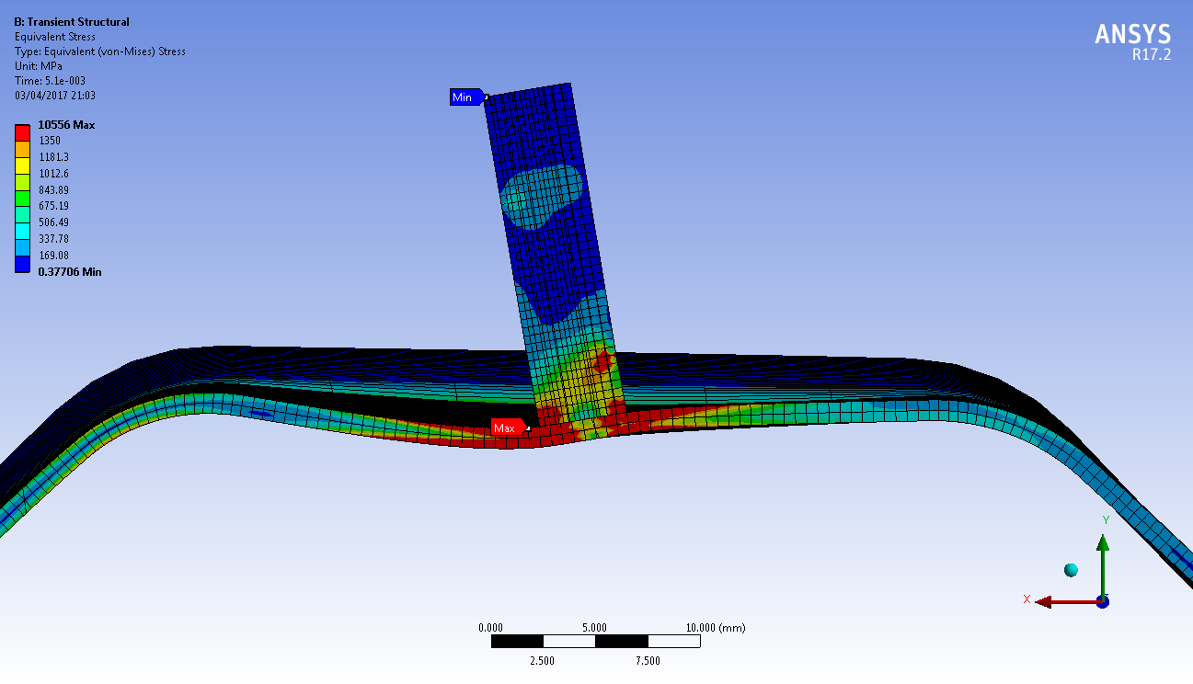
Q1 beam screen during the CLIQ discharge
P506 Elastic limit 1350 MPa
(RED AREAS)

Slide 15
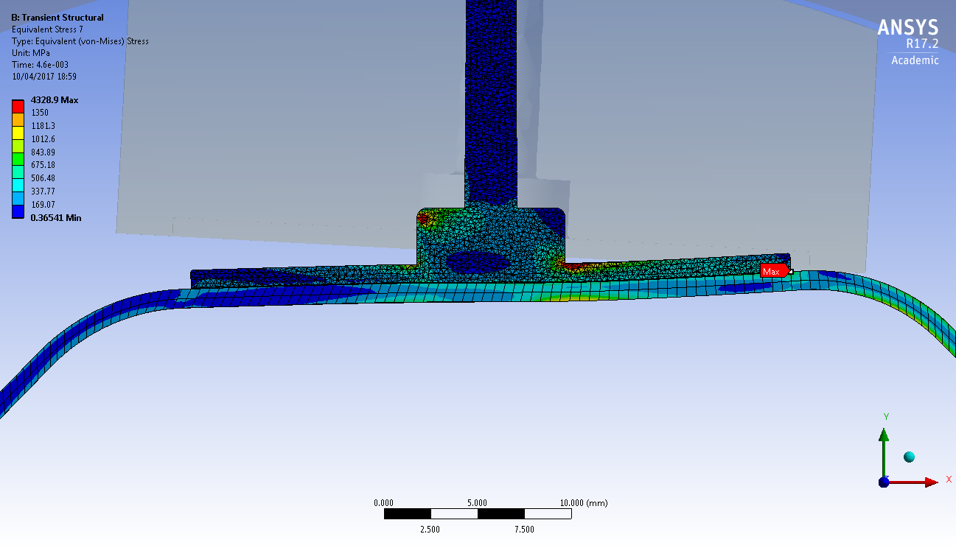
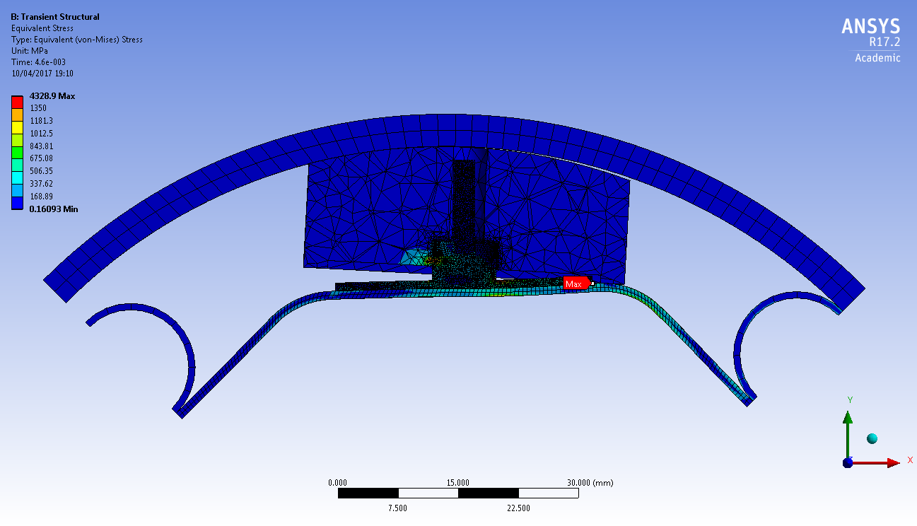
Proposed Q1 beam screen during the CLIQ discharge_v2
P506 Elastic limit 1350 MPa
(RED AREAS)

Slide 16
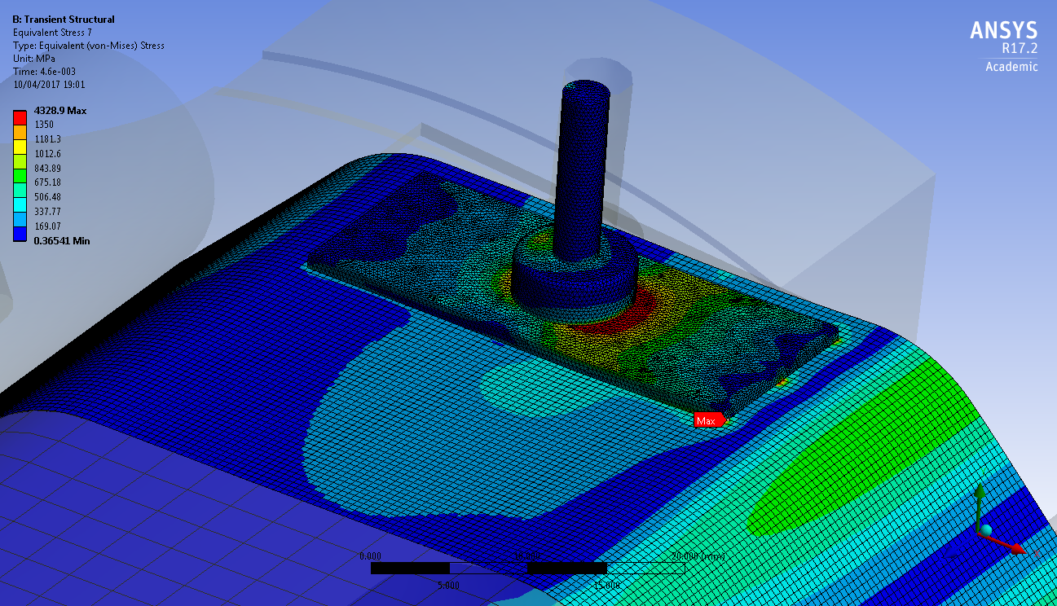
Proposed Q1 beam screen during the CLIQ discharge_v2
P506 Elastic limit 1350 MPa
(RED AREAS)

Slide 17
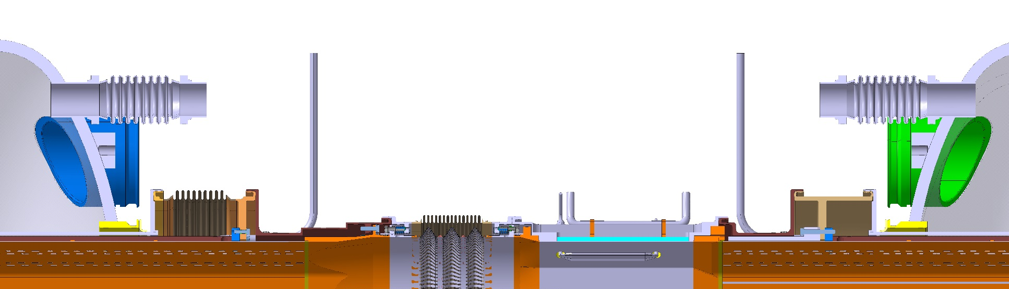
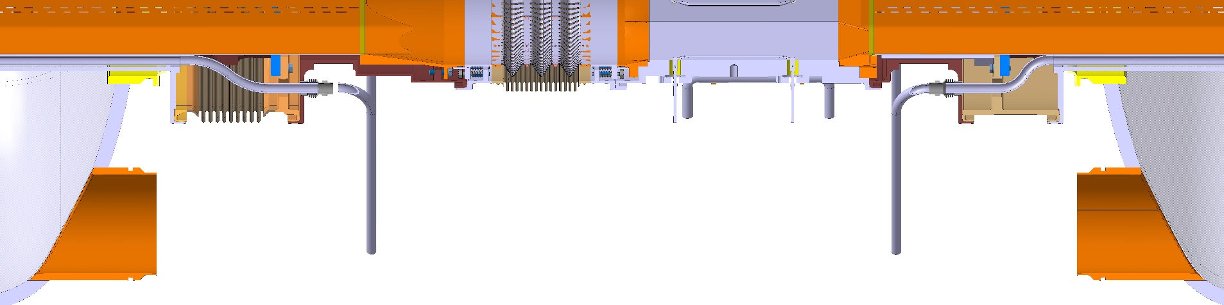
Beam screen extremities and interconnections
Layout
0/90° cut
+/-45° cut
More compact components (transversally)
Longer absorber at the beam screen extremities
Update of the interconnection module design
*BPM model provided by WP 13

Slide 18
Old pins

Slide 19
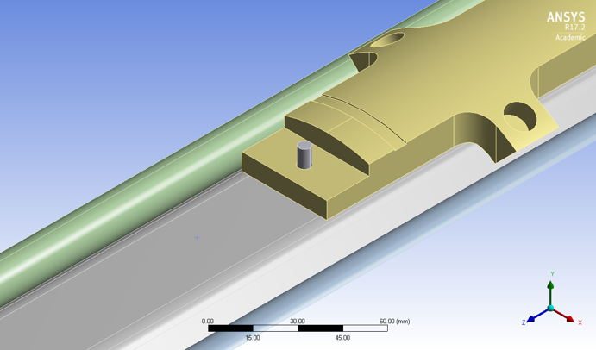
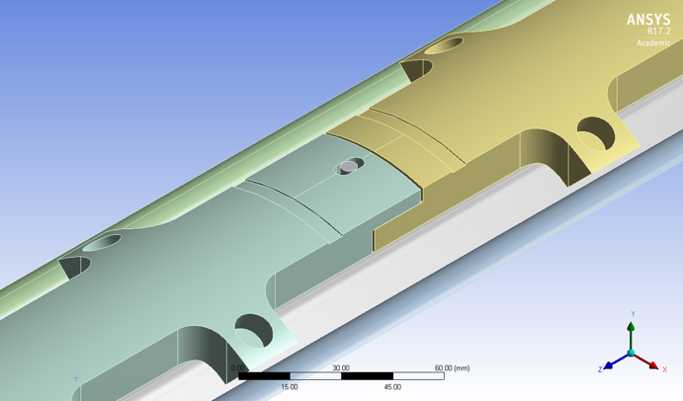
Old W blocks

Slide 20
New pins

Slide 21
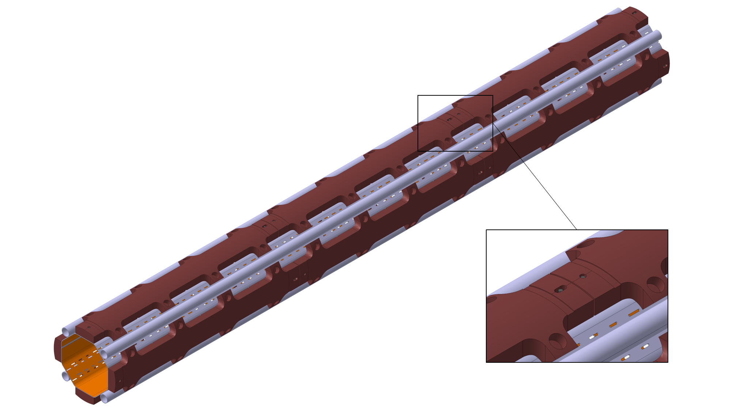
New W blocks

Slide 22
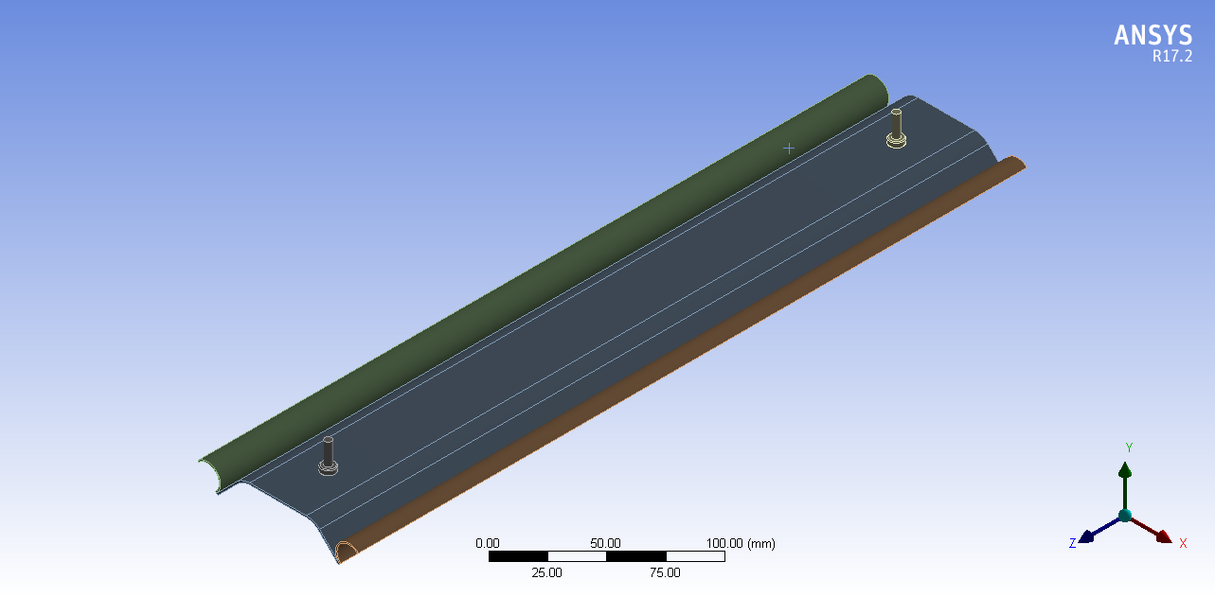
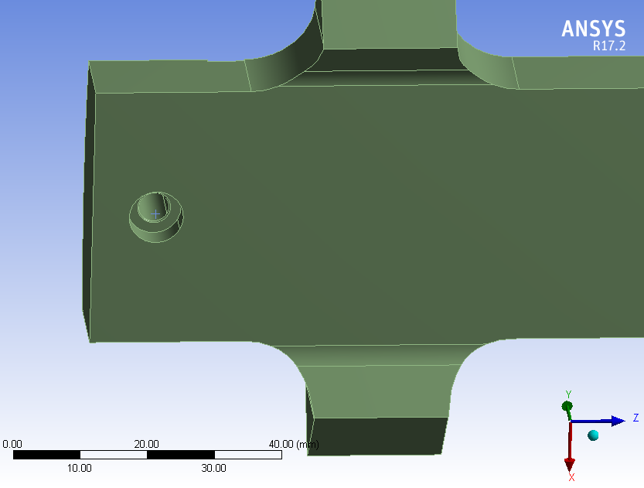
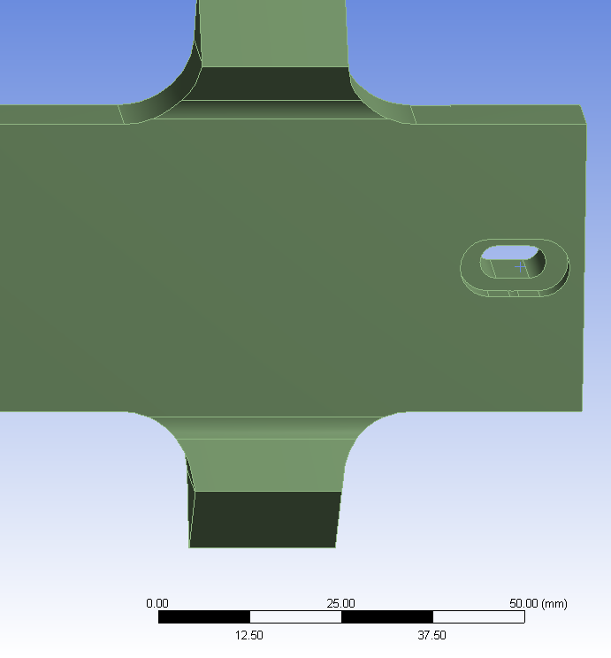
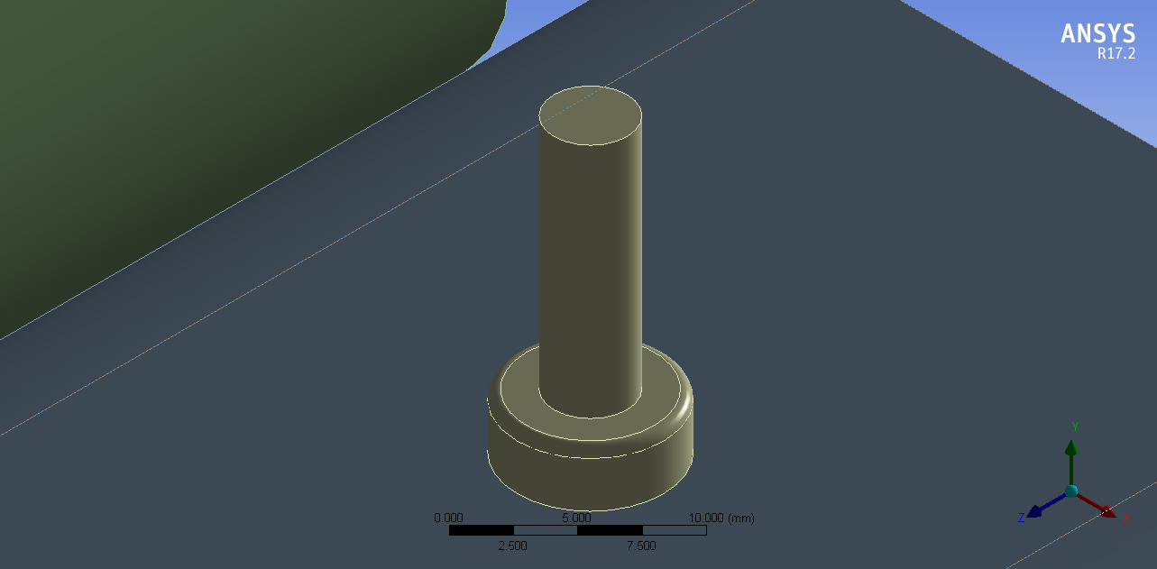
Details of the proposed beam screen design

Slide 23
Supporting system

