Slide 1






HEPI TSU Activities at ATLAS Experiment
14th International Masterclasses 2018
Hands on particle physics
Georgians (HEPI TSU) in the ATLAS experiment
Tamar Djobava
On behalf of the High Energy Physics Institute of Iv. Javakhishvili Tbilisi State University
(HEPI TSU)
Tamar.Djobava@cern.ch
6 March, 2018, Tbilisi, Georgia

Slide 2
The Large Hadron Collider Project:
A dream became reality…

Slide 3

ATLAS Collaboration
38 Countries
182 Institutions
3000 Scientific participants total
(1200 Students)
The joint team from E.Andronikashvili Institute of Physics and
High Energy Physics Institute of Tbilisi State University (HEPI TSU) became ATLAS member since 1994
Albany, Alberta, NIKHEF Amsterdam, Ankara, LAPP Annecy, Argonne NL, Arizona, UT Arlington, Athens, NTU Athens, Baku,
IFAE Barcelona, Belgrade, Bergen, Berkeley LBL and UC, HU Berlin, Bern, Birmingham, UAN Bogota, Bologna, Bonn, Boston, Brandeis, Brasil Cluster, Bratislava/SAS Kosice, Brookhaven NL, Buenos Aires, Bucharest, Cambridge, Carleton, CERN, Chinese Cluster, Chicago, Chile, Clermont-Ferrand, Columbia, NBI Copenhagen, Cosenza, AGH UST Cracow, IFJ PAN Cracow, SMU Dallas, UT Dallas, DESY, Dortmund, TU Dresden, JINR Dubna, Duke, Edinburgh, Frascati, Freiburg, Geneva, Genoa, Giessen, Glasgow, Göttingen, LPSC Grenoble, Technion Haifa, Hampton, Harvard, Heidelberg, Hiroshima IT, Indiana, Innsbruck, Iowa SU, Iowa, UC Irvine, Istanbul Bogazici, KEK, Kobe, Kyoto, Kyoto UE, Lancaster, UN La Plata, Lecce, Lisbon LIP, Liverpool, Ljubljana, QMW London, RHBNC London, UC London, Lund, UA Madrid, Mainz, Manchester, CPPM Marseille, Massachusetts, MIT, Melbourne, Michigan, Michigan SU, Milano, Minsk NAS, Minsk NCPHEP, Montreal, McGill Montreal, RUPHE Morocco, FIAN Moscow, ITEP Moscow, MEPhI Moscow, MSU Moscow, Munich LMU, MPI Munich, Nagasaki IAS, Nagoya, Naples, New Mexico, New York, Nijmegen, BINP Novosibirsk, Ohio SU, Okayama, Oklahoma, Oklahoma SU, Olomouc, Oregon, LAL Orsay, Osaka, Oslo, Oxford, Paris VI and VII, Pavia, Pennsylvania, Pisa, Pittsburgh, CAS Prague, CU Prague, TU Prague, IHEP Protvino, Regina, Rome I, Rome II, Rome III, Rutherford Appleton Laboratory, DAPNIA Saclay, Santa Cruz UC, Sheffield, Shinshu, Siegen, Simon Fraser Burnaby, SLAC, NPI Petersburg, Stockholm, KTH Stockholm, Stony Brook, Sydney, Sussex, AS Taipei, Tbilisi, Tel Aviv, Thessaloniki, Tokyo ICEPP, Tokyo MU, Tokyo Tech, Toronto, TRIUMF, Tsukuba, Tufts, Udine/ICTP, Uppsala, UI Urbana, Valencia, UBC Vancouver, Victoria, Waseda, Washington, Weizmann Rehovot, FH Wiener Neustadt, Wisconsin, Wuppertal, Würzburg, Yale, Yerevan

Slide 4

Georgians in the ATLAS collaboration
E.Andronikashvili Institute of Physics of TSU
HEPI TSU
Georgian Technical University
Detector tasks/Physics Analysis
Detector tasks/Physics Analysis
Detector Software Development
Tile Calorimeter
Operation shifts
Maintenance and consolidation works
Analysis of ATLAS Tile Calorimeter (TileCal) behavior and stability using Detector Control System (DCS) data.
Upgrade of ATLAS TileCal for High luminosity LHC.
Investigation of the performance of ATLAS TileCal Demonstrator prototype based on the testbeam data
Study of TileCal performance with new cell granularity.
Physics Analysis
Search for Flavor Changing Neutral Current (FCNC) top quark decays t → Zq (q=u,c quarks) in ATLAS Run 2 and HL-LHC conditions
Measurement of the differential cross-sections of
prompt and non-prompt production of J/ψ and ψ(2S)
in pp collisions at √s=13 TeV
Associated production of a top-antitop pair with a quarkonium state (J/ψ )

Slide 5
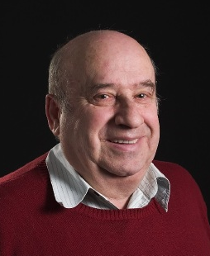
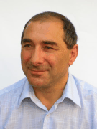
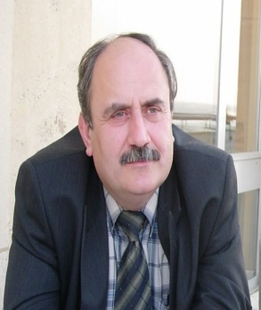
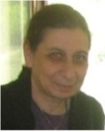

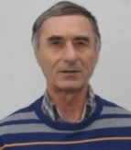

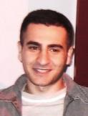
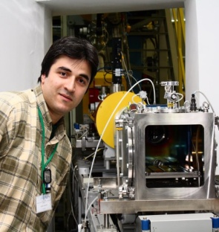
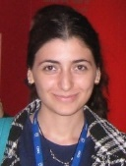
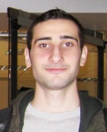
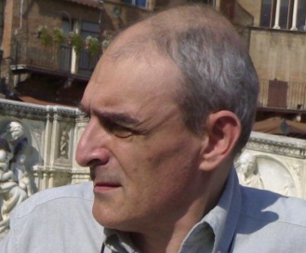
Georgians in the ATLAS collaboration
The Team Leader Dr. I.Minashvili
J.Khubua
I.Minashvili
E.Tskhadadze
T.Djobava
M.Mosidze
N.Mosulishvili
G.Devidze
A.Durglishvili
J.Jejelava
T. Zakareishvili
B. Chargeishvili
V.Kartvelishvili

Slide 6
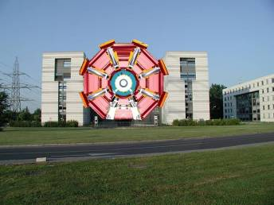

ATLAS Detector
45 m
ATLAS superimposed to the 5 floors of building 40
24 m
7000 Tonnes
The detector is a cylinder with a total length of 45 m and a radius of 12 m and weights apptoximately 7000 tonnes.

Slide 7

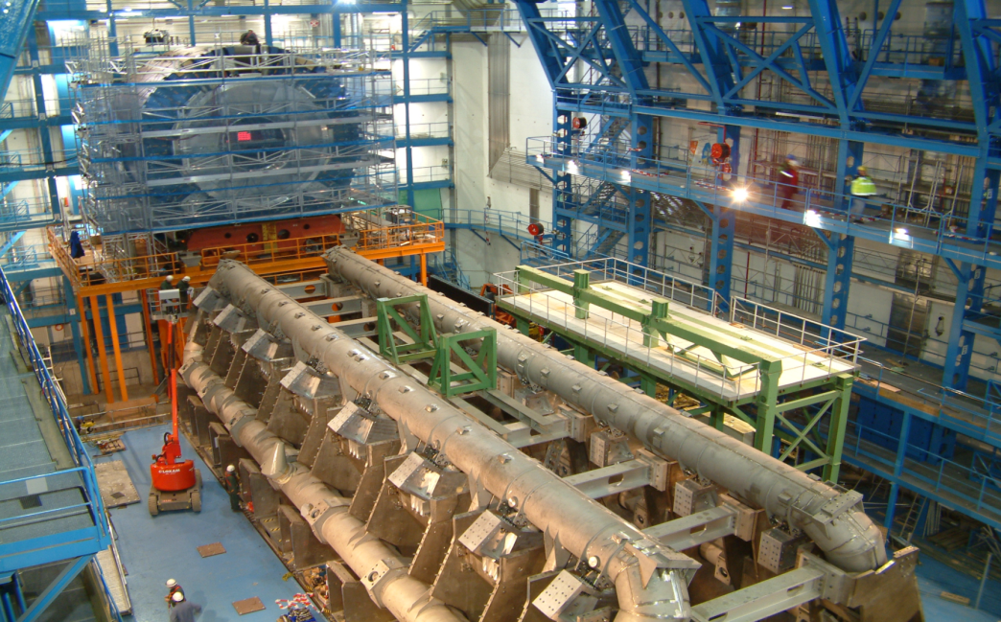
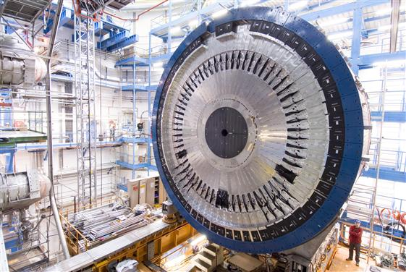
ATLAS HadronicTile Calorimeter

Slide 8
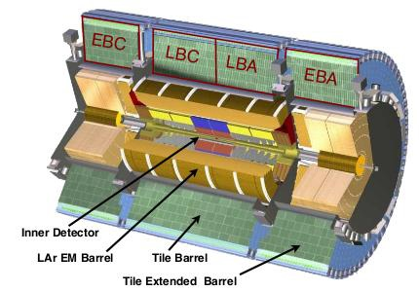
ATLAS Tile Calorimeter
• Diameter: 8.5 m
• Length= 12 m
• Weight: 2900 T
Total thickness of 7.4λ_{int} at η=0
Design goals:
● large dynamic range (detect low
signal from muons up to high
signals from jets at TeV scale)
● energy linearity ~2% for high p_{T}
jets up to few TeV
•3 cylinders with coverage: |η | <1.7
Sampling calorimeter: Fe/scintillator: 4:1
•Double PMT readout via WLS fibers (5000 cells->10k channels)
•Aim for jet energy resolution:
ΔE/E =50%/ √E⊕3 %

Slide 9

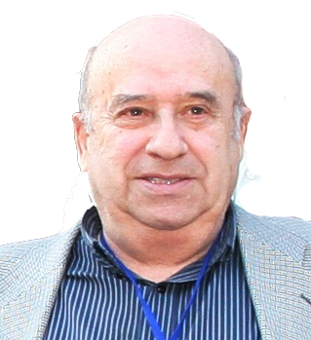
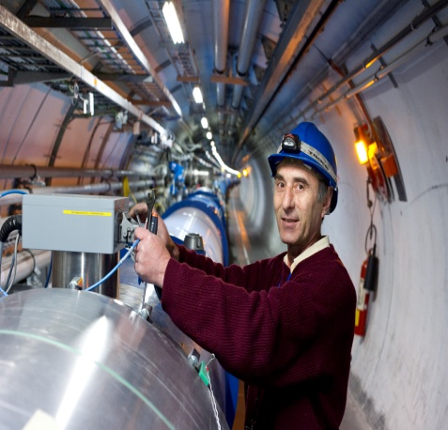
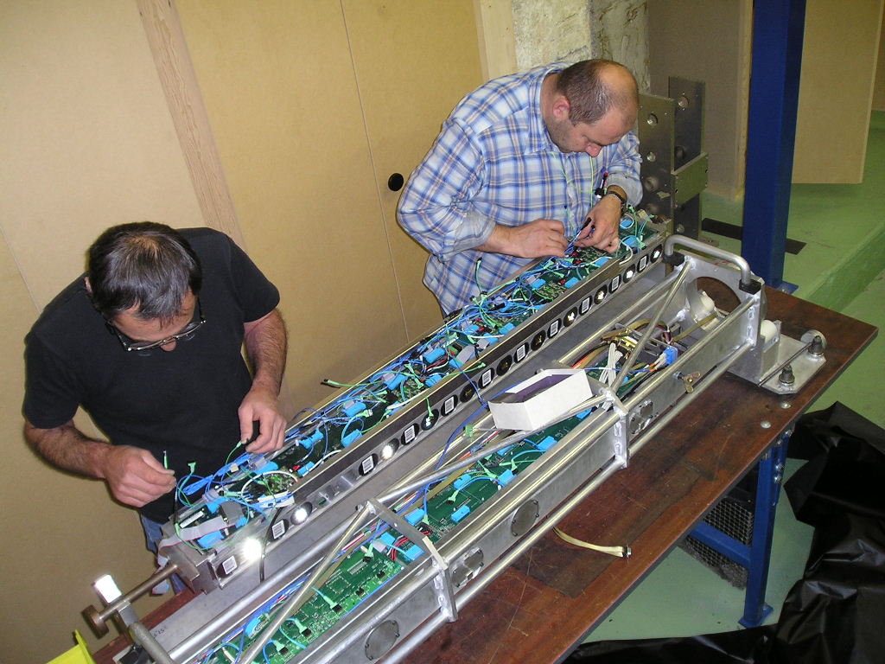
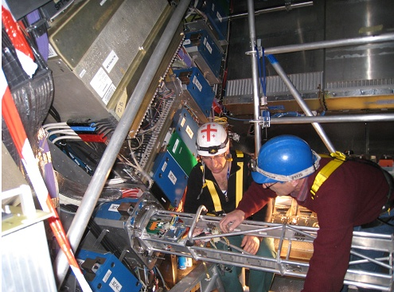
ATLAS Tile Calorimeter
Scientists from HEPI TSU under leadership of Prof. J.Khubua were and are now heavily involved in all phases of the Hadronic Tile Calorimeter, from its design, prototype tests, construction, installation, calibration, commissioning (refurbishment of super drawers-central and extended barrels), operation to the physics performance (J.Khubua, I.Minashvili, N.Mosulihvili)
energy scale and simulation
maintenance and consolidation (LS1..)
operation (shifts, data quality)
online and DAQ
Upgrade
Test beam data analysis
J.Khubua
I.Minashvili
9

Slide 10

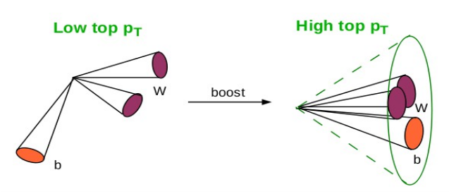
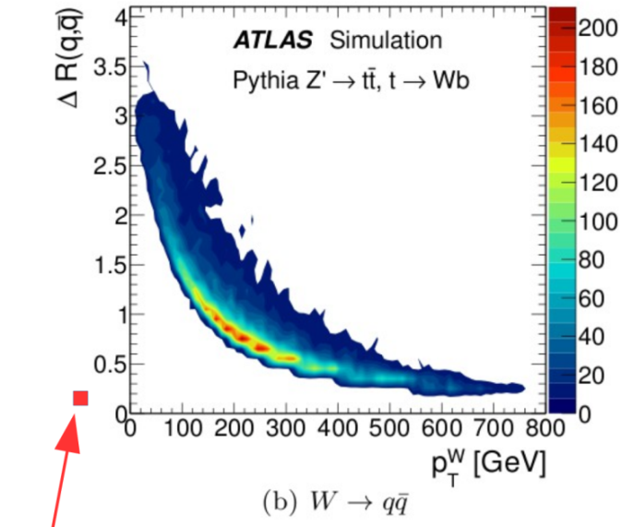
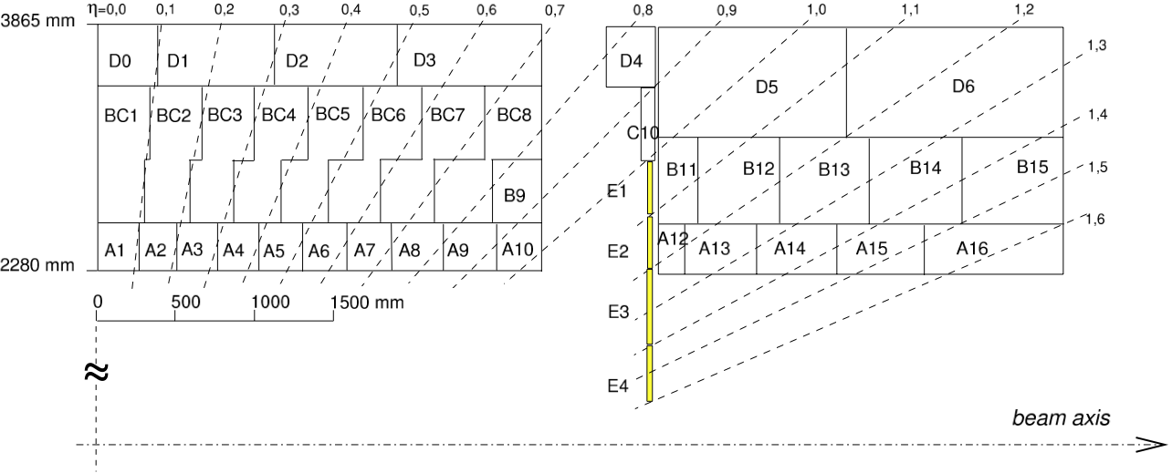
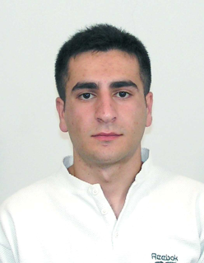
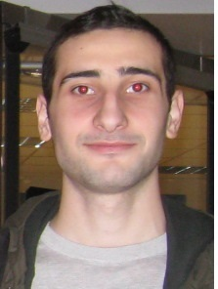
High Granularity TileCal study
TileCal phase 2 upgrade geometry
Improve granularity using multianode PMTs (8x8 channel matrix)
  Split BC cells (x2) → 3 → 4 longitudinal layers in LB
  Split A cells (x4) → eta granularity = 0.1 → 0.025
Not changing the detector (only PMTs and optical guide)
This is an upgrade idea being studied in TileCal (not yet the baseline)
Higgs, W, Z, top (p_{T} > 2 TeV) decay to narrow jets with jet radius smaller than 0.4 in φ x η
Such narrow jets have substructure (2 or 3 subjets)
Split BC
Split A
TileCal cell size (0.1x0.1) becomes comparable with a typical separation between 2 quarks from W decays
10
A. Durglishvili
B. Chargeishvili

Slide 11

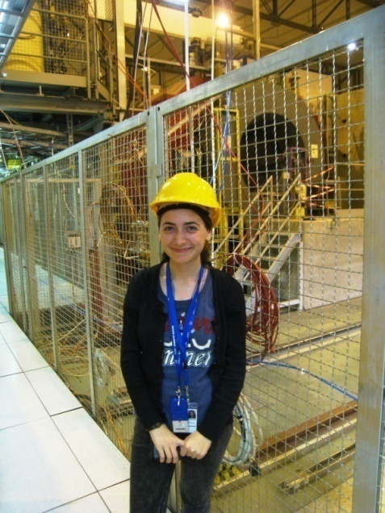
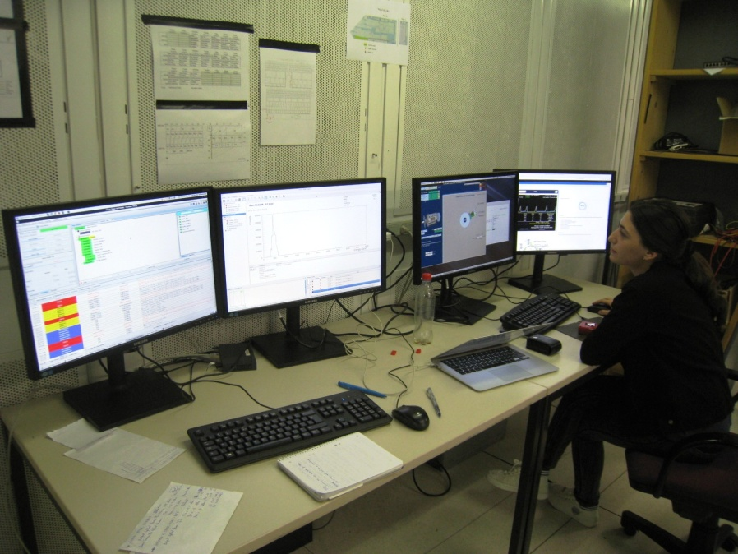
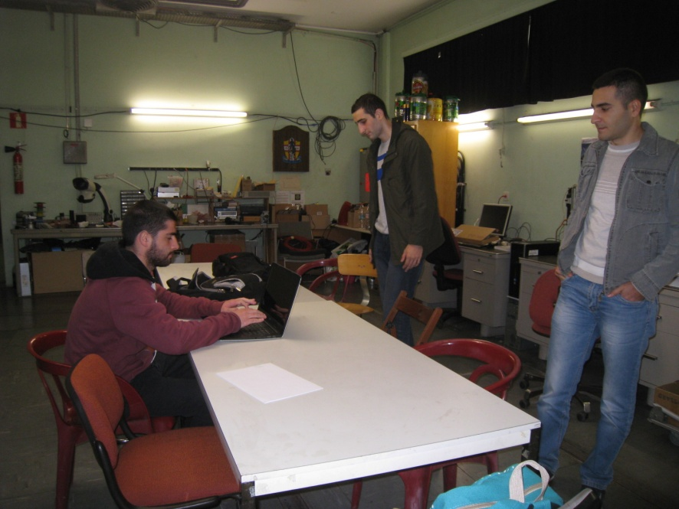
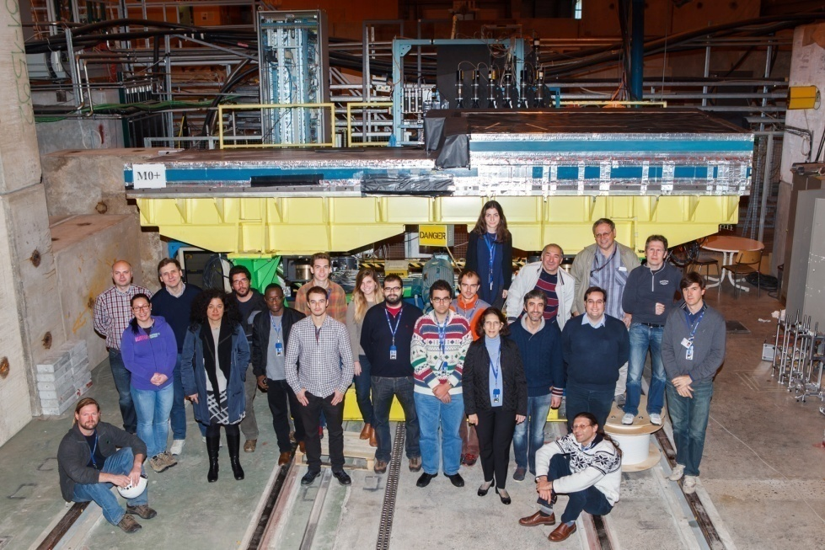
Tile Calorimeter Demonstrator Test Beam data -2015-2017
11
Notes:
11

Slide 12
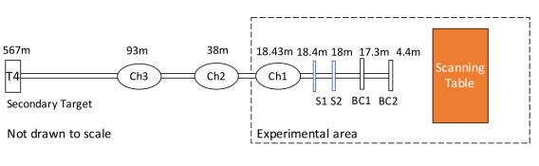
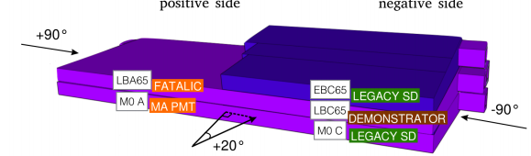
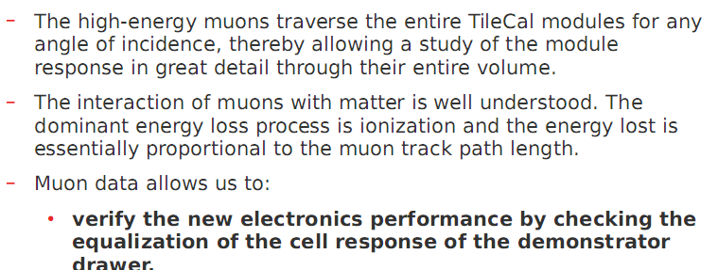
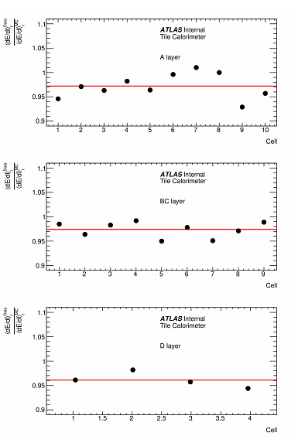
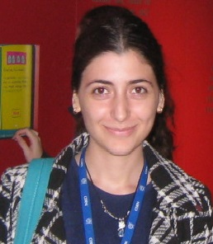
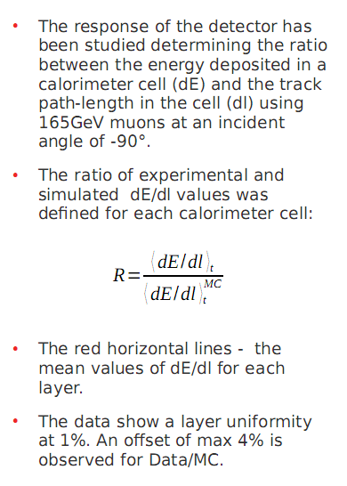
Tile Calorimeter Demonstrator Test Beam data analysis –Muon data 2017
The response of the detector has been studied determining the ratio between the energy deposited in a calorimeter cell (dE) and the track path-length in the cell (dl) using 165 GeV muons at an incident angle of -90°.
● The ratio of experimental and simulated dE/dl values was defined for each calorimeter cell:
● The red horizontal lines – the mean values of dE/dl for each layer.
● The data show a layer uniformity at 1%. An offset of max 4% is observed for Data/MC.
T.Zakareishvili
12
Notes:
12

Slide 13

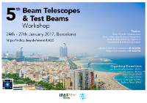
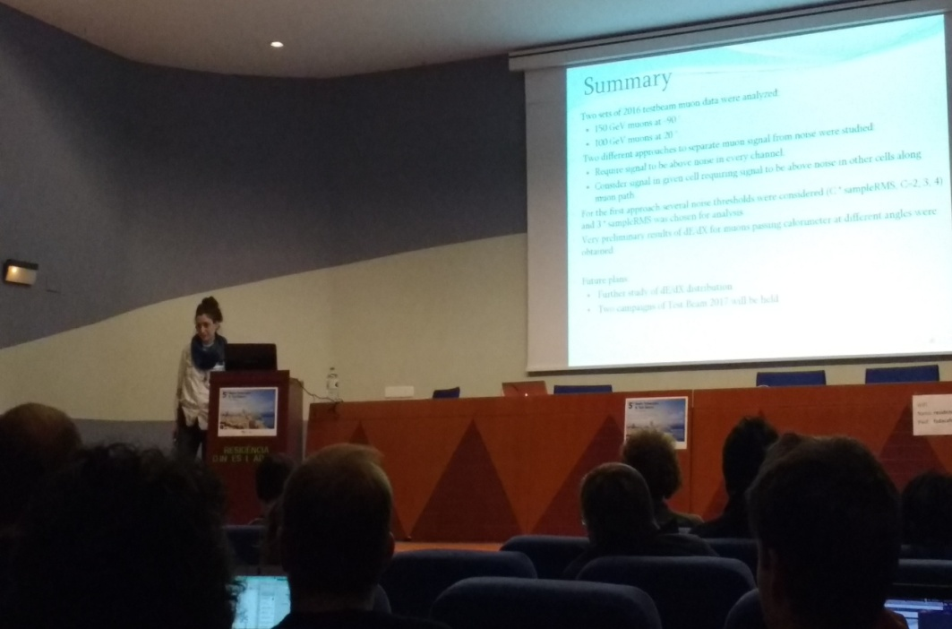

Conferences and workshops
1. 2017, 24-27 January, Barcelona, Spain, 5th Beam Telescopes and Test Beams Workshop 2017
“Muon Signals at a Low Signal-to-Noise Ratio Environment”, T. Zakareishvili; Session: Data Analysis and Test Beam Results https://indico.desy.de/indico/event/16161/contributions
2.2018, 16-19 January, Zurich, Switzerland, 6th Beam Telescopes and Test Beams Workshop 2018
“Studies of the ATLAS hadronic Calorimeter response to different particles at Test Beams”,
T. Zakareishvili; Session: Analyis, Scintillating Fibres & Calorimeters. https://indico.desy.de/indico/event/18050/session/8/contribution/34/material/slides/0.pdf
13

Slide 14

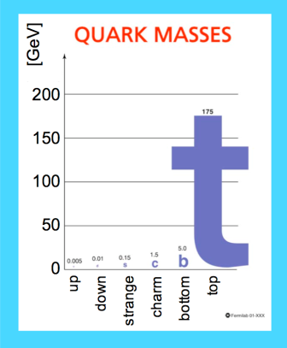
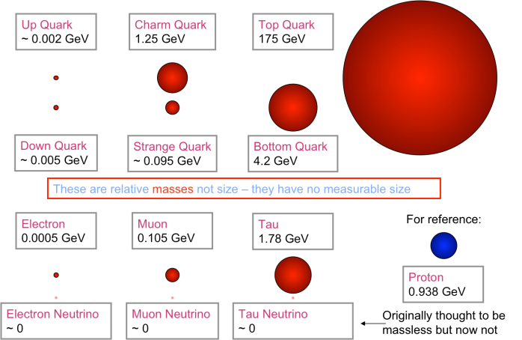
Motivations for Top Quark Physics Studies
The top quark was first observed in 1995 at the Fermilab
pp̄ Tevatron collider by CDF and DO experiments:
M_{t} = 174.3±3.2 (stat) ±4.0 (syst)
σ_{tt̄} = (CDF M_{t} = 175 GeV) = 6.5 ±_{1.4}^{1.7} pb
σ_{tt̄} = (Do M_{t} = 172 GeV) = 5.9 ± 1.7 pb
Q^{e}_{em}=2/3 l e l ; Weak isospin partner of b quark:
T^{t}₃ =1/2; Color triplet, spin ½;
The top quark is the heaviest elementary particle yet discovered. Its mass, of the same orders the electroweak scale, is about twice that of the W and Z bosons and about 35 times larger than its isospin partner, the b quark and slightly less than the mass of the gold nucleus.
Large value of top mass and short lifetime (τ_{t} ~ 5x10⁻ ²⁵ sec) make top quark unique:
  Decays before hadronization
  Sensitive window for New Physics
    Many new heavy particles produce top quarks
    Detailed properties of top probe SM & beyond
And in addition ...
Experiment: Top quark useful to calibrate the detector
Beyond Top: Top quarks are major source of background for almost every search for physics beyond the SM – New Physics

Slide 15
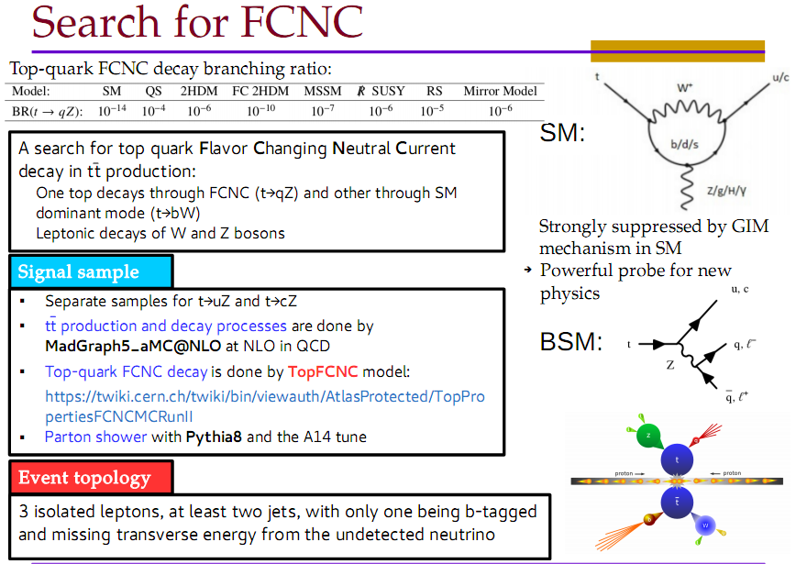
Analysis Team: J.Araque, N.Castro, B.Galhardo, F.Veloso, (LIP, Portugal)
A.Durglishvili, T.Djobava, M.Mosidze (HEPI TSU, Georgia)
S.Hellman, S.Molander (Stockholm University, Sweden)
15

Slide 16
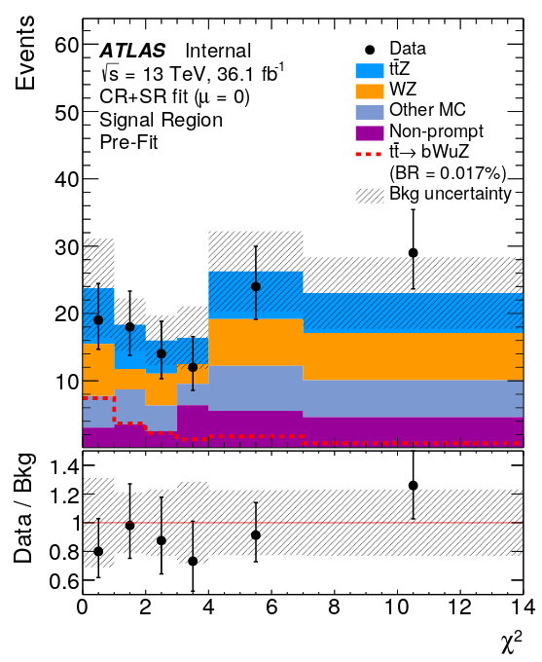
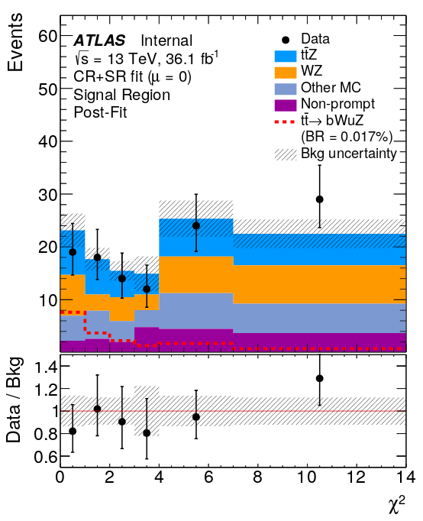
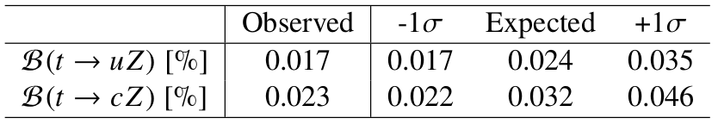
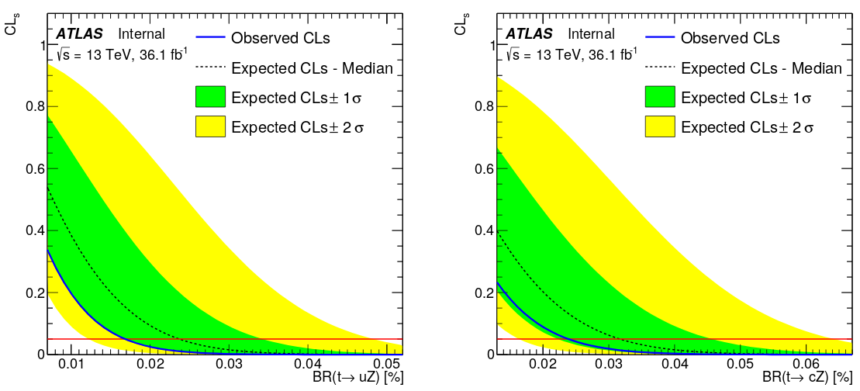
Results of t→qZ FCNC search
36 fb⁻¹ of 13 TeV data analysed
Observed data agree well with the SM background expectations
No evidence of signal is found
95% CL upper limits are set on the branching ratios of t→uZ and t→cZ
16

Slide 17

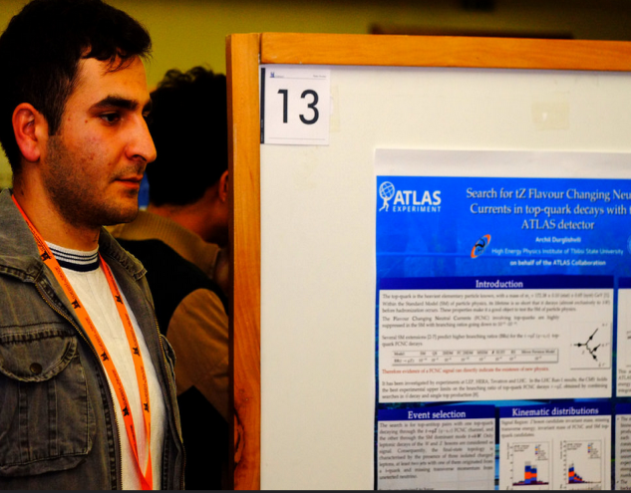
Conferences and workshops
2017, 17-22 September, Braga, Portugal, Top2017 - 10th International Workshop on Top Quark Physics , (http://top2017.lip.pt/ ) “Search for tZ Flavor Changing Neutral Currents in top quark decays with ATLAS at 13 TeV”, A.Durglishvili, Poster session; https://indico.cern.ch/event/659310/
17

Slide 18
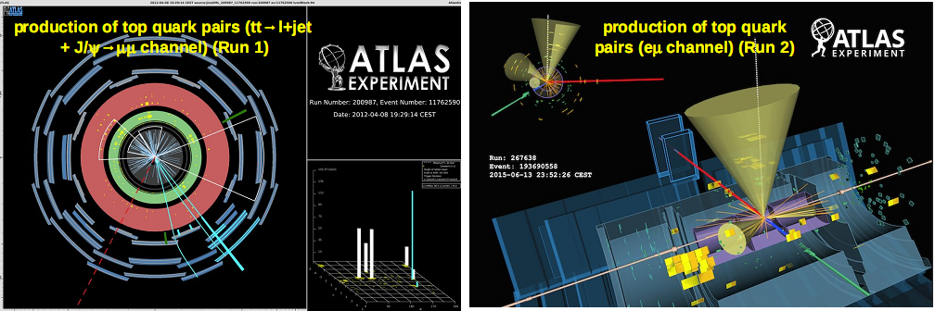
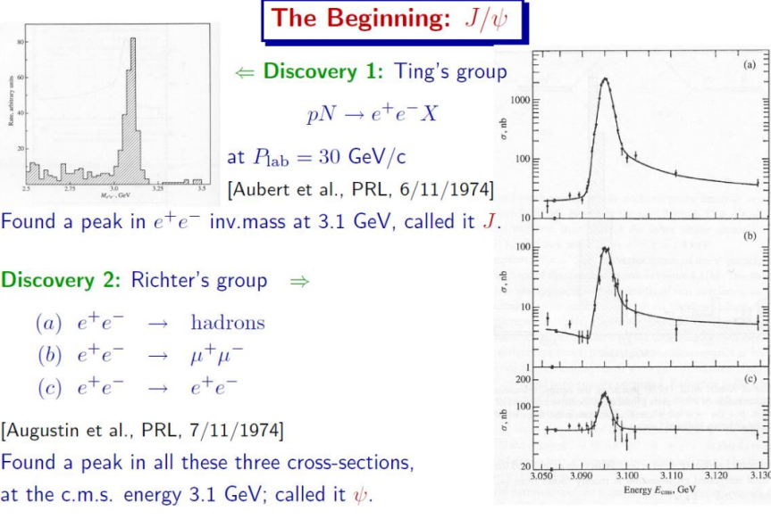
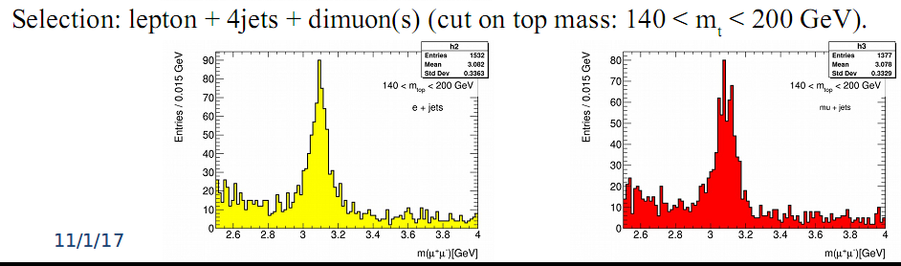
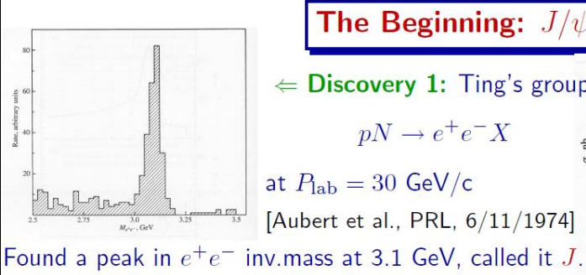
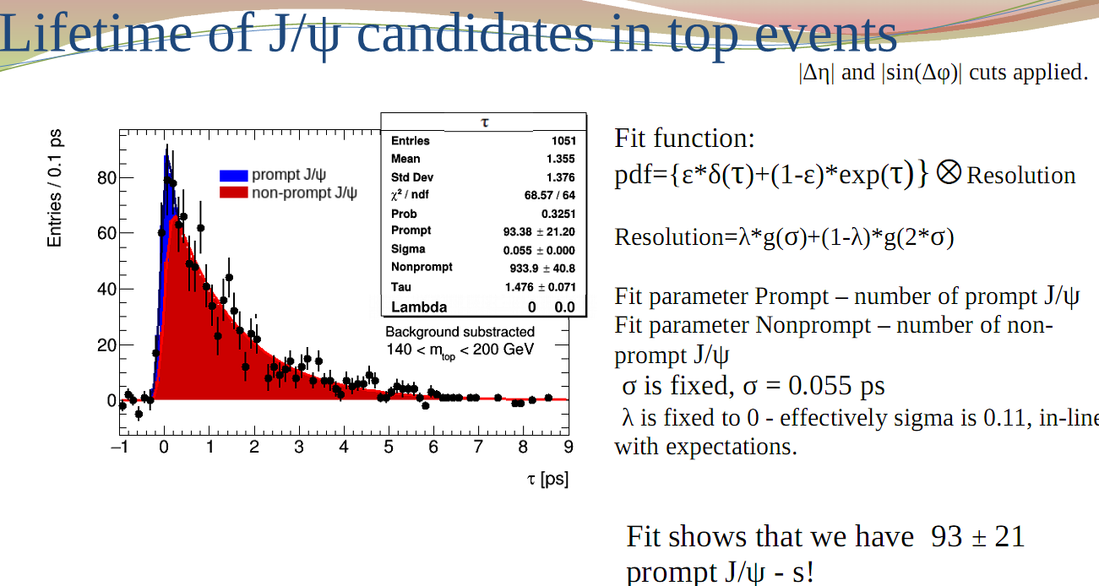
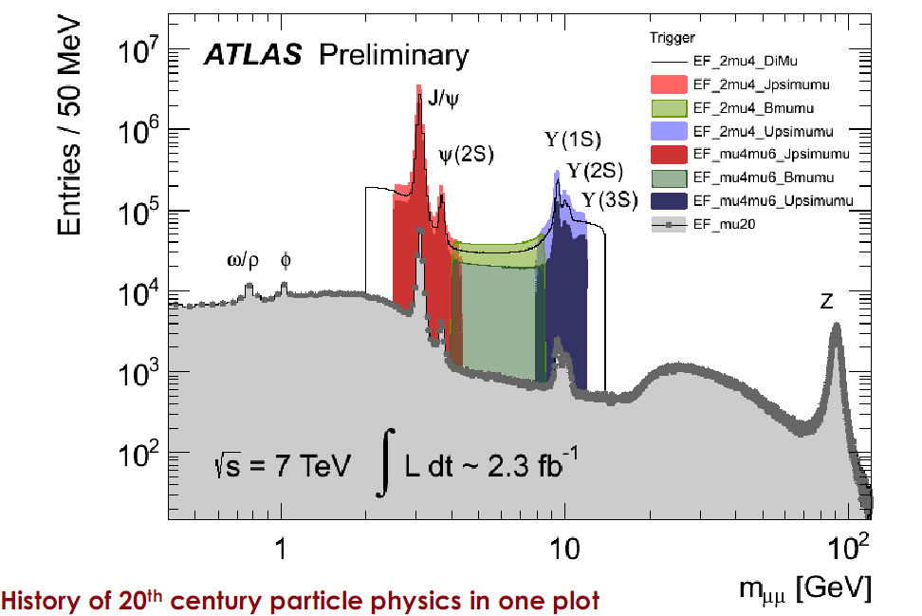
J/ψ production with top pair
Analysis Team:
V.Kartvelishvili, J.Walder
(Lancaster University (GB);
B.Chargeishvili, T.Djobava,
T. Zakareishvili (HEPI TSU)
Prof.V.Kartvelishvili
18

Slide 19

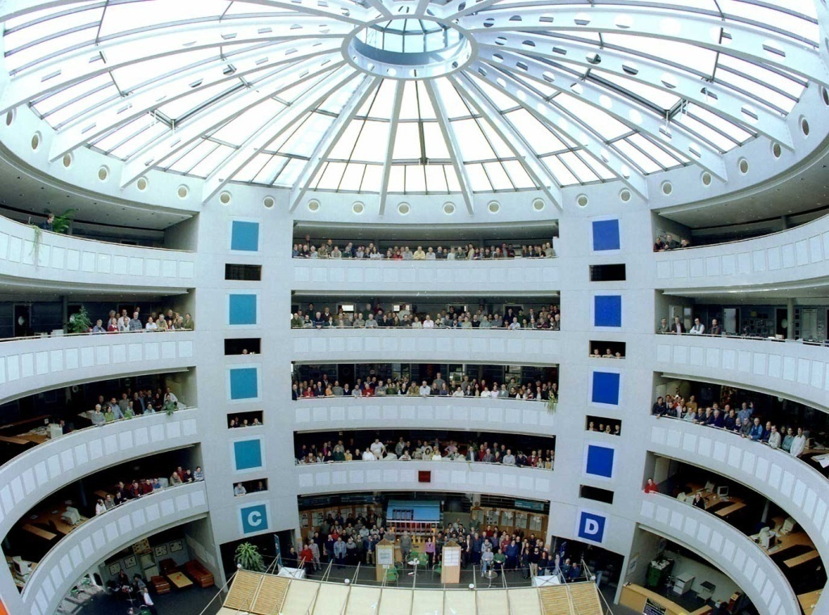

Future
Attract and involve young scientists, PhD, Masters and Bachelor students in ATLAS
ATLAS Collaboration members at CERN (Bldg. 40)

Slide 20

Thanks a lot !
gmadlobT yuradRebisaTvis!

Slide 21
Back-ups

Slide 22



The Underground
Cavern at Point-1 for
the ATLAS Detector
Length = 55 m
Width = 32 m
Height = 35 m
Side C
Side C
Side A
Side A

Slide 23

The current 95% CL observed limits on the BR( t→ qγ) vs BR(t → qZ) and
BR(t → qH) vs BR(t → qZ)
The
The current 95% CL observed limits on the (a) BR( t→ qγ) vs BR(t → qZ) and
(b) BR(t → qH) vs BR(t → qZ) planes are shown.The full lines represent the results from the ATLAS, CDF, CMS,D0,H1,LEP (combined results of the ALEPH,DELPHI,L3 and OPAL Collaborations) and ZEUS collaboration.The ATLAS lines correspond to the limit on BR(t → qZ in trilepton channel.

