Slide 1
Validation of Installed Capacity
John Gordon
WLCG MB
1st December 2009

Slide 2
Gstat 2.0
gstat 2.0 was described by Laurence Field at the November GDB http://indico.cern.ch/materialDisplay.py?sessionId=6&materialId=0&confId=45481
There are site views of Tier0, 1, 2 for WLCG
Now in the process of validating the data published
There are SAM tests to check that sites publish and sanity checks on the values published
But only sites know what they should be publishing.
I have compared some data with the published WLCG Tier1 accounts

Slide 3
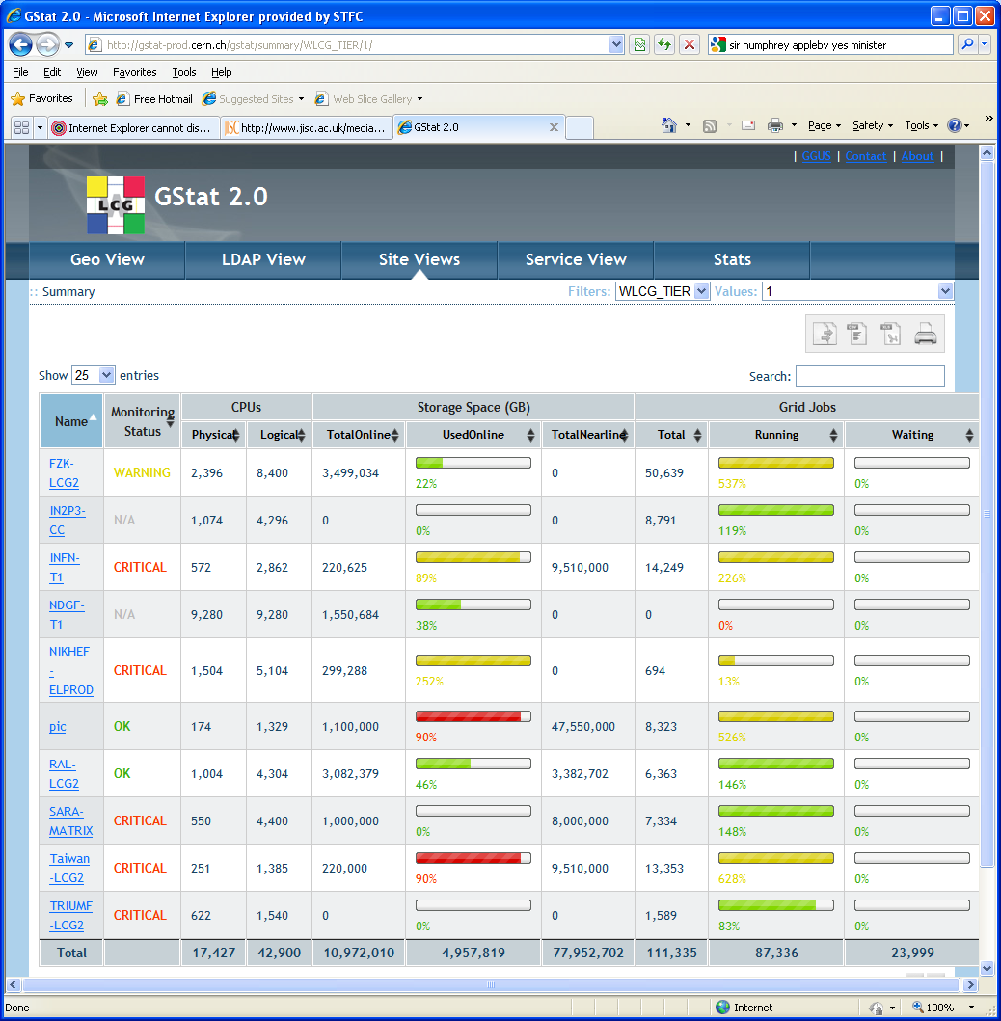

Slide 4
Validation of Tier1 by gstat
 | CPU (SI2K) |  |  |  | Disk(TB) |  |  |  | Tape (TB)
SITE-NAME | Pledge 2009 (kSI2K) | (kSI2K) | Monthly Accounts | gstat | Pledge 2009 | Accounts Installed | Accounts Allocated | gstat | Pledge 2009 | Accounts Installed | gstat
CERN | 32,970 | 37,594 | 37,594,000 | 13,476,648 | 10,065 | 7,774 | 7,774 | 0.609 | 25,063 | 25,083
FZK-LCG2 | 10,355 | 10,355 | 10,355,000 | 17,127,600 | 5,142 | 5,142 | 3,868 | 3,498 | 7,190 | 7,190
IN2P3 | 7,998 | 7,998 | 7,998,000 | 9,342,180 | 4,600 | 4,600 | 2,553 | 0 | 5,175 | 5,200
INFN-T1 | 5,300 | 3,000 | 3,000,000 | 4,607,820 | 2,300 | 1,379 | 1,300 | 220 | 2,600 | 1,500 | 9,510
NDGF-T1 | 3,030 | 3,030 | 3,030,000 | 3,047,280 | 1,580 | 1,580 | 1,202 | 1,583 | 1,660 | 1,660
NL-T1 | 7,544 | 3,833 | 3,833,000 | 19,816,720 | 3,753 | 1,110 | 940 | 1,229 | 3,548 | 460 | 8,000
pic | 2,591 | 2,591 | 2,591,000 | 1,595,181 | 1,702 | 1,042 | 1,067 | 1,100 | 1,844 | 1,050 | 47,550
RAL-LCG | 5,775 | 5,775 | 5,775,000 | 4,304,000 | 3,401 | 2,684 | 2,508 | 3,082 | 4,045 | 2,070 | 3,318
Taiwan | 5,000 | 2,432 | 2,432,000 | 3,747,170 | 3,000 | 2,500 | 1,340 | 220 | 5,000 | 3,000 | 9,510
Triumf | 1,420 | 905 | 905,000 | 3,384,240 | 990 | 500 | 500 | 0 | 750 | 750
BNL | 7,337 | 7,337 | 7,337,000 | N/A | 5,822 | 3,800 | 3,000 | N/A | 3,277 | 3,000
FNAL | 5,100 | 5,100 | 5,100,000 | N/A | 2,600 | 2,600 | 2,600 | N/A | 7,100 | 9,771
 | 94,420 | 89,950 | 89,950,000 | 80,448,839 | 44,955 | 34,711 | 28,652 | 10,933 | 67,252 | 60,734 | 77,888
Account Data - October 2009, Gstat - November 2009

Slide 5
Agreement
 | CPU (SI2K) |  |  |  | Disk(TB) |  |  |  | Tape (TB)
SITE-NAME | Pledge 2009 (kSI2K) | (kSI2K) | Monthly Accounts | gstat | Pledge 2009 | Accounts Installed | Accounts Allocated | gstat | Pledge 2009 | Accounts Installed | gstat
CERN | 32,970 | 37,594 | 37,594,000 | 13,476,648 | 10,065 | 7,774 | 7,774 | 0.609 | 25,063 | 25,083
FZK-LCG2 | 10,355 | 10,355 | 10,355,000 | 17,127,600 | 5,142 | 5,142 | 3,868 | 3,498 | 7,190 | 7,190
IN2P3 | 7,998 | 7,998 | 7,998,000 | 9,342,180 | 4,600 | 4,600 | 2,553 | 0 | 5,175 | 5,200
INFN-T1 | 5,300 | 3,000 | 3,000,000 | 4,607,820 | 2,300 | 1,379 | 1,300 | 220 | 2,600 | 1,500 | 9,510
NDGF-T1 | 3,030 | 3,030 | 3,030,000 | 3,047,280 | 1,580 | 1,580 | 1,202 | 1,583 | 1,660 | 1,660
NL-T1 | 7,544 | 3,833 | 3,833,000 | 19,816,720 | 3,753 | 1,110 | 940 | 1,229 | 3,548 | 460 | 8,000
pic | 2,591 | 2,591 | 2,591,000 | 1,595,181 | 1,702 | 1,042 | 1,067 | 1,100 | 1,844 | 1,050 | 47,550
RAL-LCG | 5,775 | 5,775 | 5,775,000 | 4,304,000 | 3,401 | 2,684 | 2,508 | 3,082 | 4,045 | 2,070 | 3,318
Taiwan | 5,000 | 2,432 | 2,432,000 | 3,747,170 | 3,000 | 2,500 | 1,340 | 220 | 5,000 | 3,000 | 9,510
Triumf | 1,420 | 905 | 905,000 | 3,384,240 | 990 | 500 | 500 | 0 | 750 | 750
BNL | 7,337 | 7,337 | 7,337,000 | N/A | 5,822 | 3,800 | 3,000 | N/A | 3,277 | 3,000
FNAL | 5,100 | 5,100 | 5,100,000 | N/A | 2,600 | 2,600 | 2,600 | N/A | 7,100 | 9,771
 | 94,420 | 89,950 | 89,950,000 | 80,448,839 | 44,955 | 34,711 | 28,652 | 10,933 | 67,252 | 60,734 | 77,888
Very little agreement of cpu
Figures in bold black are sites who have explained the discrepancy

Slide 6
Discrepancies?
 | CPU (SI2K) |  |  |  | Disk(TB) |  |  |  | Tape (TB)
SITE-NAME | Pledge 2009 (kSI2K) | (kSI2K) | Monthly Accounts | gstat | Pledge 2009 | Accounts Installed | Accounts Allocated | gstat | Pledge 2009 | Accounts Installed | gstat
CERN | 32,970 | 37,594 | 37,594,000 | 13,476,648 | 10,065 | 7,774 | 7,774 | 0.609 | 25,063 | 25,083
FZK-LCG2 | 10,355 | 10,355 | 10,355,000 | 17,127,600 | 5,142 | 5,142 | 3,868 | 3,498 | 7,190 | 7,190
IN2P3 | 7,998 | 7,998 | 7,998,000 | 9,342,180 | 4,600 | 4,600 | 2,553 | 0 | 5,175 | 5,200
INFN-T1 | 5,300 | 3,000 | 3,000,000 | 4,607,820 | 2,300 | 1,379 | 1,300 | 220 | 2,600 | 1,500 | 9,510
NDGF-T1 | 3,030 | 3,030 | 3,030,000 | 3,047,280 | 1,580 | 1,580 | 1,202 | 1,583 | 1,660 | 1,660
NL-T1 | 7,544 | 3,833 | 3,833,000 | 19,816,720 | 3,753 | 1,110 | 940 | 1,229 | 3,548 | 460 | 8,000
pic | 2,591 | 2,591 | 2,591,000 | 1,595,181 | 1,702 | 1,042 | 1,067 | 1,100 | 1,844 | 1,050 | 47,550
RAL-LCG | 5,775 | 5,775 | 5,775,000 | 4,304,000 | 3,401 | 2,684 | 2,508 | 3,082 | 4,045 | 2,070 | 3,318
Taiwan | 5,000 | 2,432 | 2,432,000 | 3,747,170 | 3,000 | 2,500 | 1,340 | 220 | 5,000 | 3,000 | 9,510
Triumf | 1,420 | 905 | 905,000 | 3,384,240 | 990 | 500 | 500 | 0 | 750 | 750
BNL | 7,337 | 7,337 | 7,337,000 | N/A | 5,822 | 3,800 | 3,000 | N/A | 3,277 | 3,000
FNAL | 5,100 | 5,100 | 5,100,000 | N/A | 2,600 | 2,600 | 2,600 | N/A | 7,100 | 9,771
 | 94,420 | 89,950 | 89,950,000 | 80,448,839 | 44,955 | 34,711 | 28,652 | 10,933 | 67,252 | 60,734 | 77,888
Many possible reasons:
Site has installed more resource since September.
Gstat measures everything, accounts are only LHC Vos
Site not publishing correctly
Can T1s explain next week?

Slide 7
Tier2s
Country | Federation | Name | Monitoring Status | Physical | Logical | TotalOnline (GB) | UsedOnline
Australia | AU-ATLAS | Australia-ATLAS | CRITICAL | 112 | 376 | 277377 | 5%
Austria | AT-HEPHY-VIENNA-UIBK | HEPHY-UIBK | CRITICAL | 39 | 262 | 53604 | 24%
Canada | CA-EAST-T2 | TORONTO-LCG2 | CRITICAL | 415 | 415 | 22881 | 49%
Canada | CA-WEST-T2 | ALBERTA-LCG2 | CRITICAL | 44 | 88 | 0 | 0%
Canada | CA-WEST-T2 | VICTORIA-LCG2 | CRITICAL | 65 | 130 | 0 | 0%
China | CN-IHEP | BEIJING-LCG2 | CRITICAL | 896 | 896 | 100327 | 16%
Estonia | EE-NICPB | TASK | CRITICAL | 2 | 8 | 1082 | 1%
Finland | FI-HIP-T2 | CSC | CRITICAL | 32 | 64 | 0 | 0%
France | FR-GRIF | GRIF | N/A | 0 | 0 | 0 | 0%
France | FR-IN2P3-CC-T2 | IN2P3-CC-T2 | N/A | 1074 | 4296 | 0 | 0%
France | FR-IN2P3-IPHC | IN2P3-IRES | CRITICAL | 224 | 1024 | 236995 | 89%
France | FR-IN2P3-LAPP | IN2P3-LAPP | CRITICAL | 160 | 512 | 182361 | 19%
France | FR-IN2P3-SUBATECH | IN2P3-SUBATECH | CRITICAL | 120 | 380 | 0 | 0%
Germany | DE-DESY-GOE-ATLAS-T2 | GoeGrid | CRITICAL | 1680 | 1680 | 517973 | 4%
Germany | DE-DESY-RWTH-CMS-T2 | DESY-HH | CRITICAL | 742 | 2956 | 633350 | 49%
Germany | DE-DESY-RWTH-CMS-T2 | DESY-ZN | N/A | 168 | 672 | 0 | 0%
Germany | DE-DESY-RWTH-CMS-T2 | RWTH-Aachen | N/A | 506 | 2024 | 564294 | 57%
Germany | DE-FREIBURGWUPPERTAL | UNI-FREIBURG | CRITICAL | 238 | 708 | 0 | 0%
Germany | DE-FREIBURGWUPPERTAL | wuppertalprod | CRITICAL | 32 | 1 | 0 | 0%
Germany | DE-MCAT | LRZ-LMU | CRITICAL | 300 | 600 | 511195 | 17%
Germany | DE-MCAT | M3PEC | CRITICAL | 6 | 24 | 1473 | 5%
Hungary | HU-HGCC-T2 | BUDAPEST | CRITICAL | 113 | 426 | 99997 | 67%
Hungary | HU-HGCC-T2 | ELTE | CRITICAL | 40 | 40 | 0 | 0%
India | IN-DAE-KOLKATA-TIER2 | IN-DAE-VECC-01 | CRITICAL | 26 | 52 | 0 | 0%
India | IN-DAE-KOLKATA-TIER2 | IN-DAE-VECC-02 | CRITICAL | 156 | 156 | 0 | 0%
India | IN-INDIACMS-TIFR | INDIACMS-TIFR | CRITICAL | 320 | 320 | 365322 | 24%
Israel | IL-HEPTier-2 | IL-TAU-HEP | CRITICAL | 16 | 64 | 64918 | 0%
Israel | IL-HEPTier-2 | TECHNION-HEP | CRITICAL | 36 | 144 | 38724 | 25%
Israel | IL-HEPTier-2 | WEIZMANN-LCG2 | CRITICAL | 56 | 180 | 0 | 0%
Italy | IT-LHCb-federation | INFN-CNAF-LHCB | CRITICAL | 572 | 2862 | 79 | 2%
Italy | IT-LHCb-federation | INFN-LNL-2 | CRITICAL | 440 | 1128 | 241959 | 76%
Italy | IT-LHCb-federation | INFN-PISA | N/A | 680 | 1720 | 31255543516 | 52%
Italy | IT-LHCb-federation | INFN-ROMA1 | CRITICAL | 73 | 262 | 195358 | 46%
Italy | IT-LHCb-federation | INFN-TORINO | N/A | 108 | 336 | 3935 | 2%
Japan | JP-Tokyo-ATLAS-T2 | TOKYO-LCG2 | CRITICAL | 60 | 120 | 357477 | 41%
Poland | PL-TIER2-WLCG | CYFRONET-LCG2 | CRITICAL | 596 | 2384 | 269300 | 44%
Portugal | PT-LIP-LCG-Tier2 | LIP-Coimbra | CRITICAL | 44 | 176 | 113190 | 37%
Portugal | PT-LIP-LCG-Tier2 | LIP-Lisbon | CRITICAL | 134 | 536 | 198397 | 62%
Republic of Korea | KR-KISTI-T2 | KTU-BG-GLITE | CRITICAL | 38 | 38 | 0 | 0%
Republic of Korea | KR-KNU-T2 | LCG_KNU | CRITICAL | 336 | 336 | 0 | 0%
Romania | RO-LCG | RO-02-NIPNE | CRITICAL | 84 | 212 | 73823 | 12%
Romania | RO-LCG | RO-03-UPB | CRITICAL | 122 | 356 | 293 | 6%
Romania | RO-LCG | RO-07-NIPNE | CRITICAL | 548 | 424 | 92021 | 14%
Romania | RO-LCG | RO-11-NIPNE | CRITICAL | 16 | 32 | 492 | 5%
Russian Fed. | RU-RDIG | JINR-LCG2 | CRITICAL | 314 | 992 | 367448 | 46%
Russian Fed. | RU-RDIG | RRC-KI | CRITICAL | 0 | 0 | 0 | 0%
Russian Fed. | RU-RDIG | ru-Moscow-FIAN-LCG2 | CRITICAL | 30 | 52 | 44498 | 5%
Russian Fed. | RU-RDIG | ru-Moscow-MEPHI-LCG2 | CRITICAL | 54 | 168 | 37388 | 4%
Russian Fed. | RU-RDIG | RU-Novosibirsk-BINP | N/A | 20 | 40 | 12999 | 38%
Russian Fed. | RU-RDIG | Ru-Troitsk-INR-LCG2 | CRITICAL | 160 | 160 | 59998 | 31%
Slovenia | SI-SiGNET | SiGNET | CRITICAL | 239 | 582 | 0 | 0%
Spain | ES-ATLAS-T2 | ifae | CRITICAL | 12 | 96 | 0 | 0%
Spain | ES-ATLAS-T2 | IFIC-LCG2 | OK | 250 | 442 | 0 | 0%
Spain | ES-ATLAS-T2 | UAM-LCG2 | CRITICAL | 86 | 346 | 0 | 0%
Spain | ES-CMS-T2 | CIEMAT-LCG2 | CRITICAL | 298 | 836 | 258034 | 49%
Spain | ES-CMS-T2 | IFCA-LCG2 | CRITICAL | 460 | 1778 | 214 | 57834%
Spain | ES-LHCb-T2 | UB-LCG2 | CRITICAL | 85 | 275 | 0 | 0%
Switzerland | CH-CHIPP-CSCS | CSCS-LCG2 | CRITICAL | 240 | 960 | 444798 | 43%
Taipei | TW-FTT-T2 | TW-FTT | CRITICAL | 254 | 508 | 350186 | 65%
UK | UK-London-Tier2 | UKI-LT2-Brunel | CRITICAL | 26 | 161 | 110469 | 78%
UK | UK-London-Tier2 | UKI-LT2-RHUL | CRITICAL | 400 | 400 | 263995 | 33%
UK | UK-NorthGrid | UKI-NORTHGRID-LIV-HEP | CRITICAL | 790 | 832 | 242109 | 28%
UK | UK-NorthGrid | UKI-NORTHGRID-MAN-HEP | N/A | 1786 | 1786 | 0 | 0%
UK | UK-ScotGrid | UKI-SCOTGRID-DURHAM | CRITICAL | 672 | 672 | 0 | 0%
UK | UK-ScotGrid | UKI-SCOTGRID-ECDF | N/A | 460 | 1436 | 8 | 50%
UK | UK-ScotGrid | UKI-SCOTGRID-GLASGOW | CRITICAL | 618 | 1912 | 448047 | 35%
UK | UK-SouthGrid | EFDA-JET | CRITICAL | 254 | 254 | 1721 | 52%
UK | UK-SouthGrid | UKI-SOUTHGRID-BHAM-HEP | CRITICAL | 208 | 320 | 60492 | 18%
UK | UK-SouthGrid | UKI-SOUTHGRID-BRIS-HEP | CRITICAL | 192 | 392 | 46884495360 | 18%
UK | UK-SouthGrid | UKI-SOUTHGRID-CAM-HEP | CRITICAL | 152 | 184 | 0 | 0%
UK | UK-SouthGrid | UKI-SOUTHGRID-OX-HEP | CRITICAL | 426 | 432 | 139950 | 43%
UK | UK-SouthGrid | UKI-SOUTHGRID-RALPP | N/A | 460 | 1544 | 557265 | 35%
USA | T2_US_MIT | MPI-K | CRITICAL | 16 | 32 | 0 | 0%
84 sites publishing as T2s
73 in T2 Report (signed MoU)
Should be 164 T2 sites
  need to flag as such
Of the 74 shown here, many are not publishing storage
Will eventually compare values with pledges
Please encourage sites to flag as T2, publish and validate storage numbers

