Slide 2
75 ns Bunch Spacing Studies with Xenon
LIU-PS Beam Dynamics Working Group
08/03/2018
S. Albright, H. Damerau, A. Lasheen
Many thanks to H. Bartosik, S. Energico, M. Morvillo

Slide 3
Introduction and Motivation
50 ns bunch spacing with lead from PS
Demonstrated with 2 bunches in 2016 (MD Days 2017)
Requires additional wide-band RF system to produce 4 bunches
Not considered immediate priority
75 ns bunch spacing as back-up option
3 bunches possible with existing hardware
Recover partial performance without slip-stacking in SPS
Beam tests with xenon at end of 2017 run
Scaling from xenon to lead?
Beam studies with lead this year

Slide 4
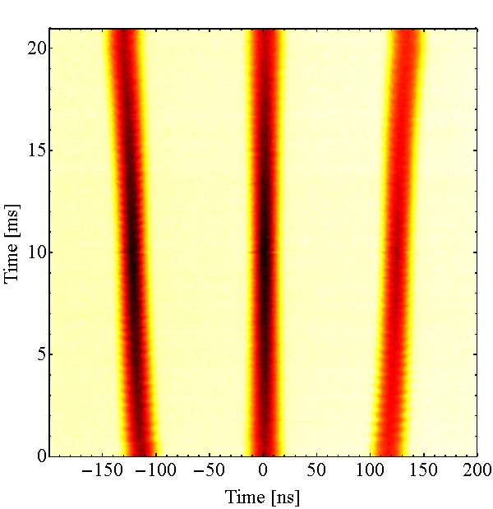
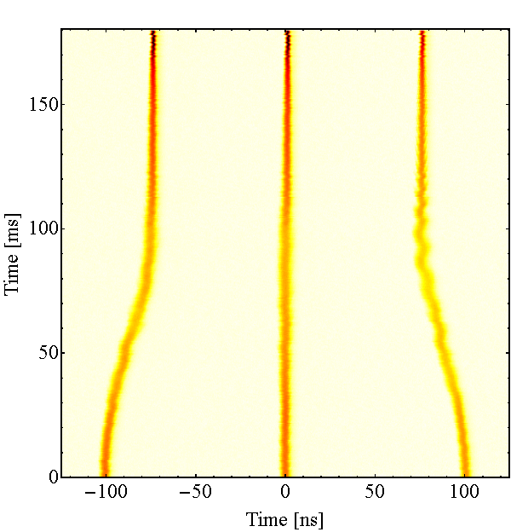
75 ns, 3 bunch scheme for ions
Inject 3 bunches from LEIR
Accelerate on h = 24 to intermediate flat-top
Batch expansion step h = 24 → 21
Accelerate on h= 21 to flat-top
Batch compression step h = 21 → 28
Re-bunching h = 28 → 169
Detuned 20 MHz cavity
Detuned 80 MHz cavity
10 MHz RF system
Intermediate flat-top
Flat-top
h = 21
h = 169
h = 28
Simulation
h = 24
h = 21

Slide 5
Injection

Slide 6
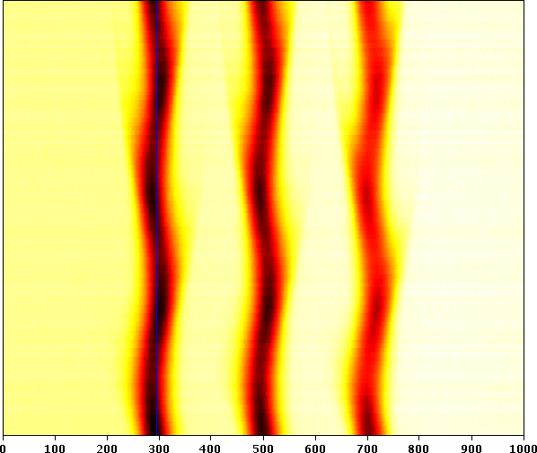
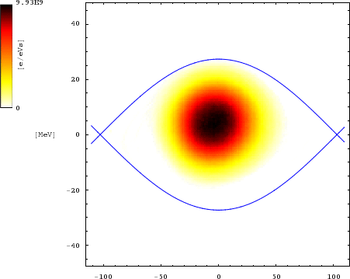
LEIR-PS transfer of 3 bunches
Single bunch transfer LEIR-PS possible at several harmonics
The PS circumference is 8 times the one of LEIR → h_{PS} = 8 h_{LEIR}
Transfer of 2 bunches: h_{LEIR} = 2 h_{PS} = 16
Transfer of 3 bunches: h_{LEIR} = 3 h_{PS} = 24
Handshake LEIR-PS with standard RF trains at h_{PS} = 1, 8 and 16
No hardware modification required thanks to programmable multi-harmonic sources (MHS)
~1 ms
ΔE [MeV]
Time [ns]
Time [ns]

Slide 7
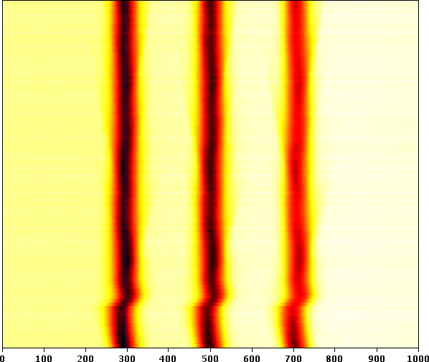
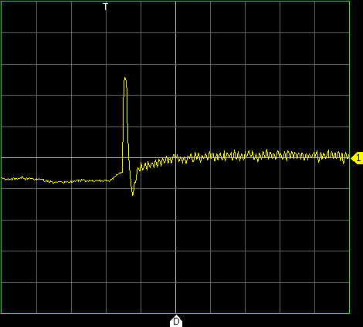
LEIR-PS transfer of 3 bunches
Longitudinally matched injection
Energy matching to be improved
Bunch still well captured by beam phase loop
Correct energy matching LEIR-PS for studies in 2018
`
Glitch when closing phase loop
Glitch when closing phase loop
Δφ_{h=24}
~1 ms
Phase error [a.u.]
Phase loop switched to beam signal
Time [ns]
1 ms

Slide 8
Acceleration and intermediate flat-top

Slide 9
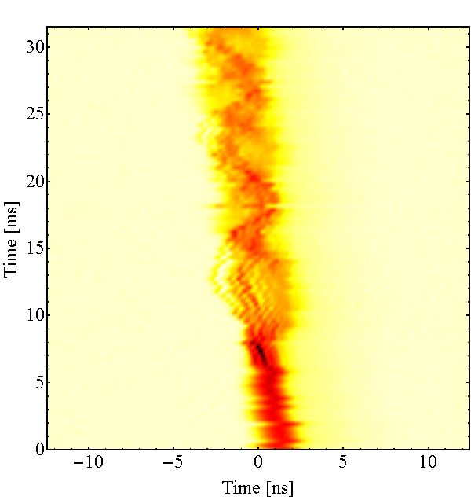
Acceleration and intermediate flat-top
The upper frequency limit of the main 10 MHz cavities excludes acceleration to the flat-top on h = 24
Highest possible harmonic compatible with f_{rev} = 473.13 kHz (¹²⁹Xe³⁹⁺) and 472.64 kHz (²⁰⁸Pb⁵⁴⁺) at flat-top is h = 21
Single batch expansion step h = 24 → 21
Simple compared to RF manipulations for nominal 100 ns beam
No issue expected at intermediate flat-top
Beam break-up after transition crossing for large density
Cured by emittance blow-up in PS from ~3 eVs to ~5.2 eVs (matched)
Break-up after transition
γ_{tr}

Slide 10
Flat-top

Slide 11
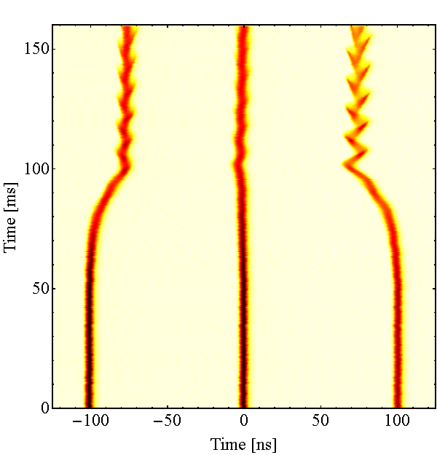
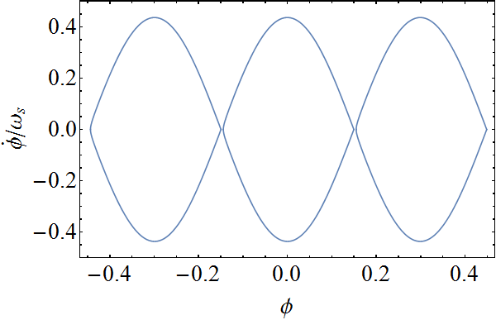
Batch compression
Moving the main RF harmonic from h = 21 → 28
Bunch spacing changes from 100 ns to 75 ns
Detuned 20 MHz cavity, slightly below the h = 28 proton frequency
Asymmetric voltages capabilities: 20 kV at h = 28, up to 200 kV at h = 21
Compromise: 80 kV (4 cavities) to 20 kV
Manipulation too fast towards the → Non-linear voltage programs
h = 21 → 28, linear in 100 ms
Normalized phase space

Slide 12
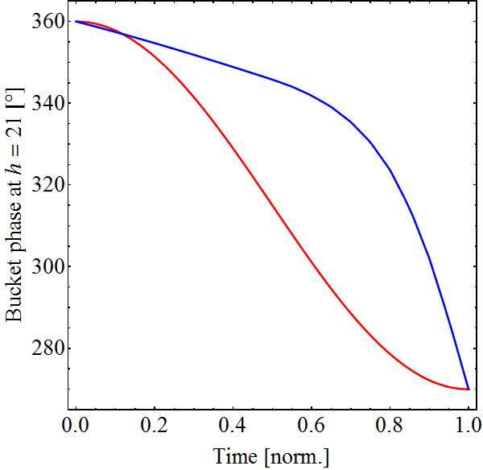
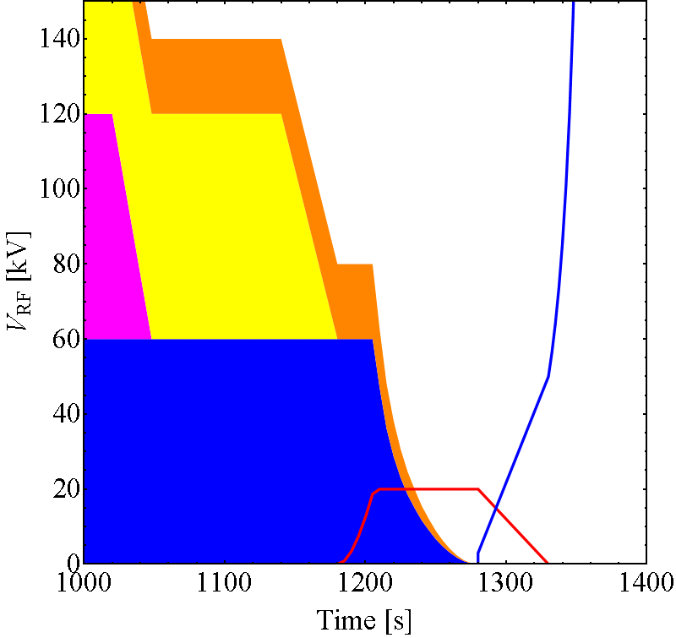
Optimized voltage programs
Non-linear voltage programs to define motion of bucket centers
Sinusoidal motion of outer buckets → continuous in φ and dφ/dt
Significantly improved adiabaticity
Phase of outer bucket
Voltage prgrams
Linear
h = 21
Non-linear voltage
h = 28
h = 169

Slide 13
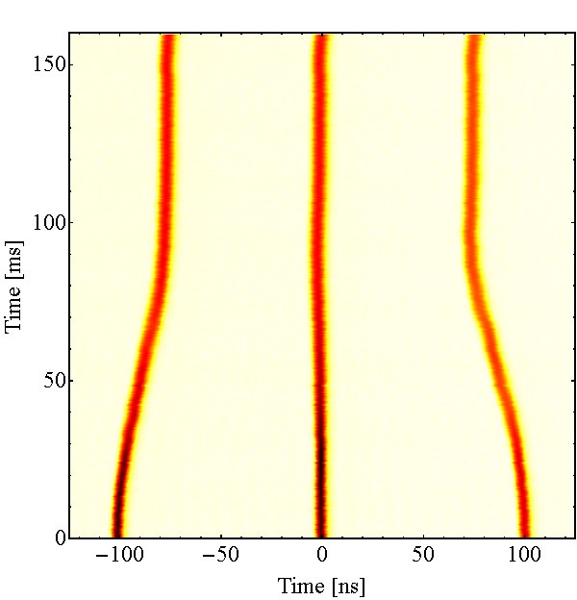
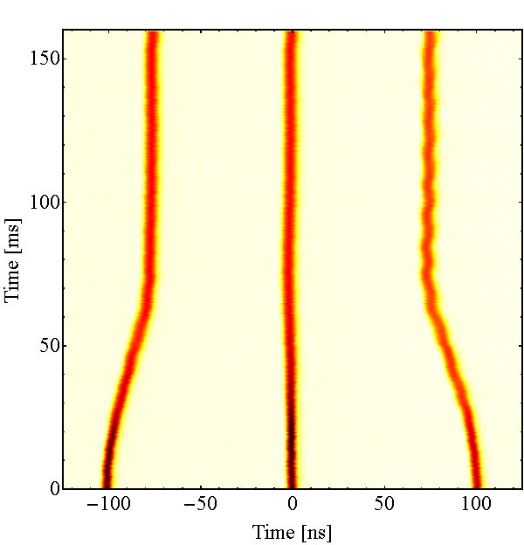
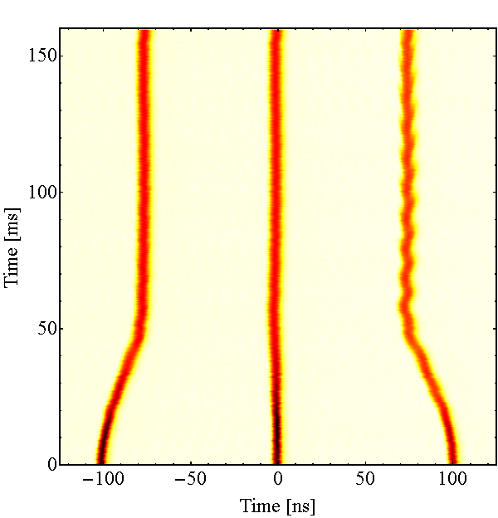
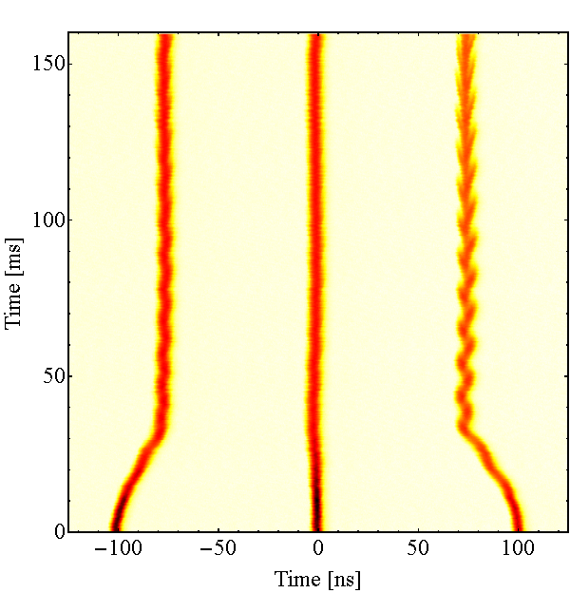
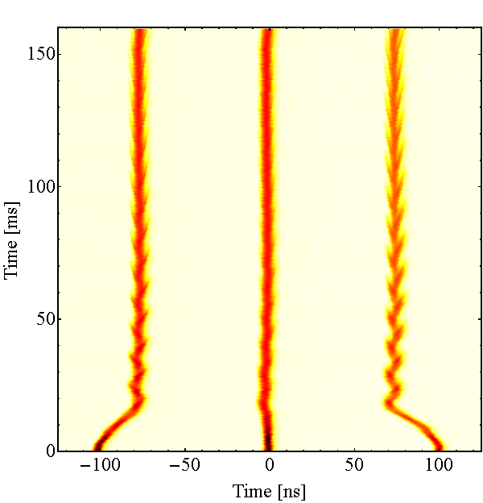
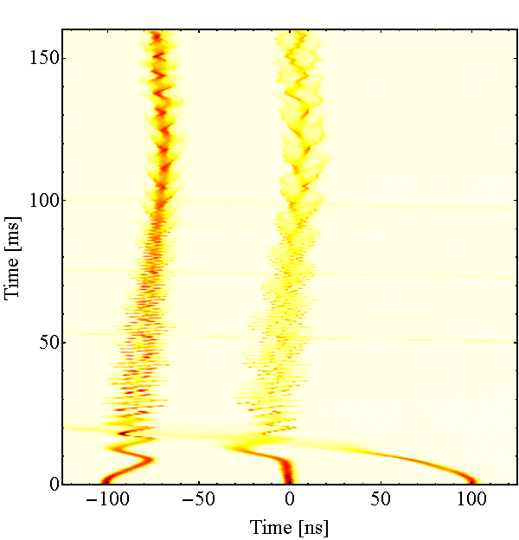
Duration of batch compression
100 ms
80 ms
60 ms
40 ms
20 ms
10 ms
No further improvement with longer manipulation → kept 100 ms

Slide 14
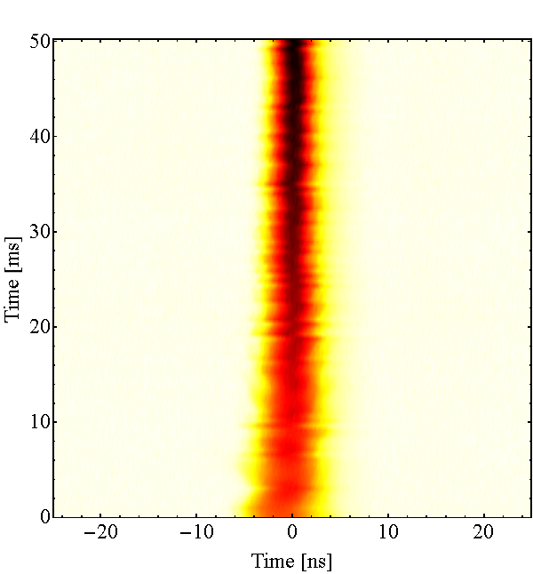
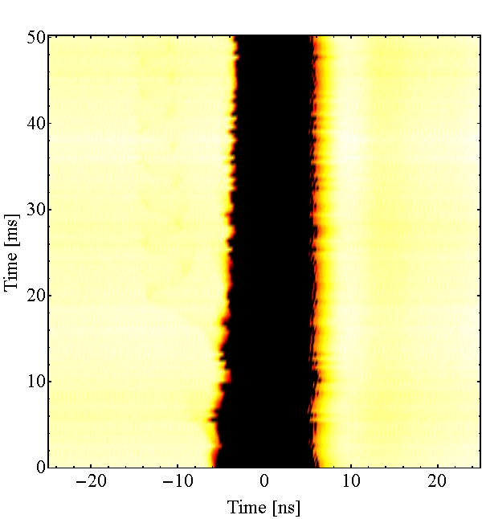
Re-bucketing to 80 MHz
Only 20 kV at h = 28 available for handover to h = 169 (80 MHz)
Sensitive: can be adjusted in phase such that bunches just fit
Expect higher population of satellite bunches than with nominal beam
May become critical with lead beams for LHC
h = 28 → 169 (left bunch)
h = 28 → 169 (satellites)

Slide 15
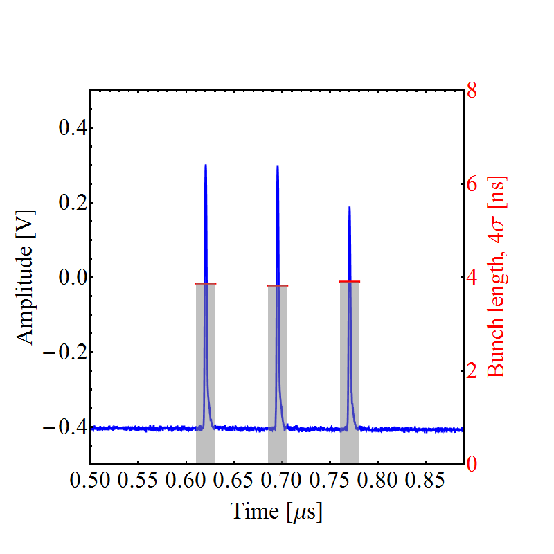
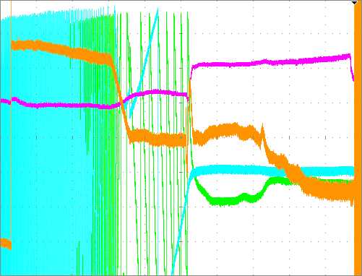
Towards extraction
Extraction synchronization (coarse and fine) work correctly
Beam phase loop at h = 21 kept until extraction
Issues to switch phase loop from h = 21 to h = 169
Understand h = 21 phase loop asymmetry during flat-top batch compression
Check h = 169 phase loop or ejection jitter when keeping phase loop at h = 21
Loop signals at flat-top
Bunches at extraction
ΔR
Δφ_{h=21}
Synchronization: h = 1/9
500 ms

Slide 16
Studies with lead

Slide 17
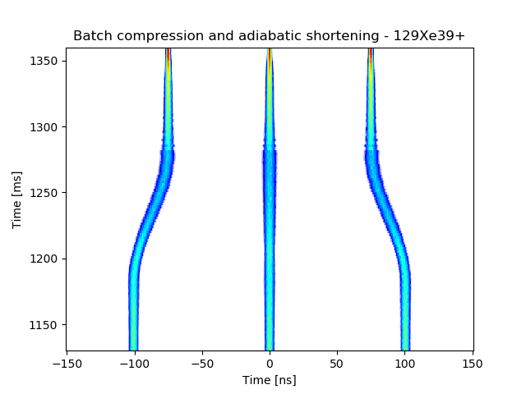
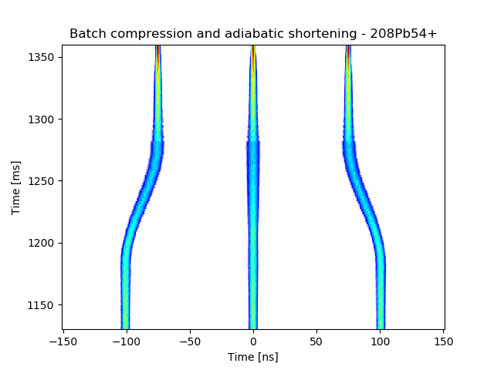
Feasibility of 75 ns with lead?
Scaling from ¹²⁹Xe³⁹⁺ to ²⁰⁸Pb⁵⁴⁺
Synchrotron frequency f_{s,Pb}/f_{s,Xe} ≈ 0.9
Bucket filling factor (ε_{l}/A_{b})_{Pb}/ (ε_{l}/A_{b})_{Xe} ≈ 1.0
Lower flat-top field for xenon in 2017
80 ms longer flat top than normally with lead
Shorten intermediate flat-top and extend flat-top, duty cycle limit?
Longitudinally xenon and lead expected to behave similarly
BLonD simulation ¹²⁹Xe³⁹⁺
²⁰⁸Pb⁵⁴⁺ case
ε_{l} = 6.5 eVs
ε_{l} = 10.4 eVs

Slide 18
Summary

Slide 19
Summary
Proof-of-principle demonstration of 3 bunches spaced by 75 ns with xenon in 2017
Transfer of 3 bunches into h = 24 buckets
Simple batch expansion at intermediate flat-top
Beam break-up at transition crossing, fixed with blow-up
Requires 2nd 20 MHz cavity for h = 21 → 28 compression
Phases during re-bucketing h = 28 → 169 very sensitive
Good longitudinal beam quality at PS extraction (4σ ≈ 4 ns)
Studies with lead in 2018
Similar longitudinal behaviour of lead and xenon expected at PS flat-top
Extension of flat-top by ~80 ms required for lead
Schedule PS studies with lead during 2nd half of May?
Feedback on beam quality from SPS needed

Slide 20

THANK YOU FOR YOUR ATTENTION!

