Slide 1
Fresca 2 vertical cryostat
Assembly sequence

Slide 2
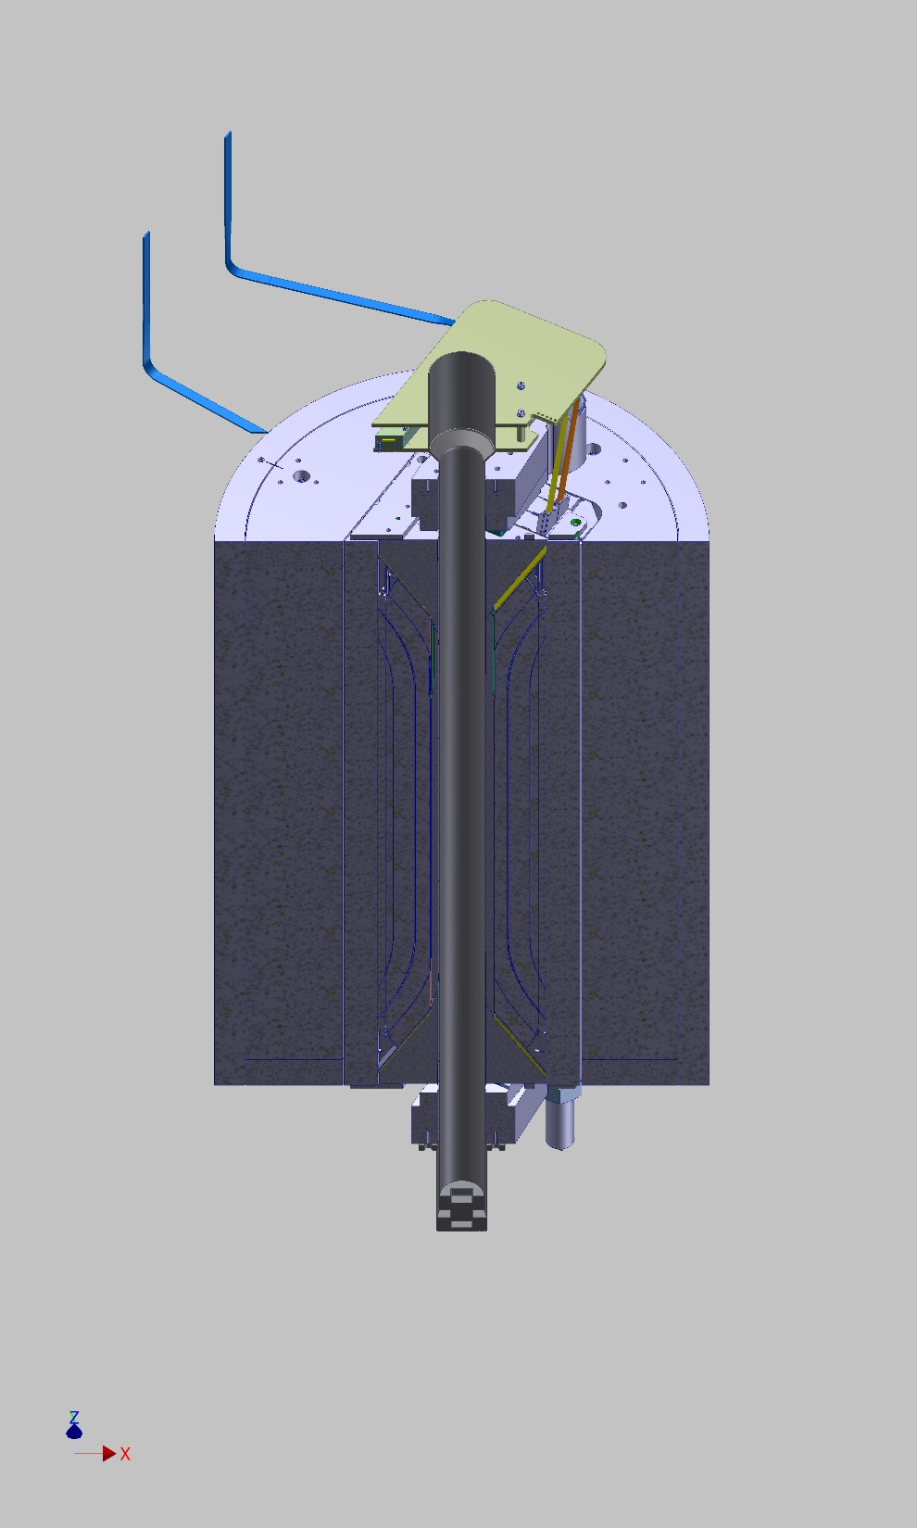
Magnet preparation
Installation of restraints at both extremities
Dummy inner cryostat
  Restrains alignment
  Positioning of magnet on lambda plate
  Positioning of bayonet feedthrough
Insertion of dummy inner cryostat for extremities positioning

Slide 3
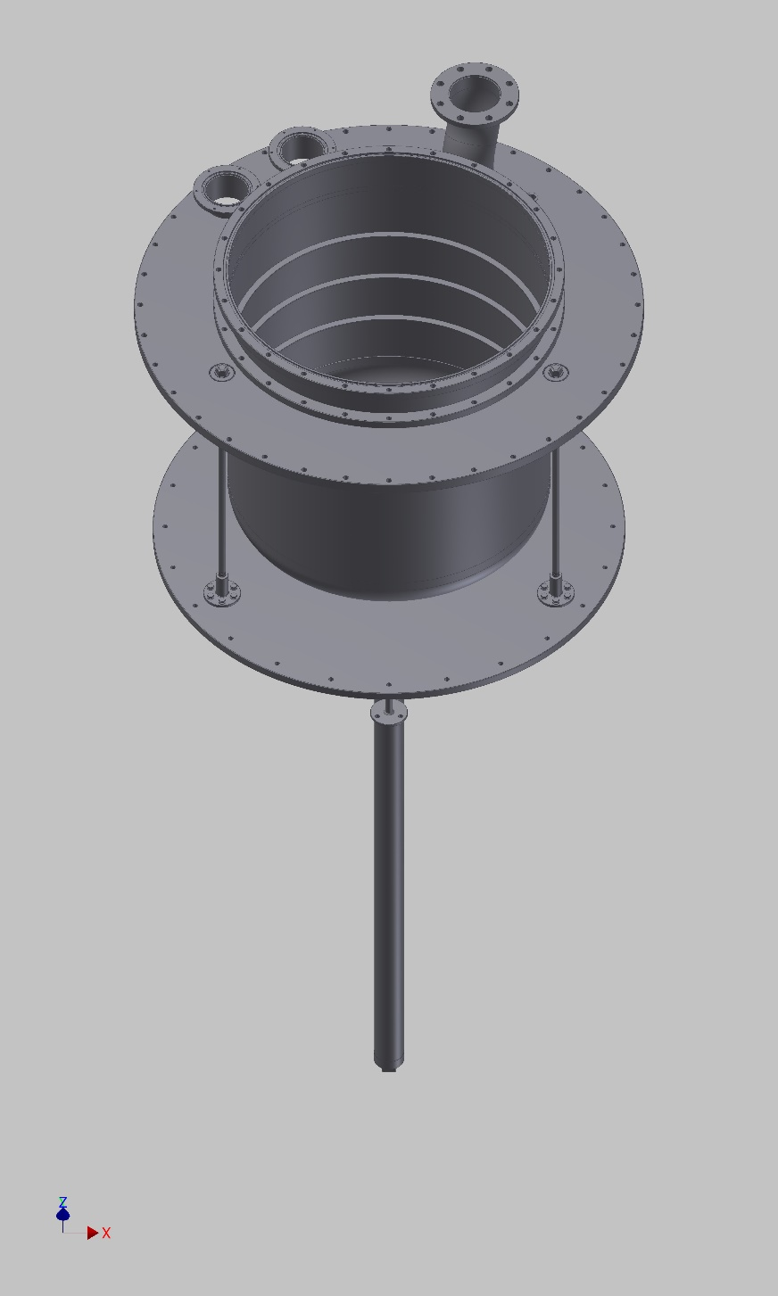
Insert assembly
Mechanical assembly of the insert (lambda plate to top plate)
Current leads
Cryogenic instrumentation
Lambda valve

Slide 4
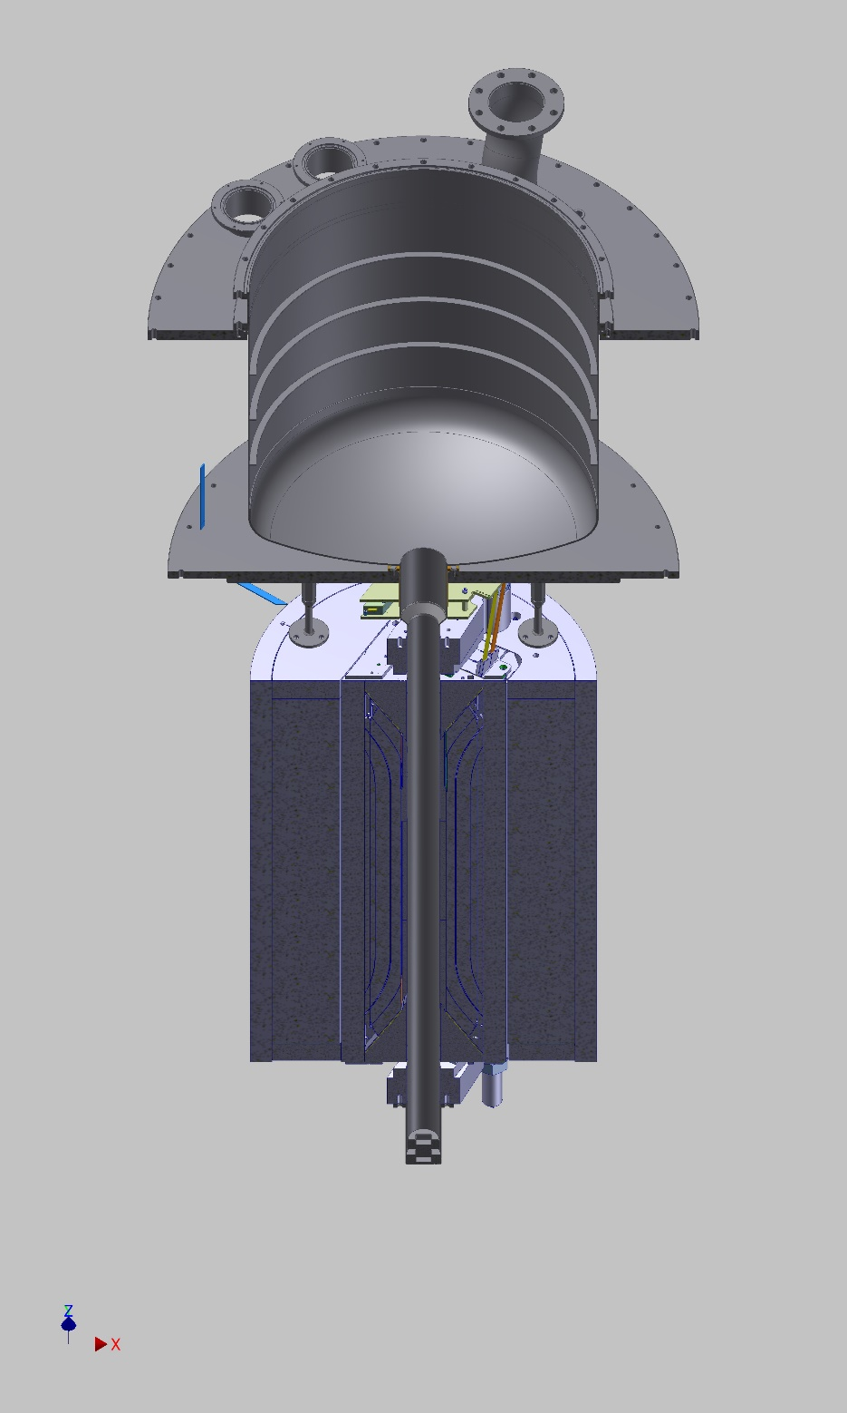
Insert assembly
Magnet
  Check orientation of magnet
  Magnet positioning
  Alignment and tightening of bayonet feedthrough
  Connection of current leads and feedthrough
  Magnet instrumentation

Slide 5
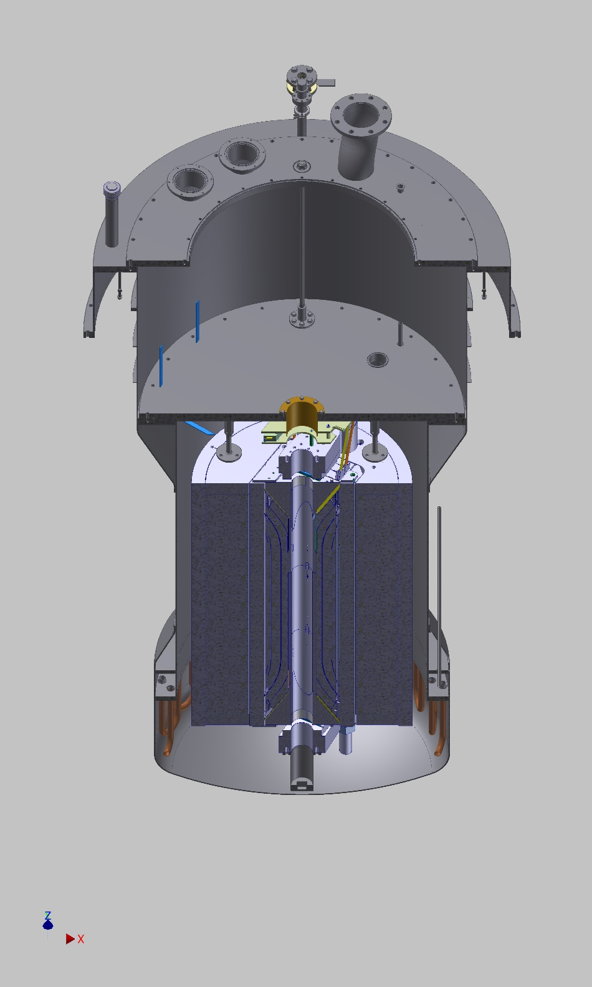
Magnet insert installation
Installation of lambda sealing
Insertion of magnet insert inside outer cryostat
Tightening of lambda sealing
  Require access inside the cryostat
Removal of tie-rods between top and lambda plate
Removal of dummy inner cryostat
Verification of magnet orientation

Slide 6
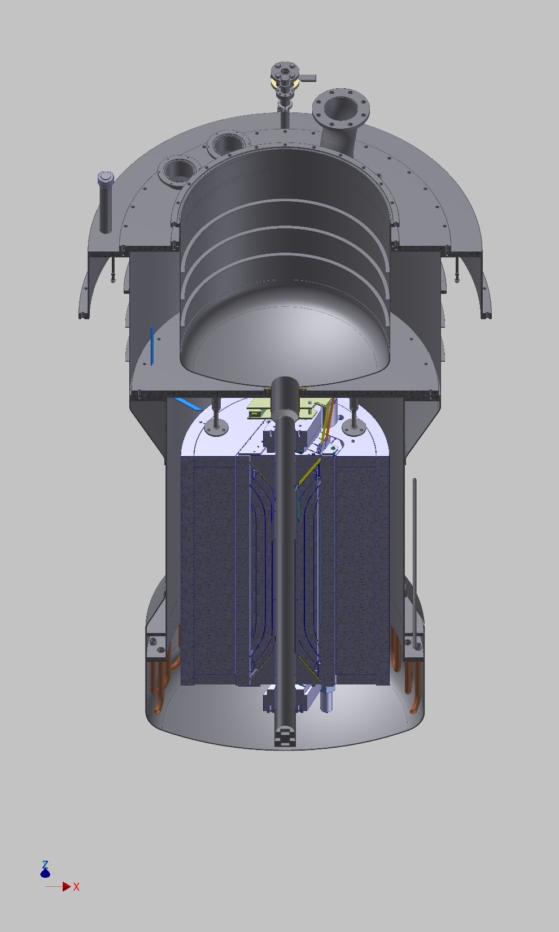
Inner cryostat installation
Insertion of inner vacuum vessel
  Magnet restrains and vacuum vessel shall be designed to guide the cryostat during insertion
Verification of outer helium vessel leak tightness

Slide 7
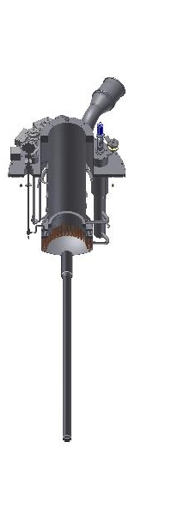
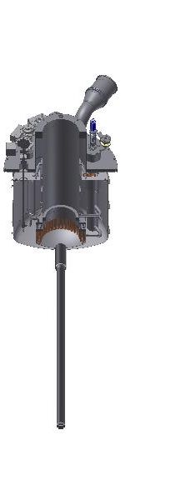
Inner cryostat installation
Installation of inner thermal shield to helium vessel
Insertion of inner helium vessel and TS inside vacuum vessel
  Guiding shall be provided for correct positioning of helium vessel inside the restraints
  Restraints shall be long enough to cope with differential thermal contractions between HeV and VV
Tightening of inner vacuum vessel thermalization
Verification of inner vacuum vessel leak tightness
Connection of cryogenic lines to valve box

Slide 8
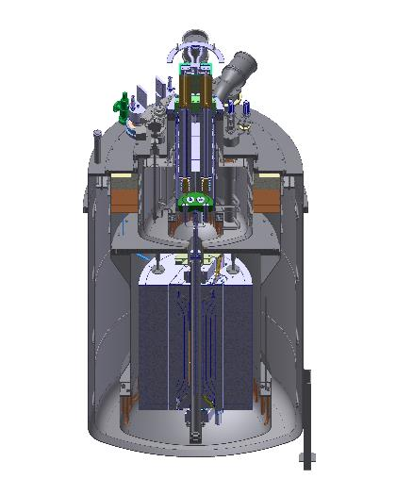
Sample insert insertion
Preparation of sample insert by CERN
Insertion inside the inner helium vessel
  Guiding shall be provided for correct positioning of sample holder during insertion
  Tolerances shall be calculated to respect the alignment and maximum rotation requirements

