Slide 1
FRESCA2 Infrastructure and
MSC Components
J. Fleiter and A. Ballarino

Slide 2
Motivation
Perform the electrical characterization of superconducting cables at temperatures in between 4.3 K and 1.9 K and in fields of up to 13 T
The basic characterization of a superconducting cable sample in the FRESCA2 test facility involves:
  Cool-down of the sample to 1.9 – 4.3 K
  Apply DC field (0-13 T) on the sample
  Ramp current in the sample until that Quench Detection System detect a quench
  Measure the voltage, the current (sample and magnet) and the temperature of the LHe thanks to a dedicated Data Acquisition System (DAQ).
Other types of measurements could also be performed in FRESCA2, like Normal Zone Propagation Velocity, Minimum quench Energy, Current distribution among the strands…

Slide 3
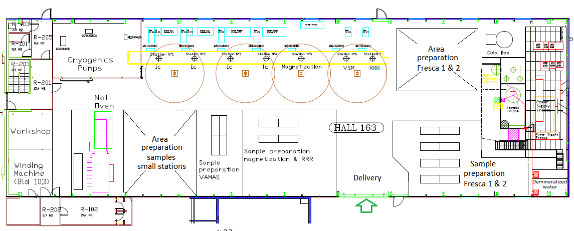
Where and When
FRESCA2 test facility will be installed in b.163, in the existing superconducting strand and cable test stand of MSC
FRESCA2 cryostat will be placed in the pit of FRESCA1
Commissioning of FRESCA2 test facility at end of 2019
Cold Box
5 g/s
Buffer
6 kLHe
Ic strands 1-4
Magnetization
VSM
RRR
FRESCA1
FRESCA2

Slide 4
FRESCA2 functional specification
Describe the requirements for FRESCA2 test facility:
  FRESCA2 magnet
  FRESCA2 Cryostat
  FRESCA2 Current leads
  Cryogenic operation of FRESCA2
  Cryogenic operation of b.163 LHe test facility
  Electrical distribution and water cooling
  FRESCA2 Magnet and sample protection
  FRESCA2 Data acquisition system
  Integration study
Functional Specification FRESCA2 test facility Functional Specification
EDMS #1935596

Slide 5
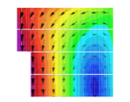
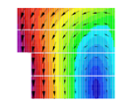
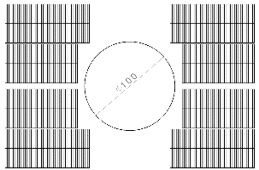

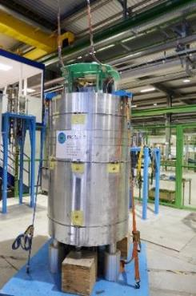
FRESCA2 Magnet
  Nb₃Sn 13 T dipole magnet
  100 mm aperture

Slide 6
FRESCA2 Cryostat (1/2)
Outer cryostat: containing the Nb₃Sn dipole magnet
  Lambda plate, 4.3 K-1.9 K, operated at atmospheric pressure
  Dimensions: H<4.10 m, Diam.<2.5 m
  Feedthroughs for instrumentation 3 in Lambda plate, 4 in top plate
Inner cryostat: containing the cable sample to be tested
  Lambda plate, 4.3 K-1.9 K, operated at atmospheric pressure
  Compatible with FRESCA1 sample inserts
  Top flange at same altitude as FRESCA1 for quick connect (32 kA)
  Sample Holder >80 mm in diameter, >2.4 m in length (splices out of field)
  Transfer of a maximum torque (sample/ Magnet) of 2000 N.m
  Rotation of the sample/magnet less than 0.5 degrees when powered
  Rotation of the sample when cold (not powered) by 90 degrees field perp. or // to sample
  Feedthroughs for instrumentation: 3 in Lambda plate, 4 in top plate
Heat in Leak
  Less than 11 W and 17 W on the 4.3 K bath of inner and outer cryostat (without the leads)
  Inner and Outer cryostat cooled down and running in parallel from a 1.9K pumping unit 2.0 g/s
  Sufficient insulation between inner and outer cryostat (sample at 300 K and magnet at 4 K when sample is inserted)

Slide 7
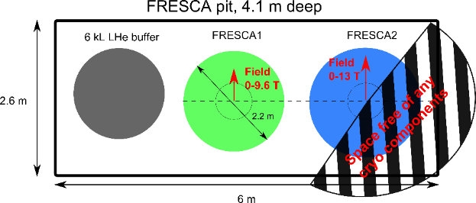
FRESCA2 Cryostat (2/2)
Available space on top flange
  Half of top flange available for operation
Implementation in the PIT
  Centre of FRESCA1 and FRESCA2 cryostats aligned
Direction of the field
  Field orientation is perpendicular to the inter-axis of FRESCA1 and FRESCA
FRESCA2 magnet quench
  Magnet shall operate up to 15 T at 1.9 K and 10 T at 4.3 K
  About 40% of magnet energy dissipated in the He bath in normal operation
    Up to 1.94 MJ at 1.9 K and 0.84 MJ at 4.3 K
  Full magnet energy dissipated in the He bath in the worst case
    Up to 4.84 MJ at 1.9 K and 2.1 MJ at 4.3 K

Slide 8
FRESCA2 Current Leads
Outer cryostat
  13 kA LHC HTS leads, operated with 4.5 K gas
  Tested successfully in SM18 in the configuration of FRESCA2
  Electrical Protection @ 100 mV and 3 mV (HTS)
  Heat in leak less than 2 W per lead at 4.5 K
  GHe mass flow per lead of 0.4 g/s in stand-by and <1 g/s at nominal
  Flow controlled by temperature (PT100) set point 50 K
  Resistive heaters to avoid icy terminal
Inner cryostat
  Existing 32 kA (24 kA) FRESCA1 leads for sample
  Electrical Protection @ 150 mV
  Heat in leak at 4.5 K of 50 W per lead at 32 kA (short time)
  GHe mass flow per lead of 0.8 g/s in standby and 1.9 g/s per lead at nominal
  Flow controlled by temperature, Resistive heaters to avoid icy terminal

Slide 9
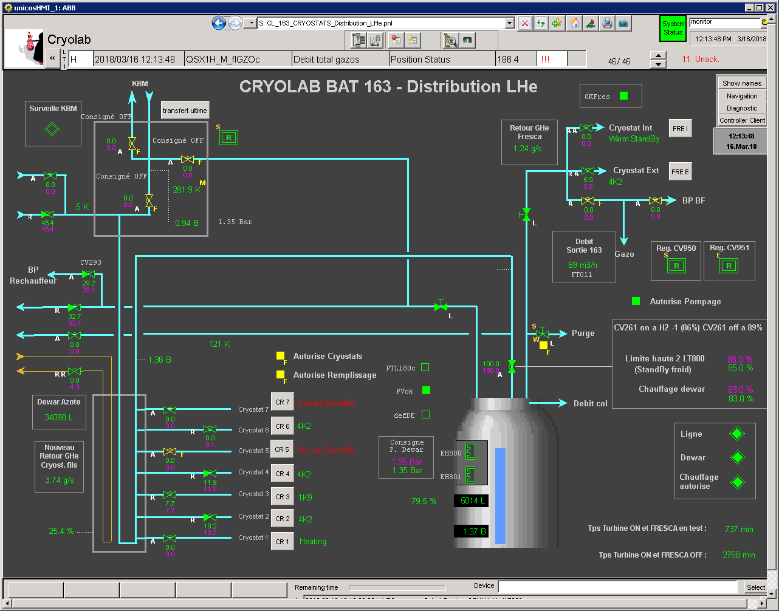
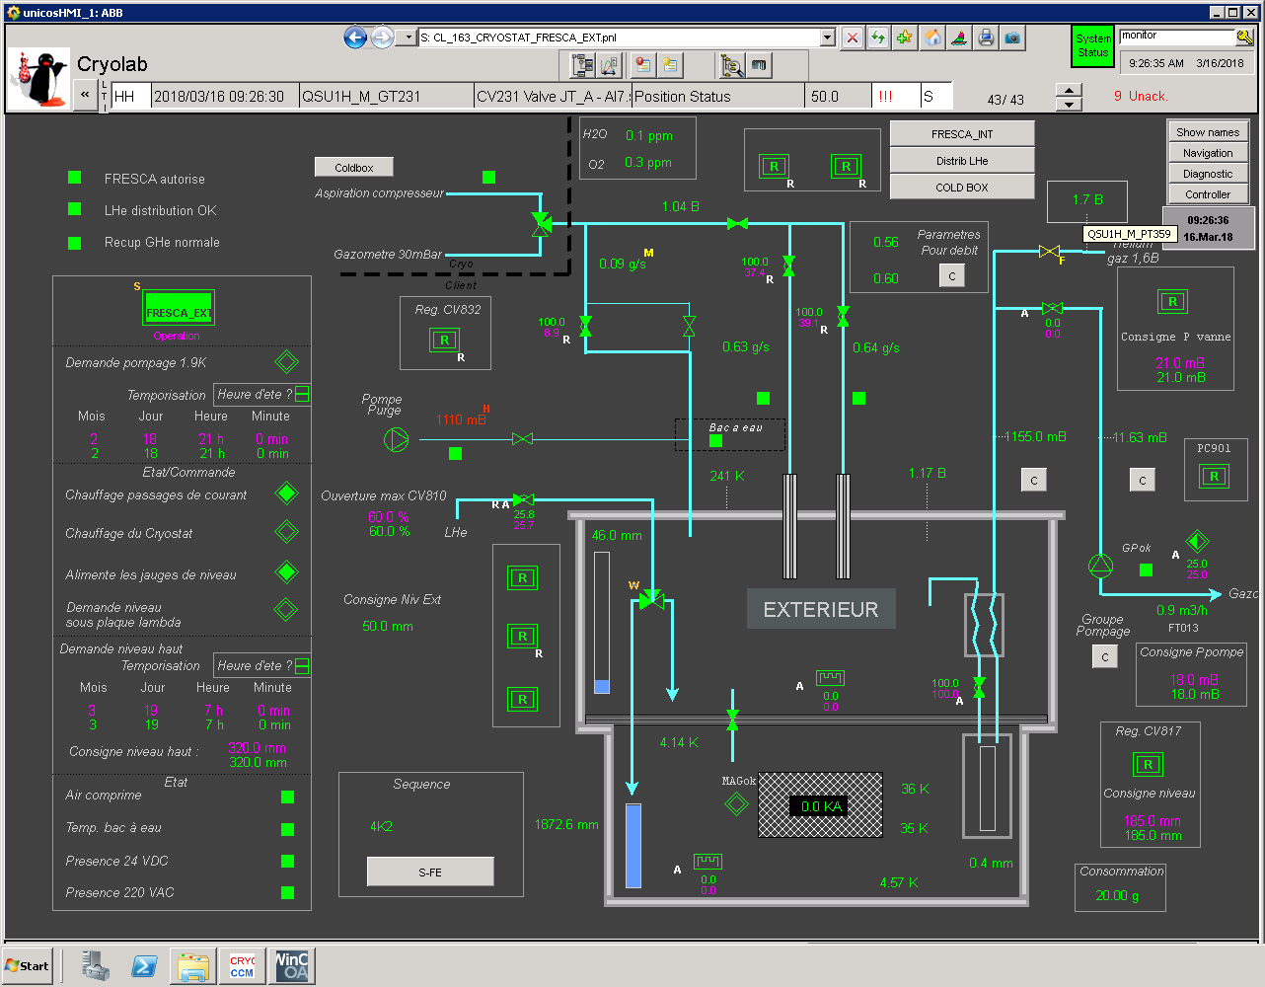
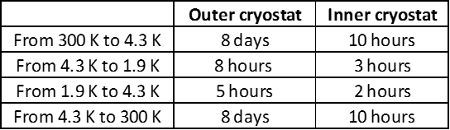
Cryogenic operation of FRESCA2
Operation performed by an automate that controls:
  Purging
  Cool-down (300 K to 4.3 K and 4 K 1.9 K)
  Nominal operation at 4.3 K or 1.9 K
  Recovery of nominal operation after quench
  Warm up (1.9 K to 4.3 K)
  Drain and warm up (4.3 K to 300 K)
ΔT<50 K for Magnet during cool down and warm up
Maximum cool down/warm up time
Cryo. OK signals to QPS
        LHe level at its nominal
        Temp of magnet and sample leads
        Magnet bath temp. and pressure

Slide 10
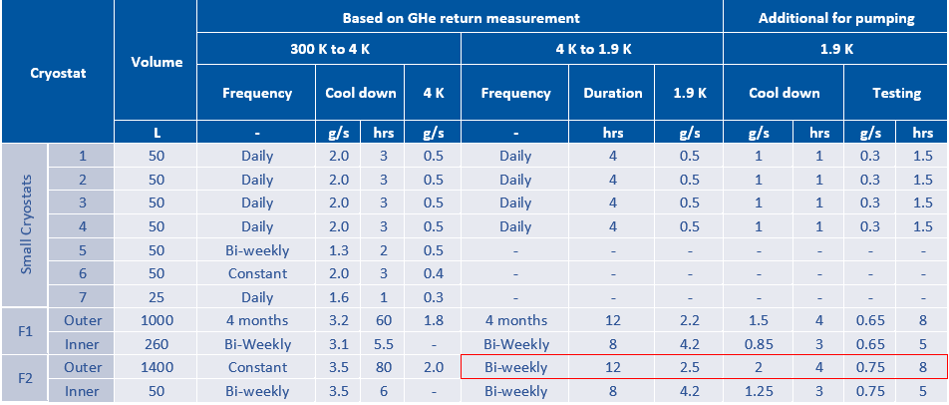
Foreseen Cryogenic operation of b.163
The FRESCA2 test facility will be installed in a building hosting a complex superconducting strands and cables test facility.
  7 small cryostats (strand Ic, Cable magnetization, VSM and RRR)
  FRESCA1
    Magnet at 4 K over 4 months
    Sample tested twice a week over 4 months
  FRESCA2:
    Magnet at 4 K all year long
    Sample tested twice a week over 8 months (never in parallel with FRESCA1)
Cryogenic operation of the different cryostats detailed in Andrew presentation (indico event 700448)
Cold Box
5 g/s
Buffer
6 kLHe
Ic strands 1-4
Magnetization
VSM
RRR
FRESCA1
FRESCA2

Slide 11
Conclusions
Two nested cryostats, operating in the temperature range 1.9-4.3 K, at atmospheric pressure
Installed in the pit of FRESCA1
Magnet cold all along the year, operated with LHC 13 kA leads
Inner cryostat cycled twice a week (300-1.9 K)
Mechanical coupling between inner cryostat and magnet is required
Possibility to rotate the inner cryostat sample insert by 90deg. when cold (LHe).

Slide 12
Thank you for your attention

Slide 13
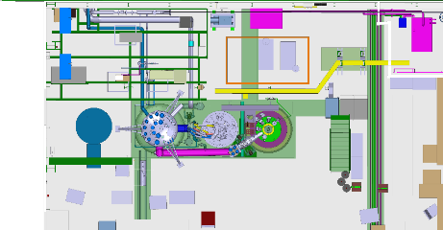

Slide 14
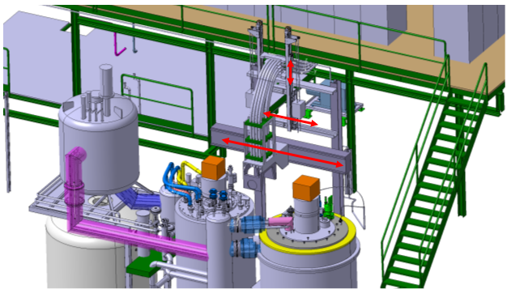
32 kA quick connect

Slide 15
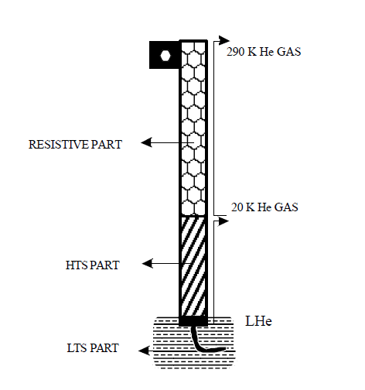
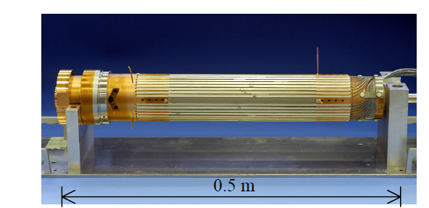
Design of the 13 kA LHC leads
Operates in the range 4K-300 K
Consists of:
  a resistive section, convection cooled by helium gas available in the LHC machine at a nominal temperature of about 20 K
  a superconducting section, self-cooled by the vapour generated by the heat conducted by the lead itself at 4.5 K
=>The two circuits are hydraulically separated.

Slide 16
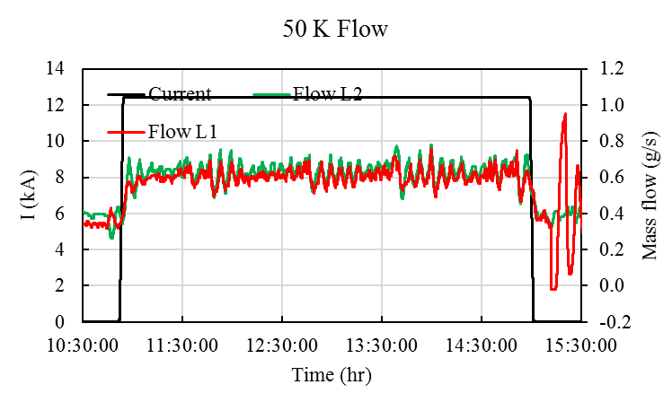
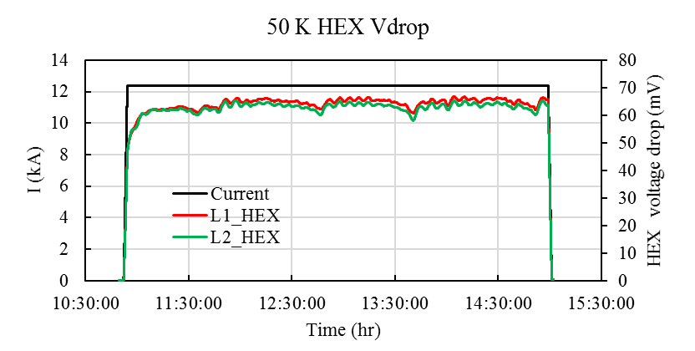
Flow scheme of 13 kA leads in FRESCA2 without the 20 K line
HTS part of the leads self cooled (as LHC)
Boil off of cryostat+leads used to cool down the HEX of the leads: 5 K He gas
The leads were tested in SM18 with this configuration over 4 hours
  Safe operation with T_{HTS}= 50 K
  Vdrop~65 mV @ 12.4 kA
  Mass flow of 0.6 g/s @12.4 kA
5 K He gas

