Slide 1
FRESCA 2 Safety equipment sizing
J. Polinski
FRESCA2 Final Design Review, 21.03.2018 CERN, CH

Slide 2
FRESCA 2 Safety Equipment
Outer Cryostat
He vessel Safety Valve – for HFM quench
He vessel Burst Disc – for vacuum vessel failure + HFM quench
Lambda Valve - for vacuum vessel failure + HFM quench
Vacuum vessel lift plate
L-L heat exchanger
Inner Cryostat
He vessel Burst Disc – for vacuum vessel failure + SC transformer quench
Lambda Valve - for vacuum vessel failure
Vacuum vessel lift plate
L-L heat exchanger

Slide 3
Burst disc + SV set pressure strategy
Absolut pressure
Gauge pressure
4.19 bar a
Maximum pressure = 1.1 MAWP = 3.19 bar g
PS = MAWP = 3.9 bar a
PS = MAWP = 2.9 bar g = BD set press.+10%
BD opening area
BD set press. = PS/1.1 = 2.636 bar g
BD set press.-10 % = 2.373 bar g
Pressure margin 0.2 bar
Max press. when SV is open = (SV set press +5%) x 1.1 = 2.173
SV set press +5% = 1.975 bar g
SV opening area
SV set press = 1.881 bar g
SV set press – 5% = 1.787 bar g
Min. press. for closing the SV
(SV set press – 5%) – 10% = 1.608 bar g
Operating press. = 0.3 bar g

Slide 4
Standards
Determination of the required Safety Equipment (SE) capacity (input data to EN ISO 4126-1 calculations) is done in accordance to EN13648-3
The SE sizing is done in accordance with EN ISO 4126-1

Slide 5
Heat loads
The heat flux W with atmospheric air to He vessel is assumed as:
W = 6 kW/m² if the surface is covered with 10 layers of MLI or if helium has the contact with foam insulation below the vessel led
W = 60 kW/m² if the surface is covered with 3 layers of MLI or is not covered with the MLI
Cable sample quench – negligible
HFM magnet quench – see next slides

Slide 6
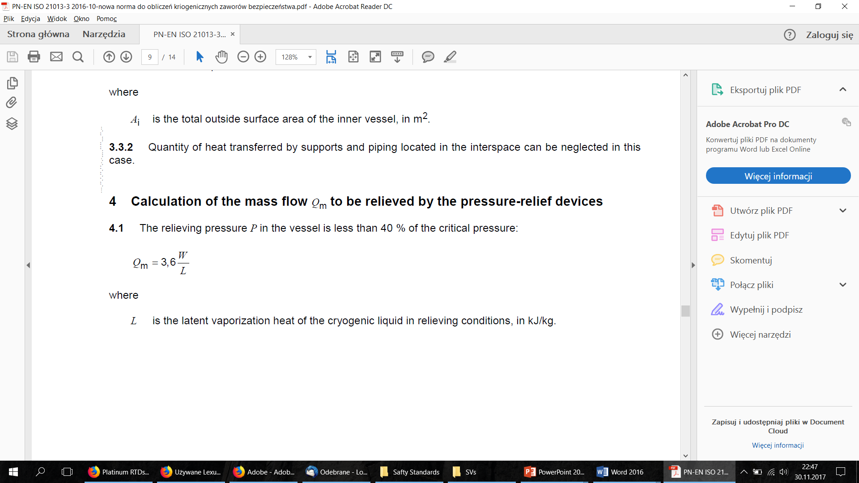
Determination of the required SEs capacity EN13648-3

Slide 7
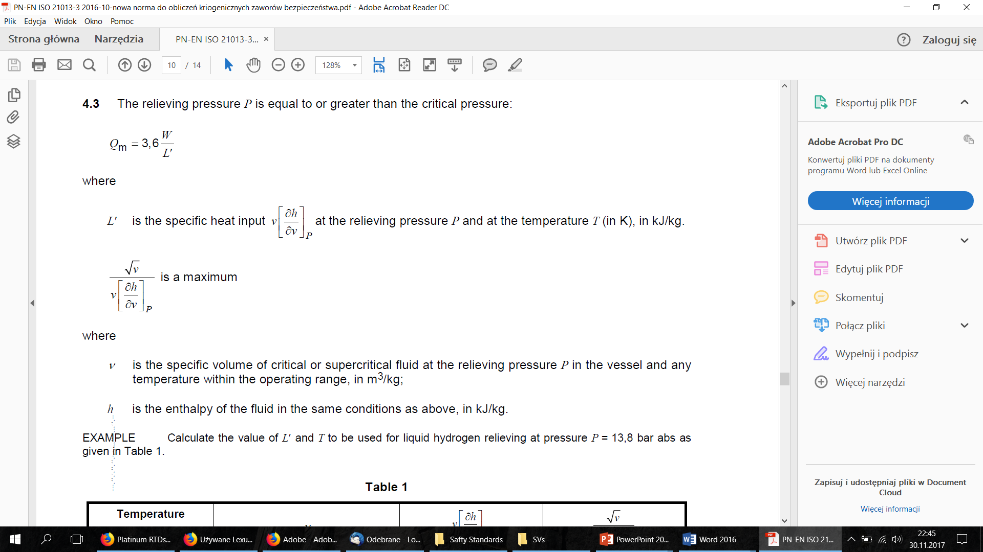
Determination of the required SEs capacity EN13648-3
= max @ T= 6.5 K

Slide 8
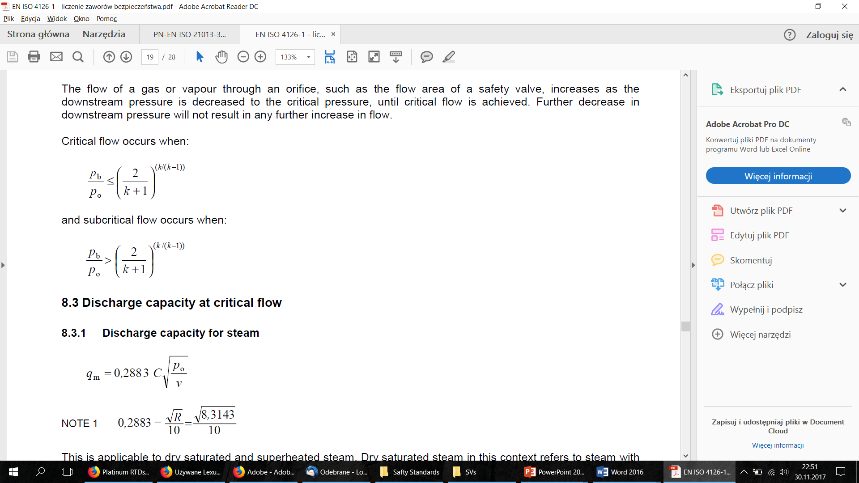
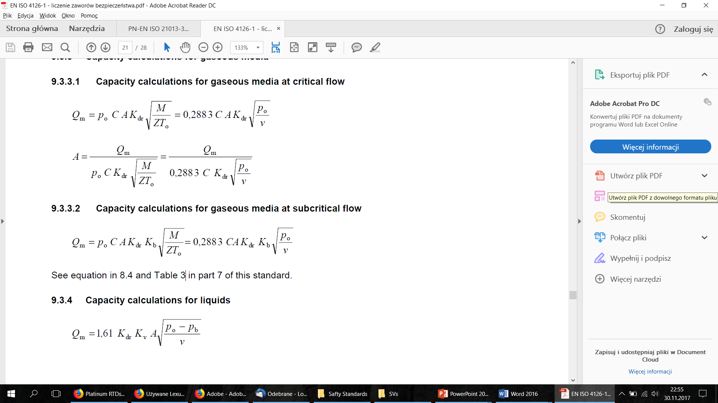
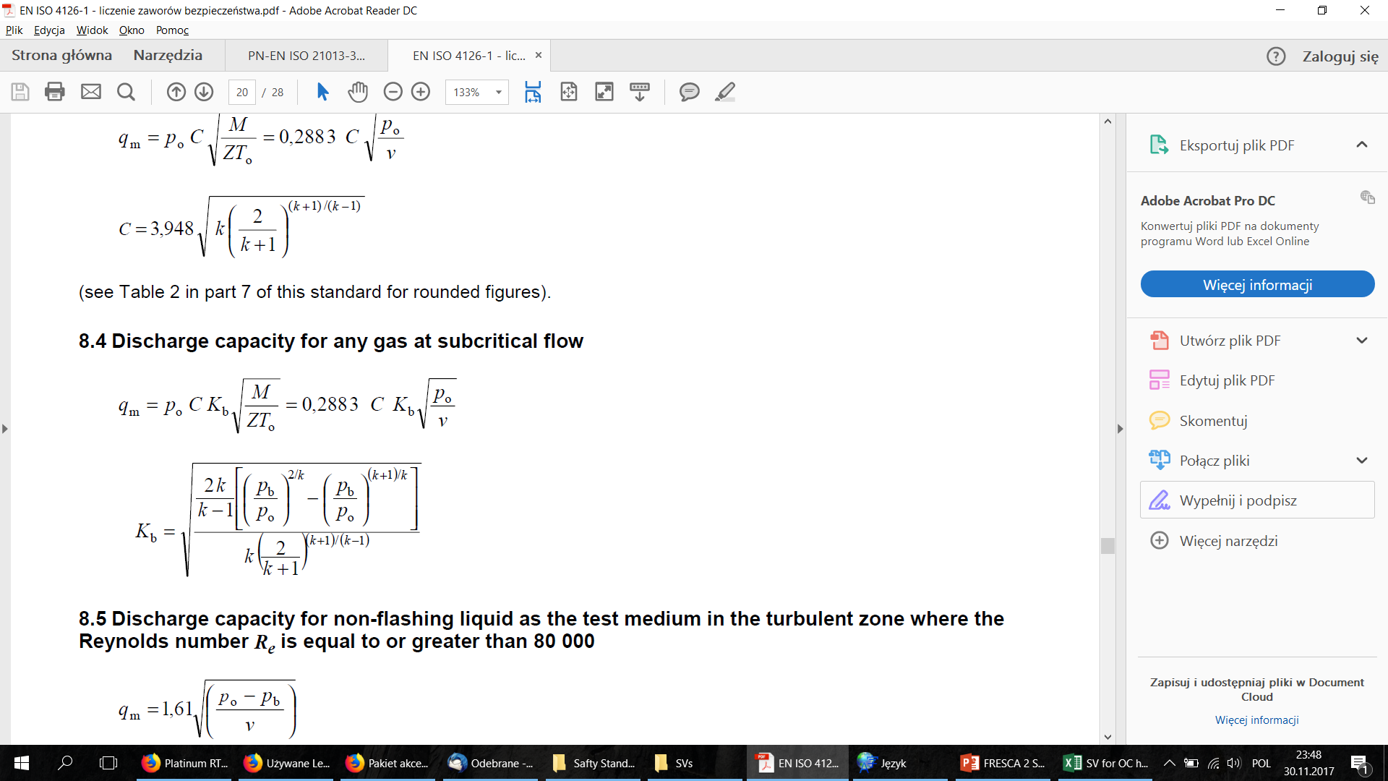
The SEs sizing - EN ISO 4126-1

Slide 9
FRESCA 2 Safety Equipment
Outer Cryostat
He vessel Safety Valve – for HFM quench
He vessel Burst Disc – for vacuum vessel failure + HFM quench
Lambda Valve - for vacuum vessel failure + HFM quench
Vacuum vessel lift plate
L-L heat exchanger
Inner Cryostat
He vessel Burst Disc – for vacuum vessel failure + SC transformer quench
Lambda Valve - for vacuum vessel failure
Vacuum vessel lift plate
L-L heat exchanger

Slide 10
Outer Cryostat He vessel SV – heat flux calculations
p_{set} = 1.88 bar g = 2.88 bar abs, T_{relief} – 5.8K
Insulation heat flux – foam insulation below vacuum vessel led : W_{ins} = 0.978 m² × 6 kW/m² = 5 868 W

Slide 11
HFM magnet quench - heat loads
Assumptions:
HFM temperature after quench – T_{HFM}
HFM area – A_{HFM}=6.85 m²
He relieving temperature 6.5K
Calcualtions
W_{HFM}=A_{HFM} ×290 ×(T_{HFM}-6.5)^{0.92}
for T_{HFM} = 80 K W_{HFM}= 104 343 W

Slide 12
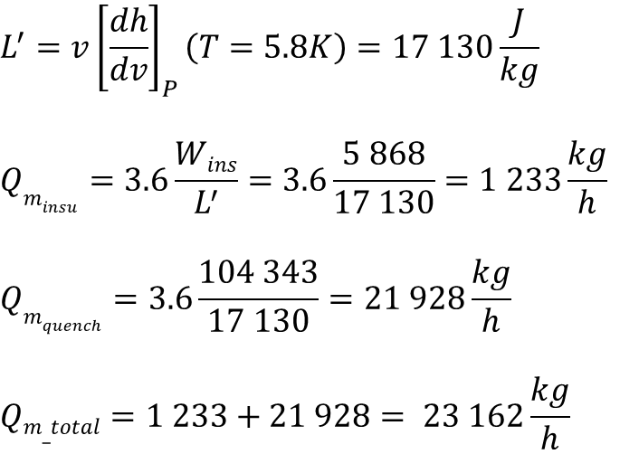
Outer Cryostat He vessel SV capacity calculations
$${L^{′}=v\left[\frac{dh}{dv}\right]}_{P}\left(T=5.8K\right)=17 130\frac{J}{kg}$$
$$Qm_{insu}=3.6\frac{Wins}{L^{′}}=3.6\frac{5 868}{17 130}=1 233\frac{kg}{h}$$
$$Qm_{quench}=3.6\frac{104 343}{17 130}=21 928\frac{kg}{h}$$
$$Qm_total=1 233+21 928=\text{ 23 16}2\frac{kg}{h}$$

Slide 13
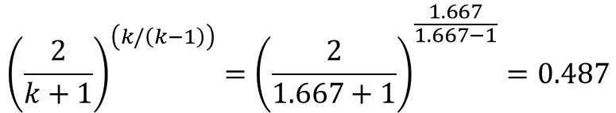
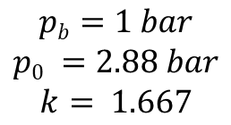
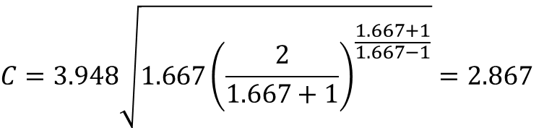
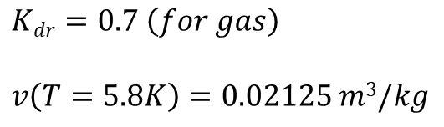

Outer Cryostat He vessel SV capacity calculations
$$pb=1 bar$$
$$p0 =2.88 bar$$
$$k= 1.667$$
$${{\left(\frac{2}{k+1}\right)}^{\left(k/\left(k−1\right)\right)}=\left(\frac{2}{1.667+1}\right)}^{\frac{1.667}{1.667−1}}=0.487$$
$\frac{pb}{p0}=\frac{1}{2.88}=0.347<0.487$ - critical flow
$$Kdr=0.7 \left(for gas\right)$$
$$v\left(T=5.8K\right)=0.02125 m3/kg$$
$$C=3.948\sqrt{1.667{\left(\frac{2}{1.667+1}\right)}^{\frac{1.667+1}{1.667−1}}}=2.867$$

Slide 14
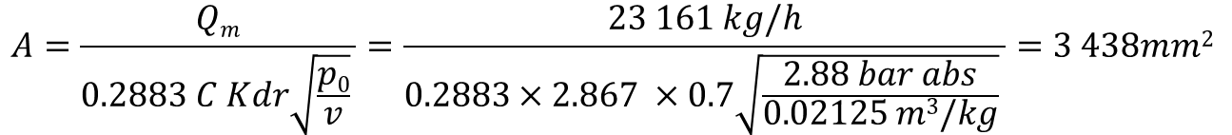
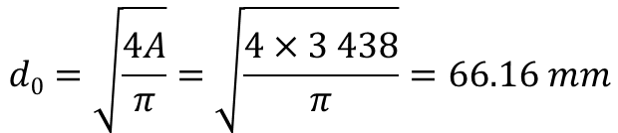
Outer Cryostat He vessel SV capacity calculations
$$A=\frac{Qm}{0.2883 C Kdr\sqrt{\frac{p0}{v}} }=\frac{23 161 kg/h}{0.2883×2.867 ×0.7\sqrt{\frac{2.88 bar abs}{0.02125 m3/kg}} }=3 438mm2$$
$$d0=\sqrt{\frac{4A}{π}}=\sqrt{\frac{4×3 438}{π}}=66.16 mm$$

Slide 15
Outer Cryostat He vessel SV capacity calculations

Slide 16
Outer Cryostat He vessel SV capacity calculations
Value estimated from HFM commissioning tests data
35 K
Calculated HFM structure temperature after the quench
5 kW

Slide 17
Outer Cryostat He vessel SV capacity calculations
Finally decided as the baseline
Value estimated from HFM commissioning tests data
35 K
Calculated HFM structure temperature after the quench
5 kW

Slide 18
FRESCA 2 Safety Equipment
Outer Cryostat
He vessel Safety Valve – for HFM quench
He vessel Burst Disc – for vacuum vessel failure + HFM quench
Lambda Valve - for vacuum vessel failure + HFM quench
Vacuum vessel lift plate
L-L heat exchanger
Inner Cryostat
He vessel Burst Disc – for vacuum vessel failure + SC transformer quench
Lambda Valve - for vacuum vessel failure
Vacuum vessel lift plate
L-L heat exchanger

Slide 19
Outer Cryostat He vessel BD – heat flux calculations
External vacuum vessel failure
10 layer Insulated area – 17.07m²
Foam insulation – 0.978 m²
Total heat flux –18.05 x 6 kW/m² = 24.05 kW
Internal vacuum vessel failure
10 layer Insulated area – 0 m²
Uninsulated area – 3.818 m²
Foam insulation – 0.978 m²
Total heat flux – 3.818 m² x 60 kW/m² + 0.978 m2 x 6 kW/m² = 234.9kW

Slide 20
Outer Cryostat He vessel BD – heat flux calculations
For vacuum vessel break + HFM quench (80K), d₀=118mm
For vacuum vessel break, no HFM quench d₀=98 mm
Final selection of the BD for OC: d₀=120 mm

Slide 21
FRESCA 2 Safety Equipment
Outer Cryostat
He vessel Safety Valve – for HFM quench
He vessel Burst Disc – for vacuum vessel failure + HFM quench
Lambda Valve - for vacuum vessel failure + HFM quench
Vacuum vessel lift plate
L-L heat exchanger
Inner Cryostat
He vessel Burst Disc – for vacuum vessel failure + SC transformer quench
Lambda Valve - for vacuum vessel failure
Vacuum vessel lift plate
L-L heat exchanger

Slide 22
Outer Cryostat lambda valve – heat flux calculations
External vacuum vessel failure (area under lambda plate)
10 layer Insulated area – 12.157 m²
Uninsulated area (cryostat top flange) – 0 m²
Total heat flux – (17.07 + 10 x 0)m² x 6 kW/m² = 72.95 kW
Internal vacuum vessel failure (area under lambda plate)
10 layer Insulated area – 0 m²
Uninsulated area – 0.673 m²
Uninsulated area (cryostat top flange) – 0 m²
Total heat flux – 0.673 m² x 60 kW/m2 = 40.38 kW
HFM quench – 103.31 kW

Slide 23
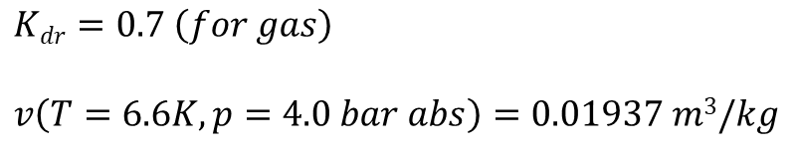

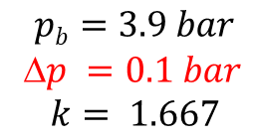
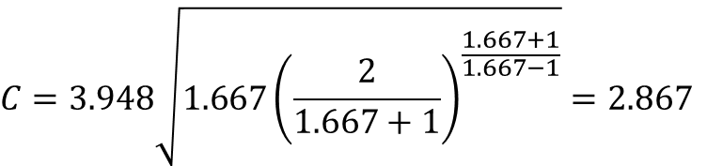
Outer Cryostat lambda valve capacity calculations
$$pb=3.9 bar$$
Δ$p =0.1 bar$
$$k= 1.667$$
$${{\left(\frac{2}{k+1}\right)}^{\left(k/\left(k−1\right)\right)}=\left(\frac{2}{1.667+1}\right)}^{\frac{1.667}{1.667−1}}=0.487$$
$$\frac{pb}{p0}=\frac{3.9}{4.0}=0.975>0.487 sub−critical flow$$
$$Kdr=0.7 \left(for gas\right)$$
$$v\left(T=6.6K, p=4.0 bar abs\right)=0.01937 m3/kg$$
$$C=3.948\sqrt{1.667{\left(\frac{2}{1.667+1}\right)}^{\frac{1.667+1}{1.667−1}}}=2.867$$
=0.304

Slide 24
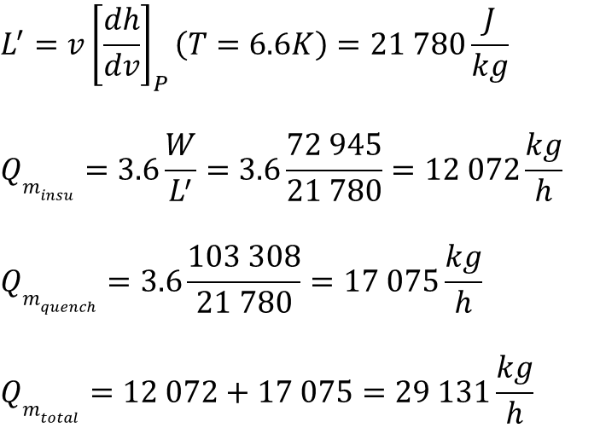
Outer Cryostat lambda valve capacity calculations
$${L^{′}=v\left[\frac{dh}{dv}\right]}_{P}\left(T=6.6K\right)=21 780\frac{J}{kg}$$
$$Qm_{insu}=3.6\frac{W}{L^{′}}=3.6\frac{72 945}{21 780}=12 072\frac{kg}{h}$$
$$Qm_{quench}=3.6\frac{103 308}{21 780}=17 075\frac{kg}{h}$$
$$Qm_{total}=12 072+17 075=\text{29 131}\frac{kg}{h}$$

Slide 25
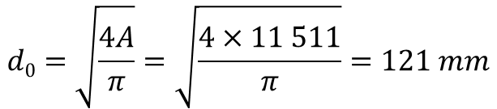
Outer Cryostat lambda valve size
$$A=\frac{Qm}{0.2883 C K_{b} Kdr\sqrt{\frac{p0}{v}} }=\frac{29 131kg/h}{0.2883×2.867 ×0.3×0.7\sqrt{\frac{4.0 bar abs}{0.01937 m3/kg}} }=11 511 mm2$$
$$d0=\sqrt{\frac{4A}{π}}=\sqrt{\frac{4×11 511}{π}}=121 mm$$

Slide 26
Outer Cryostat lambda valve size

Slide 27
Outer Cryostat lambda valve size
For Q_HFM(T=80K) d₀= 121 mm
For Q_HFM=0 d₀= 78 mm
Final size d₀= 120 mm

Slide 28
FRESCA 2 Safety Equipment
Outer Cryostat
He vessel Safety Valve – for HFM quench
He vessel Burst Disc – for vacuum vessel failure + HFM quench
Lambda Valve - for vacuum vessel failure + HFM quench
Vacuum vessel lift plate
L-L heat exchanger
Inner Cryostat
He vessel Burst Disc – for vacuum vessel failure + SC transformer quench
Lambda Valve - for vacuum vessel failure
Vacuum vessel lift plate
L-L heat exchanger

Slide 29
Outer Cryostat vacuum vessel lift plate
Sized for the d=38 mm pipe break
He flow outflow area is equal to the broken pipe cross section area
He pressure in the vessel = 3.9 bar a
Max pressure in Vacuum Vessel – 1.5 bar a
He mass outflow to vacuum vessel q_{m}=4.74 kg/s
Temperature of the He at lift plate – to be determined

Slide 30
Outer Cryostat vacuum vessel lift plate
Temperature of the He at lift plate
He vessel
No heat flux
Vac Vessel
300K
Thermal shield
77K
He flow in VV

Slide 31
Outer Cryostat vacuum vessel lift plate
Finally selected with some safety margin an in view of the available space

Slide 32
FRESCA 2 Safety Equipment
Outer Cryostat
He vessel Safety Valve – for HFM quench
He vessel Burst Disc – for vacuum vessel failure + HFM quench
Lambda Valve - for vacuum vessel failure + HFM quench
Vacuum vessel lift plate
L-L heat exchanger
Inner Cryostat
He vessel Burst Disc – for vacuum vessel failure + SC transformer quench
Lambda Valve - for vacuum vessel failure
Vacuum vessel lift plate
L-L heat exchanger

Slide 33
OC L-L HX hydraulic loop BD size calculation
The inner cryostat L-L HX hydraulic loop is compose of the manifold and pumping line
All surfaces are covered with 10 layers of MLI
The total area of the hydraulic loop is 0.413 m²
Heat flux to the loop is 0.413 m² x 6 kW = 2 477 W
BD required capacity
$Q_{m_ins}=3.6\frac{W}{L^{′}}=3.6\frac{2 477}{21 780}=421.4\frac{kg}{h}$

Slide 34

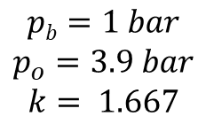
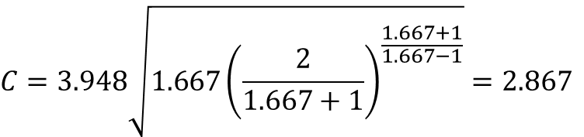
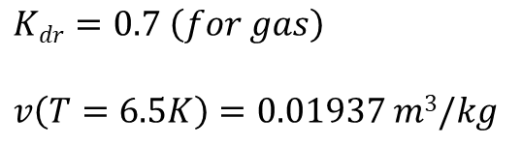
OC L-L HX hydraulic loop BD capacity calculations
$$pb=1 bar$$
$$p_{o}=3.9 bar$$
$$k= 1.667$$
$${{\left(\frac{2}{k+1}\right)}^{\left(k/\left(k−1\right)\right)}=\left(\frac{2}{1.667+1}\right)}^{\frac{1.667}{1.667−1}}=0.487$$
$$\frac{pb}{p0}=\frac{1}{3.9}=0.256<0.487 sub−critical flow$$
$$Kdr=0.7 \left(for gas\right)$$
$$v\left(T=6.5K\right)=0.01937 m3/kg$$
$$C=3.948\sqrt{1.667{\left(\frac{2}{1.667+1}\right)}^{\frac{1.667+1}{1.667−1}}}=2.867$$

Slide 35

OC L-L HX hydraulic loop BD size calculations
$A=\frac{Q_{m}}{0.2883 C K_{dr} \sqrt{\frac{p0}{v}} }=\frac{421.4 kg/h}{0.2883×2.867 ×0.7\sqrt{\frac{3.9 bar abs}{0.019116 m3/kg}} }=52.6 mm2$
$$d_{0 }=\sqrt{2×A}=\sqrt{2×52.6}=10.24 mm$$

Slide 36
Outer Cryostat safety equipment summary
He vessel Safety Valve – d₀ = 46 mm
He vessel Burst Disc – d₀ = 120 mm
Lambda Valve - d₀ = 120 mm
Vacuum vessel lift plate - d₀ = 130 mm
L-L heat exchanger - d₀ = 10 mm

Slide 37
Inner Cryostat safety equipment summary
He vessel Burst Disc – d₀ = 25 mm
Lambda Valve - d₀ = 32 mm
Vacuum vessel lift plate - d₀ = 130 mm
L-L heat exchanger - d₀ = 10 mm

