Slide 1
LHCb 2009-Q4 report

Slide 2
Activities in 2009-Q4
Core Software
  Stable versions of Gaudi and LCG-AA
Applications
  Stable as of September for real data
  Fast minor releases to cope with reality of life…
Monte-Carlo
  Some MC09 channel simulation
  Few events in foreseen 2009 configuration
  Minimum bias MC09 stripping
Real data reconstruction
  As of November 20th

Slide 3
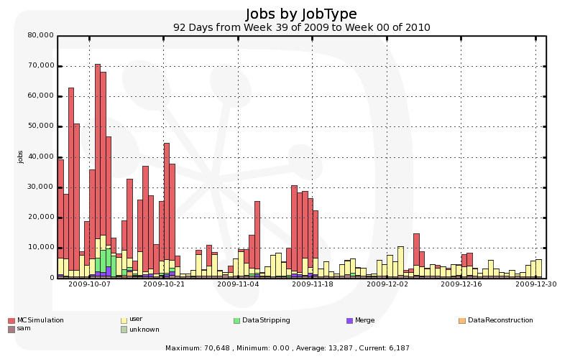
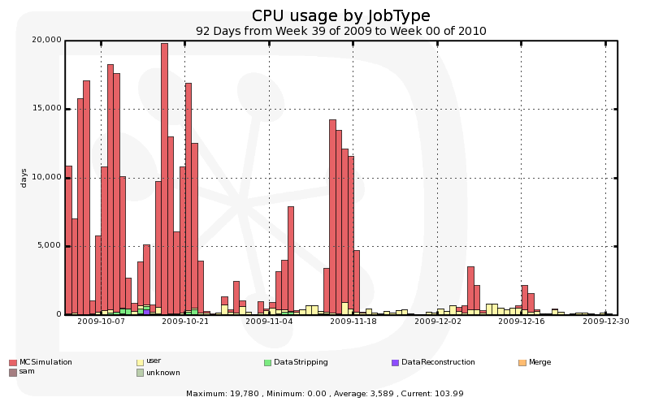
Jobs in 2009-Q4

Slide 4
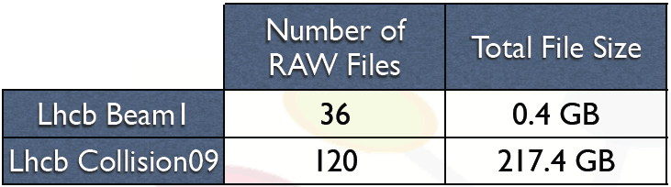
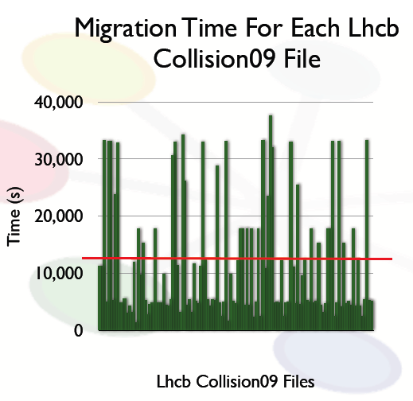
First experience with real data
Very low crossing rate
  Maximum 8 bunches colliding (88 kHz crossing)
  Very low luminosity
  Minimum bias trigger rate: from 0.1 to 10 Hz
  Data taken with single beam and with collisions

Slide 5
Real data processing
Iterative process
  Small changes in reconstruction application
  Improved alignment
  In total 5 sets of processing conditions
    Only last files were all processed twice
Processing submission
  Automatic job creation and submission after:
    File is successfully migrated in Castor
    File is successfully replicated at Tier1
  If job fails for a reason other than application crash
    The file is reset as “to be processed”
    New job is created / submitted
  Processing more efficient at CERN (see later)
    Eventually after few trials at Tier1, the file is processed at CERN
  No stripping ;-)
    DST files distributed to all Tier1s for analysis

Slide 6
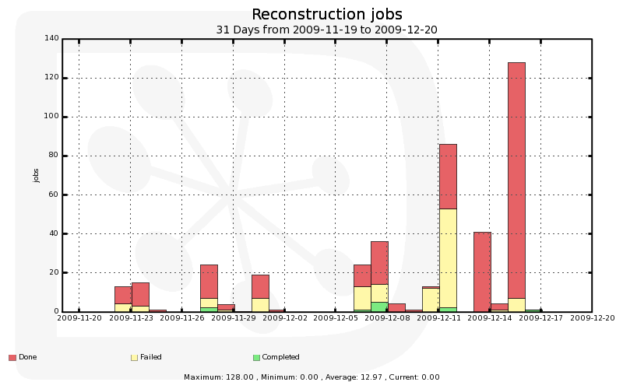
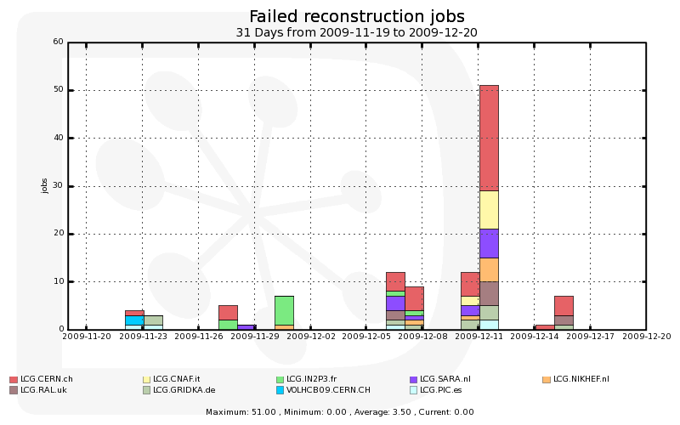
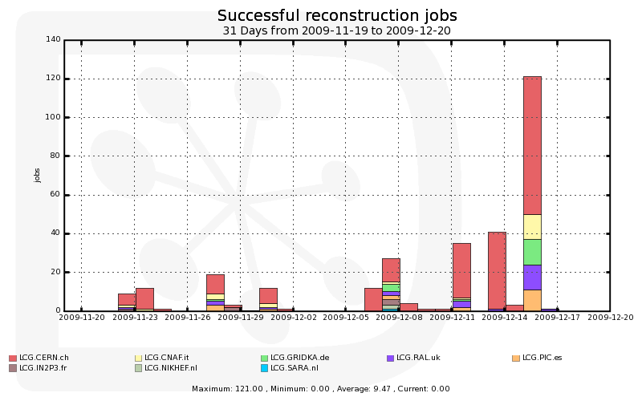
Reconstruction jobs

Slide 7
Issues with real data
Castor migration
  Very low rate: had to change the migration algorithm for more frequent migration
Issue with large files (above 2 GB)
  Real data files are not ROOT files but open by ROOT
  There was an issue with a compatibility library for slc4-32 bit on slc5 nodes
    Fixed within a day
Wrong magnetic field sign
  Due to different coordinate systems for LHCb and LHC ;-)
  Fixed within hours
Data access problem (by protocol, directly from server)
  Still dCache issue at IN2P3 and NIKHEF
    dCache experts working on it
  Moved to copy mode paradigm for reconstruction
  Still a problem for user jobs
    Sites have been banned for analysis

Slide 8
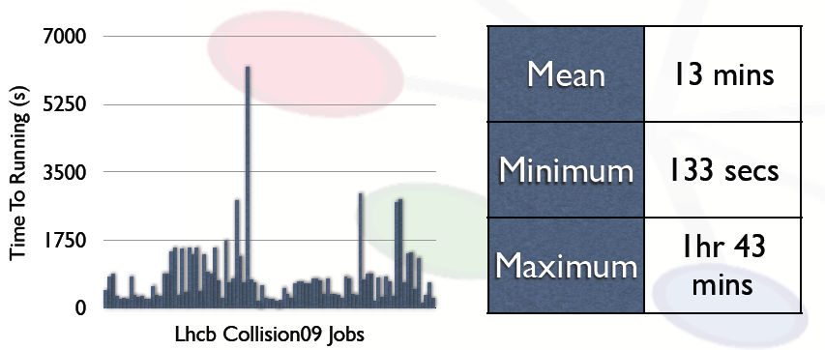
Transfers and job latency
No problem observed during file transfers
  Files randomly distributed to Tier1
  Will move to distribution by runs (few 100’s files)
  For 2009, runs were not longer than 4-5 files!
Very good Grid latency
  Time between submission and jobs starting running

Slide 9
Brief digression on LHCb position w.r.t. MUPJs
So-called Multi-User Pilot Jobs (MUPJ) are used by DIRAC on all sites that accept role=Pilot
  They are just regular jobs!
MUPJs match any Dirac job in the central queue
  Production or User analysis (single queue)
  Each PJ can execute sequentially up to 5 jobs
    If remaining capabilities allow (e.g. CPU time left)
    MUPJ has 5 tokens for matching jobs
  role=Pilot proxy can only retrieve jobs, limited to 5
A limited user proxy is used for DM operations of the payload
  Cannot be used for job submission
Proxies can be hidden when not needed
DIRAC is instrumented for using gLexec (in any mode)
First experience
  Problems are not with gLexec but with SCAS configuration

Slide 10
MUPJs (cont’d)
LHCb is not willing to loose efficiency due to the introduction of badly configured gLexec
  Yet another point of failure!
  Cannot afford testing individually all sites at once
This topic has been lasting over 3 years now
  Where is the emergency? Why did it take so long if so important?
Propose to reconsider pragmatically the policy
  They were defined when the frameworks had not been evaluated, and VOs had to swallow the bullet
  Re-assessing the risks was not really done in the TF (yet)
  Questionnaire leaves decisions to sites
    We got no message that sites are unhappy with current situation
  MUPJs are just jobs for which their owner is responsible
    Move responsibility to MUPJ owner (“the VO”)
    Two tier trust relation ( Sites / VO / User )
    Apply a posteriori control and not a priori mistrust
  VOs should assess the risk on their side

Slide 11
Conclusions
Concentrating on real data
  Very few data (200 GB)!
  Very important learning exercise
  A few improvements identified for the 2010 running
    Run distribution (rather than files)
    Conditions DB synchronization check
      Make sure Online Conditions are up-to-date
Still some MC productions
  With feedback from first real data
    E.g. final position of the VeLo (15 mm from beam)
Analysis
  First analysis of 2009 data made on the Grid
  Foresee a stripping phase for V⁰ physics publications
LHCb definitely wants to continue using MUPJs!

