Slide 1
Non-exponential behaviour of pp dσ/dt a(p)review
T. Csörgő
Wigner Research Center for Physics, Budapest, Hungary
EKE GYKRC, Gyöngyös, Hungary
Introduction and motivation
Results before LHC
TOTEM results
Interpretations
Results and cross-checks*
Outlook*
Summary
Partially supported by NKTIH FK 123842 and FK123959
and EFOP 3.6.1-16-2016-00001

Slide 2




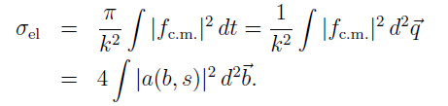
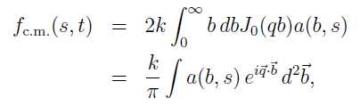


Theoretically
Using M.M. Block, Phys.Rept. 436 (2006) 71-215

Slide 3
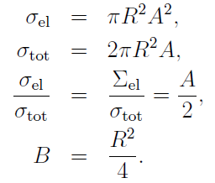


Gray Disc vs Gray Gaussian
For a Gray Disc,
a(b,s)=i A/2 Θ(b-R)
For a Gray Gaussian:
a(b,s) = i A/2 exp(-2(b/R)**2)
Gray Gaussian A(b) →
Exponential dσ/dt.
Non-exponential dσ/dt →
a non-Gaussian behaviour of
A(b) shadow profile function
For a black disc or Gaussian, A = 1 and σ_{el}/σ_{tot} = ½
in both cases

Slide 4
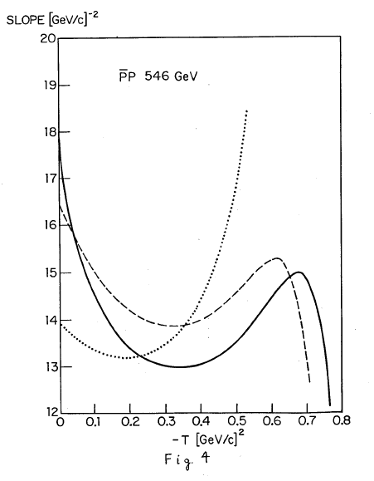
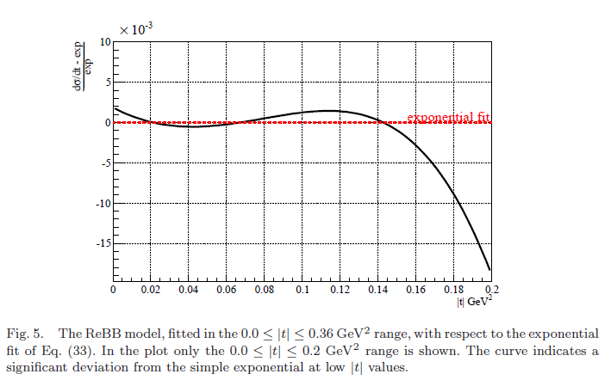
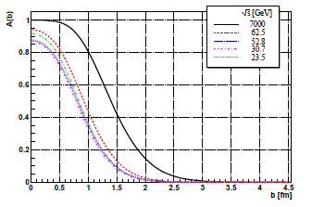

Possible theory interpretations
ReBB: Quark-Diquark Model
Non-exponential dσ/dt:
a non-Gaussian A(b)
F. Nemes, T.Cs, M. Csanád
Int.J.Mod.Phys. A30 (2015) no.14, 1550076
from Glauber-Velasco
PLB 147 (1984) 380
Slope is not quite
Exponential:
a non-Gaussian behaviour

Slide 5
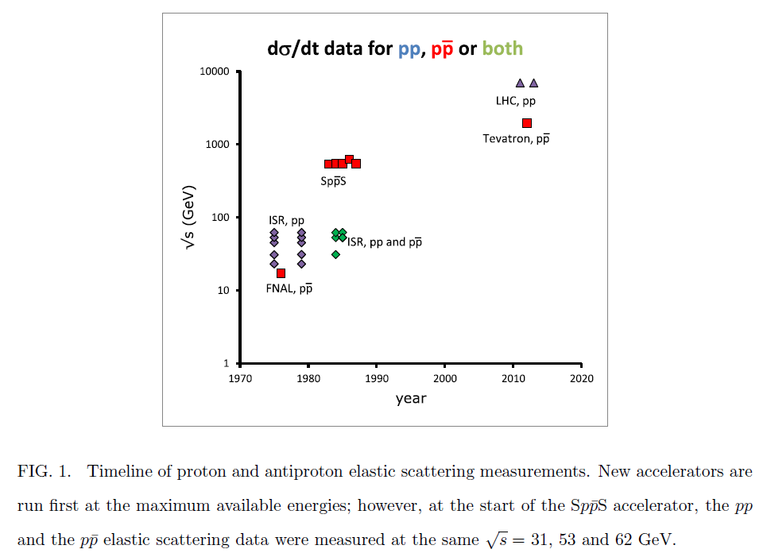
Datasets on pp and ppbar, before 2015
Suggests to run down LHC to ~ Tevatron energies
A. Ster, L. Jenkovszky and T. Cs, PRD 91 (2015) 074018

Slide 6
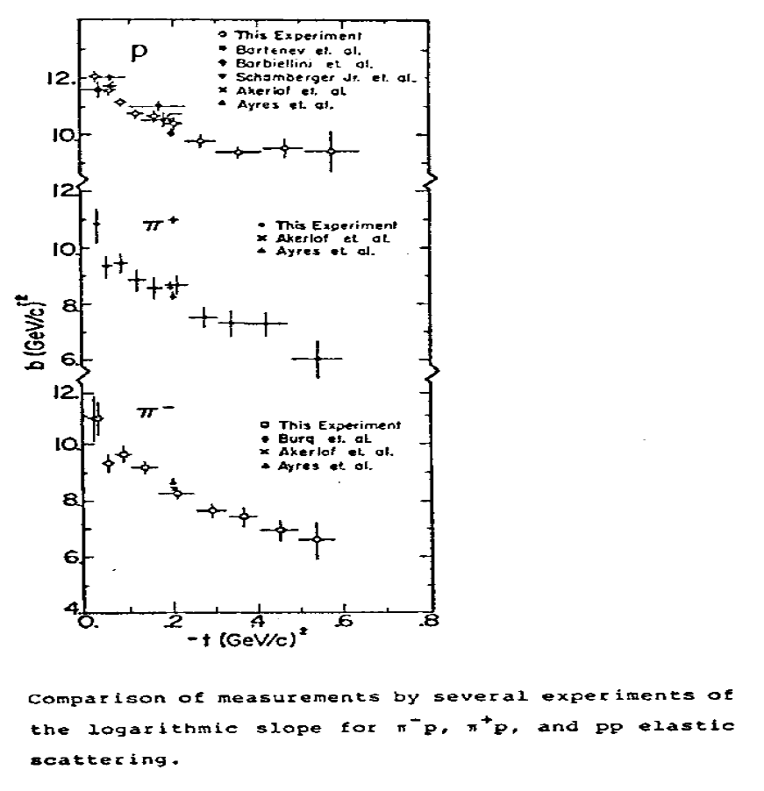
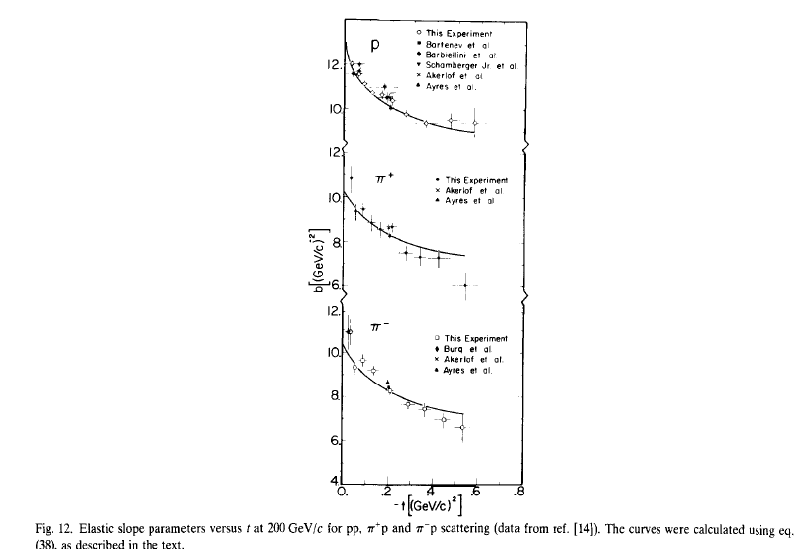
FNAL E-0069: evidence for non-expon
FNAL E-0069, A.Schiz et al.: Phys. Rev. D24 (1981) 26
Reviewed in K. Goulianos, Phys. Rept. 101 (1983) 169-219
Satisfactory fits with exp(-B(t) |t|): non-exponential in 1981!

Slide 7
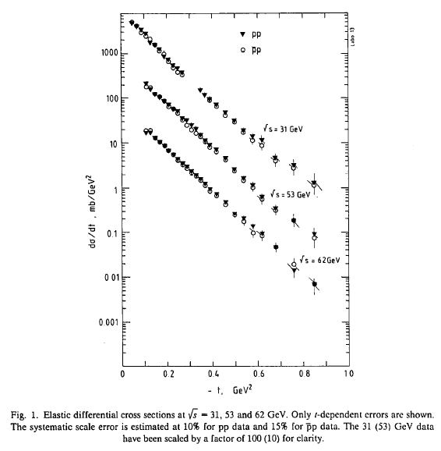
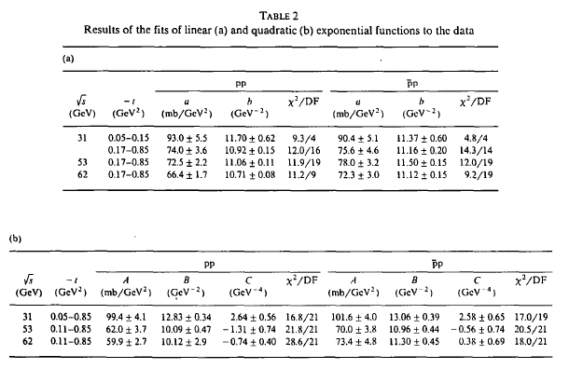
A. Breakstone et al. Nucl. Phys. B 248, 253 (1984).
Hints non-exponential/”break”:
pp@ISR, √s=21.5-52.8 GeV,
change of slope, B=B(t,s)
|t|~ 0.1 GeV²
Barbiellini et al,
Phys. Lett. B 39, 663 (1972):
B(t_{low}) ≠ B(t_{higher})
At √s=52.8 GeV SpbarpS
slope is same and breaks the same way in pbarp and in pp
M. Ambrosio et al.
Phys. Lett. B 115, 495 (1982).
Same slope in pp and pbar-p at
|t|~ 0.14 GeV² ,
fits with exp(-B|t|- C t²)
at √s=31, 55, 62 GeV
A. Breakstone et al. Nucl. Phys. B 248, 253 (1984).

Slide 8
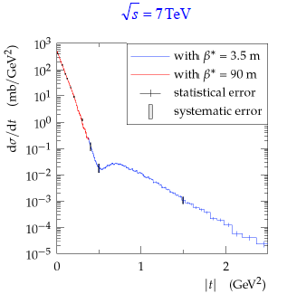
TOTEM results at LHC before 2015
LHC data, pre-2014-15: satisfactory fits with exp(-B |t|) at low t.
TOTEM data at 8 TeV, low |t|: evidence for non-exponential cone

Slide 9
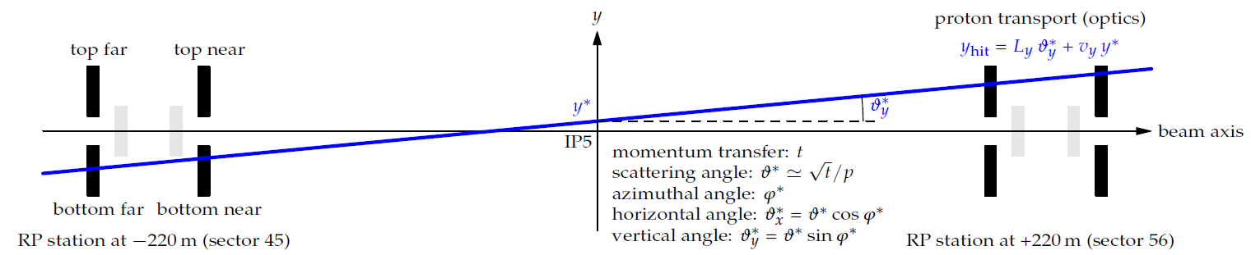
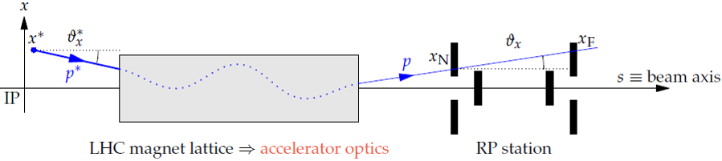
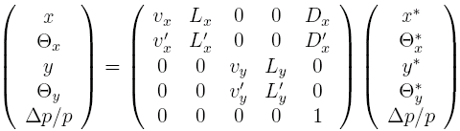
TOTEM: LHC Optics for Elastic pp
Precise σ_{tot} and dσ/dt determination by TOTEM
needs excellent controll of LHC optics from data

Slide 10
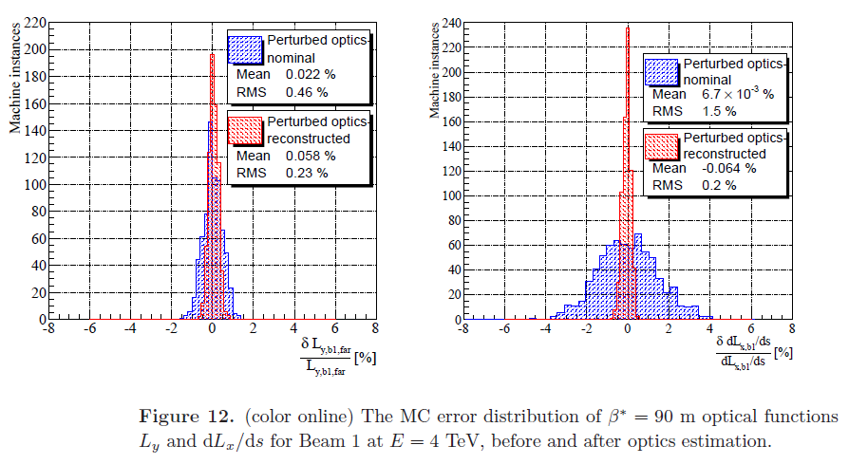
LHC Optics Determination, β*= 90 m
TOTEM: Precise control of LHC imperfections with perturbed LHC optics and recalibration from data at IP5: factors of 2 - 10
arXiv:1406.0546

Slide 11
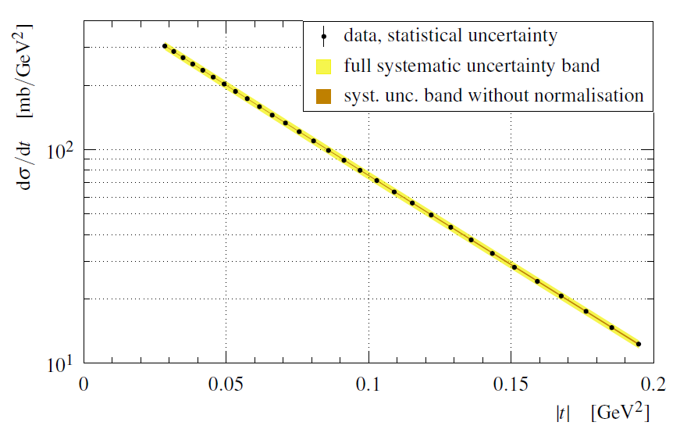
TOTEM dσ/dt @ 8 TeV
t = -p² θ*²; „optimized binning”; almost exponential but if one looks in detail, NOT

Slide 12
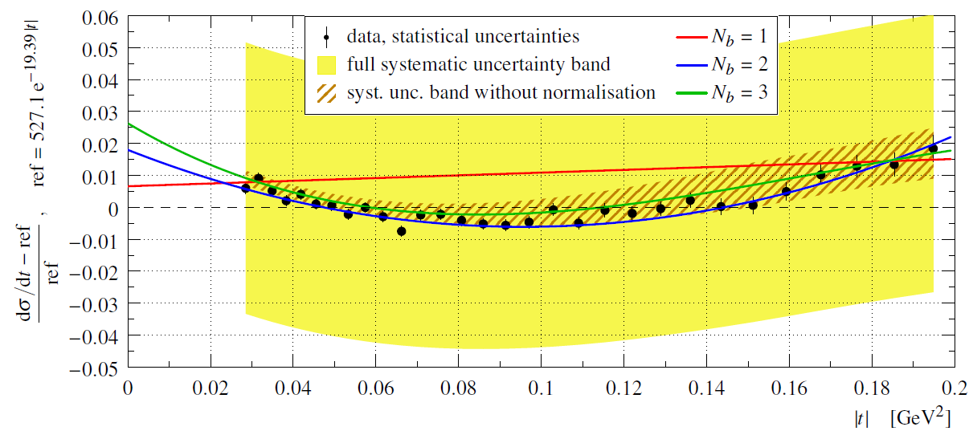
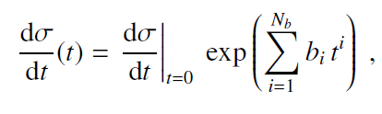



Differential cross-section @ 8 TeV
N_{b} = 1 fits excluded. Relative to best exponential, a significant 7.2σ deviation found.

Slide 13
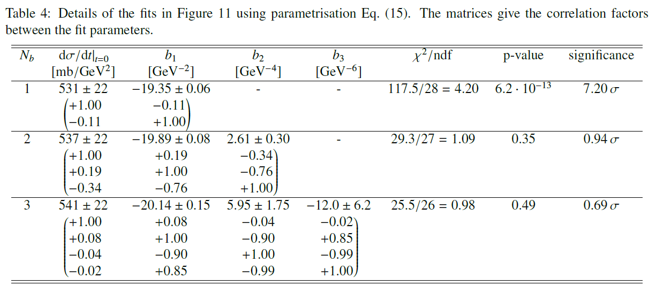
Differential cross-section @ 8 TeV
N_{b} = 1 fits excluded. Relative to best exponential, a significant 7.2σ deviation found.

Slide 14
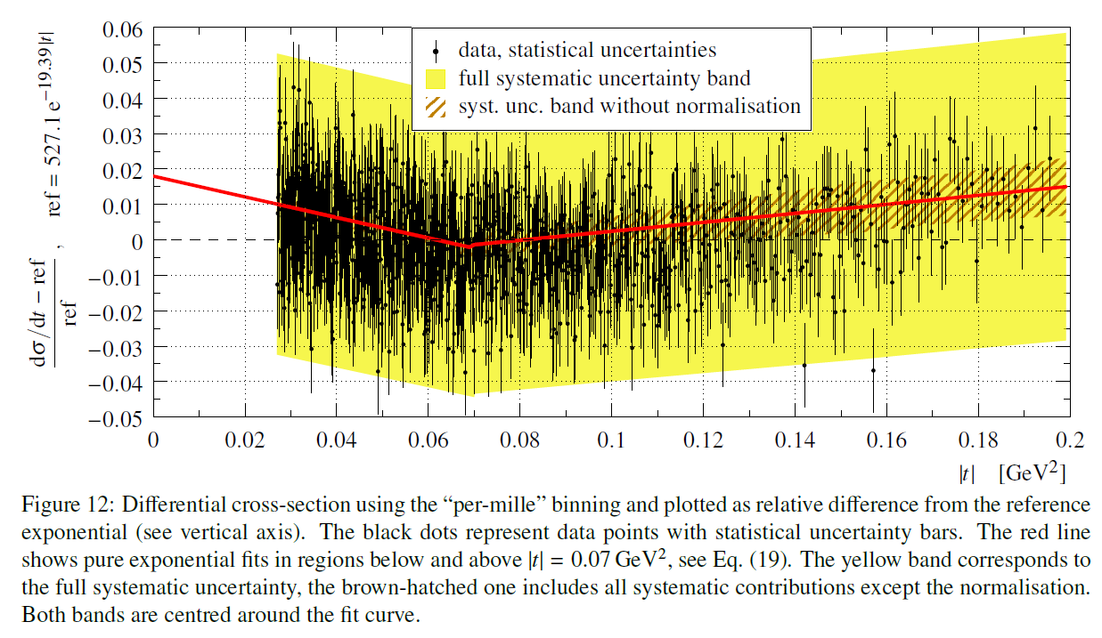
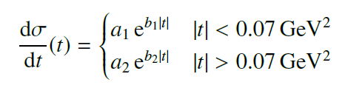

Cross-check: „per-mille” binnings
Simple exp fits excluded. Different binnings show the same effect. Here 7.8 σ significance.

Slide 15
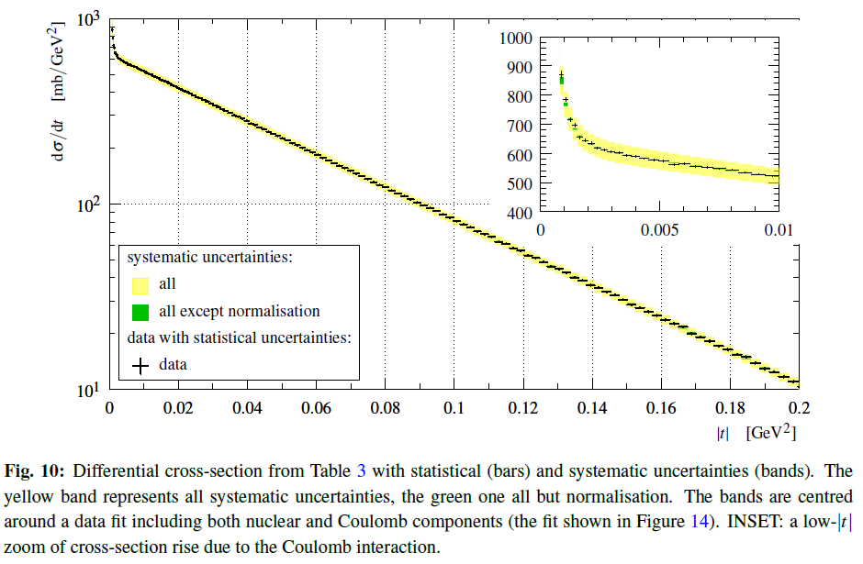
TOTEM dσ/dt @ 13 TeV
TOTEM data from preprint CERN-PH 2017/335. Non-exponential at 13 TeV, too.

Slide 16
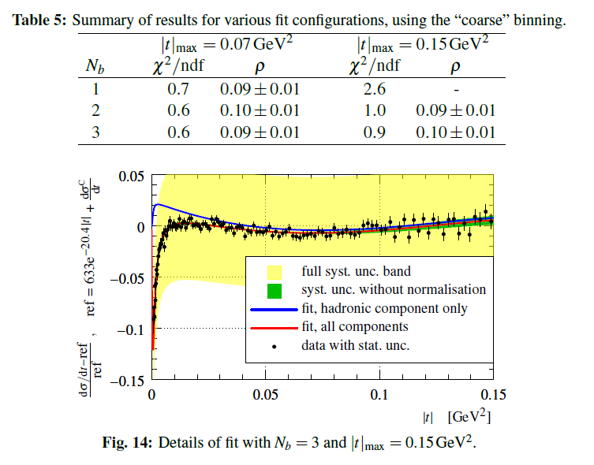

TOTEM dσ/dt @ 13 TeV, CERN-PH 2017/335
TOTEM: non-exponential behavior is seen clearly also at 13 TeV, but emphasis on ρ

Slide 17
Interpretations
TOTEM results on non-exponential behavior
and indications of Odderon: triggered theoretical interpretations.
60+ theory models so far
Work in progress on reviewing these models trying to find the common, important part
if possible model-independently
Only a few of all the possible models will be highlighted or summarized here
Blacker, Edgier and Larger: BEL effect
or BnotEL effect?

Slide 18
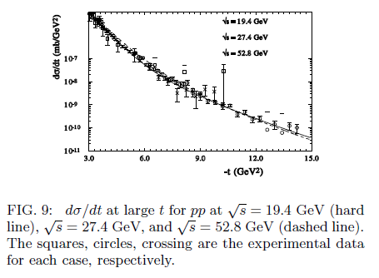
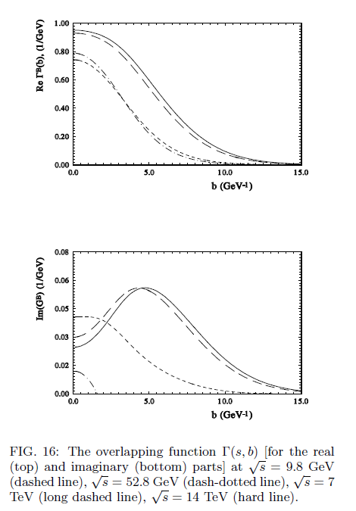
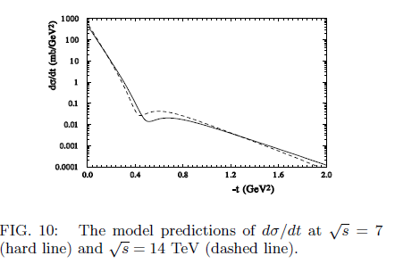
Selyugin, arXiv:1505.02426
Prediction:
Black disc limit is reached at LHC, but 7 TeV data not yet fitted

Slide 19
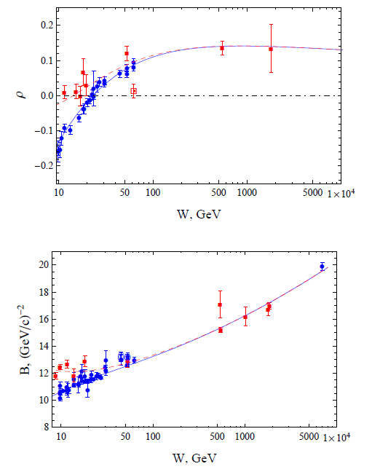
Block, Durand, Ha, Halzen , arXiv:1505.02426
Conclusions:
The fitted data satisfy the black disc limit within errors
but the new TOTEM data at
13 TeV data challenges
this interpretation

Slide 20
Summary
Nucl. Phys. B899 (2015) 297 by TOTEM:
low-|t| dσ/dt for elastic pp at √s = 8 TeV
with unprecedented precision
Significantly non-exponential behaviour
first at FNAL-0069 already,
TOTEM confirmed at 13 TeV
Theoretical interpretations:
Work in progress on reviewing them
Common picture:
Non-Gaussian shadow profile of protons
Opening of a new channel likely
Between 2.76 and 7 TeV,
New trends seen also at 13 TeV

Slide 21
Thank you for your attention
Questions and Comments ?

Slide 22
Backup slides – Questions?

Slide 23
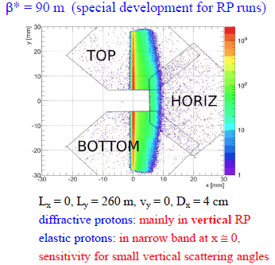
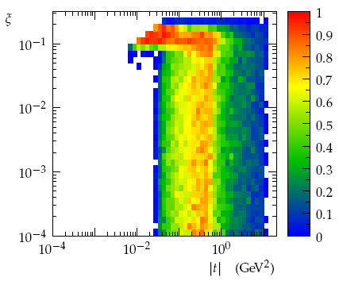

LHC optics and proton acceptance
t = -p² θ*²: four-momentum transfer squared; ξ = Δp/p: fractional momentum loss
β* = 90 m
Diffraction:
all ξ if |t| ≥ 10⁻² GeV²,
soft & semi-hard diffr.
Elastic: low to mid |t|
Total cross-section
β* = 90 m MC simulation shown
Parallel to point focussing, v_{y} ~ 0
Large effective lenght L_{y}
Elastic scattering events: in vertical RPs

Slide 24
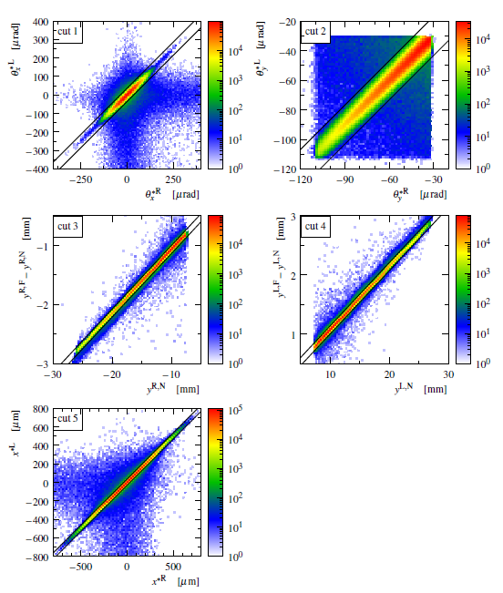
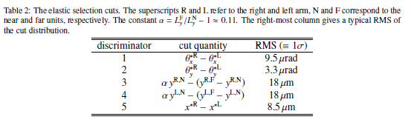
Kinematic cuts: selection of elastics
Precise control of LHC optics
and elastic scattering:
Kinematics reconstruction
Alignment
Optics recalibration
Resolution unfolding
Acceptance correction
Background substraction
Detection & efficiency
Angular resolution
Normalization
Binning

Slide 25
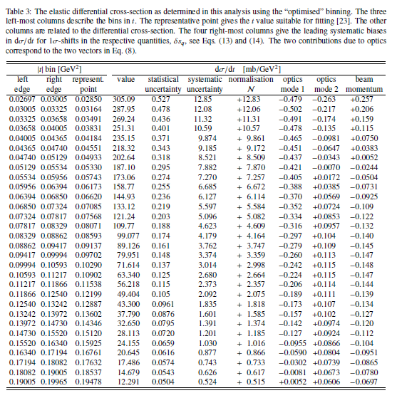
Backup slide – covariance matrix

Slide 26
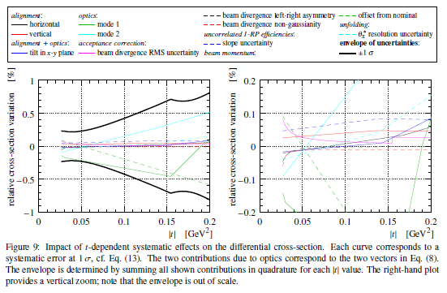
Backup slide: systematics
No significant effect found on the total pp cross-section, σ_{tot}

Slide 27
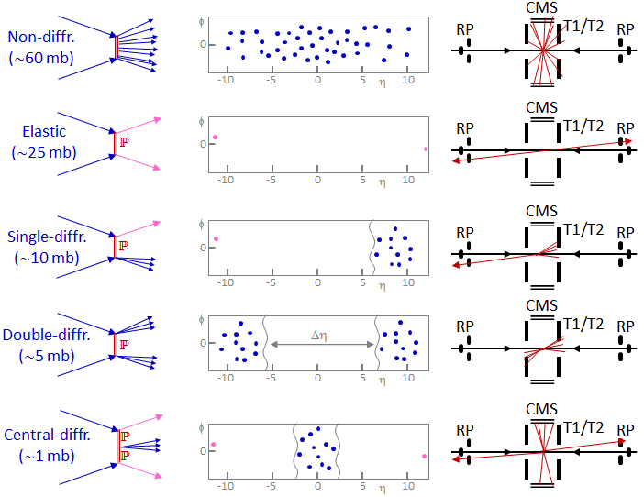
TOTEM physics at LHC
TOTEM TOTEM
TOTEM TOTEM
TOTEM TOTEM
TOTEM TOTEM
TOTEM TOTEM
Elastic and diffractive scattering: colorless exchange

