Slide 1
Scalla/xrootd
Andrew Hanushevsky
SLAC National Accelerator Laboratory
Stanford University
29-October-09
ATLAS Tier 3 Meeting at ANL
  http://xrootd.slac.stanford.edu/

Slide 2
Outline
System Overview
  What’s it made of and how it works
Opportunistic Clustering
  Batch nodes as data providers
Expansive Clustering
  Federation for speed and fault tolerance
    The Virtual Mass Storage System
Fullness vs Simplification

Slide 3

Full Scalla/xrootd Overview
BeStMan
xrootd protocol for random I/O
SRM
xrootdFS
FUSE
P_{a}
redirector
Machine
xrootd cluster
SRM
manages
Grid-SE
transfers
X
C
X
X
C
N
X
C
N
Machine
Machine
Machine
Supports >200K
data servers
Grid protocol for sequential bulk I/O
Clients
P_{g}
GridFTP
xrootd
Minimum for
a cluster
X
ftpd
cmsd
GRID
Globus ftpd
with or without
xrootdFS
C
cnsd
Needed for
SRM support
N

Slide 4
The Components
xrootd
  Provides actual data access
cmsd
  Glues multiple xrootd’s into a cluster
cnsd
  Glues multiple name spaces into one name space
BeStMan
  Provides SRM v2+ interface and functions
FUSE
  Exports xrootd as a file system for BeStMan
GridFTP
  Grid data access either via FUSE or POSIX Preload Library
This might not be needed
for typical Tier 3 sites!

Slide 5
Getting to xrootd hosted data
Via the root framework
  Automatic when files named root://....
  Manually, use TXNetFile() object
    Note: identical TFile() object will not work with xrootd!
xrdcp
  The native copy command
POSIX preload library
  Allows POSIX compliant applications to use xrootd
gridFTP
BeStMan (SRM add-on)
  srmcp for srm-to-srm copies
FUSE
  Linux only: xrootd as a mounted file system
Native Set
Simple Add
Intensive
Full Grid Set

Slide 6
Cluster Maneuvering
xrdcp root://R//foo /tmp
xroot Server
Data
Files
Application
xroot Server
xroot Client
Linux
Redirector
open(“/foo”);
Server Machine A
Linux
Linux
1
Who has /foo?
Client Machine
3
Try B
Server Machine R
4
/foo
open(“/foo”);
xroot Server
Data
Files
2
The xrootd system does all of these
steps automatically
without application (user)
intervention!
I do!
Linux
Server Machine B

Slide 7
Corresponding Configuration File
# General section that applies to all servers
#
all.export /atlas
if redirector.slac.stanford.edu
all.role manager
else
all.role server
fi
all.manager redirector.slac.stanford.edu 3121
# Cluster management specific configuration
#
cms.allow *.slac.stanford.edu
# xrootd specific configuration
#
xrootd.fslib /opt/xrootd/prod/lib/libXrdOfs.so
xrootd.port 1094

Slide 8
File Discovery Considerations
The redirector does not have a catalog of files
  It always asks each server, and
  Caches the answers in memory for a “while”
    So, it won’t ask again when asked about a past lookup
Allows real-time configuration changes
  Clients never see the disruption
Does have some side-effects
  The lookup takes less than a millisecond when files exist
  Much longer when a requested file does not exist!

Slide 9
Handling Missing Files
xrdcp root://R//foo /tmp
xroot Server
Data
Files
Application
xroot Server
xroot Client
Linux
Redirector
open(“/foo”);
Server Machine A
Linux
Linux
1
Who has /foo?
Client Machine
2
Nope!
Server Machine R
5
/foo
xroot Server
Data
Files
File deemed not to exist
if there is no response
after 5 seconds!
Linux
Server Machine B

Slide 10
Missing File Considerations
System optimized for “file exists” case!
  This is the classic analysis situation
    Penalty for going after missing files
Aren’t new files, by definition, missing?
  Yes, but that involves writing data!
    The system is optimized for reading data
  So, creating a new file will suffer a 5 second delay
    Can minimize the delay by using the xprep command
      Primes the redirector’s file memory cache ahead of time

Slide 11
Why Do It This Way?
Simple, lightweight, and ultra-scalable
  Ideal for opportunistic clustering
    E.g., leveraging batch worker disk space
  Ideal fit with PROOF analysis
  Has the R³ property (Real-Time Reality Representation)
  Allows for ad hoc changes
    Add and remove servers and files without fussing
    Restart anything in any order at any time
  Ideal for expansive clustering
    E.g., cluster federation & globalization
      Virtual mass storage systems and torrent transfers

Slide 12
Opportunistic Clustering
Xrootd extremely efficient of machine resources
  Ultra low CPU usage with a memory footprint 20 ≈ 80MB
    Ideal to cluster just about anything
Batch Nodes
File Servers
Redirector
xrootd
cmsd
xrootd
cmsd
xrootd
job
cmsd
job
Clustered Storage System Leveraging Batch Node Disks

Slide 13
Opportunistic Clustering Caveats
Using batch worker node storage is problematic
  Storage services must compete with actual batch jobs
    At best, may lead to highly variable response time
    At worst, may lead to erroneous redirector responses
Additional tuning will be required
  Normally need to renice the cmsd and xrootd
    As root: renice –n -10 –p cmsd_pid
    As root: renice –n -5 –p xroot_pid
You must not overload the batch worker node
  Especially true if exporting local work space

Slide 14
Opportunistic Clustering & PROOF
Parallel Root Facility layered on xrootd
  Good architecture for “map/reduce” processing
Batch-nodes provide PROOF infrastructure
  Reserve and use for interactive PROOF
    Batch scheduler must have a drain/reserve feature
  Use nodes as a parallel batch facility
    Good for co-locating application with data
  Use nodes as data providers for other purposes

Slide 15
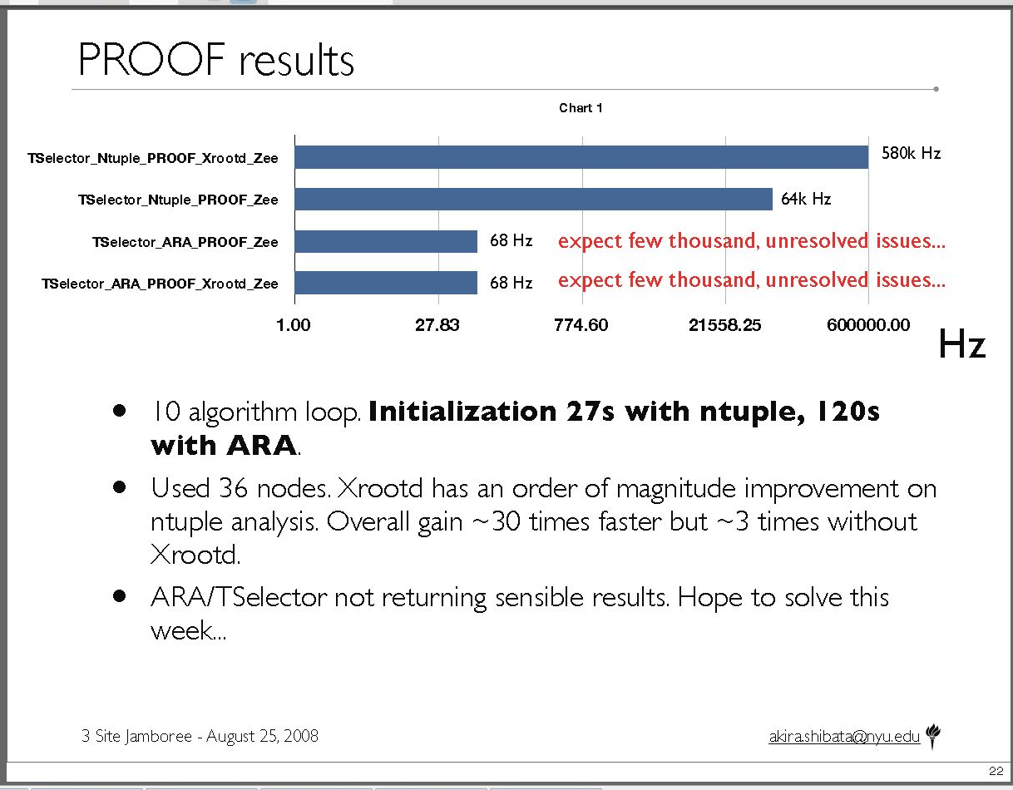
PROOF Analysis Results
Akira’s talk about “Panda oriented” ROOT analysis comparison at the Jamboree
http://indico.cern.ch/getFile.py/access?contribId=10&sessionId=0&resId=0&materialId=slides&confId=38991

Slide 16
Expansive Clustering
Xrootd can create ad hoc cross domain clusters
  Good for easily federating multiple sites
    This is the ALICE model of data management
  Provides a mechanism for “regional” data sharing
    Get missing data from close by before using dq2get
      Architecture allows this to be automated & demand driven
  This implements a Virtual Mass Storage System

Slide 17

Virtual Mass Storage System
BNL
all.role meta manager
all.manager meta atlas.bnl.gov:1312
root://atlas.bnl.gov/
includes
SLAC, UOM, UTA
xroot clusters
xrootd
Meta Managers can be
geographically replicated!
cmsd
xrootd
xrootd
xrootd
cmsd
cmsd
cmsd
SLAC
UOM
UTA
all.manager meta atlas.bnl.gov:1312
all.role manager
all.manager meta atlas.bnl.gov:1312
all.role manager
all.manager meta atlas.bnl.gov:1312
all.role manager

Slide 18
What’s Good About This?
Fetch missing files in a timely manner
  Revert to dq2get when file not in regional cluster
Sites can participate in an ad hoc manner
  The cluster manager sorts out what’s available
Can use R/T WAN access when appropriate
Can significantly increase WAN xfer rate
  Using torrent-style copying

Slide 19
Torrents & Federated Clusters
BNL
all.role meta manager
all.manager meta atlas.bnl.gov:1312
xrootd
Meta Managers can be
geographically replicated!
xrdcp –x xroot://atlas.bnl.gov//myfile /tmp
cmsd
xrootd
xrootd
xrootd
cmsd
cmsd
cmsd
/myfile
/myfile
SLAC
Cluster
UOM
Cluster
UTA
Cluster
all.manager meta atlas.bnl.gov:1312
all.manager meta atlas.bnl.gov:1312
all.manager meta atlas.bnl.gov:1312
all.role manager
all.role manager
all.role manager

Slide 20
Improved WAN Transfer
The xrootd already supports parallel TCP paths
  Significant improvement in WAN transfer rate
    Specified as xrdcp –S num
Xtreme copy mode uses multiple data sources
  Specified as xrdcp –x
  Transfers to CERN; examples:
    1 source (.de): 12MB/sec ( 1 stream)
    1 source (.us): 19MB/sec ( 15 streams)
    4 sources (3 x .de + .ru): 27MB/sec ( 1 stream each)
    4 sources + || streams: 42MB/Sec (15 streams each)
    5 sources (3 x .de + .it + .ro): 54MB/Sec (15 streams each)

Slide 21
Expansive Clustering Caveats
Federation & Globalization are easy if . . . .
  Federated servers are not blocked by a firewall
    No ALICE xroot servers are behind a firewall
There are alternatives . . . .
  Implement firewall exceptions
    Need to fix all server ports
  Use proxy mechanisms
    Easy for some services, more difficult for others
All of these have been tried in various forms
  Site’s specific situation dictates appropriate approach

Slide 22
Summary Monitoring
Needed information in almost any setting
Xrootd can auto-report summary statistics
  Specify xrd.report configuration directive
Data sent to one or two locations
  Use provided mpxstats as the feeder program
    Multiplexes streams and parses xml into key-value pairs
  Pair it with any existing monitoring framework
    Ganglia, GRIS, Nagios, MonALISA, and perhaps more

Slide 23
Summary Monitoring Setup
monhost:1999
Monitoring
Host
mpxstats
ganglia
Data
Servers
xrd.report monhost:1999 all every 15s

Slide 24
Putting It All Together
Data Nodes
Manager Node
Basic xrootd Cluster
cmsd
cmsd
+
Name Space xrootd
cnsd
+
xrootd
xrootd
xrootd
cnsd
+
SRM Node
(BestMan, xrootdFS, gridFTP)
xrootdFS
=
GRID
LHC Grid Access
BestMan
gridFTP
SRM Node

Slide 25
Can’t We Simplify This?
The cnsd present for XrootdFS support
  Provide composite name space for “ls” command
FUSE present for XrootdFS support
XrootdFS & FUSE for BeSTMan support
BeSTMan for SRM support
SRM for push-type grid data management
  dq2get is a pull function and only needs gridFTP
Answer: Yes! This can be simplified.

Slide 26
Tearing It All Apart
Data Nodes
Manager Node
cmsd
cmsd
Basic xrootd Cluster
cnsd
+
xrootd
xrootd
xrootd
dq2get Node
(gridFTP + POSIX Preload Lib)
=
Simple Grid Access
xrootdFS
Posix
Preload
Library
Even more effective
if using a VMSS
dq2get
GRID
BestMan
gridFTP
SRM Node
dq2get Node

Slide 27
In Conclusion. . .
Xrootd is a lightweight data access system
  Suitable for resource constrained environments
    Human as well as hardware
  Geared specifically for efficient data analysis
Supports various clustering models
  E.g., PROOF, batch node clustering and WAN clustering
  Has potential to greatly simplify Tier 3 deployments
Distributed as part of the OSG VDT
  Also part of the CERN root distribution
Visit http://xrootd.slac.stanford.edu/

Slide 28
Acknowledgements
Software Contributors
  Alice: Derek Feichtinger
  CERN: Fabrizio Furano , Andreas Peters
  Fermi/GLAST: Tony Johnson (Java)
  Root: Gerri Ganis, Beterand Bellenet, Fons Rademakers
  SLAC: Tofigh Azemoon, Jacek Becla, Andrew Hanushevsky, Wilko Kroeger
  LBNL: Alex Sim, Junmin Gu, Vijaya Natarajan (BeStMan team)
Operational Collaborators
  BNL, CERN, FZK, IN2P3, RAL, SLAC, UVIC, UTA
Partial Funding
  US Department of Energy
    Contract DE-AC02-76SF00515 with Stanford University

