Slide 1


Test results of MQXFS1d
(all preliminary)
S. Stoynev, et al.
Satellite meeting on MQXF
10 May 2018
BNL

Slide 2
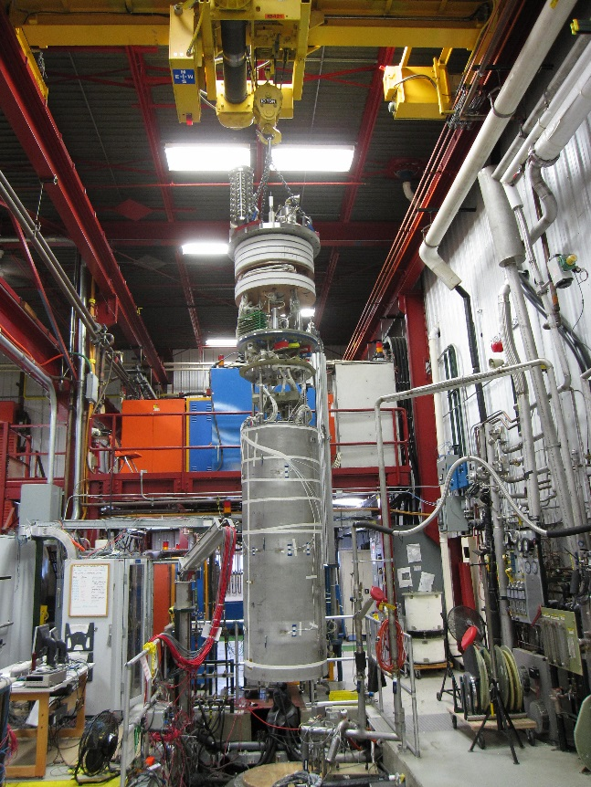
Introduction
MQXFS1 is the first 150 mm diameter, 1.5 m long Nb3Sn quadrupole from LARP/HiLumi
  Coils fabricated by CERN (#103 and #104) and LARP (#3 and #5)
The first test was performed in early 2016 (MQXFS1a)
  The magnet reached 18.1 kA / 84.2% SSL / 145 T/m / 12.5 T @ 1.9 K
  However coil unloading was observed and training stopped
After the test the azimuthal pre-stress was increased (~35%)
The magnet was re-tested in the end of 2016 (MQXFS1b)
  Good training memory
  The magnet reached 19.0 kA @ 1.9 K
MQXFS1c with increased axial pre-stress was tested
in April-July 2017
  Lost part of the training memory
  Reached ultimate current and showed erratic training
SS Shell was welded to the magnet and a new test
MQXFS1d is underway
MQXFS1d during test preparations

Slide 3
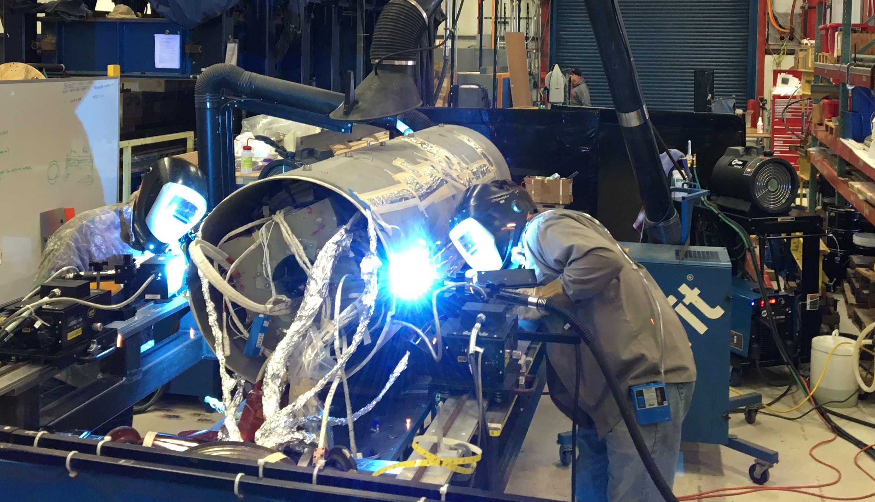
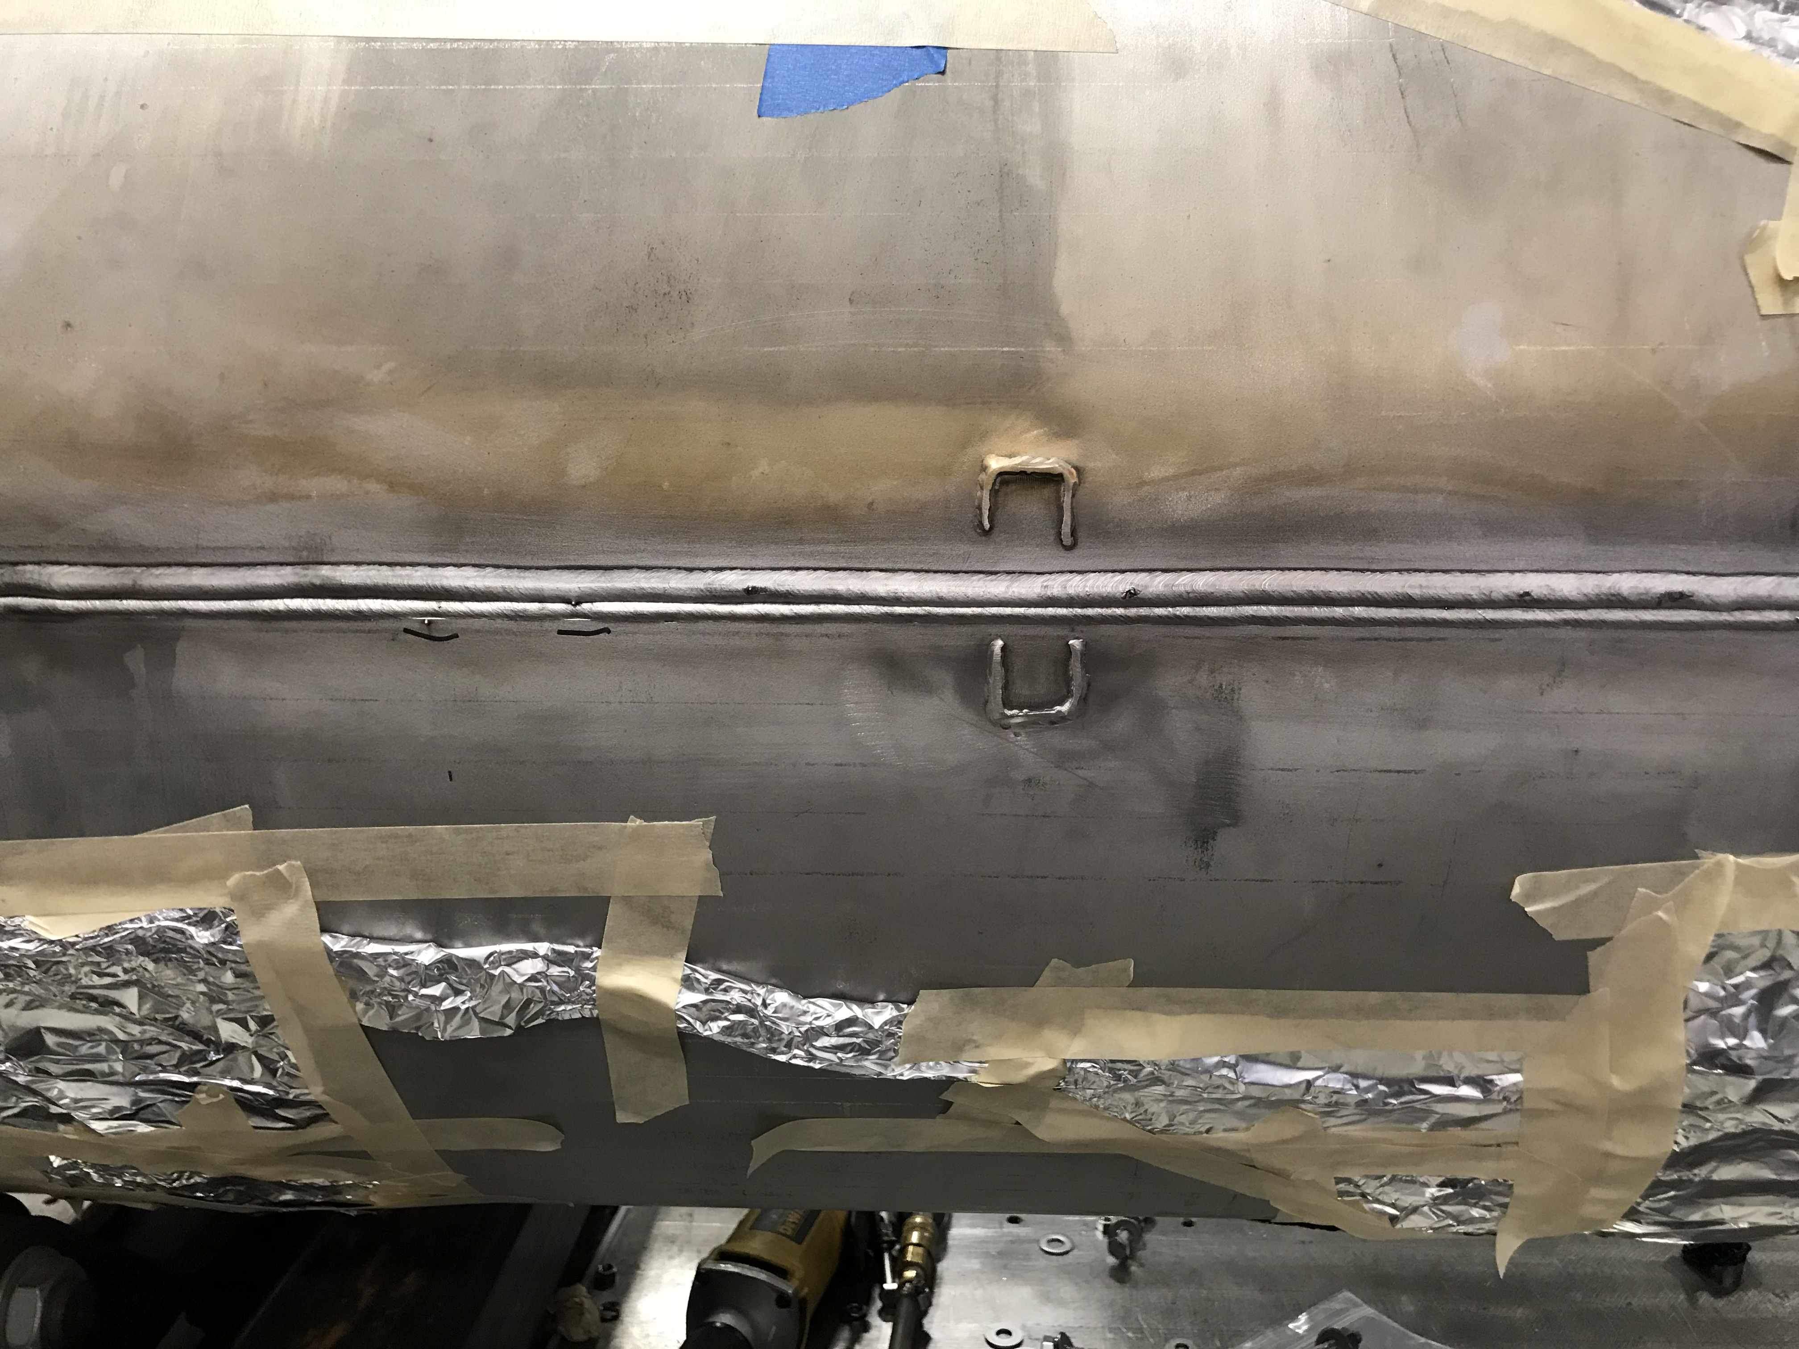
Welding for MQXFS1d
Temperature rise:
After 1st Pass – 2°C
After 2nd Pass - 2°C
After 3rd Pass – 1.5°C
Total Rise 5 °- 6°C
**Returned to Room Temperature in 48 hours.
Analysis showed consistent with expectations prestress
increase at ~ 20 (7) MPa level for coil in T (Z) direction
(and no difference expected cold)

Slide 4
Cable properties and SSL Estimates
Coils made of Nb₃Sn strand
RRP 108/127 (#3 and #5)
RRP 132/169 (#103 and #104)
SSL at 1.9 K: 21.5 kA (coil #103)
Cable width, mm |  | 18.094
Cable mid. thickness, mm |  | 1.529
Keystone angle, degree |  | 0.518
Twistpitch, mm |  | 109
Number of strands |  | 40
Core |  | 316 SS
Short-sample
 | Current | Field | Gradient | Current | Field | Gradient |  | Nom. Current | Nom. Gradient | Nom. Field | % Iss
 | 4.3 K | 4.3 K | 4.3 K | 1.9 K | 1.9 K | 1.9 K |  | 1.9 K | 1.9 K | 1.9 K | 1.9 K
 | kA | T | T/m | kA | T | T/m |  | kA | T/m | T | %
Coil 103 | 19.550 | 13.383 | 155.164 | 21.50 | 14.599 | 169.083 |  | 16.47 | 132.667 | 11.425 | 77
Coil 104 | 19.775 | 13.525 | 156.783 | 21.78 | 14.769 | 171.026 |  | 16.47 | 132.667 | 11.425 | 76
Coil 3 | 20.118 | 13.740 | 159.245 | 22.28 | 15.080 | 174.573 |  | 16.47 | 132.667 | 11.425 | 74
Coil 5 | 19.725 | 13.493 | 156.424 | 21.85 | 14.813 | 171.526 |  | 16.47 | 132.667 | 11.425 | 75
Magnet | 19.550 | 13.383 | 155.164 | 21.50 | 14.599 | 169.083 |  | 16.47 | 132.667 | 11.425 | 77

Slide 5
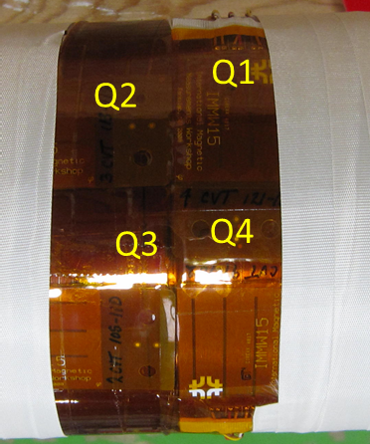
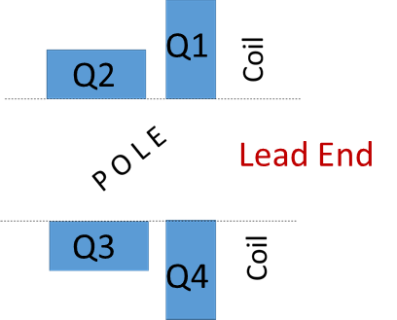
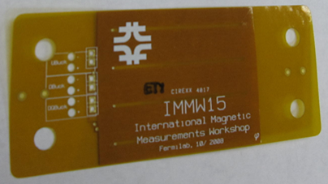
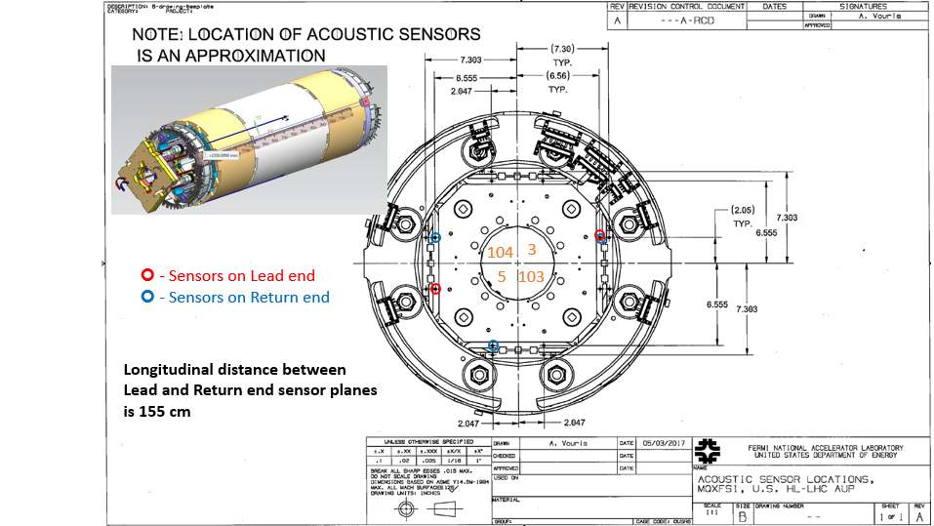
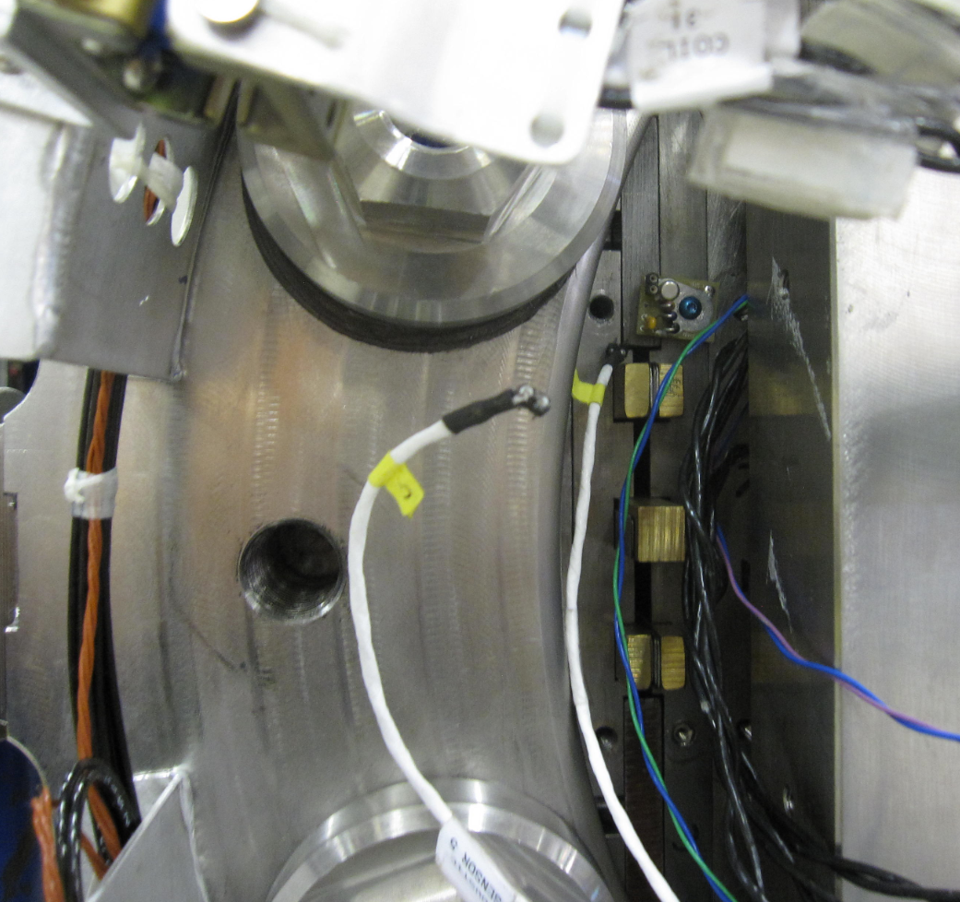
Instrumentation
LARP magnet instrumentation:
Voltage taps on the IL and OL
CERN and LARP SG systems
(strain gauges on the coils, rods
and new shell)
Quench antennas (QA) on coil 3, LE
Acoustic sensors from LBNL (testing, 100 kHz DAQ)
(for some quenches)
Antennas are placed on the warm finger
Three sensors at non-LE and
Two sensors at LE

Slide 6
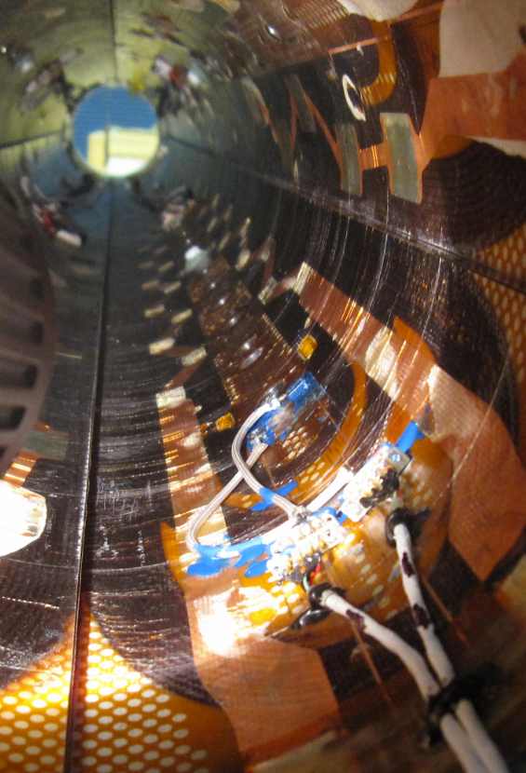
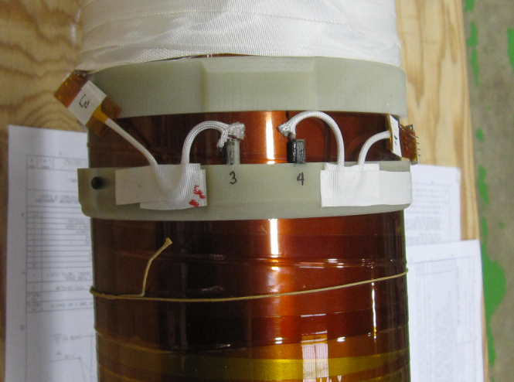
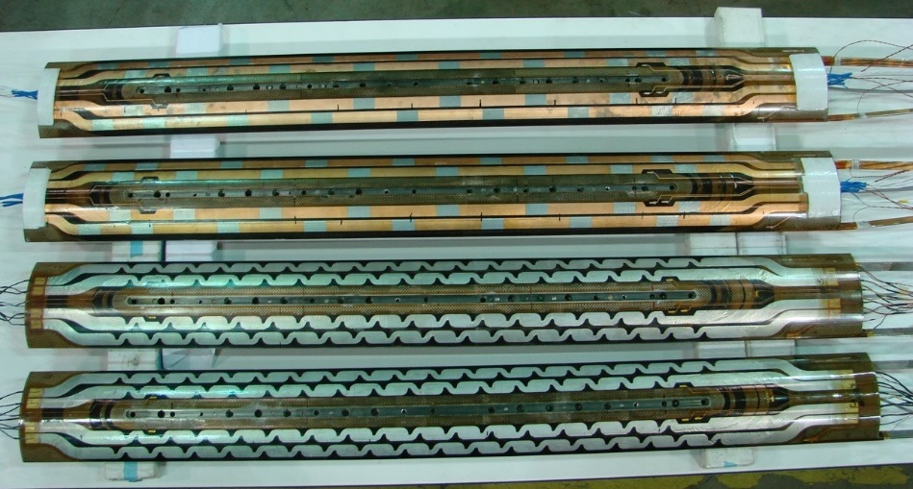
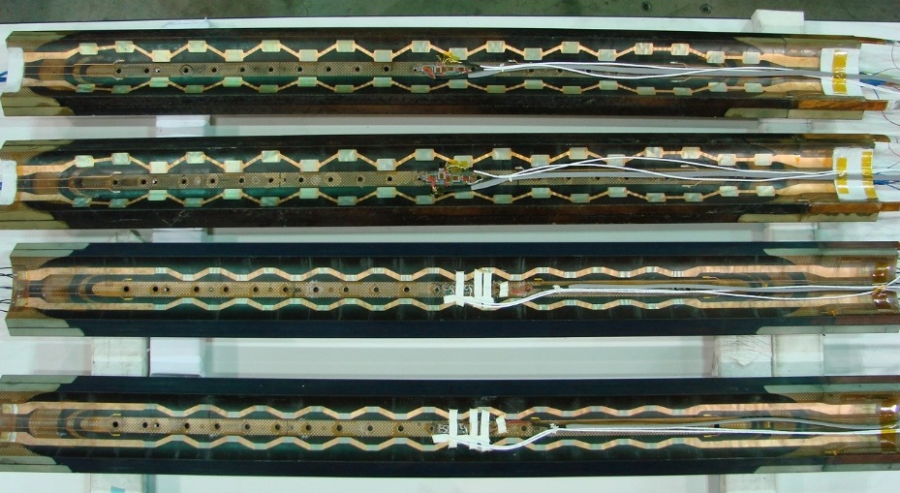
Instrumentation
Hall probes (using the same 100 kHz DAQ as acoustics) – for some quenches
Magnet is protected with IL/OL PH
Two on the pole (coil 5, non-LE),
π/2 angle difference
Two on the warm finger (over coil 5, LE)
OL Heaters
IL Heaters
CERN coils
LARP coils

Slide 7
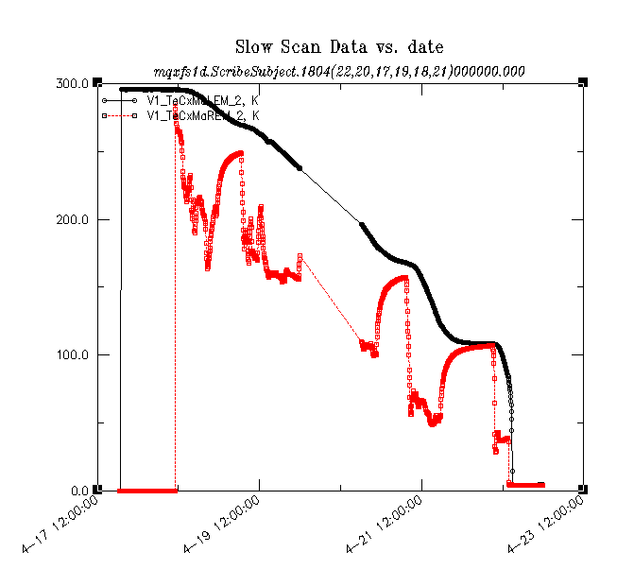
Timeline of the test so far
Cool-down
As in the previous tests
- Warm magnetic measurements
- Controlled cool-down
- 120 mΩ dump resistor for check-outs
- 30 mΩ resistor for training and studies
Start:
18 April 2018
After initial verification procedures the cold test
proceeded in the following order
Training to above ultimate level
Ramp rate and temperature dependence studies
Energy loss measurements
Magnetic measurements (Z scan at Nominal current)
Warm up

Slide 8
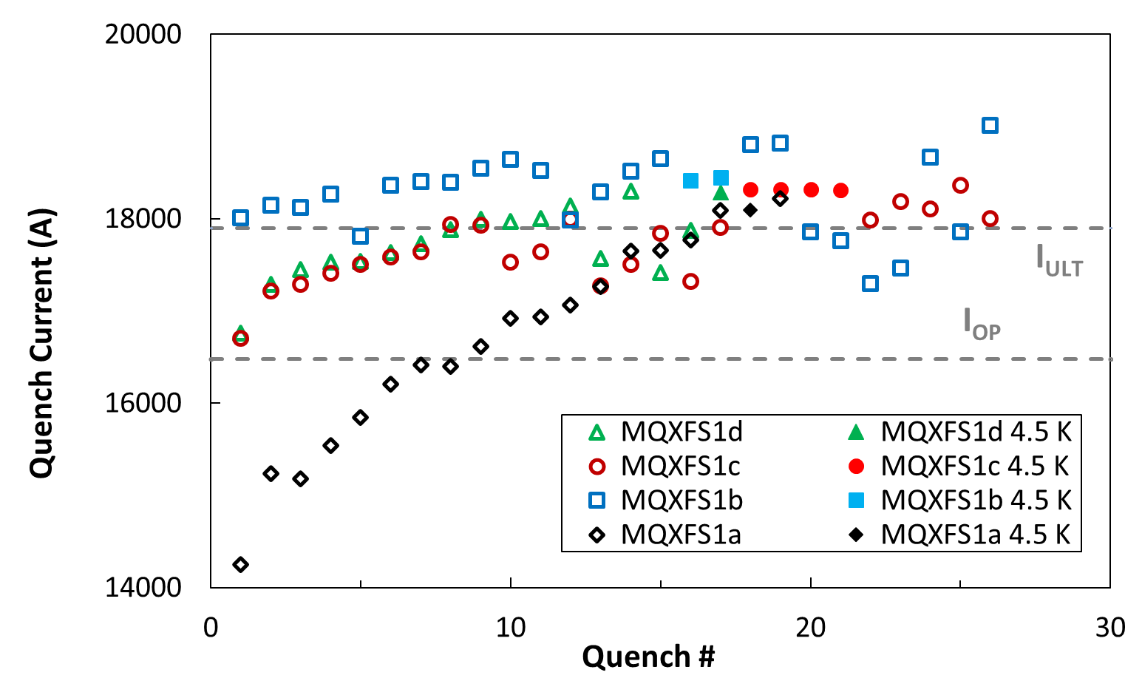
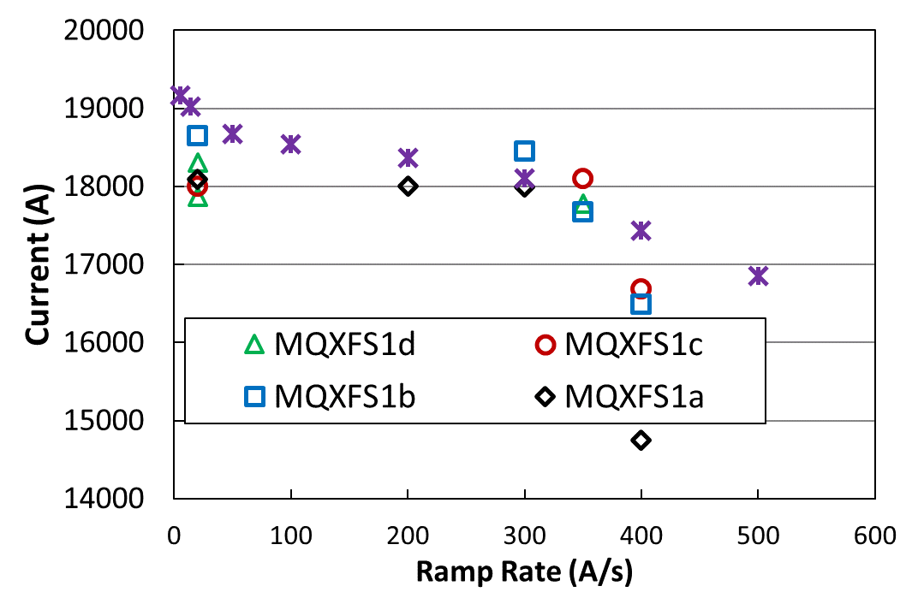
Quench history
MQXFS1d repeated MQXFS1c training very closely
Repetition of re-training closely
following MQXFS1c
Same features at 4.5 K
(high/stable/same coil 5 as before*)
Detraining quenches in coils 5
(for the first time)
Coil 5 becomes limiting
All high ramp rate quenches
(above 300 A/s, quenches in the mid-plane)
so far were in coil 5;
this time the quench was in coil 104 (b2_b3)
Still consistent by magnitude

Slide 9
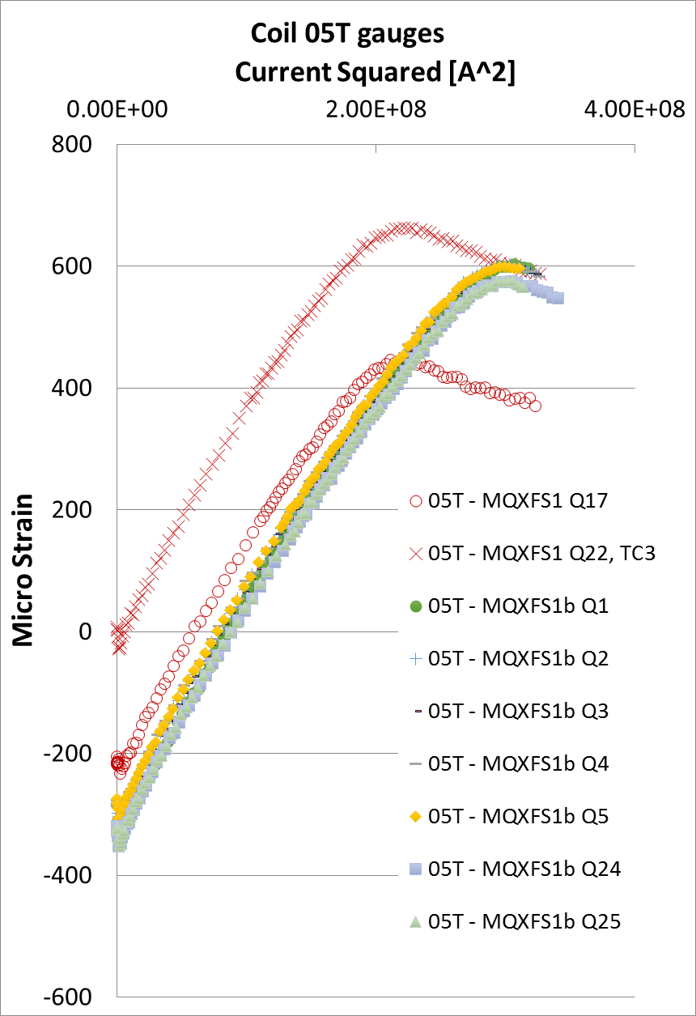
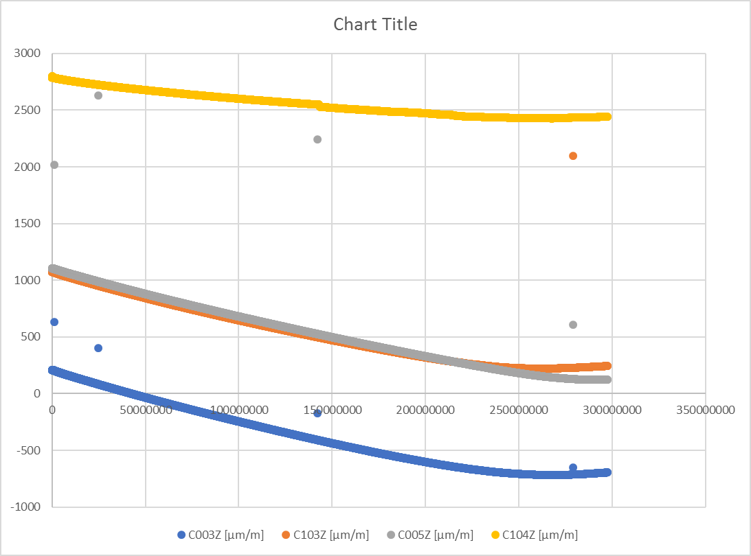
Strain gauge data
Still under analysis
MQXFS1d
MQXFS1a in RED
(2 quenches)
15 kA
17 kA
MQXFS1c
(rest)
I^2 (A^2)
A new DAQ for SG is being commissioned (in parallel with the other system).
Despite a sign and offsets to correct the powering response is similar to MQXFS1b (and c)

Slide 10
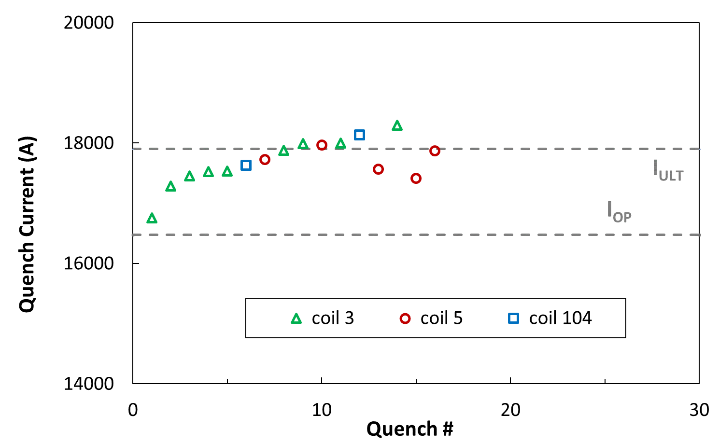
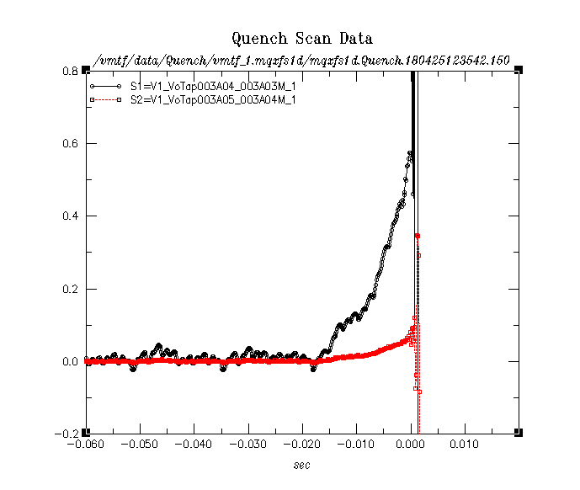
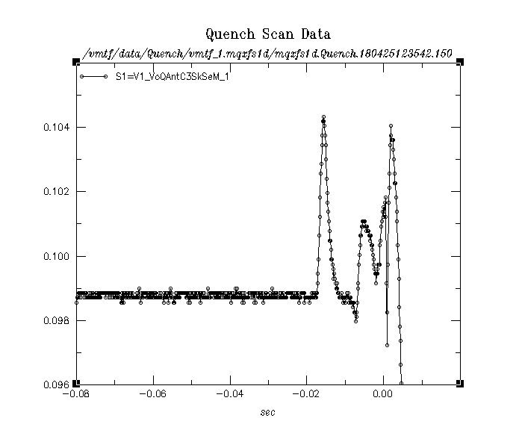
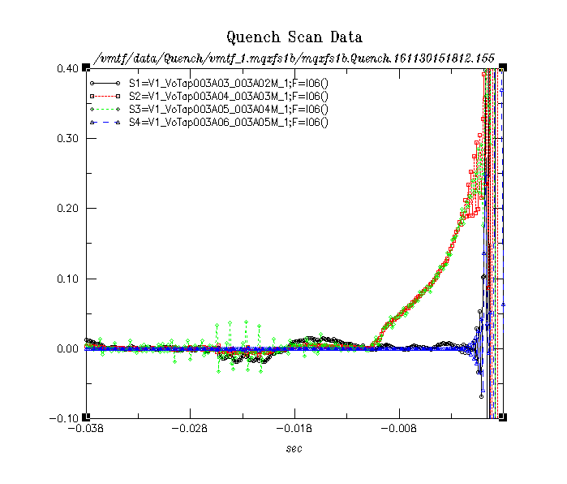
Quench locations and pattern
MQXFS1d
VT signals
For coil 3, QA responds in Q4 (and Q3)
which is on the non-transition side.
MQXFS1b for comparison
Very clean signal
(no “precursors”
within 1 s)
[V]
VT signals
(pick up signal typically
observed in a4_a5;
here it is scaled by a
factor of 9)

Slide 11
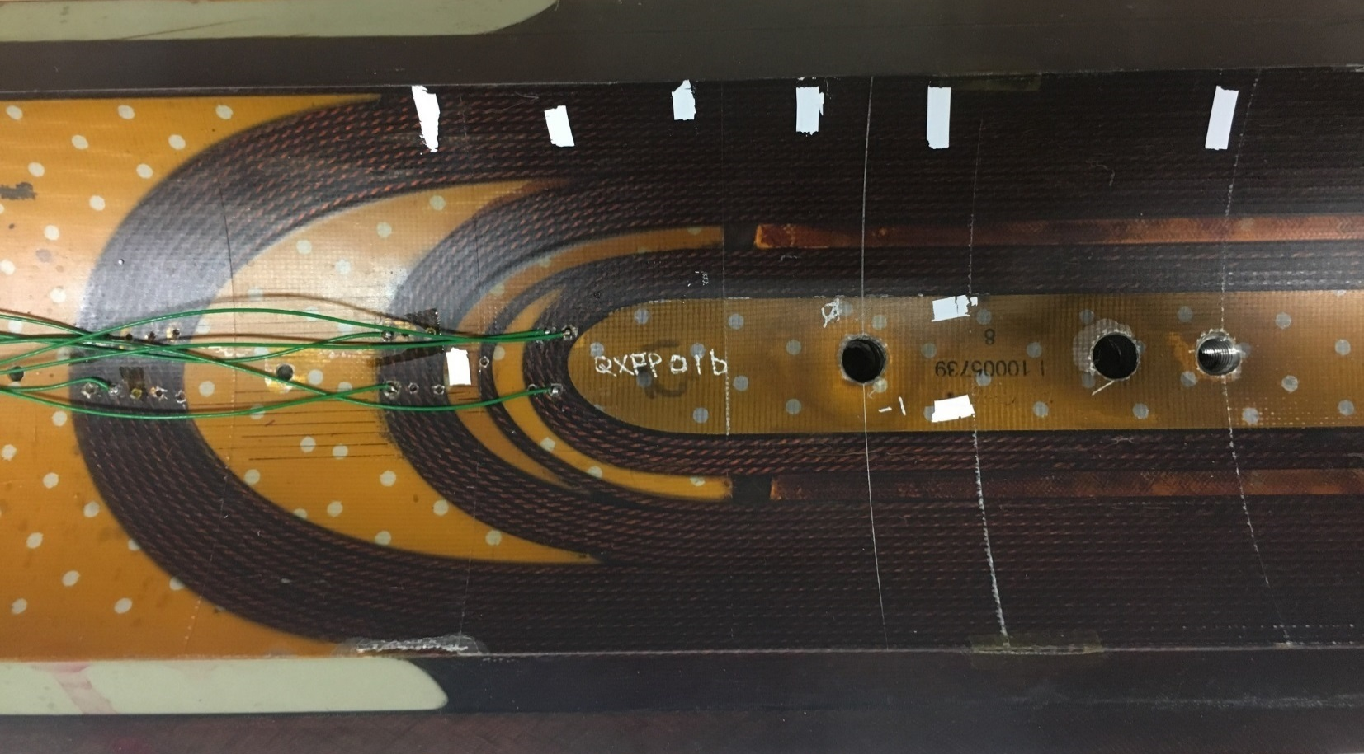
Likely region of quenches in coil 3
From voltage tap signal we see no propagation from a4_a3 into any other segments.
With 20ms delay between quench and dump, at 2cm/ms we are about 15” away from VT04/03 and we should see layer-to-layer quench propagation too (if across segments)
Thus we only look at 4 layers next to the inner surface of the wedge on either transition
or non-transition side for most quenches
From QA analysis we can state the most likely region where quenches happen
This region is where the wedge and the spacer meet,
more likely at the non-transition side (QA analysis)
THIS SLIDE IS BASED ON TESTING BEFORE MQXFS1D. NOW WE ALSO
KNOW THE COIL SIDE AND HAVE A CONFIRMATION ON THE STATEMENTS
# 19 11/22 11:02
QA 4-5, 03
#18 11/11 19:23
QA 4-5, 104
#24 11/30 15:18
QA 3-4
# 22 11/23 19:25
QA 3-4, 03
#23 11/30 11:53
QA 3-4, 03
#Quench to Flat Top
11/30 19:23
QA 4-5, 03
#Quench at Flat Top
12/01 11:34
QA 4-5, 03
#21 11/23 14:48
QA 5, 03
#25 12/07 18:05
QA 4
#20 11/22 14:51
QA 5-6 – 6, 03
De-training is in bold, #20 - #25, the text
position is NOT indication of the quenching side

Slide 12
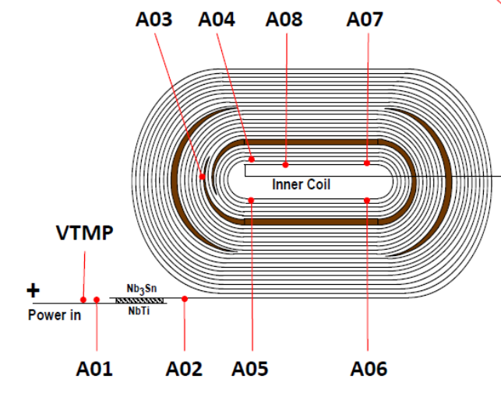
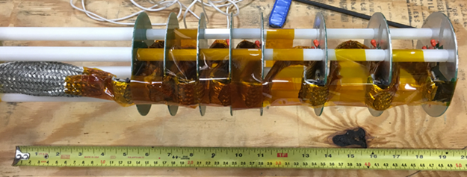
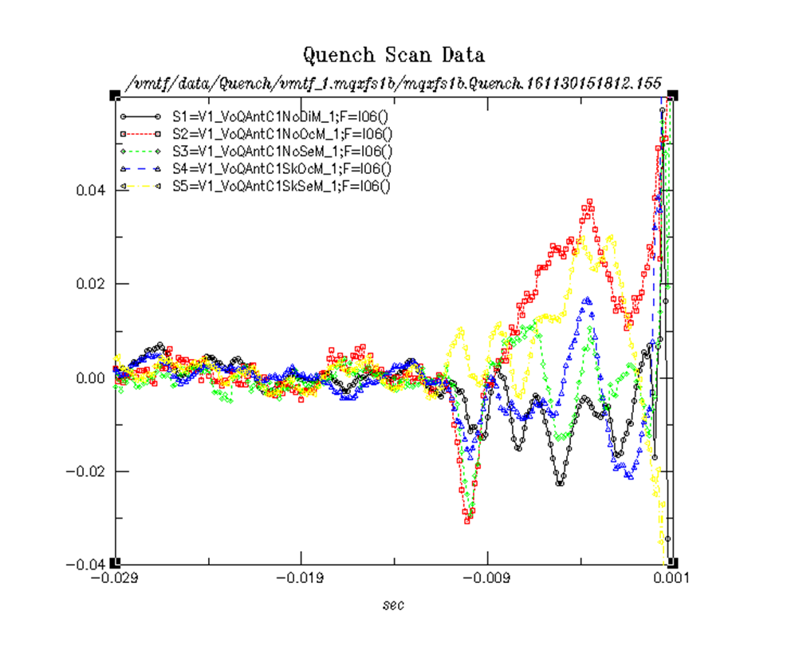
Quench locations in coil 3 – MQXFS1b/c
Most of the quenches we saw in coil 3 happened
in the lead-end of the multi-turn segment a3_a4
We reconfigured the quench antenna (few times)
to get a better hold on the quench location
One of the QA configurations used
for better localization of quenches
[V]
VT signals
(pick up signal typically
observed in a4_a5;
here it is scaled by a
factor of 9)
[V]
QA signals

Slide 13
Holding current test
Over two hours at Nominal current during magnetic measurements

Slide 14
Not yet analyzed data
Energy loss measurements
Magnetic measurements
Acoustic measurements
Hall probe measurements
Strain gauges (only preliminary)

Slide 15
Test plan
Warm-up (now) to room temperature and cool-down
Re-train (with CLIQ?)
Repeat few protection tests (reproducibility)
Few splice resistance measurements (comparisons with previous results)
Magnetic measurements if necessary
Cold RRR
Heaters hipot at 80 K

