Slide 1
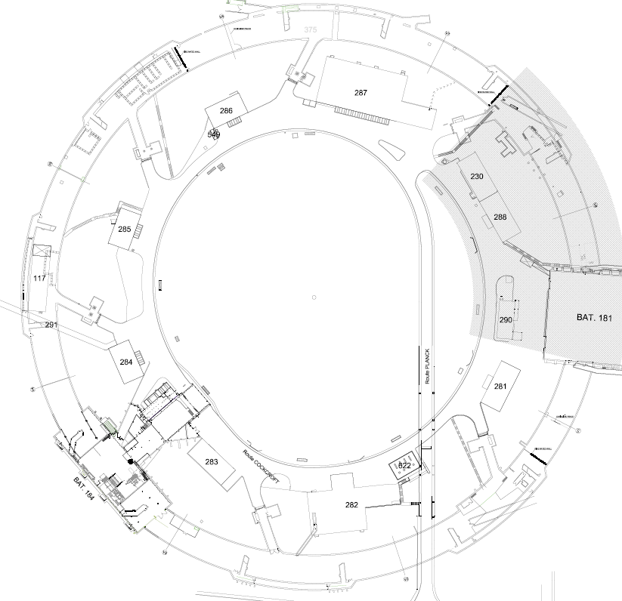
Technical work packages
STATUS & UPDATES
Organisation,
Planning & Budget vs. Baseline
C. Colloca
RWTCS Steering Commitee

Slide 2
INFRASTRUCTURE WORK
WORK PACKAGES | WORK PACKAGE OWNER | WORK PACKAGE TEAM
Civil engineering & building work | C. Colloca SMB/SE | L. Maricalva, R. Ortega, T. Moro SMB/SE
Electricity | J. Gomez SMB/SE | F. Vincent SMB/SE
HVAC | G. Rouge SMB/SE
Cranes & handling/lifting equipment | O. Boettcher EN/HE | Y. Seraphin EN/HE
IT networks | L. Borakiewicz IT/CS
Access control | R. Nunes BE/ICS | N. Rama BE/ICS
Fire detection | D. Raffourt BE/ICS

Slide 3
- Fire doors ISR3, ISR4, ISR5, ISR6, ISR7
- Electricity ISR4 & bldg 184
- Sanitary bloc bldg. 184
- Offices modif, meeting & changing rooms bldg 184
- HVAC unit for bldg. 184
- Local urgent slab repairs ISR3, ISR5, ISR6 and ISR7
- Old telephone network dismounting ISR5 & ISR6
- Embedded network assessment & inventory
- Resin tests results (4 samples / 5 OK)
FINISHED WORK (NOV - MARCH 17)

Slide 4
- Floor reparing and closing ISR5 & ISR6 (underground connections & passages, holes filling, water channels & grids construction)
- Replacing of metallic stairs ISR2, ISR4 and ISR8
- Fire doors ISR2 (entrance + separation from ‘machine’ zone)
- ISR2:
- Ceiling painting
- Electricity dismounting
- Floor sealing holes
- Rails alignment
- Corbels repairs
On going/starting WORK

Slide 5
- HVAC : IT opened - > FC of June
- Electrical study for ISR2
- Infrastructure supports for HVAC: preparation of ‘consultation’ file
- Replacement of metallic stairs (ISR2, ISR4, ISR8) : execution file preparation
- Floor preparation, channels & grids + waterproofing: estimates
- BLDG 573, 574, 225: budget & planning delivered to HSE/RP … waiting for IPP
On going/starting STUDIES

Slide 6
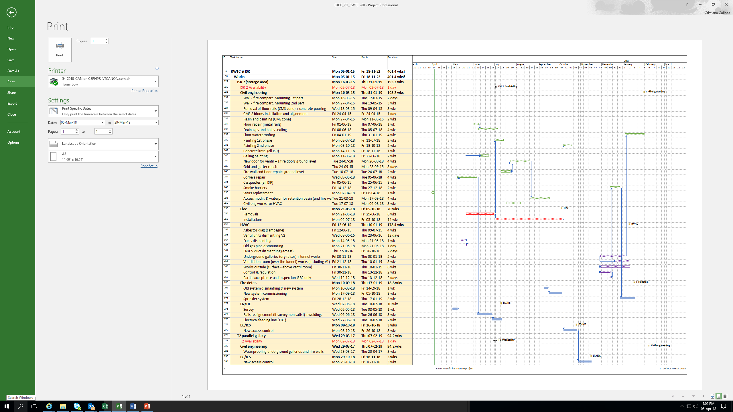
PLANNING

Slide 7
SPENDING PROFILE
EXPENDITURES (FOR TUNNEL WORK ONLY – NO SECURITY) | 2018 | 2019 | 2020 | 2021 | 2022 | 2023
GLOBAL BUDGET* (kCHF) | 1’630 | 2’600 | 500 | 430 | 500 | 200
TOTAL | 5860
Floor preparation, channels & grids + waterproofing = + 1900 kCHF over 6 years
Planning v 60
*Without ‘Access control’, ‘Human resources’

Slide 8
BLDG. 573, 522 AND 574
UPGRADE/CHANGE OF DESTINATION | BLDG. 225 | BLDG. 573 | BLDG. 574
GLOBAL BUDGET* (kCHF) | 280 | 325 | 215
*These estimates take into account: Building work (small walls, waterproofing etc.) Electricity HVAC IT Fire detection They do not take into account access control, fire compartments, sprinklers and smoking extraction systems (risk analysis still on going for bldg 225)
Current estimated duration : 2 years from the IPP approval
(if the new bldg. close to bldg. 184 is ‘postponed’)

Slide 9
HSE/RP CONTROL BLDG
Budget : 800 kCHF
Duration : 2 years from the start of design
Constraints : one of ISR4 access condemned +
parking reduction

Slide 10

THANK YOU
FOR THE ATTENTION!

