Slide 1
GE1/1 production for LS2 and GE2/1 production schedule
M. Bianco on behalf of the GEM TC

Slide 2
Outline
GE1/1 Installation Schedule
GE1/1 SC Integration & QC8 Tests time
QC8 Test Stand upgrade for GE2/1 (Impact on GE1/1 tests)
GE2/1-ME0 production sites & module distribution
GE2/1 (TDR-Merlin) Electronic schedule
GE2/1 Installation Schedule (Ready for installation)
GE2/1 Chambers Integration & QC8 Tests time
ME0 (TDR-Merlin) Electronic schedule

Slide 3
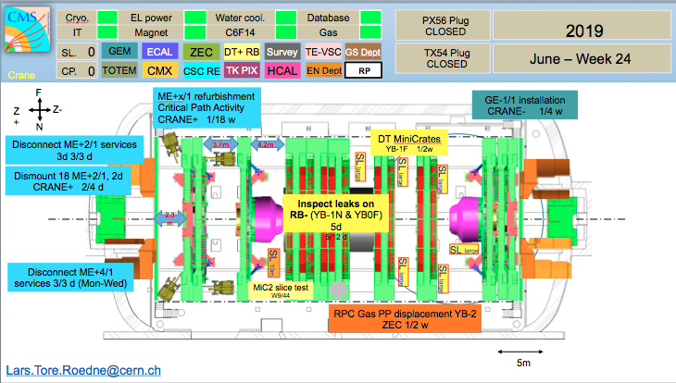
GE1/1 Installation Schedule
GE1/1 Chambers Installation will proceed in two separate moments:
Negative EndCap 10th June to 6th 2019 July (4 Weeks – 20 w.d.)
Positive EndCap 27th Jan to 21st Feb 2020 (4 Weeks – 20 w.d.)
Negative EndCap: ready for installation End Feb 2018 (No date in Merlin)
Positive EndCap: ready for installation End Aug 2019 (No date in Merlin)

Slide 4
GE1/1 SC Integration and QC8 Tests time
Expected at CERN by beginning of May:
  140 VFAT3
  10 GEBv3-S, 6 GEBv3-L and 6 OH
Expected at CERN in June :
  10 pieces of each GEB and 20 OH
  1000 VFAT3 Hybrids
From July
  Full speed: 10 GEBv3-S, 10 GEBv3-L and 40 OH
Mechanical assembly will take 2 days for each SC
Expect to assemble 2 SC + ½ SC by end of May (3rd SC to be completed as soon as the missing VFAT will arrive), than 3 SC in June and 4 SC/month till Aug, from September Full Speed 8 SC/months
QC8 Test test designed to host up to 15 SC in parallel, to be completed by end of May, during the SC production phase SC can be under QC8 Test up to ~ 2 months
38 SC expected to be assembled by Dec 2018, second nose assembled by end of Apr 2019

Slide 5
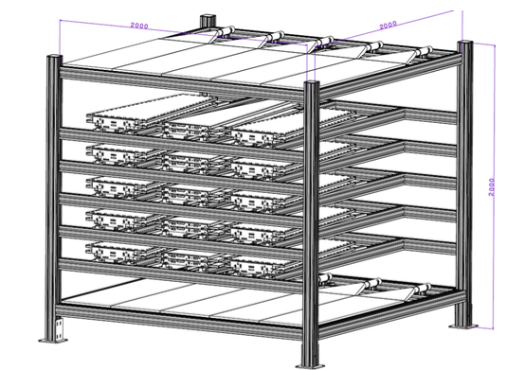
QC8 Test Stand upgrade for GE2/1
From Apr 2019, QC8 capacity will be reduced to 12 GE1/1 SC to allow for first GE2/1 tests at CERN
Layer of the QC8 test stand to be used for first electronic integration tests at CERN from April 2019

Slide 6
GE2/1 –ME0 modules for production sites
GE2/1 – ME0 assembly module will be distribute between several assembly sites, actually the schedule is built with the assumption of 4 production sites
Each assembly site is expected to take care of 72 GE2/1 modules and 54 ME0 modules
The time allocated in the schedule for the production of each batch of GE2/1-ME0 modules has been tuned on the experience of GE1/1 assembly pace adding the time needed for the shipment of the module components and receive back the assembled module
Additional production site are under evaluation for the production these can speed up the module production rate
Prod site | GE2/1 | ME0
#1 | M1 (72 modules) | 54 modules (1/4 total prod.)
#2 | M2 (72 modules) | 54 modules (1/4 total prod.)
#3 | M3 (72 modules) | 54 modules (1/4 total prod.)
#4 | M4 (72 modules) | 54 modules (1/4 total prod.)
No overlap in assembly/test phases in all production sites are presents
The GE1/1 module assembly will end by 2018 Summer, well in advance of the start of GE2/1 module assembly
GE2/1 assembly modules phase is expected to be concluded by 7th Jan 2022 and the ME0 assembly is expected to start on 3rd June 2022 (4 months of float plus the intrinsic float accounted for each module assembly)

Slide 7
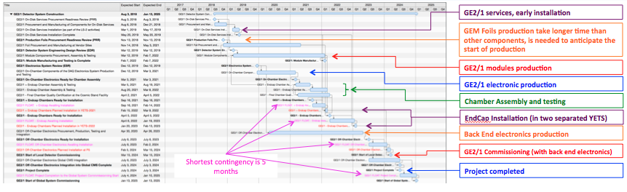
GE2/1 Schedule Overview
2.5.2.5.6.1 | GE2/1 Disk 1: Move chambers from 904 to P5 | 10-Feb-22 | 2-Mar-22
2.5.2.5.6.2 | GE2/1 Disk 1 Chamber Installation | 15-Feb-22 | 7-Mar-22
2.5.2.5.6.3 | GE2/1 Disk 1 Chamber Services Connection and Testing | 17-Feb-22 | 9-Mar-22
2.5.2.5.6.4 | GE2/1 Disk 2: Move chambers from 904 to P5 | 17-Jan-23 | 6-Feb-23
2.5.2.5.6.5 | GE2/1 Disk 2 Chamber Installation | 20-Jan-23 | 9-Feb-23
2.5.2.5.6.6 | GE2/1 Disk 2 Chamber Services Connection and Testing | 24-Jan-23 | 13-Feb-23

Slide 8
GE2/1 Electronic Schedule
Task (From R&D to ESR) | Start Date | End Data
GE2/1 DAQ Electronics Design and Prototyping | Jun 17, 2016 | Dec 14, 2017
GE2/1 Demonstrator DAQ Electronics Production & Testing | Dec 15, 2017 | June 4, 2018
GE2/1 Final Demonstrator Production & Testing | May 9, 2018 | Mar 6, 2019
GE2/1 Detector System Engineering Design Review (EDR) | Mar 12, 2019 | Mar 12, 2019
GE2/1 DAQ Electronics Integration with Final Backend Technology and Testing | Mar 7, 2019 | Dec 11, 2019
GE2/1 Electronics System Review (ESR) | Dec 12, 2019 | Dec 12, 2019
GE2/1 Modules design almost completed, (RO boards expected to be finalized one per week)
Material procurement and components production will start beg. May 2018
Modules assembly and qualification from July to October 2018
First GE2/1 chamber ready at CERN for integration with preliminary FE Electronics Nov 2018
The assembled two GE2/1 working prototype will be used in Apr 2019 for mechanical integration in CMS experiment (strongly suggested by CMS TC)
End of Apr 2019 on working GE2/1 chamber shipped to FIT for electronic test

Slide 9
GE2/1 ready for installation
Task (Mass Production) | Start Date | End Data
GE2/1 On-Chamber Components of the DAQ Electronics System Production and testing | Dec 12, 2019 | Mar 3, 2021
GE2/1 On-Chamber Electronics Ready for Chamber Assembly | Mar 3, 2021 | Mar 3, 2021
GE2/1 Endcap 1 Chamber Assembly & Testing | Mar 5, 2021 | Aug 19, 2021
GE2/1 - Endcap 2 Chamber Assembly & Testing | Aug 20, 2021 | Mar 8, 2022
GE2/1 - Final Chamber Quality Certification at the Cosmic Stand Facility | April 2, 2021 | April 5, 2022
GE2/1 1 Endcap Chambers Ready for Installation | Nov 16, 2021 | Nov 16, 2021
GE2/1 1 Endcap Chambers Ready for Installation | April 5, 2022 | April 5, 2022
GE2/1 Modules production expected to start in May/June 2019
Possibility to start the GE2/1 integration earlier than what expected in Merlin schedule (Mar 5 2021), middle 2020 is a reasonable date; electronic mass production expected to be launched by Dec 2019, first batches of electronics could be used
In the actual schedule only 5 months are considered for the QC8 (cosmic test) of the first EndCap chambers (36 chambers), QC8 for GE2/1 could handle only 5 chambers in parallel in this picture only only ~3 weeks per chamber will be available for the final certification

Slide 10
ME0 Electronic Schedule
Task (From R&D to ESR) | Start Date | End Data
ME0 DAQ Electronics Principle and Engineering Design and Prototyping | Nov 14, 2016 | Aug 21, 2020
ME0 DAQ Electronics for Final Demonstrator Manufacturing & Testing | July 16, 2018 | Aug 21, 2020
ME0 Module and Chamber (stack) Prototypes Mechanical Testing | Dec 20, 2018 | July 7, 2020
ME0 Final Demonstrator: Full Chamber (stack) Integration & Testing | Feb 2, 2021 | Oct 27, 2021
ME0 Detector System Engineering Design Review (EDR) | Oct 28, 2021 | Oct 28, 2021
ME0 Electronics System Review (ESR) | Apr 27, 2021 | Apr 27, 2021
ME0 Module and Stack mechanical design completed
ME0 module design will start as soon as the GE2/1 modules design will be completed and validated
At least one ME0 module, expected to be ready and available for electronic tests by Nov 2019

Slide 11
Backup

Slide 12
GE2/1 milestones
W.B.S | Title | Planned End
2.52.10.85 | Full Size Chamber Prototype with Partially Instrumented Readout Built, Tested | May 1, 2018
2.5.2.10.106 | Chamber Design Optimization Studies Completed, Chamber Design Finalized | May 8, 2018
2.5.2.10.120 | PRR for On-Detector Services for Installation in LS2 | Aug 3, 2018
2.5.2.10.140 | PRR for Foil Production | Nov 13, 2018
2.5.2.10.170 | EDR | Mar 12, 2019
2.5.2.10.185 | On Disk Services Installation at P5 is Complete | May 20, 2019
2.5.2.10.200 | ESR | Dec 12, 2019
2.5.2.10.210 | On-Chamber Electronics Manufacturing and Testing Completed | Mar 3, 2021
2.5.2.10.260 | Chamber for Disk-1, Assembled, Tested and Ready for Installation | Nov 18, 2021
2.5.2.10.275 | Installation data agreed upon with TC Endcap 1 | Feb 14, 2022
2.5.2.10.300 | Chamber for Disk-2, Assembled, Tested and Ready for Installation | Apr 5, 2022
2.5.2.10.360 | Installation data agreed upon with TC Endcap 1 | Jan 19, 2023
2.5.2.10.390 | Detector Commissioning Starts | Mar 15, 2024
2.5.2.10.400 | Global System Commissioning Starts | Jan 13, 2025

Slide 13
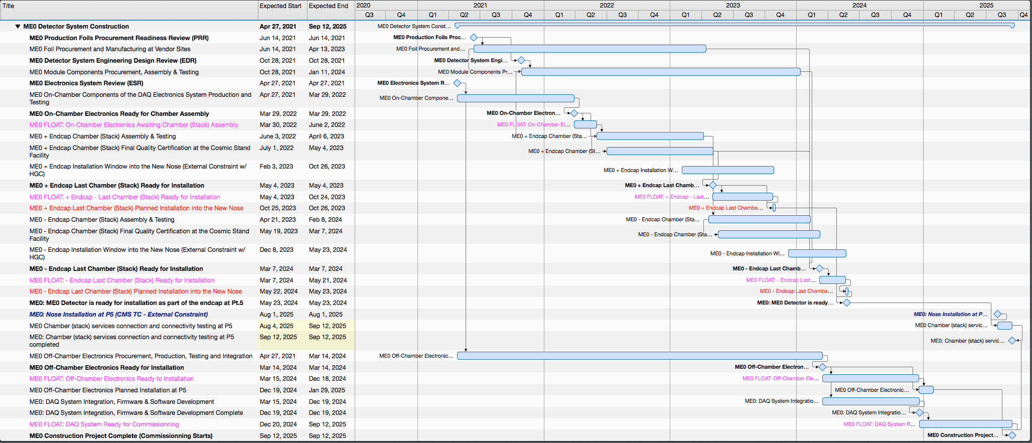
ME0 Schedule Overview
GEM Foils production take longer time than other components, is needed to anticipate the start of production
ME0 on chamber electronic production
ME0 modules production
Stack Assembly and testing
EndCap Installation
Shortest contingency is 2.5 months
Back End electronics production
Project completed
Critical path for the ME0 project:
  Chamber (stack) assembly has to finish in time to allow HCG electronic installation
  Assembly is driven by GEM module production
    On-chamber electronics production is not on the critical path
  Shortest float is currently 2.5 months for the last stack of the “-” Endcap
    The pace is driven by the module production, not stack assembly
    Baseline schedule assumes that module production pace is the same both early and late in the production cycle
    There is potential to speed up module production if necessary (also tracked in risk register)

Slide 14
ME0 milestones
W.B.S | Title | Planned End
2.5.3.10.75 | Chamber (stack) prototype mechanical design completed | Dec 18, 2018
2.5.3.10.85 | Chamber (stack) prototype mechanical prototype testing and validation completed | Dec 24, 2019
2.5.3.10.95 | On Chamber Electronic prototype manufacturing and testing completed | Aug 21, 2020
2.5.3.10.120 | ESR | Apr 27, 2021
2.5.3.10.120 | PRR for foils production | Jun 14,2021
2.5.3.10.140 | EDR | Oct 28, 2021
2.5.3.10.170 | On chamber Electronics Manufacturing and Testing complete, ready for stack assembly | Mar 29, 2022
2.5.3.10.200 | Chamber for Disk-1, Assembled, Tested and Ready for Installation | May 4, 2023
2.5.3.10.210 | Off-Chamber Electronics Manufacturing and Testing completed | Jun 8, 2023
2.5.3.10.225 | Detector Disk 1 -Need by Date for Insertion into the New Nose | Oct 10,2023
2.5.3.10.275 | Chamber for Disk-2, Assembled, Tested and Ready for Installation | May 9, 2024
2.5.3.10.285 | ME0 Detector ready for installation as part of the endcap at Pt.5 | May 23, 2024
2.5.3.10.295 | Nose Installation at P5 | Aug 1, 2025
2.5.3.10.300 | Full Detector Commissioning Starts | Sep 12, 2025

