Slide 2
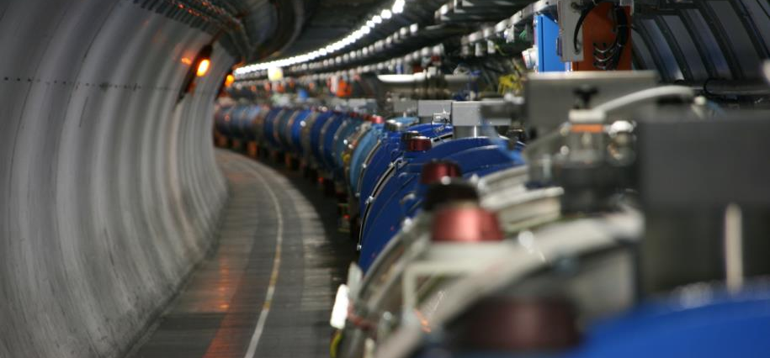
Re-commissioning of the superconducting circuits
Meeting n.4
Mirko Pojer and Matteo Solfaroli
Beams Department
Operation Group

Slide 3
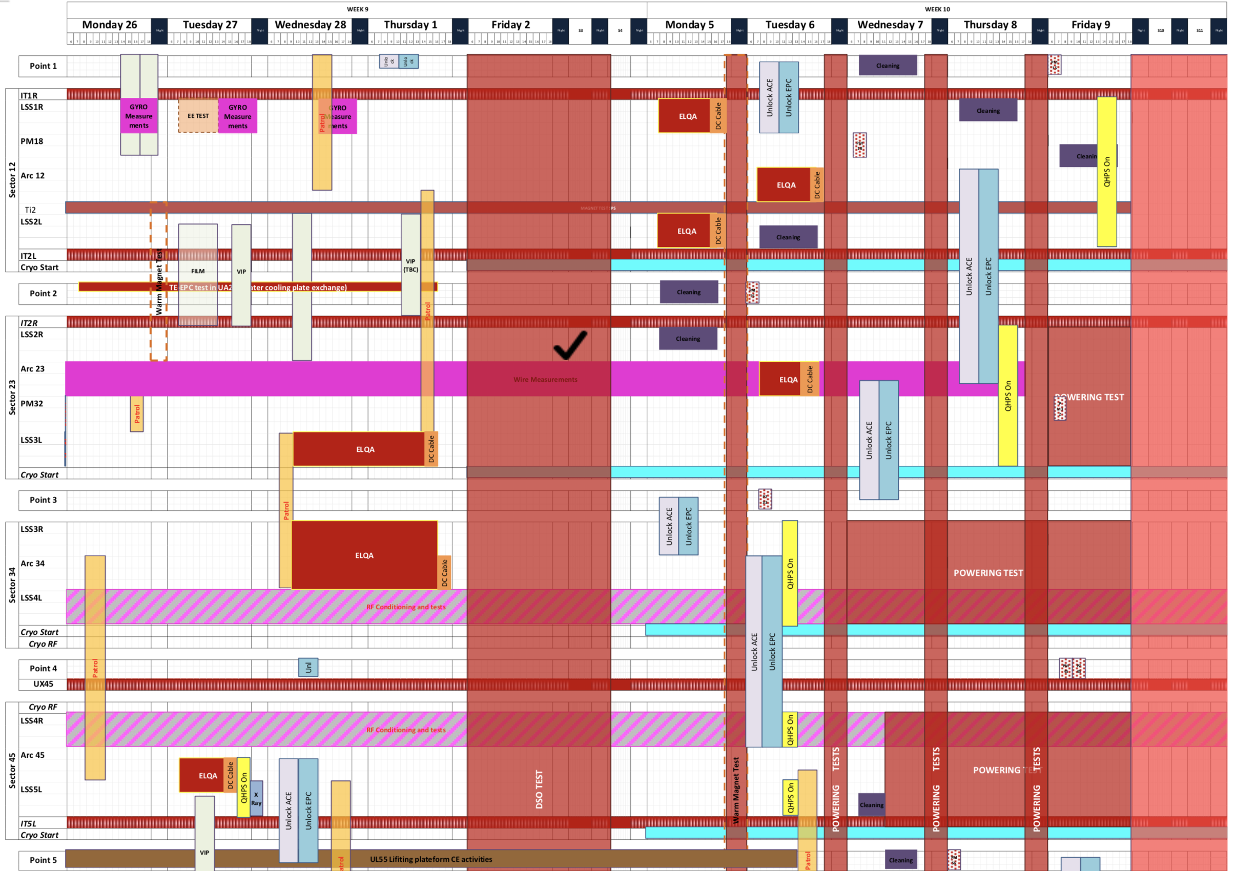
Status of preparation
Today
ElQA
IT.R1 and LR1
  Unlocking OK
  QHPS OK
A12, ML2 and IT.L2
  Unlocking on Thu.8
  QHPS on Fri.9
IT.R2 and MR2
  Unlocking on Thu.8
  QHPS on after QPS-IST
A23
  Unlocking in L3 OK, in R2 on Thu.8
  QHPS on Thu.8
A34
  Unlocking OK
  QHPS OK
ML4
  Unlocking OK
  QHPS OK
MR4, A45, LL5, IT.L5
  Unlocking OK
  QHPS OK

Slide 4
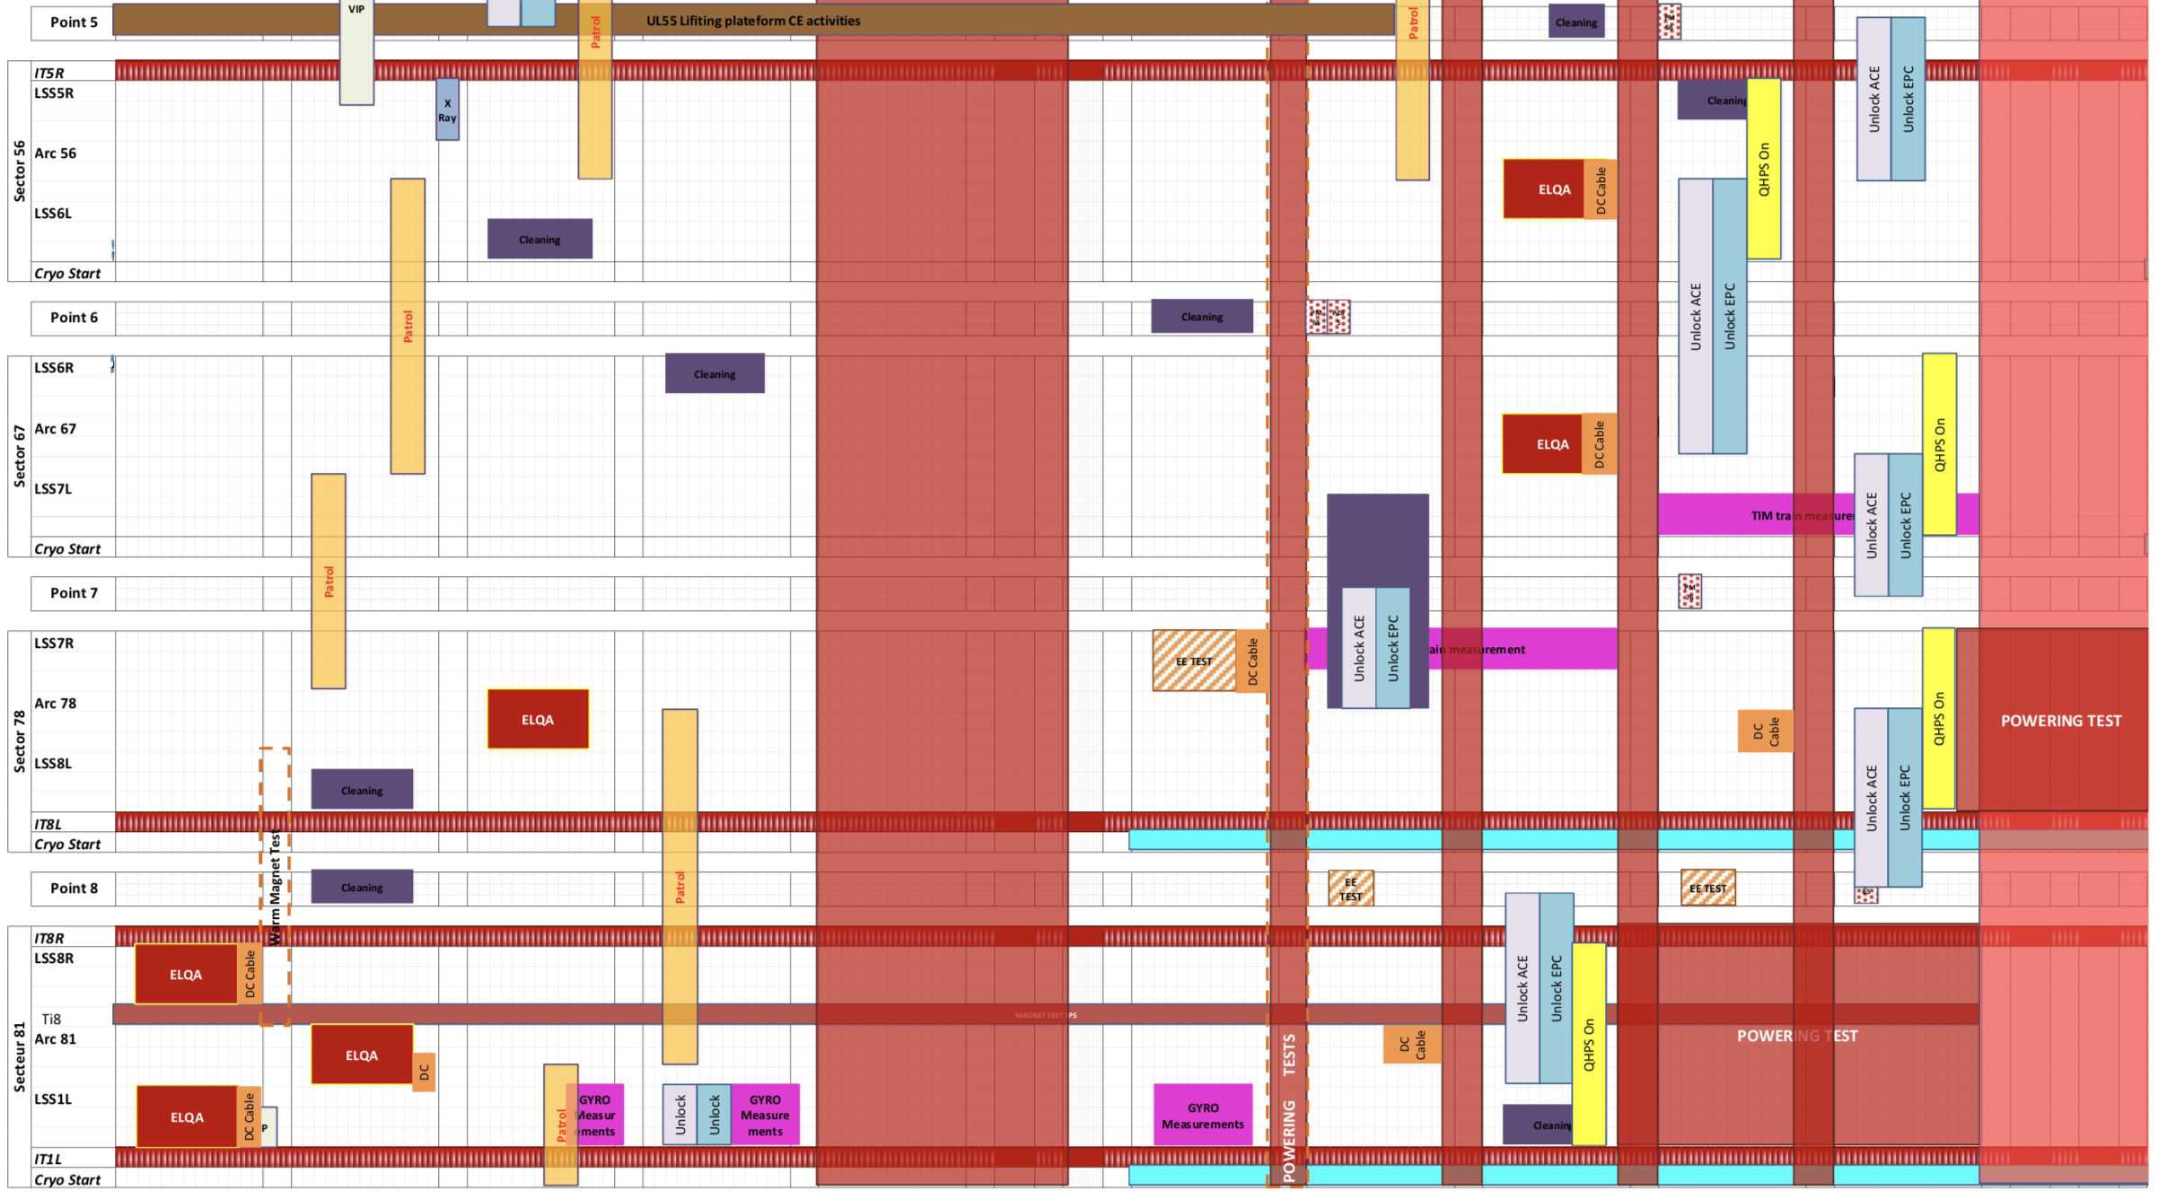
Status of preparation_2
Today
IT.R5 and LR5
  Unlocking on Fri.9
  QHPS on after QPS-IST
A56
  Unlocking on Thu.8
  QHPS on Thu.8; IPQs after QPS-IST
ML6 and MR6
  Unlocking on Thu.8
  QHPS on after QPS-IST
A67
  Unlocking on Fri.9
  QHPS on Fri.9; IPQs after QPS-IST
A78
  Unlocking on Fri.9
  QHPS on Fri.9; IPQs after QPS-IST
ML8 and IT.L8
  Unlocking on Fri.9
  QHPS on after QPS-IST
IT.R8 and MR8
  Unlocking OK
  QHPS on after QPS-IST
A81
  Unlocking OK
  QHPS ??
LL1 and IT.L1
  Unlocking OK
  QHPS OK

Slide 5
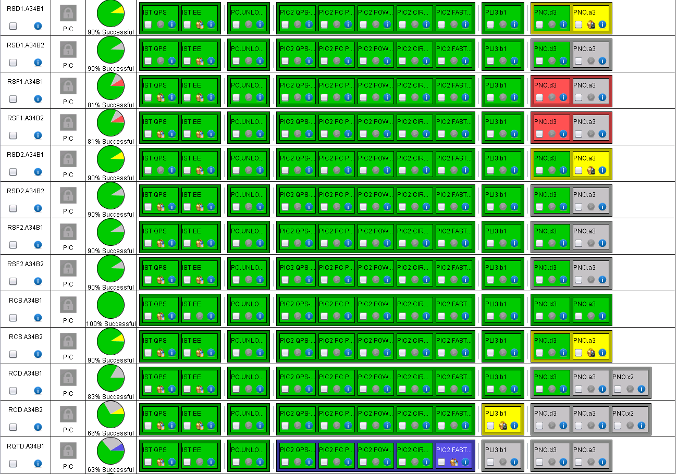
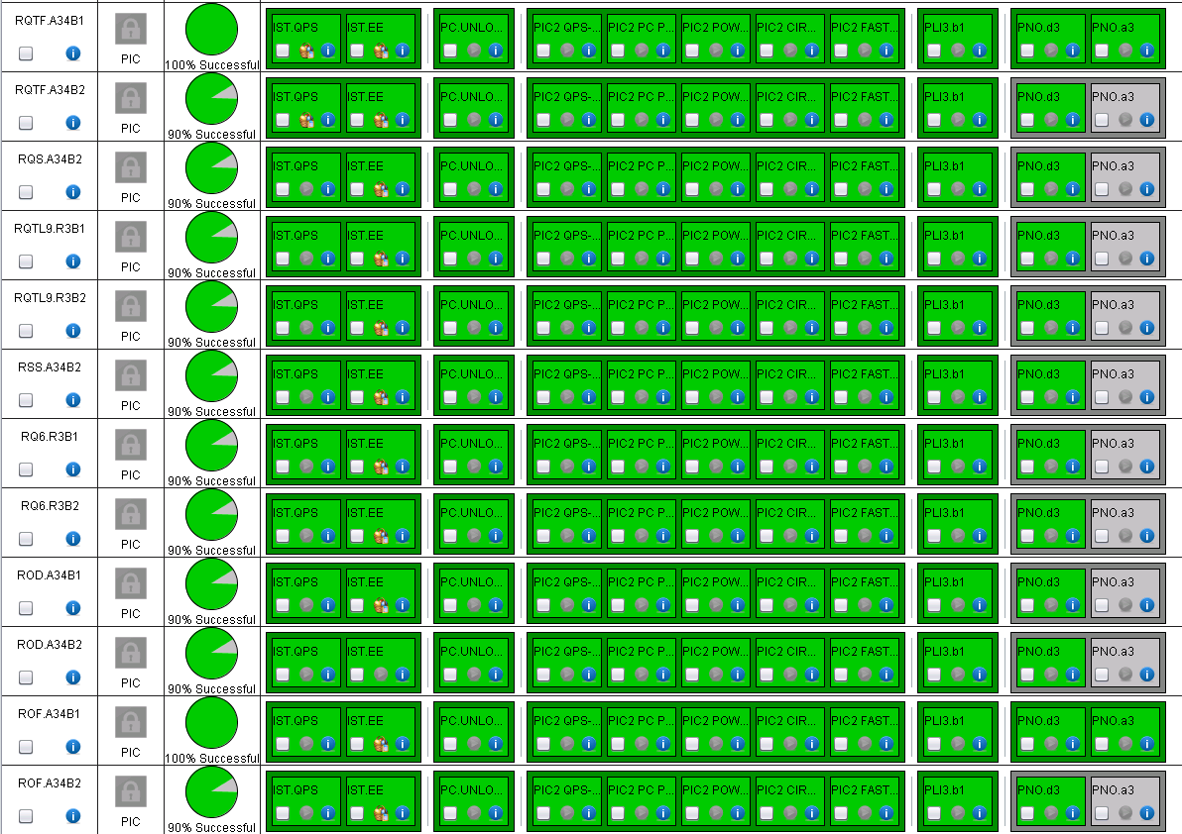
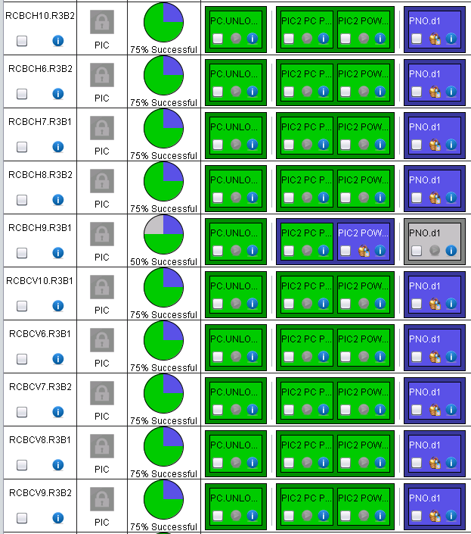
A34
60 A + 120 A almost completed
Main circuits to be released by QPS
RCBCH9.R3B1 ➔ MI
Some 120 A ➔ EPC
RQS.L4B1 ➔ MI+MP3
RQTD.A34B1 ➔ MI

Slide 6
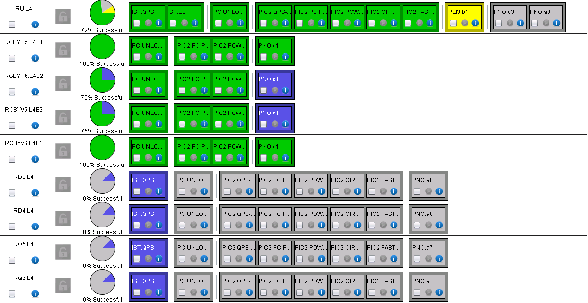
ML4
Almost completed
RU.L4 problem with PM (see RU.R4)
IPQs heaters to be charged
120 A ➔ MP3 + EPC

Slide 7
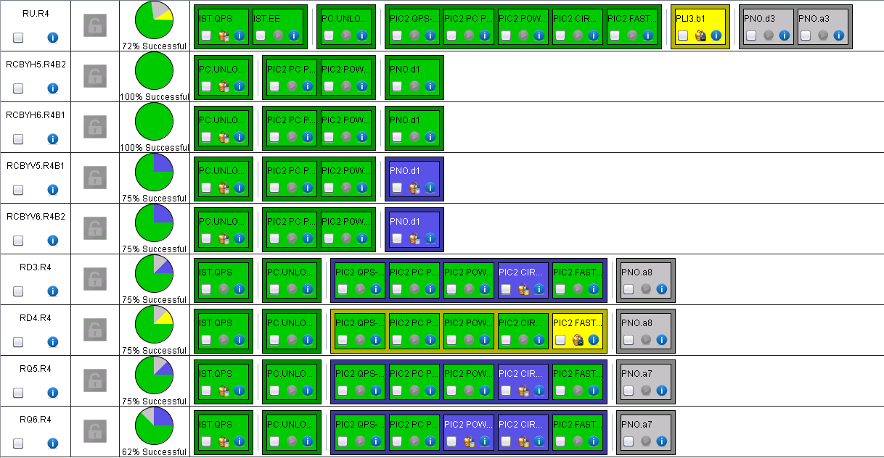
MR4
Phase 1 completed
RU.R4 problem with QPS PM. Repeated with QPS board fixed and it worked
RD3 + RQ6 ➔ MI
RQ5 + RQ6 ➔ MP3
120 A ➔ EPC+MP3

Slide 8
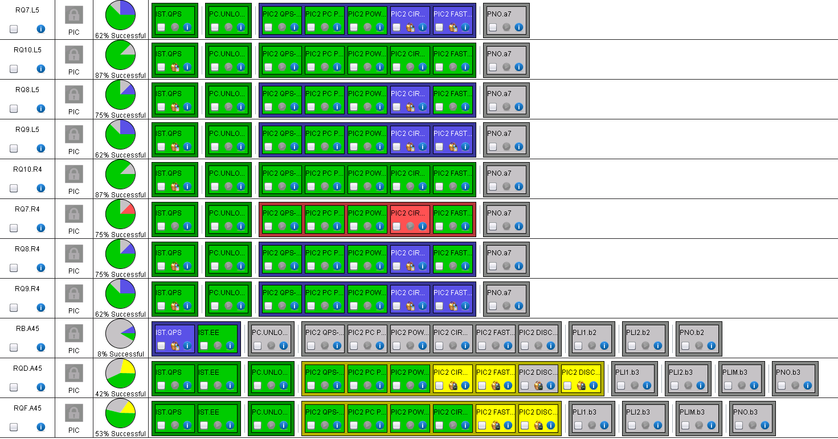
A45 Mains and IPQs
IPQs:
All “PIC circuit quench” ➔ MP3
All “PIC FPA” ➔ MI
RB.A45 eletta exchanged ➔ problem not fully fixed, but OK (to be released by QPS)
RQD.A45 PC discharge request performed, a trick has to be done
RQ7.R4 circuit quench via QPS (MP3 to check)

Slide 9
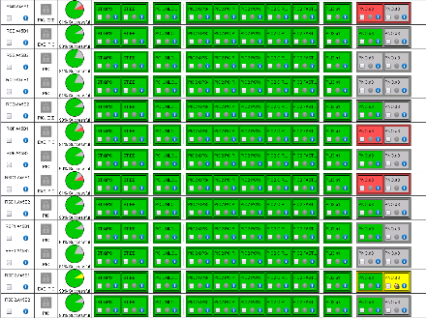
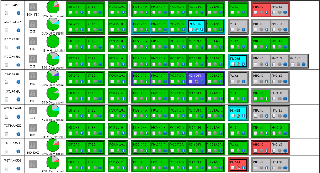
A45 low current circuits
60 A + 120 A completed
600 A ongoing this morning (no long tests because of access)
RCS.A45B1 ➔ MI

Slide 10
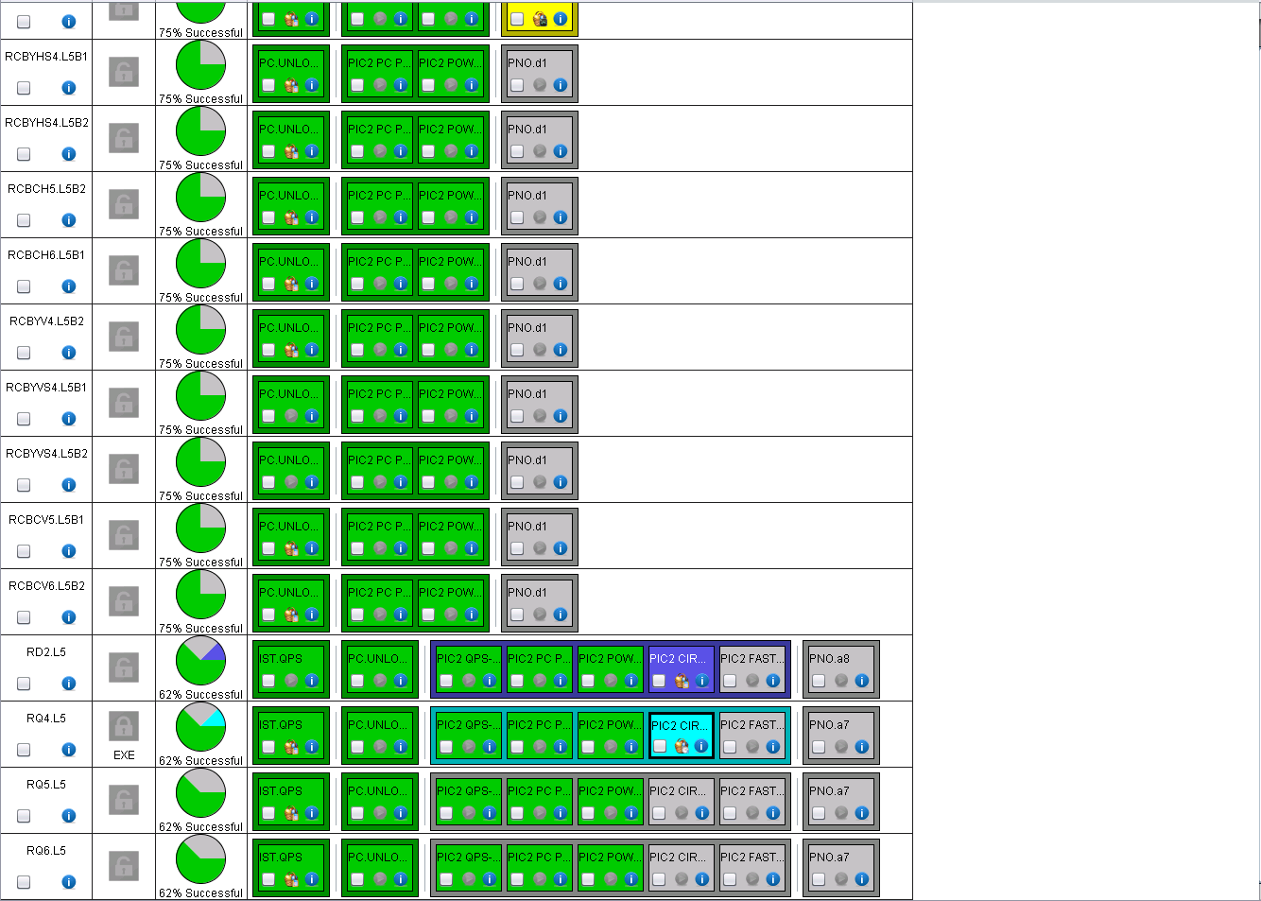
LL5
Ongoing this morning…
RD2.L5 ➔ MI

Slide 11
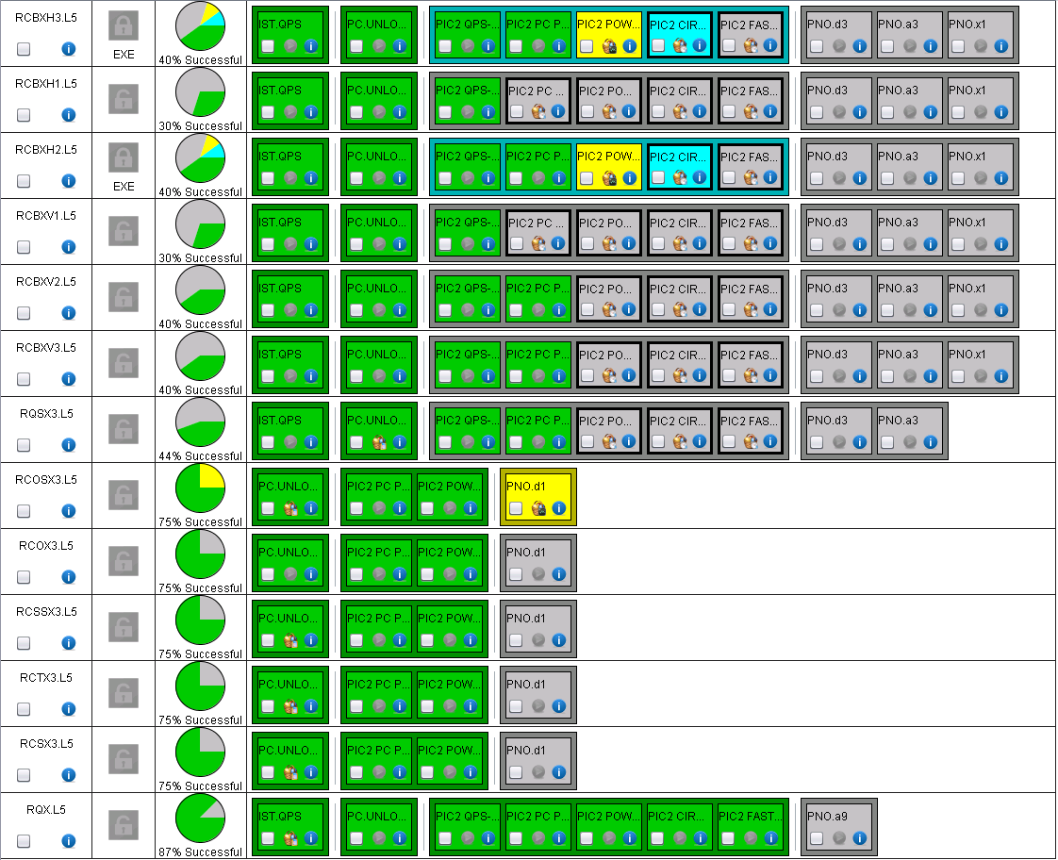
XL5
Ongoing this morning…
Phase1 completed on RQX

Slide 12
More
QPS IST completed (circuit ready to start) also in
  LL1 (test on IP8 QURC-A ➔ OK only tomorrow?)
  MR1 (capacity load test ➔ OK tonight?)
  A81 (test on IP8 QURC-A ➔ OK only tomorrow?)
  A new version of ACCTESTING will be released today with a new constraint on PNO.d3 execution!

Slide 13
For the future…

Slide 14
Cooling water calibration campaign
CV requested to carry on a verification campaign on all sectors.
  RB.A45 is presently on water fault (RQD/F. A45 fixed)
  Plan to be agreed
In addition, a check will be done per sector, by stopping the pumps feeding the entire sector once all circuits are un-locked

Slide 15
LHC main converter calibration
I would like to ask you to foresee a window of about half a day during hardware commissioning for the calibration of all the LHC main dipole and quadrupole and inner triplet converters.
This can also be done per sector in which case I would require about ½ hour per sector.
This is done by me remotely in coordination with the engineer in charge. It requires the converters to be unlock and OFF, with all faults cleared.
The calibration simulates a current of 13kA in the converter so any interlocks that might trip the converter at that current need to be masked. I will let you evaluate when is the best moment to do it, minimizing the impact on commissioning.
Miguel
To be organized possibly at the end of next week!

Slide 16
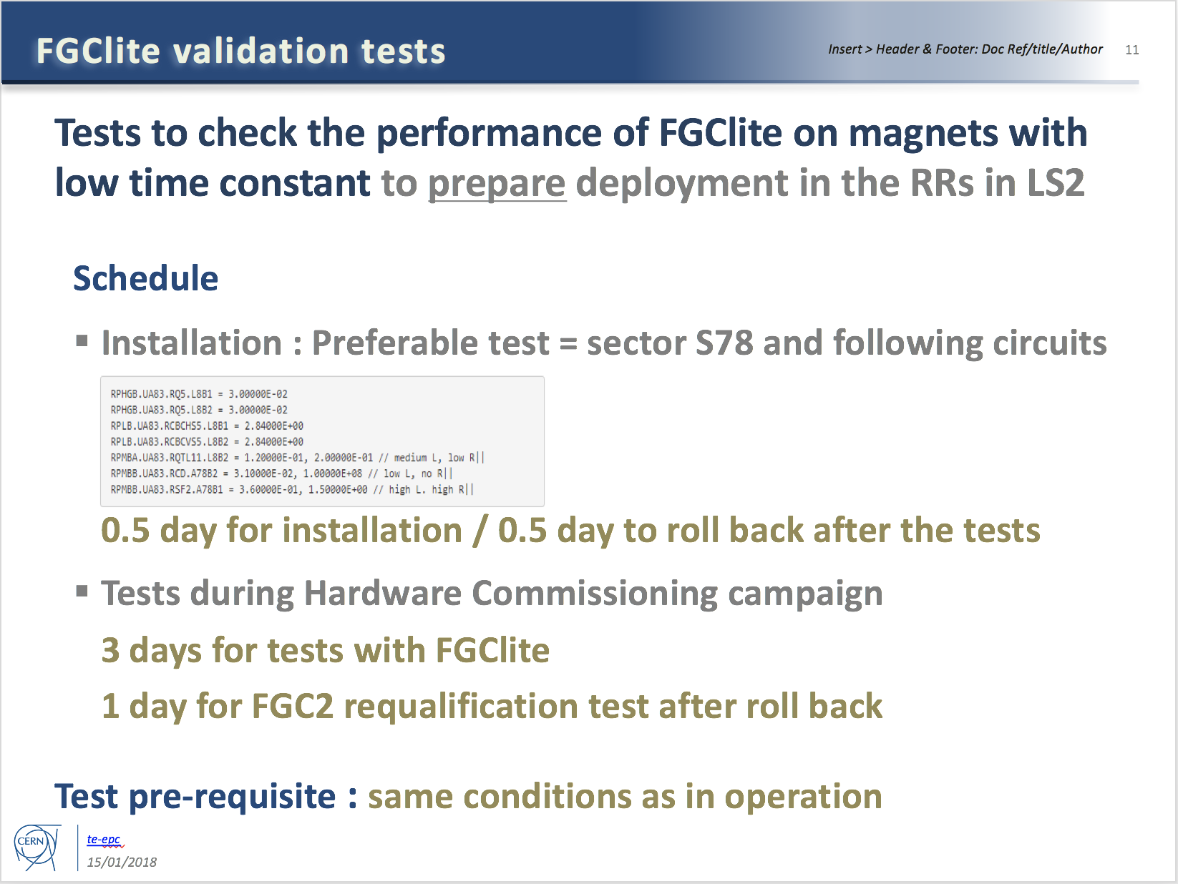
Additional tests required by EPC
To be done after circuit commissioning (if time allows)

Slide 17
Specific Powering Tests – High Priority
# | Description | Test duration * | Period | Cryo
1 | Local (30 m) localisation of shorts in RCS.A78B2, RCO.A78B1, RCO.A78B2 | 2 days | End of the powering tests. | 1.9 K
2 | Global (400 m) localisation of short in RCO.A45B1 | 1 day | Start YETS (DONE) | 1.9 K
3 | Change in EE delay of RB circuits | 0.5 day | During powering tests | 1.9 K
4a | Voltage pick-up of the QPS due to current in the bypass diode | 2 days | Anytime during YETS | <20 K
4b | Heater-induced quench on 2 MB’s | 0.5 day | Start YETS (DONE) | 1.9 K
5 | Quench heaters test in S12 | 0.5 day | End of YETS, during the QPS IST | 1.9 K
6 | Resistance in RQF.A23 and RQD.A78 | 1 day | End of powering tests | 1.9 K
Installation being finalized
Remember to do the 500 V and 900 V tests while switching on
*: not including the time for installation & removal of equipment

Slide 18
Specific Powering Tests – Medium Priority
# | Description | Test duration * | Period | Cryo
7 | Change in EE delay of RQD/F circuits | 0.5 day | During powering tests | 1.9 K
8 | Resistance in ROD.A56B1 | 1 day | Start of YETS (DONE) | 1.9 K
9 | Internal resistance of 3-6 MB’s | 1 day | Start of YETS or during powering tests | 1.9 K
10 | Investigate degradation of RCBXH/V in IR1/5 | 0.5 day | Start of YETS (DONE) | 1.9 K
System installed in S34
Results of investigations priori to YETS:
Short could not be reproduced in RCO.A45B1 (only few 100kOhms occasionally visible)
2 heater induced quenches performed in S45
Location of increased resistance in ROD identified, segment in question to be bypassed in LS2
None of the 12 RCBXH/V circuits showed any visible degradation after having been cycled many times and after having seen quite a bit of radiation. Final conclusions will be made after the powering test in March 2018.
*: not including the time for installation & removal of equipment

Slide 19
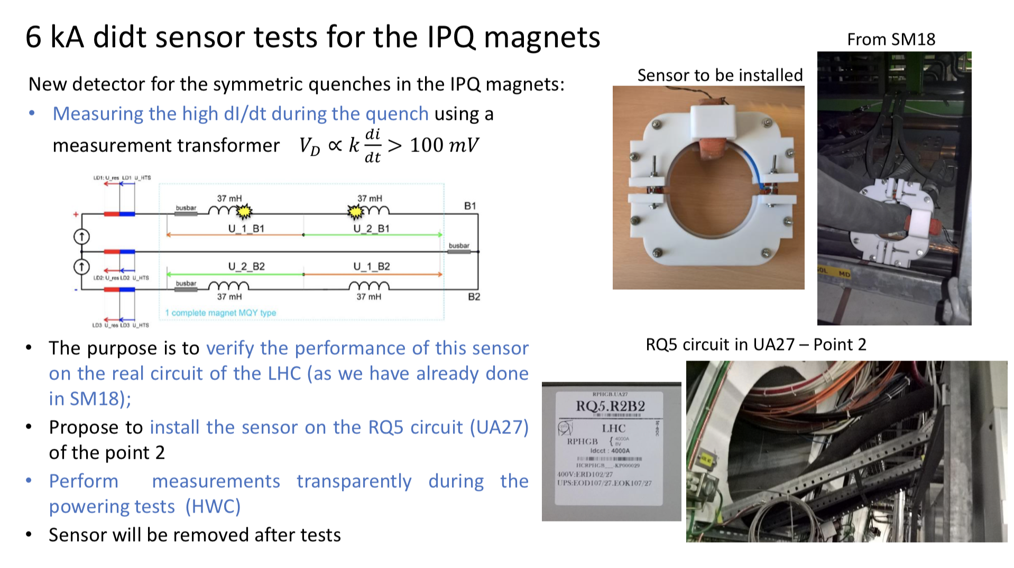
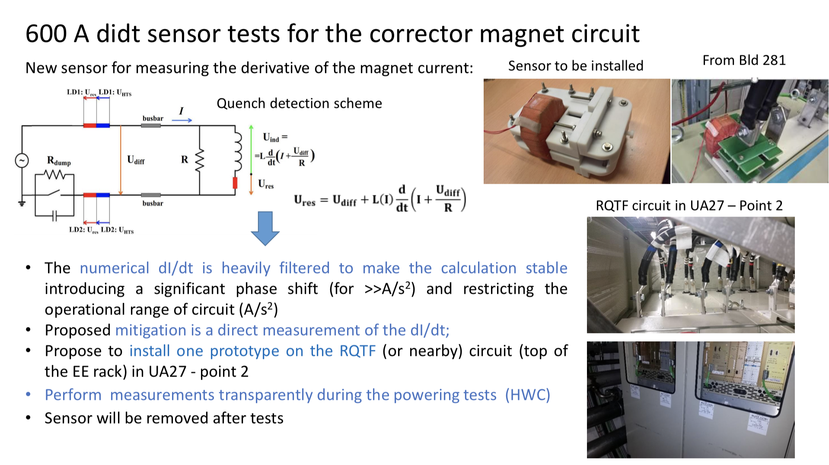
Powering at high current for RQ5.R2 and RQTF.A23B1 should be done only after informing Ernesto de Matteis

Slide 20
Conical connection check in UA27
Following the problem with the conical connection after LS1, MPE would like to repeat the conical connection measurements in UA27
  System installed before end of YETS
  Measurements parasitically done
  System to be removed at the end of commissioning (condemnation required)

Slide 21
Warm magnets test
Tests under the responsibility of P. Schwarz (MSC) and H. Thiesen
OP support to power the circuits
All circuits were checked for water faults
The problem with the failing converters of Monday has been identified: in the LSA database there was no value defined for the acceleration of the 4 RPADO converters! Now fixed
Another problem was identified: many circuits were in simulation, together with many circuits in different sectors!
The affected circuits have been tested over night without any issue

Slide 22
Thank you for the attention!

