Slide 1


Meeting
Introduction
March 8, 2018 I Hans ströher (Forschungszentrum jülich)

Slide 2
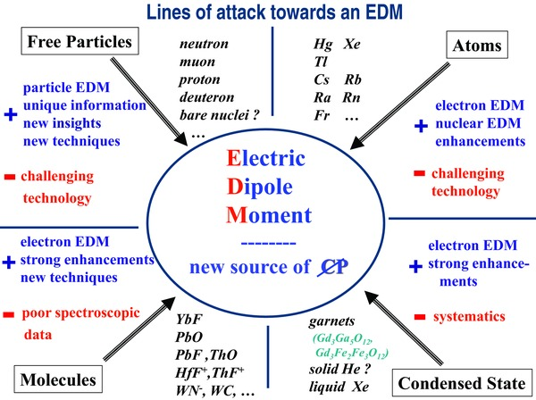
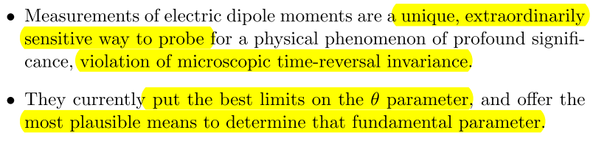
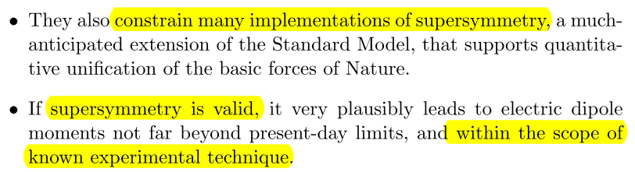
Meeting
Why EDM measurements
Statements by Frank Wilczek (2014):

Slide 3
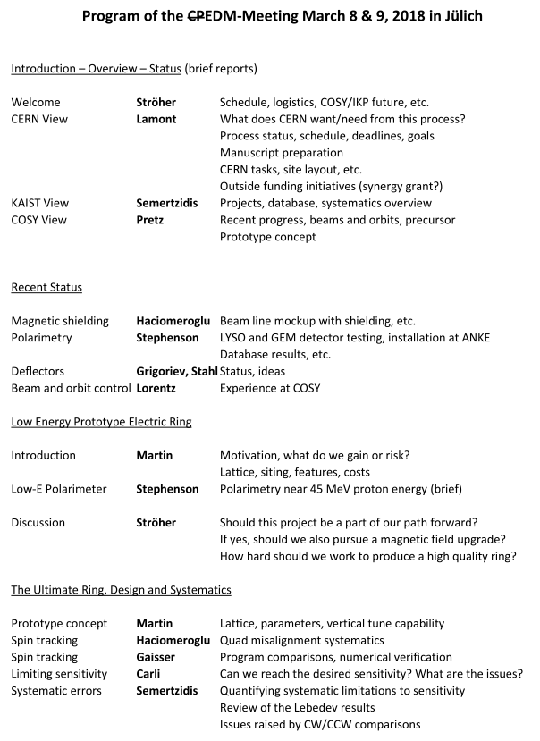
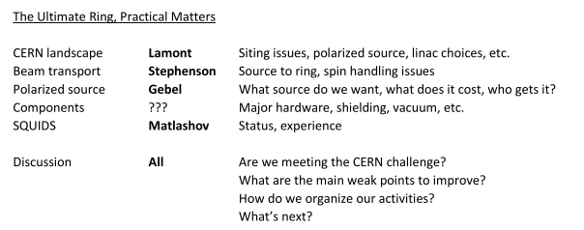

Meeting
Motivation

Slide 4
Meeting
Status IKP

Slide 5
Meeting
Schedule, dates
March 26 PBC Theory Workshop (CERN)
June 13/14 PBC General Workshop (CERN)
Oct. 1/2 JEDI CM (Cracow)
Dec.18 Deadline EPPSU

Slide 6
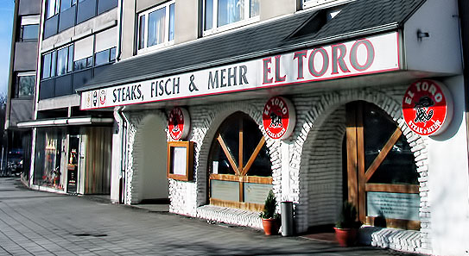
Meeting
Dinner tonight
Jülich, Große Rurstraße 34
→ Who will join?

