Slide 2
Proton EDM hardware challenges
J. Borburgh
with valuable input from M. Atanasov, M. Barnes, C. Carli, L. Jorat, M. Lamont, A. Prost, V. Senaj, N. Voumard

Slide 3
Outline
Baseline lattice
Bends
Quadrupoles
Injection devices, septa and fast deflectors
Conclusion

Slide 4
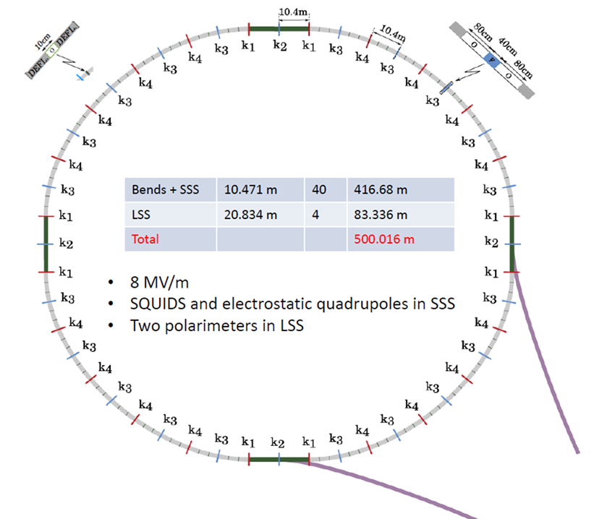
Baseline lattice
Arc cell
Drifts before and after bend 0.8 m (used for experiments and/or correctors/skew quad/sextupole/BPM )
2 bends of 4.16 m
Drift between bends 0.1 m
Quad 0.4 m
Total cell length: 10.417 m
Beam
Protons
700.74 MeV/c
232.8 MeV

Slide 5
Physical length vs Effective length
SPS ZS septa: 3000 mm active length and 3378 mm device length; spacing > 870 mm
LEP ZL: 4000 mm active length; 4500 mm device length; spacing > 650 mm
Note: Additional space would be needed for vacuum valves in case plug-in systems would be adopted to reduce down time in case of exchange due to failure

Slide 6
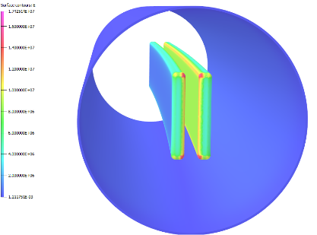
Bend requirements
Total number of bends: 80
L_{physical}: 4.1585 m
L_{eff}: 3.7985 m
Gap width: 30 mm
Deflection angle: 78.54 mrad
E_{gap}: 8.655 MV/m
V_{per polarity}: ±130 kV
Electrode height: 200 mm [1]
Cylindrical electrodes [1]
Vacuum: 10⁻¹¹ mbar [1]
Field homogeneity: 1 ppm on Ø20 mm [2]
Power supply stability < 1.10⁻⁴ [2]
Magnetic leak field: <10⁻¹¹ T [3]

Slide 7
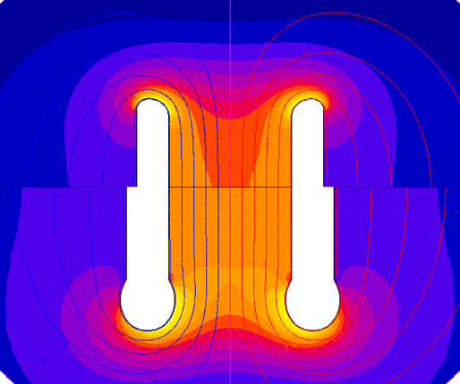
Bend challenges
Feasibility of 1 ppm field homogeneity tbc.
Electrode profile needed to achieve required homogeneity causes higher fields on electrodes → need to reduce the average field assumed for the beam.
E field high for use of Ti. Alternatives (TiN coated Al)?

Slide 8
Bend challenges
Non // plates induce skew quadrupolar effect → need to estimate achievable electrode precision to estimate requirements for skew quads in lattice.
Does magnetic leak field requirement exclude use of stainless steel?
To study if Al or Ti qualify as alternative construction materials.
Assume bends at room temperature: bake out needed to obtain required vacuum.
Assume all bends powered in // to reduce systematics, HV conditioning prior to operation needs to be studied.

Slide 9
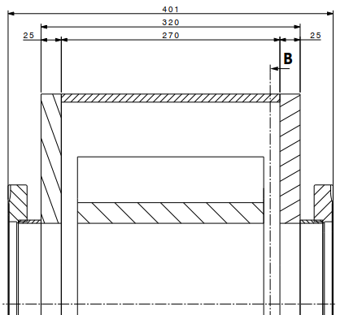
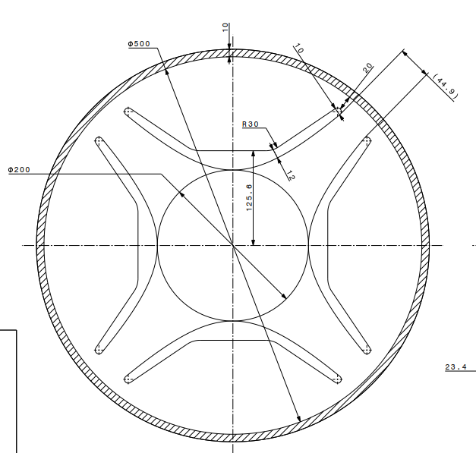
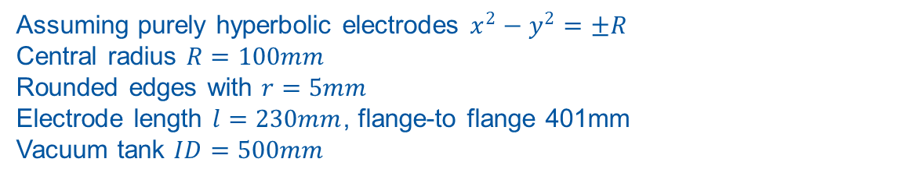
0.4 m Quad
Assuming purely hyperbolic electrodes $x^{2}−y^{2}=±R$
Central radius $R=100mm$
Rounded edges with $r=5mm$
Electrode length $l=230mm$, flange-to flange 401mm
Vacuum tank $ID=500mm$

Slide 10
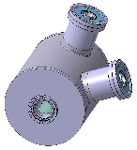
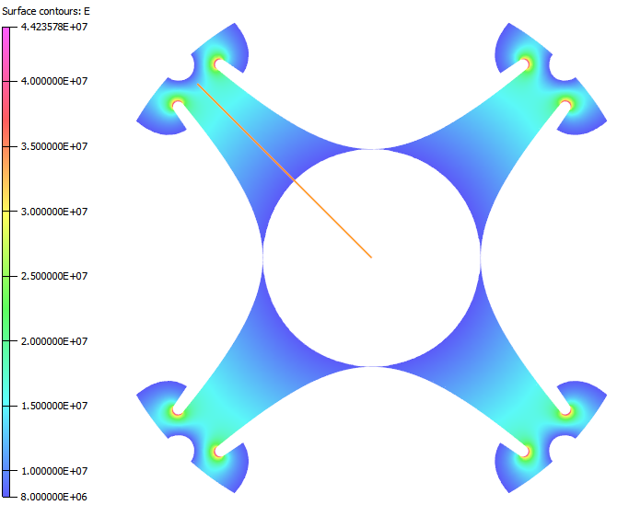
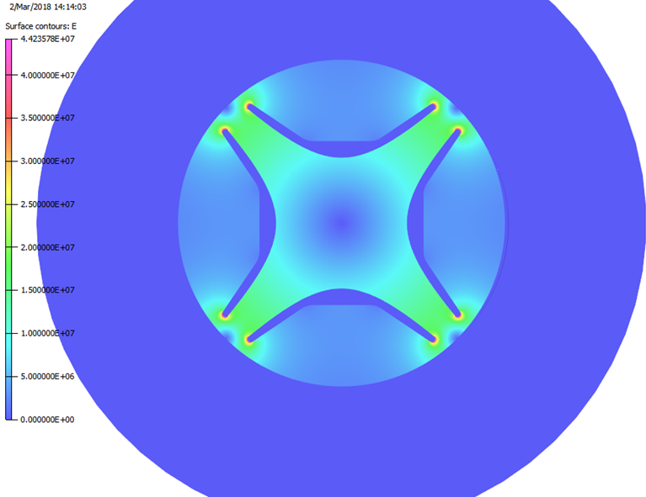

Quadrupoles
Field strength depends on strong or weak focussing lattice.
Aperture (w x h): 30 x 200 mm²
k = 50 MV/m² (strong focussing), assuming L_{eff} = 0.4 m
L_{ph}= 400 mm → L_{eff} = 246 mm → k = 81 MV/m²
Knowing that $U=±\frac{1}{2}kR^{2}$ → $U=±404 kV$
E_{pole-tip}: 8.1 MV/m
E_{pole-wings}: >20 MV/m

Slide 11
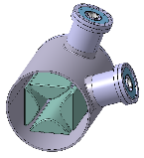
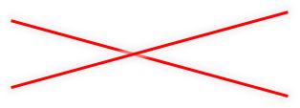
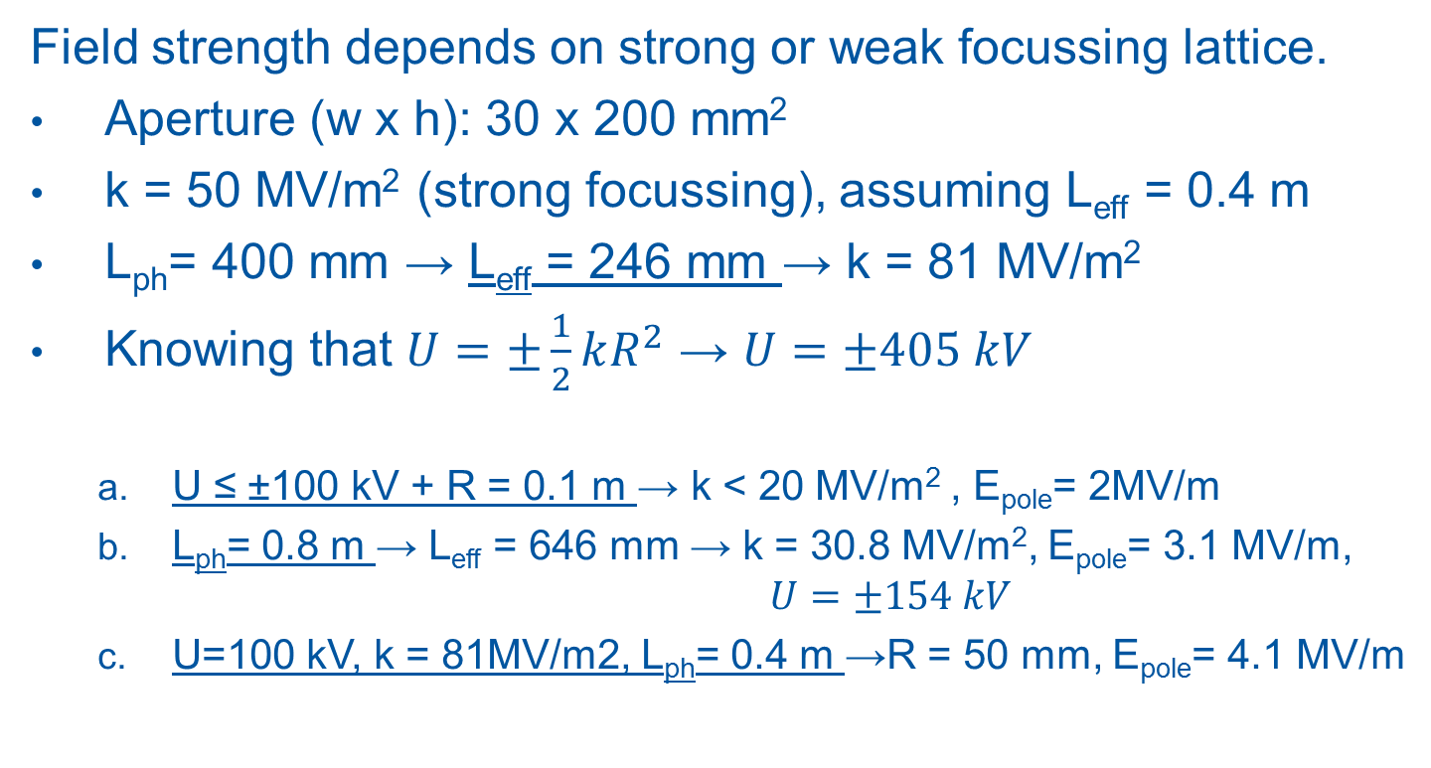
Quadrupoles
Field strength depends on strong or weak focussing lattice.
Aperture (w x h): 30 x 200 mm²
k = 50 MV/m² (strong focussing), assuming L_{eff} = 0.4 m
L_{ph}= 400 mm → L_{eff} = 246 mm → k = 81 MV/m²
Knowing that $U=±\frac{1}{2}kR^{2}$ → $U=±405 kV$
  U ≤ ±100 kV + R = 0.1 m → k < 20 MV/m² , E_{pole}= 2MV/m
  L_{ph}= 0.8 m → L_{eff} = 646 mm → k = 30.8 MV/m², E_{pole}= 3.1 MV/m, $U=±154 kV$
  U=100 kV, k = 81MV/m2, L_{ph}= 0.4 m →R = 50 mm, E_{pole}= 4.1 MV/m

Slide 12
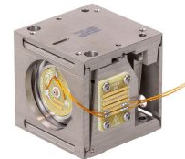
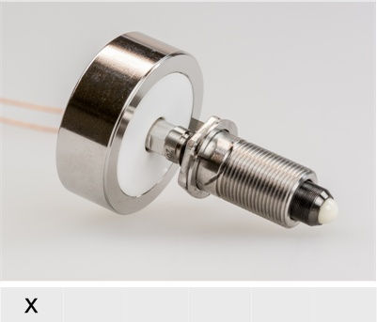
Quad challenges
Field homogeneity dominated by end fields. Could be mitigated to some extend [4]. Need to determine minimum quad length that can achieve requirements
HV feedthrough integration challenging for short quads.
Alignment precision tbd, but assumed to be critical.
Cryo quad makes alignment/positioning more complex, but industrial solutions may exist [5], using flexure guides and piezo actuators.
Main quads to be powered in 4 families; conditioning to be studied.
Courtesy WWW.JPE.NL

Slide 13
Injection straights
Uses most of LSS
P⁺
Injection septum
Fast deflector
4750 mm
3500 mm
3000 mm

Slide 14
Injection devices
 | Injection septum | Fast deflector
L _{physical} [m] | 3.5 | 3.0
Active length [m] | 3.0 | 2.5
Deflection angle [mrad] | 57.34 | 10
Gap width [mm] | 30* | 42.5**
Field [MV/m] | 8.0 | 1.674
Radius of curvature electrodes [m] | 52.32 | -
Nominal electrode voltage [kV] | - 240 | ± 35.6
T_{rise} and T_{fall} (2‰ - 998‰) [µs] | DC | 1.0
Capacitance per electrode (to gnd) [pF] | ~ 660 | < 500
* Assuming curved or segmented septum and electrode
** Assuming parallel electrodes

Slide 15
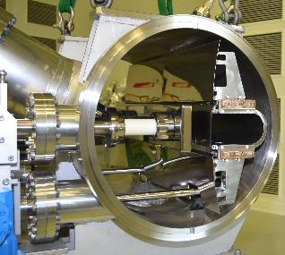
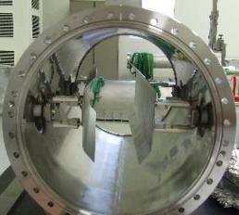
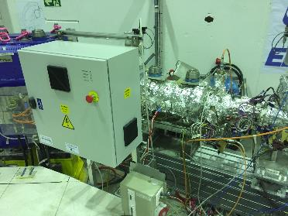
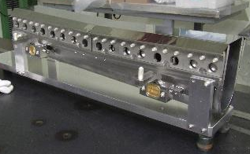
Segmented septum, fast deflector examples
Segmented septum MedAustron
Fast deflector at CERN in ELENA

Slide 16
Open issues injection devices
Segmented foil septum v.s. curved wire septum
Feasibility of Fast Deflector pulse generator:
  rise and fall time feasibility to be validated
  voltage switch: not easily done using off the shelf switches (for example Behlke refreshes their switches at regular intervals even when switched off, and the electrodes wouldn’t remain grounded).
  Switches need to be located close to fast deflectors (0.5 m). Feasibility and reliability in the radiation to be studied.
  HV feedthroughs need development, not commercially available.
Alternative: stripline kicker(s)
  replacing fast deflector would reduce voltages to 30 kV (-20%) on plates, but at cost of added complexity.
  replacing the septum with a stripline kicker is not feasible.

Slide 17
Conclusion
Electrode material will determine max. field strength, hence size of elements.
Quad field strength to be quantified and feasibility of precision requirement to be determined.
Lattice needs updating with:
  Longer quads
  Skew quads
  Trim quads
  Sextupoles
  Vertical correctors
  Present circumference seems optimistic
Conditioning strategy for quads and bends to be studied.
Injection equipment feasible in principle.
  Fast deflector rise and fall time requirement to be validated.
Use of stainless steel for construction desirable, but compatibility with magnetic leak field requirements tbc.

Slide 18
References
M. Lamont, “EDM strage ring – siting at CERN”, CERN EDM WG meeting, 1 June 2017
Y. Semertzidis, “All-electric versus combined field storage ring”, EDM kick-off meeting, CERN,13-14 March 2017
Reference to leak field level
R. Baartman, “Quadrupole shapes”, Phys. Rev. ST – Accel. Beams 15, 074002 (2012)
www.janssenprecisionengineering.com

Slide 19
Back-up slides

Slide 20
Bend

Slide 21
Fast deflector

Slide 22
Electrostatic injection septum

