Slide 1
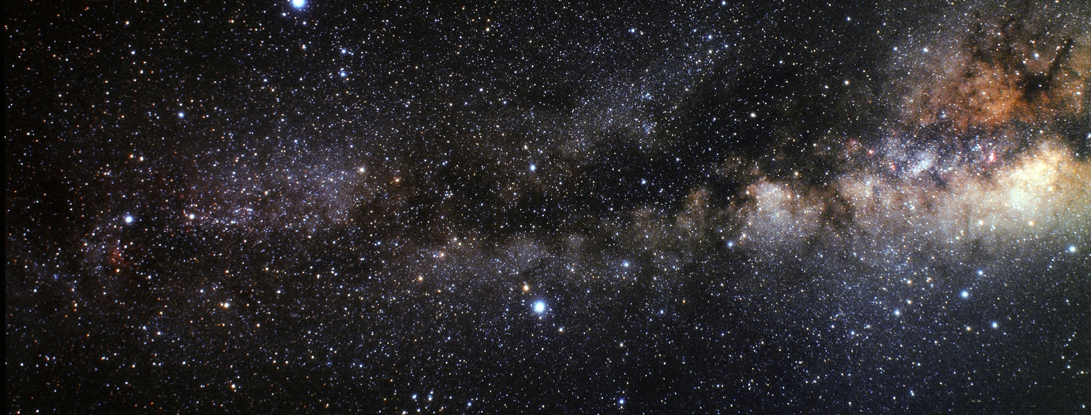
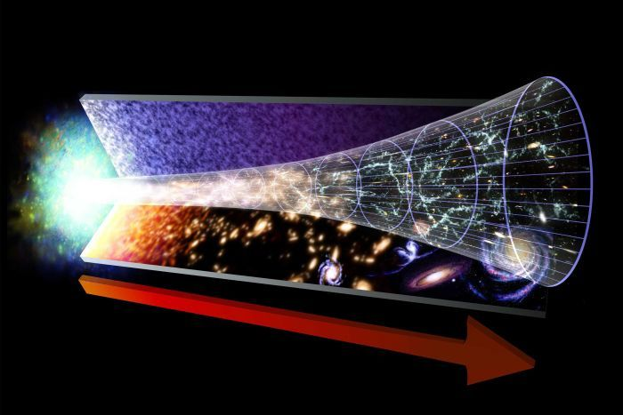
CP-EDM Collaboration Meeting
The Fate of Antimatter
Electrostatic Combined Function Elements
for the EDM ring
Achim Stahl – RWTH Aachen University – JARA-FAME

Slide 2
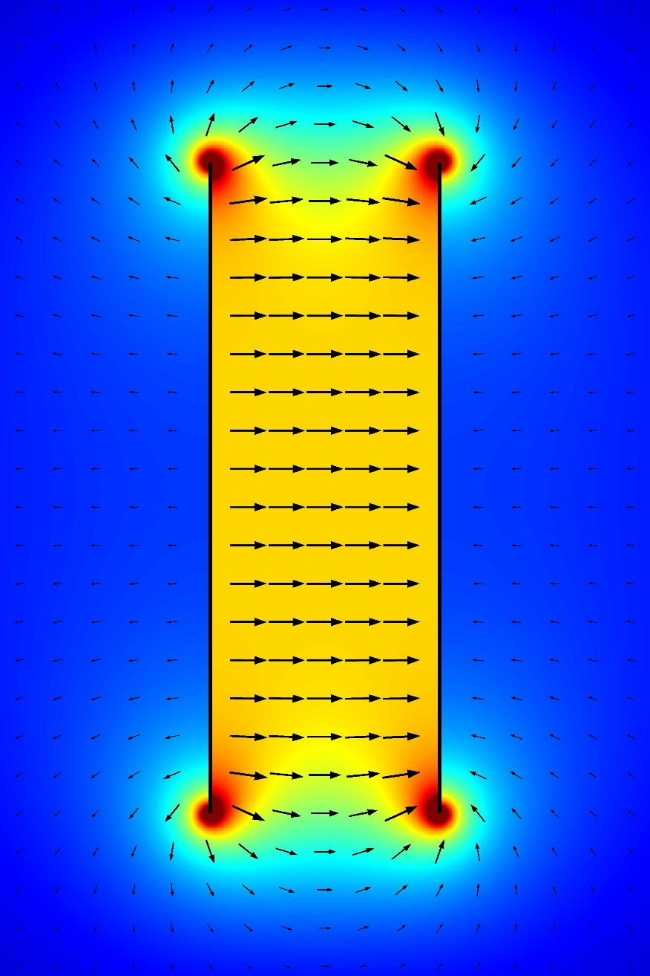
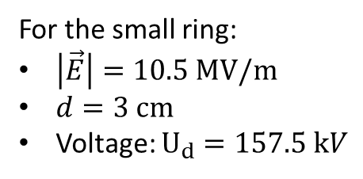
The Dipole Field
For the small ring:
$\left|\vec{E}\right|=10.5 MV/m$
$d=3 cm$
Voltage: $U_{d}=157.5 kV$
+U_{d}
-U_{d}
Inhomgeneities towards the edges
High capacitance -> risk of destruction

Slide 3
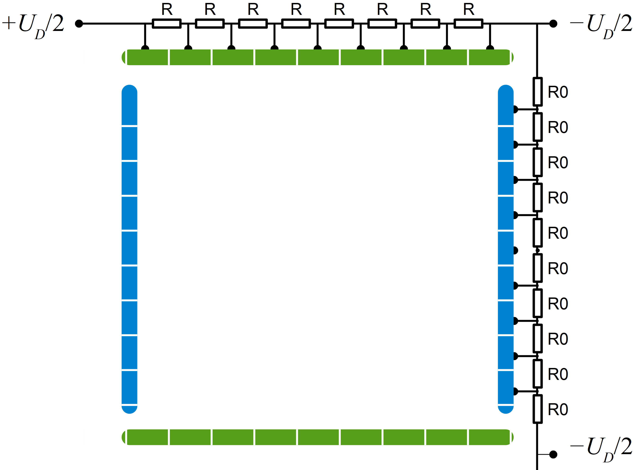
Dipole in A FieldCage
Field shaping electrodes
more homogenious field
small capacitance per strip

Slide 4
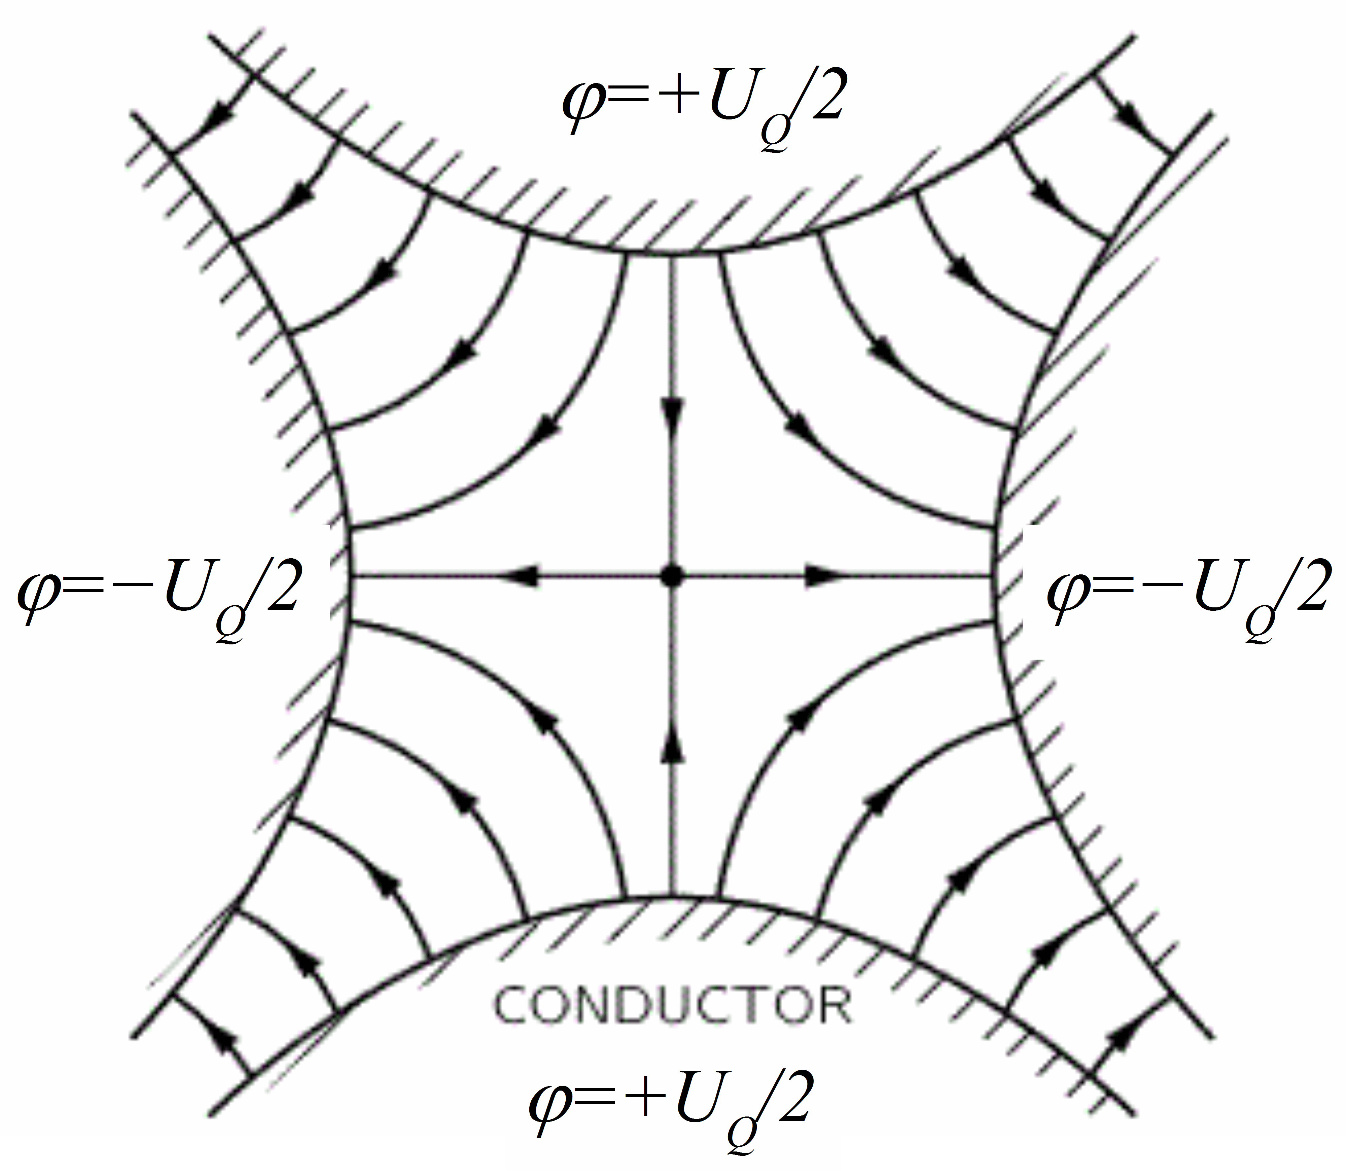
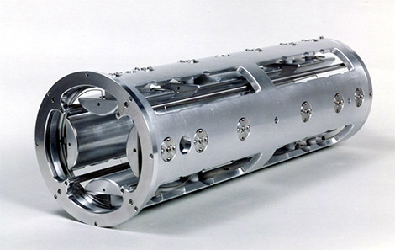
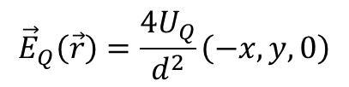
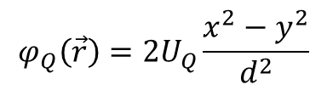
The Quadrupole Field
$$φ_{Q}\left(\vec{r}\right)=2U_{Q}\frac{x^{2}−y^{2}}{d^{2}}$$
$${\vec{E}}_{Q}\left(\vec{r}\right)=\frac{4U_{Q}}{d^{2}}\left(−x,y,0\right)$$

Slide 5
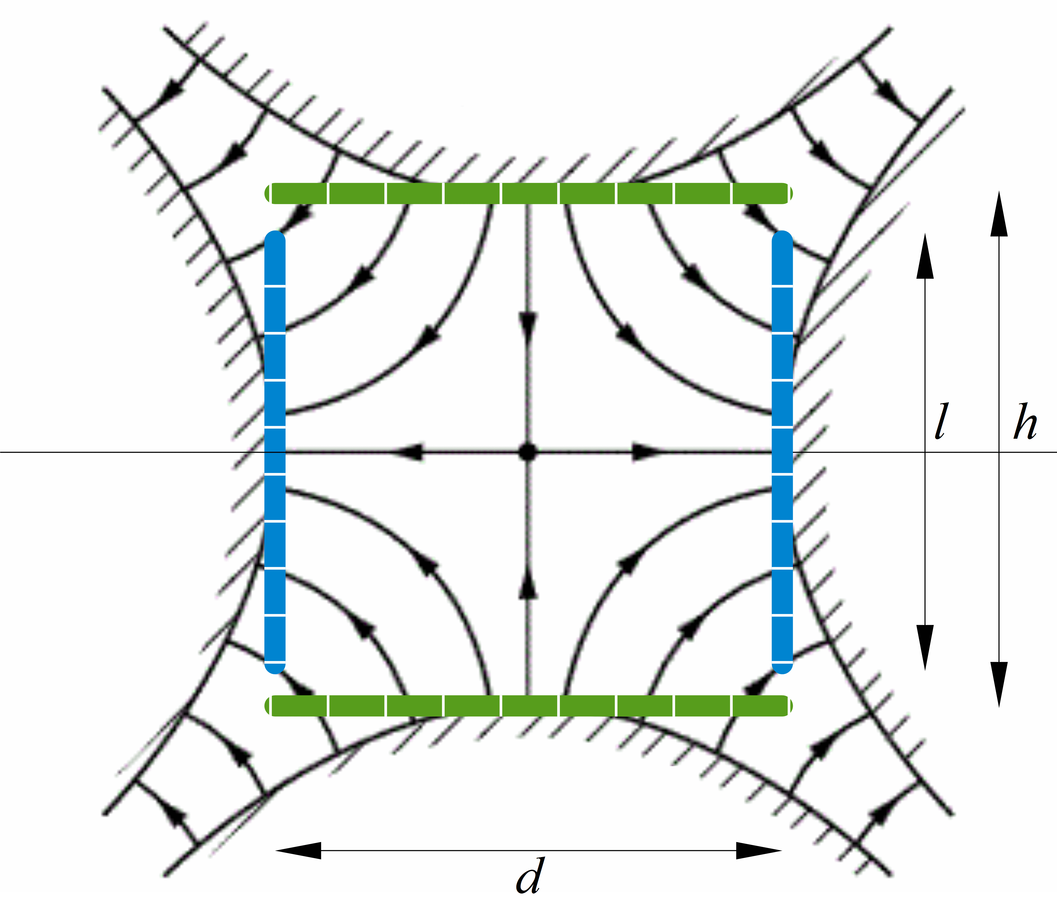
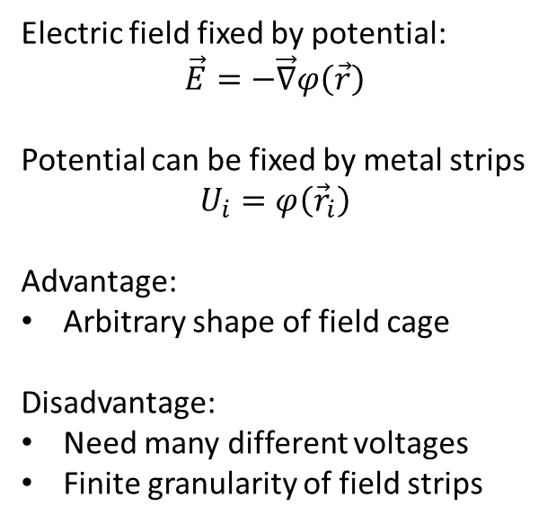
The Quadrupole Field
Electric field fixed by potential:
$$\vec{E}=−\vec{∇}φ\left(\vec{r}\right)$$
Potential can be fixed by metal strips
$$U_{i}=φ\left({\vec{r}}_{i}\right)$$
Advantage:
Arbitrary shape of field cage
Disadvantage:
Need many different voltages
Finite granularity of field strips

Slide 6
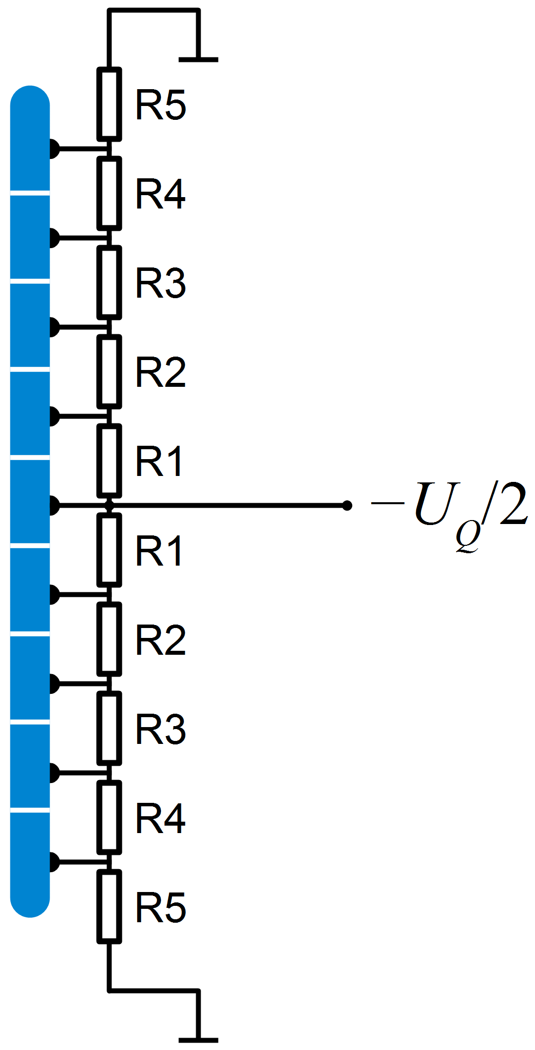

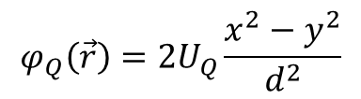
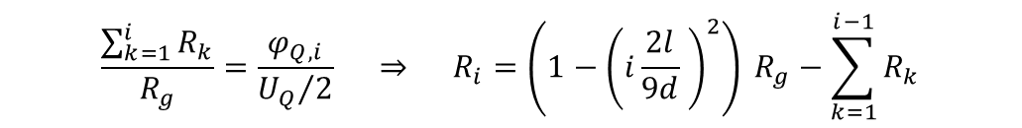

Quadrupole Electrodes
Example: 9 strips
$${\vec{r}}_{i}=\left(±\frac{d}{2},i\frac{l}{9},0\right)$$
$$φ_{Q,i}=φ_{Q}\left({\vec{r}}_{i}\right)=\frac{2U_{Q}}{d^{2}} \left(\frac{d^{2}}{4}−i^{2}\frac{l^{2}}{81}\right)=\frac{U_{Q}}{2}\left(1−{\left(i\frac{2l}{9d} \right)}^{2}\right)$$
$$\frac{\sum_{k=1}^{i}{R_{k}}}{R_{g}}=\frac{φ_{Q,i}}{{U_{Q}}/2} ⇒ R_{i}=\left(1−{\left(i\frac{2l}{9d} \right)}^{2}\right) R_{g}−\sum_{k=1}^{i−1}{R_{k}}$$
$$φ_{Q}\left(\vec{r}\right)=2U_{Q}\frac{x^{2}−y^{2}}{d^{2}}$$

Slide 7
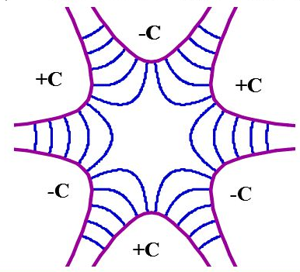
The Sextupole Field
Any multipole field can be generated
with a field cage!

Slide 8
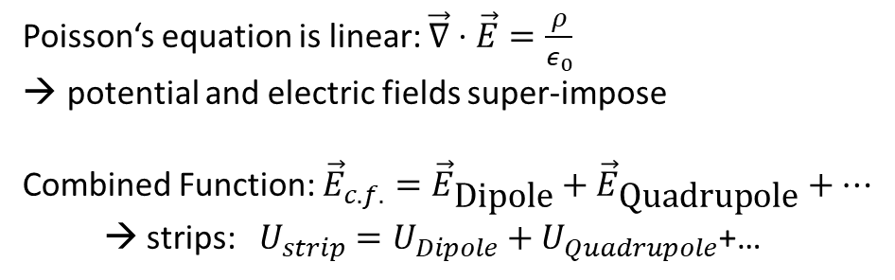
Combined Function
Poisson‘s equation is linear: $\vec{∇}⋅\vec{E}=\frac{ρ}{ε_{0}}$
potential and electric fields super-impose
Combined Function: ${\vec{E}}_{c.f.}={\vec{E}}_{\text{Dipole}}+{\vec{E}}_{\text{Quadrupole}}+…$
→ strips: $U_{strip}=U_{Dipole}+U_{Quadrupole}$+…

Slide 9
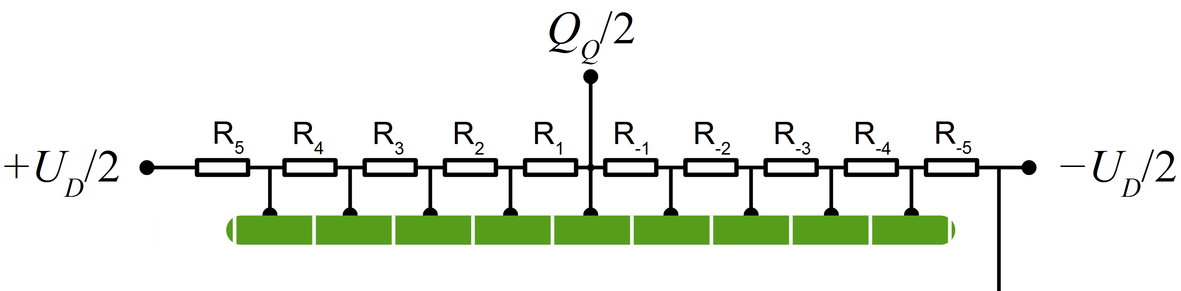
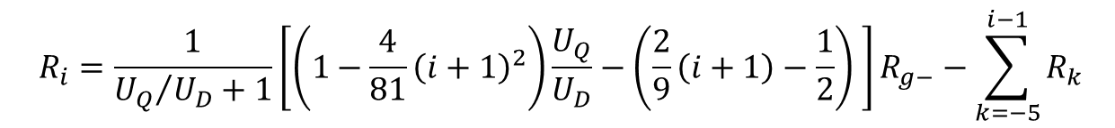
Example: Dipole + QUAD
$$R_{i}=\frac{1}{{U_{Q}}/{U_{D}}+1}\left[\left(1−\frac{4}{81}{\left(i+1\right)}^{2}\right)\frac{U_{Q}}{U_{D}}−\left(\frac{2}{9}\left(i+1\right)−\frac{1}{2}\right) \right]R_{g−}−\sum_{k=−5}^{i−1}{R_{k}}$$
Problem: Ratio of Dipole/Quad strength fixed by resistors
→ Better to supply each strip with programmable voltage

Slide 10
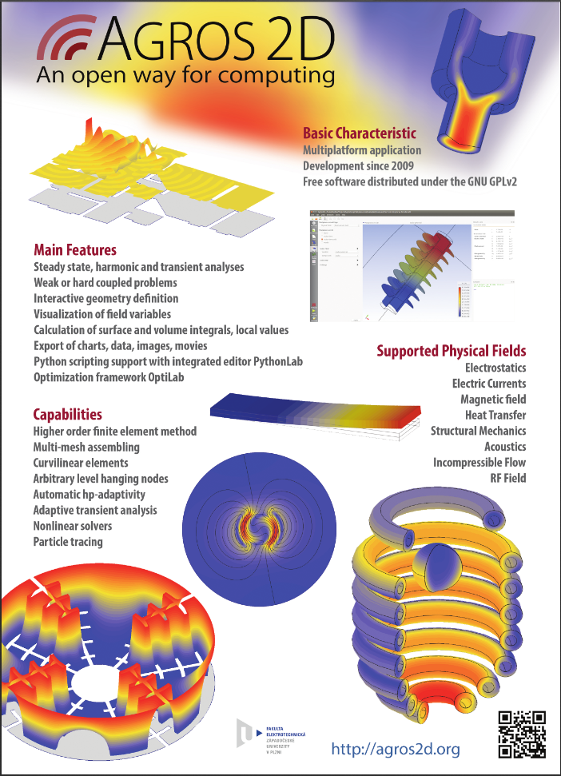
FEM-Calculation
with Agros2d

Slide 11
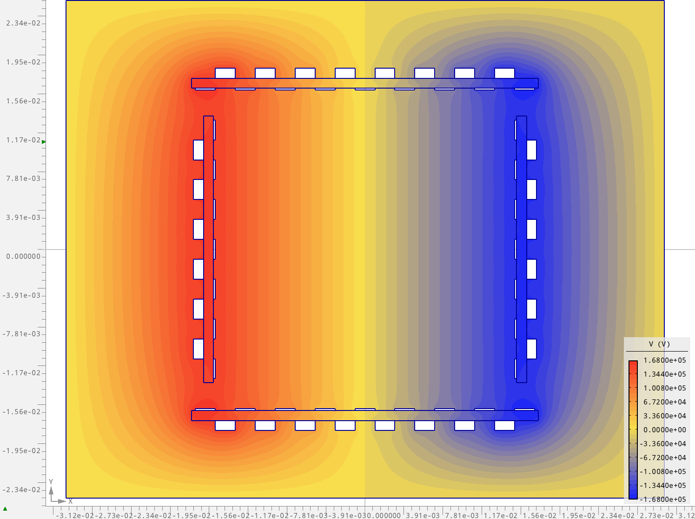




AGROS: Dipole
inner strip
2mm x 200μm
glass plate
1mm
outer strip
2mm x 1mm
+157.5 kV
-157.5 kV
$$\frac{16}{15}U_{d}$$
$$\frac{14}{15}U_{d}$$
$$… … …$$
$$−\frac{16}{15}U_{d}$$

Slide 12
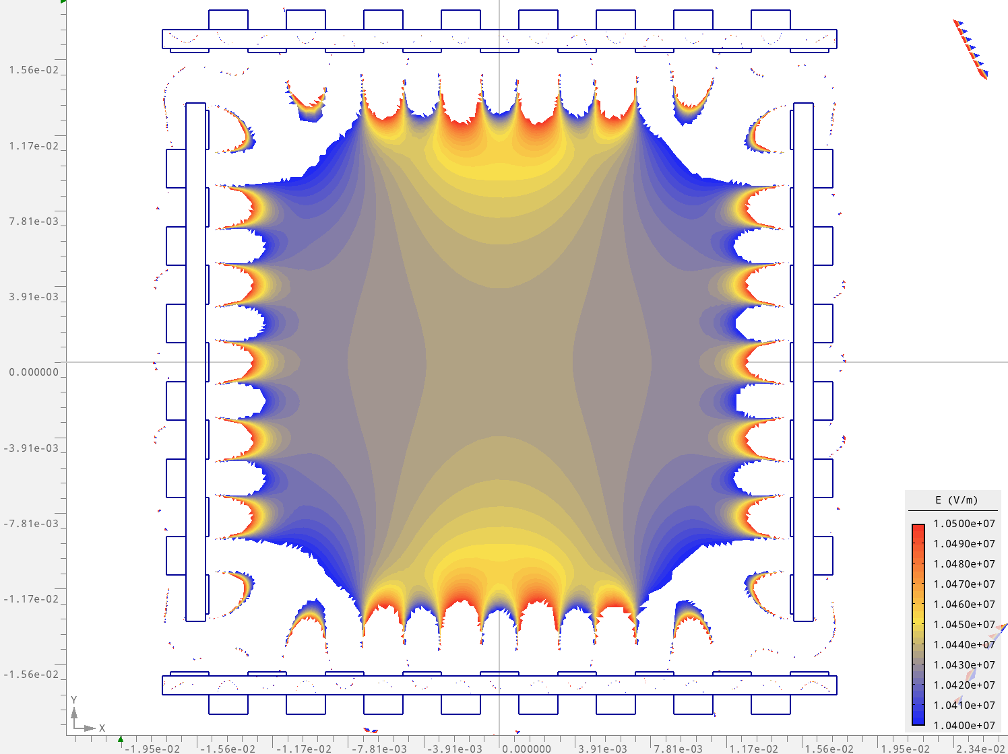

AGROS: Dipole
$$\left|\vec{E}\right|$$
scale 1%

Slide 13
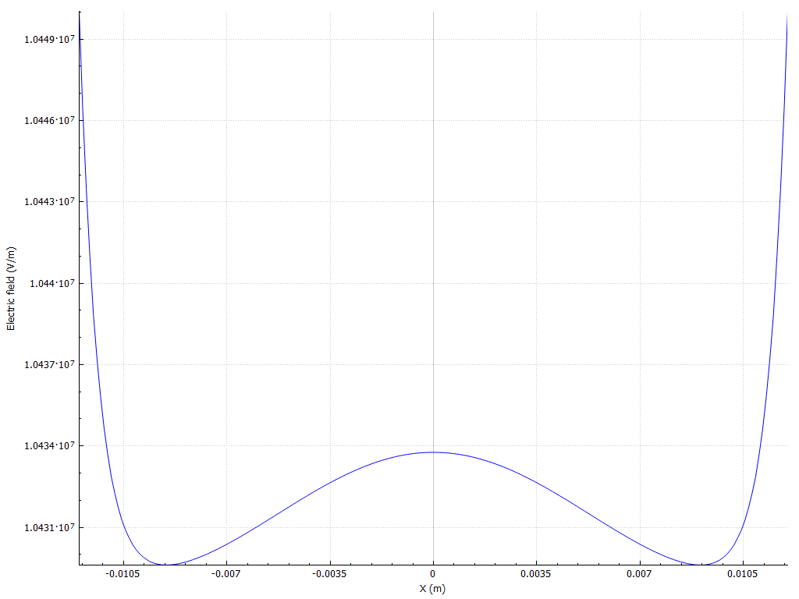
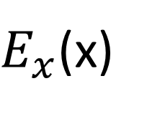


AGROS: Dipole
$E_{x}$(x)
$$−12 mm$$
$$+12 mm$$

Slide 14
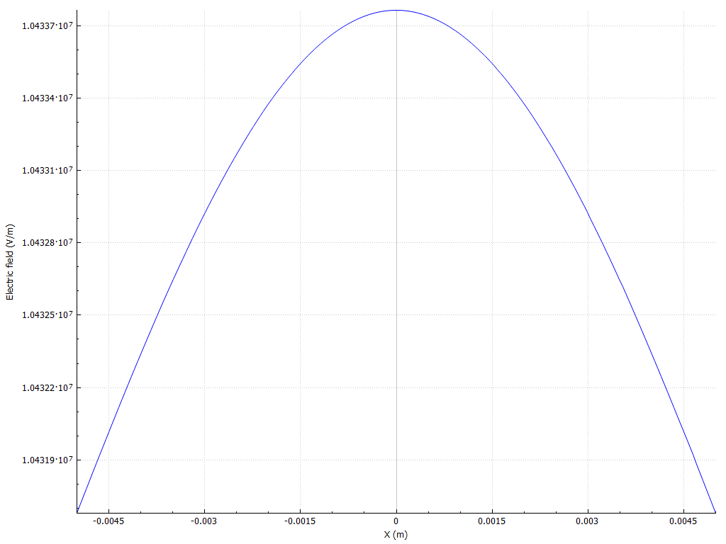

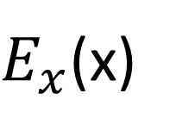








AGROS: Dipole
$$−66,3 kV/m$$
$E_{x}$(x)
$$\frac{ΔE}{E}={10}^{−4}$$
nominal field:
$$10.5 MV/m$$
$$−68,1 kV/m$$
$$y=0 mm$$
$$−5 mm$$
$$−3 mm$$
$$+3 mm$$
$$+5 mm$$

Slide 15
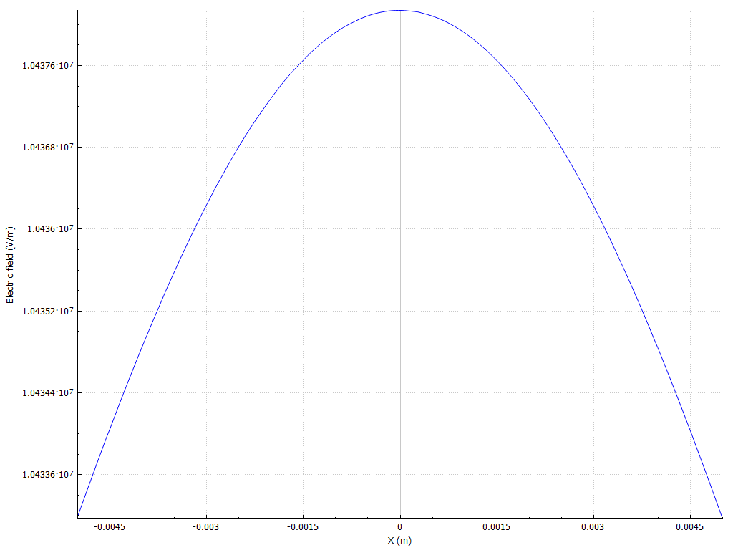







AGROS: Dipole
$E_{x}$(x)
$$−62,4 kV/m$$
$$\frac{ΔE}{E}={10}^{−4}$$
$$E_{x}(x=0)$$
$y=0 mm$ $−66.3 kV/m$
$y=5 mm$ $−62.0 kV/m$
nominal field:
$$10.5 MV/m$$
$$−66,4 kV/m$$
$$y=5 mm$$
$$−5 mm$$
$$−3 mm$$
$$+3 mm$$
$$+5 mm$$

Slide 16
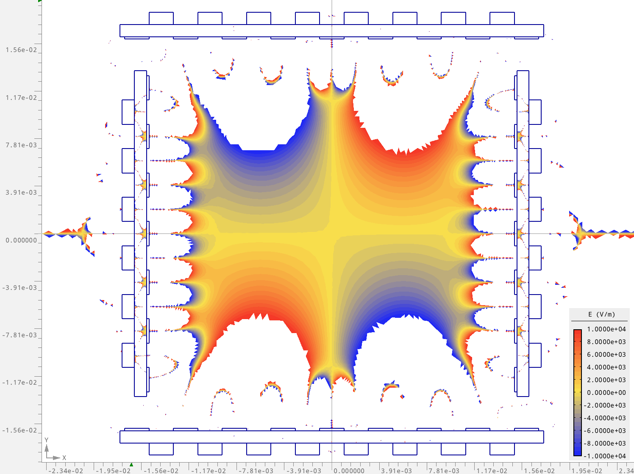


AGROS: Dipole
$$E_{y}$$
scale $±10 kV/m$

Slide 17
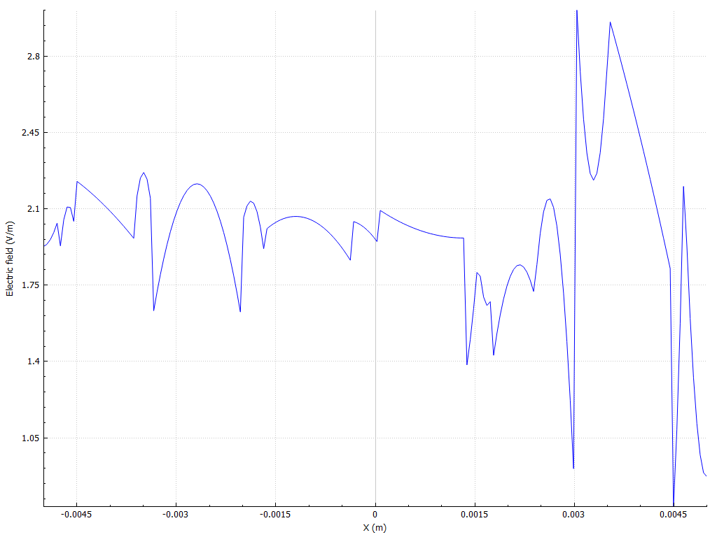
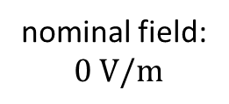
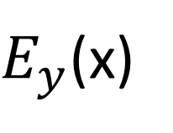



AGROS: Dipole
$E_{y}$(x)
$$2,8 V/m$$
nominal field:
$$0 V/m$$
$$1 V/m$$
$$y=0 mm$$
$$−5 mm$$
$$+5 mm$$

Slide 18
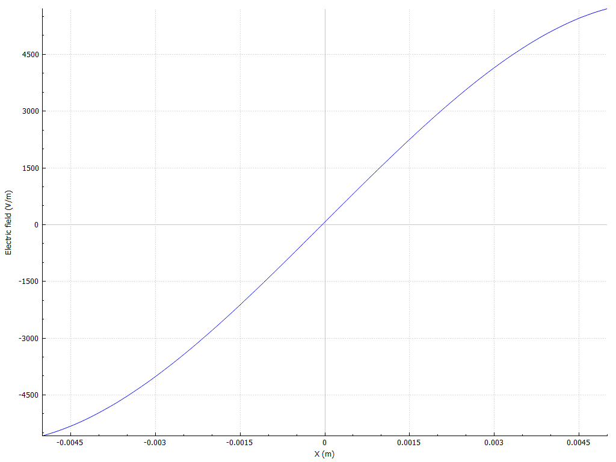

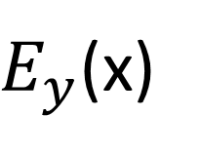






AGROS: Dipole
$E_{y}$(x)
$$4.5 kV/m$$
$$\frac{E_{y}}{E_{x}}={+2⋅10}^{−4}$$
$$\frac{E_{y}}{E_{x}}={−2⋅10}^{−4}$$
nominal field: 0
$$−4.5 kV/m$$
$$y=5 mm$$
$$−5 mm$$
$$−3 mm$$
$$+3 mm$$
$$+5 mm$$

Slide 19
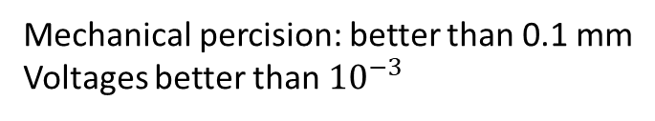

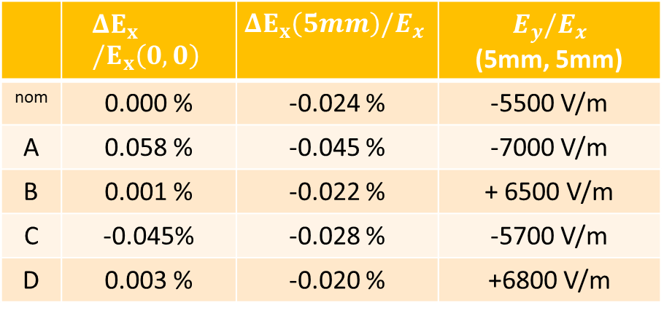



AGROS: Dipole
D. $−150 V$
Impact of imperfections on the field
Mechanical percision: better than 0.1 mm
Voltages better than ${10}^{−3}$
B. $0.2mm$ up
A. $0.1mm$ left
C. voltage -0.1%
 | $$ΔE_{x}/E_{x}\left(0,0\right)$$ | $$ΔE_{x}\left(5mm\right)/E_{x}$$ | $$E_{y}/E_{x}$$ (5mm, 5mm)
nom | 0.000 % | -0.024 % | -5500 V/m
A | 0.058 % | -0.045 % | -7000 V/m
B | 0.001 % | -0.022 % | + 6500 V/m
C | -0.045% | -0.028 % | -5700 V/m
D | 0.003 % | -0.020 % | +6800 V/m
D. $−150 V$

Slide 20
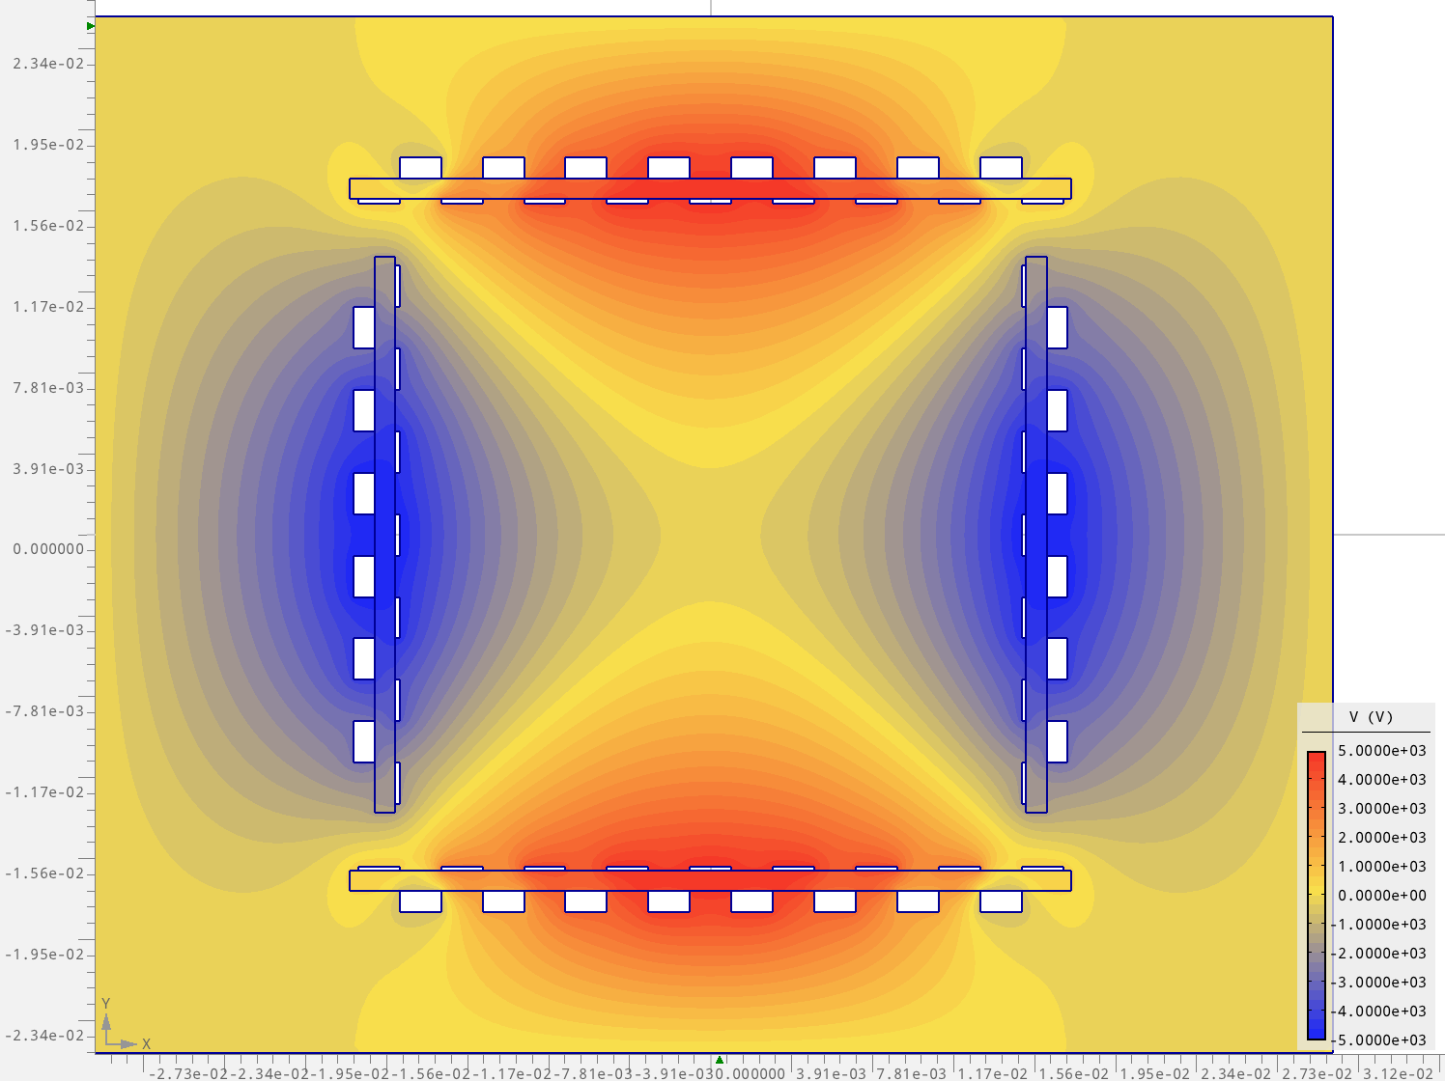

AGROS: Quadrupole
$$φ\left(\vec{r}\right)$$

Slide 21
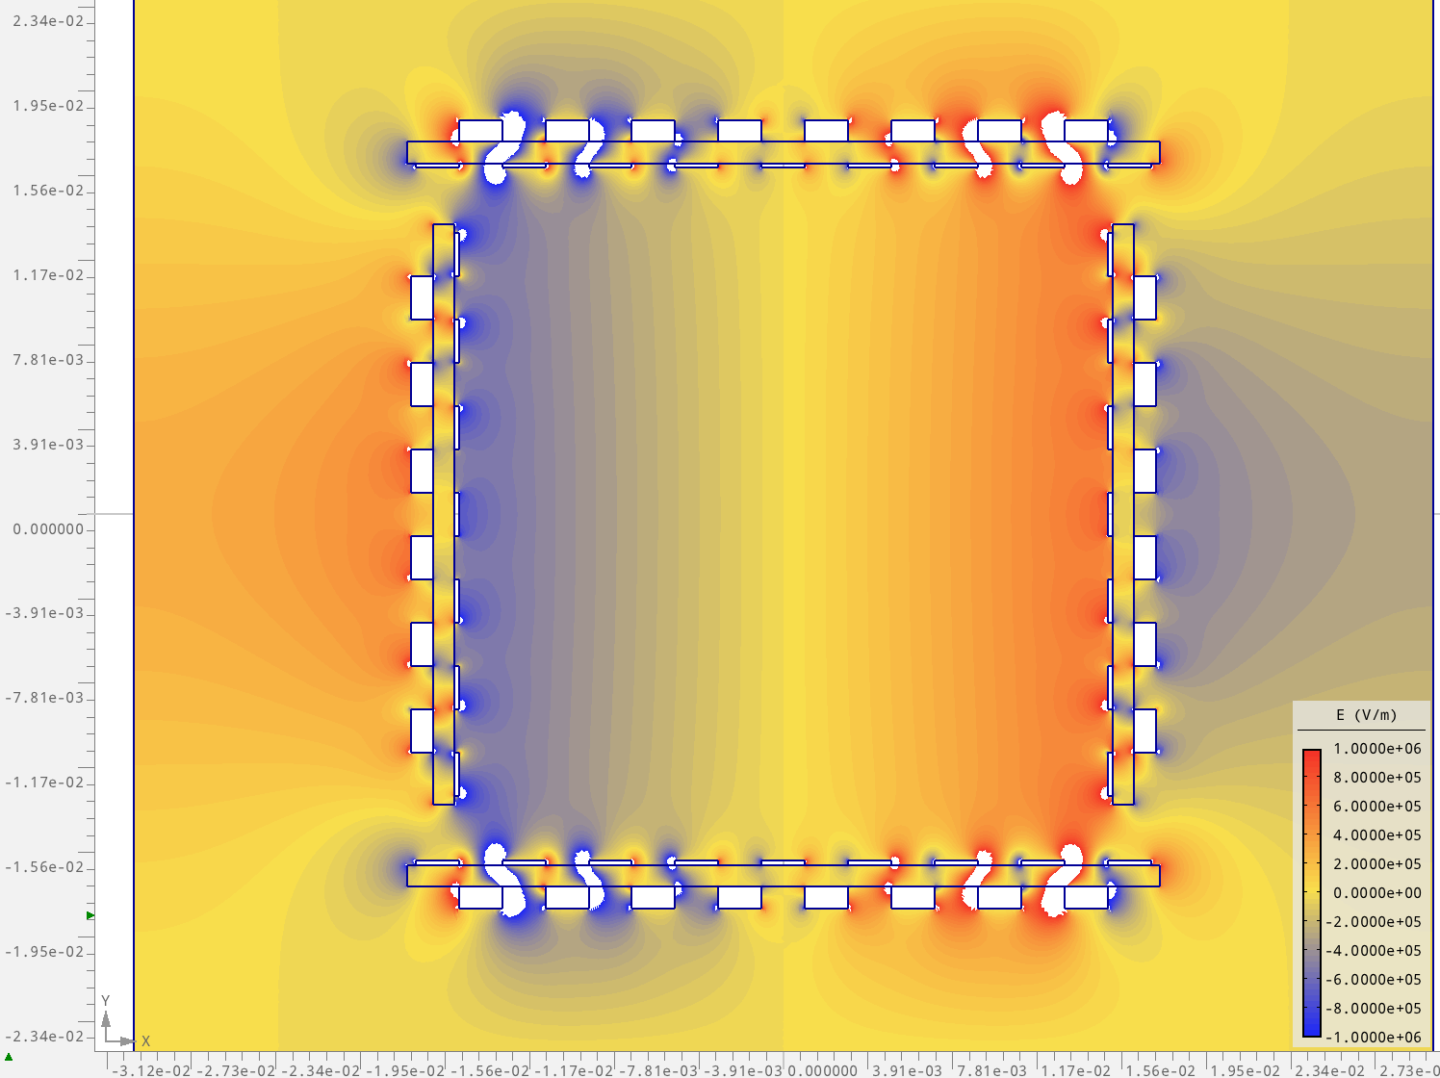
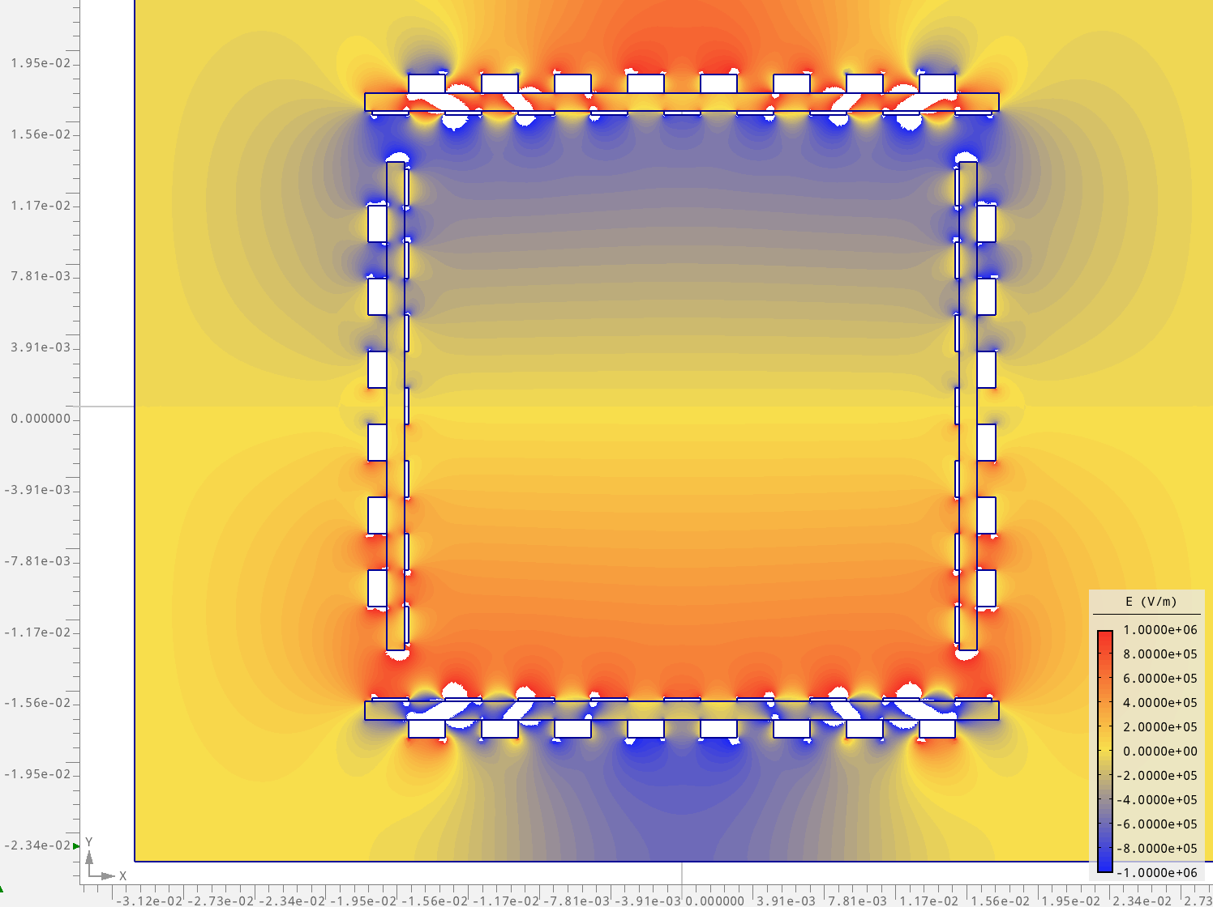


AGROS: Quadrupole
$$E_{x}\left(\vec{r}\right)$$
$$E_{y}\left(\vec{r}\right)$$

Slide 22
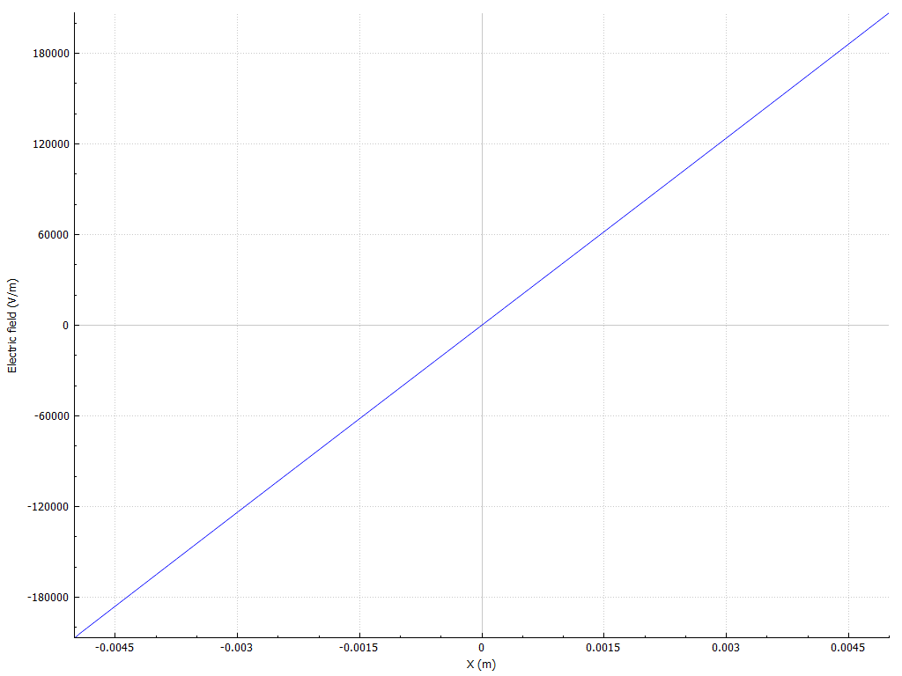
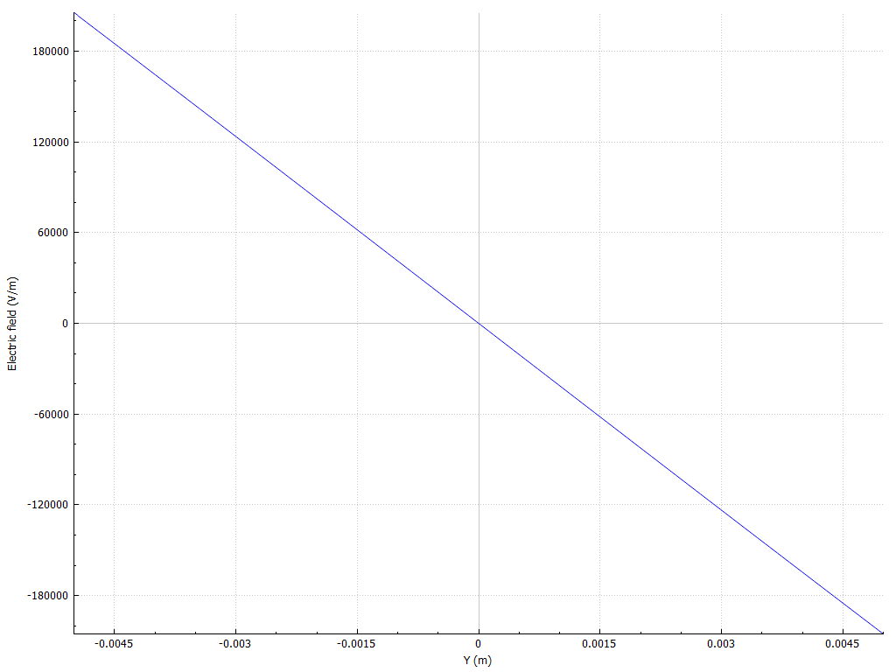










AGROS: Quadrupole
$$E_{x}\left(x\right)$$
$$E_{y}\left(y\right)$$
$$180 kV/m$$
$$180 kV/m$$
$$−180 kV/m$$
$$−180 kV/m$$
$$−5 mm$$
$$5 mm$$
$$−5 mm$$
$$5 mm$$
No quality check, yet

Slide 23
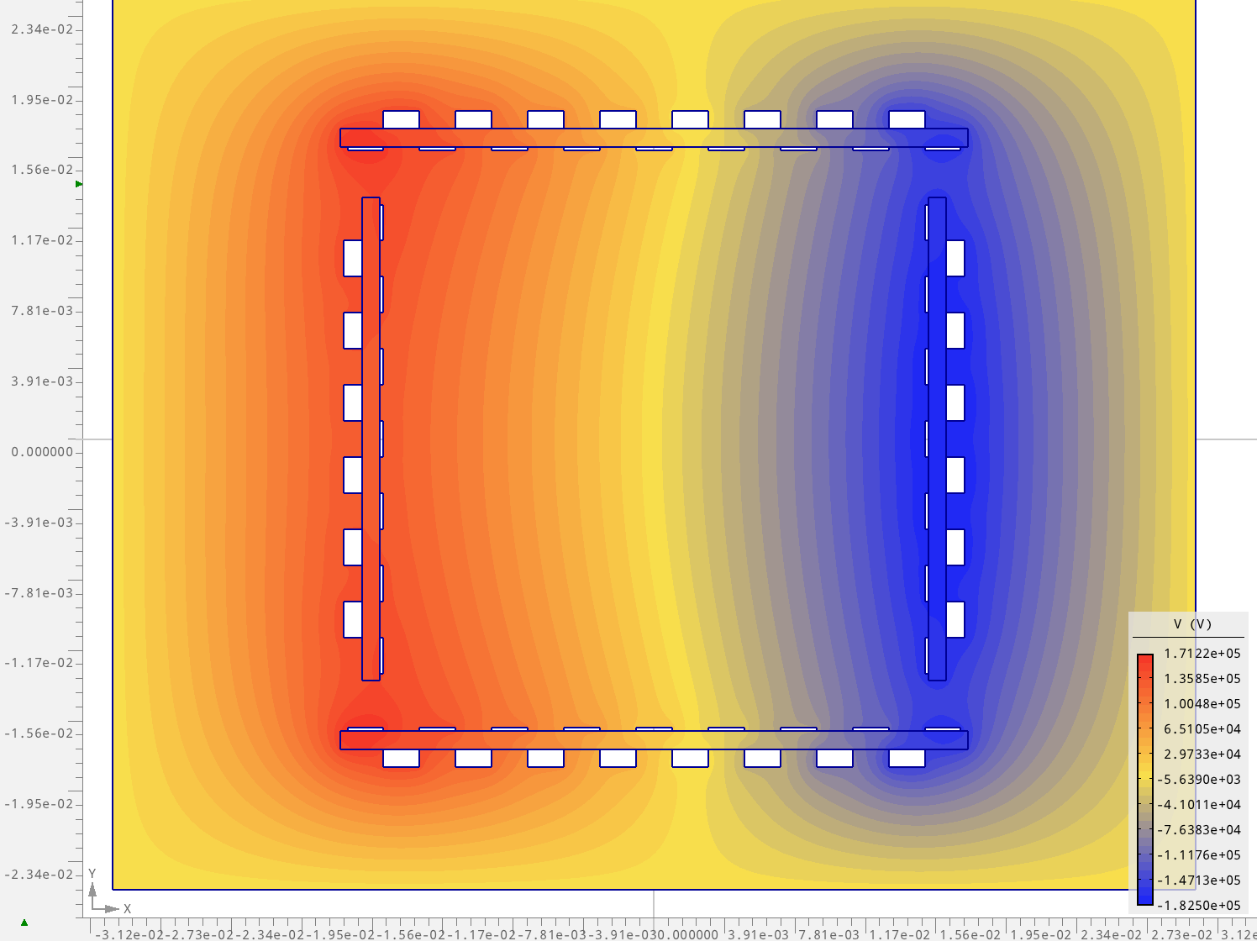

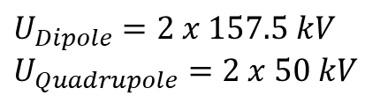
AGROS: Combined Function
$$φ\left(\vec{r}\right)$$
$U_{Dipole}=2 x 157.5 kV$
$U_{Quadrupole}=2 x 50 kV$

Slide 24
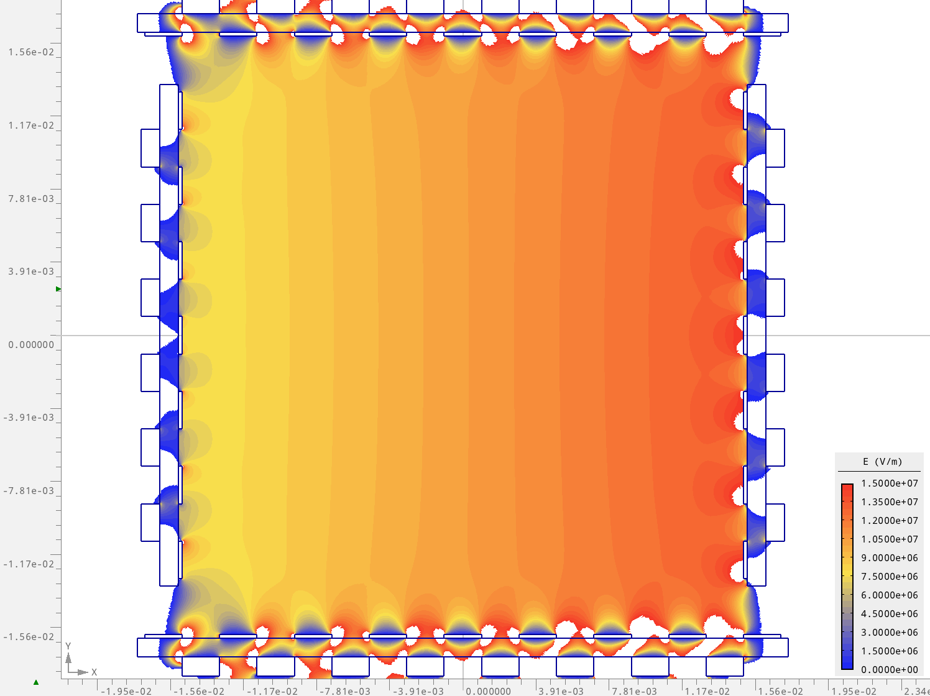
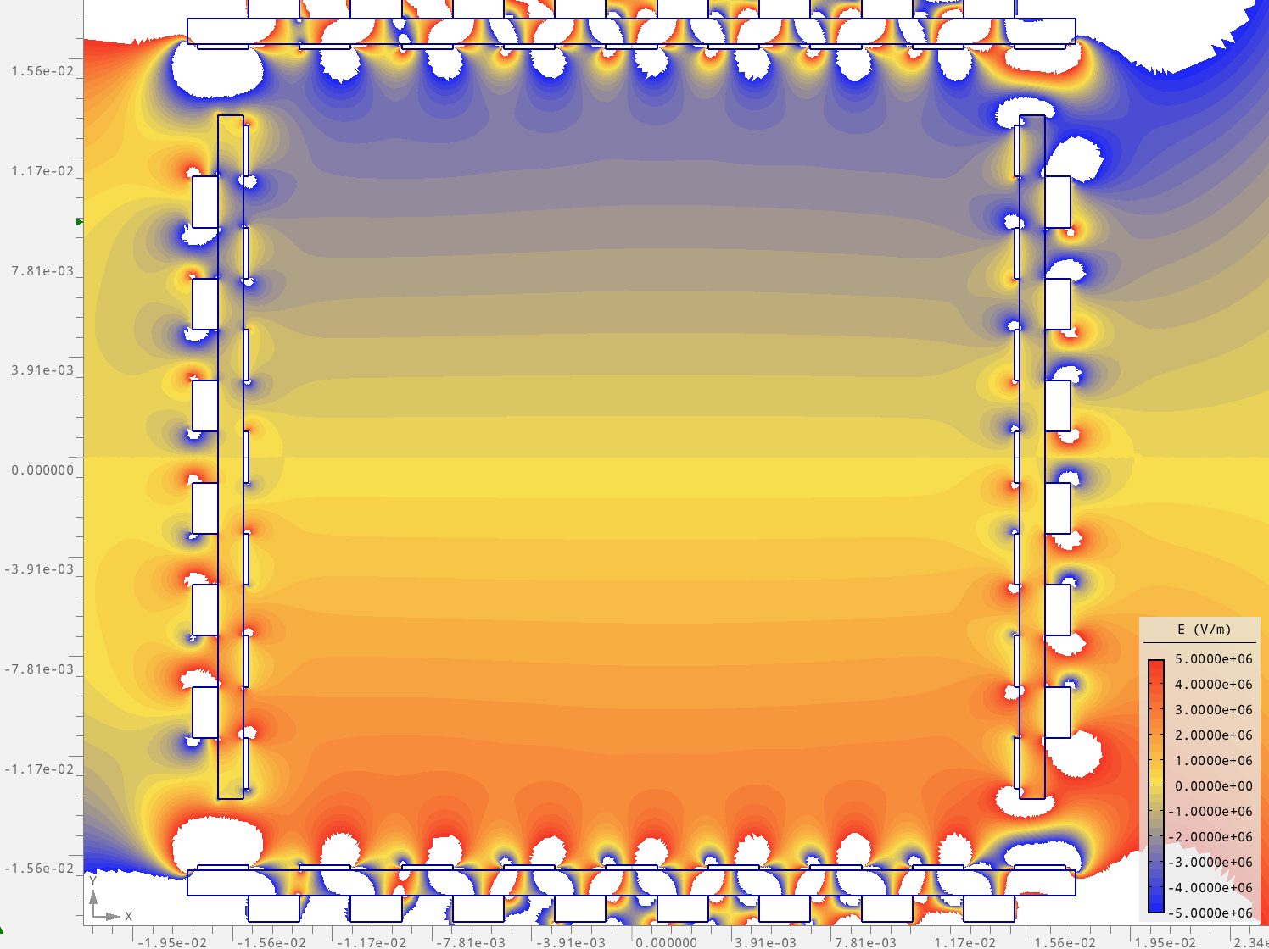


AGROS: Combined Function
$$E_{x}\left(\vec{r}\right)$$
$$E_{y}\left(\vec{r}\right)$$
scale: $0\frac{MV}{m} …15\frac{MV}{m}$
scale: $−5\frac{MV}{m} …+5\frac{MV}{m}$

Slide 25
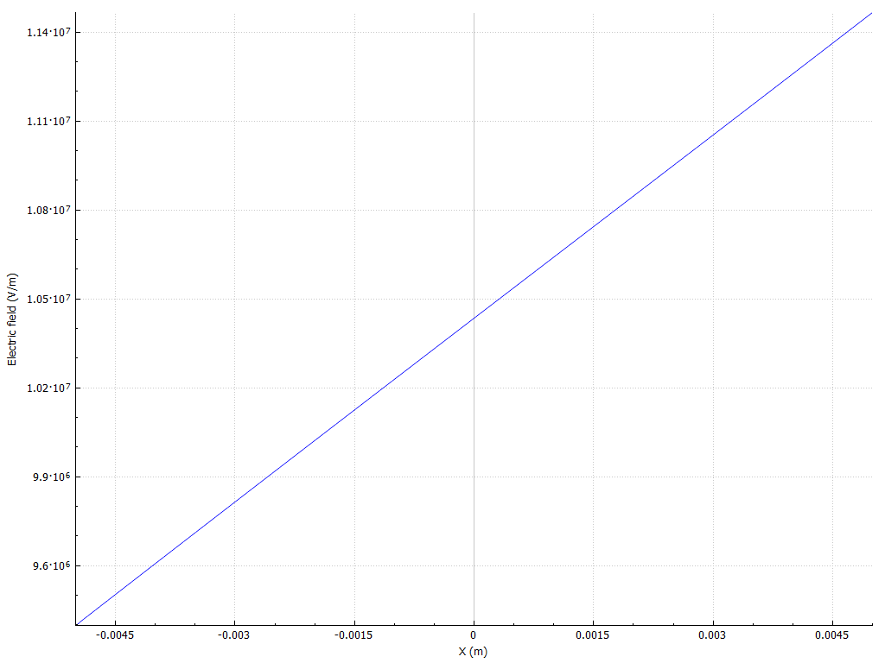










AGROS: Combined Function
$$E_{x}\left(x\right)$$
$$E_{y}\left(y\right)$$
$$11.4 MV/m$$
$$0.9 MV/m$$
$$10.5 MV/m$$
$$9.4 MV/m$$
$$−0.9 MV/m$$
$$−5 cm$$
$$5 cm$$
$$−5 cm$$
$$5 cm$$
No quality check, yet

Slide 26

Deformation of Plates
Force on vertical plates
Capacitance: $C=\frac{ε_{0}A}{d}=7.7\frac{pF}{m}$ (height $2.6 cm$, distance $3.0 cm$)
Charge: $Q=C⋅U=2.4 μC/m$ (voltage $2⋅175.5 kV$)
Field Strength: $\left|\vec{E}\right|=\frac{U}{d}=10.5 MV/m$
Stored Energy: $E_{C}=\frac{1}{2}CU^{2}=14\frac{mJ}{strip}/m$
Force on Plate: $F=Q⋅E=25 N/m$

Slide 27
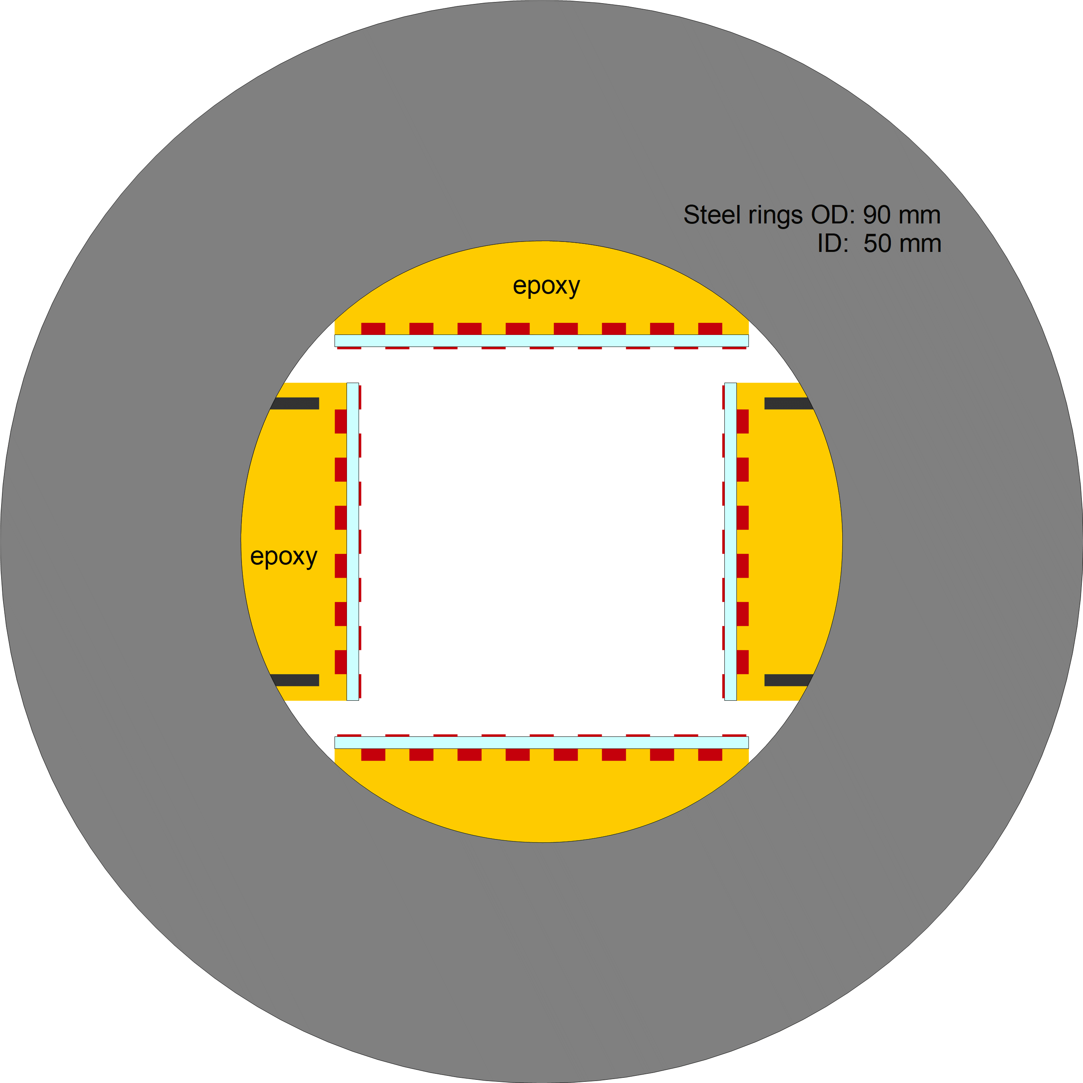
1st Idea on Mechanics
Steel disks every 10 cm (?)
electrodes glued into stiff plates
might need stiffeners inside plates

Slide 28
Beam Position Monitors
electronics
ground mesh

Slide 29
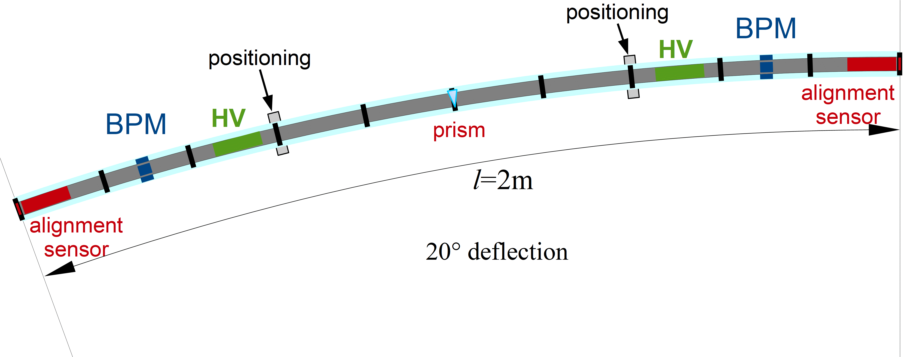
Deflectors

Slide 30
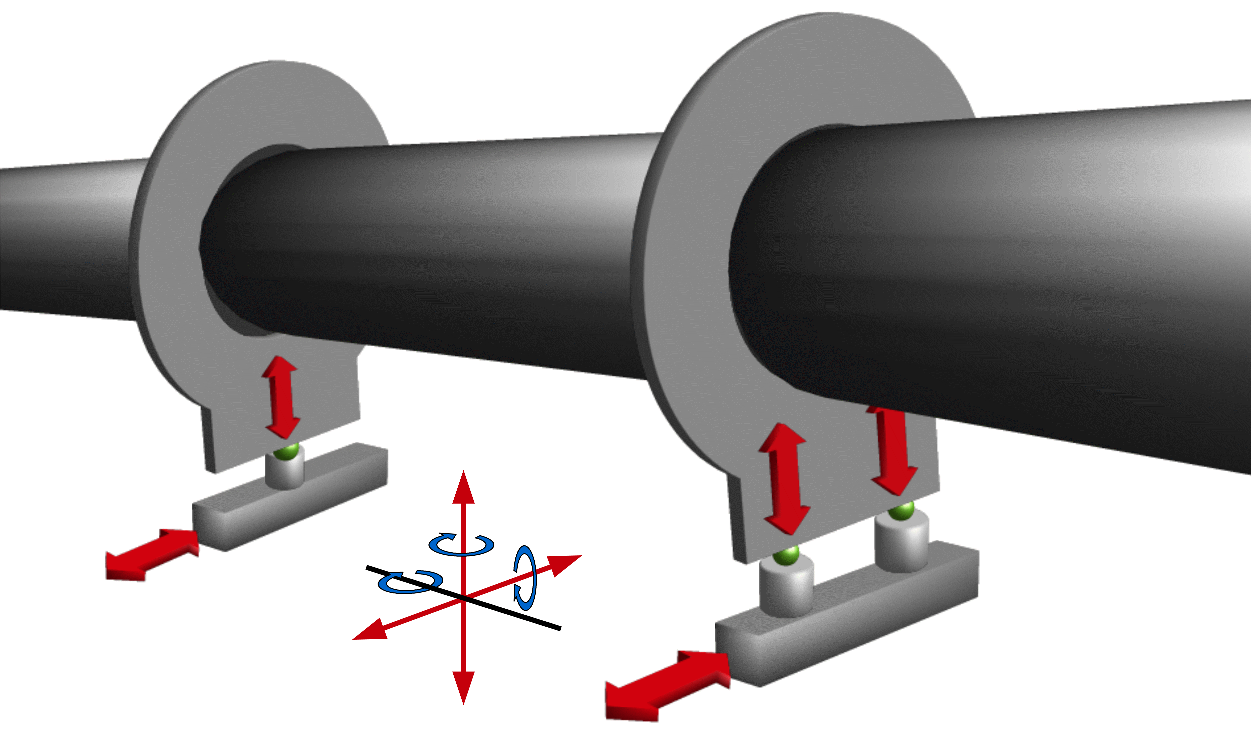
Mechanical Positioning

Slide 31


Mechanical Positioning
Piezo-Actuators ?

Slide 32

Laser Alignment
Not to scale
2 systems: above & below deflector
Laser alignment system used for example in CMS (Stefan Schael)
IR-Laser (amplitude modulated)
Si-strip detectors detect beam
Metal layers removed for transmission of IR-beam

Slide 33

Vacuum System
Beam pipe
Steel pipe
ID 15 cm

Slide 34

Vacuum System
Beam pipe
Steel pipe
ID 15 cm

Slide 35

Magnetic Shielding
High Temperature
Superconductor

Slide 36

Thermal Insulation
Polyurethane foam
15 cm shown
(LNG cargo uses 25 cm)

Slide 37


Magnetic Shielding
FINEMET
Nanocrystaline
Soft Magnetic Material
$$μ_{r}=30000…100000$$

Slide 38
Next Steps
Continue Field Calculations (optimize homogenity / study tolerances)
Understand field of bend deflectors
(Student starting on April 1st)
Design HV-network and stabilization
(Under discussion with Jochen Steinmann)
Talk to workshops for production methode of plates
Understand integration of BPMs
Talk to Stefan on laser alignment system
Understand effectiveness & cost of HTS shielding

Slide 39


Thanks

