Slide 1
The magic ring
S.Martin
cpEDM 09-03-2018

Slide 2
Lebedev ring Lattice Data
 | weak | strong |  |  | beta_kin | 0.5984
Energy | 232.79 | 232.79 | MeV |  | cp | 700.74 | MeV/c
N | 14 | 14 |  |  | Brho | 2.3374 | Tm
C | 263 | 300 |  |  | gamma kin | 1.2481
Focusing k in bends | 0.199 | 0 | 1/m |  | Arc structure | 7*(F-B-B-B-D-B-B-B-F)----------
Tune Qx | 1.229 | 2.32 |  |  | E field | 10 | MV/m
Tune Qy | 0.456 | 0.31 |  |  | length plate | 2.7443 | m
Beta x max | 34 | 29.1 | m |  | Tan delta | 0.0654
Beta y max | 91.7 | 204 | m |  | delta | 0.0654 | Rad
Diespersion | 45.5 | 17.35 | m |  | delta/2 | 0.0327
dP/P max | 0.0003 | 0.0009 | +- |  | No Defl | 96.0000
dP/P rms | 0.0001 | 0.0003 |  |  | Dist defl | 1 | m
acceptance x norm | 5 | 5.8 | mm mrad |  | length def tot | 3.7443 | m
eps x norm | 0.56 | 0.31 | mm mrad |  | No Quads
eps y norm | 1.52 | 2.2 | mm mrad |  | length Quad | 0.8 | m
rev. Frequency | 682.1 | 597.3 | KHz |  | Dist Quad | 0.8000 | m
mom. Comp. Alpha | 1.785 | 0.51 |  |  | length quad tot | 1.6000 | m
Frequency slip eta | 1.144 | -0.132 |  |  | Dist F D center | 12.8330 | m
Transition |  | 376 | MeV
HF
Bucket height | 4.97*10-4 | 1.3*10-3
Harm. Number | 70 | 70
Qsynchrotron | 0.002 | 0.006
RF Ampl. V0 | 13 | 10 | KV
f RF | 47.75 | 41.81 | MHz
Bucket length | 3.75 | 4.3 | m
Bunch length | 27 | 31 | m

Slide 3
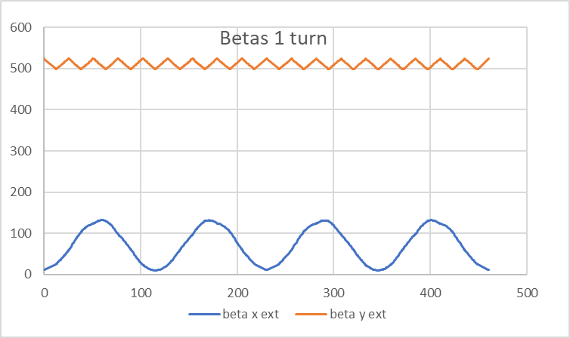
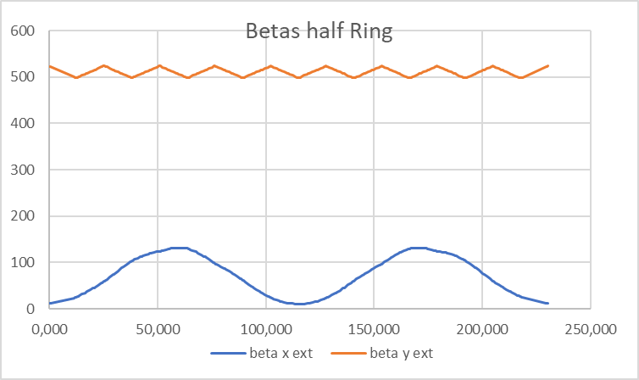
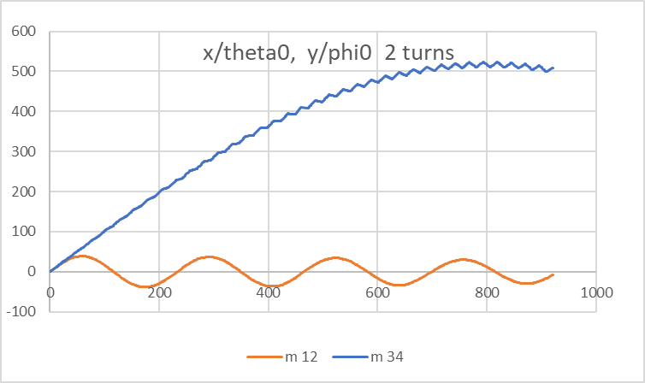
Lebedev ring: Lattice functions Qx=1.9, Qy=0.1

Slide 4
To Do
Andreas Spin tracking
Martin Runge – Kutta (very high quality)
Sig RF, live time, system design
Helmut Field calculation, Rogovski Pick ups
Kyril, Achim e-Bends
Ed, Erakli Polarimeter
……………………………………………………………

