Slide 2

CLIQ components redundancy
Alejandro Fernandez Navarro
With inputs from: Joaquim Mourao, Andrea Apollonio, Volker Geitner and Arjan Verweij
TE-MPE-PE
14.03.2018
CLIQ components redundancy
A. Fernandez

Slide 3
Outline
Introduction
CLIQ failure rate study
Capacitor bank configuration
Conclusions
CLIQ components redundancy
A. Fernandez

Slide 4

CLIQ (Coupling-Loss Induced Quench)
Current change
Magnetic field change
Coupling losses (Heat)
Temperature rise
QUENCH
CLIQ components redundancy
A. Fernandez

Slide 5
Introduction
Manufactured and successfully tested the first two versions of CLIQ units (2015-2017). The third version, intended to be the final version, under development.
Three CLIQ v1 units tested on an LHC main dipole within the HL-LHC program (2015-2017).
Three CLIQ v2 units successfully qualified (2017) and ready to be used in an extensive R&D program at the SM18 test facilities at CERN. Five CLIQ v2 units to be manufactured by the industry.
A further optimization of parameters is expected in the following months. CLIQ v3 prototype to be manufactured at CERN.
CLIQ v3 is intended to protect the LHC inner triplet magnets following their installation in 2024-25.
CLIQ components redundancy
A. Fernandez

Slide 6
CLIQ failure rate study
Goal: To assess the appropriate level of redundancy of the internal CLIQ components.
Assessment of the failure rates and failure modes of the CLIQ components:
Using datasheets, inputs from experts, and Isograph Reliability Workbench (MIL-HDBK)
Identify the safety critical failure scenarios and analyze the combinations of failures leading to them:
Inputs from previous failure scenarios studies of different CLIQ systems.
Study possible components redundancy to minimize the risk
Calculation of failure rates depending on redundancy level of CLIQ components
CLIQ components redundancy
A. Fernandez

Slide 7
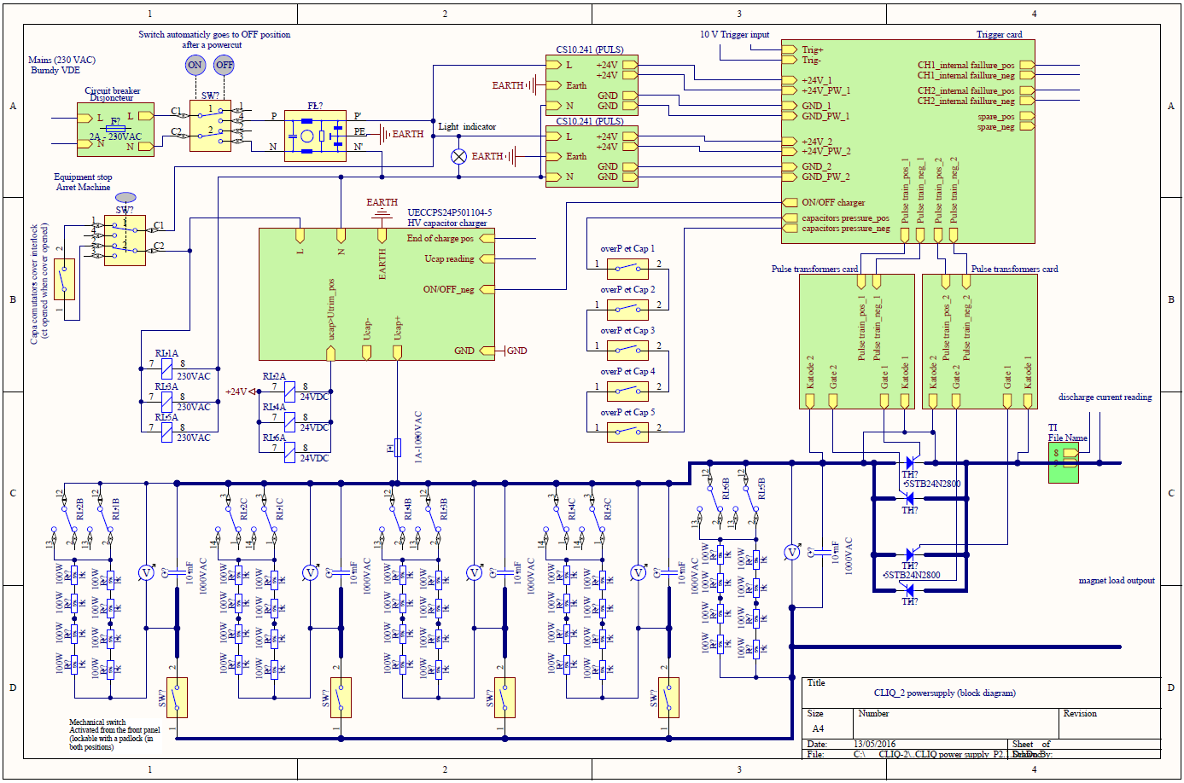
CLIQ failure rate study
Circuit schematic of the CLIQ v2 unit
TC power supply
Redundant power supply
Trigger card
Redundant circuit
Capacitor charger
Pulse transformer
Redundant transformer
Capacitor bank
(1,2 parallel/series,4?)
Bi-directional thyristor
Redundant thyristor
Courtesy of Joaquim Mourao
CLIQ components redundancy
A. Fernandez

Slide 8
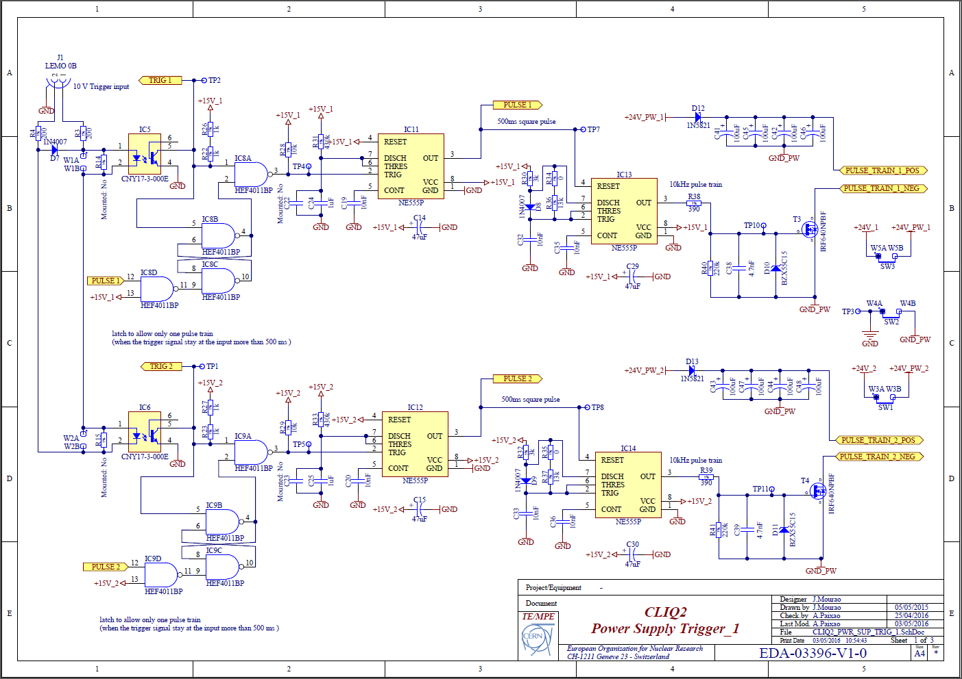
Example of calculation of components failure rates: trigger card
CLIQ failure rate study
Courtesy of Joaquim Mourao
CLIQ components redundancy
A. Fernandez

Slide 9
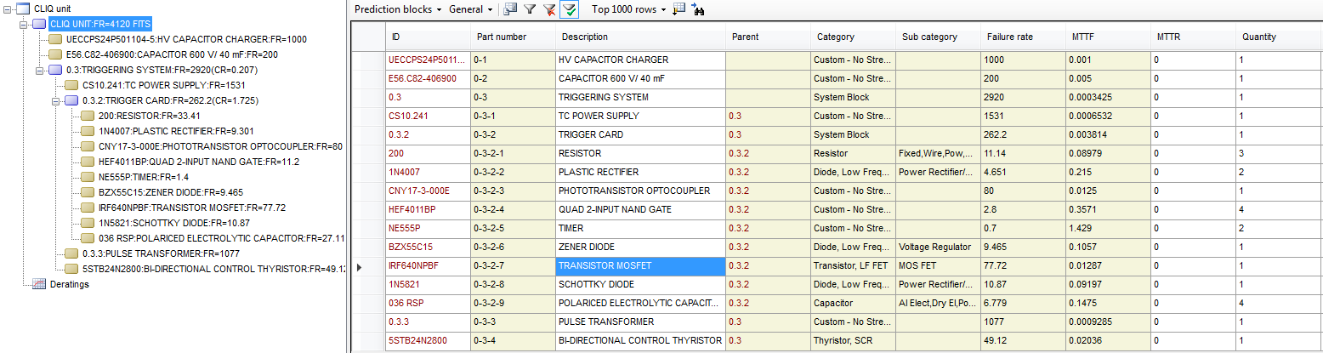
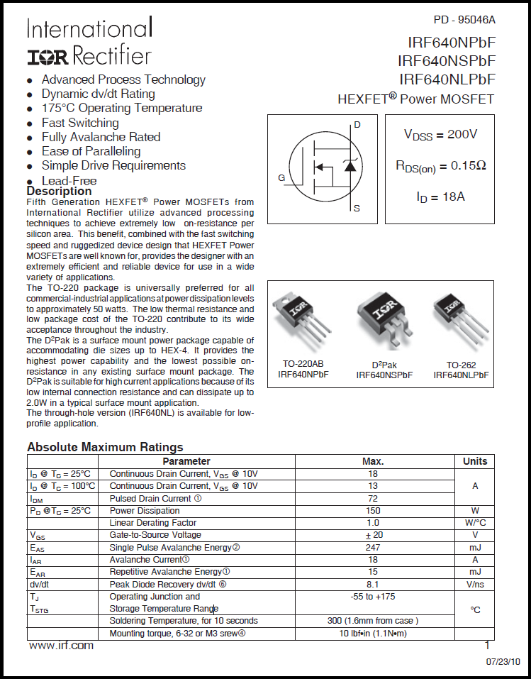
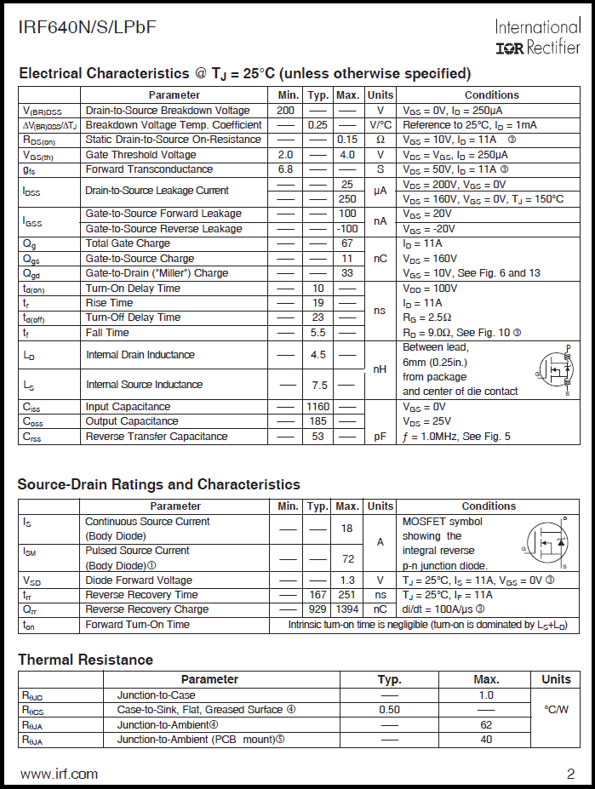
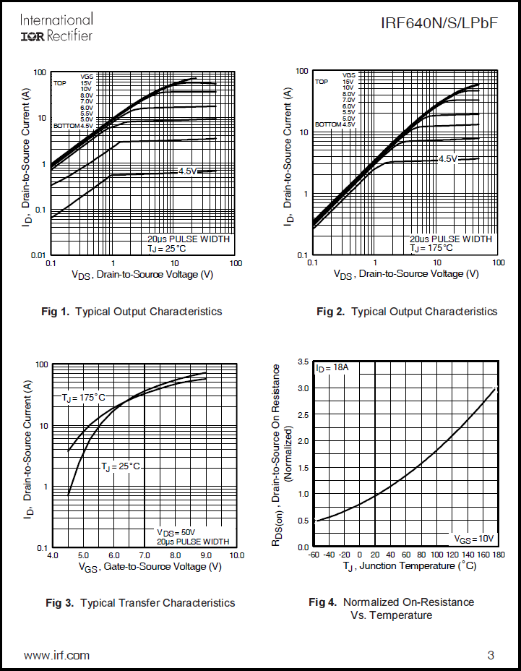
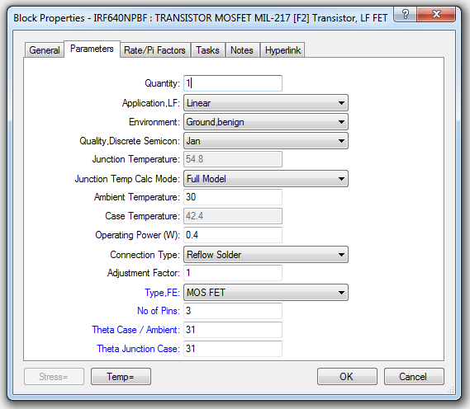
Calculation of failure rates with Isograph Reliability Workbench (MIL-HDBK-217F)
CLIQ failure rate study
CLIQ components redundancy
A. Fernandez

Slide 10
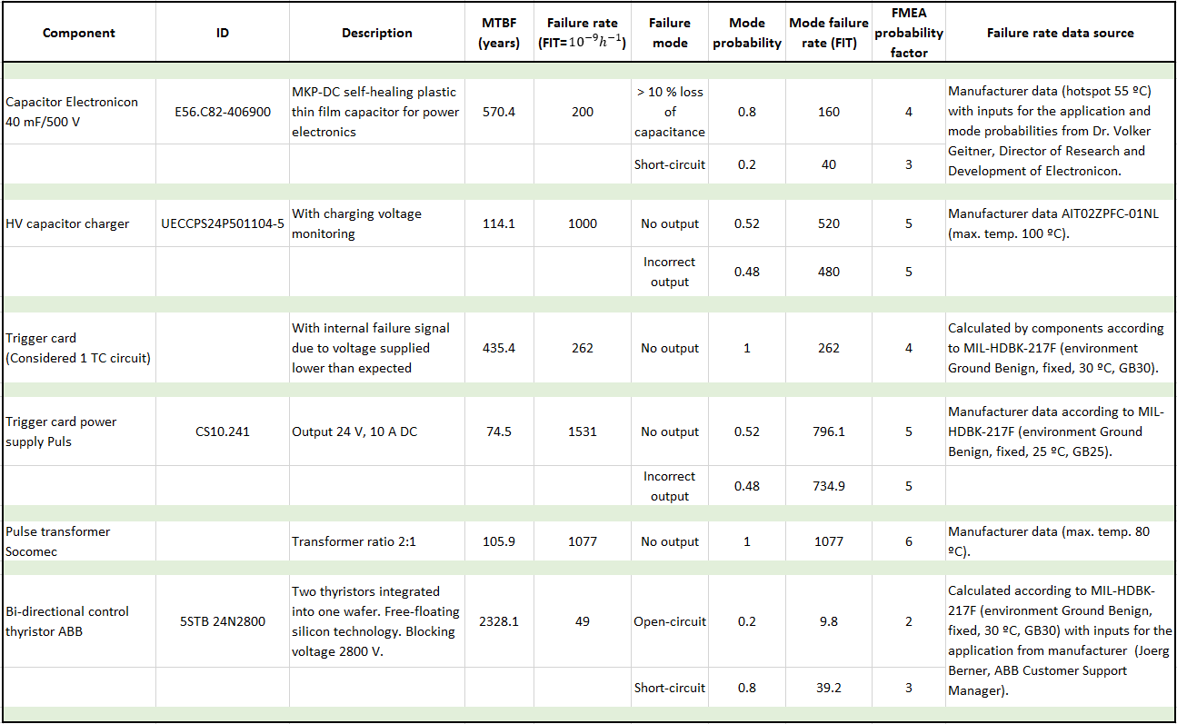
CLIQ failure rate study
Failure rates and failure modes of the CLIQ components
To be updated: new capacitor charger of reference
CLIQ components redundancy
A. Fernandez

Slide 11
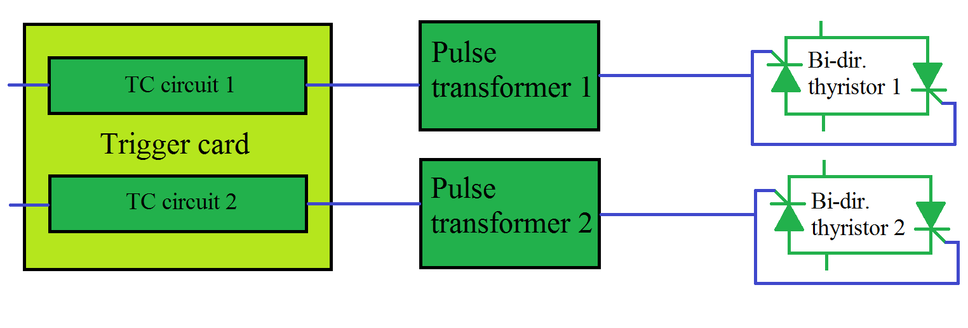
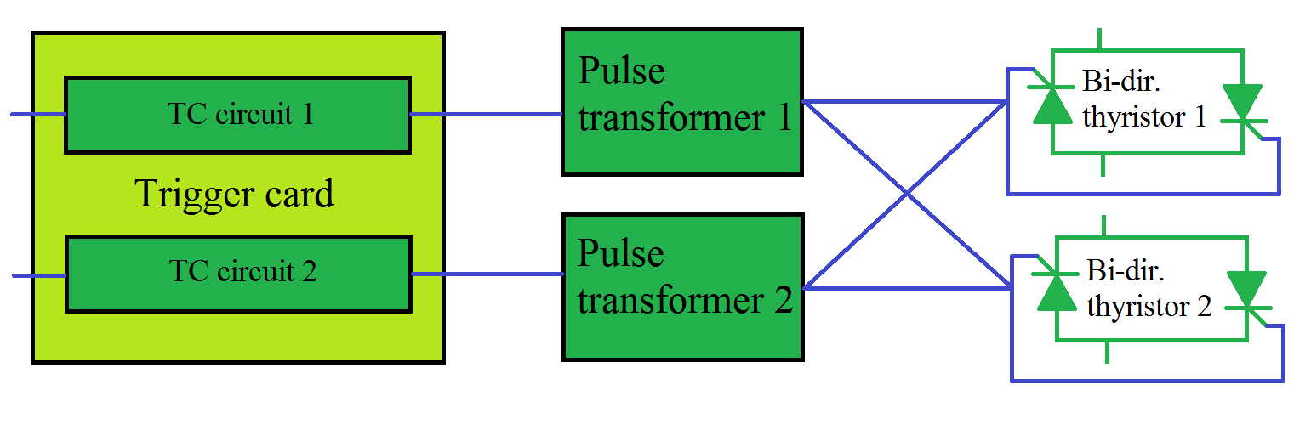


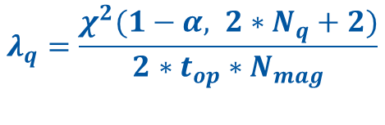


Thyristors, straight Vs. cross connection
$$λ_{TCf}=262 FIT$$
$$λ_{PTf}=1077 FIT$$
$$λ_{BTf}=49 FIT$$
$$P_{if}=1−e^{{−λ}_{if}t}$$
$$P_{notTrigg}=P_{TCf}^{2}+P_{PTf}^{2}+P_{BTf}^{2}+2P_{TCf}P_{PTf}+{2P}_{TCf}P_{BTf}+{2P}_{PTf}P_{BTf}=1−e^{{−λ}_{notTrigg}t}$$
$$λ_{notTrigg}=16.7 FIT$$
The very little difference in failure rates doesn’t justify the risk of loosing both triggering channels because of a short-circuit from anode to gate.
$⇒$ Keep the triggering channels independent (straight connection)
~0
~0
$$P_{notTrigg}=P_{TCf}^{2}+P_{PTf}^{2}+P_{BTf}^{2}+2P_{TCf}P_{PTf}+{2P}_{TCf}P_{BTf}^{2}+{2P}_{PTf}P_{BTf}^{2}=1−e^{−λ_{notTrigg}t}$$
$$λ_{notTrigg}=15.6 FIT$$
CLIQ components redundancy
A. Fernandez

Slide 12
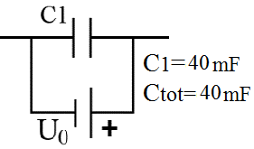
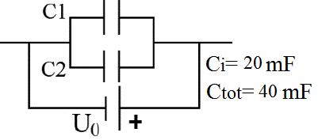
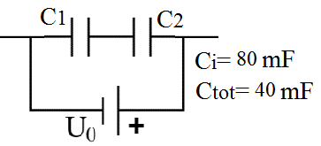
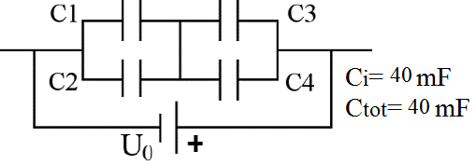
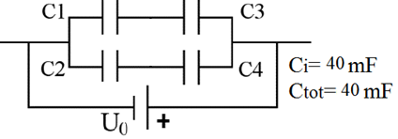
CLIQ failure rate study
Failure scenarios
Safety critical
Triggering delay of 1 ms of the CLIQ unit
Spurious triggering of the CLIQ unit
Not-triggering of the CLIQ unit
Non-nominal discharge due to one/several capacitors in open/short circuit (depending on the capacitor bank configuration)
Short-circuit of the capacitor bank of one CLIQ unit
Triggering system redundancy
Capacitor bank redundancy possibilities
CLIQ components redundancy
A. Fernandez

Slide 13
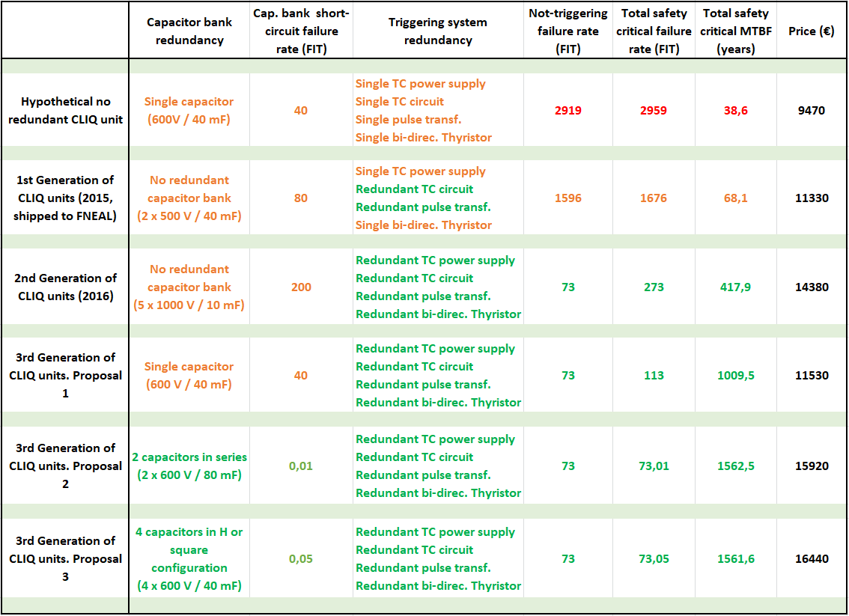
Total CLIQ failure rate and price depending on redundancy level
The series production of the CLIQ units will significantly reduce these estimated prices
CLIQ components redundancy
A. Fernandez

Slide 14



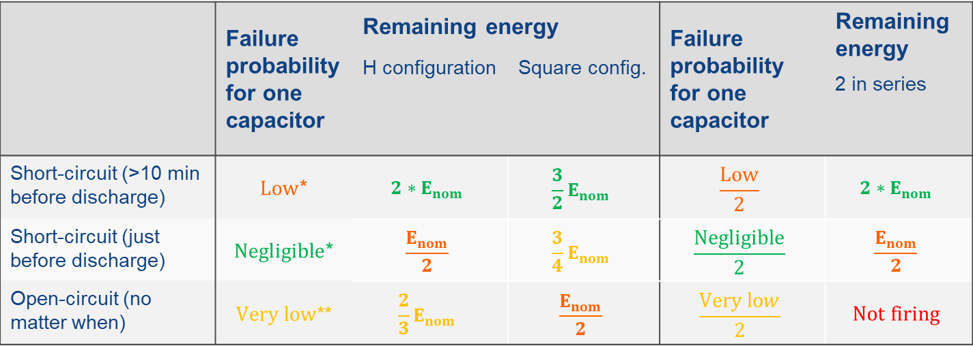
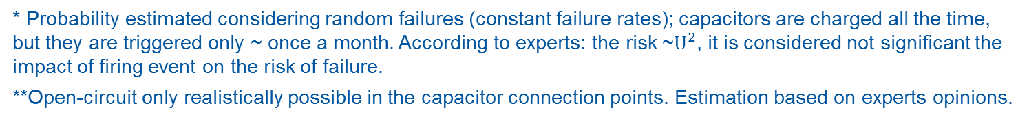
Capacitor bank configuration
Assumption 1: if the short-circuit occurs > 10 minutes before the CLIQ discharge, the rest of capacitors will be charged until their new charging voltage.
Assumption 2: In case of short-circuit, the rest of capacitors would be able to discharge their energy through the shorted one.
 | Failure probability for one capacitor | Remaining energy |  | Failure probability for one capacitor | Remaining energy
 |  | H configuration | Square config.
 |  |  |  |  | 2 in series
Short-circuit (>10 min before discharge) | $Low$* | $$2∗E_{nom}$$ | $$\frac{3}{2}E_{nom}$$ | $$\frac{Low}{2}$$ | $$2∗E_{nom}$$
Short-circuit (just before discharge) | $Negligible$* | $$\frac{E_{nom}}{2}$$ | $$\frac{3}{4}E_{nom}$$ | $$\frac{Negligible}{2}$$ | $$\frac{E_{nom}}{2}$$
Open-circuit (no matter when) | $Very low$** | $${\frac{2}{3}E}_{nom}$$ | $$\frac{E_{nom}}{2}$$ | $$\frac{Very low}{2}$$ | $$Not firing$$
* Probability estimated considering random failures (constant failure rates); capacitors are charged all the time, but they are triggered only ~ once a month. According to experts: the risk ~$U^{2}$, it is considered not significant the impact of firing event on the risk of failure.
**Open-circuit only realistically possible in the capacitor connection points. Estimation based on experts opinions.
CLIQ components redundancy
A. Fernandez

Slide 15
Conclusions
General:
Full redundancy of the triggering system is already implemented in CLIQ v2 and will be used for CLIQ v3 (from the power supply of the trigger card to the bi-directional thyristors). The two triggering channels are independent. Just one not-triggering failure every 1563 years is expected.
There is not a technological limit for further redundancies or monitoring systems, but a cost increase.
Capacitor bank configuration for CLIQ v3:
Either H or square configurations are recommended for CLIQ v3. CLIQ will fire with partial energy in case of short-circuit or open circuit of one capacitor, and the probability of short-circuit or open-circuit of the whole capacitor bank is negligible. The series configuration shows lower failure probabilities (factor 2) but will not fire in case of open-circuit of one capacitor.
Between H and square configurations, both options show advantages and disadvantages depending on the type of failure. Further risk analysis is on-going to make this choice.
Short-circuit of one capacitor can be detected if there is monitoring charging voltage across every capacitor. Open-circuit cannot be detected without triggering the system. A maintenance strategy will be defined.
CLIQ components redundancy
A. Fernandez

Slide 16
Annex
CLIQ components redundancy
A. Fernandez

Slide 17
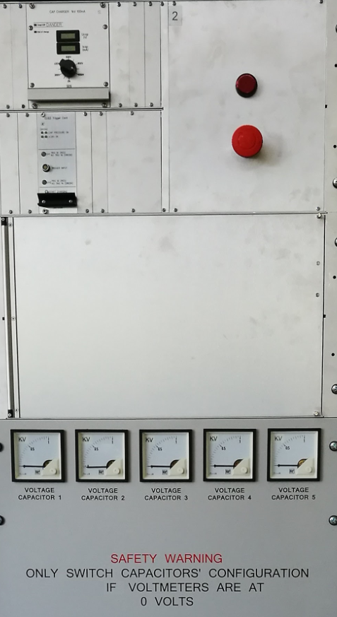
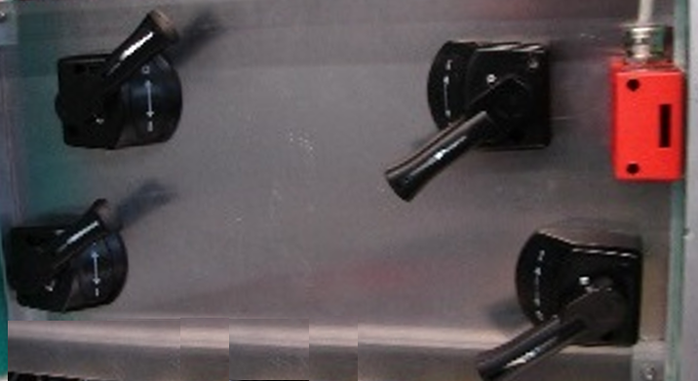
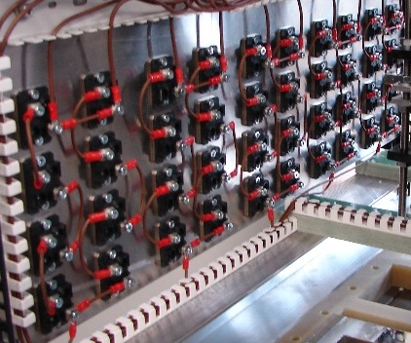
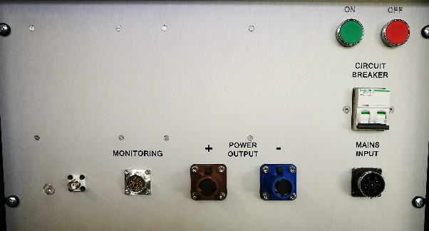
Safety first
Equipment stop button stop, mains current breaker, on/off switch
Interlock triggers when user opens the door for capacitance selection
Padlocks on the capacitance selectors
-> The stored energy is dissipated in the resistor bank
MPE Technical Meeting

