Slide 2
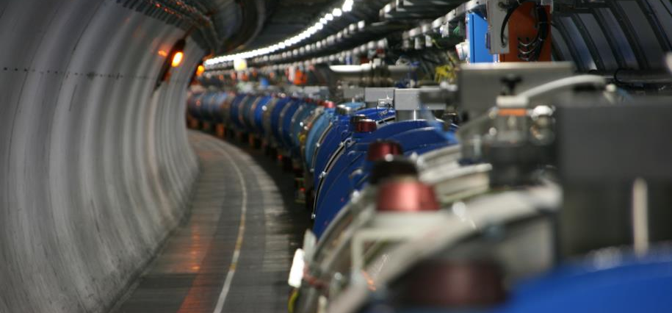
Re-commissioning of the superconducting circuits
Meeting n.5
Mirko Pojer and Matteo Solfaroli
Beams Department
Operation Group

Slide 3
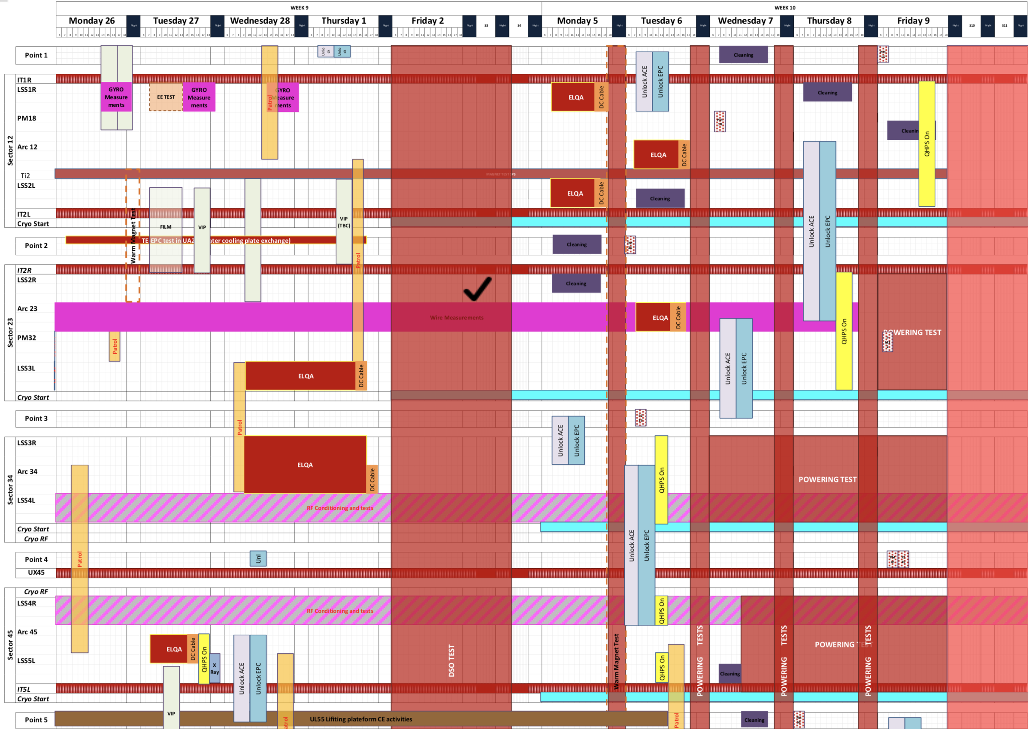
Status of preparation
Today
IT.R1
  Unlocking OK
  OK to switch ON QHPS
LR1
  Unlocking OK
  QHPS OK
A12
  Unlocking OK
  OK to switch ON remaining QHPS in 2L
ML2 and IT.L2
  Unlocking OK
  OK to switch ON remaining QHPS
IT.R2 and MR2
  Unlocking OK
  OK to switch ON remaining QHPS
A23
  Unlocking OK
  QHPS in 2R not yet ready
A34
  Unlocking OK
  QHPS OK
ML4
  Unlocking OK
  QHPS OK
MR4, A45, LL5, IT.L5
  Unlocking OK
  QHPS OK

Slide 4
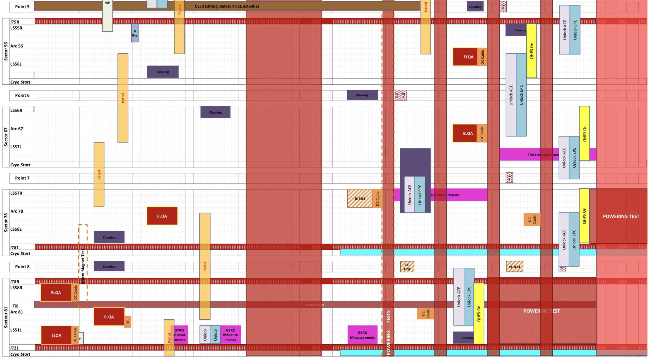
Status of preparation_2
Today
IT.R5 and LR5
  Unlocking on Fri.9
  QHPS on after QPS-IST
A56
  Unlocking OK in 6L
  Unlocking on Fri. 9 for 5R
  QHPS on after QPS-IST for IPQs
ML6 and MR6
  Unlocking OK
  QHPS on after QPS-IST
A67
  Unlocking OK
  QHPS on after QPS-IST for IPQs
A78
  Unlocking OK
  QHPS OK
ML8 and IT.L8
  Unlocking OK
  QHPS OK
IT.R8 and MR8
  Unlocking OK
  QHPS on after QPS-IST
A81
  Unlocking OK
  OK to switch ON QHPS
LL1
  Unlocking OK
  QHPS OK
IT.L1
  Unlocking OK
  OK to switch ON QHPS

Slide 5
Cryogenics plan
 | Present | Next action | CS OK
S12 | Capacity load test until Saturday morning | BS regeneration (24h) | Monday morning
S23 |  |  | OK
S34 |  |  | OK
S45 |  |  | OK
S56 | Reconfiguration until Thurs night Reconfiguration until Thurs night | BS re-generation (24h) | Friday night
S67 |  | BS re-generation (24h) | Saturday afternoon
S78 | Moving back to QURC – A |  | Thursday evening
S81 |  | BS regeneration (24h) to be re-done | Friday evening

Slide 6

General advancement
The 60 A in 4oo8 sectors are done (which already account for 1/3 of the successful tests)
Only Phase 1 for the moment
Tests have been started in 4oo8 sectors
The Mains have been started in 1 sector
IT started (phase 1 completed) in 1 sector
16oo94 IPQ/Ds started (phase 1 completed) in 1 sector

Slide 7
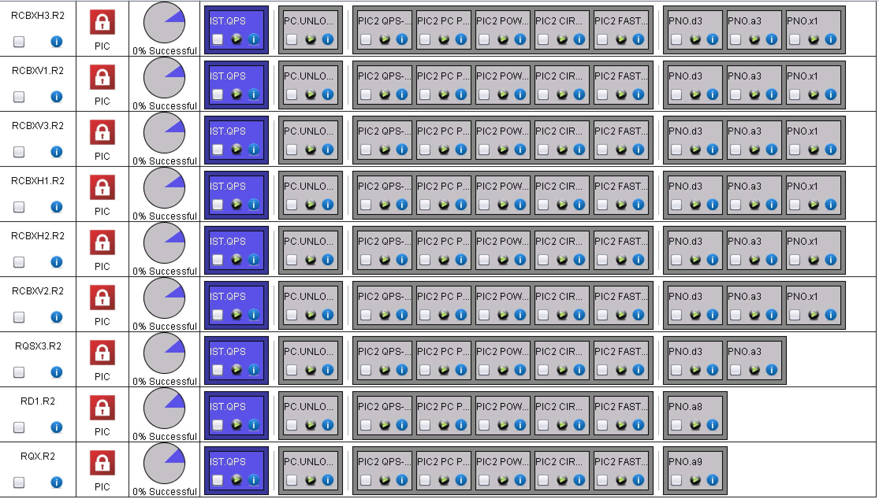
XR2
120 A are over

Slide 8
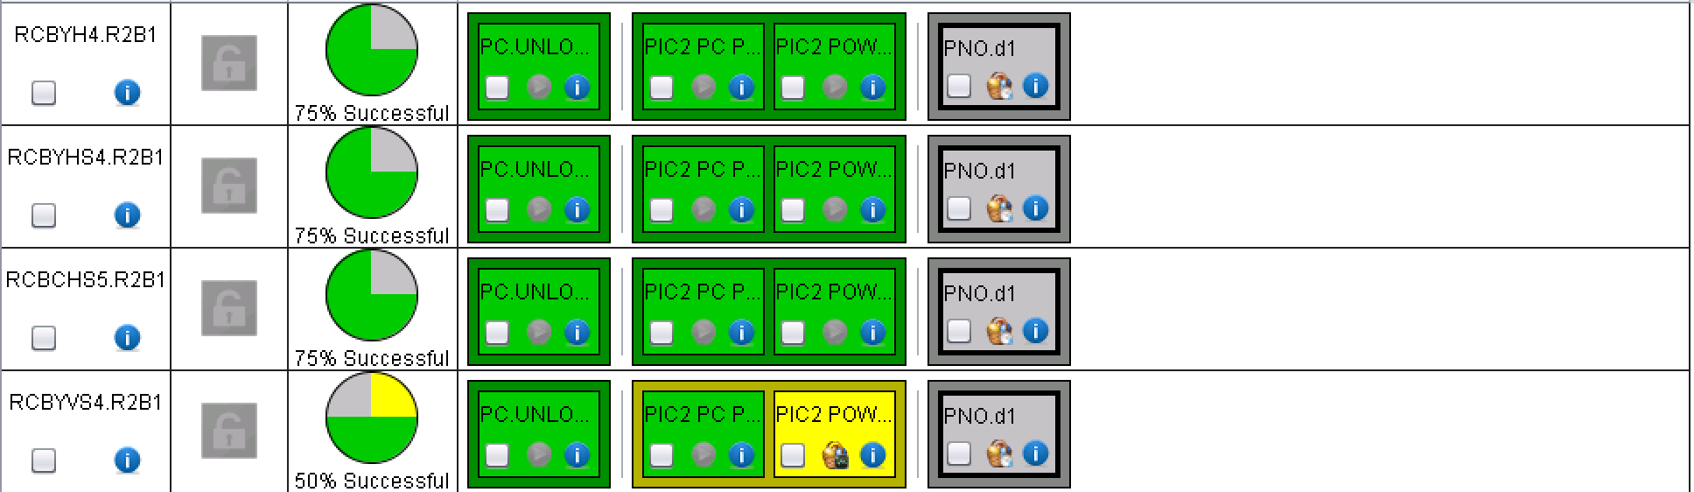
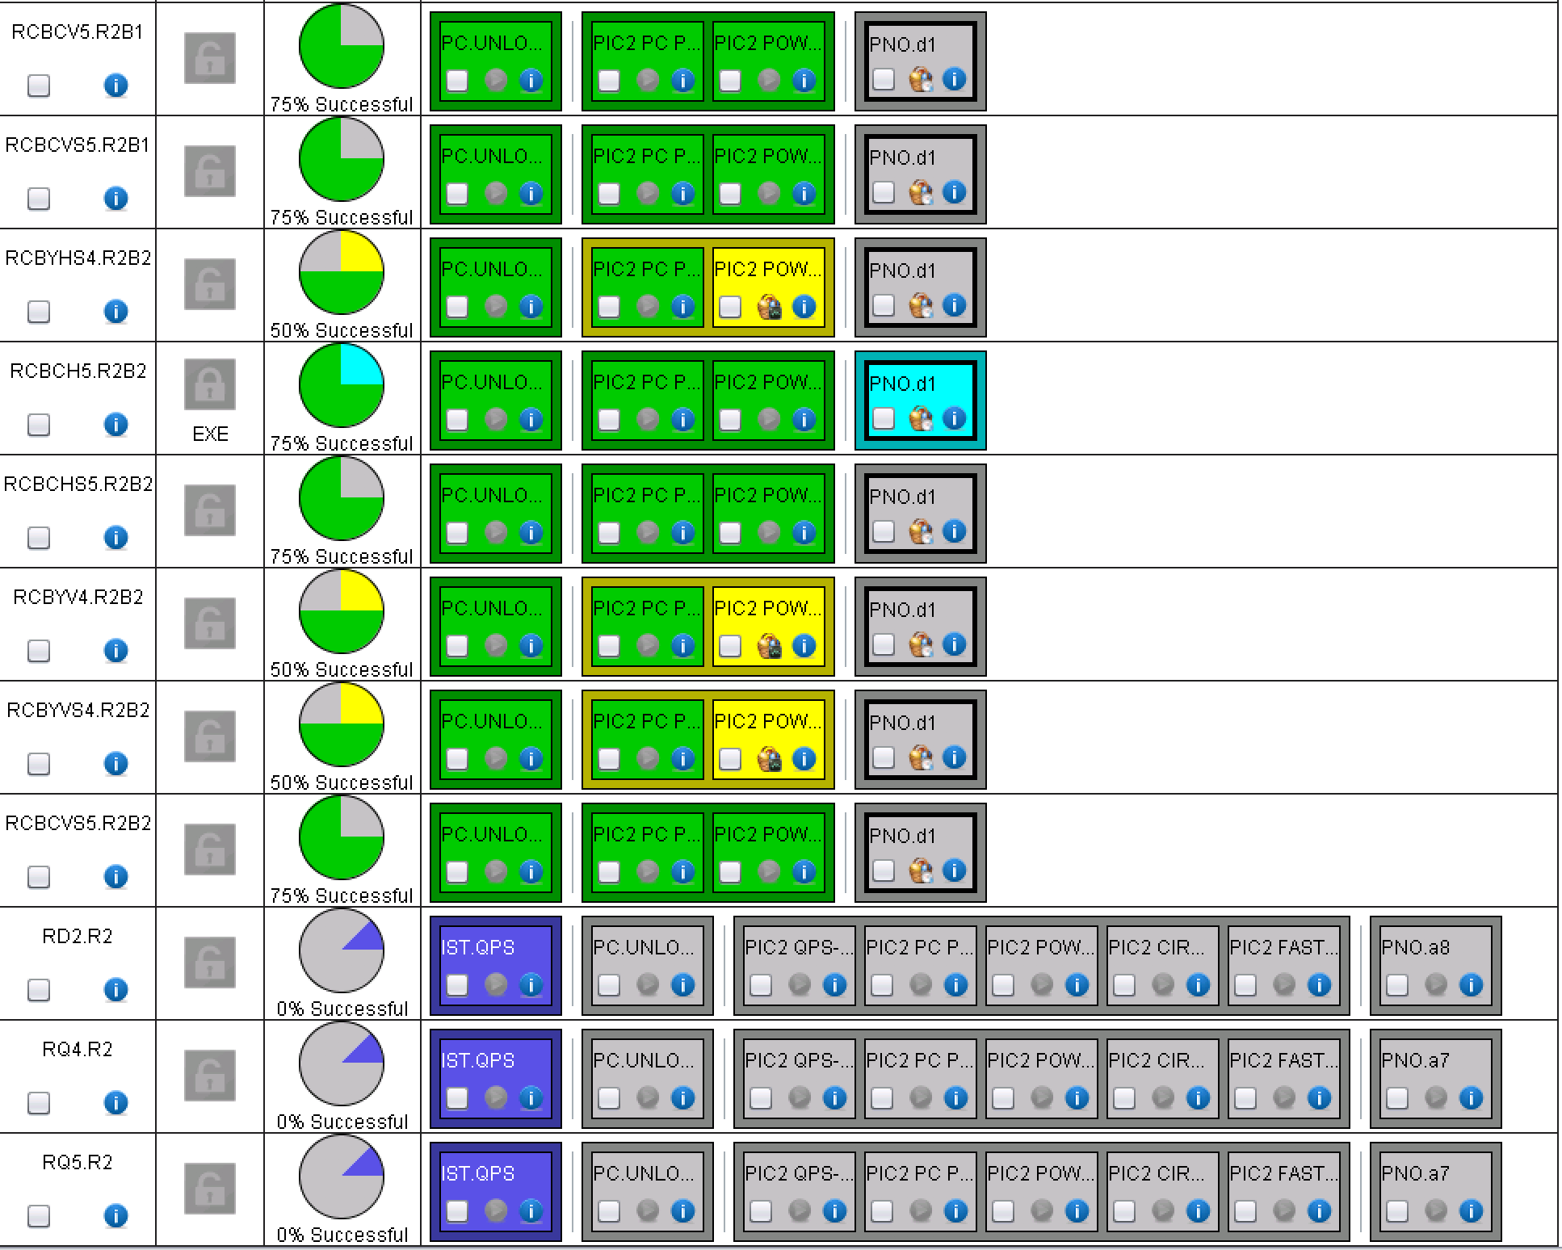
MR2

Slide 9
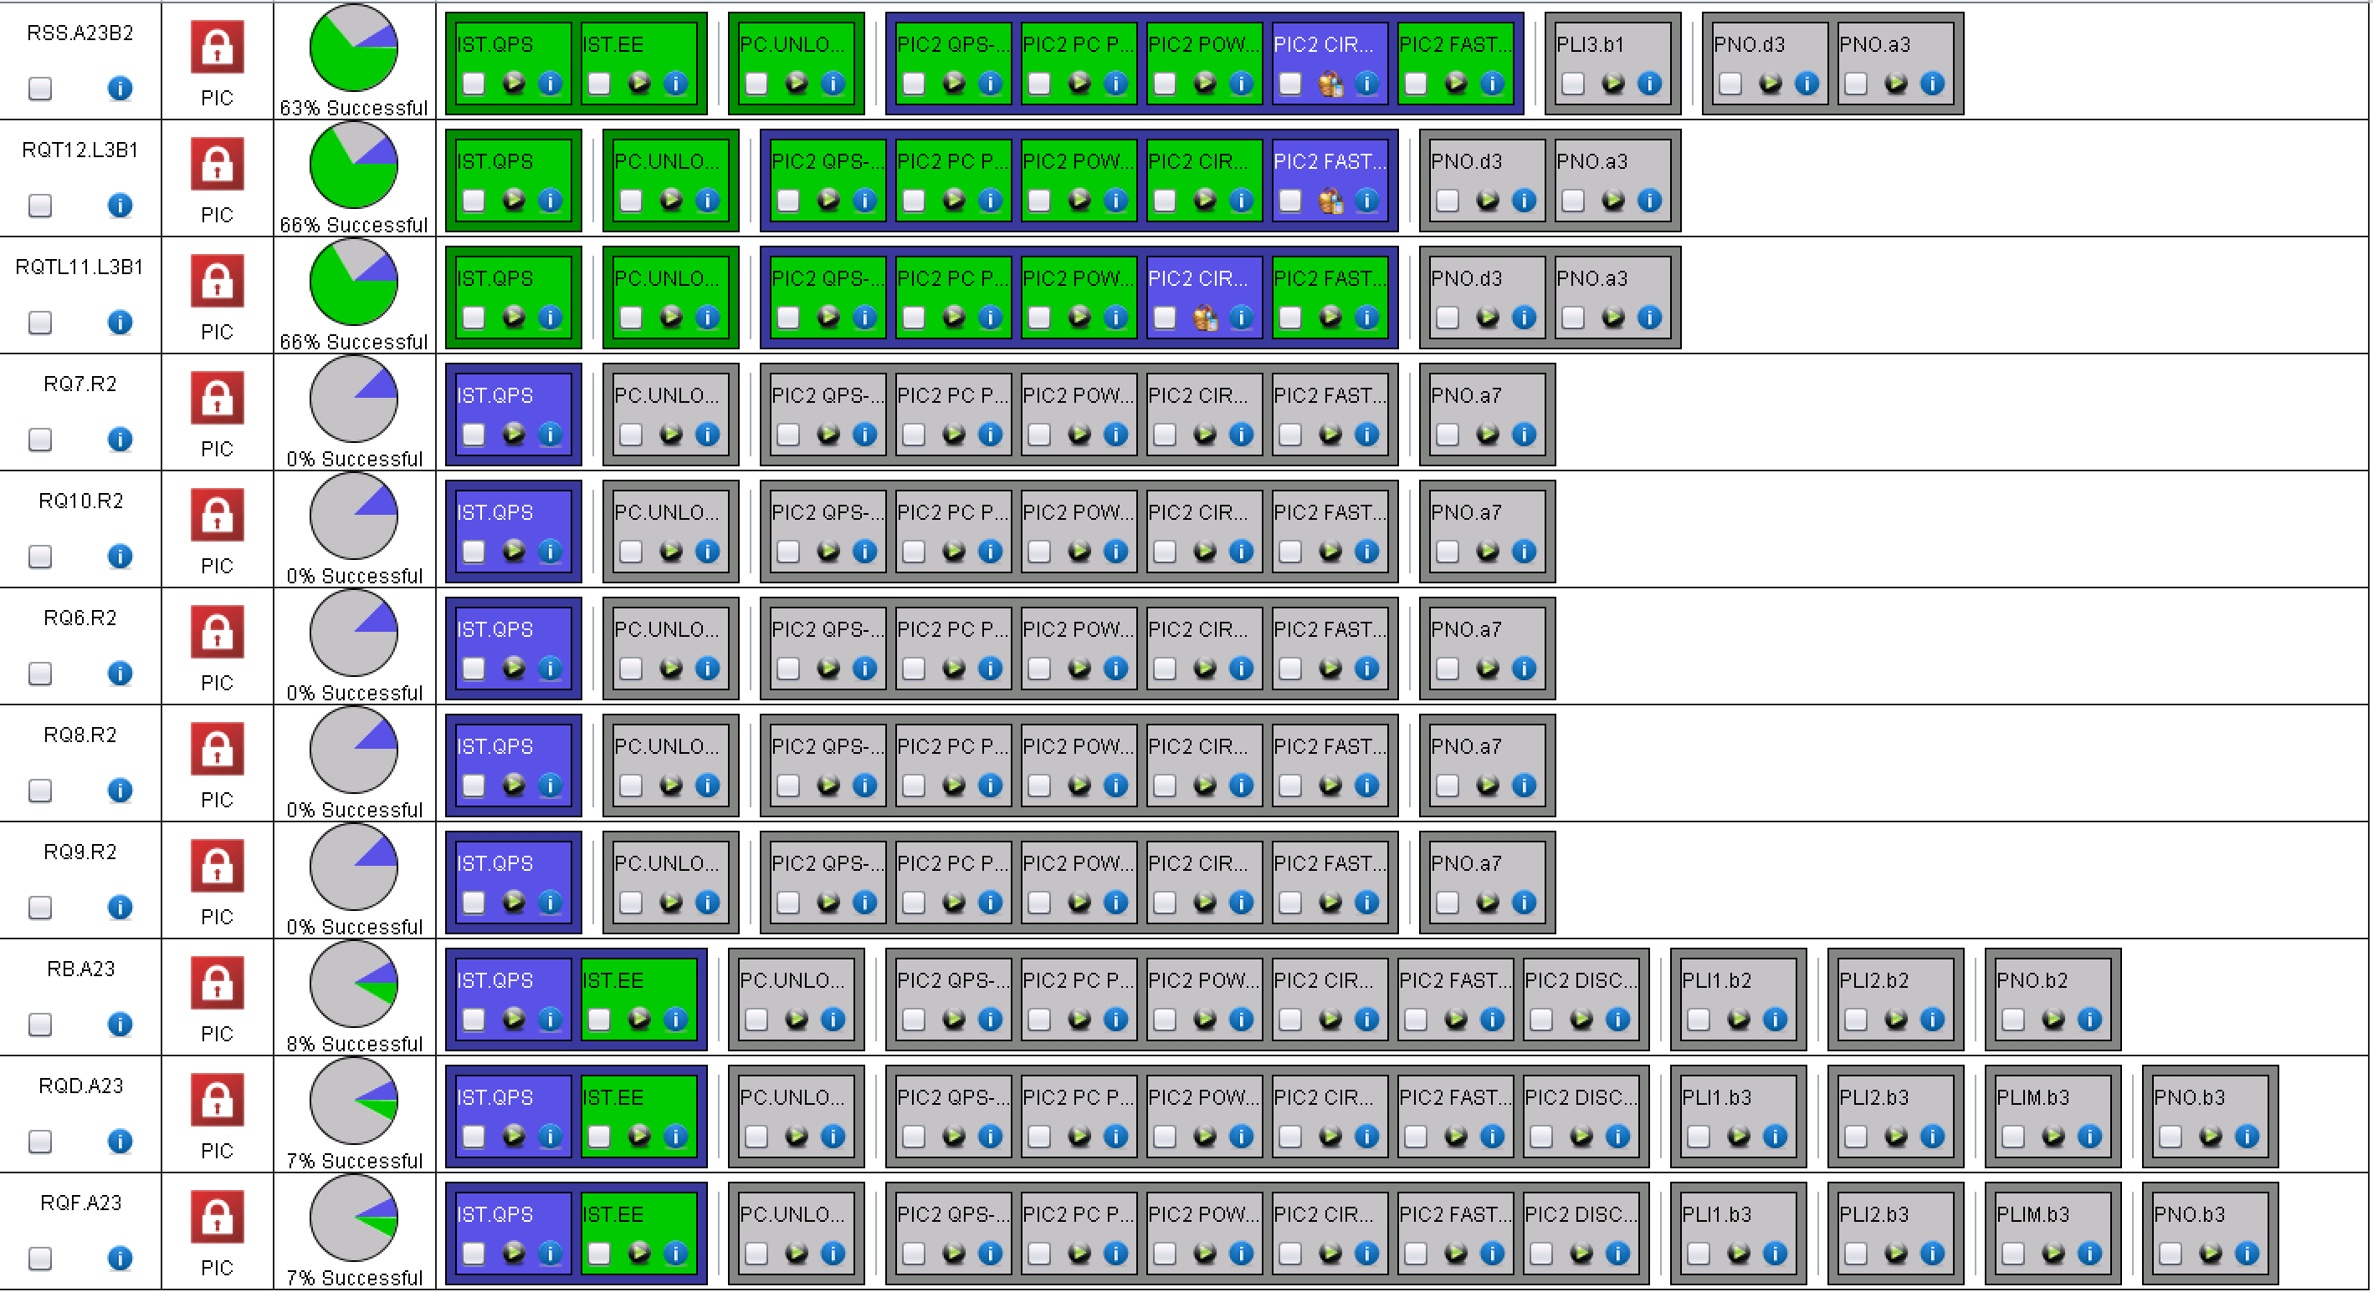
A23
Still many circuits to release, but already done a lot
60 A completed, 120 A completed, 600 A well advanced
PIC +MPP
PIC
PIC +MPP

Slide 10
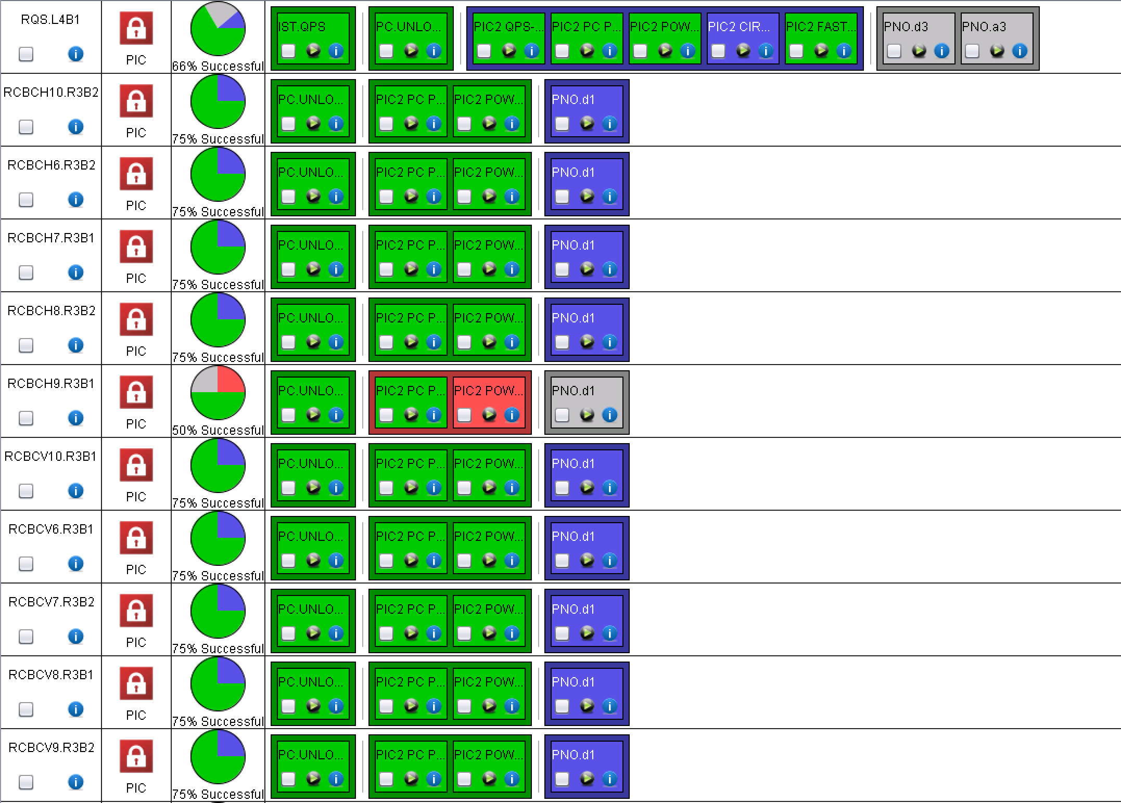
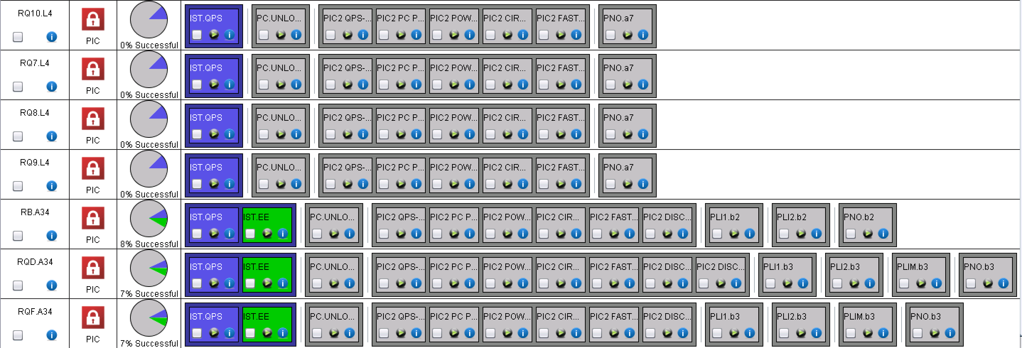
A34
60 A are completed, 600 A almost completed
MP3 to sign

Slide 11
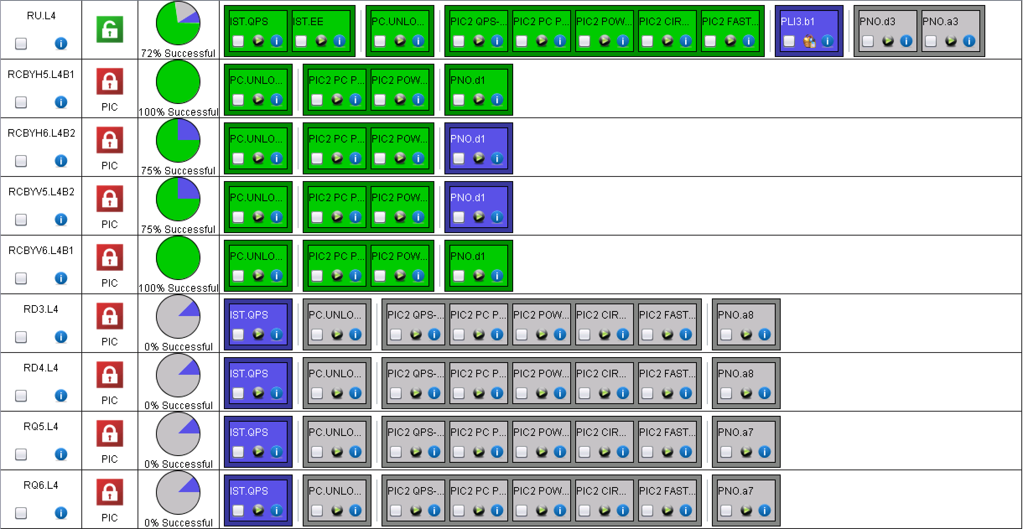
ML4
Undulators: problem with PM
EPC and MP3
EPC and MP3

Slide 12
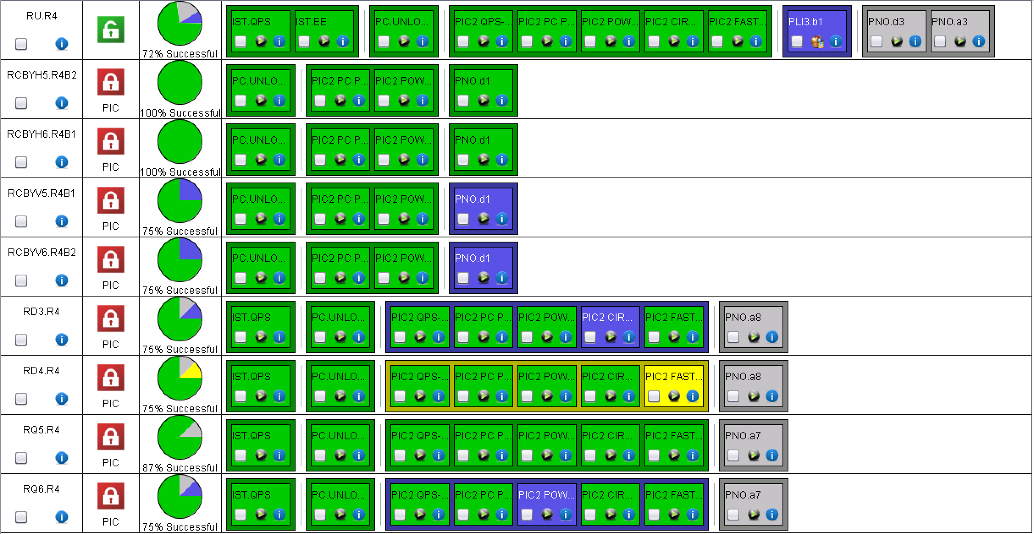
MR4
Phase 1 almost completed
RU.R4: problem with QPS PM; repeated with QPS board fixed and it worked
EPC+MP3
EPC+MP3
PIC
PIC

Slide 13
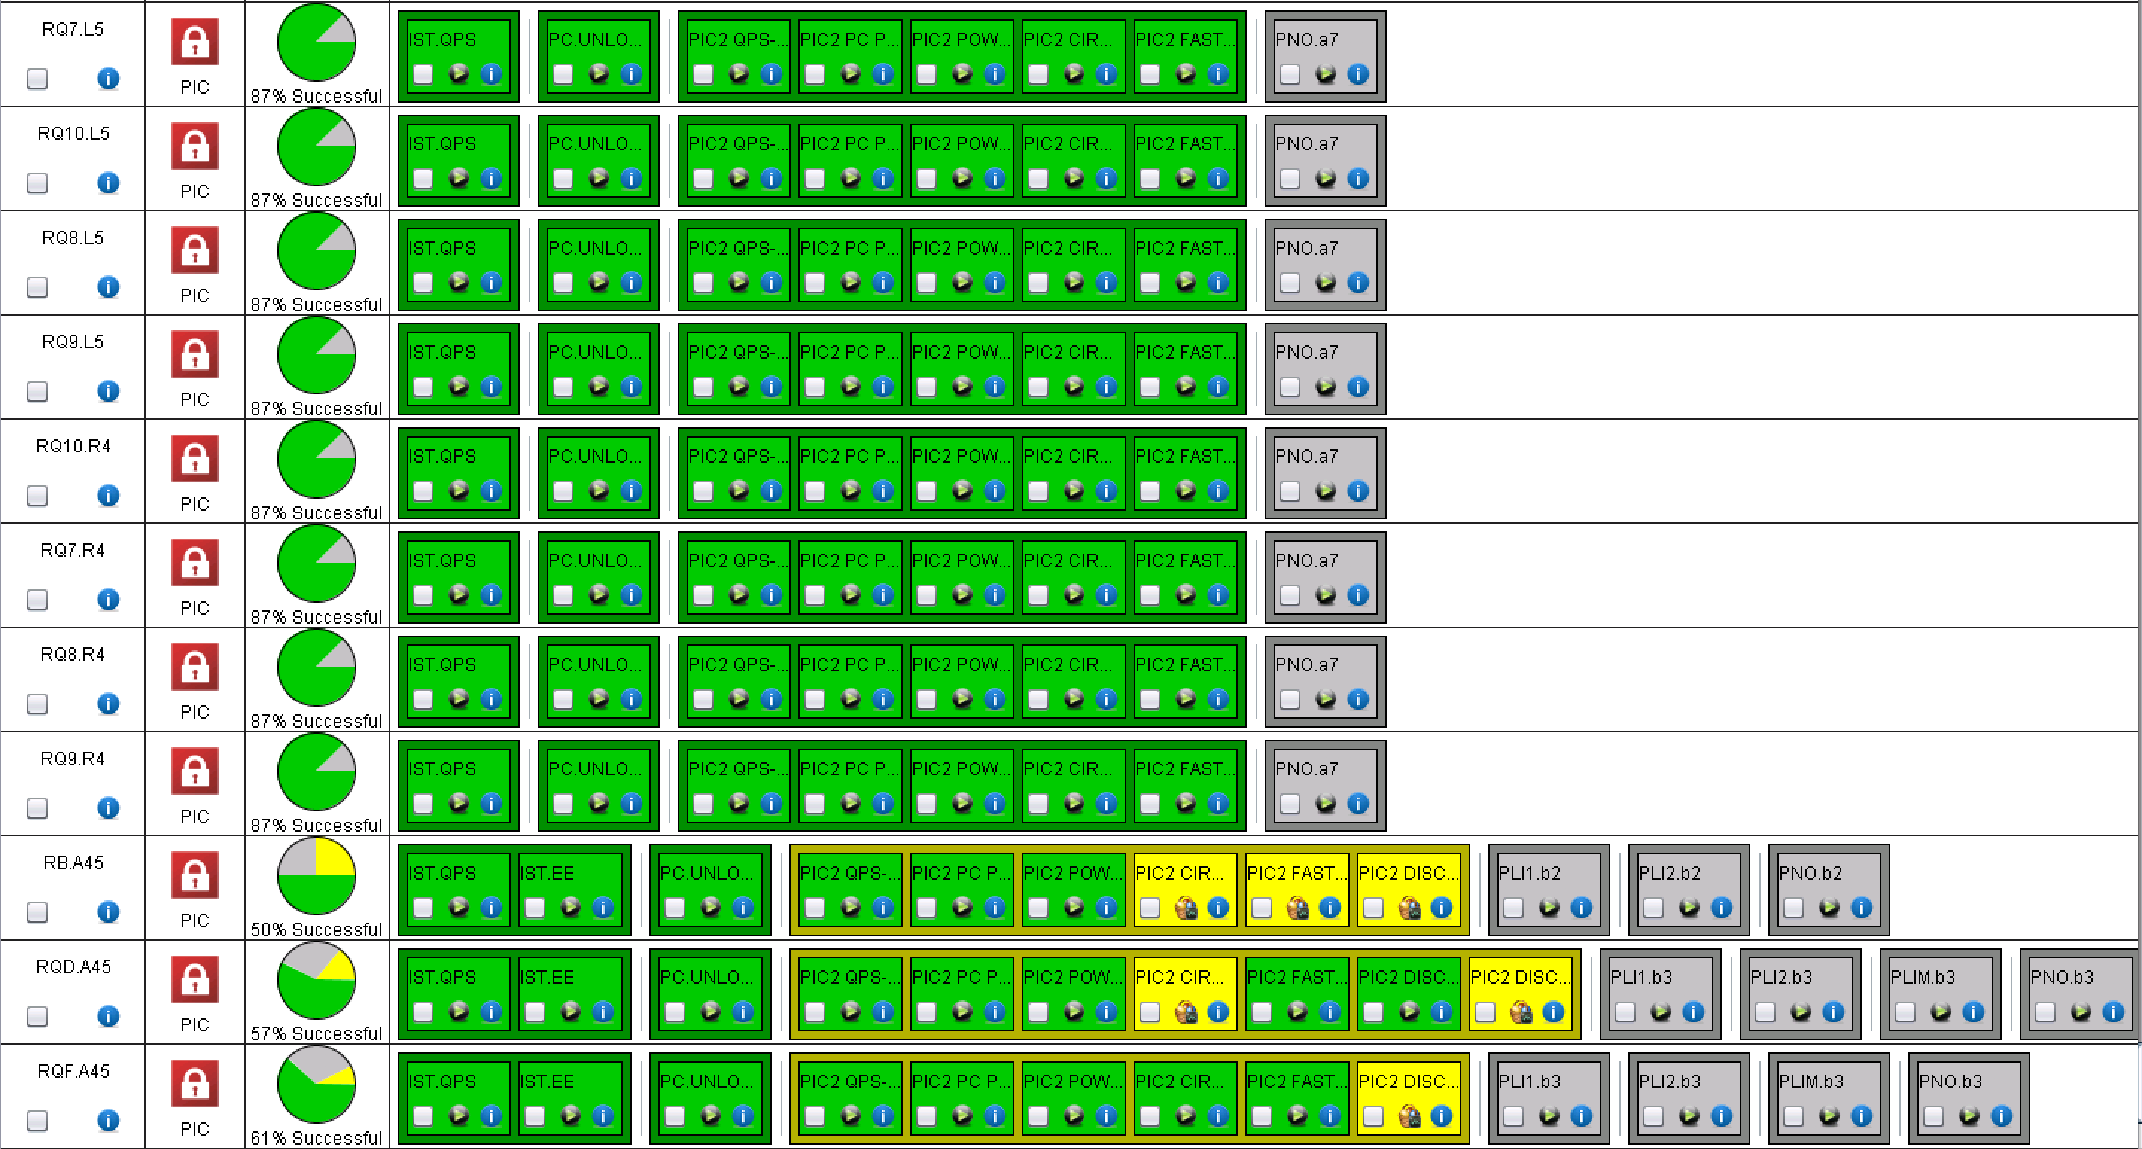
A45
Phase 1 almost completed
60 A and 120 A completed
600 A: last test missing for many

Slide 14
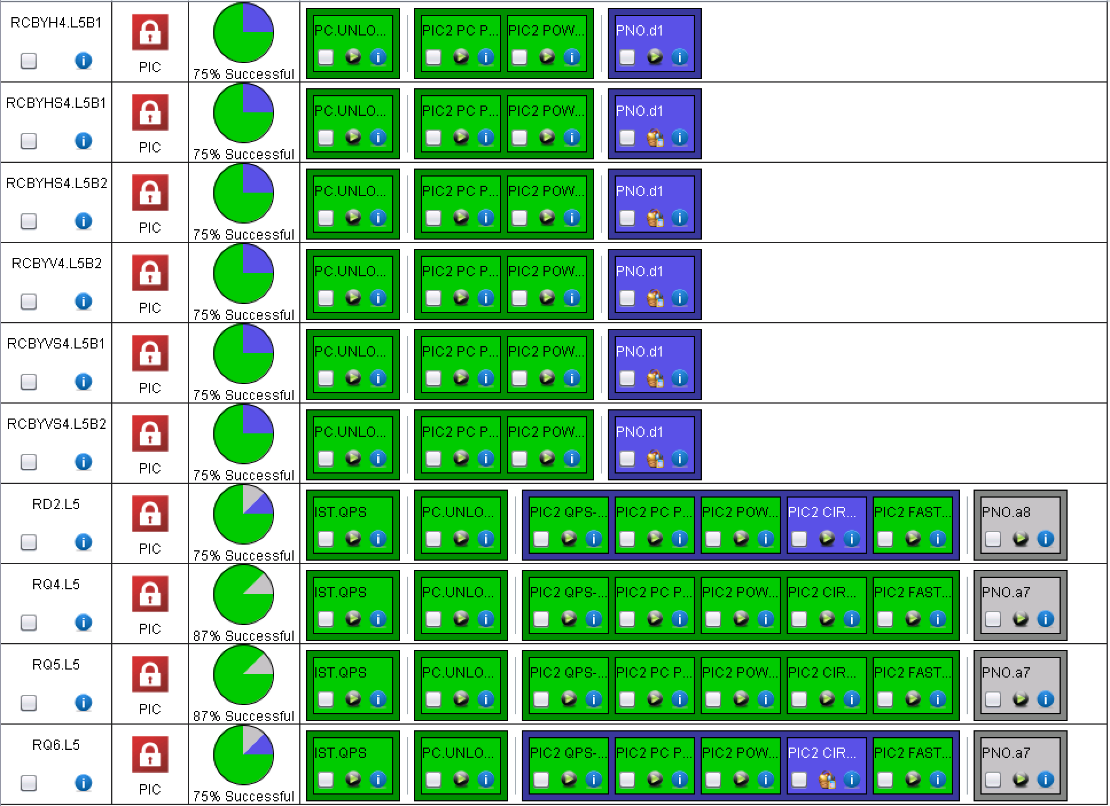
LL5
EPC+MP3
PIC
PIC

Slide 15
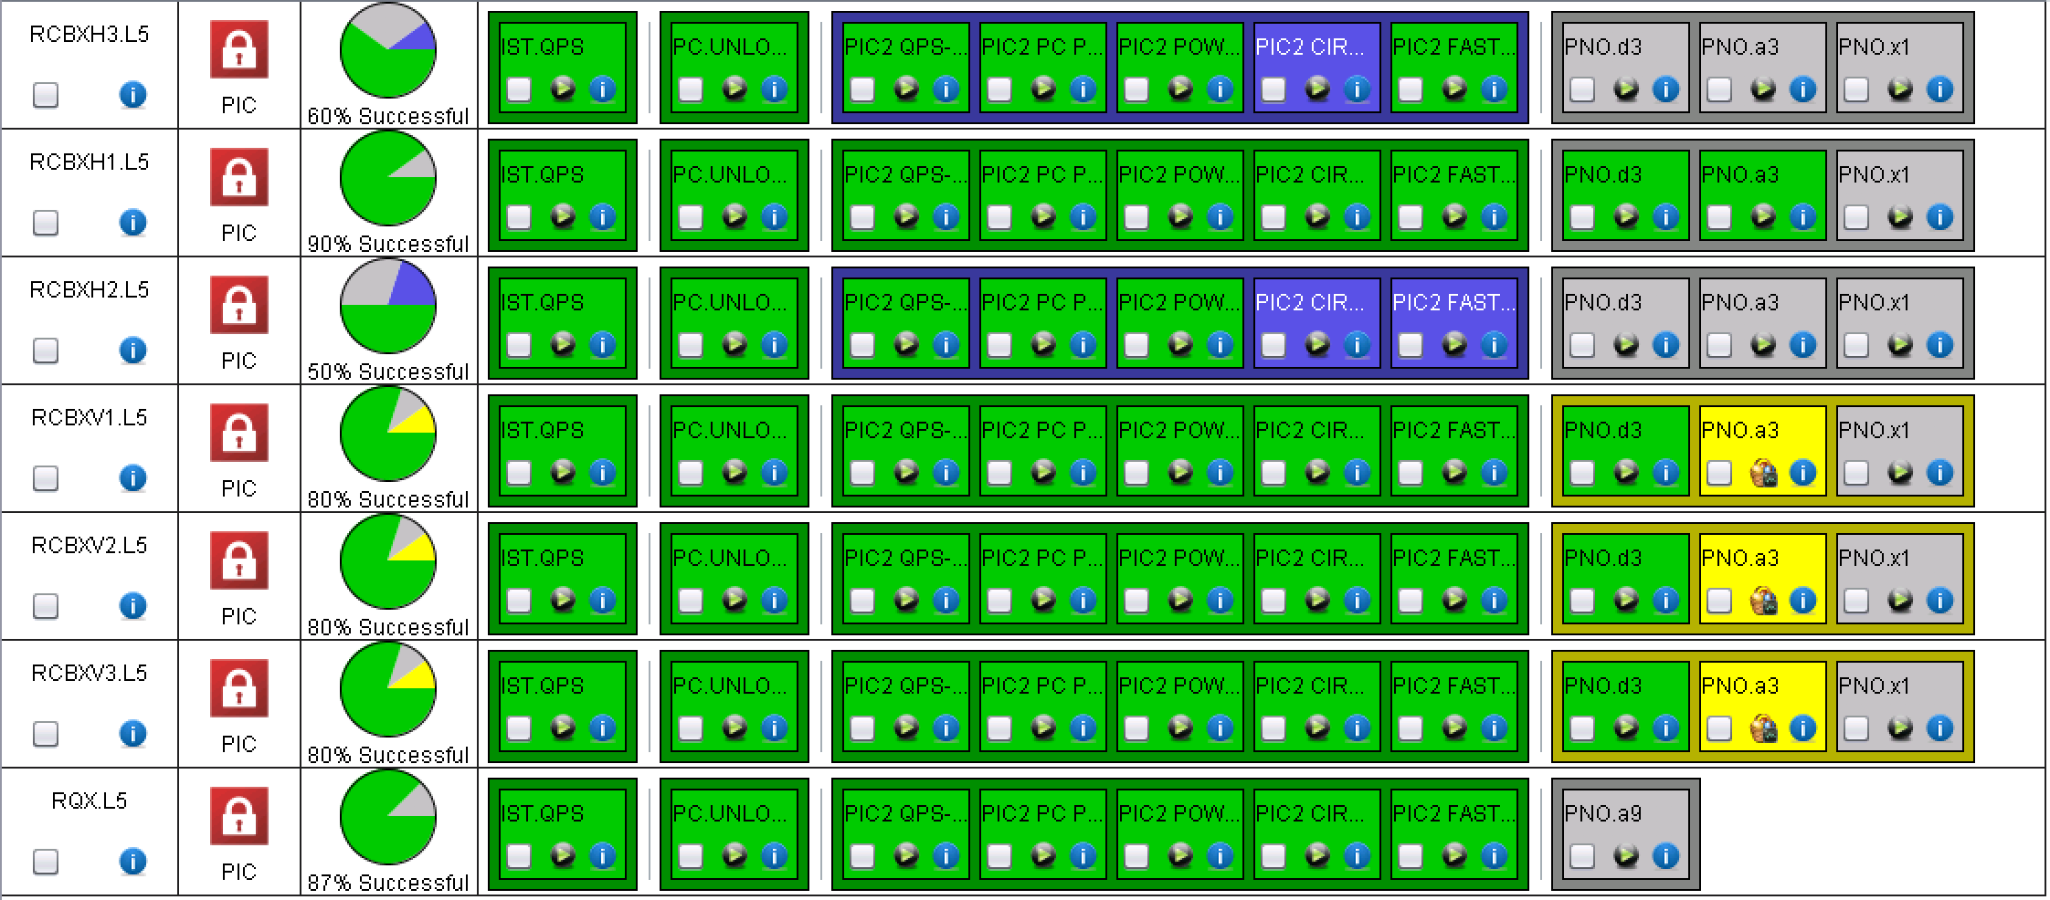
XL5
PIC+MP3
PIC+MP3

Slide 16
For the future…

Slide 17
Cooling water calibration campaign
CV requested to carry on a verification campaign on all sectors.
  RB.A45 is presently on water fault (RQD/F. A45 fixed)
  Plan to be agreed
In addition, a check will be done per sector, by stopping the pumps feeding the entire sector once all circuits are un-locked

Slide 18
LHC main converter calibration
I would like to ask you to foresee a window of about half a day during hardware commissioning for the calibration of all the LHC main dipole and quadrupole and inner triplet converters.
This can also be done per sector in which case I would require about ½ hour per sector.
This is done by me remotely in coordination with the engineer in charge. It requires the converters to be unlock and OFF, with all faults cleared.
The calibration simulates a current of 13kA in the converter so any interlocks that might trip the converter at that current need to be masked. I will let you evaluate when is the best moment to do it, minimizing the impact on commissioning.
Miguel
To be organized possibly at the end of next week!

Slide 19
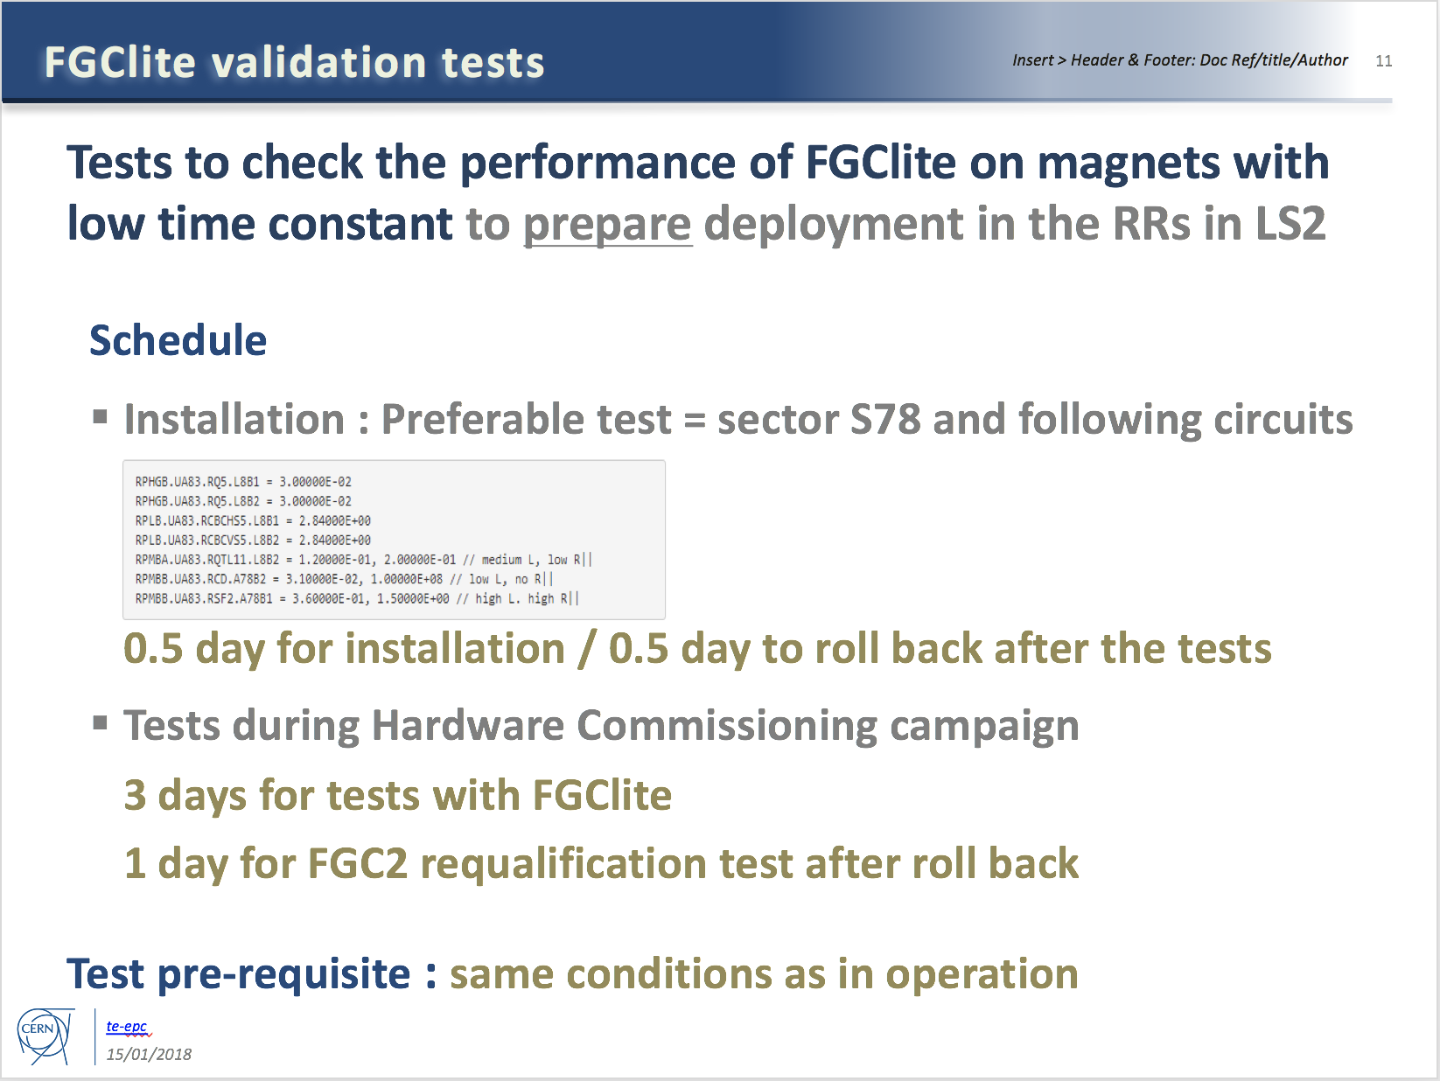
Additional tests required by EPC
To be done after circuit commissioning (if time allows)

Slide 20
Specific Powering Tests – High Priority
# | Description | Test duration * | Period | Cryo
1 | Local (30 m) localisation of shorts in RCS.A78B2, RCO.A78B1, RCO.A78B2 | 2 days | End of the powering tests. | 1.9 K
2 | Global (400 m) localisation of short in RCO.A45B1 | 1 day | Start YETS (DONE) | 1.9 K
3 | Change in EE delay of RB circuits | 0.5 day | During powering tests | 1.9 K
4a | Voltage pick-up of the QPS due to current in the bypass diode | 2 days | Anytime during YETS | <20 K
4b | Heater-induced quench on 2 MB’s | 0.5 day | Start YETS (DONE) | 1.9 K
5 | Quench heaters test in S12 | 0.5 day | End of YETS, during the QPS IST | 1.9 K
6 | Resistance in RQF.A23 and RQD.A78 | 1 day | End of powering tests | 1.9 K
Installation being finalized
Remember to do the 500 V and 900 V tests while switching on
*: not including the time for installation & removal of equipment

Slide 21
Specific Powering Tests – Medium Priority
# | Description | Test duration * | Period | Cryo
7 | Change in EE delay of RQD/F circuits | 0.5 day | During powering tests | 1.9 K
8 | Resistance in ROD.A56B1 | 1 day | Start of YETS (DONE) | 1.9 K
9 | Internal resistance of 3-6 MB’s | 1 day | Start of YETS or during powering tests | 1.9 K
10 | Investigate degradation of RCBXH/V in IR1/5 | 0.5 day | Start of YETS (DONE) | 1.9 K
System installed in S34
Results of investigations priori to YETS:
Short could not be reproduced in RCO.A45B1 (only few 100kOhms occasionally visible)
2 heater induced quenches performed in S45
Location of increased resistance in ROD identified, segment in question to be bypassed in LS2
None of the 12 RCBXH/V circuits showed any visible degradation after having been cycled many times and after having seen quite a bit of radiation. Final conclusions will be made after the powering test in March 2018.
*: not including the time for installation & removal of equipment

Slide 22
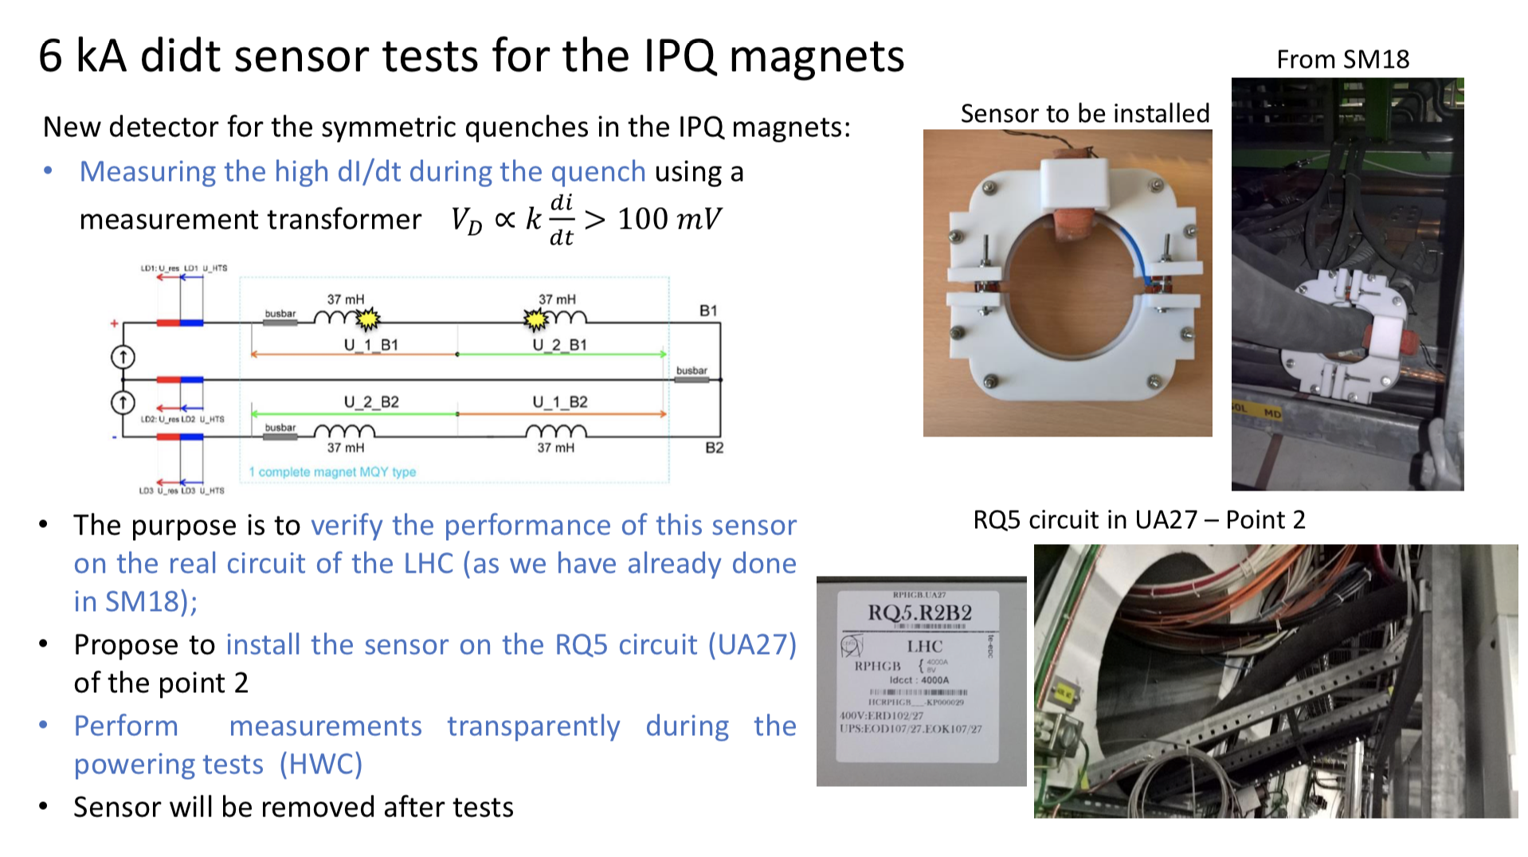
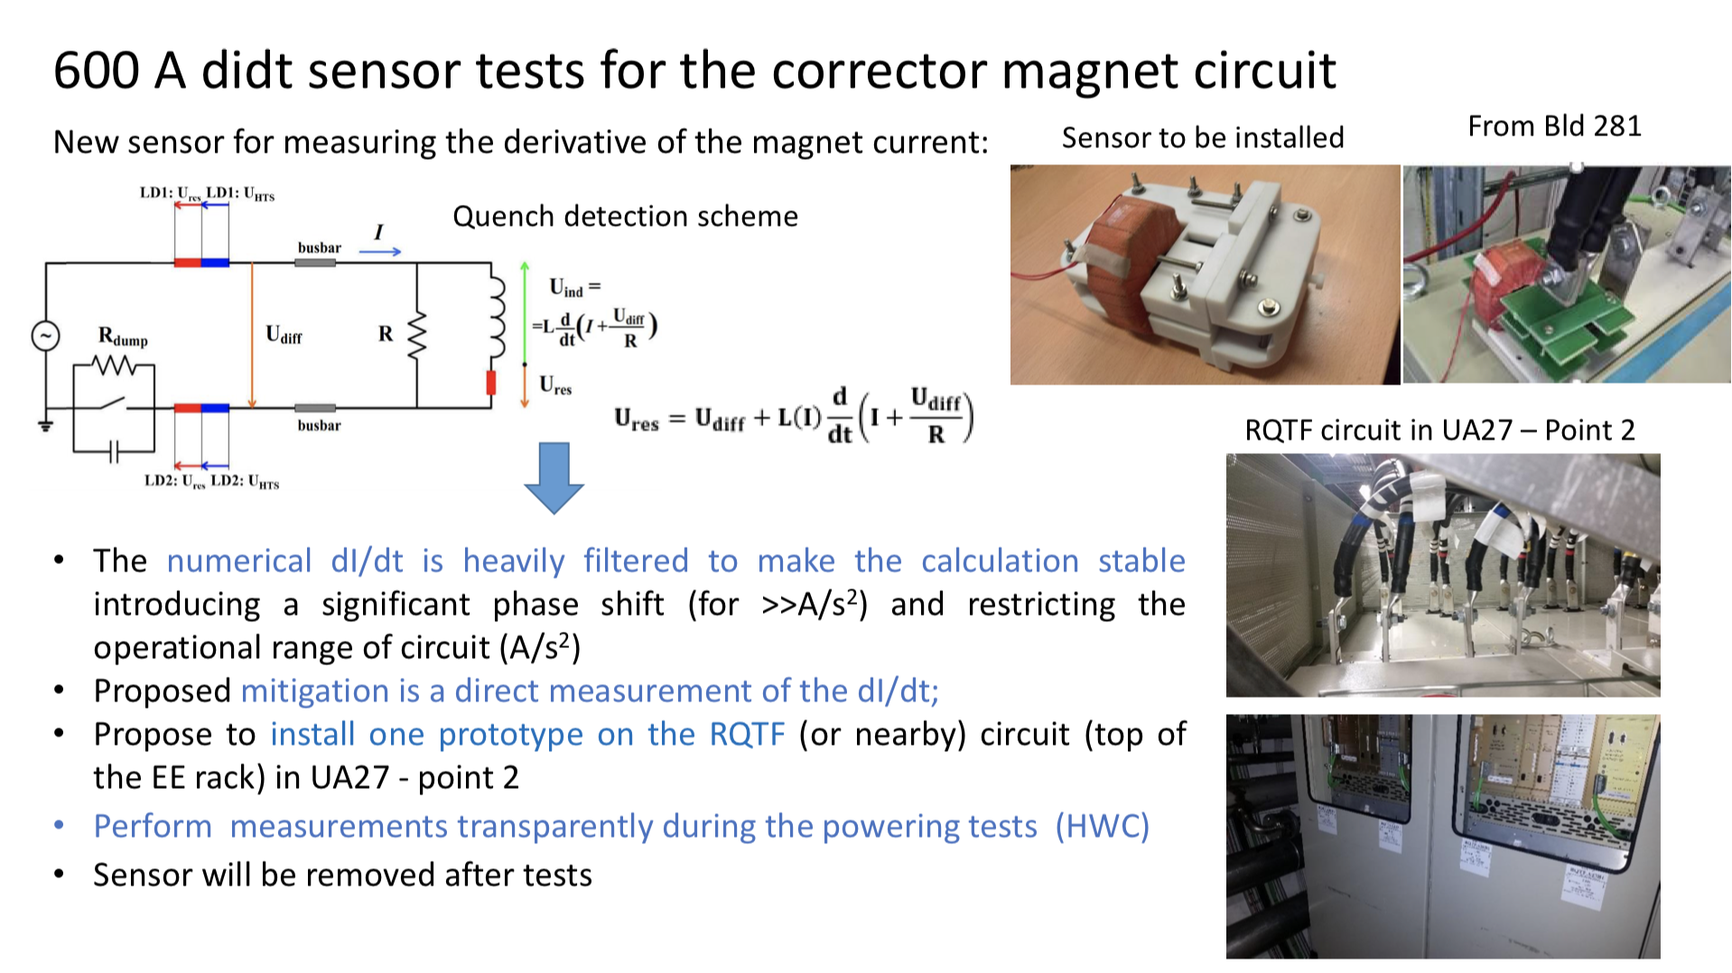
Powering at high current for RQ5.R2 and RQTF.A23B1 should be done only after informing Ernesto de Matteis

Slide 23
Conical connection check in UA27
Following the problem with the conical connection after LS1, MPE would like to repeat the conical connection measurements in UA27
  System installed before end of YETS
  Measurements parasitically done
  System to be removed at the end of commissioning (condemnation required)

Slide 24
Warm magnets test
Tests under the responsibility of P. Schwarz (MSC) and H. Thiesen
OP support to power the circuits
All circuits were checked for water faults
The problem with the failing converters of Monday has been identified: in the LSA database there was no value defined for the acceleration of the 4 RPADO converters! Now fixed
Another problem was identified: many circuits were in simulation, together with many circuits in different sectors!
The affected circuits have been tested over night without any issue

Slide 25
Thank you for the attention!

