Slide 1
Impact of low-x resummation on QCD analysis of HERA data
xFitter developer’s team
A M Cooper-Sarkar
arXIV:1802.00064
Low-x resummation:
Improves the description of HERA data at low-x, low-Q2, high-y, without need for further parameters (as for example when adding higher twist terms)
Results in a rising low-x gluon, which is always larger than the total Sea

Slide 2
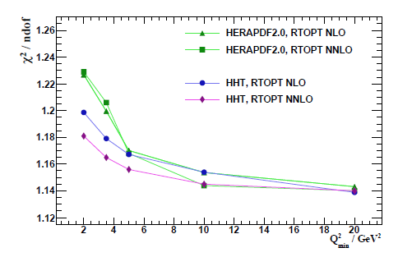
The χ2/ndf of the HERAPDF2.0 NLO and NNLO fits deteriorate as the minimum value of Q² for data entering the fit is lowered
One way to improve this is to add higher twist terms - HHT analysis 1604.02299
But low Q2 is also low x and we have long suspected that the low-x region could require BFKL– ln(1/x) resummation. This does not require any extra parameters to fit the data (as higher twist does). It requires extending the DGLAP formalism to include ln(1/x) resummation. The tool to do this is the HELL code (Bonvini et al)

Slide 3
HELL has been implemented in xFitter
1. Here we explore consequences for a HERAPDF style fit
HELL implements resummation corrections to the fixed order splitting functions and coefficient functions up to NLL accuracy in ln(1/x), denoted as NLLx. The fixed order quantities are calculated by APFEL within the FONLL variable flavour number scheme.
2.Thus we must use FONLL for the HERAPDF fit
4. The computation of ln(1/x) resummation is unreliable at low scales due to the large value of α_{S} thus the starting scale is raised to Q²₀=2.56GeV² rather than the usual HERAPDF value of Q²₀=1.9GeV².
3. Consequently the charm quark threshold, μ_{c}, must be displaced above Q₀ while keeping the charm mass, m_{c}, fixed. (see 1707.05343)
5. Finally NLLx resummation can be applied

Slide 4
2.The increase in χ2 for FONLLC is well known and relates to the treatment of FL; terms up to are included for RTOPT, but terms up to are included for FONLLC. The gluon does not change shape
3. Raising the charm matching scale makes very little difference (see back-up) to χ2 or to gluon shape
4. Raising the initial scale has no effect on χ2, but does marginally change the shape of the gluon—this is a model variation which will be accounted for
5. The χ2 for the NNLO fit improves dramatically at the final step
The shape of the gluon is also changed dramatically from flattening/turning over at low-x to singular at low-x

Slide 5
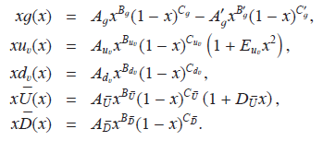
Further considerations:
Since we have change the heavy quark scheme the charm and beauty masses used may not be optimal for the new scheme. Thus charm and beauty data from HERA are included in the fit and charm and beauty mass scans are performed to determine new values m_{c}=1.46 and m_{b}=4.5GeV. Only m_{c} differs from that of the HERAPDF and the charm threshold is move to μ_{c}=1.64 correspondingly.
We include these heavy flavour data in the fits from now on since they are potentially sensitive to low x resummation.
Since we have a very different shape of the gluon PDF a parametrisation scan is performed at NNLO+NLLx to determine if the HERAPDF parametrisation is adequate. The form of the parametrisation is confirmed, however the negative term in the gluon is now small ~3σ from zero. In fact this is also the case for the NNLO fit due to the raised starting scale Q²₀=2.56GeV²
Nevertheless the resulting gluon shapes for NNLO and NNLO+NLLx are very different.
The form of the common parametrisation used for both NNLO and NLLO+NLLx is

Slide 6
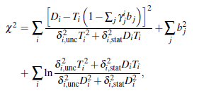
After these adjustments – and adding PDF uncertainties we have
A decrease in χ2 of 74 using ln(1/x) resummation
Largely due to the NC e+p 920 data
But also less need for shifts of systematic uncertainties

Slide 7

What is included in PDF uncertainties?
Experimental uncertainties for sure, but also model and parametrisation uncertainties according to the usual HERAPDF procedure
Δm_{c} = ± 0.05, Δm_{b} = 0.25, Δα_{s} = 0.001 around 0.118
Q²₀ = 2.88 rather than 2.56 GeV²
Q²_{min}= 2.5,5.0 rather than 3.5 GeV²
The largest difference comes from changing the Q²_{min} to 5 GeV²
Parametrisation uncertainties are evaluate by adding extra terms D,E,F to the polynomials
which describe
the PDFs
This can give different shapes to the PDFs even when the χ2 of the fit is barely different. The largest difference comes from a D_{uv} term.
Clearly since the data used in the NNLO and NNLO+NLLx fits are the same the uncertainties on the fits are highly correlated. Thus to evaluate the real difference in the gluon shapes we must account for correlations.
Uncertainties are evaluated by MC replicas of the data using the same random number sequence for both fits to evaluate the spread of the synchronised differences- and this is shown above as xΔg(x,Q²)

Slide 8
NNPDF: arXiv:1710.05935, see similar trends in the gluon shape and improvements in χ2
However because the treatment of charm in NNPDF is different—fitted charm, rather than perturbative charm– we show several variants of their analysis in order to aid comparison, with our work
NOTE how all gluons are more consistent after ln(1/x) resummation is included

Slide 9
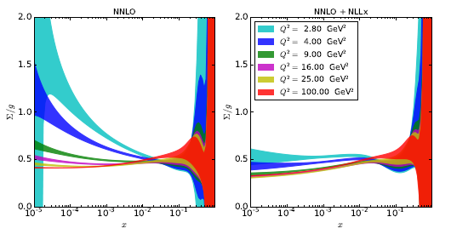
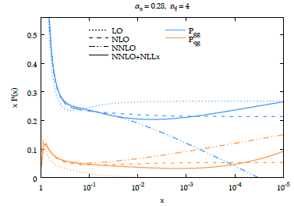
Further study of the shapes of the gluon and the sea
In fixed order fits at NNLO the gluon dips below the sea at low-x as Q² is reduced.
This is a general feature of NNLO fits- not just of HERAPDF.
These plots show the ratio of total sea Σ to gluon vs x for various Q2 for NNLO and NNLO+NLLx fits.
The ratio is much more stable with Low x resummation
This arises from the behaviour of the P_{qg} and P_{gg} splitting functions.
At NNLO
Whereas for NNLO+NLLx

Slide 10
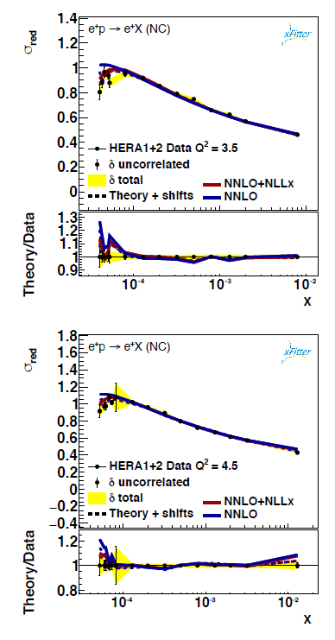

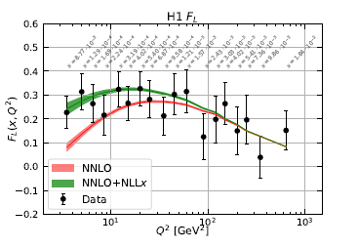
Comparison to data
Comparison to data in the lowest Q² bins shows that the fit with low x resummation is much better able to follow the turn over of the data that happens at low-x, low Q², high-y due to the F_{L} term in the reduced cross section
Looking at H1 F_{L} data directly shows that FL is larger at low Q²/x for the NLLx fit
Theory +shifts means shifts due to experimental systematics- the term Σγb in the χ2

Slide 11
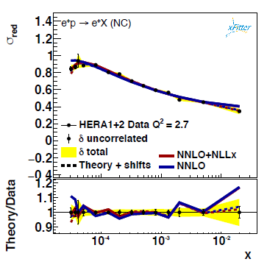
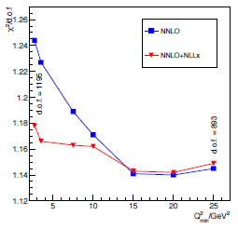
We also extend below the usual low Q2 cut –off for the data, down to Q2=2.7GeV2.
The NNLO+NLLx fit including these data gives very similar PDFs to the standard fit
To dileneate the kinematic region for which NLLX resummation improves the fits we perform a χ2 scan in Q²_{min} for NNLO and NNLO+NLLx fits
This shows an improvement at low Q², Q²_{min} < 15 GeV²

Slide 12
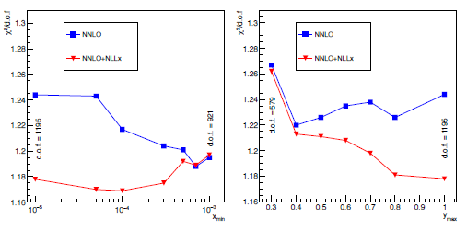
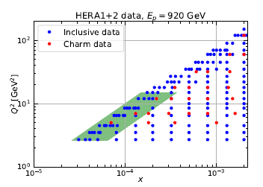
We also scan vs x_{min} seeing improvement for x_{min} < 5.10 ⁻⁴
And against y^{max} seeing improvement for y_{max}>0.4
This emphasizes the importance of low x resummation at high-y for the DIS data because of the role of the
FL term
The scans shown here were done refitting the PDFs at each step—thus they dileneate a region where the fixed order calculation is poor –even with refitting –as illustrated on the x, Q² plane here.

Slide 13
Summary
Low-x resummation:
Improves the description of HERA data at low-x, low-Q2, high-y, without need for further parameters (as for example when adding higher twist terms)
Results in a rising low-x gluon, which is always larger than the total Sea

Slide 14
Back-up

Slide 15
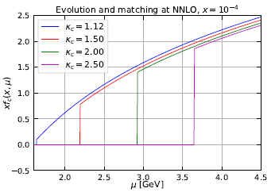
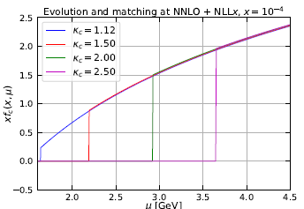

Technical aside on charm matching scale
The slight change in shape of the gluon when the charm threshold is displaced is partly due to the PDF matching conditions . Moving up the charm threshold using fixed order NNLO depresses the charm PDF at larger scales. Since charm is generated by gluon splitting this requires a slightly larger gluon to compensate. However PDF matching conditions are also affected by logs of 1/x, which are resummed in HELL such that the spread cause by matching is significantly reduced for NNLO+NLLx.

Slide 16
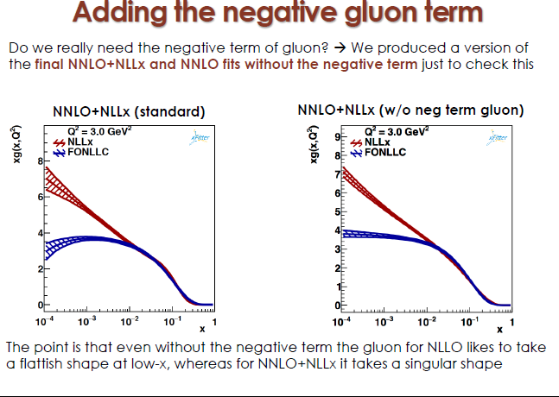

Slide 17
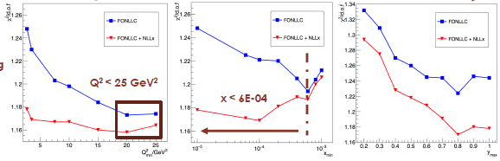
IF we do not refit at every step of the scan but we use the same PDFs as determined for the minimal cuts, we get these results.
The improvement of NLLx is still at low-x and low Q2 but is not so obviously concentrated at high-y. The refitting takes into account the need to fit DIS data for which the effect of F_{lL} is concentrated at high-y

Slide 18
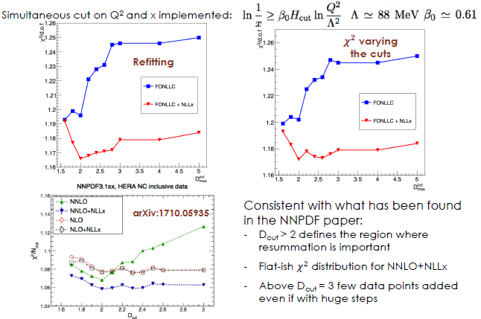
We could also perform a cut jointly in x and Q² which follows the dependence of resummation terms on α_{S}(Q²) ln(1/x) ie on ln(1/x)/ln(Q²)

Slide 19
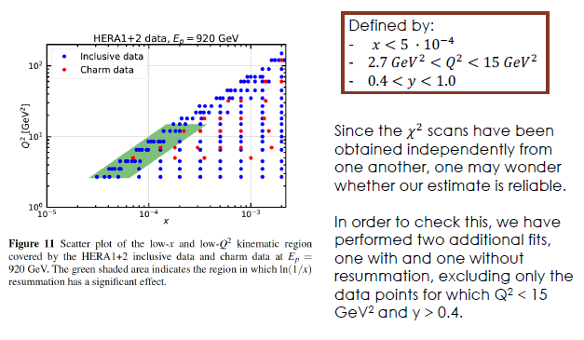
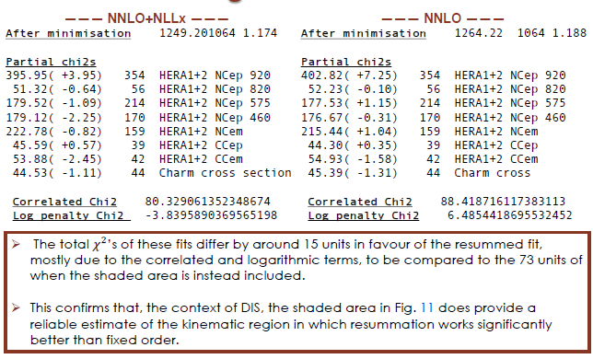

Slide 20
The relevance of this kinematic region to the LHeC is obvious

