Slide 1
General introduction of version 10.4-patch01 and prospects
Makoto Asai
SLAC FPD
April 10th, 2018
@ Geant4 Technical Forum

Slide 2
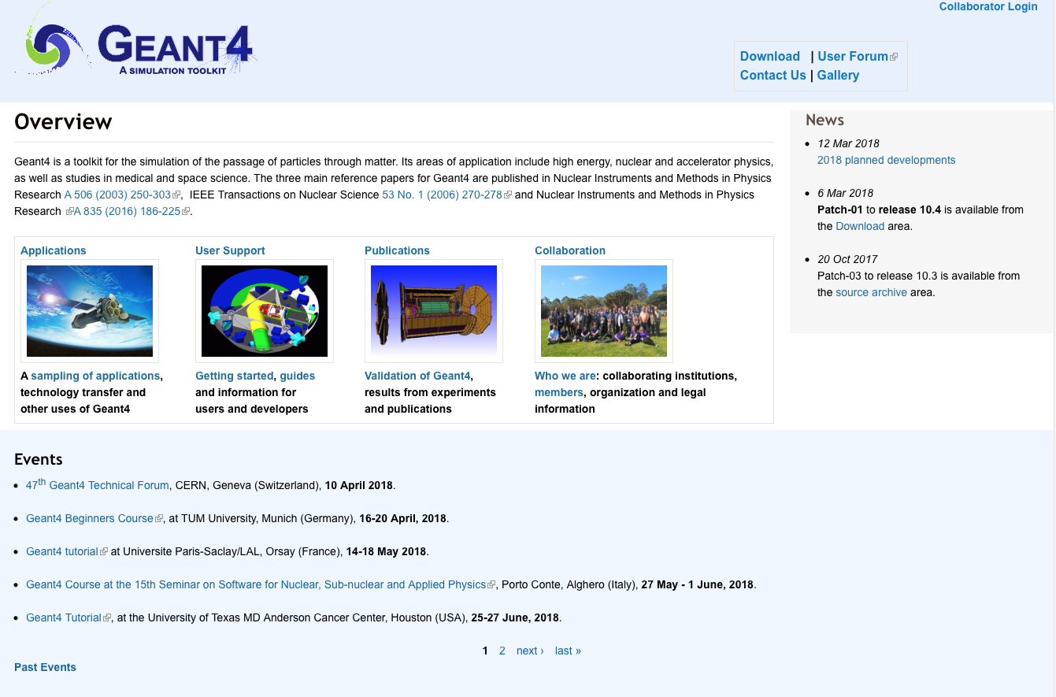
We moved to a new Drupal site
http://geant4.org/ ( http://cern.ch/geant4/ )
We will continue updating/enriching pages.

Slide 3
Releases and events
Recent release
  Mar 6th, 2018 – Geant4 10.4-patch01 release
As announced, 2018 work plan is listed here.
  http://geant4.web.cern.ch/support/planned_features
Coming releases
  Next public release : December 7th, 2018
    Next beta release : June 29th, 2018
  Patch releases for versions 10.4 and 10.3 will be made as needed
Other events
  Several tutorial courses are listed on the event section of the collaboration home page.
  Future tutorials will be announced.

