Slide 1
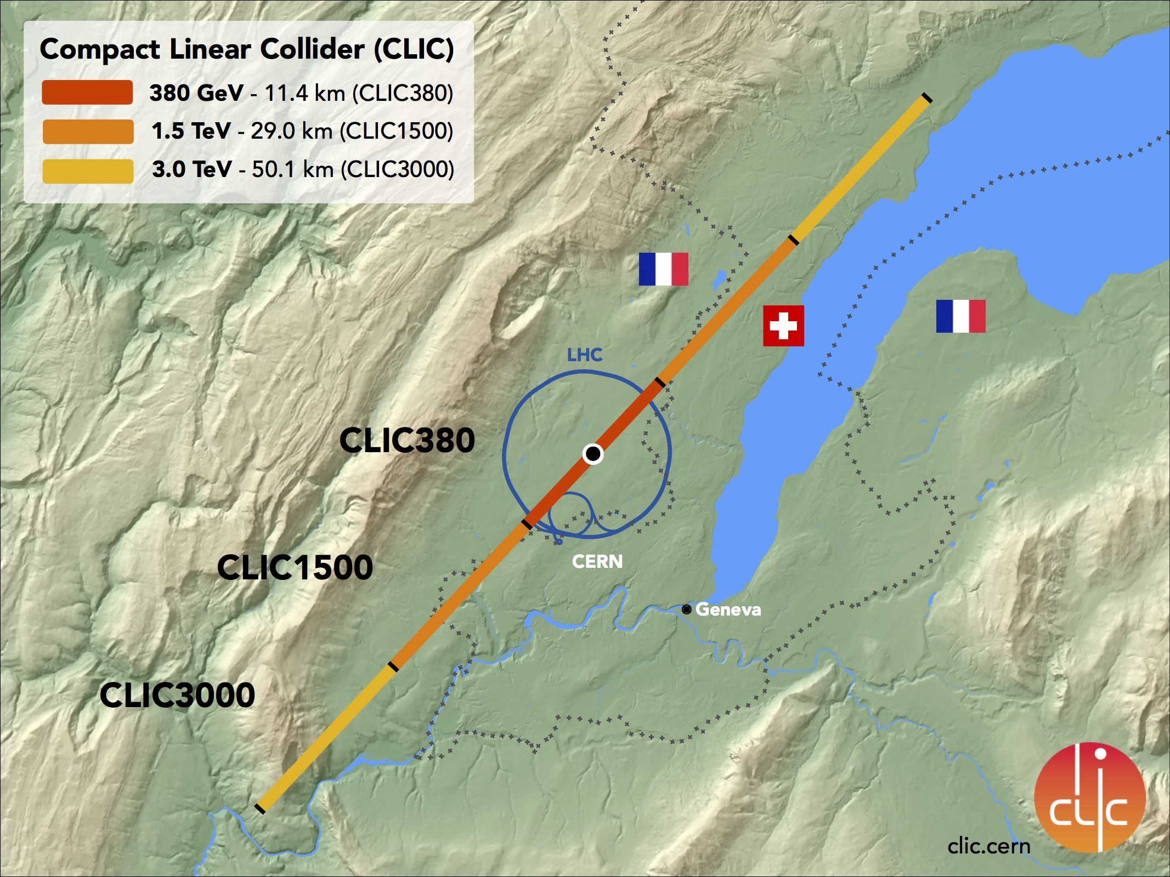
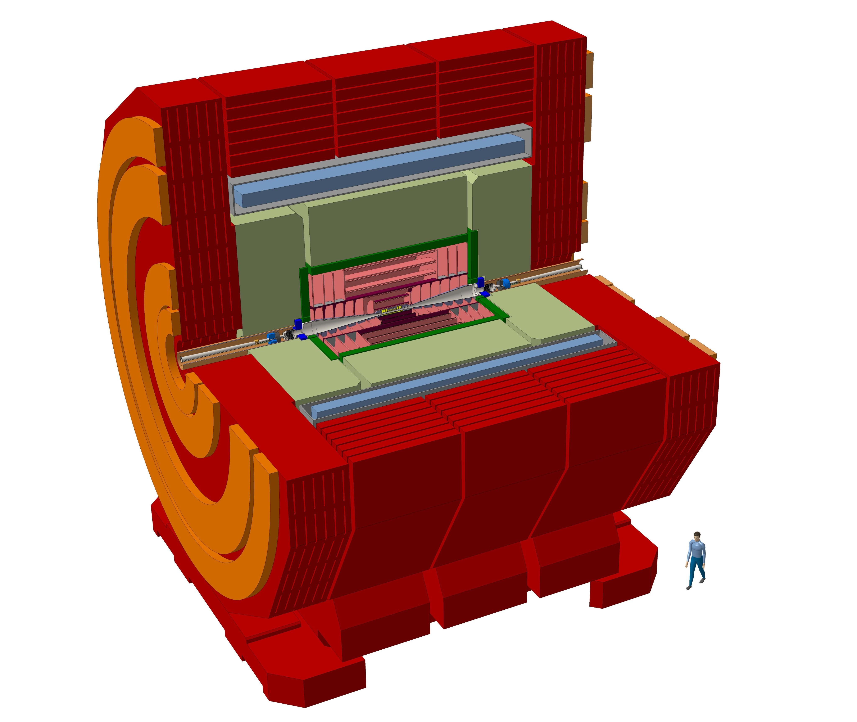
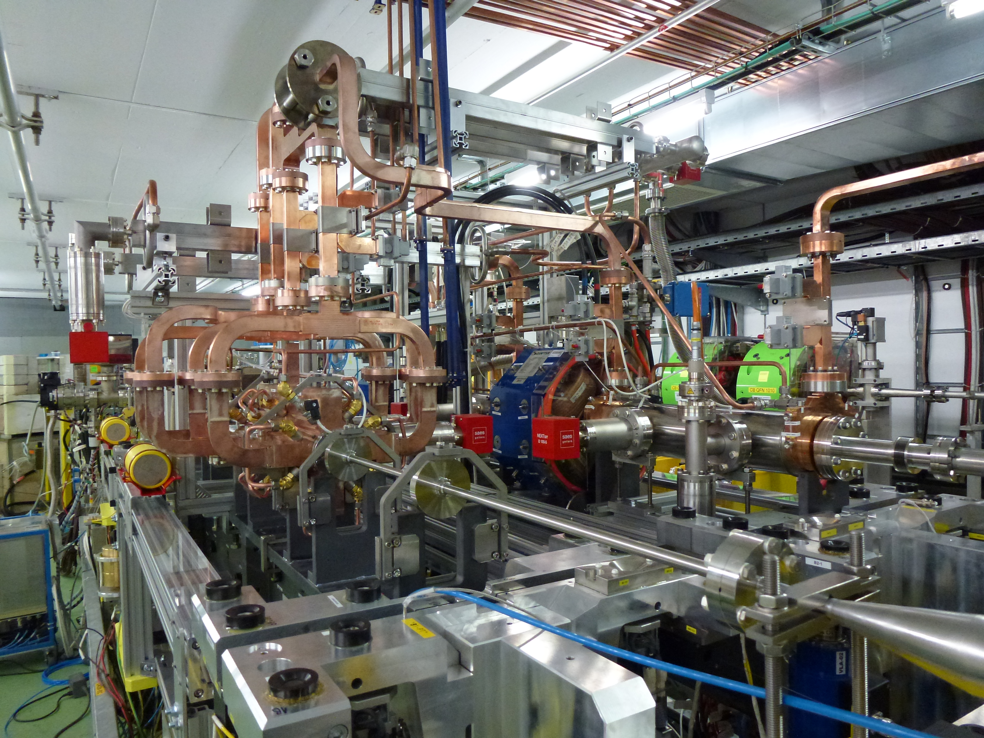
News on the CLIC physics potential
Motivation
Top Physics
Higgs Physics
Future
Nigel Watson
University of Birmingham
on behalf of the
CLICdp Collaboration

Slide 2
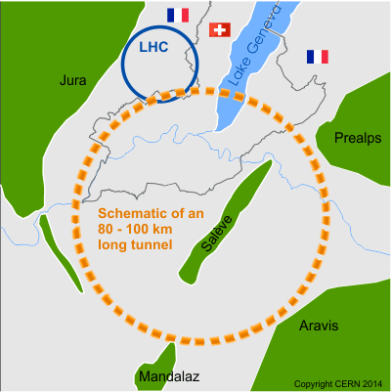
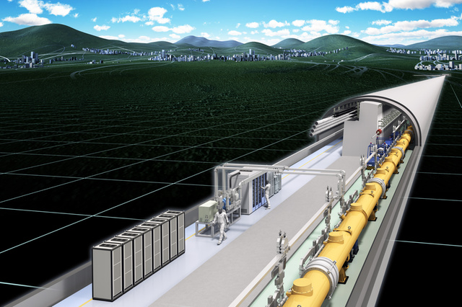
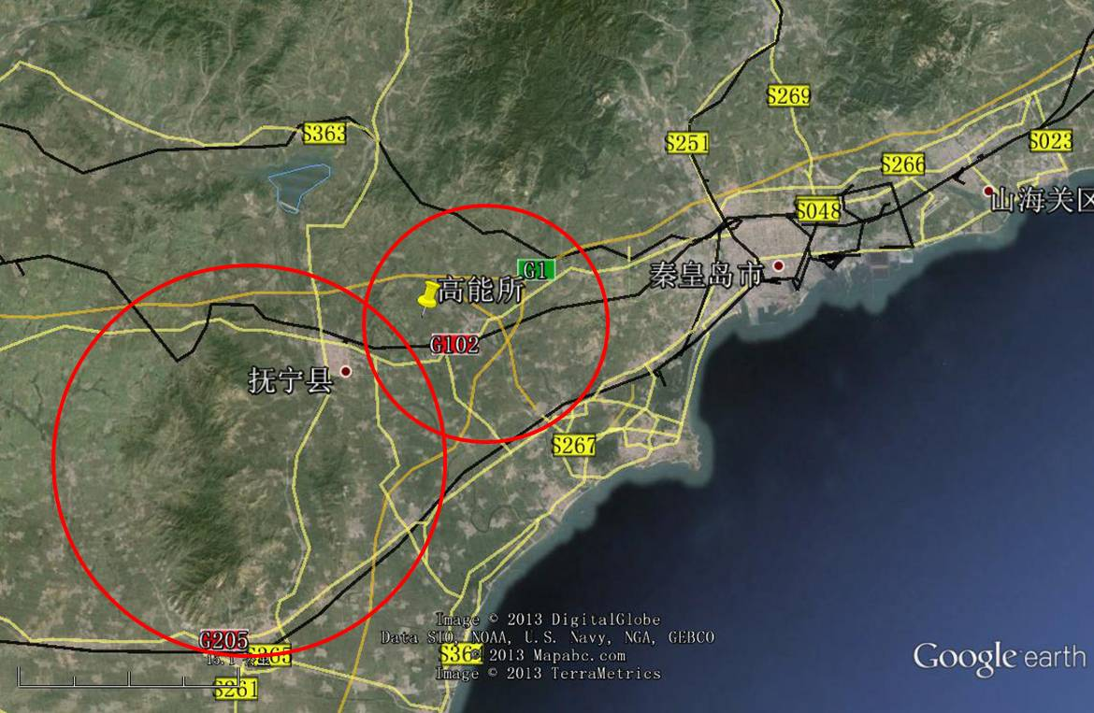
Motivation: why CLIC?
Compact Linear Collider (CLIC):
CERN √s: 380 GeV, 1.5 TeV, 3 TeV
Length: 11 km, 29 km , 50 km
Future Circular Collider (FCC-ee): CERN √s: 90-350 GeV
Circumference: 97.75 km
International Linear Collider (ILC):
Japan (Kitakami) √s: 250 (-500) GeV (+1 TeV)
Length: 17, 31 km (50 km)
Circular Electron Positron Collider (CEPC): China√s: 90-240 GeV
Length: 100 km

Slide 3
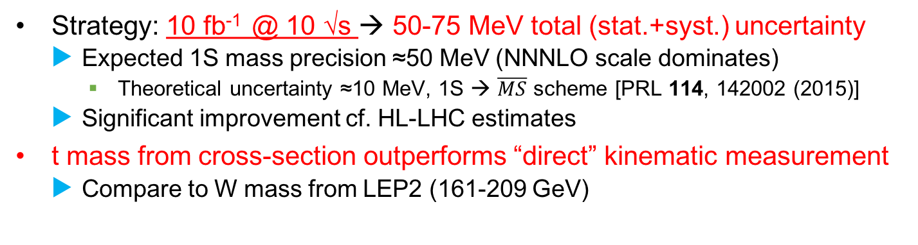
Precise top quark mass
CLICdp work in progress
CLICdp work in progress
Nominal beam parameters
CLIC flexibility:
Dedicated beam
params reduce
beamstrahlung
Strategy: 10 fb⁻¹ @ 10 √s → 50-75 MeV total (stat.+syst.) uncertainty
Expected 1S mass precision ≈50 MeV (NNNLO scale dominates)
Theoretical uncertainty ≈10 MeV, 1S → $\overline{MS}$ scheme [PRL 114, 142002 (2015)]
Significant improvement cf. HL-LHC estimates
t mass from cross-section outperforms “direct” kinematic measurement
Compare to W mass from LEP2 (161-209 GeV)

Slide 4

Precise top quark mass
CLICdp work in progress
CLICdp work in progress
Low charge parameters
CLIC flexibility:
Dedicated beam
params reduce
beamstrahlung
Strategy: 10 fb⁻¹ @ 10 √s → 50-75 MeV total (stat.+syst.) uncertainty
Expected 1S mass precision ≈50 MeV (NNNLO scale dominates)
Theoretical uncertainty ≈10 MeV, 1S → $\overline{MS}$ scheme [PRL 114, 142002 (2015)]
Significant improvement cf. HL-LHC estimates
t mass from cross-section outperforms “direct” kinematic measurement
Compare to W mass from LEP2 (161-209 GeV)

Slide 5
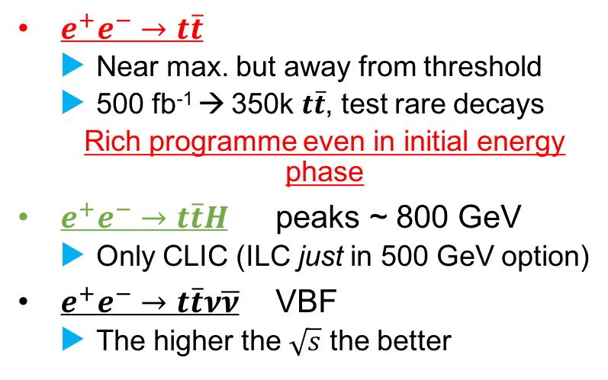

$t\overline{t}$ above threshold
$e^{+}e^{−}→t\overline{t}$
Near max. but away from threshold
500 fb⁻¹ → 350k $t\overline{t}$, test rare decays
Rich programme even in initial energy phase
$e^{+}e^{−}→t\overline{t}H$ peaks ~ 800 GeV
Only CLIC (ILC just in 500 GeV option)
$e^{+}e^{−}→t\overline{t}ν\overline{ν}$ VBF
The higher the $\sqrt{s}$ the better

Slide 6
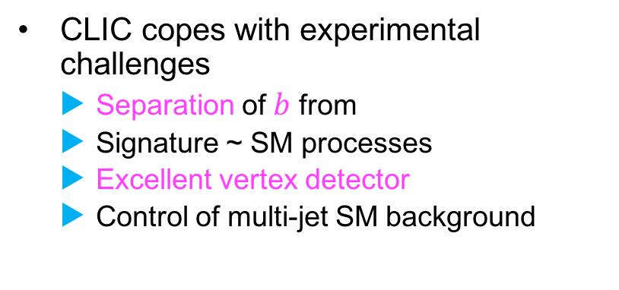

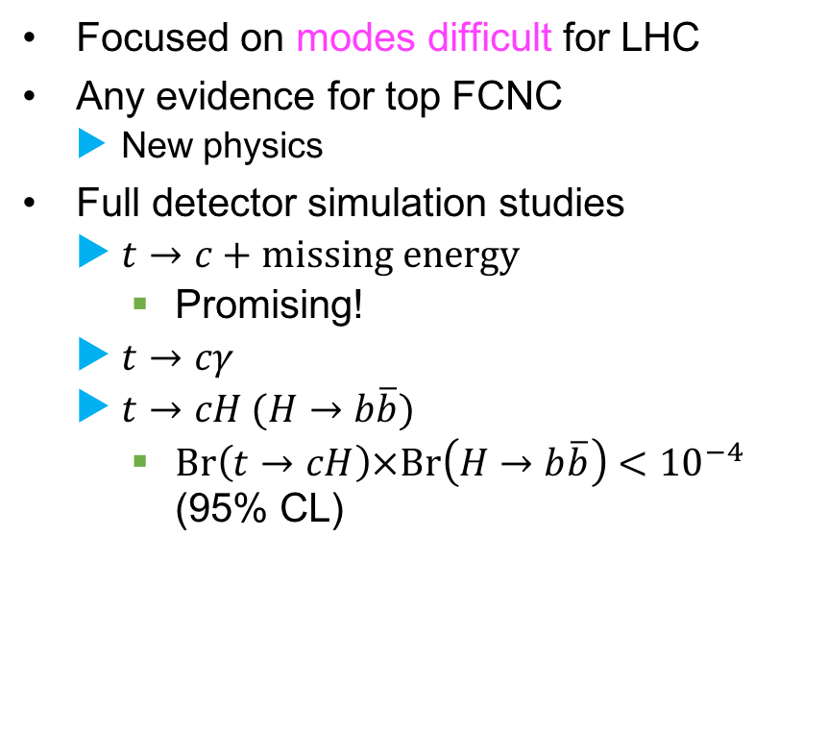
Rare decays
CLICdp work
in progress
Focused on modes difficult for LHC
Any evidence for top FCNC
New physics
Full detector simulation studies
$t→c+\text{missing} \text{energy}$
Promising!
$t→cγ$
$t→cH (H→b\overline{b})$
$\text{Br}\left(t→cH\right)×\text{Br}\left(H→b\overline{b}\right)<{10}^{−4}$ (95% CL)
$$t→cγ$$
CLIC copes with experimental challenges
Separation of $b$ from
Signature ~ SM processes
Excellent vertex detector
Control of multi-jet SM background

Slide 7
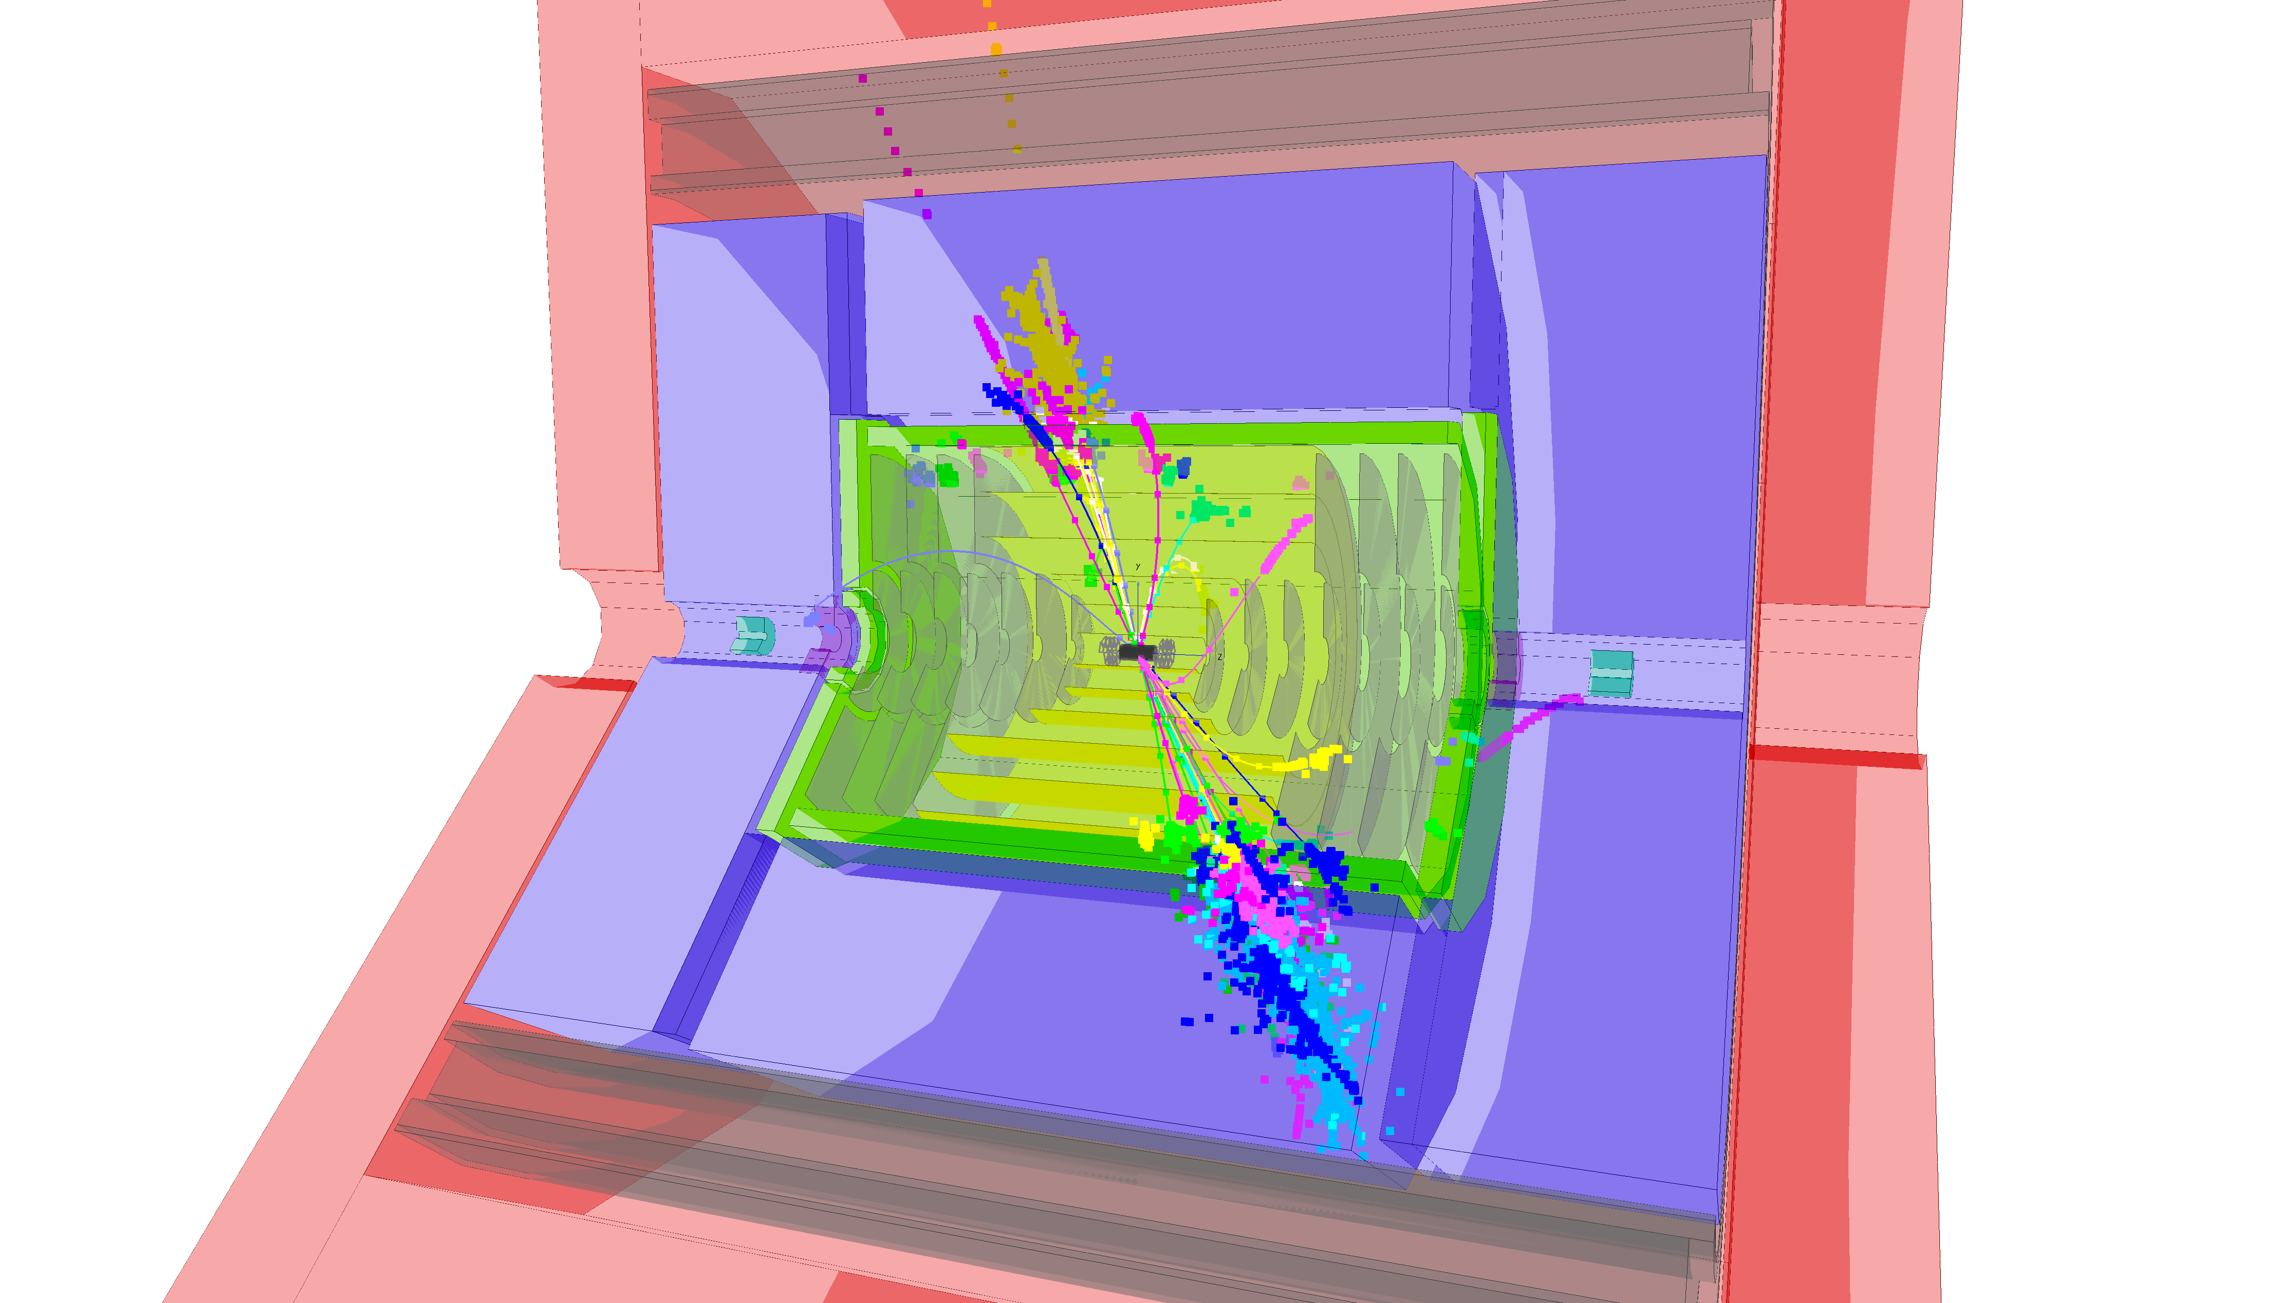
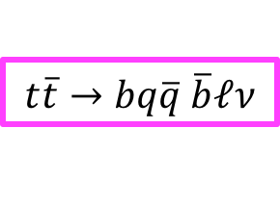
Boosted top reconstruction
Transverse momentum (GeV)
Jets in high-energy top decays not distinct
Reconstruct “large” jet
Find substructure ~ t → Wb → qqb
CLIC profits from LHC experience
e.g “Johns-Hopkins” top tagger
φ
η
CLICdp work in progress
Typical event
efficiency
$$t\overline{t}→bq\overline{q} \overline{b}ℓν$$

Slide 8
Identified W and b-jet systems
Transverse momentum (GeV)
Transverse momentum (GeV)
Jets in high-energy top decays not distinct
Reconstruct “large” jet
Find substructure ~ t → Wb → qqb
CLIC profits from LHC experience
e.g “Johns-Hopkins” top tagger
φ
η
CLICdp work in progress
Typical event
efficiency
$$t\overline{t}→bq\overline{q} \overline{b}ℓν$$

Slide 9
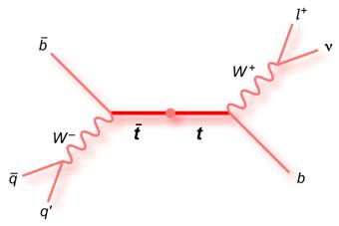
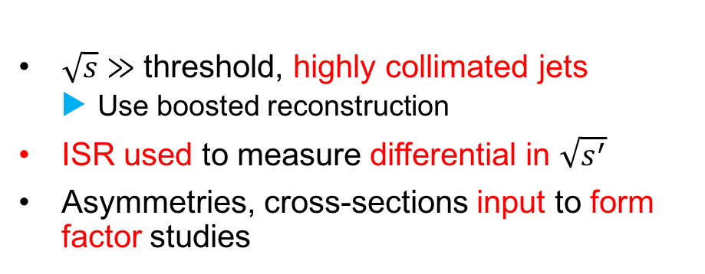
Asymmetries with radiative events
7 objects to be reconstructed:
2 b-jets, 2 other jets
Charged lepton and neutrino
Photon(s) from ISR/Beamstrahlung
CLICdp work
in progress
CLICdp work
in progress
$\sqrt{s}≫$ threshold, highly collimated jets
Use boosted reconstruction
ISR used to measure differential in $\sqrt{s^{′}}$
Asymmetries, cross-sections input to form factor studies

Slide 10
Top Form Factors
10⁻¹
10⁻¹
CP Conserving FF
CP Violating FF
10⁻²
10⁻²
10⁻³
10⁻³
[CERN YR 2016-004, arxiv:1710.06737]
Notes:
[For lhs plot, from CERN-2016-004_Updated baseline for a staged Compact Linear Collider.pdf]
Simulation studies of the measurements of the top-quark form factors [51], extracted from the top pair- production cross section and top forward-backward asymmetries, have been performed for CLIC at 380 GeV [10]. Figure 9 shows a comparison of the uncertainties on the top-quark form factors between HL-LHC at 14 TeV [52, 53], ILC at 500 GeV [33, 54, 55] and CLIC at 380 GeV. At ILC and CLIC, the top couplings to the electroweak gauge bosons can be extracted with precisions at the percent level, well beyond those projected for HL-LHC. Since the theory uncertainties are not yet calculated at 380 GeV, the CLIC uncertainties include a theory uncertainty of 3%, corresponding to the maximal theory uncertainty on the tt production cross section at the threshold [51]. This is a very conservative upper limit.
As all couplings between top quarks and electroweak gauge bosons are predicted to high precision by the SM, a stringent comparison between the observed and the predicted couplings can be performed. In many BSM models the top couplings to the electroweak interaction are substantially modified. This is the case, for example, in composite Higgs models or extra dimension models, where coupling modifications are of the order of 10% [46, 55, 56], resulting in a large discovery potential for future e+e− colliders. Additional information can also be extracted from an analysis of the top-quark decays [57].

Slide 11
Top Form Factors
Disentangled by beam polarisation +: σ(tt); F-B asymmetry; lepton helicity angle
10⁻¹
10⁻¹
CP Conserving FF
CP Violating FF
10⁻²
10⁻²
10⁻³
10⁻³
Sensitivity to contact interactions rises with energy – good for CLIC
Notes:
[For lhs plot, from CERN-2016-004_Updated baseline for a staged Compact Linear Collider.pdf]
Simulation studies of the measurements of the top-quark form factors [51], extracted from the top pair- production cross section and top forward-backward asymmetries, have been performed for CLIC at 380 GeV [10]. Figure 9 shows a comparison of the uncertainties on the top-quark form factors between HL-LHC at 14 TeV [52, 53], ILC at 500 GeV [33, 54, 55] and CLIC at 380 GeV. At ILC and CLIC, the top couplings to the electroweak gauge bosons can be extracted with precisions at the percent level, well beyond those projected for HL-LHC. Since the theory uncertainties are not yet calculated at 380 GeV, the CLIC uncertainties include a theory uncertainty of 3%, corresponding to the maximal theory uncertainty on the tt production cross section at the threshold [51]. This is a very conservative upper limit.
As all couplings between top quarks and electroweak gauge bosons are predicted to high precision by the SM, a stringent comparison between the observed and the predicted couplings can be performed. In many BSM models the top couplings to the electroweak interaction are substantially modified. This is the case, for example, in composite Higgs models or extra dimension models, where coupling modifications are of the order of 10% [46, 55, 56], resulting in a large discovery potential for future e+e− colliders. Additional information can also be extracted from an analysis of the top-quark decays [57].

Slide 12
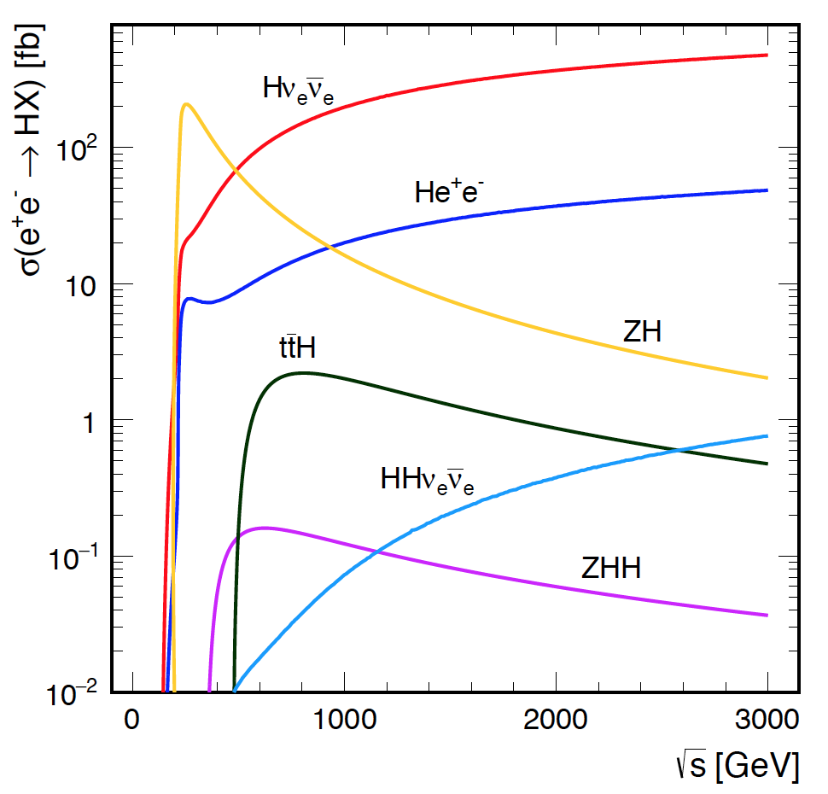
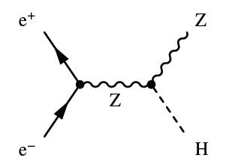
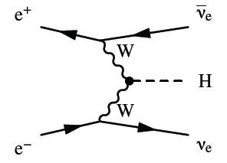
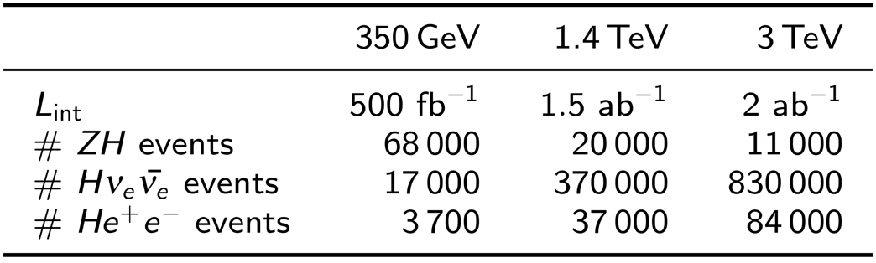
Higgs physics at CLIC ]
Dominant processes:
Higgsstrahlung
σ ~ 1/s
Higgs id. from Z recoil
WW(ZZ) - fusion
σ ~ log(s)
Large yield at high E
For unpolarised beams.
Hνν increases ×1.8 for -80% e⁻ polarisation (baseline plan)
[EPJ C (2017) 77:475]

Slide 13
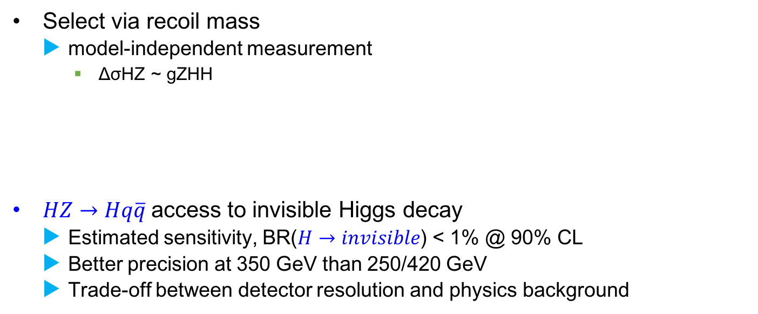
e⁺e⁻ → ZH @ ~350 GeV
M reconstructed [GeV]
[EPJ C (2017) 77:475]
Select via recoil mass
model-independent measurement
ΔσHZ ~ gZHH
$HZ→Hq\overline{q}$access to invisible Higgs decay
Estimated sensitivity, BR($H→invisible$) < 1% @ 90% CL
Better precision at 350 GeV than 250/420 GeV
Trade-off between detector resolution and physics background
M_{qq} [GeV]
Z → μμ BR~3.5% very clean
Z → ee BR~3.5% very clean
Z → qq BR~70% almost model independent
Δ(σ_{HZ}) = ±3.8%
Δ(g_{HZZ}) =±0.8%
Δ(σ_{HZ}) = ±1.8%

Slide 14
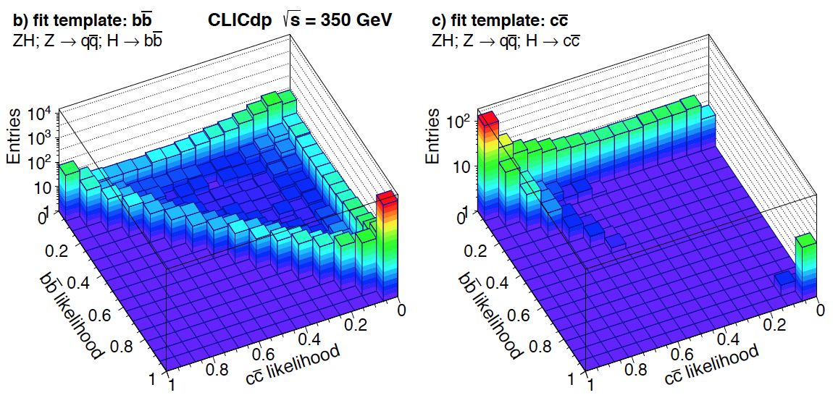
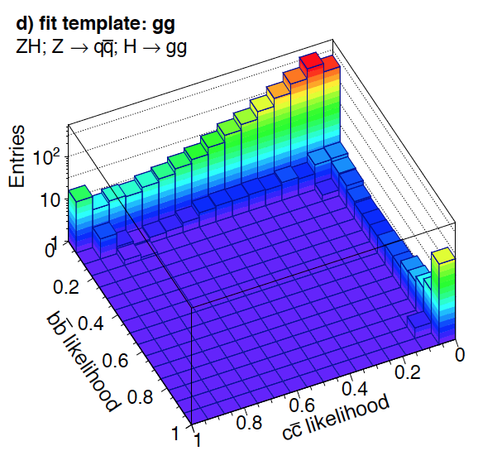
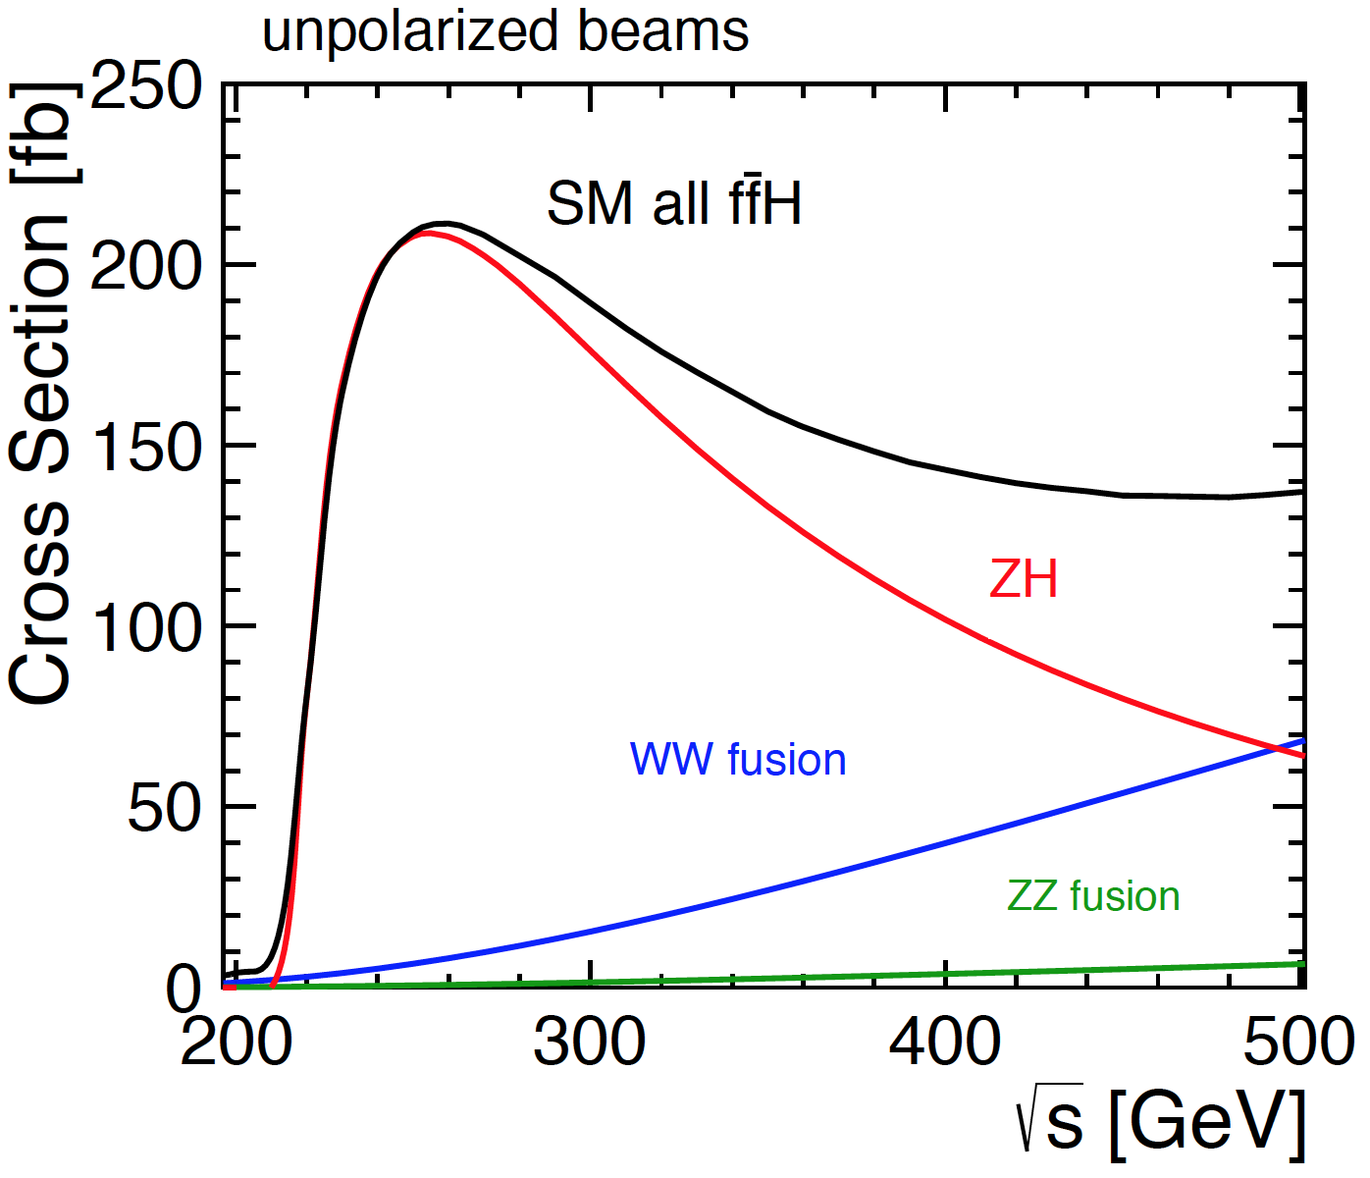
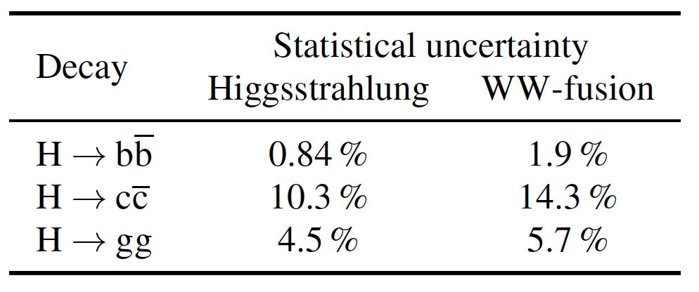




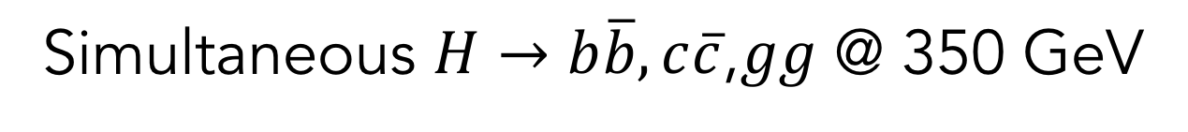
Simultaneous $H→b\overline{b}, c\overline{c}$,$gg$ @ 350 GeV
Compare $b\overline{b}$likelihood versus $c\overline{c}$ likelihood for different event classes
$$H→b\overline{b}$$
$$H→c\overline{c}$$
$$H→gg$$
arXiv:1608.07538
2 production and 3 decay modes
Δ(σ✕BR)_{SM}/(σ✕BR)_{SM} at 350 GeV, 500 fb⁻¹

Slide 15
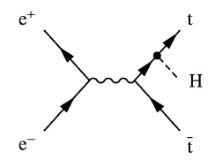
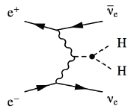
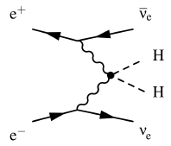
Higgs physics above 1 TeV
Vector boson fusion:
e⁺e⁻ ➔ Hνν, e⁺e⁻ ➔ He⁺e⁻
High σ + increased luminosity
Access to rare Higgs decays
-
ttH production:
Extraction of Yukawa coupling y_{t}
Best at √s above 700 GeV
Studied at 1.4 TeV, 1.5 ab⁻¹
Fully hadronic (8 jets)
Semi-leptonic (6 jets + lepton + ν)
Statistical accuracy:
Δ(g_{Htt}) = ±4.4% at 1.4 TeV

Slide 16
Higgs coupling precision
Full CLIC programme, 5 years each stage
Assumes 80% e- pol., >1 TeV
Recoil mass approach
Model independent analysis
~1% level for most couplings
H width free, allows extra non-SM decays,
H width to +-3.6%
Full simulation study, details
Eur. Phys. J. C 77, 475 (2017)
CLIC has unique sensitivity and energy reach

Slide 17
Summary
e⁺e⁻ machine at few 10² GeV will measure Higgs and top properties
Precision >> HL-LHC and less model dependent
First CLIC stage at 350/380 GeV allows
Higgs production: Higgsstrahlung and WW fusion
Top quark: threshold and continuum regions
Rare decays
Higher-energy e⁺e⁻ collider has more BSM discovery potential
Direct detection up to kinematic limit
Indirect discovery via precise EW measurements up to ~few x10 TeV
Sensitivity often rises steeply with the centre-of-mass energy
CLIC is unique, only proposed multi-TeV e⁺e⁻ machine

Slide 18
Backup material

Slide 19
Motivation: why e⁺e⁻?
proton
p-p collisions | e⁺e⁻ collisions
Initial state for hard scatter? Initial state/event unknown Limits achievable precision Proton are complicated... | Initial state Initial state ~well defined High-precision measurements e⁺/e⁻ are point-like
High rates of QCD backgrounds Complex triggering schemes High radiation levels | Cleaner experimental environment Simple trigger scheme/readout Low radiation levels
High cross-sections for colored-states | Superior sensitivity for electro-weak states
High-energy circular colliders feasible | >≈350 GeV needs a linear collider

Slide 20
Contact Interaction vs. sqrt(s)
Gauthier Durieux, arXiv:1708.09849, PoS(DIS2017)088

Slide 22
Costings

Slide 23
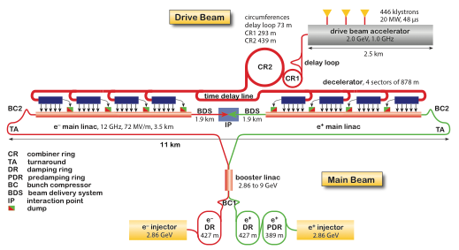
Initial energy

Slide 24
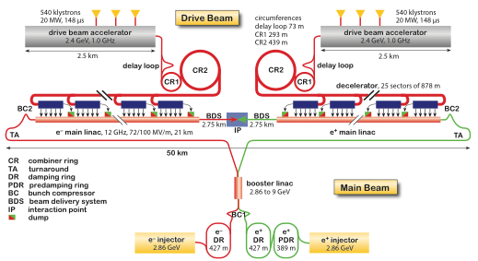
Higher energy

Slide 25
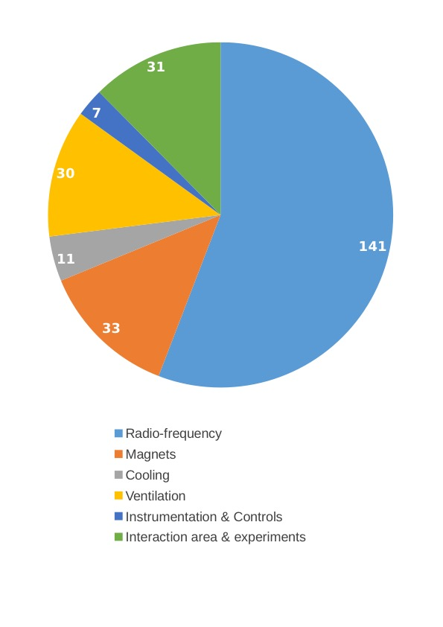
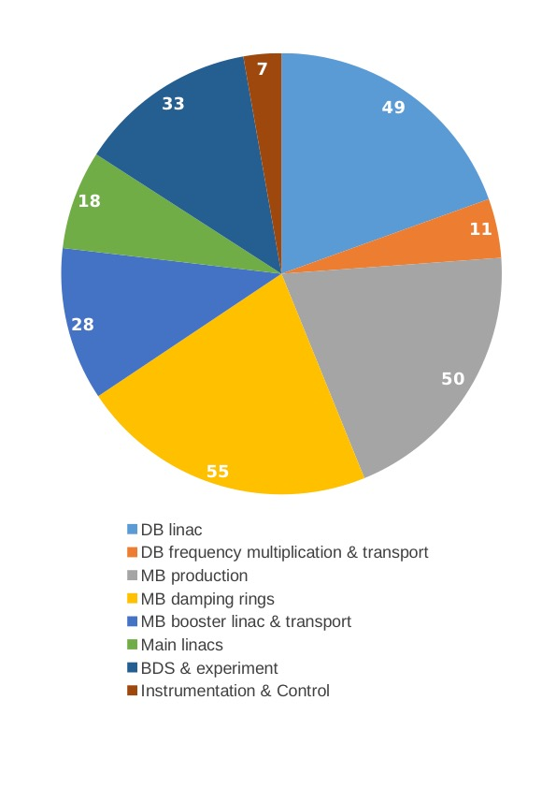

Slide 27
e⁺e⁻ → ZH @ ~350 GeV
M reconstructed [GeV]
Select via recoil mass
model-independent measurement
Δσ_{HZ} ~ g_{ZHH}
[EPJ C (2017) 77:475]
M_{qq} [GeV]
Z → μμ BR~3.5% very clean
Z → ee BR~3.5% very clean
Z → qq BR~70% almost model independent
Δ(σ_{HZ}) = ±3.8%
Δ(g_{HZZ}) = ±0.8%
Δ(σ_{HZ}) = ±1.8%
$HZ→Hq\overline{q}$ access to invisible Higgs decay BR(H→inv) < 1% @ 90% CL
ZH → Hqq: better precision at 350 GeV than at 250 GeV or 420 GeV
Trade-off between detector resolution and physics background

