Slide 1
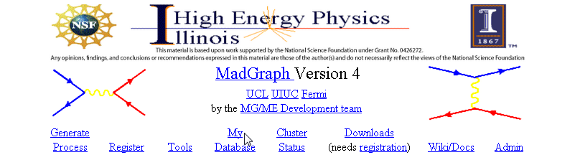
MadGraph/MadEvent
Workshop 1
Renormalization / Callibration
5
Notes:
Activities
Lecture 1 SM + Partonic Cross Sections + Collaboration?
1) Generate partonic diagrams gg > tt~, gg > tt~h
2) Create account, repeat exercise
2) Generate subprocesses?
Lecture 2 (Hadronic Collisions) MC integration…. Full explanation
1) Generate pp > tt~ > bb~mu+e- ve~ vm, pp > h > tt~bb~, background pp>tt~bb~, mbb>100, gg>h and backgrounds
3) Download onto local computers and perform analysis
4) Generate events, determine cuts
Lecture 3 (Radiation/Hadronization)
1) Create a new model

Slide 2
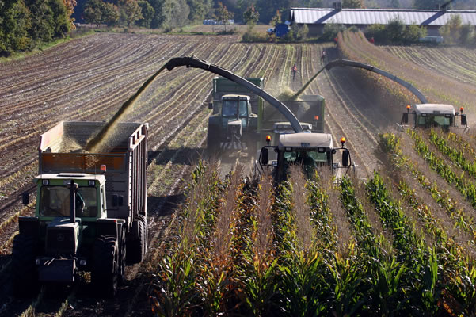
5

Slide 3
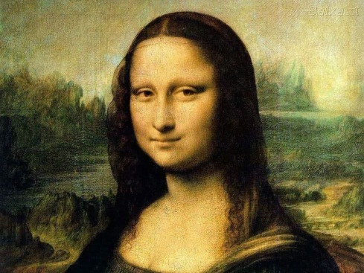
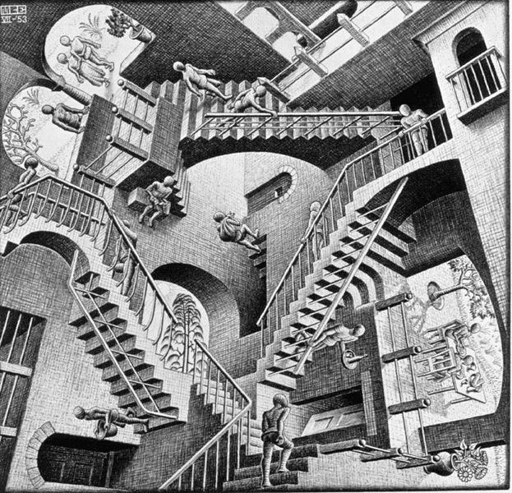

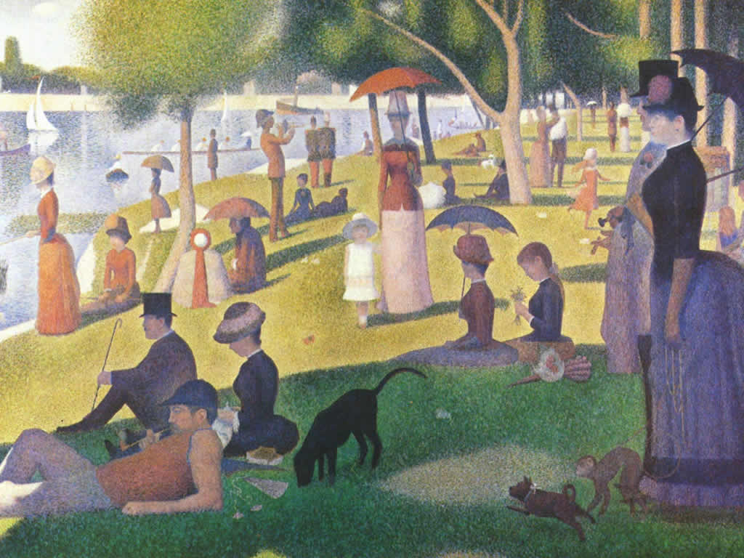
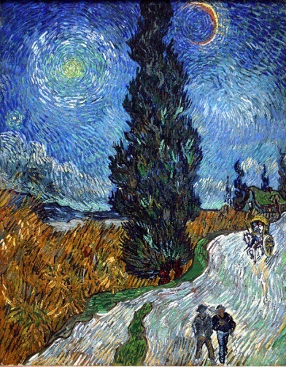
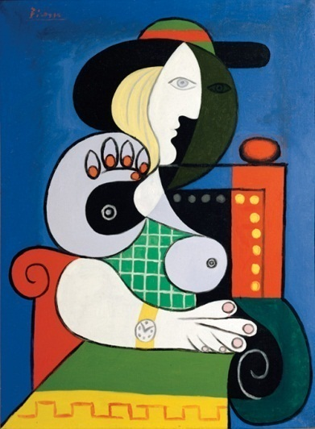
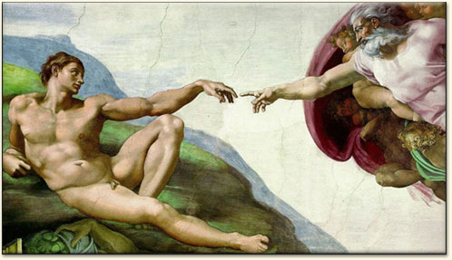
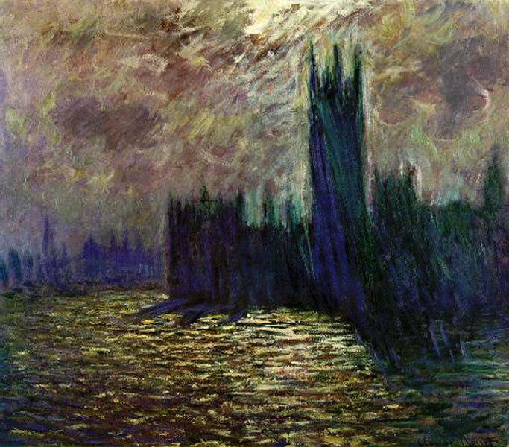
Goals
8
Notes:
Goals:
Many great artists speaking….
Appreciation
Skills (mixing paints)
Mona Lisa --- Leonardo De Vinci 1503 Italy
Pablo Picasso ---Cubism 1881-1973 Spain
Henri Matisse ---Cut-outs---color 1869-1954 France
Maurits Escher --- Shadow, perspective Dutch
Claude Monet ----1840-1926 impressionism
Georges Seurat --- 1859-1891 Color, Pointillism
Vincent van Gogh --1853-1890 Dutch
Michelangelo --- human form
Geraldine
3

Slide 4
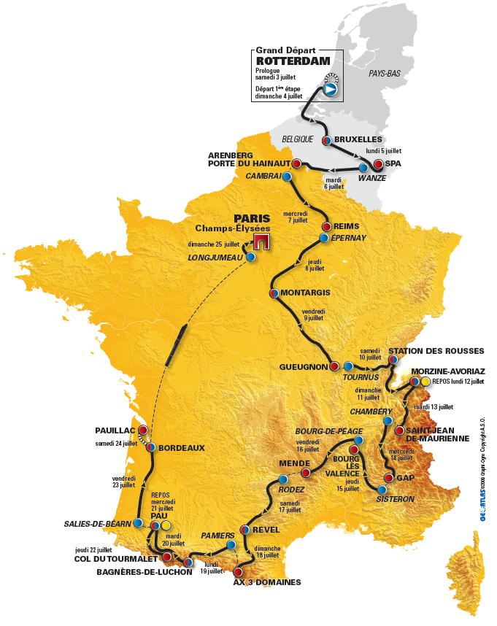
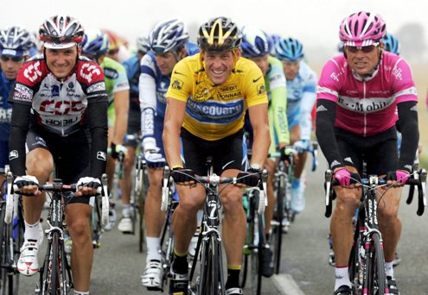
RoadMap
Motivation, Introduction
Hadronic Event Generation
Analysis and Outlook
Notes:
Tour de france

Slide 5
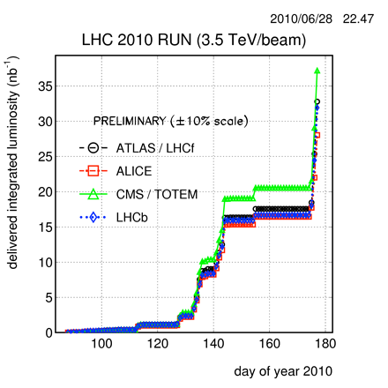
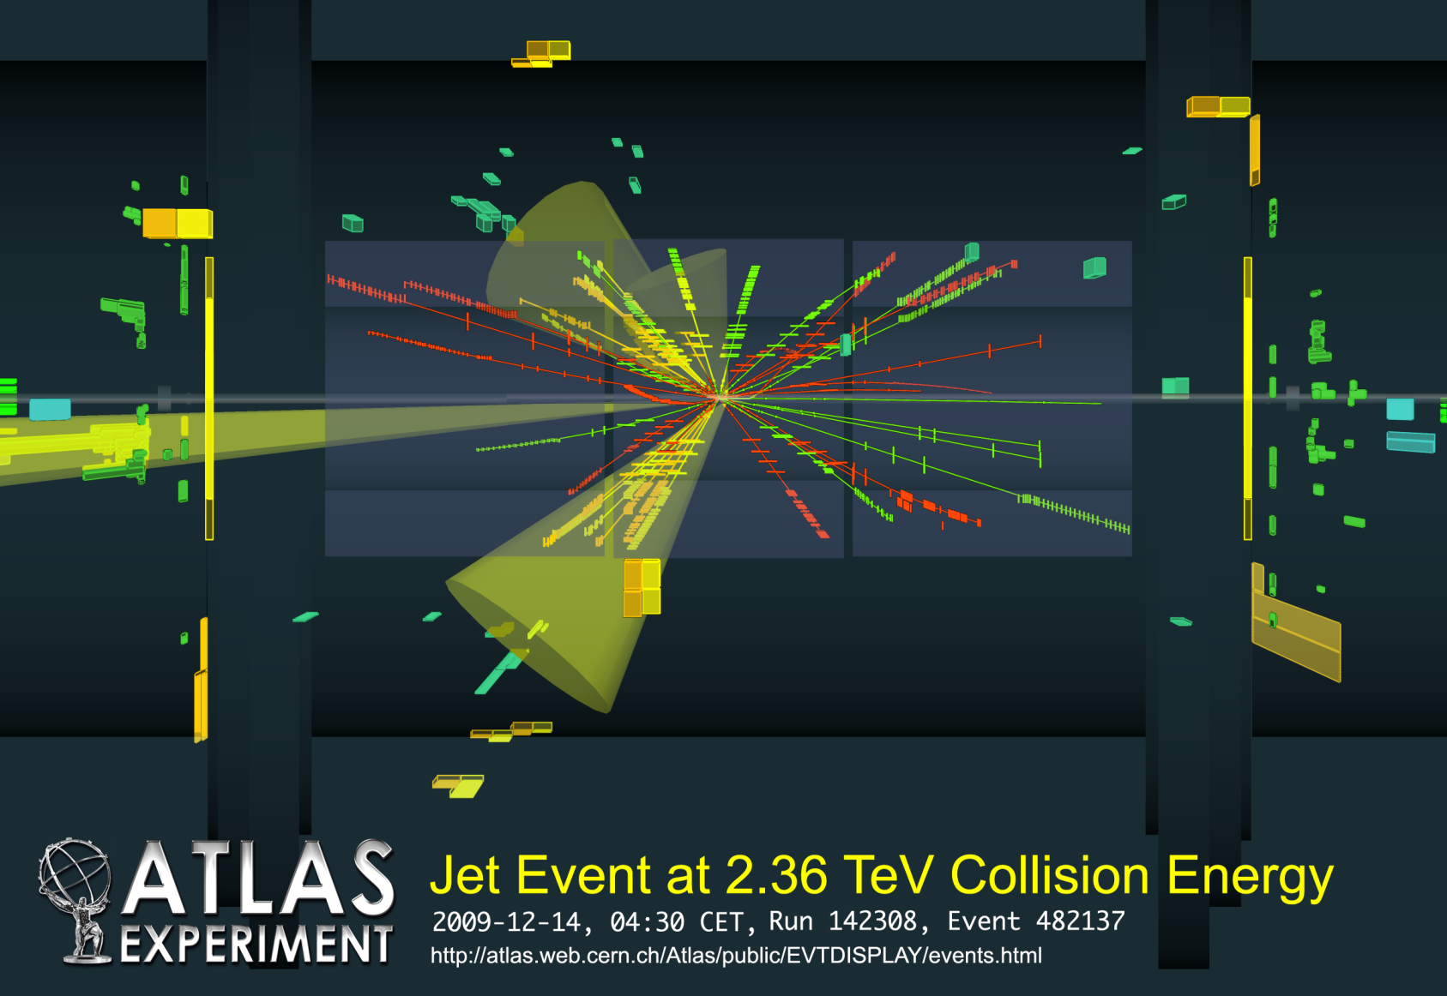
A Great Time In Physics
9
Notes:
Daily show
BBC
NPR
Google
Angels and Demons
Responsibility to Share w/ public

Slide 6
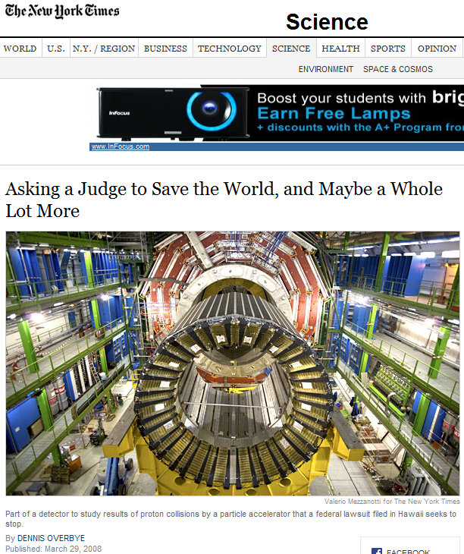


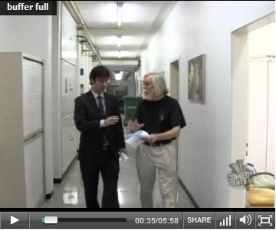


A Great Time In Physics
11

Slide 7
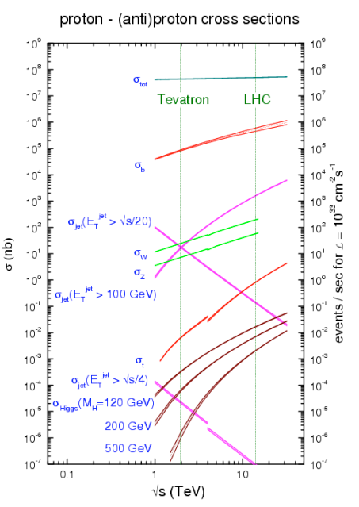

The Challenge
1 / 1,000,000,000
14
Notes:
Top quark 1/billion 1/100 billion…. Speed 10^9 / second. 8m x 16m x 0.5m = 500 billion grains of sand.
50 ears/bushel x 183 bushels/acre 200 kernals/cob = 200,000/acre Or 1 kernal in 5000 Acres

Slide 8
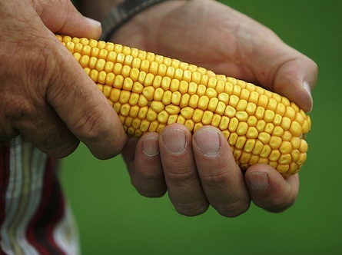
Notes:
50 ears/bushel x 183 bushels/acre 200-400 kernals/cob = 2.7 M /acre Or 1 kernal in 500 Acres

Slide 9
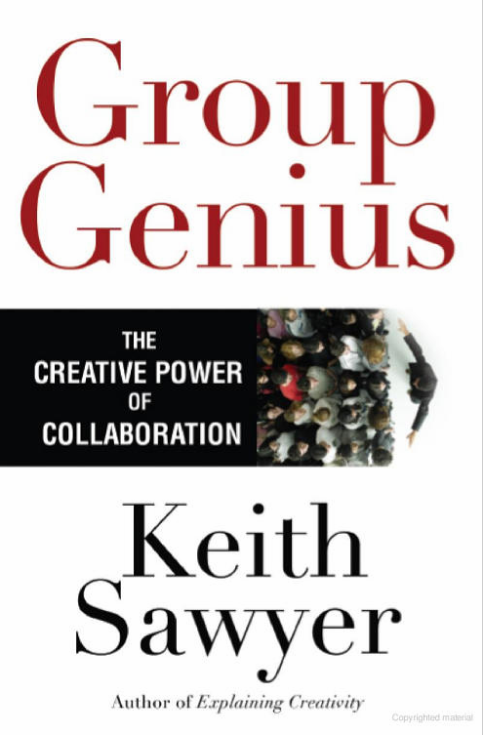
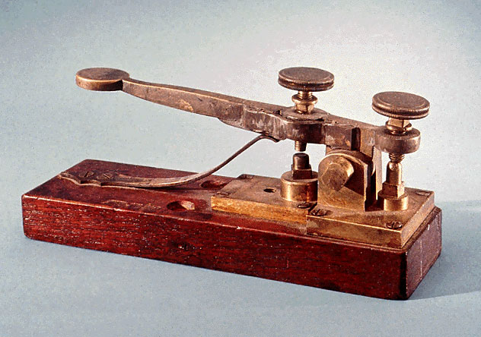
KEY
16
Notes:
Story of radiation treatment…. Troops and castle/bridges
Find your group

Slide 10

Form teams of 3
At least 1 computer
At most 2 computers
20

Slide 11
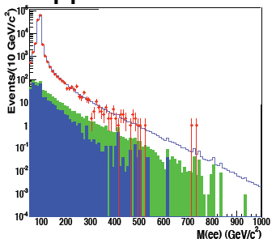
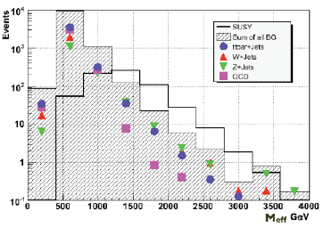
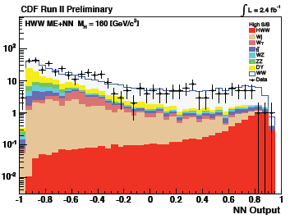
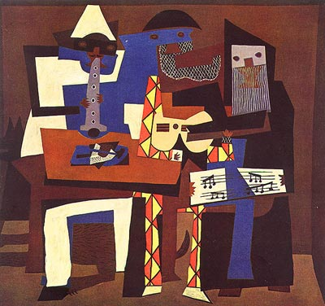
Discoveries at hadron colliders
(adapted from MLM)
Peak (easy)
Shape (medium)
Rate (hard)
22
Notes:
Add images MonaLisa, Seurat, Le Bateau by Matisse caused a minor stir when the Museum of Modern Art, which housed it, hung the print upside-down for 46 days in 1961 until Genevieve Habert, a stockbroker, noticed the mistake and notified a guard. Habert later informed theNew York Times who in turn notified Monroe Wheeler, the Museum's art director. As a result, the artwork was rehung properly.[1]

Slide 12
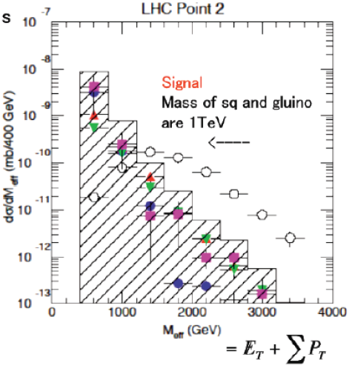
SuperSymmetry at LHC
23

Slide 13
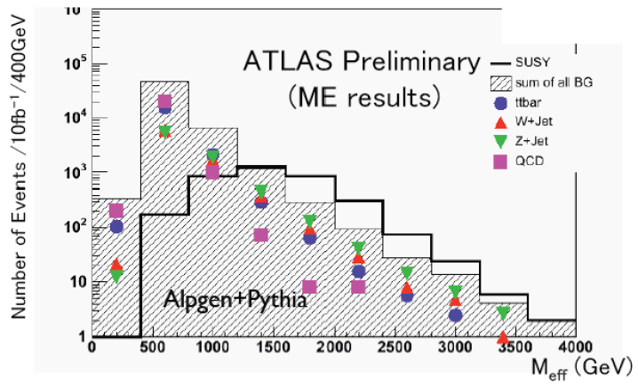
New MC shows much harder!
24

Slide 14
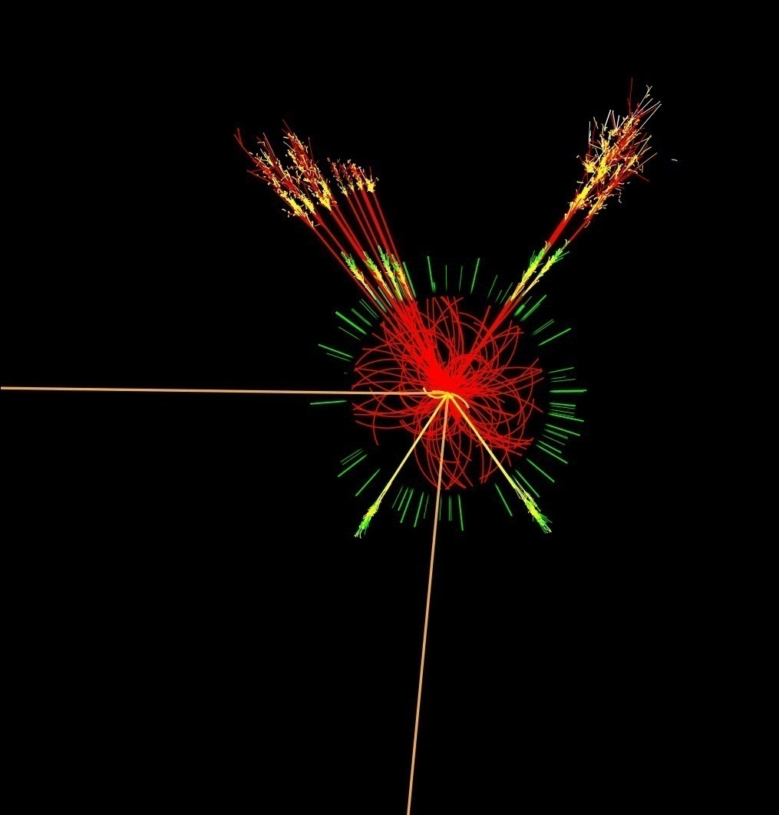
Discovery Path @ LHC
Rediscover Standard Model
Identify excess
Identify nature of excess
Repeat
26

Slide 15
Standard Model
u
d
u
u
e⁻
u
ν
e⁻
u
Notes:
Most successful Theory in Science 30 orders of magnitude
photon mass < 10⁻¹⁸ eV , Tevatron > 10¹² eV

Slide 16
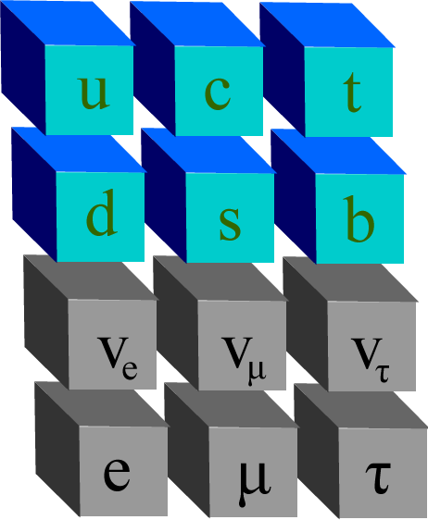
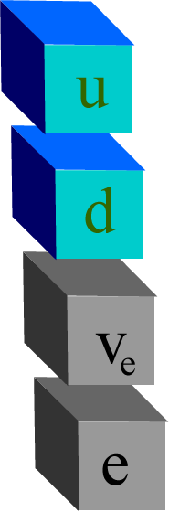
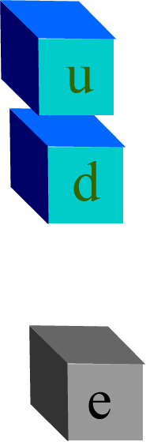
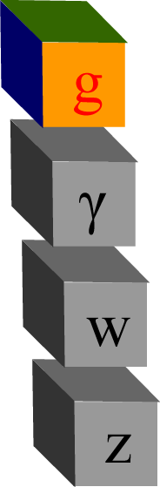
Standard Model
d
u
d
Matter
Leptons Quarks
Force Carriers
d
u
u
e⁻
d
ν
30
Notes:
Most successful Theory in Science 30 orders of magnitude
photon mass < 10⁻¹⁸ eV , Tevat
Oscar W. Greenberg color
ron > 10¹² eV
Anti-matter… Relativity

Slide 17
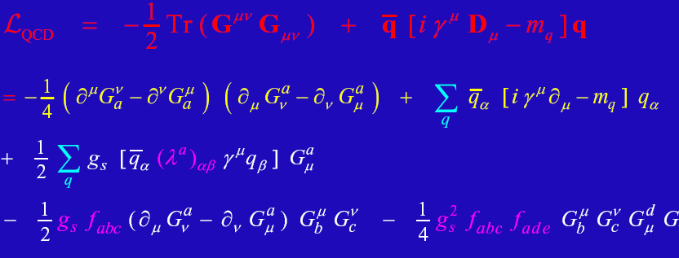
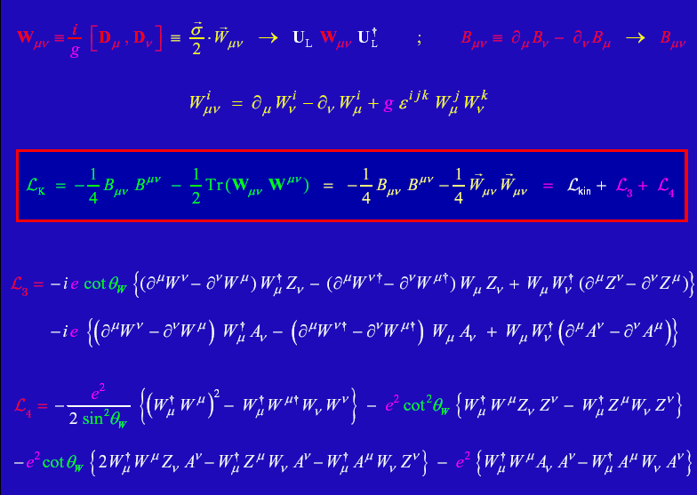
Details
32

Slide 18
Perturbation Theory
34

Slide 19
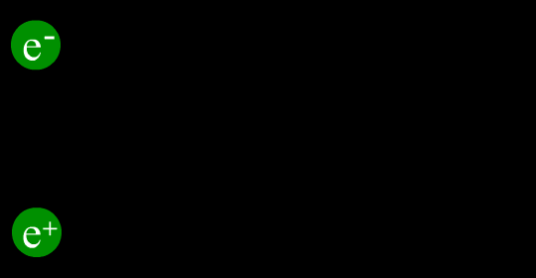
Example: e⁺e⁻ → μ⁺μ⁻
Scattering cross section
Feynman Diagrams
37
Notes:
19

Slide 20
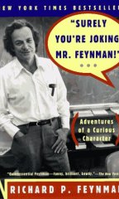
Feynman Rules!
γ | QED
Z | QED
W⁺⁻ | QED
g | QCD
h | QED (m)
38
Partial list from SM
Notes:
20
Add picture of Feynman

Slide 21
Feynman Rules!
These are basic building blocks, combine to form “allowed” diagrams
  e.g. u u~ -> t t~
Draw Feynman diagrams:
  gg -> tt~ (gg -> bb~ e+ ve j j )
  gg -> tt~h
Determine “order” for each diagram
Order is QCD²
45
22
Notes:
21
Add picture of Feynman

Slide 22
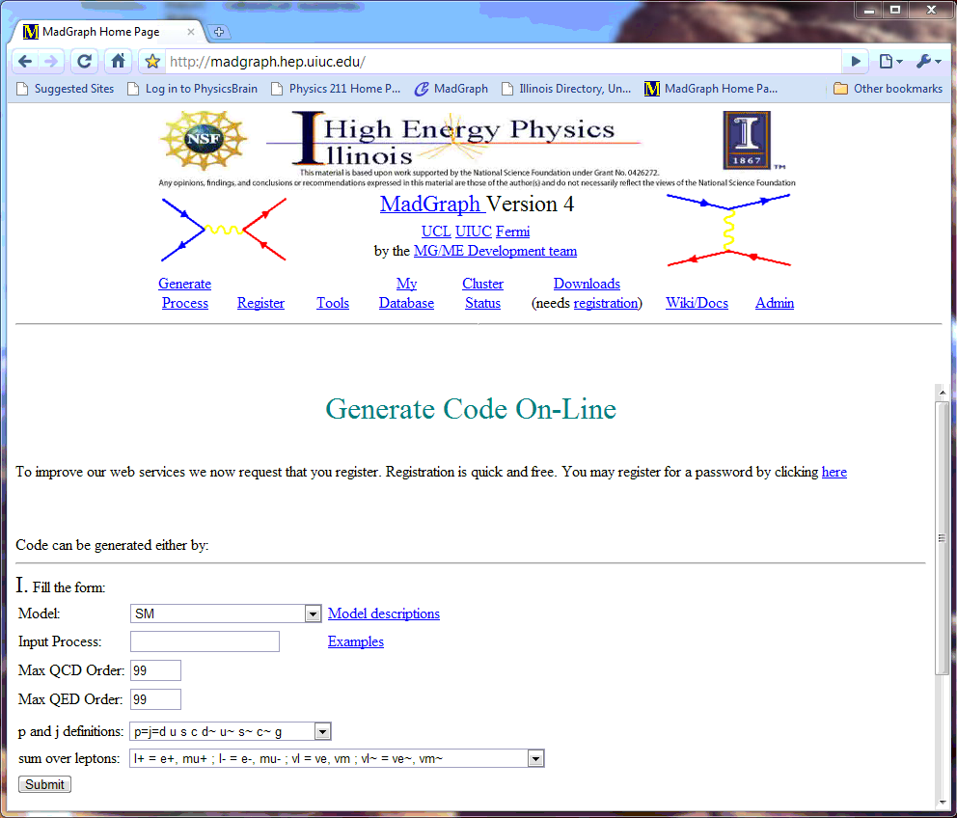
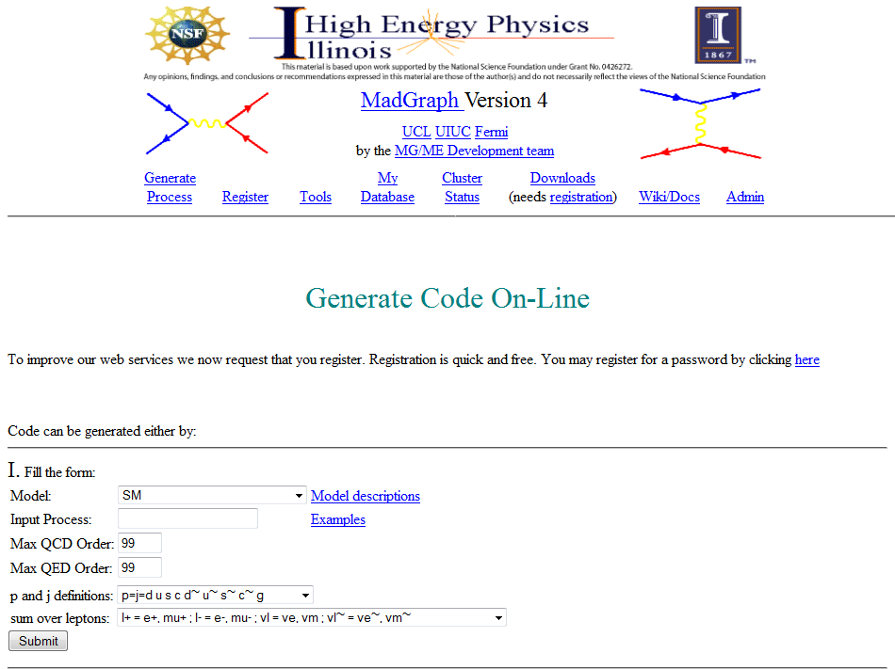
50

Slide 23
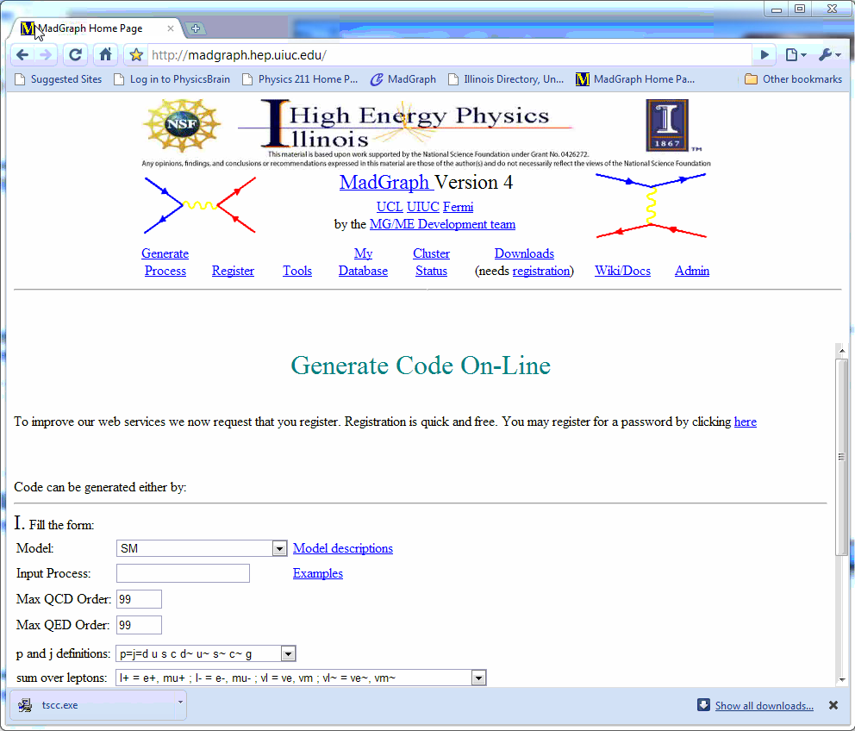
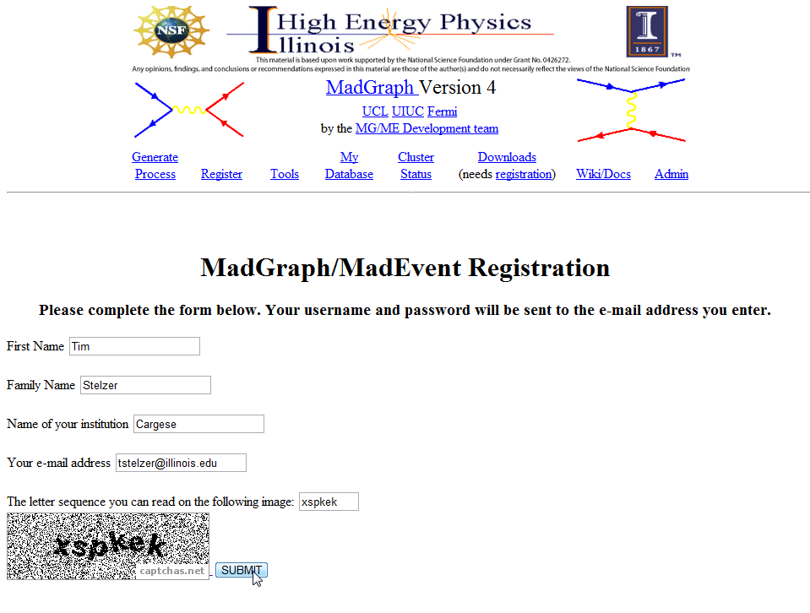
Register
http://madgraph.hep.uiuc.edu/
60

