Slide 2
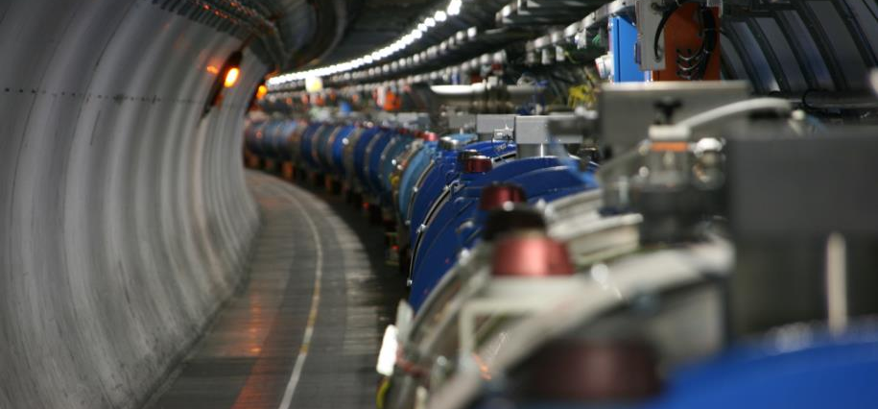
Re-commissioning of the superconducting circuits
Meeting n.6
Mirko Pojer and Matteo Solfaroli
Beams Department
Operation Group

Slide 3
Cryogenics plan
 | Present | Next action | CS OK
S12 | Capacity load test until Saturday morning | BS regeneration (24h) | Monday morning
S23 |  |  | OK
S34 |  |  | OK
S45 |  |  | OK
S56 | Reconfiguration until Thurs night | BS re-generation (24h) | Friday night
S67 |  | BS re-generation (24h) | Saturday afternoon
S78 | Moving back to QURC – A |  | Thursday evening
S81 |  | BS regeneration (24h) to be re-done | Friday evening

Slide 4

General advancement
Very efficient week-end, thanks to the unlock of all circuits and the release of many circuits by QPS
Beam screen conditioning done in all sectors: cryo now fully available all over the ring (test on QURC-A of IP8 at the end if time permits)
Main Dipoles released in 2 sectors
Main Quadrupoles released in 4 (but blocked in 1, see later)
All IPDs PIC2-circuit_quench_via_QPS have been failed by PIC due to missing data: possibly an issue on the analysis tool as the data seem to be there.
Many tests failed the automatic analysis and have to be manually signed in Acc_testing (e.g. the 120 A powering failure tests did not pass the automatic analysis)
Some of the IPQs are failing the PNO.a7 test if not set in MD mode, due to a long decay time: to be corrected for the future
PNO.x1 not yet done on IT 600 A: need to change the current and synchronize (we’ll do once all circuits of a powering SS are OK)
Cooling water interlock to be tested in all sectors this week (to be agreed with CV)
13 kA calibration to be probably done on Friday

Slide 5
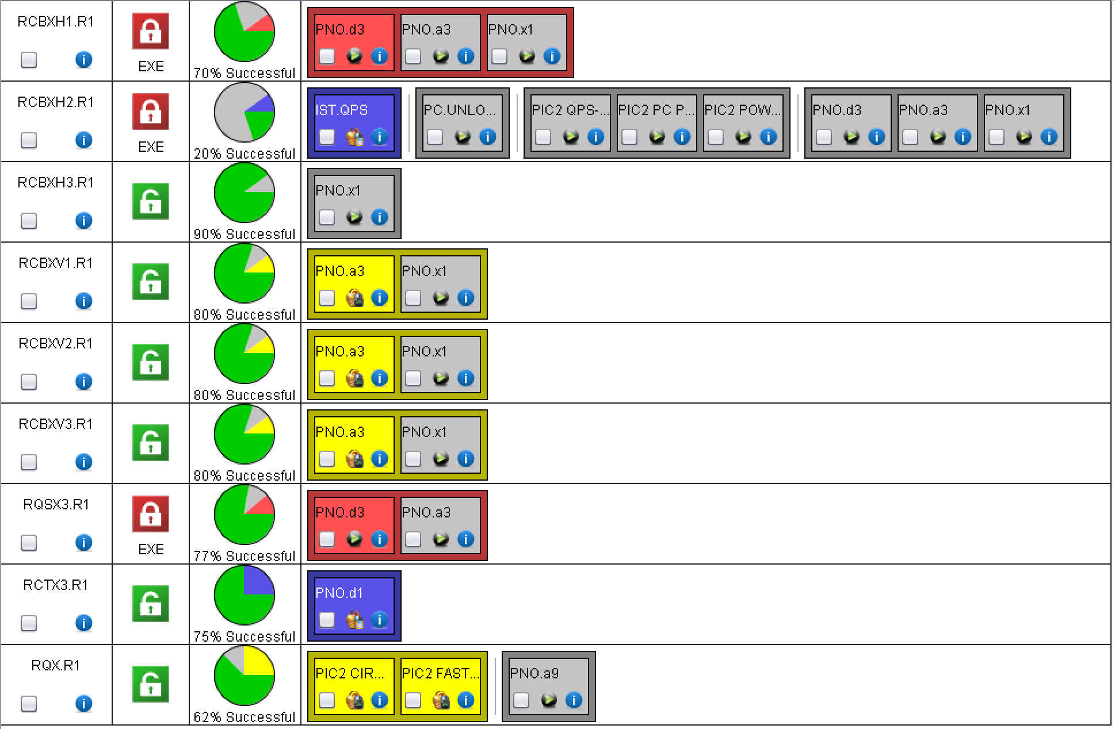
XR1
To be checked how 2 PIC tests could be done before unlocking!!!

Slide 6
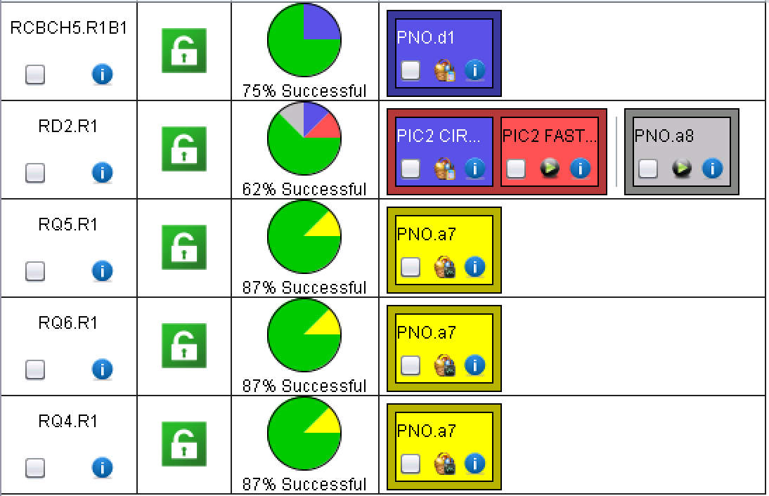
LR1

Slide 7
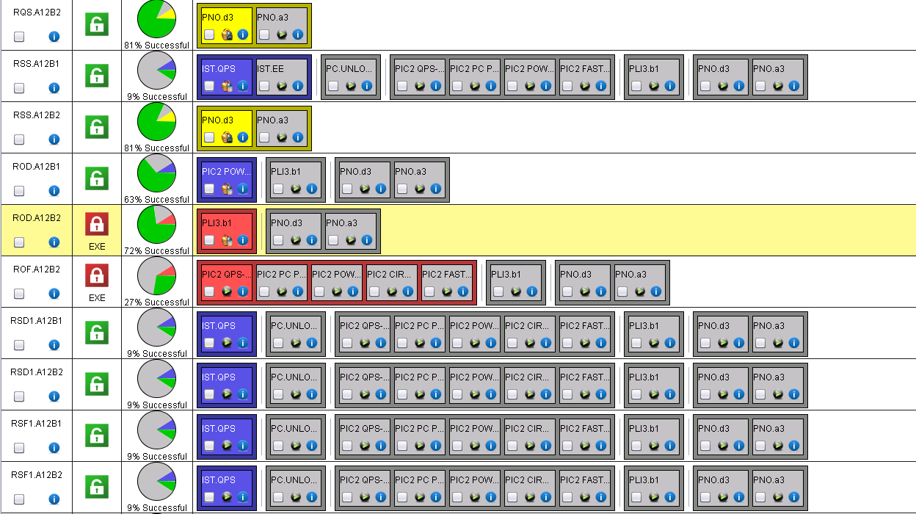
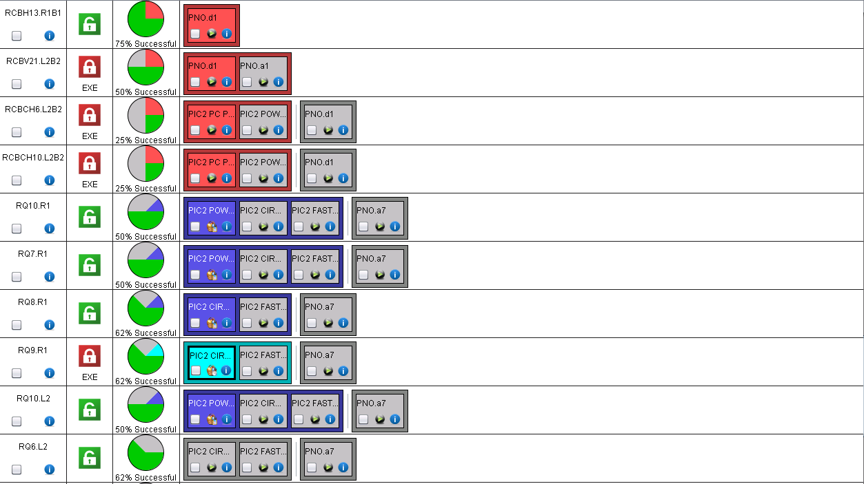
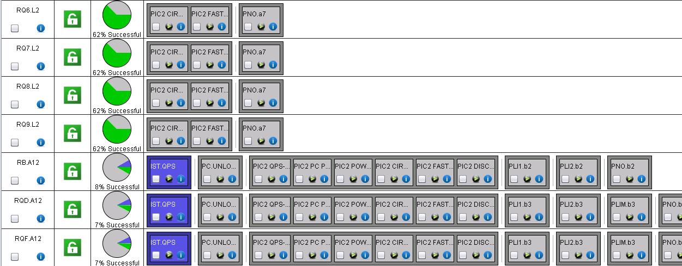
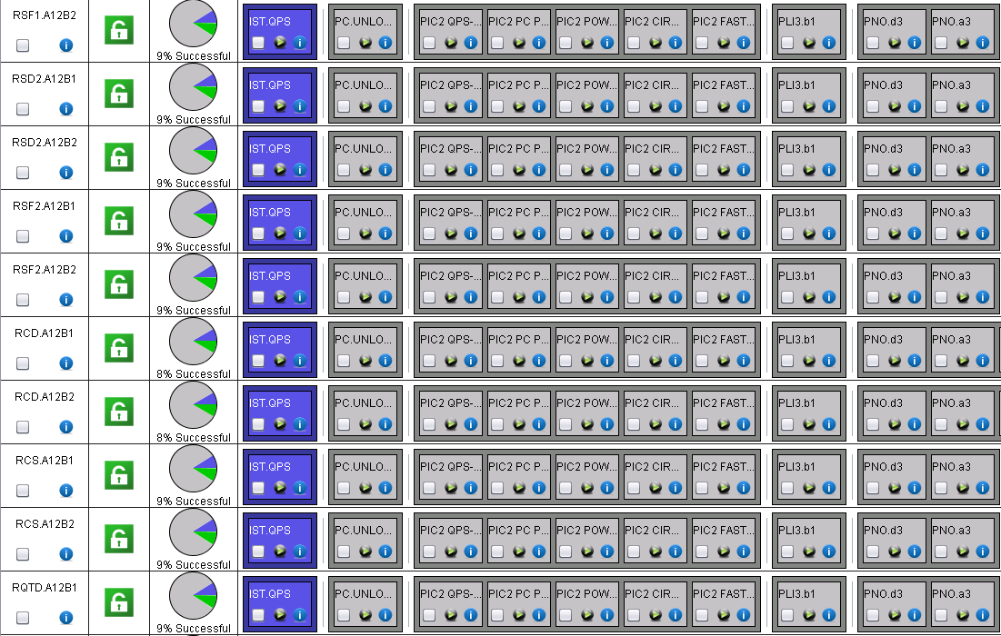
A12
QH discharge to be done at 500 and 900 V??
Many 600 A still to be released
60 A completed
No manual signature, but red!

Slide 8
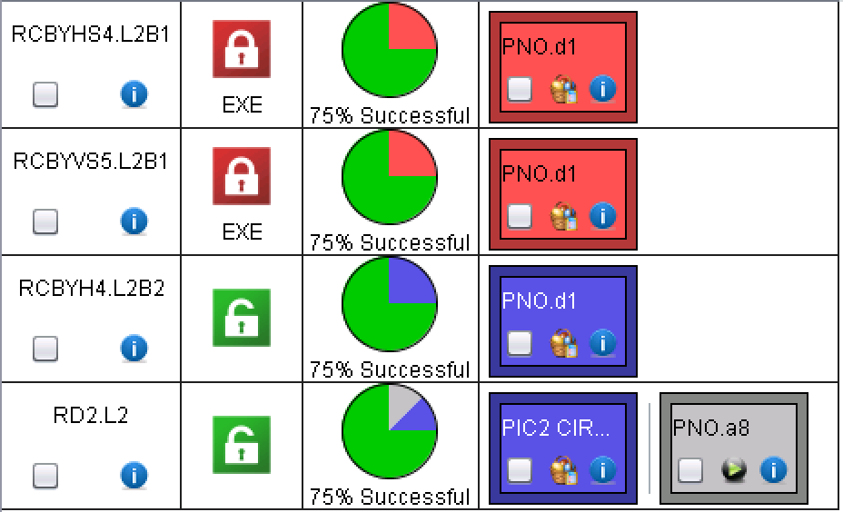
ML2
Automatic analysis failed, signed by EPC (still requiring MP3 signature)
Analysis to be reviewed!

Slide 9
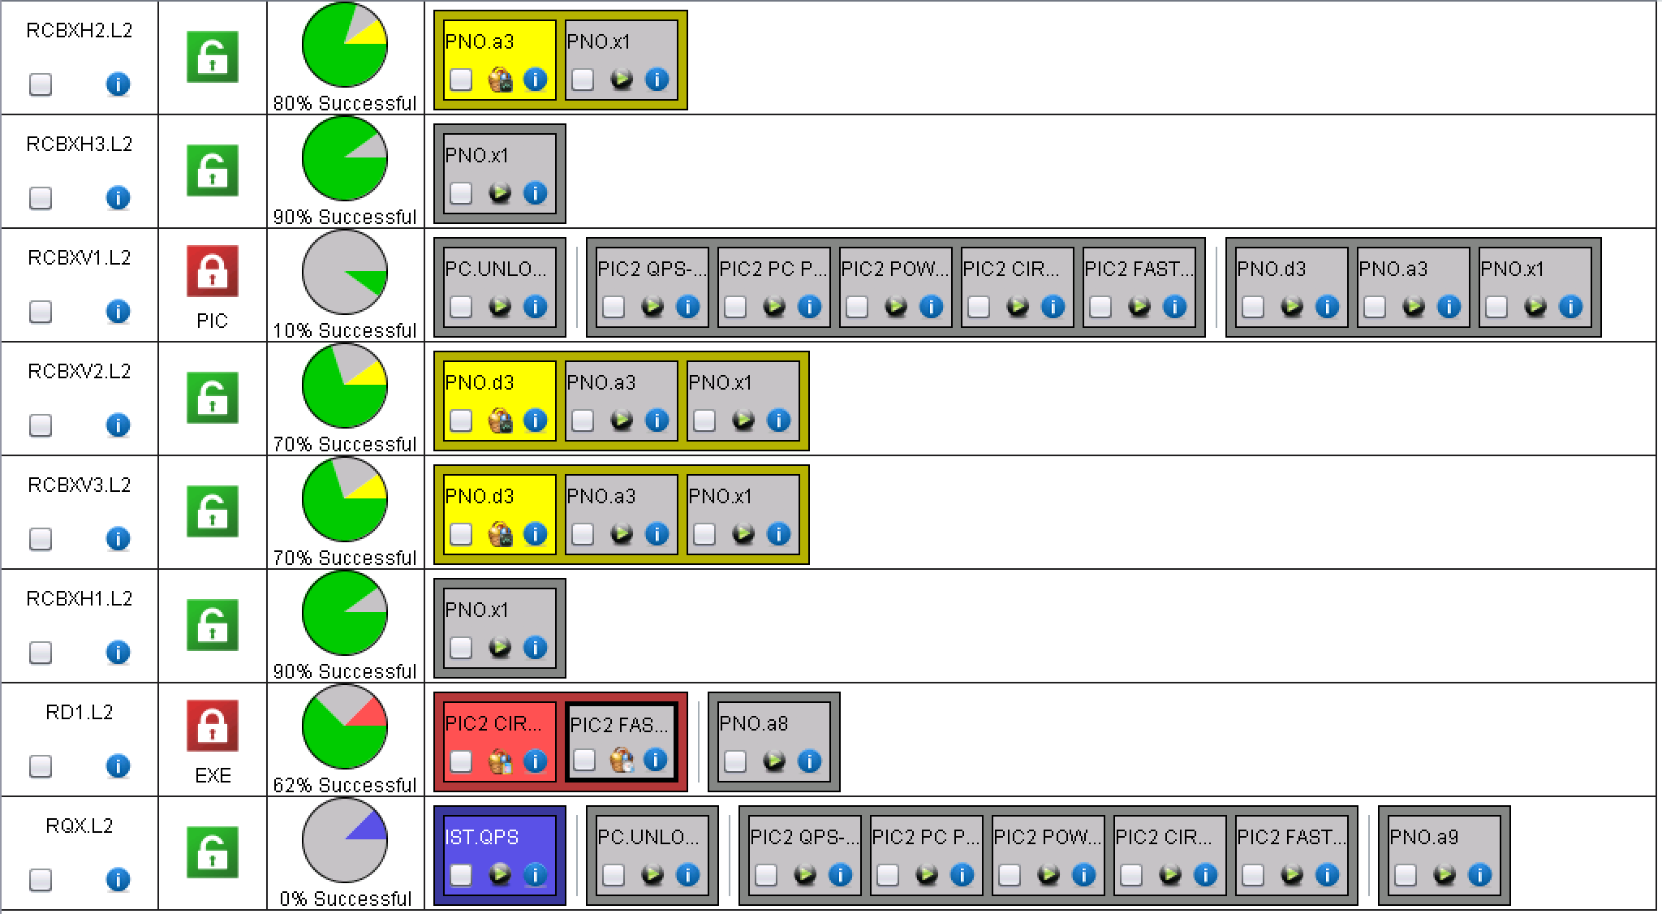
XL2
RCBXV1.L2: FGC keeps rebooting: power issue?
Analysis to be reviewed!

Slide 10
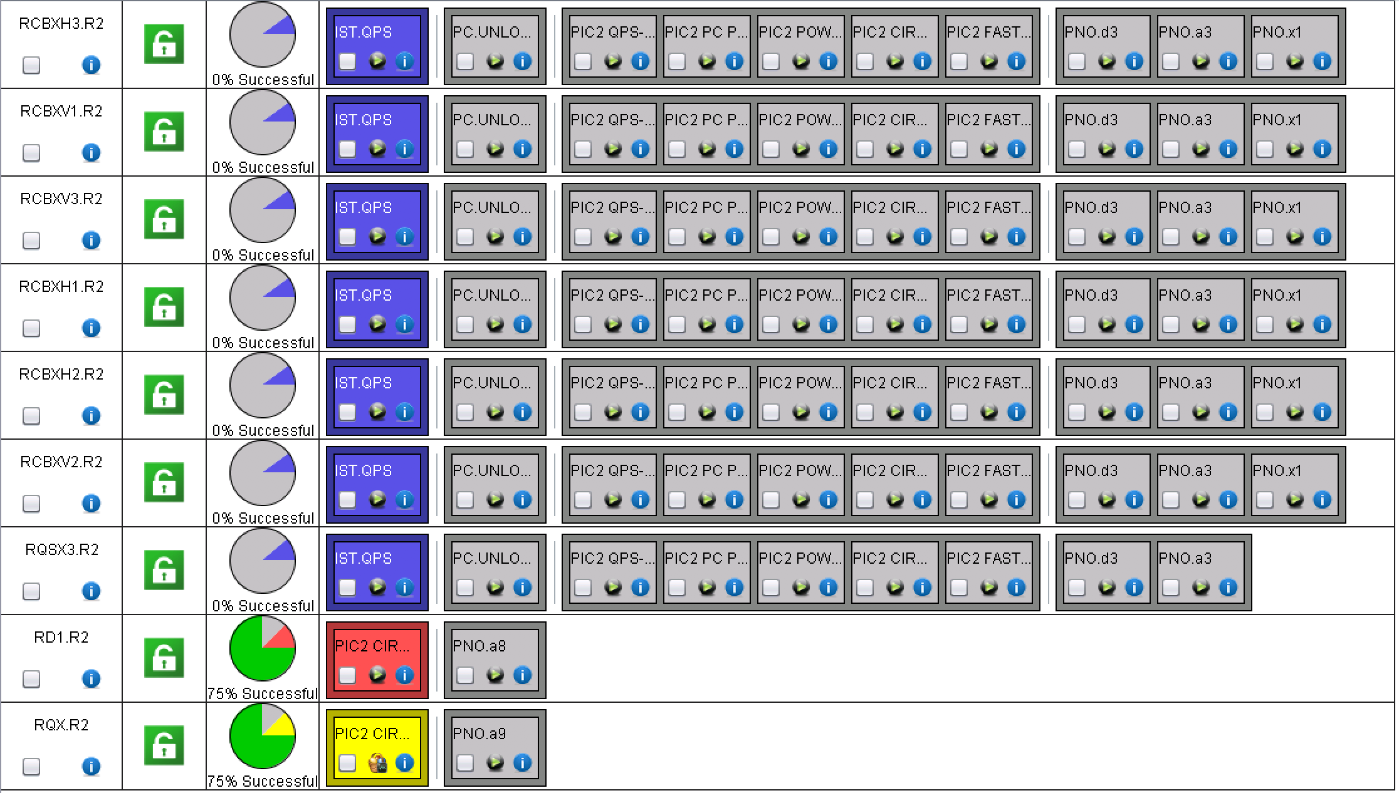
XR2
Analysis to be reviewed!

Slide 11
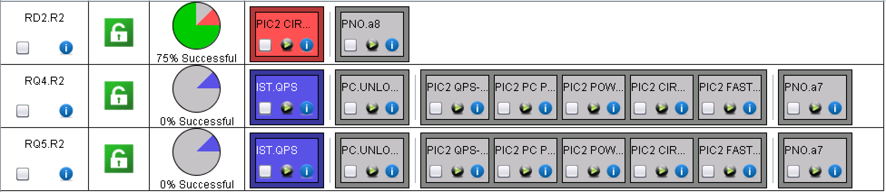
MR2
Analysis to be reviewed!

Slide 12
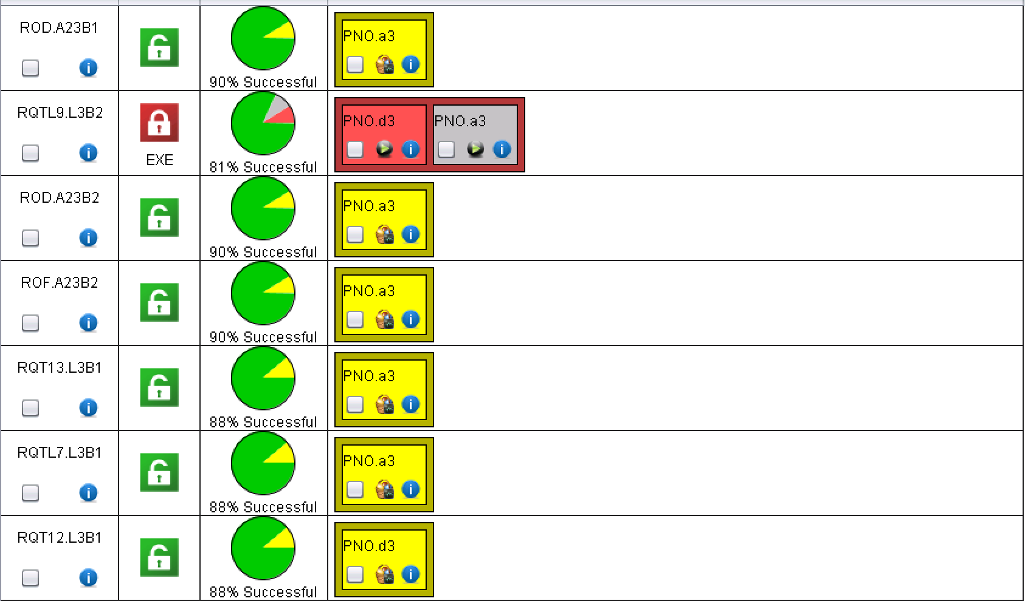
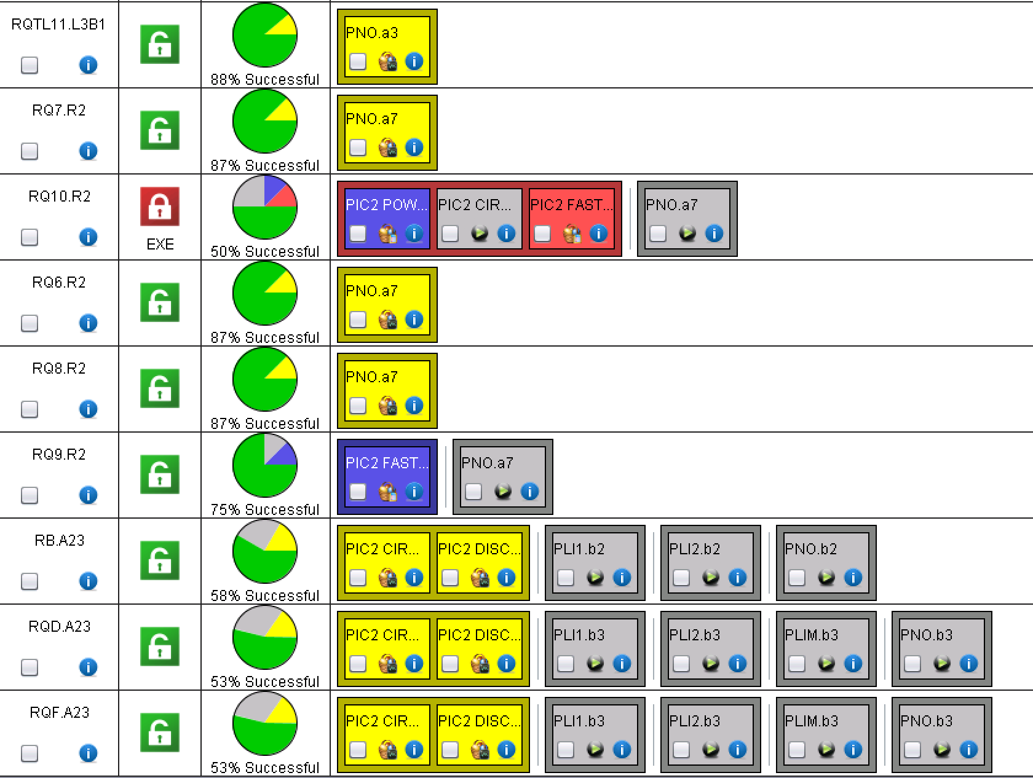
A23
Interlock test still to be done on many 600 A

Slide 13
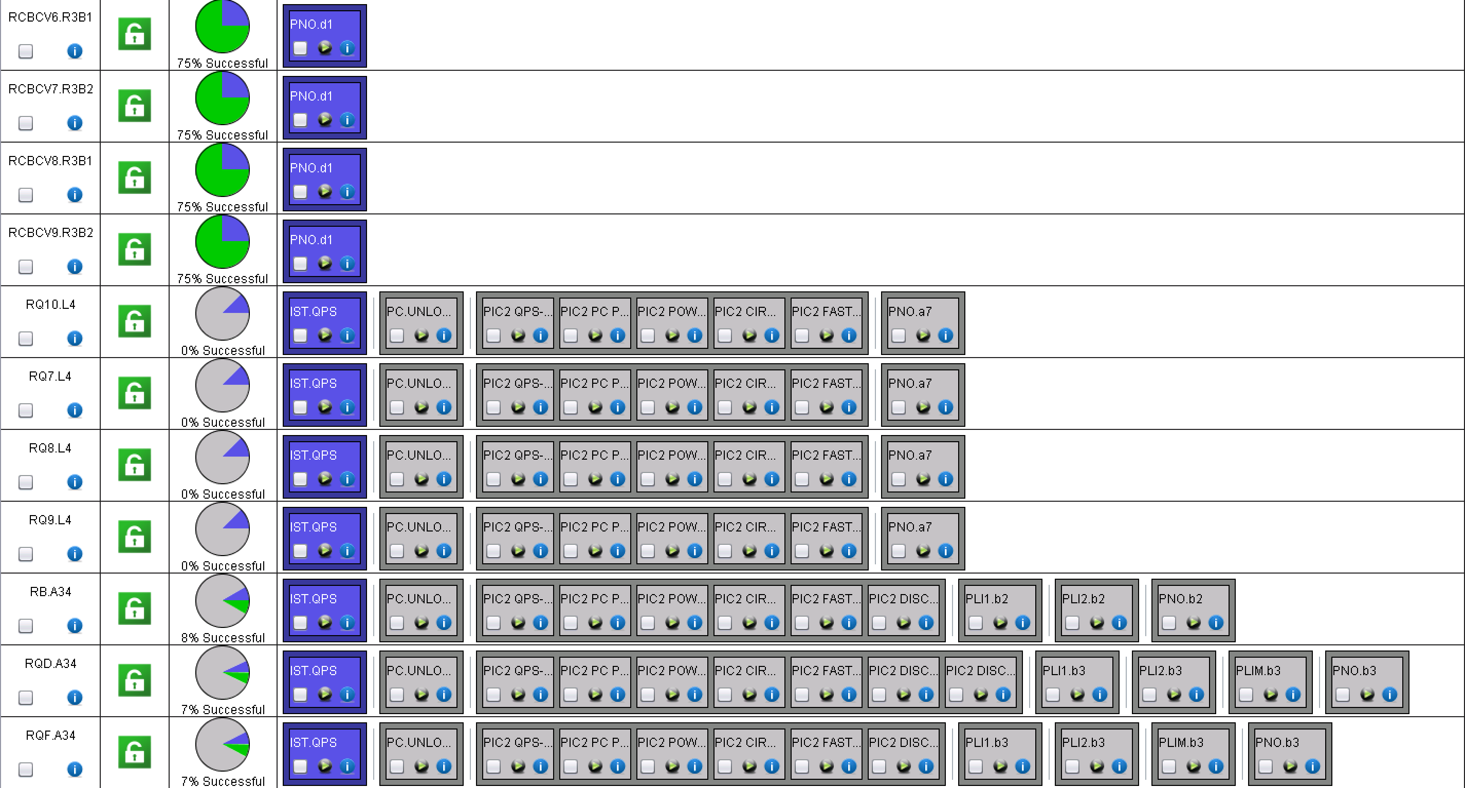
A34
IPQs to be released by QPS

Slide 14
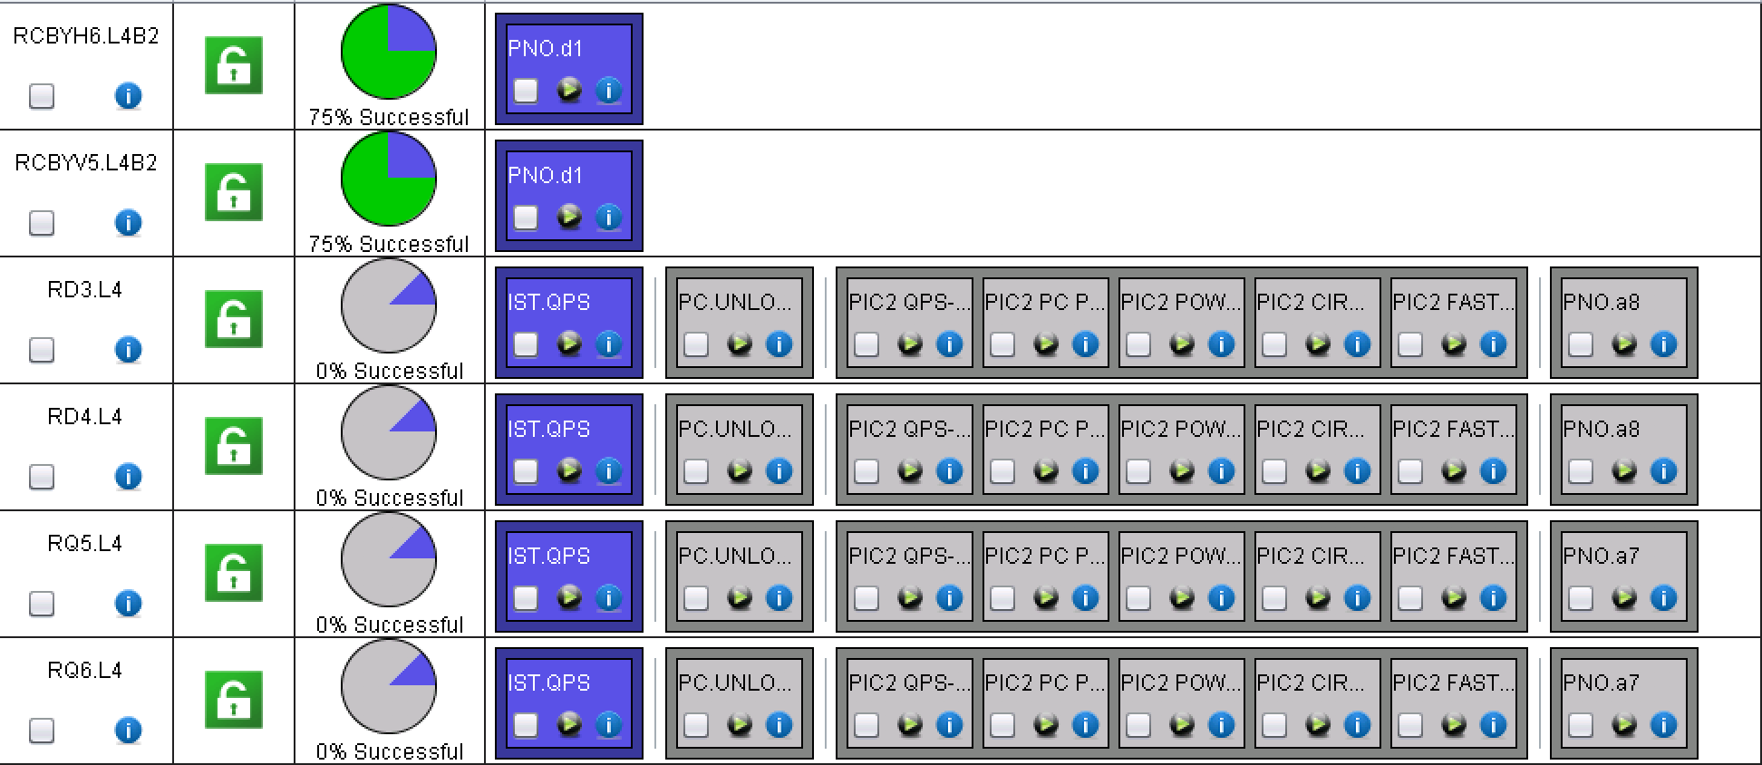
ML4
IPQs to be released by QPS

Slide 15
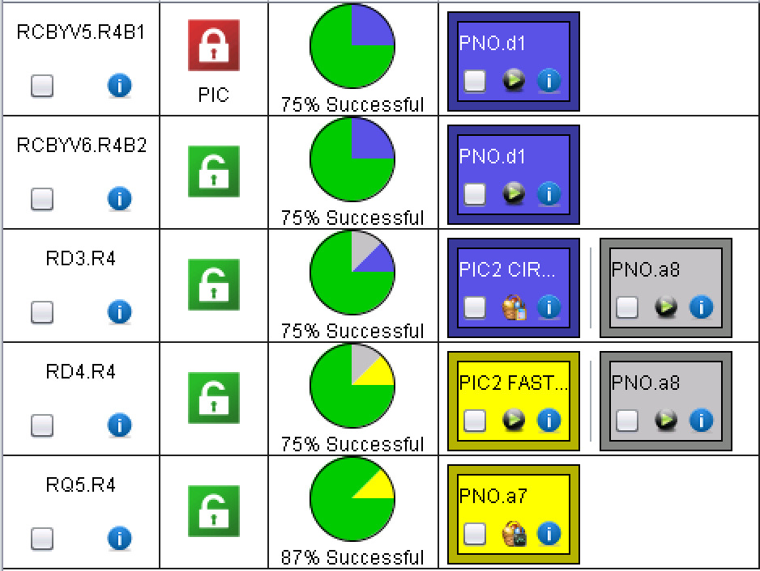
MR4

Slide 16
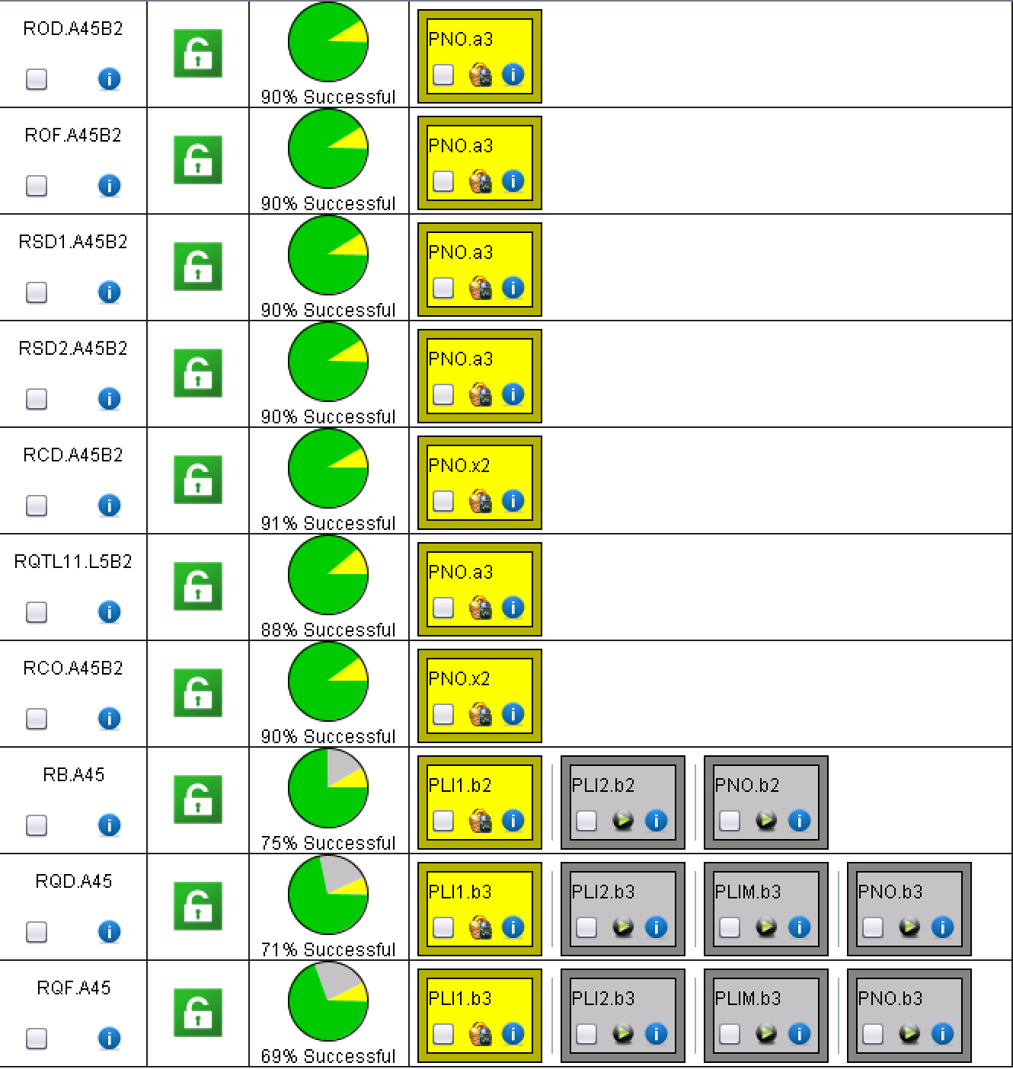
A45
Mains are at 2 kA test

Slide 17
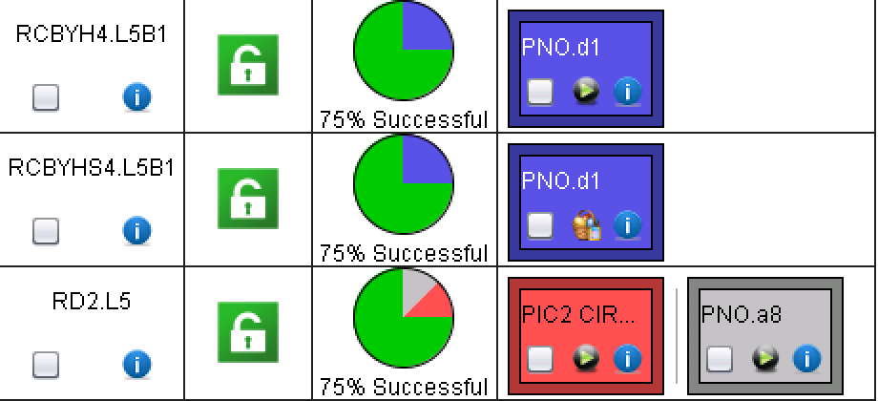
LL5
Analysis to be reviewed!

Slide 18
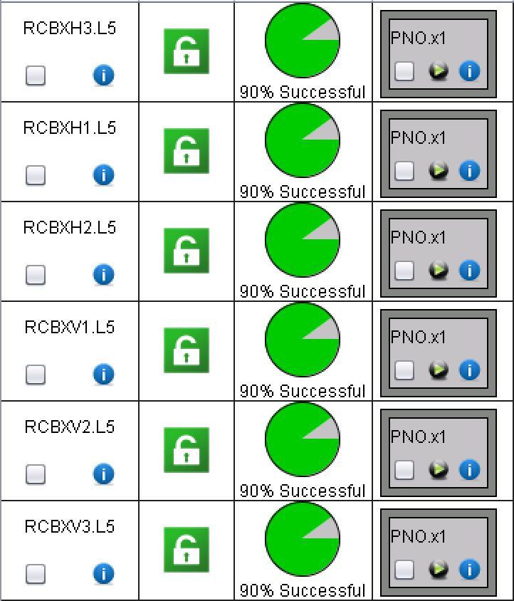
XL5
LSA updated; need to update the PC database to carry on!

Slide 19
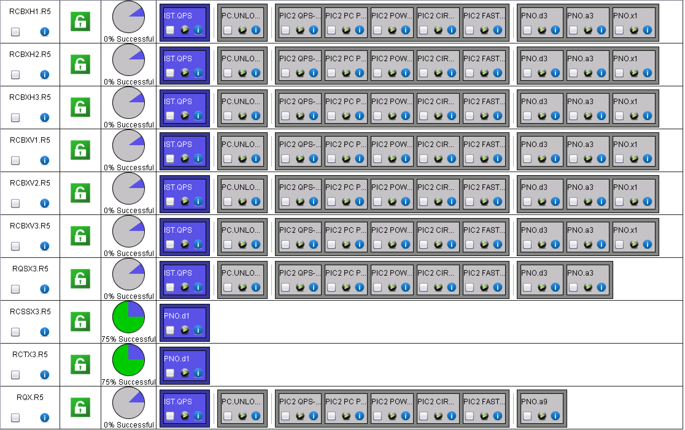
XR5

Slide 20
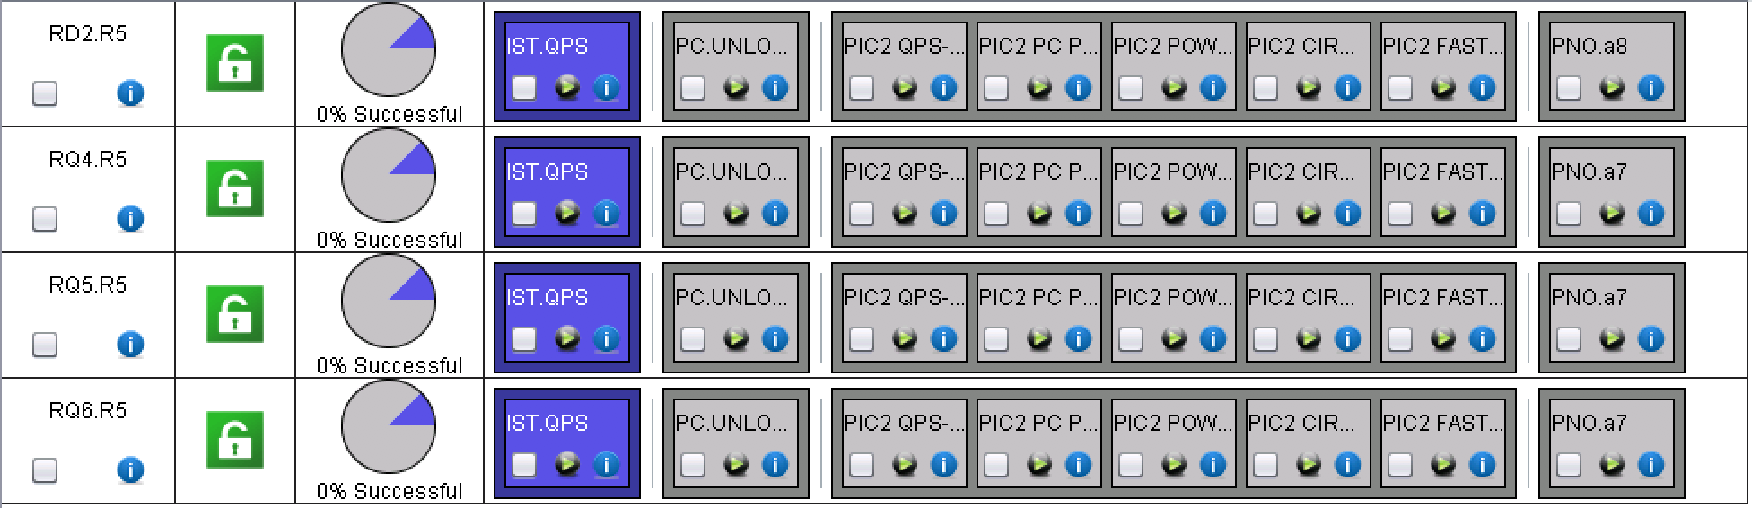
LR5

Slide 21
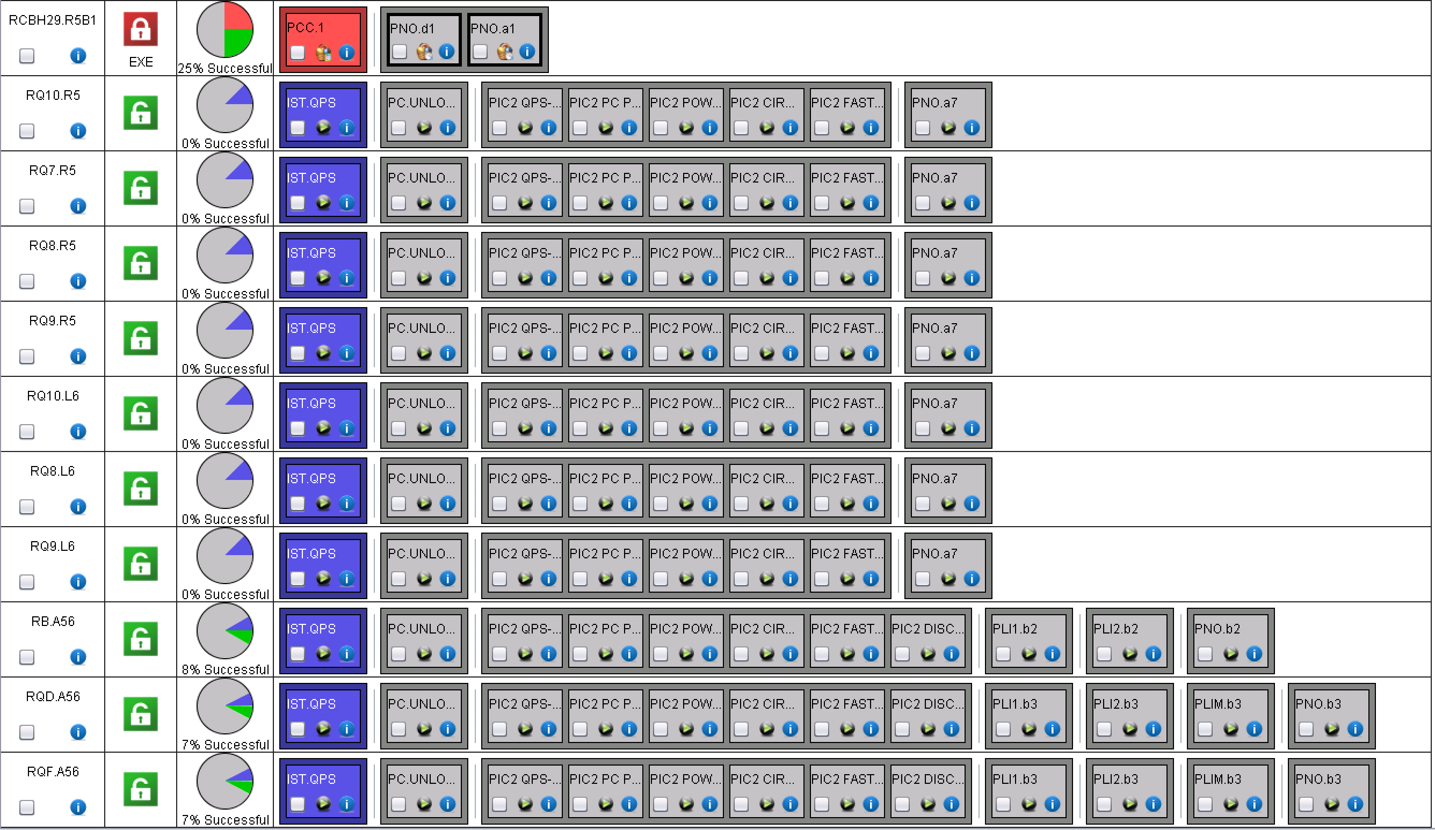
A56
Interlock test to be done on many 600 A
This has a permanent fault on the FGC!

Slide 22
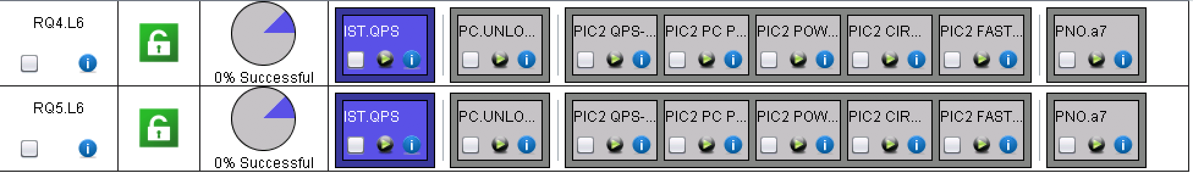
ML6

Slide 23

MR6

Slide 24
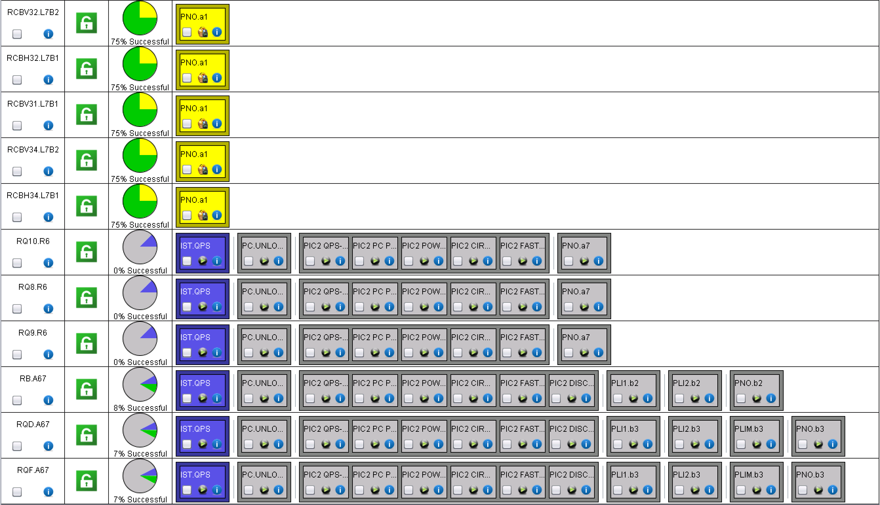
A67
Few 600 A still to be released
The analysis of several 60 A is lost somewhere
To be checked how this is possible

Slide 25
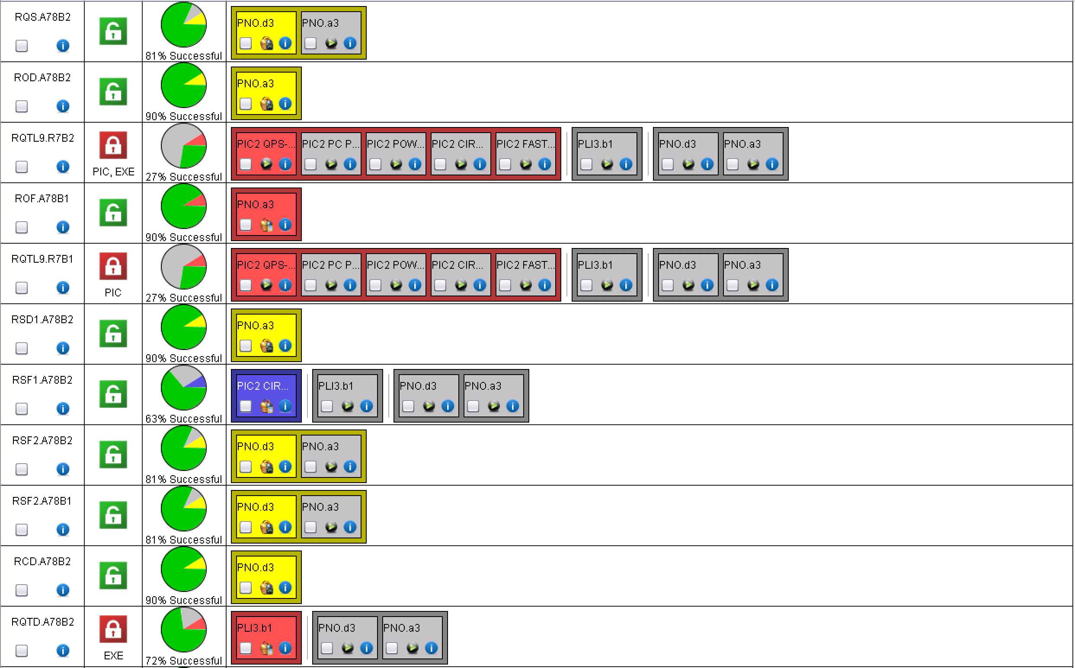
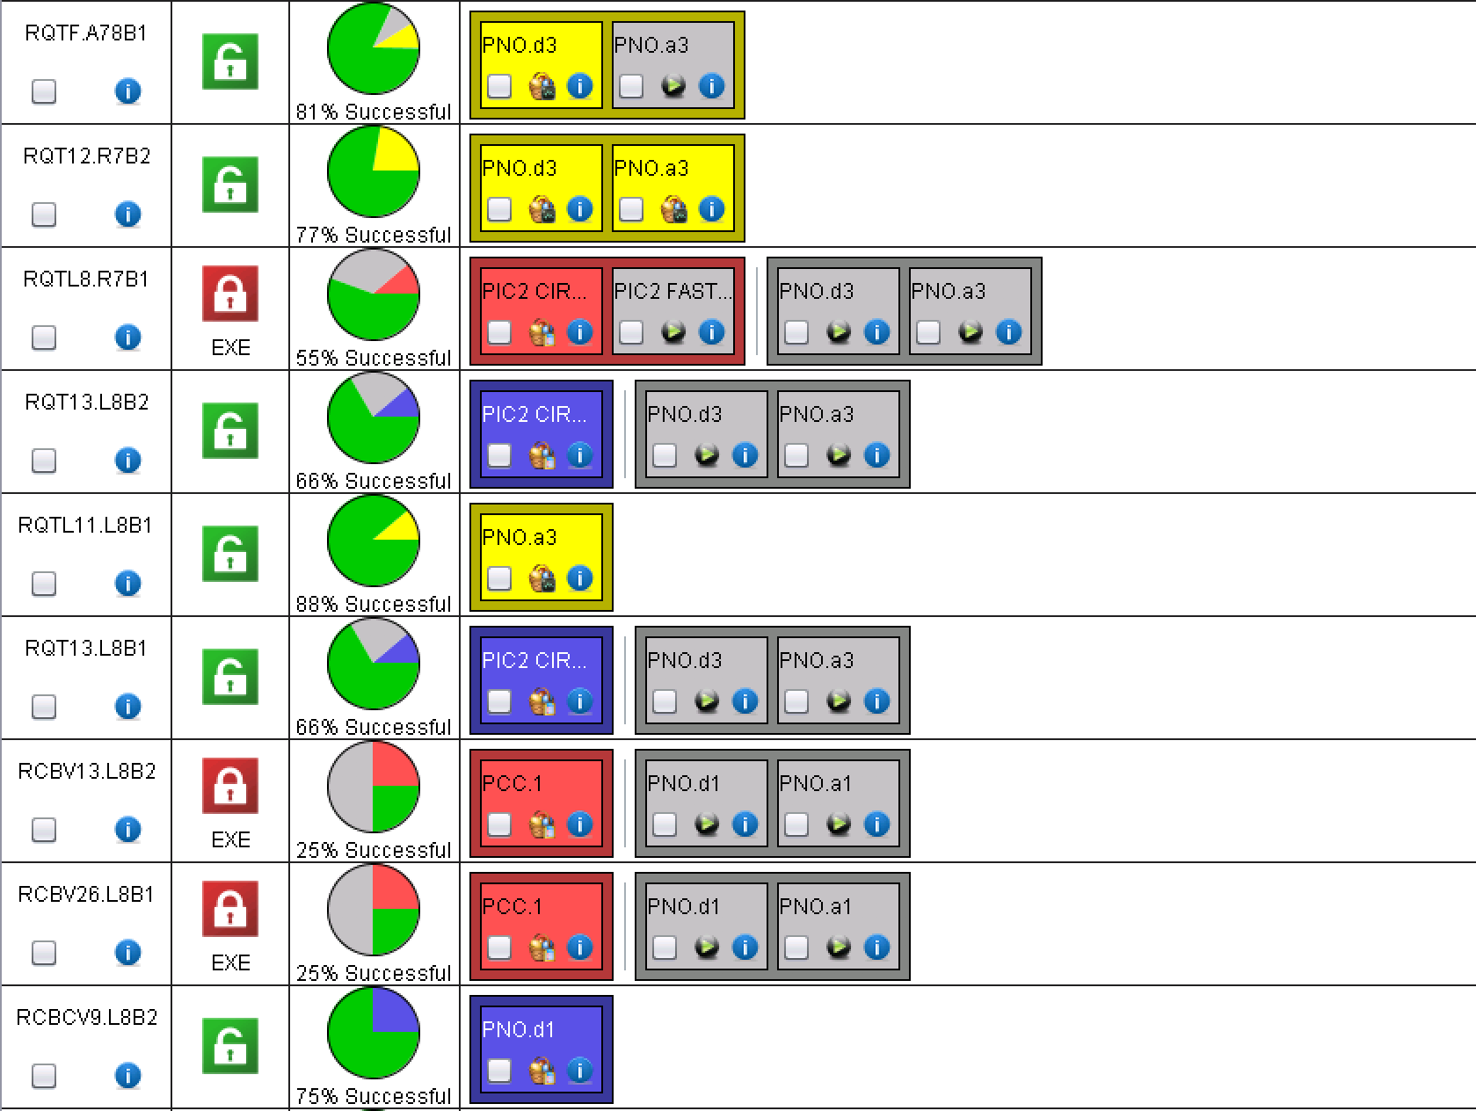
A78
RQTL9.R7B1/2 are in water fault

Slide 26
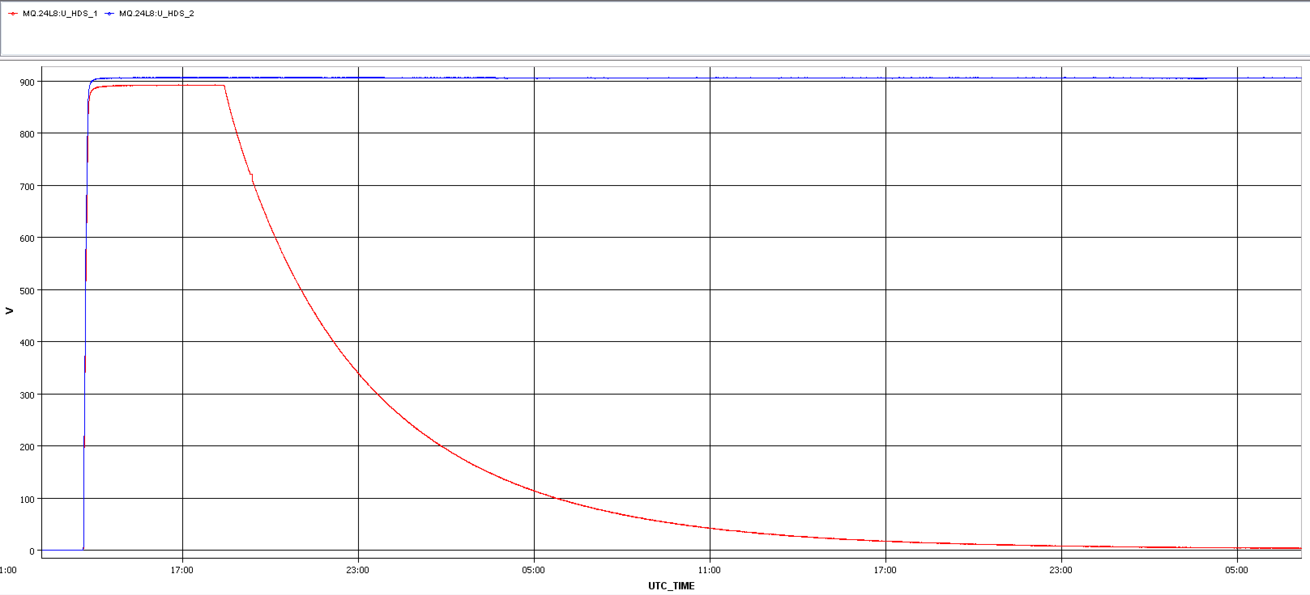
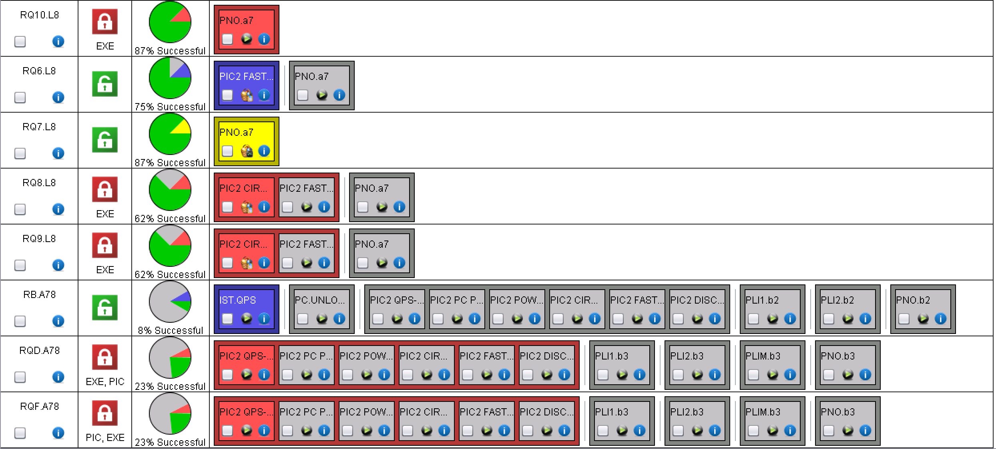
A78_cont
RQD/F no QPS OK
MQ24.L8: QH switch probably broken…
Analysis to be reviewed!

Slide 27
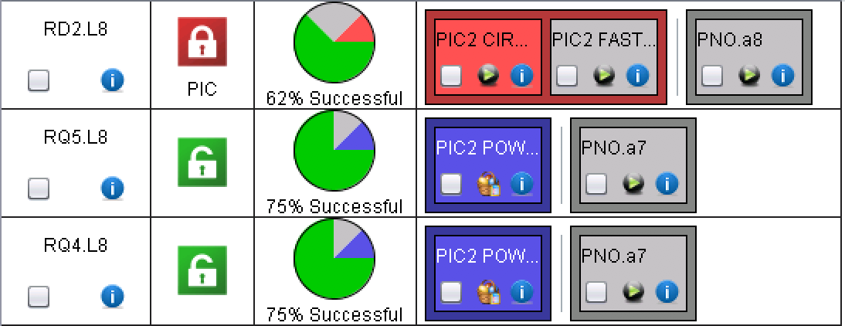
ML8
PM files missing: QPS to take a look (might be the same problem as for the others)

Slide 28
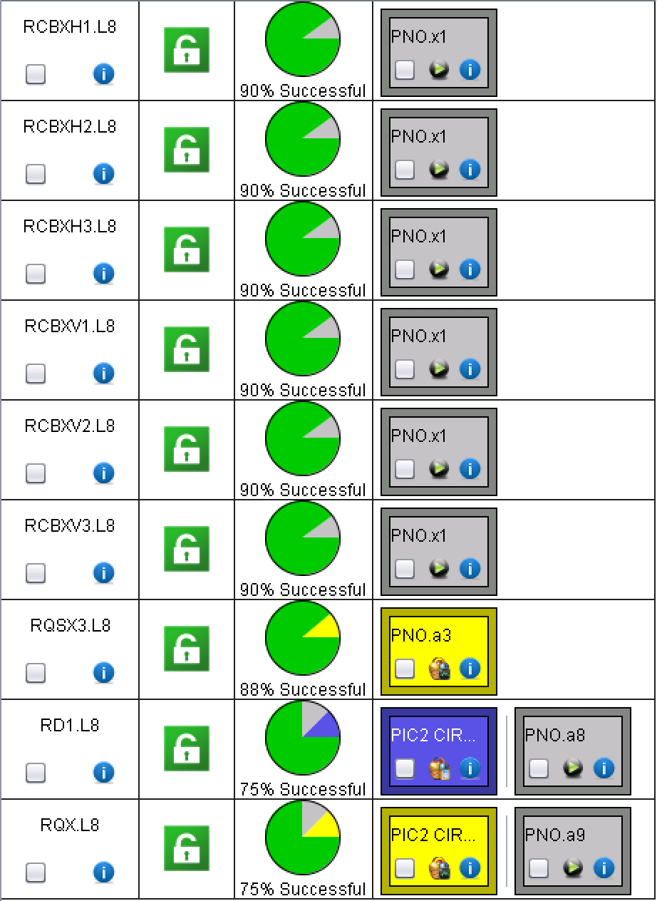
XL8
LSA updated; need to update the PC database to carry on!

Slide 29
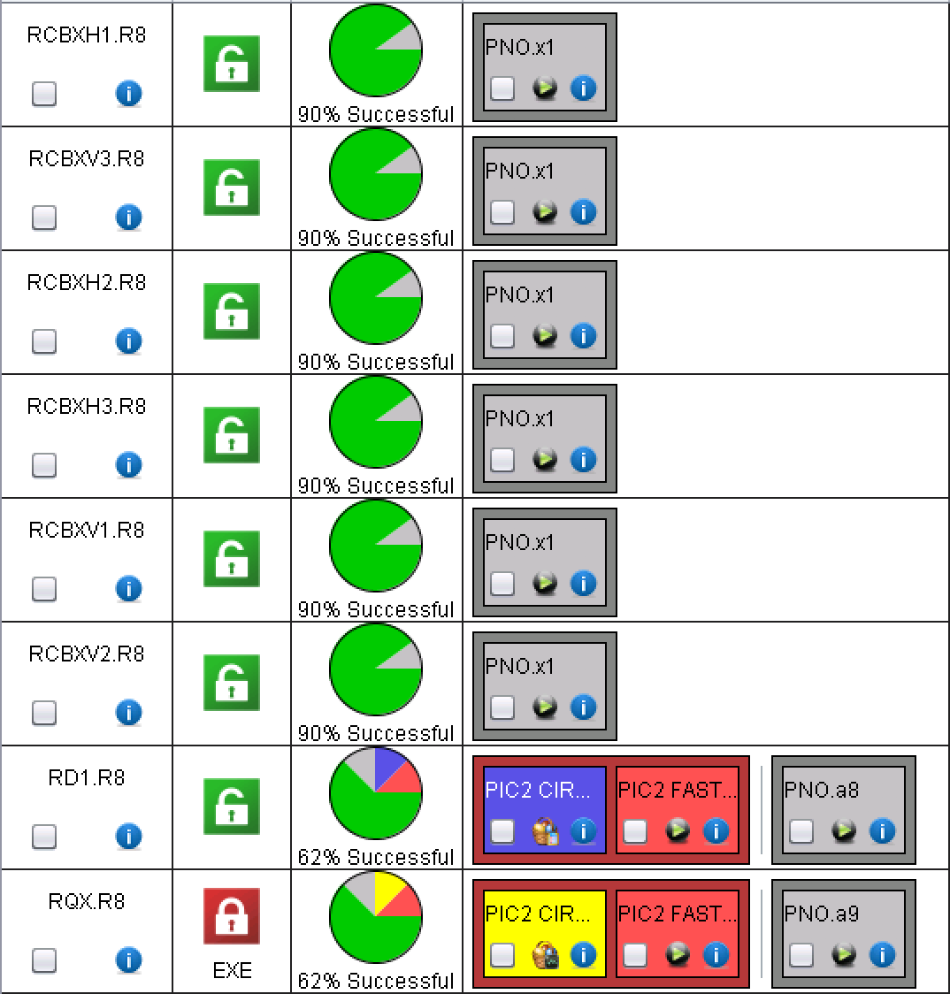
XR8
LSA updated; need to update the PC database to carry on!

Slide 30
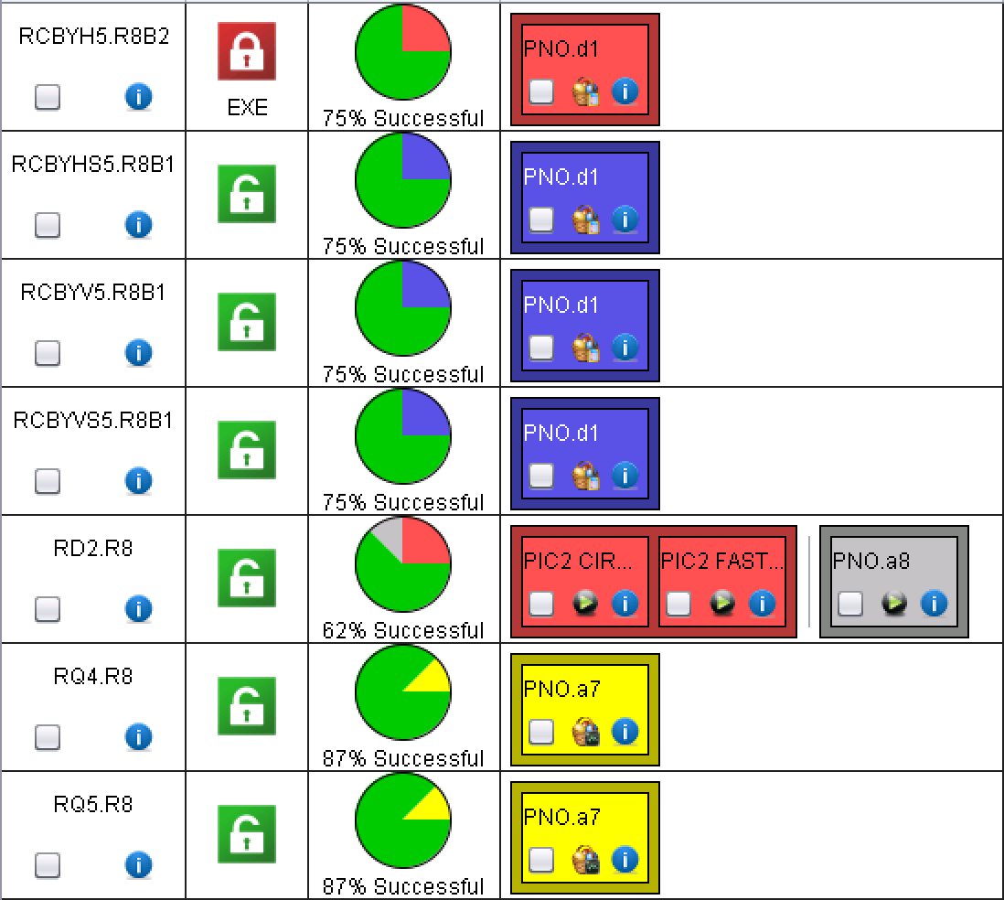
MR8

Slide 31
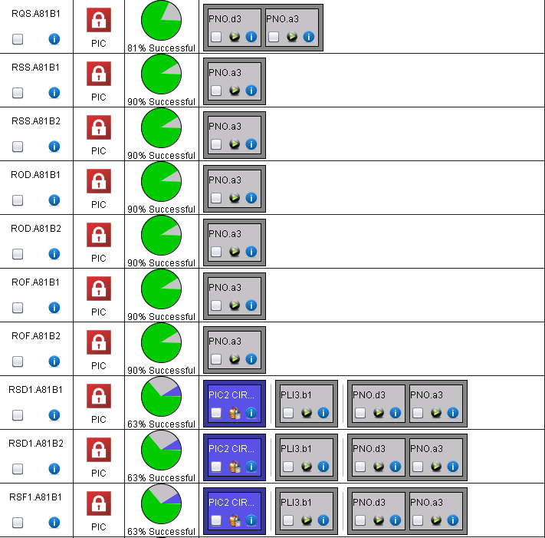
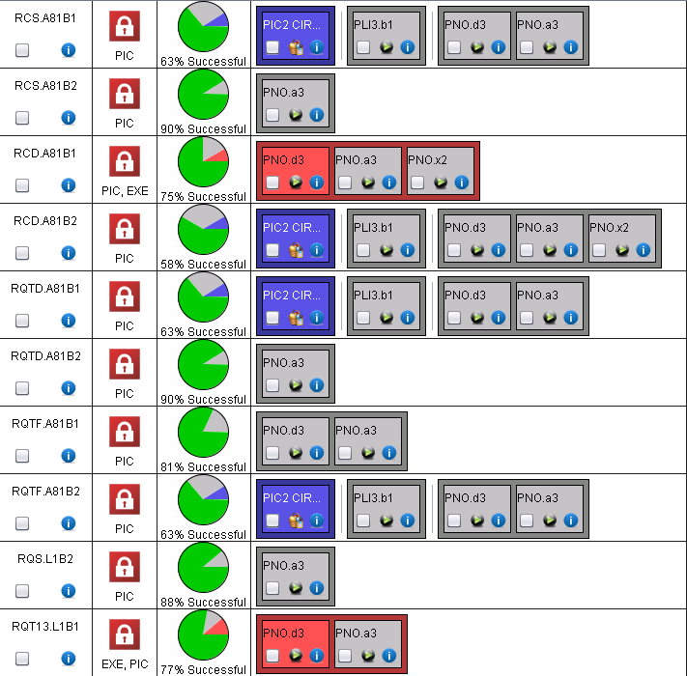
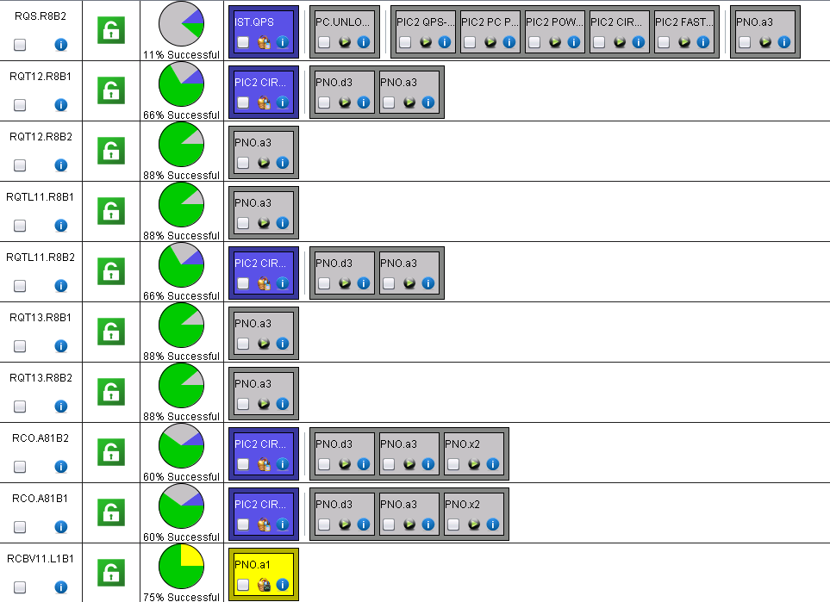
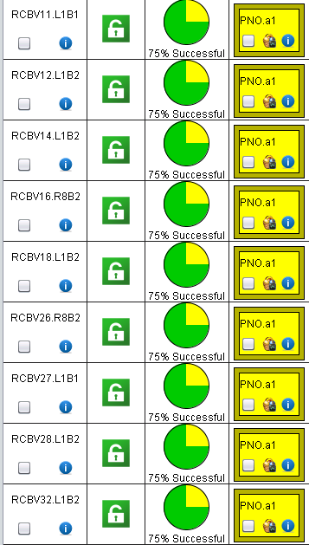
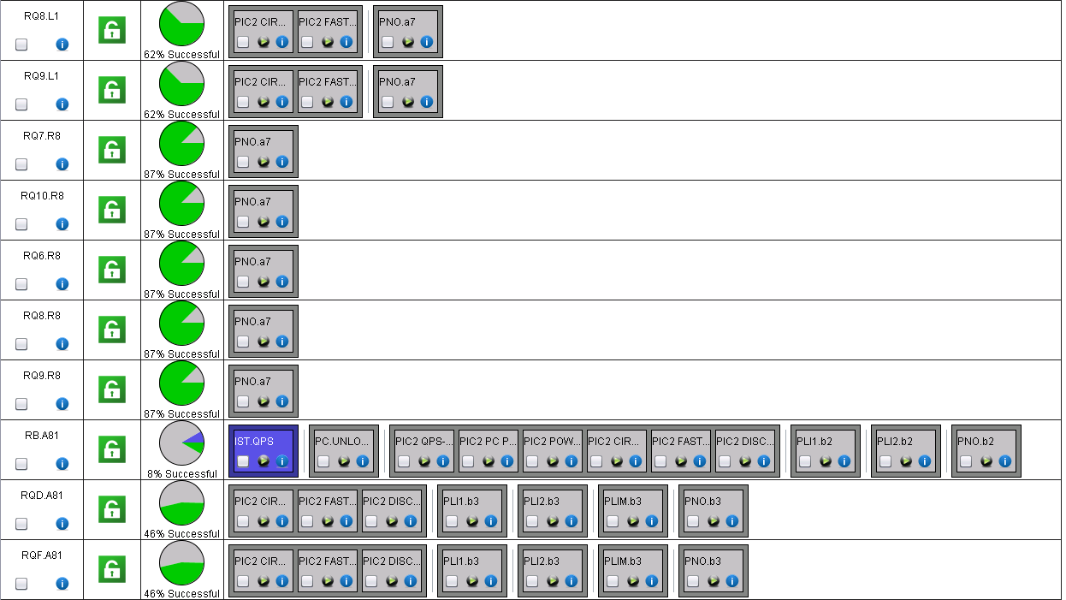
A81
The analysis of several 60 A is lost somewhere

Slide 32
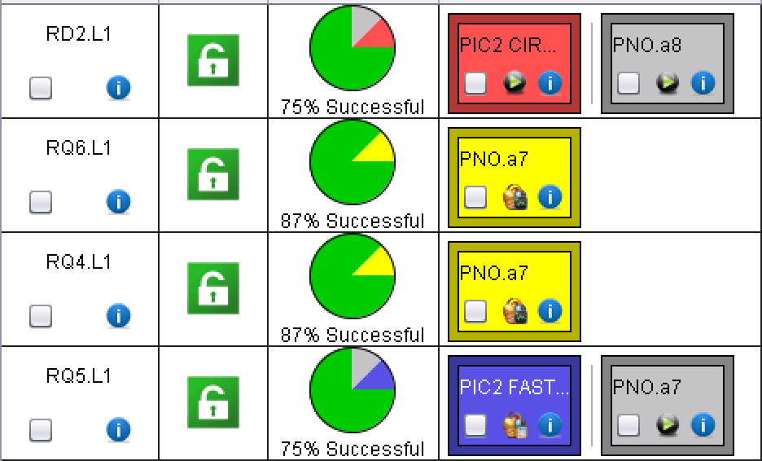
LL1

Slide 33
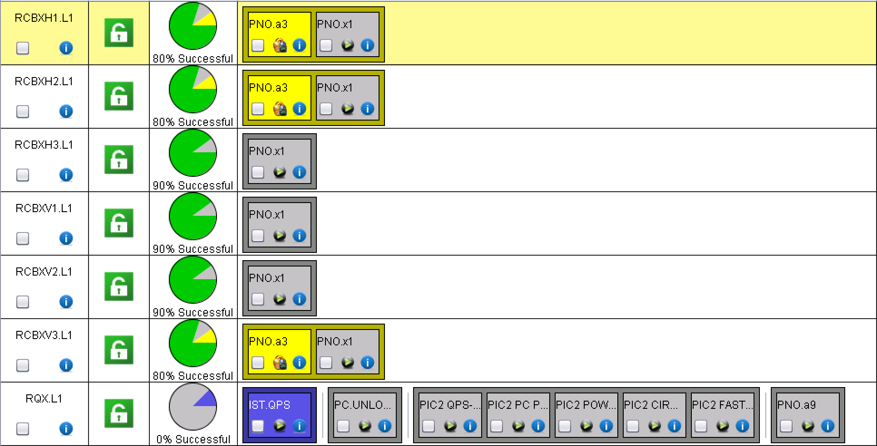
XL1
LSA updated; need to update the PC database to carry on!

Slide 34
For the future…

Slide 35
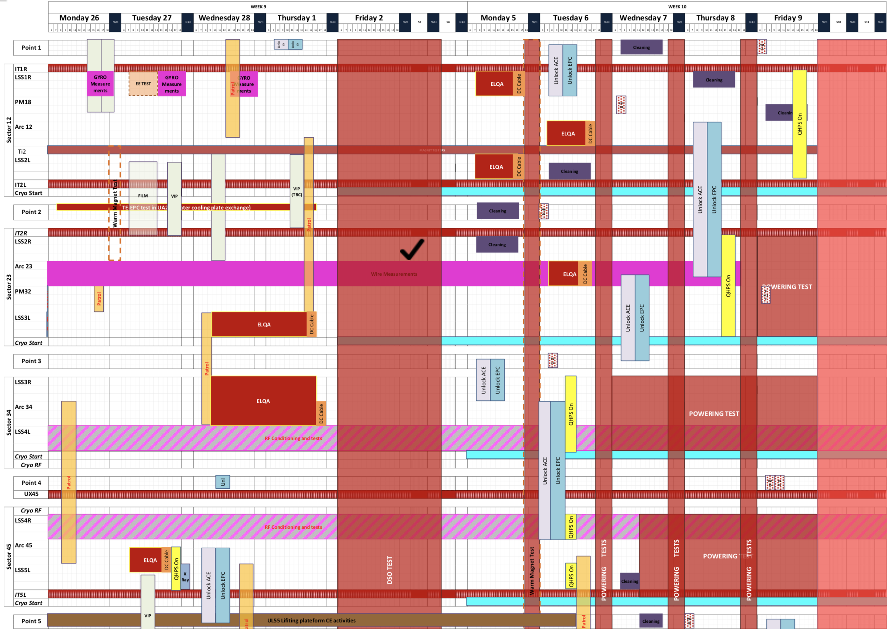
Status of preparation
Today
IT.R1
  Unlocking OK
  OK to switch ON QHPS
LR1
  Unlocking OK
  QHPS OK
A12
  Unlocking OK
  OK to switch ON remaining QHPS in 2L
ML2 and IT.L2
  Unlocking OK
  OK to switch ON remaining QHPS
IT.R2 and MR2
  Unlocking OK
  OK to switch ON remaining QHPS
A23
  Unlocking OK
  QHPS in 2R not yet ready
A34
  Unlocking OK
  QHPS OK
ML4
  Unlocking OK
  QHPS OK
MR4, A45, LL5, IT.L5
  Unlocking OK
  QHPS OK

Slide 36
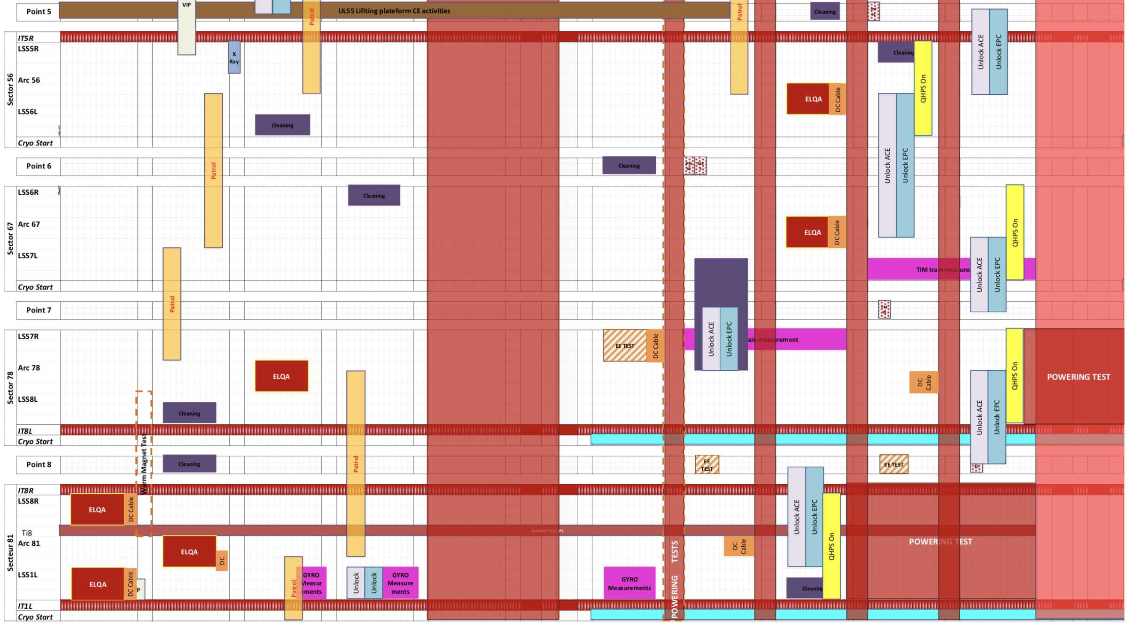
Status of preparation_2
Today
IT.R5 and LR5
  Unlocking on Fri.9
  QHPS on after QPS-IST
A56
  Unlocking OK in 6L
  Unlocking on Fri. 9 for 5R
  QHPS on after QPS-IST for IPQs
ML6 and MR6
  Unlocking OK
  QHPS on after QPS-IST
A67
  Unlocking OK
  QHPS on after QPS-IST for IPQs
A78
  Unlocking OK
  QHPS OK
ML8 and IT.L8
  Unlocking OK
  QHPS OK
IT.R8 and MR8
  Unlocking OK
  QHPS on after QPS-IST
A81
  Unlocking OK
  OK to switch ON QHPS
LL1
  Unlocking OK
  QHPS OK
IT.L1
  Unlocking OK
  OK to switch ON QHPS

Slide 37
LHC main converter calibration
I would like to ask you to foresee a window of about half a day during hardware commissioning for the calibration of all the LHC main dipole and quadrupole and inner triplet converters.
This can also be done per sector in which case I would require about ½ hour per sector.
This is done by me remotely in coordination with the engineer in charge. It requires the converters to be unlock and OFF, with all faults cleared.
The calibration simulates a current of 13kA in the converter so any interlocks that might trip the converter at that current need to be masked. I will let you evaluate when is the best moment to do it, minimizing the impact on commissioning.
Miguel
To be organized possibly at the end of next week!

Slide 38
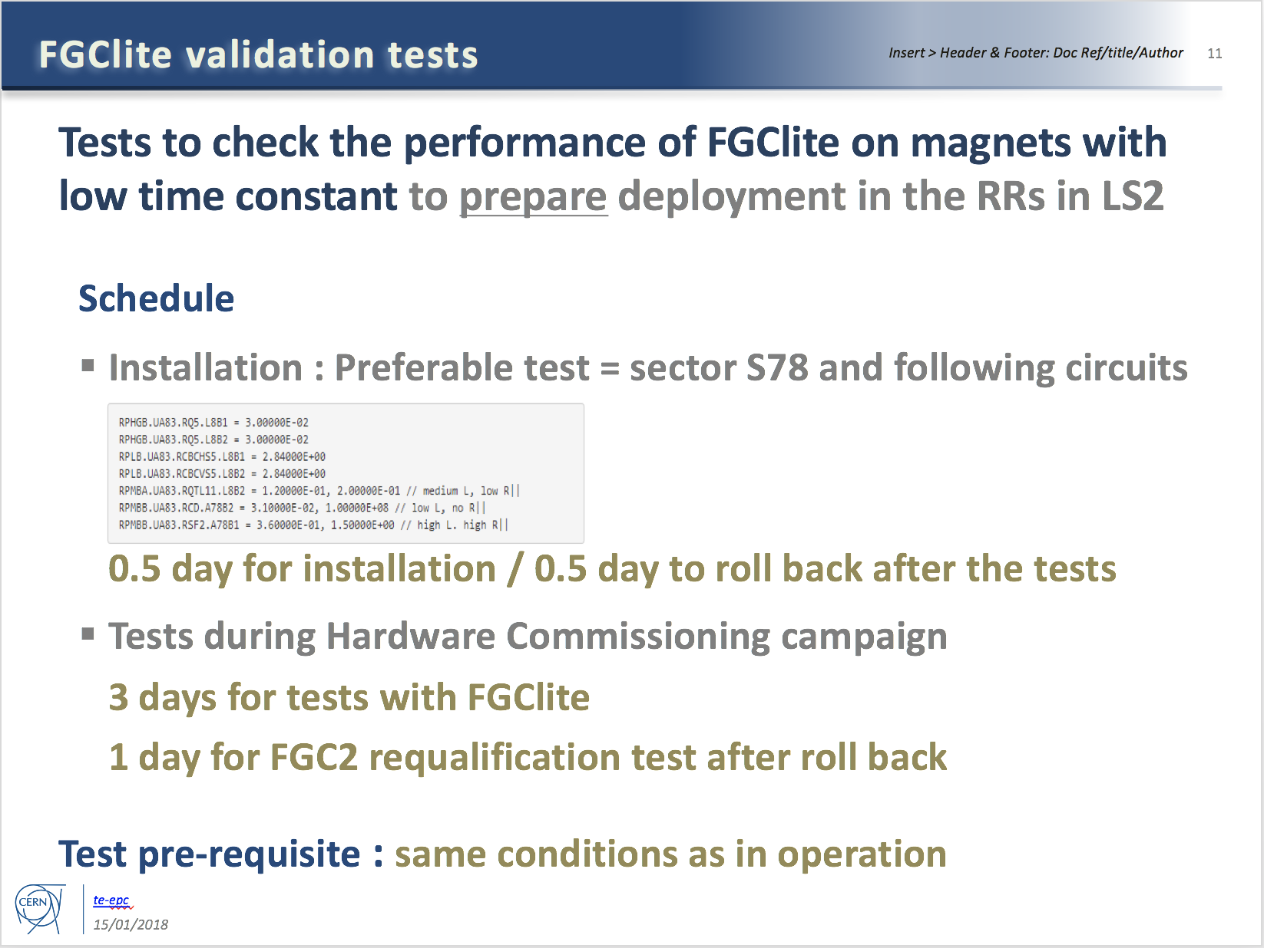
Additional tests required by EPC
To be done after circuit commissioning (if time allows)

Slide 39
Specific Powering Tests – High Priority
# | Description | Test duration * | Period | Cryo
1 | Local (30 m) localisation of shorts in RCS.A78B2, RCO.A78B1, RCO.A78B2 | 2 days | End of the powering tests. | 1.9 K
2 | Global (400 m) localisation of short in RCO.A45B1 | 1 day | Start YETS (DONE) | 1.9 K
3 | Change in EE delay of RB circuits | 0.5 day | During powering tests | 1.9 K
4a | Voltage pick-up of the QPS due to current in the bypass diode | 2 days | Anytime during YETS | <20 K
4b | Heater-induced quench on 2 MB’s | 0.5 day | Start YETS (DONE) | 1.9 K
5 | Quench heaters test in S12 | 0.5 day | End of YETS, during the QPS IST | 1.9 K
6 | Resistance in RQF.A23 and RQD.A78 | 1 day | End of powering tests | 1.9 K
Installation being finalized
Remember to do the 500 V and 900 V tests while switching on
*: not including the time for installation & removal of equipment

Slide 40
Specific Powering Tests – Medium Priority
# | Description | Test duration * | Period | Cryo
7 | Change in EE delay of RQD/F circuits | 0.5 day | During powering tests | 1.9 K
8 | Resistance in ROD.A56B1 | 1 day | Start of YETS (DONE) | 1.9 K
9 | Internal resistance of 3-6 MB’s | 1 day | Start of YETS or during powering tests | 1.9 K
10 | Investigate degradation of RCBXH/V in IR1/5 | 0.5 day | Start of YETS (DONE) | 1.9 K
System installed in S34
Results of investigations priori to YETS:
Short could not be reproduced in RCO.A45B1 (only few 100kOhms occasionally visible)
2 heater induced quenches performed in S45
Location of increased resistance in ROD identified, segment in question to be bypassed in LS2
None of the 12 RCBXH/V circuits showed any visible degradation after having been cycled many times and after having seen quite a bit of radiation. Final conclusions will be made after the powering test in March 2018.
*: not including the time for installation & removal of equipment

Slide 41
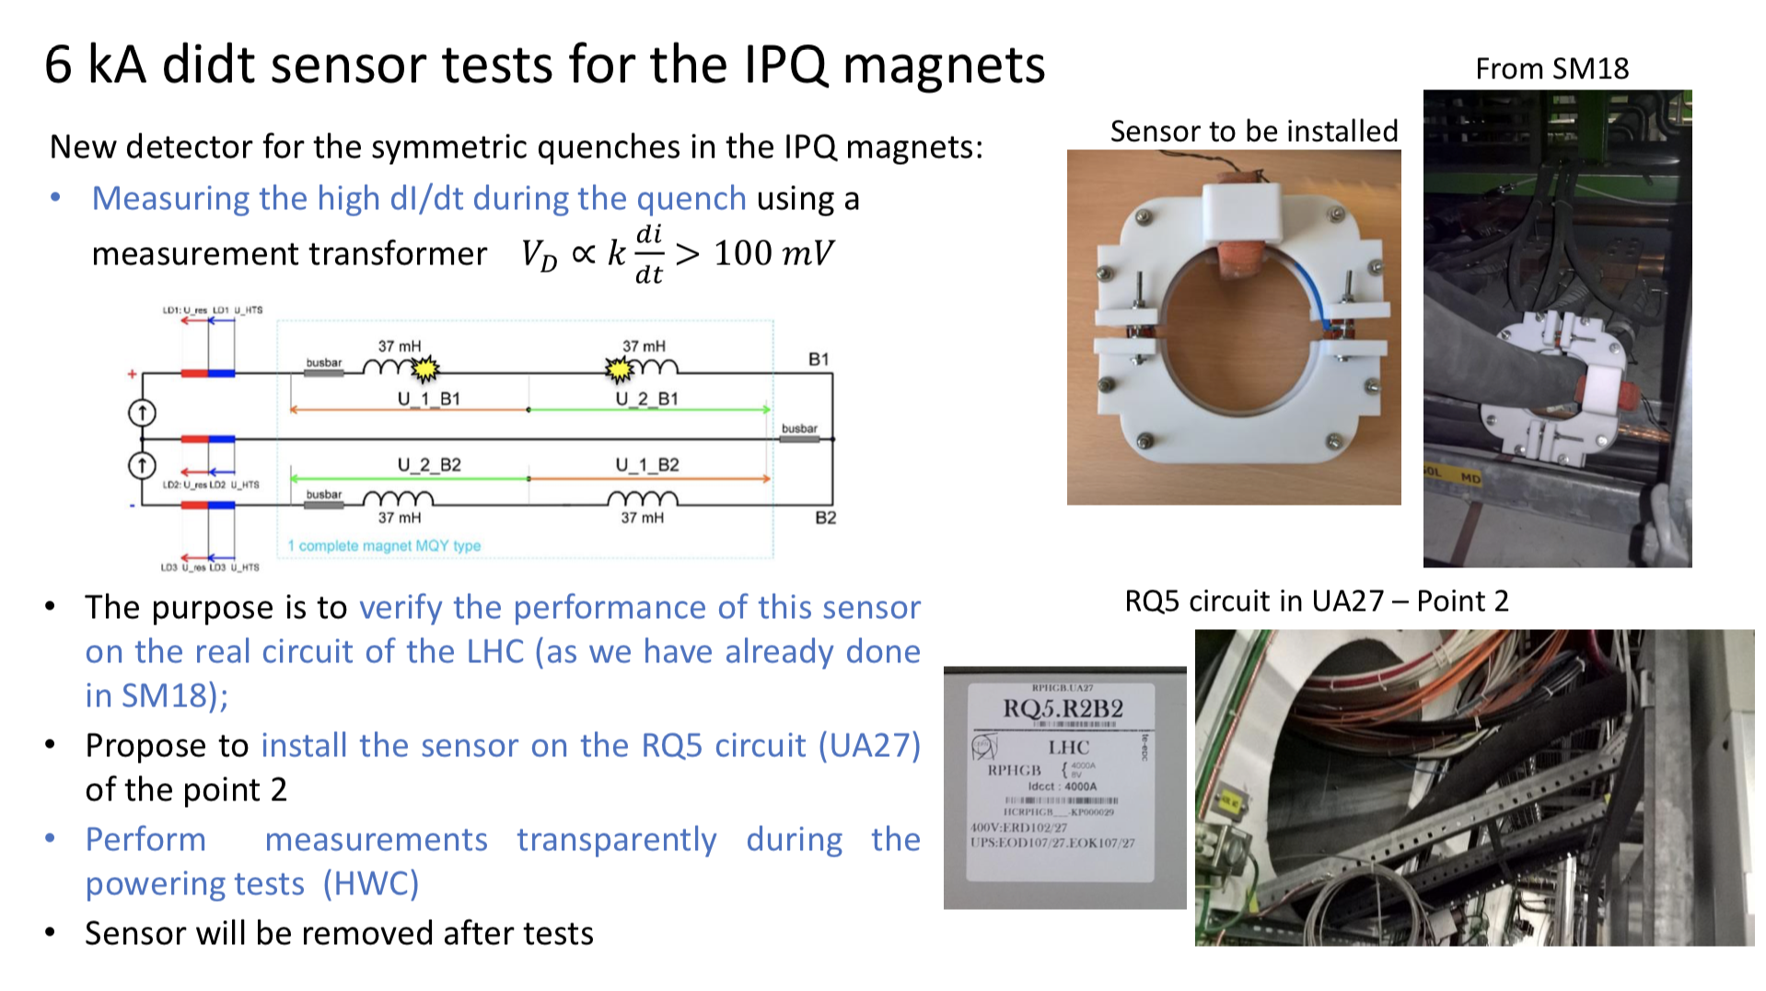
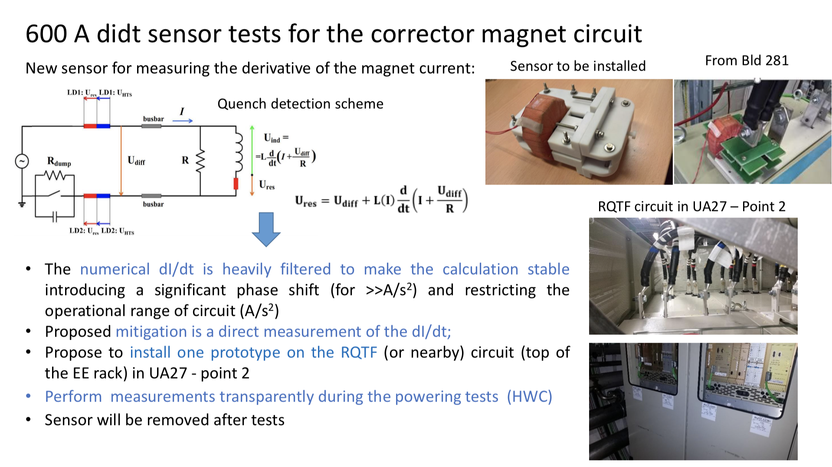
Powering at high current for RQ5.R2 and RQTF.A23B1 should be done only after informing Ernesto de Matteis

Slide 42
Conical connection check in UA27
Following the problem with the conical connection after LS1, MPE would like to repeat the conical connection measurements in UA27
  System installed before end of YETS
  Measurements parasitically done
  System to be removed at the end of commissioning (condemnation required)

Slide 43
For the future future…
For IPQs: PNO.a7 sometimes fails on Wait PCs to be FAULT_OFF; should probably increase the timeout
For all, but in particular the 600 A: should separate the PNO@training_current from the other tests
For 600 A: should reset the EE automatically after SOF mode
….

Slide 44
Thank you for the attention!

