Slide 1
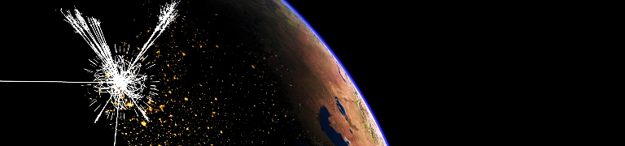
Foundations of statistics (1)
Andreas Hoecker (CERN)
CERN Summer Student Lecture, 26–29 July 2018
If you have questions, please do not hesitate to contact me: andreas.hoecker@cern.ch

Slide 2
Outline (4 lectures)
  1st lecture:
    Introduction
    Probability
  2nd lecture:
    Probability axioms and hypothesis testing
    Parameter estimation
    Confidence levels
  3rd lecture:
    Maximum likelihood fits
    Monte Carlo methods
    Data unfolding
  4th lecture:
    Multivariate techniques and machine learning
Slides with title: Digression — …
→ not discussed here, for later reading

Slide 3
Outline (4 lectures)
  1st lecture:
    Introduction
    Probability
  2nd lecture:
    Probability axioms and hypothesis testing
    Parameter estimation
    Confidence levels
  3rd lecture:
    Maximum likelihood fits
    Monte Carlo methods
    Data unfolding
  4th lecture:
    Multivariate techniques and machine learning
…a bit dry

Slide 4
Acknowledgements and some further reading
I am grateful to Helge Voss, whose comprehensive statistics lectures serve as model for the present lectures. His latest lectures on multivariate analysis and neural networks at the School of Statistics, 2016: https://indico.in2p3.fr/event/12667/other-view?view=standard
Glen Cowan’s book “Statistical data analysis” represents a great introduction: http://www.pp.rhul.ac.uk/~cowan/sda
PDG reviews by G. Cowan on probability (http://pdg.lbl.gov/2013/reviews/rpp2013-rev-probability.pdf ) and statistics (http://pdg.lbl.gov/2013/reviews/rpp2013-rev-statistics.pdf) :
Luca Lista’s lectures “Practical Statistics for Particle Physicists”, at the CERN-JINR school 2016: https://indico.cern.ch/event/467465/other-view?daysPerRow=5&view=nicecompact
Kyle Cranmer’s article “Practical Statistics for the LHC”, arXiv:1503.07622
Harrisson Prospers 2015 CERN Academic Training lecture “Practical Statistics for LHC Physicists”: https://indico.cern.ch/event/358542/
Machine learning introduction: T. Hastie, R. Tibshirani, J. Friedman, “The Elements of Statistical Learning”, Springer 2001; C.M. Bishop, “Pattern Recognition and Machine Learning”, Springer 2006
Very incomplete list. Some more references are given throughout the lecture.

Slide 5
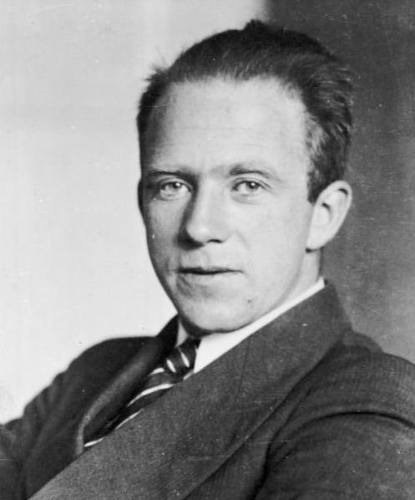

Why we need probability in the particle world
Since Pierre-Simon Laplace’s times (1749–1827) the universe’s fate was deterministic and, in spite of technical difficulties, was considered predictible if the complete equation of state were known.
Challenged by Heisenberg’s uncertainty principle (1927), Albert Einstein proclaimed “Gott würfelt nicht ” (“God does not play dice”), but so-called hidden variables to bring back determinism through the back door into the quantum world were never found.
In quantum mechanics, particles are represented by wave functions. The size of the wave function gives the probability that the particle will be found in a given position. The rate, at which the wave function varies from point to point, gives the speed of the particle.
Quantum phenomena like particle reactions occur according to certain probabilities. Quantum field theory allows us to compute cross-sections of particle production in scattering processes, and decays of particles. It cannot, however, predict how a single event will come out. We use probabilistic “Monte Carlo” techniques to simulate event-by-event realisations of quantum probabilities.
Pierre-Simon de Laplace
Albert Einstein
Werner Heisenberg

Slide 6
Statistics of large systems
Statistical physics uses probability theory and statistics to make statements about the approximate physics of large populations of stochastic nature, neglecting individuals.
Heavy-ion collisions at the LHC are modelled using notions of hydrodynamics (the strongly interacting medium behaves like perfect fluid)
Statistical mechanics provides a framework for relating the microscopic properties of individual atoms and molecules to the macroscopic properties of materials that can be observed in everyday life. It thus explains thermodynamics as a natural result of statistics, classical mechanics, and quantum mechanics at the microscopic level.
Display of ATLAS Run-2 Heavy-Ion collision
Probability and statistics are fundamental ingredients & tools in all modern sciences

Slide 7
Statistics in measurement processes
In addition to the intrinsic probabilistic character of particle reactions, the measurement process through the interaction of particles with active detector materials contributes statistical degrees of freedom leading to measurement errors and to genuine systematic effects (eg, detector misalignment), that need to be considered in the statistical analysis

Slide 8
Statistics in measurement processes
Multiple scattering (diffusion) of light passing through a wetter and wetter windscreen (left to right).
Track fitting in the LHC environment is challenging. It must deal with ambiguities, hit overlaps, multiple scattering, bremsstrahlung, multiple vertices, etc. Track fitters take Gaussian noise (e.g., Kalman filter) and non-Gaussian noise (e.g., Gaussian sum filter) into account.
Fitting is a statistical procedure that takes into account a priori known uncertainties.

Slide 9
Measurements and hypothesis testing
From a measured data sample, we want to determine parameters of a known model (eg, the top-quark mass in the Standard Model), we want to discover and measure missing pieces of the model (eg, the Higgs boson, neutrino masses), and we want to watch out for the unknown (test the data versus the predictions of a known model), or exclude parameters of suggested new physics models
Supersymmetry ?
The Standard Model:
The model needed to be developed
Its particles needed to be observed
Its parameters needed to be measured
Is it all there is ?

Slide 10
Ingredients
Due to the intrinsic randomness of the data, probability theory is required to extract the information that addresses our questions. Statistics is used for the actual data analysis.
The interpretation of probability depends on the statement we want to make.
    For repeatable experiments, probability can be a measure of how frequently a statement is true
    In a more subjective approach, one could expresses a degree of belief of a statement
Repeatable experiments are for example:
    Playing a dice and finding 6
    Fluctuations in a background distribution and finding a peak of some size or more (note that the contrary: the probability that the peak is due to a background fluctuation, is not repeatable)
[ ATLAS, arXiv:1506.00962 ]
Non-repeatable statements are for example:
    The probability that dark matter is made of axions
    The probability that the new 125 GeV boson is the Higgs boson

Slide 11
Short excursion: Look-elsewhere effect (aka: trials factor)
If we compute the probability (relative frequency) of an observed “bump” to happen under the background hypothesis, we need to take into account that the bump might occur anywhere in the spectrum as we do not know where the new physics would lie
→ Need to correct observed result by the trials factor (eg, using pseudo Monte Carlo event)
    Ignoring the trials factor would be similar to ignoring that the probability of finding 6 when playing dice increases from 0.17 with a single dice to, eg, 0.60 with 5 dice
Repeatable experiments are for example:
    Playing a dice and finding 6
    Fluctuations in a background distribution and finding a peak of some size or more (note that the contrary: the probability that the peak is due to a background fluctuation, is not repeatable)
[ ATLAS, arXiv:1506.00962 ]

Slide 12
Random variables
In a statistical context, instead of “data” that follow a distribution, one often (typically) speaks of a “random variable”
The data follow an (unknown) distribution of a random variable. Although we plot error bars around observed data points, a given observation does not have an uncertainty. It is fixed. It would be more correct to plot the error bar around the prediction. By plotting the error bar around the observation, we assume by convenience the observed value to be the truth.
Custom:
Actually:
Observation
Observation
Prediction
Prediction

Slide 13
Statistical distributions
Measurement results typically follow some “distribution”, ie, the data do not appear at fixed values, but are “spread out” in a characteristic way
Which type of distribution it follows depends on the particular case
    It is important to know the occurring distributions to be able to pick the correct one when interpreting the data (example: Poisson vs. Compound Poisson)
    …and it is important to know their characteristics to extract the correct information

Slide 14
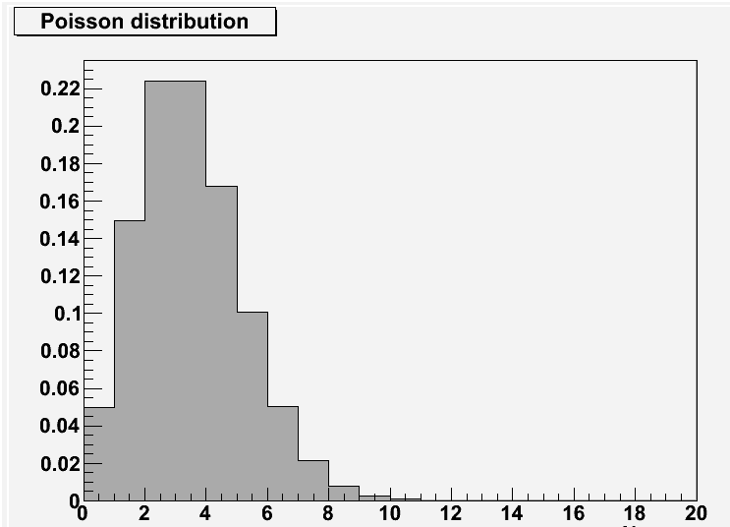
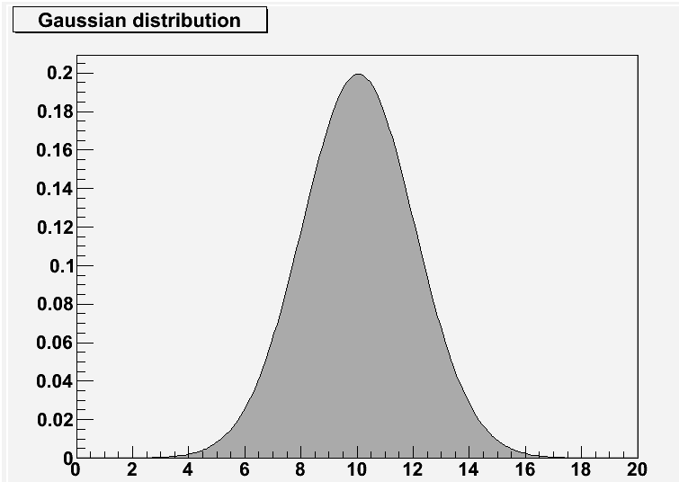

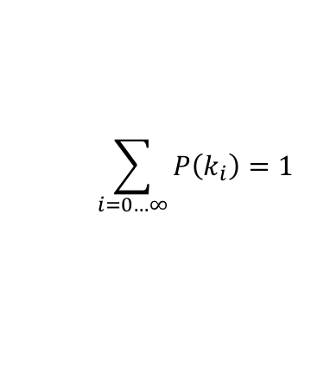


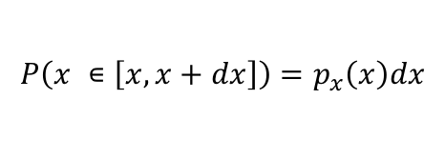

Probability distribution / density of a random variable
Random variable $k$ (discrete) or $x$ (continuous): quantity or point in sample space
Discrete variable
Continuous variable
$$P\left(k_{i}\right)=p_{i}$$
$$P\left(x ∊\left[x,x+dx\right]\right)=p_{x}\left(x\right)dx$$
Normalisation (your parameter/event space covers all possibilities - unitarity)
$$\sum_{i=0…∞}{P\left(k_{i}\right)}=1$$
$$\int_{−∞}^{∞}{p_{x}\left(x\right)dx}=1$$
Poisson distribution
Gaussian (or Normal) distribution
$$k_{i}=N_{observed}$$
$$x=m_{observed}$$

Slide 15
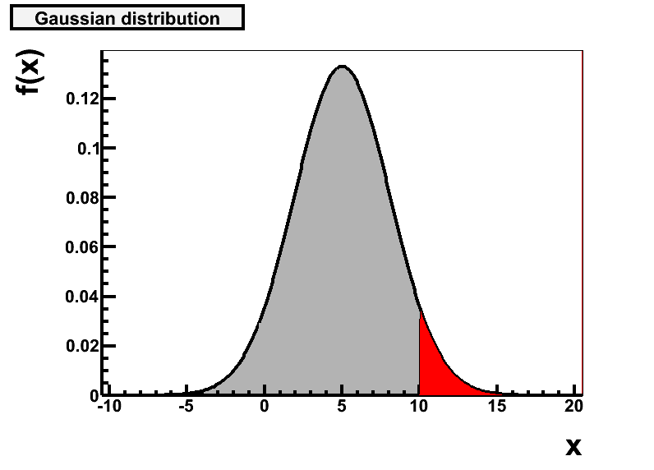
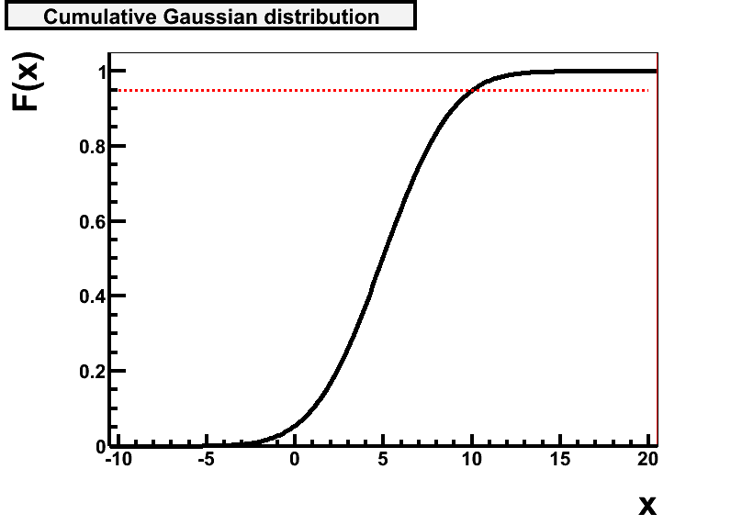



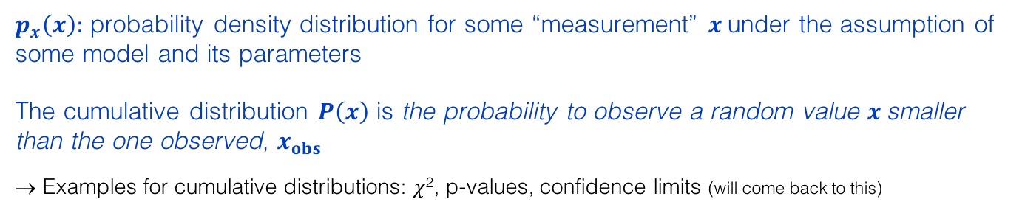





Cumulative distribution
$p_{x}\left(x\right)$: probability density distribution for some “measurement” $x$ under the assumption of some model and its parameters
The cumulative distribution $P\left(x\right)$ is the probability to observe a random value $x$ smaller than the one observed, $x_{obs}$
→ Examples for cumulative distributions: 𝜒², p-values, confidence limits (will come back to this)
$$\int_{−∞}^{x}{p_{x}\left(x′\right)dx′}≡P(x)$$
$$p_{x}\left(x\right)=dP(x)/dx$$
Gaussian distribution
Cumulative Gaussian distribution
$$p_{x}\left(x\right)$$
$$P\left(x\right)$$
Probability density function (PDF)
Cumulative distribution
$$x$$
$$x$$
$$x_{obs}$$
$$x_{obs}$$

Slide 16
Selected probability (density) distributions
Imagine a monkey discovered a huge bag of alphabet noodles. The monkey blindly draws noodles out of the bag and places them in a row. The text reads:
ROGER FEDERER
The probability for this to happen is about 10^{–17}
Infinite monkey theorem: provided enough time, the monkey will type Shakespeare's Hamlet

Slide 17
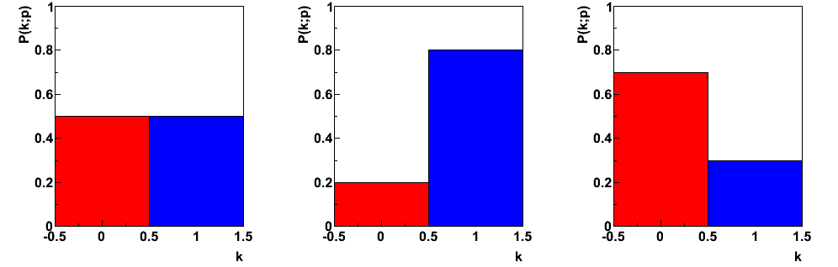
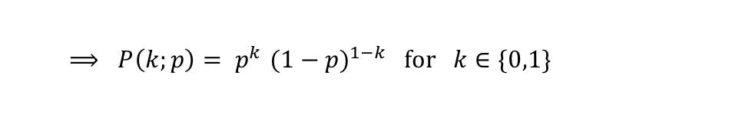
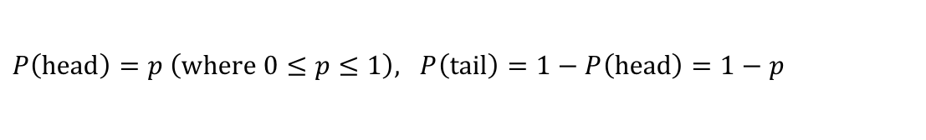
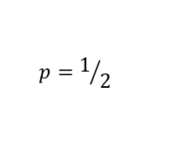
Bernoulli distribution
Experiment with two possible discrete outcomes: k = 1 / k = 0 (or yes / no or head / tail, etc)
What is the probability of one or the other ?
$P\left(head\right)=p \left(where 0≤p≤1\right), P\left(tail\right)=1−P\left(head\right)=1−p$
  $⟹ P\left(k;p\right){= p}^{k}$ $(1−p)^{1−k} for k∈\{0,1\}$
$$p=1/2$$
p = 0.5
p = 0.8
p = 0.3
tail
head

Slide 18
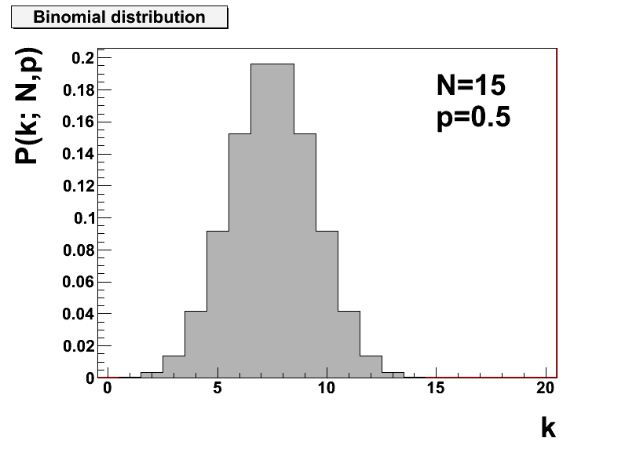


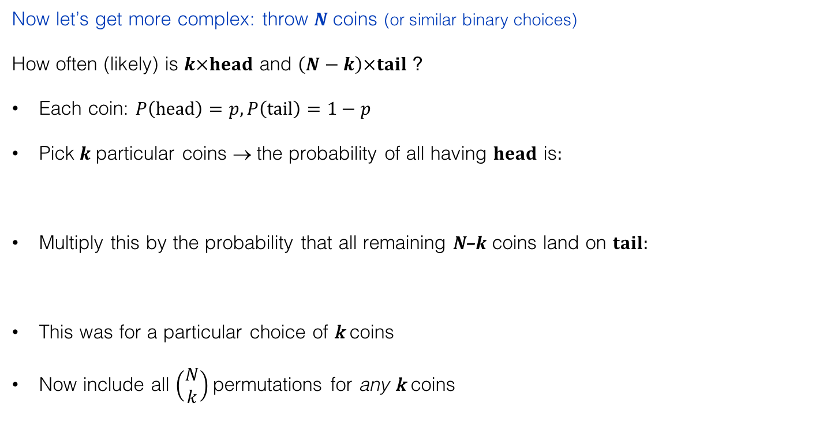

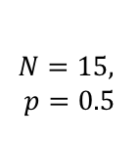

Binomial distribution (very important!)
Now let’s get more complex: throw N coins (or similar binary choices)
How often (likely) is $k×head$ and $\left(N−k\right)×tail$ ?
Each coin: $P\left(head\right)=p, P\left(tail\right)=1−p$
Pick 𝒌 particular coins → the probability of all having $head$ is:
Multiply this by the probability that all remaining N–k coins land on $tail$:
This was for a particular choice of k coins
Now include all $\left(\begin{aligned}N \\ k\end{aligned}\right)$permutations for any k coins
  $$P\left(k×head\right)={P\left(head\right)∙P\left(head\right)∙…∙P\left(head\right)=P\left(head\right)}^{k}=p^{k}$$
$P{\left(head\right)}^{k}∙P{\left(tail\right)}^{N−k}=p^{k}$ $(1−p)^{N−k}$
Binomial distribution
$$N=15,$$
$$p=0.5$$
$$P(k;N,p)$$
$P(k;N,p)=p^{k}$ $(1−p)^{N−k}\left(\begin{aligned}N \\ k\end{aligned}\right)$
where $\left(\begin{aligned}N \\ k\end{aligned}\right)=\frac{N!}{k!\left(N−k\right)!}$ is the binomial coefficient
$$k$$

Slide 19
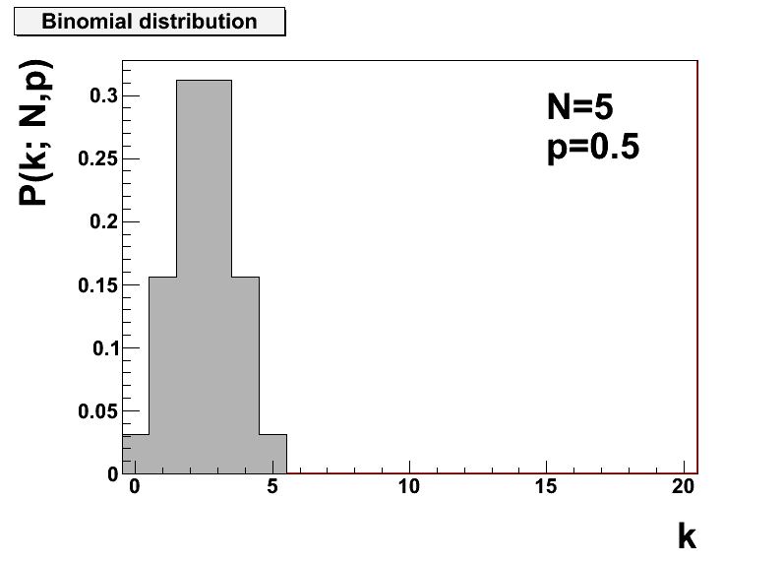
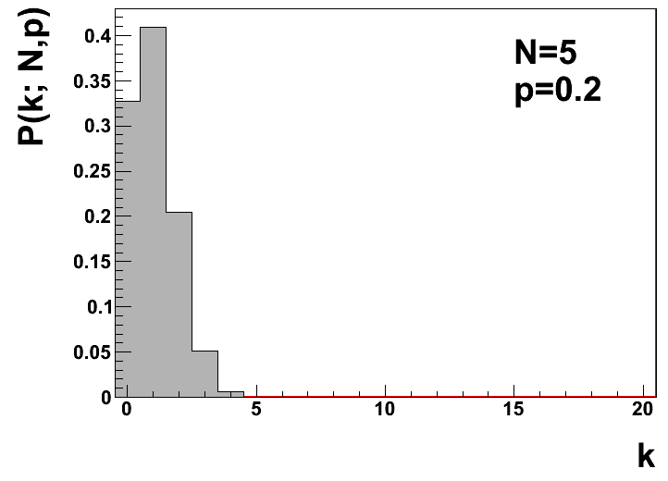

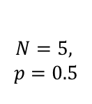

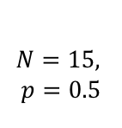


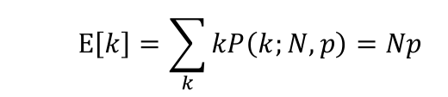


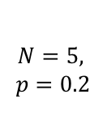
Binomial distribution (continued)
Example binomial distributions:
$$N=15,$$
$$p=0.5$$
$$N=5,$$
$$p=0.5$$
$$N=5,$$
$$p=0.2$$
$$P(k;N,p)$$
$$P(k;N,p)$$
$$P(k;N,p)$$
$$k$$
$$k$$
$$k$$
Expectation value: sum over all possible outcomes and average (i.e.: weighted average)
Variance: (see next slide for definition)
  $$E\left[k\right]=\sum_{k}{kP\left(k;N,p\right)}=Np$$
  $$V[k]=Np(1−p)$$

Slide 20
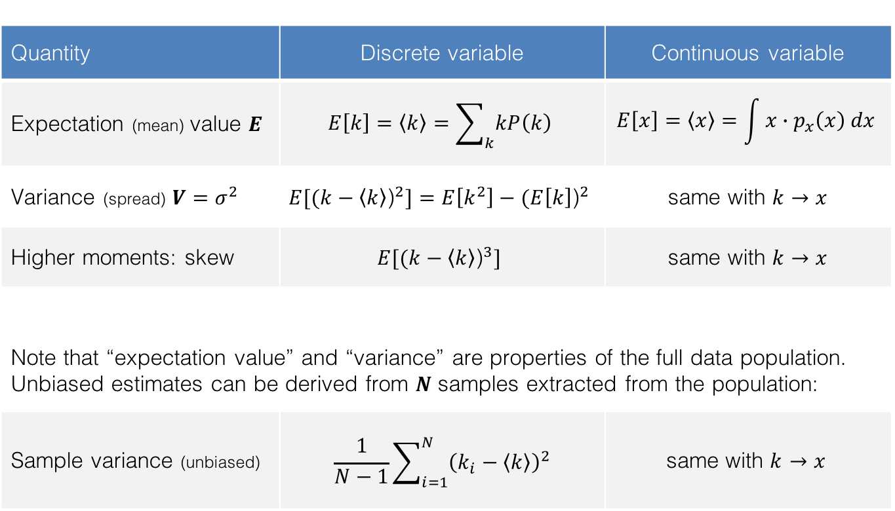
Characteristic quantities of distributions
Quantity | Discrete variable | Continuous variable
Expectation (mean) value $E$ | $$E\left[k\right]=\left\langle k\right\rangle =\sum_{k}{kP\left(k\right)}$$ | $$E\left[x\right]=\left\langle x\right\rangle =\int{x∙p_{x}\left(x\right) dx}$$
Variance (spread) $V=σ^{2}$ | $$E[{(k−\left\langle k\right\rangle \text{)}}^{2}]=E\left[k^{2}\right]−{(E\left[k\right]\text{)}}^{2}$$ | same with $k→x$
Higher moments: skew | $$E[{(k−\left\langle k\right\rangle \text{)}}^{3}]$$ | same with $k→x$
Note that “expectation value” and “variance” are properties of the full data population. Unbiased estimates can be derived from $N$ samples extracted from the population:
Sample variance (unbiased) | $$\frac{1}{N−1}\sum_{i=1}^{N}{{\left(k_{i}−\left\langle k\right\rangle \right)}^{2}}$$ | $$\text{same} \text{with} k→x$$

Slide 21

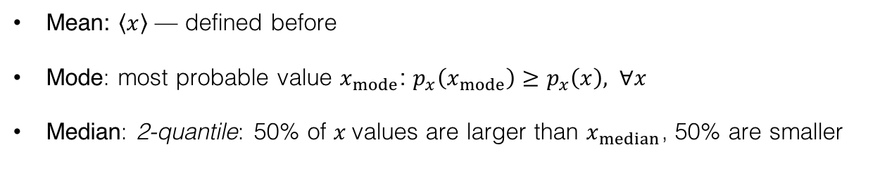



Characteristic quantities of distributions (continued)
Mean, Mode, Median:
Mean: $\left\langle x\right\rangle$ — defined before
Mode: most probable value $x_{mode}$: $p_{x}\left(x_{mode}\right)≥p_{x}\left(x\right), ∀x$
Median: 2-quantile: 50% of $x$values are larger than $x_{median}$, 50% are smaller
    Can generalise k-quantile : points at regular intervals of the cumulative distribution.
    Boundaries of binning chosen such that each bin contains the 1/k-th of total integral of distribution.
Symmetric curve (& single peak):
Skewed curve:
mean = mode = median
$$p_{x}\left(x\right)$$
$$p_{x}\left(x\right)$$
mode median mean
$$x$$
$$x$$

Slide 22
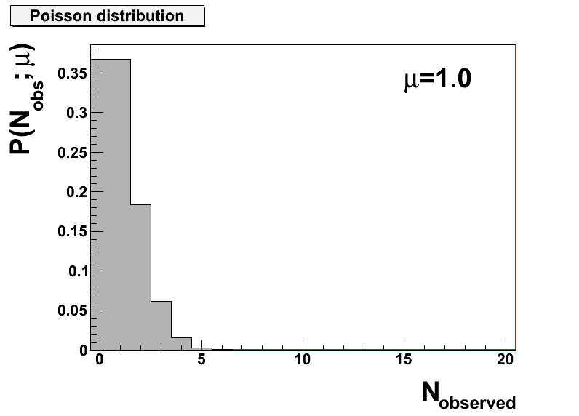
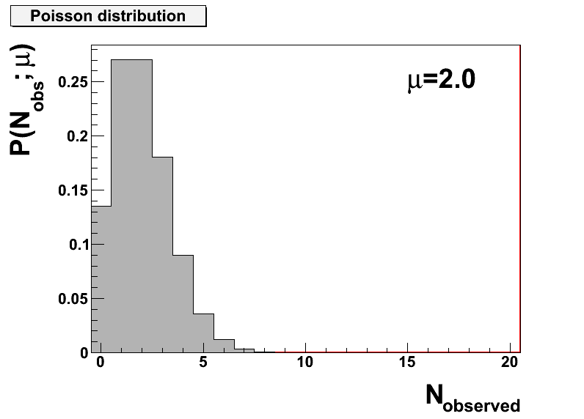
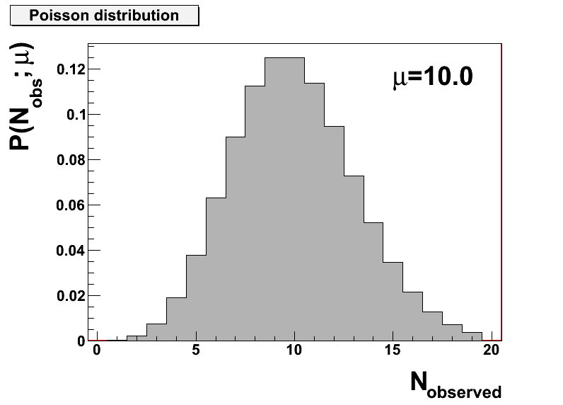




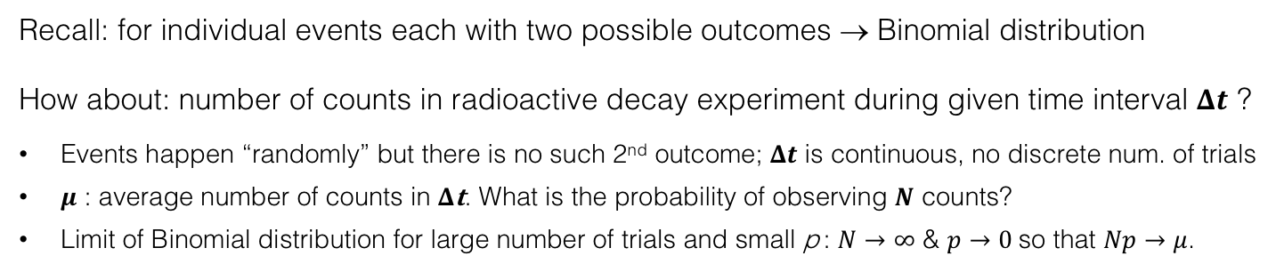
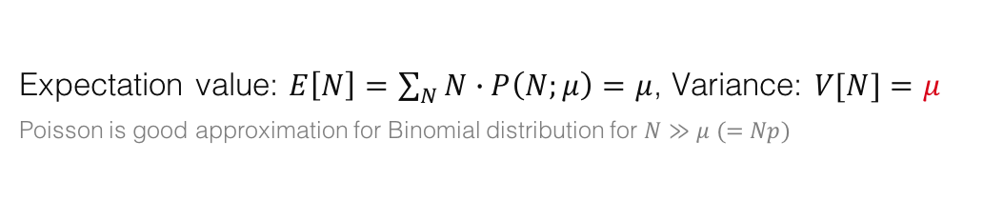





Poisson distribution
Recall: for individual events each with two possible outcomes → Binomial distribution
How about: number of counts in radioactive decay experiment during given time interval $Δt$ ?
Events happen “randomly” but there is no such 2nd outcome; $Δt$ is continuous, no discrete num. of trials
𝝁 : average number of counts in 𝚫𝐭. What is the probability of observing $N$ counts?
Limit of Binomial distribution for large number of trials and small p : $N→∞$ & $p→0$so that $Np→μ$.
→
$$P\left(N;μ\right)=\frac{μ^{N}}{N!}e^{−μ}$$
Poisson distribution:
$$P\left(n;μ\right)$$
$$μ=1$$
$$P\left(n;μ\right)$$
$$μ=2$$
$$P\left(n;μ\right)$$
$$μ=10$$
$$N$$
$$N$$
$$N$$
Expectation value: $E\left[N\right]=\sum_{N}{N∙P\left(N;μ\right)}=μ$, Variance: $V[N]=μ$
Poisson is good approximation for Binomial distribution for $N≫μ (=Np)$

Slide 23

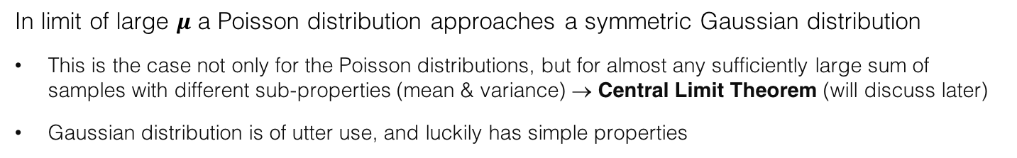
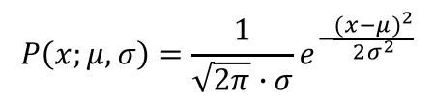
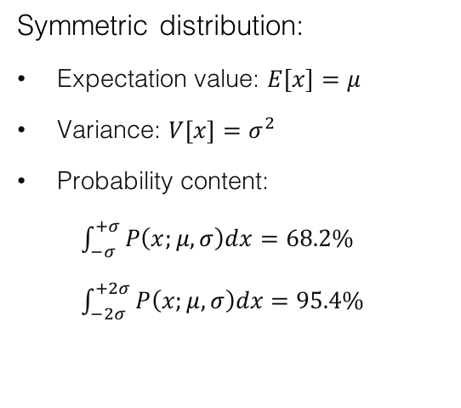
Gaussian (also: “Normal”) distribution
In limit of large $μ$ a Poisson distribution approaches a symmetric Gaussian distribution
This is the case not only for the Poisson distributions, but for almost any sufficiently large sum of samples with different sub-properties (mean & variance) → Central Limit Theorem (will discuss later)
Gaussian distribution is of utter use, and luckily has simple properties
$$P\left(x;μ,σ\right)=\frac{1}{\sqrt{2π}∙σ}e^{−\frac{{(x−μ)}^{2}}{2σ^{2}}}$$
→
Gauss distribution:
Symmetric distribution:
Expectation value: $E\left[x\right]=μ$
Variance: $V[x]=σ^{2}$
Probability content:
$\int_{−σ}^{+σ}{P\left(x;μ,σ\right)dx}=68.2\%$
$\int_{−2σ}^{+2σ}{P\left(x;μ,σ\right)dx}=95.4\%$
$$x$$

Slide 24
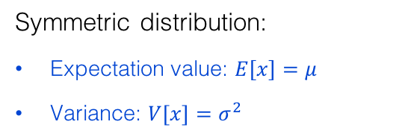
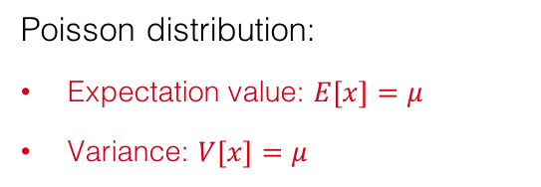
Gaussian (also: “Normal”) distribution
In limit of large $μ$ a Poisson distribution approaches a symmetric Gaussian distribution
This is the case not only for the Poisson distributions, but for almost any sufficiently large sum of samples with different sub-properties (mean & variance) → Central Limit Theorem (will discuss later)
Gaussian distribution is of utter use, and luckily has simple properties
$$P\left(x;μ,σ\right)=\frac{1}{\sqrt{2π}∙σ}e^{−\frac{{(x−μ)}^{2}}{2σ^{2}}}$$
→
Gauss distribution:
Symmetric distribution:
Expectation value: $E\left[x\right]=μ$
Variance: $V[x]=σ^{2}$
Poisson distribution:
Expectation value: $E\left[x\right]=μ$
Variance: $V[x]=μ$
→ For large $μ$, the standard deviation ($σ$) of the expected event counts is $\sqrt{μ}$ !

Slide 25
Some other distributions
Uniform (“flat”) distribution
Exponential distribution
Particle decay density versus time (in the particle’s rest frame!)
Relativistic Breit-Wigner distribution
Distribution of resonance of unstable particle as function of centre-of-mass energy in which the resonance is produced (originates from the propagator of an unstable particle)
Chi-squared (𝜒²) distribution
Sum of squares of Gaussian distributed variables; used to derive goodness of a fit to describe data
Landau distribution
Fluctuation of energy loss by ionization of charged particle in thin matter (eg, charge deposition in silicon detector)
Many more, see http://pdg.lbl.gov/2015/reviews/rpp2015-rev-probability.pdf for definitions and properties.
Because of the long tail, mean or variance are undefined

Slide 26
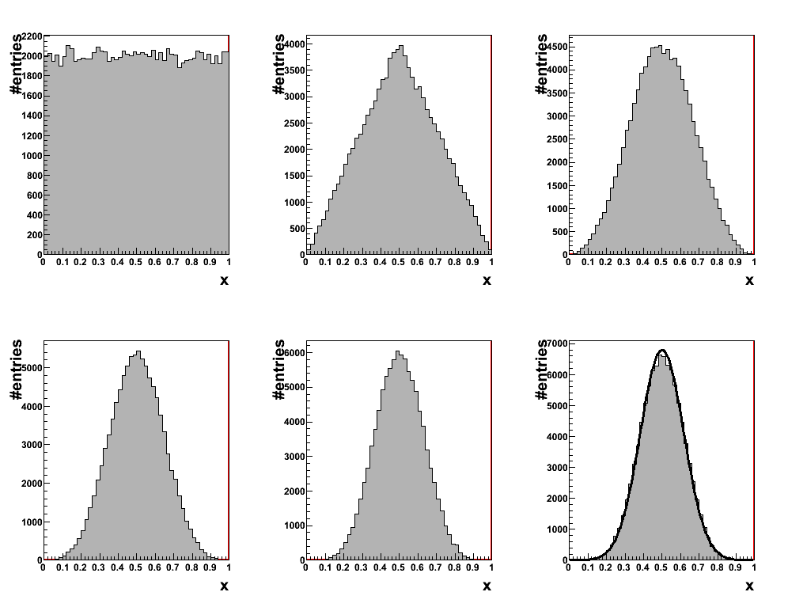


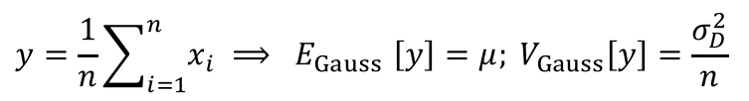

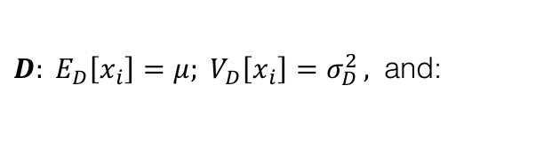



Central limit theorem (CLT)
CLT: the sum of $n$ independent samples $x_{i}$ ($i=1,…,n$) drawn from any PDF $D(x_{i}$) with well defined expectation value and variance is Gaussian distributed in the limit $n→∞$
$$y=\frac{1}{n}\sum_{i=1}^{n}{x_{i}} {⟹ E}_{Gauss}\left[y\right]=μ; V_{Gauss}\left[y\right]=\frac{σ_{D}^{2}}{n}$$
$D: E_{D}\left[x_{i}\right]=μ; V_{D}\left[x_{i}\right]=σ_{D}^{2 },$ and:
$n$=1
$n$=2
$n$=3
Averaging reduces the variance
$n$=4
$n$=5
$n$=6
Example: summing up uniformly distributed ensembles within [0,1]

Slide 27
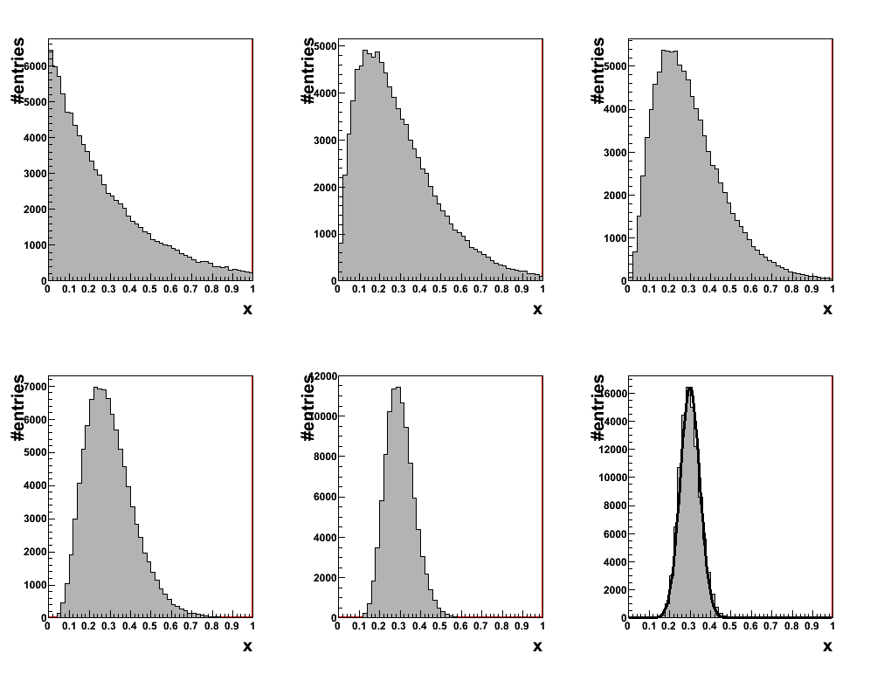

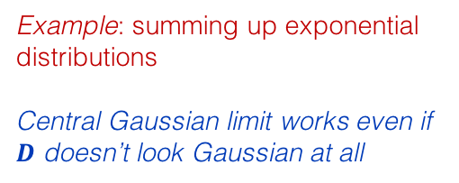

Central limit theorem (CLT)
CLT: the sum of $n$ independent samples $x_{i}$ ($i=1,…,n$) drawn from any PDF $D(x_{i}$) with well defined expectation value and variance is Gaussian distributed in the limit $n→∞$
$$y=\frac{1}{n}\sum_{i=1}^{n}{x_{i}} {⟹ E}_{Gauss}\left[y\right]=μ; V_{Gauss}\left[y\right]=\frac{σ_{D}^{2}}{n}$$
$D: E_{D}\left[x_{i}\right]=μ; V_{D}\left[x_{i}\right]=σ_{D}^{2 },$ and:
$n$=1
$n$=2
$n$=3
$n$=4
$n$=18
$n$=36
Example: summing up exponential distributions
Central Gaussian limit works even if $D$ doesn’t look Gaussian at all

Slide 28
Central limit theorem (CLT)
CLT is key concept in probability theory: it implies that probabilistic and statistical methods that work for Gaussian distributions can be applicable to many problems involving other types of distributions
Crucial for experimental particle physics: can propagate systematic uncertainties in a Gaussian manner via quadratic addition (see later)

Slide 29

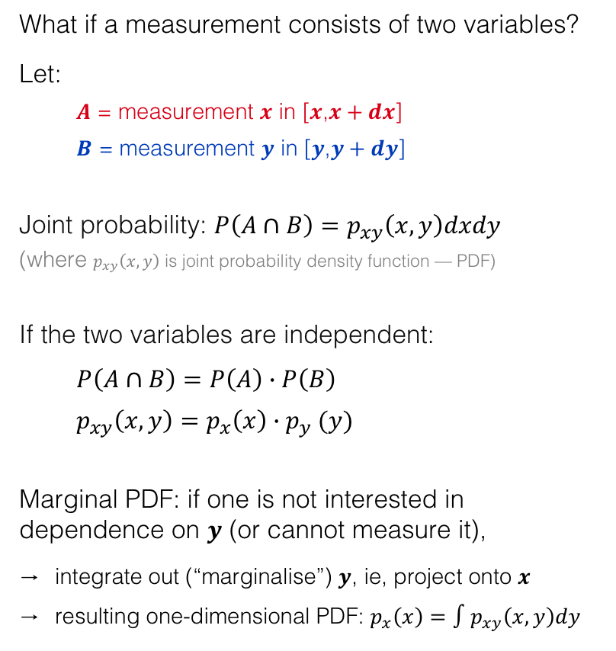

Multidimensional random variables
What if a measurement consists of two variables?
Let:
  $A$ = measurement $x$ in [$x$,$x+dx$]
  $B$ = measurement $y$ in [$y$,$y+dy$]
Joint probability: $P\left(A∩B\right)=p_{xy}\left(x,y\right)dxdy$
(where $p_{xy}\left(x,y\right)$ is joint probability density function — PDF)
If the two variables are independent:
$P\left(A∩B\right)=P\left(A\right)∙P\left(B\right)$
$p_{xy}\left(x,y\right)=p_{x}\left(x\right){∙p}_{y}(y)$
Marginal PDF: if one is not interested in dependence on $y$ (or cannot measure it),
integrate out (“marginalise”) $y$, ie, project onto $x$
resulting one-dimensional PDF: $p_{x}\left(x\right)=∫p_{xy}\left(x,y\right)dy$
From: Glen Cowan, Statistical data analysis
some event “$A$”
i
some event “$B$”

Slide 30




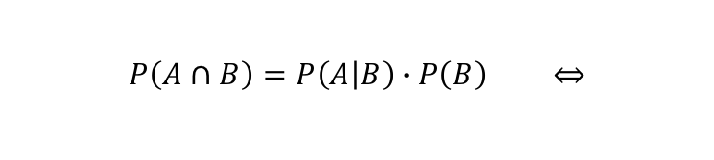
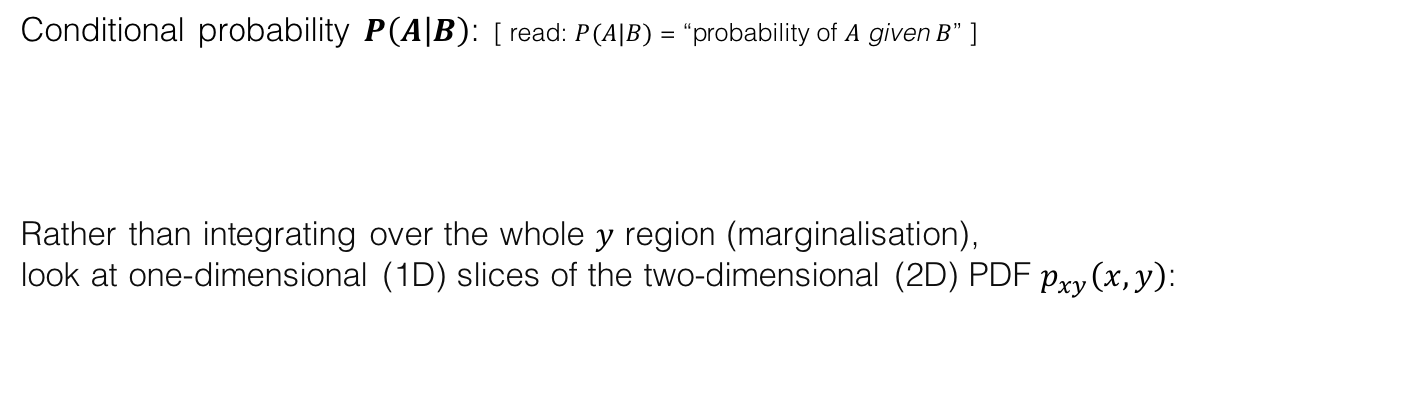

Conditioning versus marginalisation
Conditional probability $P\left(A | B\right)$: [ read: $P(A|B)$ = “probability of $A$ given $B$” ]
Rather than integrating over the whole $y$ region (marginalisation), look at one-dimensional (1D) slices of the two-dimensional (2D) PDF $p_{xy}\left(x,y\right)$:
$$P\left(A | B\right)=\frac{P\left(A∩B\right)}{P\left(B\right)}=\frac{p_{xy}\left(x,y\right)dxdy}{p_{y}\left(y\right)dy}$$
$$P\left(A∩B\right)=P\left(A | B\right)∙P\left(B\right) ⇔$$
$$p_{y}\left(y | x_{1}\right)=p_{xy}(x=const=x_{1},y)$$
$$p_{y}\left(y | x\right)$$
$$p_{y}\left(y | x_{1}\right)$$
$$p_{y}\left(y | x_{2}\right)$$
From: Glen Cowan, Statistical data analysis

Slide 31
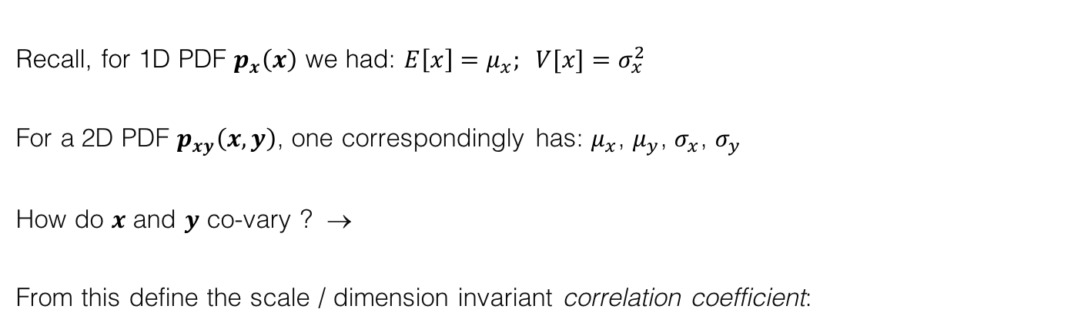

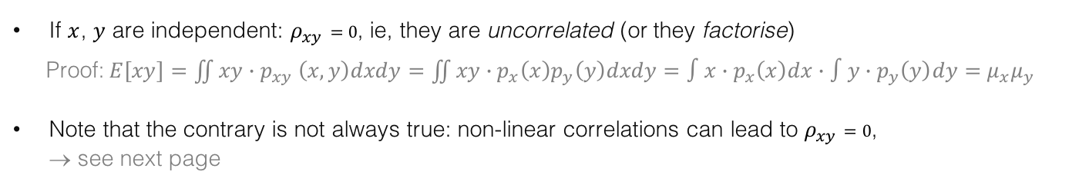
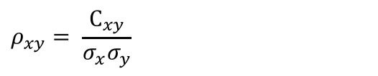
Covariance and correlation
Recall, for 1D PDF $p_{x}\left(x\right)$ we had: $E\left[x\right]=μ_{x}; V[x]=σ_{x}^{2}$
For a 2D PDF $p_{xy}\left(x,y\right)$, one correspondingly has: $μ_{x}$, $μ_{y}$, $σ_{x}$, $σ_{y}$
How do $x$ and $y$ co-vary ? →
From this define the scale / dimension invariant correlation coefficient:
$${C_{xy}=covariance}_{xy}=E\left[\left(x−μ_{x}\right)\left(y−μ_{y}\right)\right]=E\left[xy\right]−{μ_{x}μ}_{y}$$
$$ρ_{xy}= \frac{C_{xy}}{σ_{x}σ_{y}}$$
, where $ρ_{xy}⊂[−1,+1]$
If $x$, $y$ are independent: $ρ_{xy}=0$, ie, they are uncorrelated (or they factorise)
Proof: $E\left[xy\right]=\iint{xy{∙p}_{xy}\left(x,y\right)dxdy}=\iint{xy∙p_{x}\left(x\right)p_{y}\left(y\right)dxdy}=∫x∙p_{x}\left(x\right)dx∙∫y∙p_{y}\left(y\right)dy=μ_{x}μ_{y}$
Note that the contrary is not always true: non-linear correlations can lead to $ρ_{xy}=0$, → see next page

Slide 32
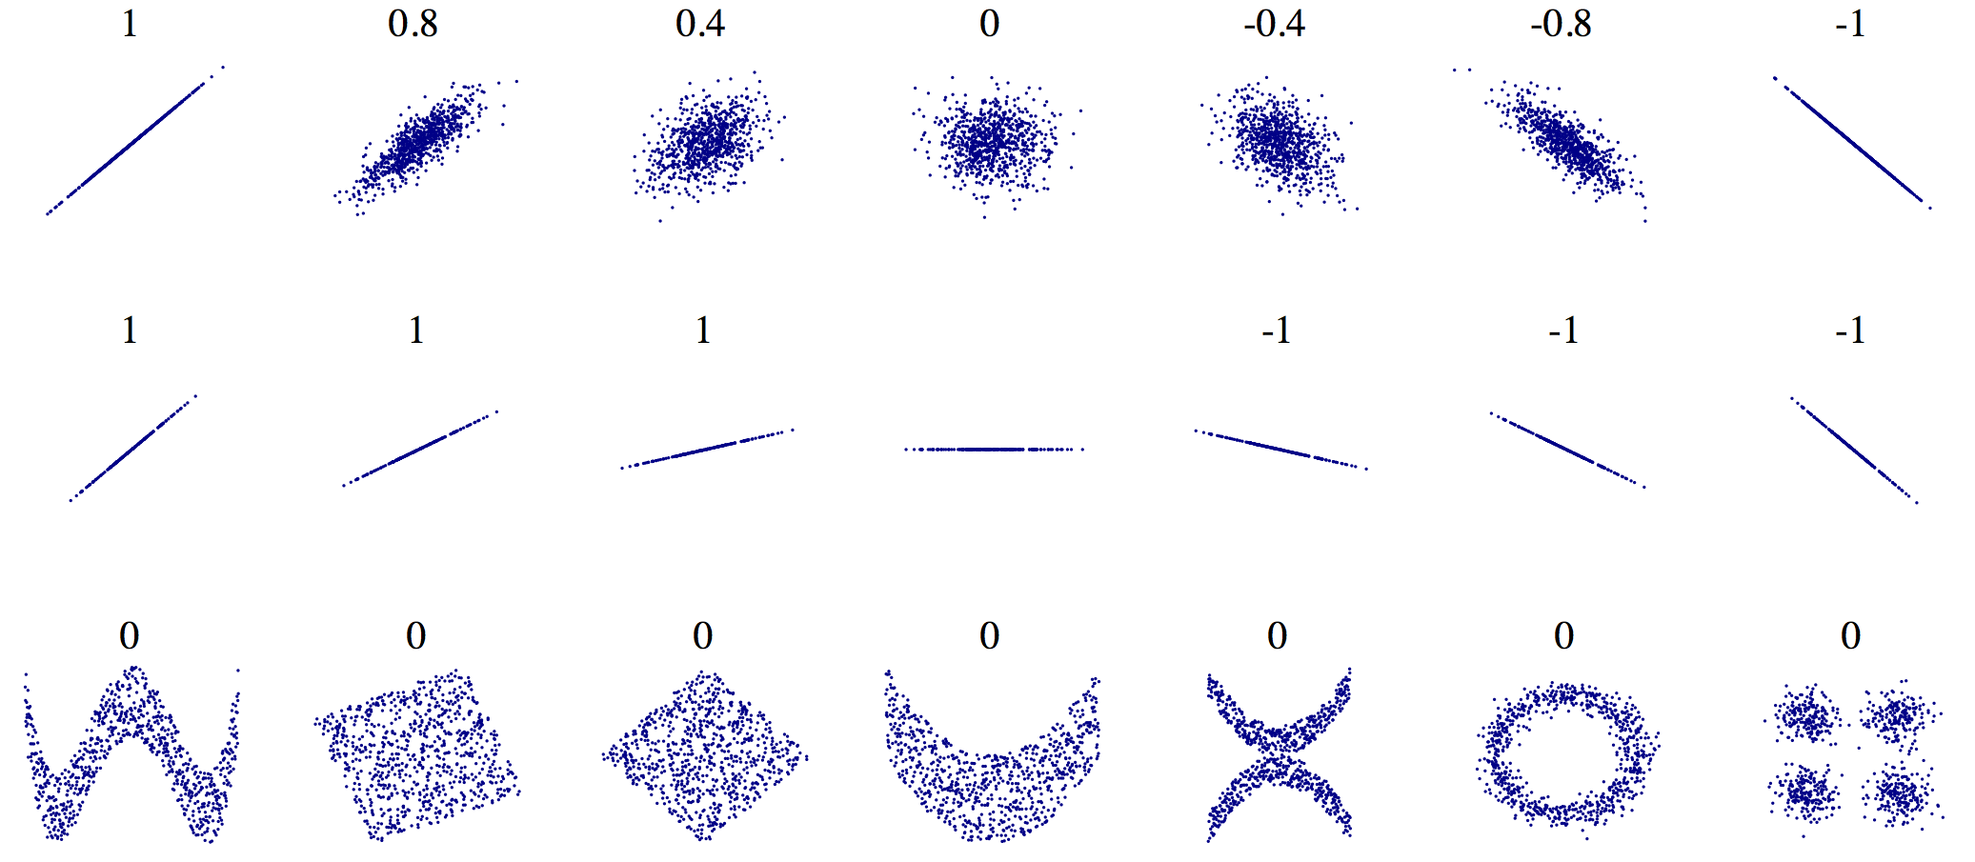



Correlations
Figure from: https://en.wikipedia.org/wiki/Correlation_and_dependence
The correlation coefficient measures the noisiness and direction of a linear relationship:
$$y$$
$${=ρ}_{xy}$$
$$x$$
…it does not measure the slope $ρ_{xy}$ (see above figures)
…and non-linear correlation patterns are not or only approximately captured by $ρ_{xy}$ (see above figures)

Slide 33
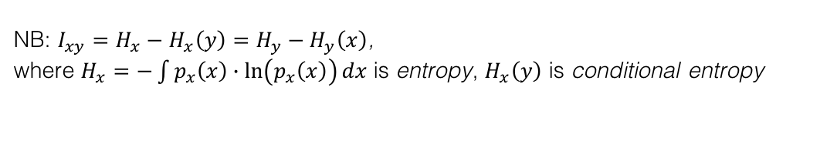
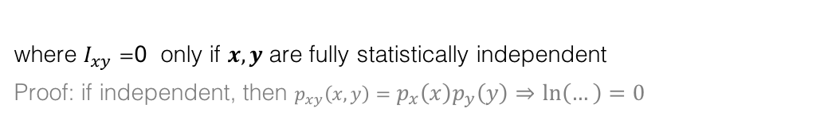
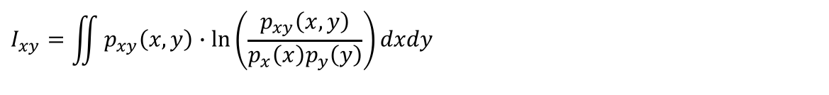
Digression — Mutual information
Non-linear correlation can be captured by the “mutual information” quantity $I_{xy}$:
$$I_{xy}=\iint{p_{xy}\left(x,y\right)∙ln\left(\frac{p_{xy}\left(x,y\right)}{p_{x}\left(x\right)p_{y}\left(y\right)}\right)dxdy}$$
Measure of mutual dependence between two variables: “How much information is shared among them”
where $I_{xy}=$0 only if $x,y$are fully statistically independent
Proof: if independent, then $p_{xy}\left(x,y\right)=p_{x}\left(x\right)p_{y}\left(y\right)⇒\ln\left(…\right)=0$
NB: $I_{xy}=H_{x}−H_{x}\left(y\right)=H_{y}−H_{y}\left(x\right)$, where $H_{x}=−\int{p_{x}\left(x\right)∙\ln\left(p_{x}\left(x\right)\right)dx}$ is entropy, $H_{x}\left(y\right)$ is conditional entropy

Slide 34
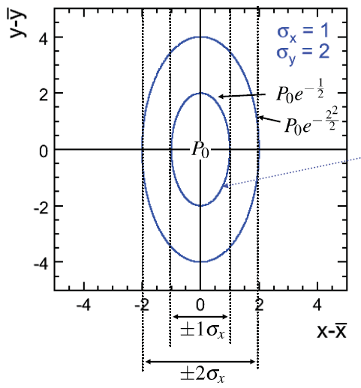




2D Gaussian (uncorrelated)
Two variable $x, y$ are independent: ${[ p}_{xy}\left(x,y\right)=p_{x}\left(x\right)∙p_{y}\left(y\right) ]$
$$p_{xy}\left(x,y\right)=\frac{1}{\sqrt{2π}σ_{x}}e^{−\frac{{\left(x−μ_{x}\right)}^{2}}{2σ_{x}^{2}}}∙\frac{1}{\sqrt{2π}σ_{y}}e^{−\frac{{\left(y−μ_{y}\right)}^{2}}{2σ_{y}^{2}}}$$
$$y−μ_{y}$$
$$x−μ_{x}$$

Slide 35







2D Gaussian (correlated)
Two variable $x, y$ are not independent: ${[ p}_{xy}\left(x,y\right)≠p_{x}\left(x\right)∙p_{y}\left(y\right) ]$
$$p_{\overset{⃑}{x}}\left(\overset{⃑}{x}\right)=\frac{1}{2π\sqrt{det(C)}}∙exp\left(−\frac{1}{2}{\left(\overset{⃑}{x}−\overset{⃑}{μ}\right)}^{T}C^{−1 }(\overset{⃑}{x}−\overset{⃑}{μ})\right)$$
where:
is the (symmetric) covariance matrix
Corresponding correlation matrix elements:
$$y−\left\langle y\right\rangle$$
$$C=\left(\begin{matrix}\left\langle x^{2}\right\rangle −{\left\langle x\right\rangle }^{2} & \left\langle xy\right\rangle −\left\langle x\right\rangle \left\langle y\right\rangle \\ \left\langle xy\right\rangle −\left\langle x\right\rangle \left\langle y\right\rangle & \left\langle y^{2}\right\rangle −{\left\langle y\right\rangle }^{2}\end{matrix}\right)$$
$$ρ_{ij}=ρ_{ji}= \frac{C_{ij}}{\sqrt{C_{ii}∙C_{jj}}}$$
$$x−\left\langle x\right\rangle$$

Slide 36










Digression — SQRT decorrelation
Find variable transformation that diagonalises a covariance matrix $C$
Determine “square-root” $C^{′}$ of $C$ (such that: $C=C^{′}∙C^{′}$) by first diagonalising $C$
Example: original correlations
$$y$$
$$D=S^{T}∙C∙S ⟺ C^{′}=S∙\sqrt{D}{∙S}^{T}$$
where $D$ is diagonal, $\sqrt{D}=\left\{\sqrt{d_{11}},…,\sqrt{d_{nn}}\right\}$, and $S$ an orthogonal matrix
$$x$$
Linear decorrelation of correlated vector $x$ then obtained by
$$y$$
$$x′={\left(C^{′}\right)}^{−1}∙x$$
Principle component analysis (PCA) is another convenient method to achieve linear decorrelation
(PCA is linear transformation that rotates a vector such that the maximum variability is visible. It identifies most important gradients)
$$x$$

Slide 37





Digression — SQRT decorrelation
Find variable transformation that diagonalises a covariance matrix $C$
Determine “square-root” $C^{′}$ of $C$ (such that: $C=C^{′}∙C^{′}$) by first diagonalising $C$
Example: after SQRT decorrelation
$$′$$
$$y$$
$$D=S^{T}∙C∙S ⟺ C^{′}=S∙\sqrt{D}{∙S}^{T}$$
where $D$ is diagonal, $\sqrt{D}=\left\{\sqrt{d_{11}},…,\sqrt{d_{nn}}\right\}$, and $S$ an orthogonal matrix
$$′$$
$$x$$
Linear decorrelation of correlated vector $x$ then obtained by
$$′$$
$$y$$
$$x′={\left(C^{′}\right)}^{−1}∙x$$
SQRT decorrelation works only for linear correlations!
$$′$$
$$x$$

Slide 38








Functions of random variables
Glen Cowan: Statistical data analysis
  Any function of a random variable is itself a random variable
  E.g., $x$ with PDF $p_{x}(x)$becomes: $y=f(x)$
$y$ could be a parameter extracted from a measurement
$$y=f(x)$$
  What is the PDF $p_{y}(y)$?
  Probability conservation: $p_{y}\left(y\right)|dy|=p_{x}(x)|dx|$
  For a 1D function $f(x)$ with existing inverse:
  Hence:
$$dy$$
$$dx$$
$$x$$
  $$dy=\frac{df\left(x\right)}{dx}dx ⟺ dx=\frac{df^{−1}\left(y\right)}{dy}dy$$
$$p_{y}(y)=p_{x}\left(f^{−1}(y)\right)\left|\frac{dx}{dy}\right|$$
Note: this is not the standard error propagation but the full PDF !

Slide 39

Error propagation
  Let’s assume a measurement $x$ with unknown PDF $p_{x}(x)$, and a transformation $y=f(x)$
  $\overline{x}$ and $\hat{V}$ are estimates of $μ$ and variance $σ^{2}$of $p_{x}(x)$
  What are $E\left[y\right]$ and, in particular, $σ_{y}^{2}$ ? → Taylor-expand $f\left(x\right)$ around $\overline{x}:$
  $f\left(x\right)=f\left(\overline{x}\right)+{\left.\frac{df}{dx}\right|}_{x=\overline{x}}\left(x−\overline{x}\right)+…$ $⇒$ $E\left[f\left(x\right)\right]≃f\left(\overline{x}\right)$ (because: $E\left[x−\overline{x}\right]=0$ !)
  Now define $\overline{y}=f\left(\overline{x}\right)$, and from the above follows:
  $y−\overline{y}≃{\left.\frac{df}{dx}\right|}_{x=\overline{x}}\left(x−\overline{x}\right)$
  $E\left[{(y−\overline{y})}^{2}\right]={\left({\left.\frac{df}{dx}\right|}_{x=\overline{x}}\right)}^{2}E\left[{(x−\overline{x})}^{2}\right]$
  ${\hat{V}}_{y}={\left({\left.\frac{df}{dx}\right|}_{x=\overline{x}}\right)}^{2}{\hat{V}}_{x}$
  $σ_{y}={\left.\frac{df}{dx}\right|}_{x=\overline{x}}∙σ_{x}$
→ (approximate) error propagation

Slide 40



Error propagation (continued)
  In case of several variables, compute covariance matrix and partial derivatives
  Let $f=f(x_{1},…,x_{n})$ be a function of $n$ randomly distributed variables
  ${\left({\left.\frac{df}{dx}\right|}_{x=\overline{x}}\right)}^{2}{\hat{V}}_{x}$ becomes: (where: $\overline{x}=({\overline{x}}_{1},…,{\overline{x}}_{n})$)
  with the covariance matrix:
$$\sum_{i,j=1}^{n}{{\left.\frac{∂f}{∂x_{i}}\frac{∂f}{∂x_{j}}\right|}_{\overline{x}}}∙{\hat{V}}_{i,j}$$
$${\hat{V}}_{i,j}=\left[\begin{matrix}σ_{x_{1}}^{2} & ⋯ & σ_{x_{1}x_{n}} \\ ⋮ & ⋱ & ⋮ \\ σ_{x_{n}x_{1}} & ⋯ & σ_{x_{n}}^{2}\end{matrix}\right]$$
  The resulting “error” (uncertainty) depends on the correlation of the input variables
    Typically (not always!) positive correlations lead to an increase of the total error,
    and negative correlations decrease the total error
For complicated functional dependence $f=f(x_{1},…,x_{n})$, it is often more practical to use Monte Carlo techniques (“pseudo MC generation”) to propagate uncertainties

Slide 41
Summary for today
  Probability and statistics are everywhere in science, and in particular profoundly contained in particle physics and in the physics of large ensembles
  Overview of some important probability density distributions given, and also:
  Joint / marginal / conditional probabilities
  Covariance and correlations
  Error propagation
  Tomorrow: how to use these concepts for hypothesis testing

