Slide 1


Semantic Web Technologies in the field of
Incident Management
„Wolfgang Gentner Tag“
18.11.2009
Lars Aprin, DG-SCH

Slide 2
General information in advance
About me
  University of Wuppertal
  Start date at CERN: April 2008
  Safety Commission
  Supervisor: Ralf Trant (Head of SC)
About my work
  Knowledge Representation in the domain of Safety
  Focus on semantical methods
About this presentation
  Part 1: Basic introduction into the Semantic Web
  Part 2: Incident analysis and prevention
  Part 3: Proposal for a semantically based Incident Management
Notes:
Zu Part1: Non-Technical !!

Slide 3
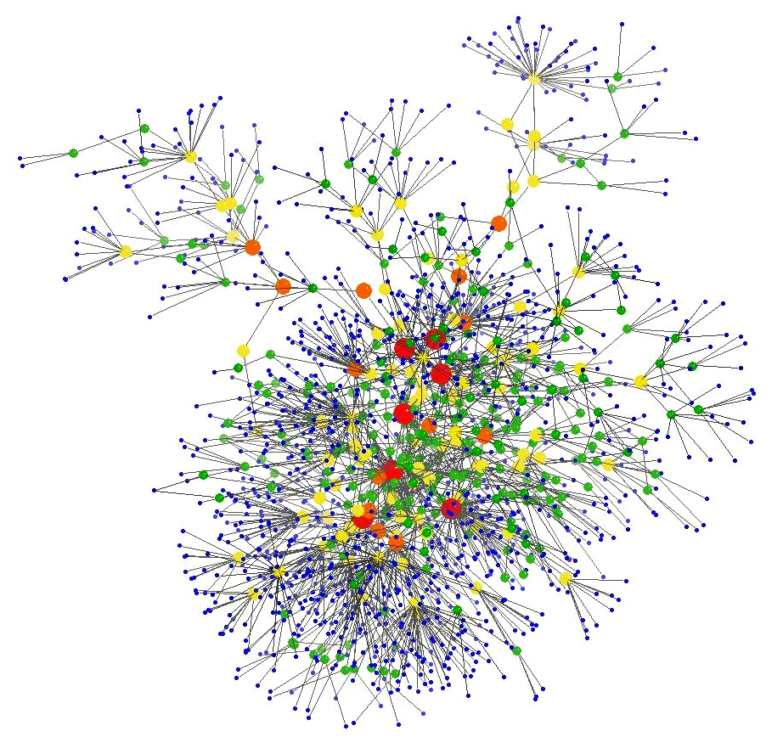
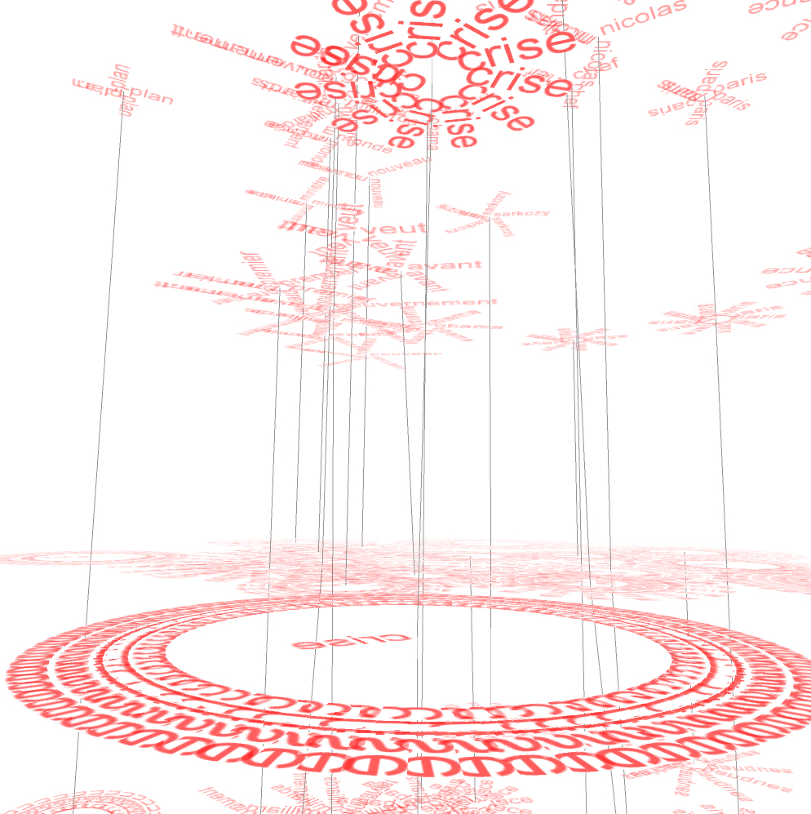
Part 1: The Semantic Web
What is the Semantic Web?
How does it work?
Notes:
Explaining the SW basically is necessary to understand the third part of the presentation.
I try to give anwers to this 3 questions.
SW is a very wide subject so I can explain only very roughly.

Slide 4
Part 1: The Semantic Web
What is it all about?
Recent subfield of „Knowledge Representation“
  Collection of languages and methods to represent knowledge in a way that it can be processed partly automatically
Semantic Web is just a label
  For the application of these technologies on a global scale
  Focus is on the technologies behind that label
Semantics is a subfield of linguistics
  Study of meaning of words (“What do words mean?”)
  In contrast to syntax („How do words fit together?“) and pragmatics („How to do things with words?“)
Subject of increasingly more projects
  Commercial and research
Notes:
zu 1a): Explain Knowledge Representation: KR deals with the question how you can represent and technically implement the knowledge of a particular domain
zu 3) Why do is it called „Semantic Web“? It refers to linguistics where semantics are dealing with „meaning“ of terms
Global scale not mz subject

Slide 5
Part 1: The Semantic Web
How does it work?
There is not really a logical gap between World Wide Web and Semantic Web
  Continuum between the WWW and the Semantic Web
  Semantic Web is the consequent advancement of the WWW
Notes:
zu 1): Explaining the SW on basis of the WWW

Slide 6

Part 1: The Semantic Web
The basic idea of the WWW (Hypertext)
The WWW is a large collection of documents. Each document has a unique idendity (Uniform Resource Locator)
href
href
The documents are connected among each other
href
(„See also“)
href
Important:
All resources are „Documents“
All relations are simple associative relations
href
href
(„See also“)

Slide 7
Part 1: The Semantic Web
The basic idea of the Semantic Web
This Presentation
[DOCUMENT]
Safety Science
[TOPIC]
Semantic Web Technologies offer the possibility to define much more types of resources (Uniform Resource Identifier)
Ralf Trant
[PERSON]
is_a
author
supervisor
Ralf Trant lives in the area of Geneva
Labour Safety
[TOPIC]
Lars Aprin
[PERSON]
Subject
Resources are connected among each other by various relations (not only the simple „see-also“ one)
is_a
works_at
Safety Commission deals
among others with Labour Safety
Incident Management
[TOPIC]
Safety Commission
[INSTITUTION]
Different resources grow together
Automated reasoning
part_of
Geneva
[PLACE]
CERN
[INSTITUTION]
located_in
Notes:
zu 1) Types depend on the domain and knowledge field
Things grow together
zu 1) Resources have similiar idenitifier than the URL of Websites

Slide 8
Part 1: The Semantic Web
Ontologies - The glue of the Semantic Web
Ontologies are about ordering knowledge on a conceptual level
  All relevant things and their relations among each other are described
  Typical elements: Class, Instance, Relation, Attribute/Values, Constraints and Rules
  On base of Desciption Logics
  Automatic reasoning is possible
There are several languages to express ontologies
  OWL, RDF(S), F-Logic, etc.
  Languages are W3C recommendated
Notes:
zu 1): Key concept

Slide 9
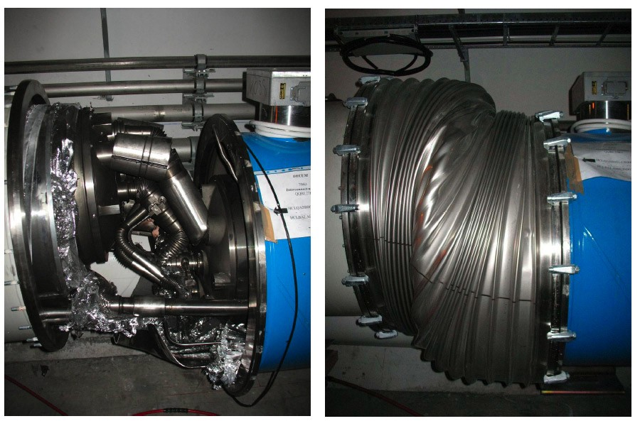
Part 2: Incident Management
What is Incident Management about?
How does it work?
Notes:
Explaining the SW basically is necessary to understand the third part of the presentation.
I try to give anwers to this 3 questions.
SW is a very wide subject so I can explain only very roughly.

Slide 10
Part 2: Incident Management
What is Incident Management?
Definition of „Incident“
  Any undesired event or emergency that resulted or could have resulted in any harm to human, property or environment
  Including „near misses“ and „accidents“
Scopes of Incident Management
  Preventing the incident to happen
  Returning to normal as quickly as possible after an incident
  Learning from the incident
Basic operations of Incident Management
  Emergency responses
  Analysis of the incident causes
  Integrating the analysis results (Preventive measures)

Slide 11





Part 2: Incident Management
Incident Analysis: All facets, all views
Emergeny
Management
Prevention
Legislation
Training and Education
Personal Protective Equipment
Facets of a possible incident
X
Views on the incident
Notes:
Holisitc (Root cause) analysis has to take care about both: the facets and the views
Left side: Incident prevention; Right side: Incident analysis: „You look form different perspectives at different facets of the incident“
Results of the incident analysis leads to changed prevention measures

Slide 12
Part 3: Proposal for a semantically based Incident Management
What is my work about?
Which tasks have to be implemented?
Notes:
Explaining the SW basically is necessary to understand the third part of the presentation.
I try to give anwers to this 3 questions.
SW is a very wide subject so I can explain only very roughly.

Slide 13
Part 3: Proposal for a semantically based Incident Management
Motivation and goals of my work
Bringing Incident Management and Semantic Technologies together
  Development of a semantically supported Incident Management System
  Basic idea: Representing CERN activities in an ontological framework with the objective of inferring Safety knowledge
Advantages of the use of ontologies
  More tightly focused information supply and decision support for all participating stakeholders
  Support in Risk Assessment and selection of prevention measures
  Better statistical data (Correlations between various resources)
Notes:
In the next slides I will present a coneptual diagram

Slide 14
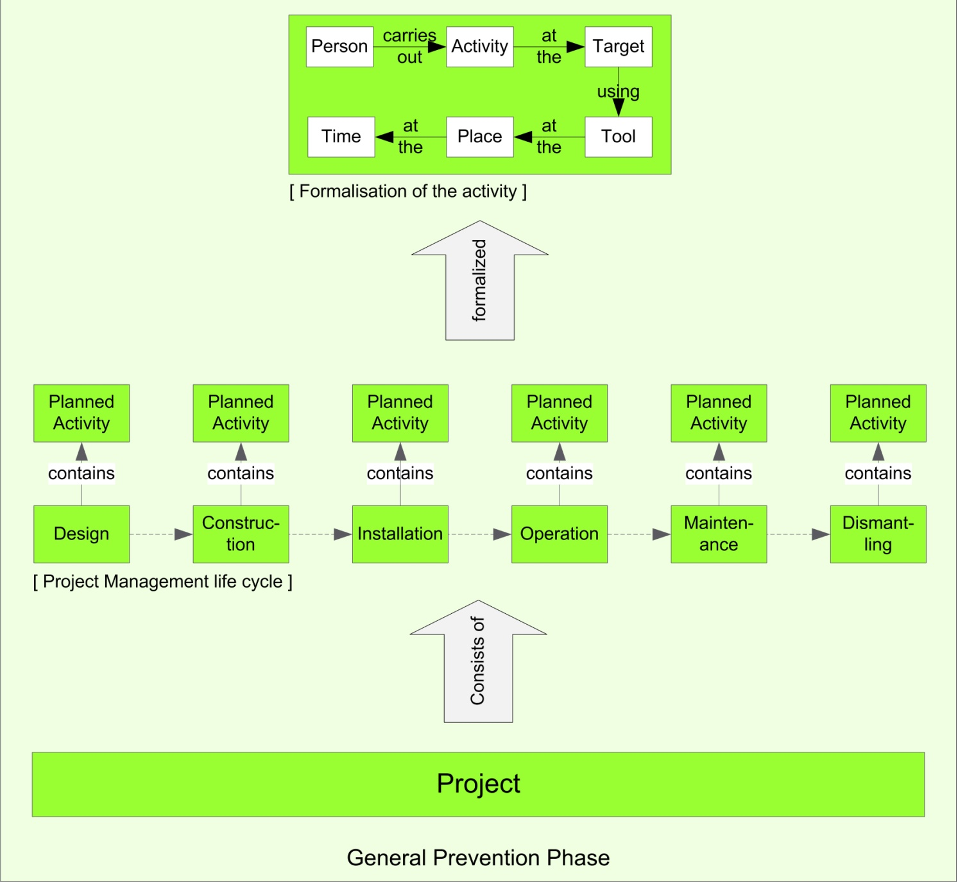
First step:The activity is described using formal standard descriptors.
EXAMPLE:
Place: Roof of Building 123
Target: Insulation
Ordre de Maintenance (ODM),
Avis d´Intervention (ADI),
Avis d´Ouverture de Chantiers (AOC), etc.
The maintenance phase consists of different activities.
EXAMPLE:
Repairing the insulation of the roof of building 123
A project typically consists of several phases.
EXAMPLE:
In our example we focus on the maintenance phase
Incident Management starts with a project.
EXAMPLE:
Construction of a new building.
Notes:
In the following I will describe how Ontologies may support the process of Incident Prevention. I will describe it using an daily life example.
Use this map to dsecribe a typical analysis cycle
Grün: Knowledge goes from the ontology to the Incident Management
Red: Knowledge goes from the Incident Management to the Ontology

Slide 15

Searching semantically the CERN Safety Ontology for the descriptors of the activity.
EXAMPLE RESULTS:
The insulation is part of the roof of building 123.
Also skylights are part of the roof of building 123.
There was an accident in the past where a man felt through a skylight.
=> There is a risk of falling through a skylight during repairing the insulation of building 123.
Next step: Representing the activity descriptors in the CERN Safety Ontology.
This ontology contains knowledge about what Safety relevant things (Human Resources, Buildings, Documents, etc.) are and how they are linked up.
EXAMPLE:
Putting „Roof of Building 123“ and „Insulation“ in the ontology.
Prevention measures will be suggested on base of the ontological conclusions.
EXAMPLE:
Forwarding the accident report (when the man felt through a skylight) to the TSO of building 123.
Recommend to cover the skylight with a safeguard.

Slide 16


Slide 17

Then the results of the analysis are described using formal standard descriptors.
EXAMPLE:
Place: Roof of Building 123
Tool: Screwdriver
Risk: Flying object
Prevention measure: Cordoning off
Incident Analysis is conducted concerning causation, pacifying and prevention of the incident.
EXAMPLE:
Results concerning prevention:
Cordoning off the near area of building 123.
Incident (accident or near miss) happens.
EXAMPLE:
The scredwdriver goes flying and hits a pedestrian´s head.

Slide 18
Finally: Updating the relations between the elements of the accident analysis results.
-> The ontology contains new prevention knowledge for prospective CERN projects.
Next step: Representing the standard descriptors of analysis results in the CERN Safety Ontology.
EXAMPLE:
Putting „Roof of Building 123“, „Screwdriver“, „Flying objects“ and „Cordoning off“ into the ontology.

Slide 19
Part 3: Proposal for a semantically based Incident Management
Breaking the model down into concrete tasks
Development of the ontology
  Cooperative process
  Finding methodologies
Defining languages to formalize the different activities and analysis results
  Interfaces
Defining rules for the reasoning processes
Integration into the existing IT landscapes

Slide 20
Conclusions
Incident Management is an important field in Safety
Semantical Technology is a very suitable approach for many challenges in the field of Incident Management
  Increasingly more projects are started
  All necessary technology exists
CERN is a good area of application
  All in one place
Also other CERN domains apart from Safety can benefit from a semantically structured knowledge web

Slide 21
Thanks for listening.

