Slide 1


Enhancement of the
Resonance Ionization Laser Ion Source (RILIS) at ISOLDE
-
Setting up a complementary all solid-state laser system
Sebastian Rothe
Gentner Day 2009

Slide 2
Outline
Introduction
  Myself
  ISOLDE
  Laser Ion Source
The new Laser System
  Facts
  Comparison of established Dye and new Ti:Sa
Agenda
Summary

Slide 3
Outline
Introduction
  Myself
  ISOLDE
  RILIS Laser Ion Source
The new Laser System
  Facts
  Comparison of established Dye and new Ti:Sa
Agenda
Summary

Slide 4


About myself
...02/2009
Diploma thesis at Uni Mainz: Resonance ionisation spectroscopy on Si
Construction and specification of a Cr:forsterite laser (Cr:Fo)
Integration into existing laser system of Ti:sapphire lasers (Ti:Sa)
Resonance ionisation spectroscopy (RIS) on Si & Sc
Developments on the Frequency Conversion Unit
  Installation at JYFL/Jyväskylä, Finaland
05-06/2009
Research visit to TRIUMF/Vancouver, Canada
Installation of Cr:Fo at TRILIS (TRIUMF Resonance Laser Ion Source)
08/2009
CERN/ISOLDE User
09/2009
Start of Ph.D. at CERN in ISOLDE/RILIS team (EN-STI/LP)

Slide 5
Outline
Introduction
  Myself
  ISOLDE
  RILIS Laser Ion Source
The new Laser System
  Facts
  Comparison of established Dye and new Ti:Sa
Agenda
Summary

Slide 6
ISOLDE Introduction
ISOLDE is an isotope production facility
Of the 3100 known isotopes, 256 are stable. Only 83 radioactive isotopes are found in nature.
Isotope range ⁶He to ²³²Ra (Z: 2-88, N:4-144)
Intensity 10¹¹ down to 1 ions/s
Up to now >800 isotopes of 70 elements have been produced at ISOLDE
Half lifes 10 ms to stable
Energy range 10⁻⁶ eV (10 mK) to 3 MeV/u
- Trapped in ISOLTRAP or WITCH
- Post accelerated by REX-ISOLDE

Slide 7
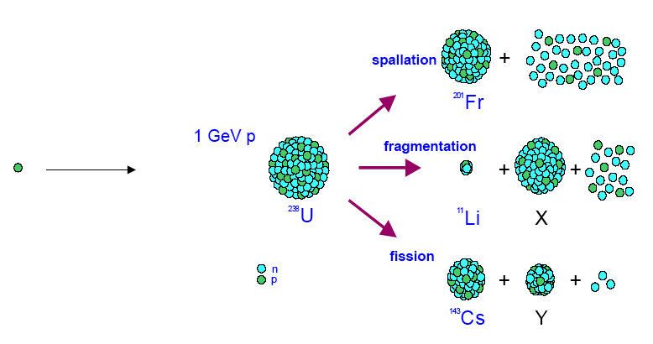
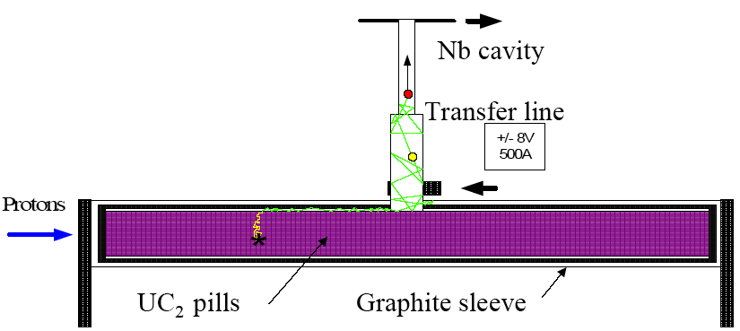
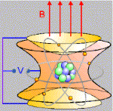
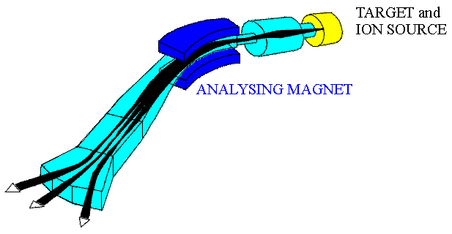

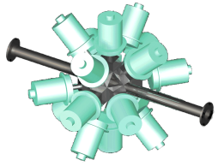
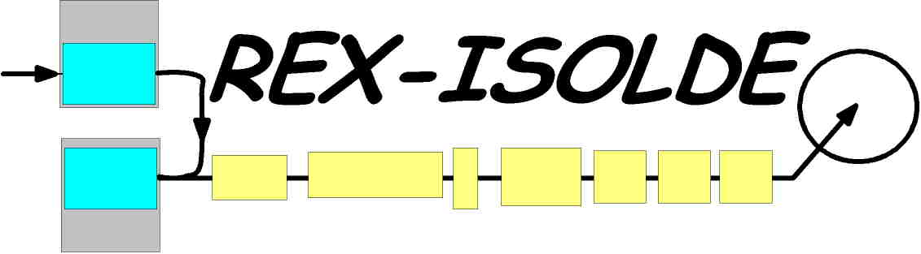
ISOLDE Introduction - The ISOL process
Production
Ionization / Extraction
Ionization
Effusion
Isotope Separation
Post acceleration
or to Experiment:
ISOLTRAP
Q/A
(Examples)

Slide 8
ISOLDE Introduction - Overview
Protons
GPS Target
HRS Target
Laser Cabin
Magnets
Control Room
Experiments

Slide 9
Outline
Introduction
  Myself
  ISOLDE
  RILIS Laser Ion Source
The new Laser System
  Facts
  Comparison of established Dye and new Ti:Sa
Agenda
Summary

Slide 10
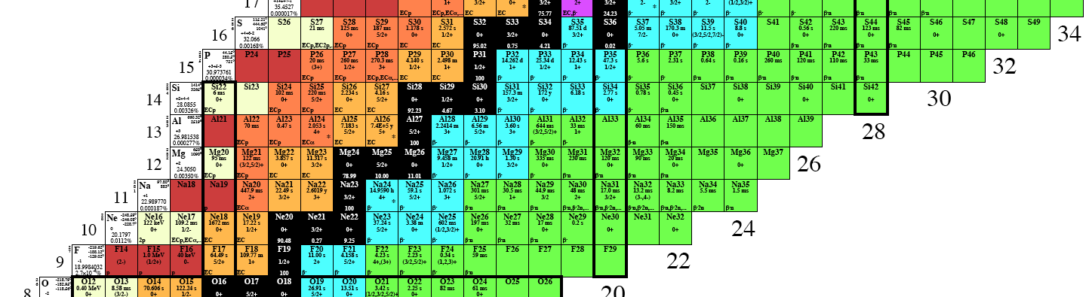

Resonance Ionization Laser Ion Source - RILIS
AI
Atom source
Ion optics
Mass separation
IP
Rydberg
Atoms
Excited states
Ions
Experiment
Laser beams
Ground state
Resonance ionization: Stepwise resonant excitation of atoms and final ionization
Z – selective & very efficient
Mass selection
R I L I S
Z selection
RILIS (Z)
GPS or HRS
+ Mass separation (Q/A)
= Isotope selection

Slide 11
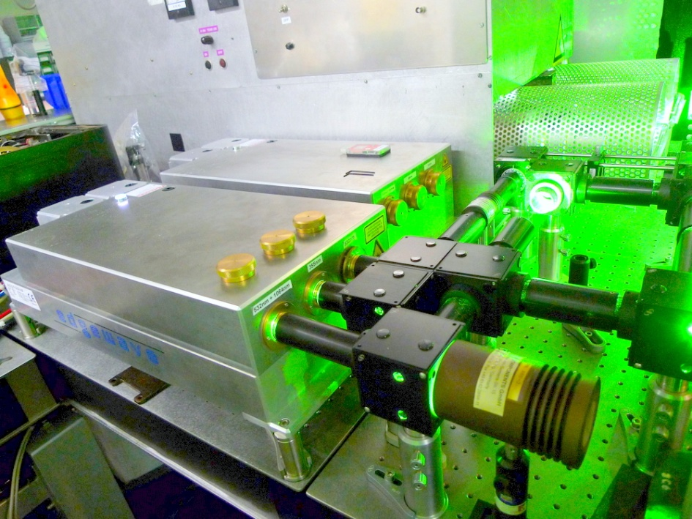
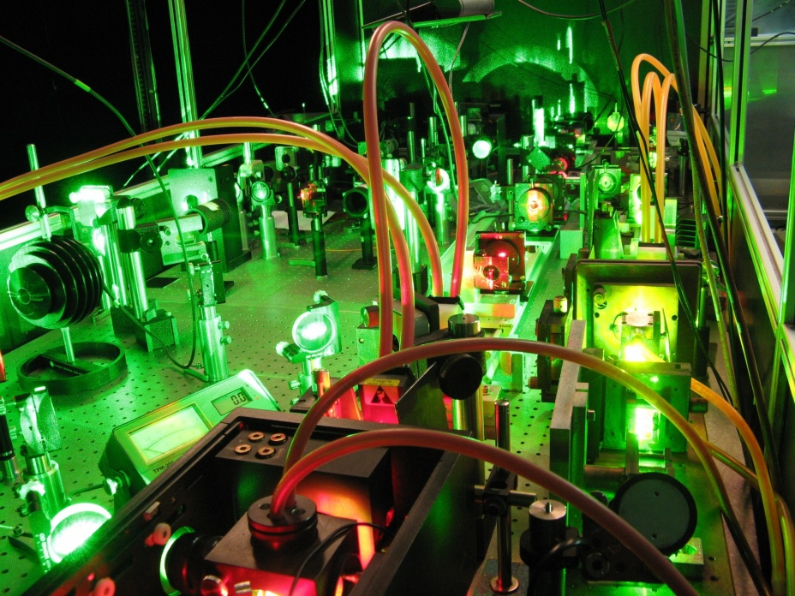
Current Status of RILIS Dye Lasers
Dye lasers pumped by frequency doubled Nd:YAG (Edgewave), 10kHz
Wavelength tuning range:
Fundamental (ω) 540 - 850 nm (8 W)
2nd harmonic (2ω) 210 - 425 nm (2 W)
3rd harmonic (3ω) 213 - 265 nm (.15W)
RILIS operation per year: >> 2000 h
Problem
Time needed for elment change: 2 - 3 days

Slide 12
Outline
Introduction
  Myself
  ISOLDE
  RILIS Laser Ion Source
The new Laser System
  Facts
  Comparison of established Dye and new Ti:Sa
Agenda
Summary

Slide 13
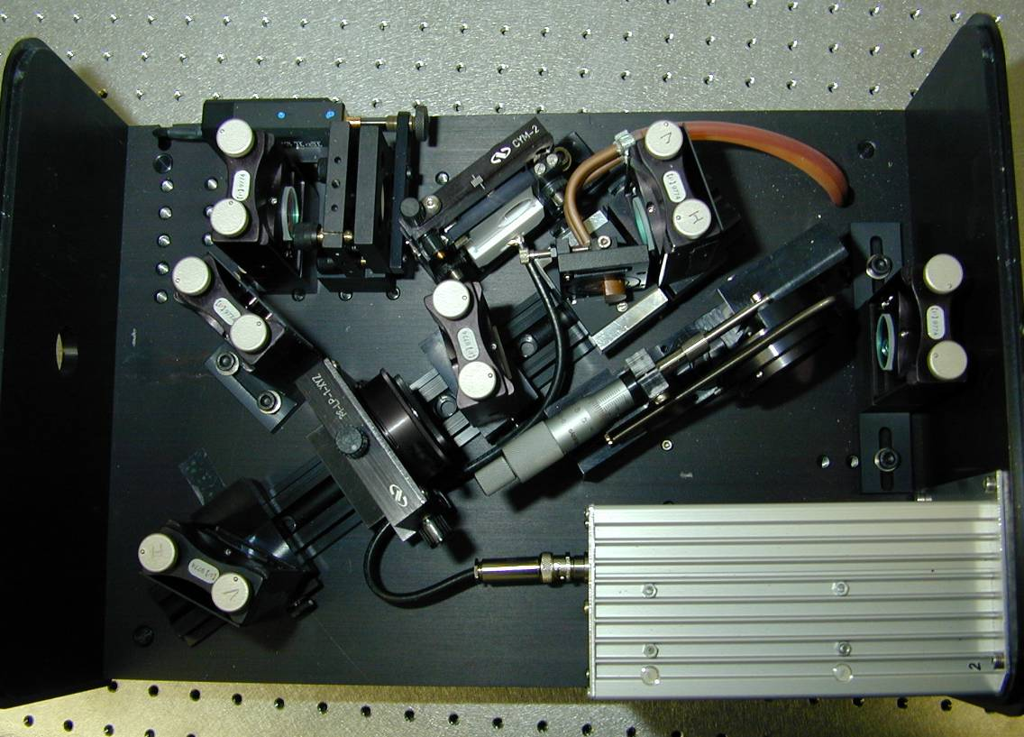
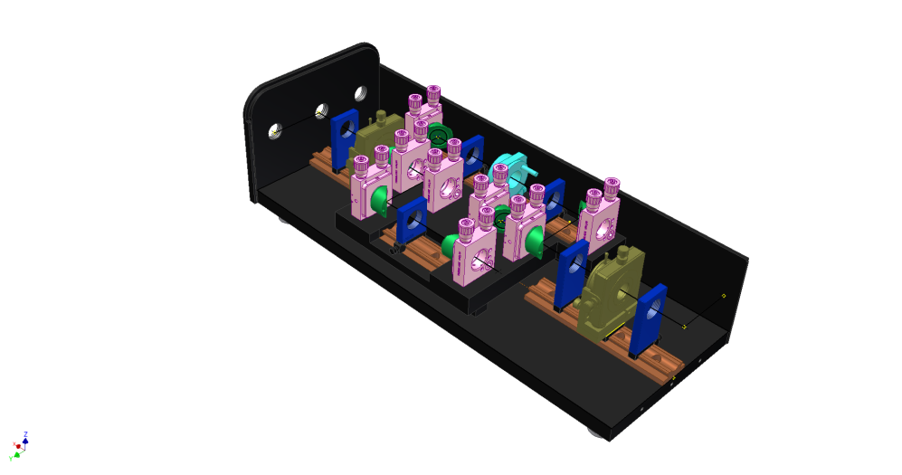
Solution: Installation af a second laser system : Solid State Ti:Sa Lasers
2 Pump lasers
Nd:YAG, Photonics Industries, 532 nm, 60 W at 10 kHz
3 Solid state Ti:sapphire lasers
Design adapted from University of Mainz
Wavelength tuning range:
3-5W Fundamental 690 - 980 nm (red - IR)
2 Frequency Conversion Units
1 W 2nd harmonic 350 - 470 nm (blue)
0.2W 3rd , 4th harmonic 205 - 315 nm (UV)

Slide 14
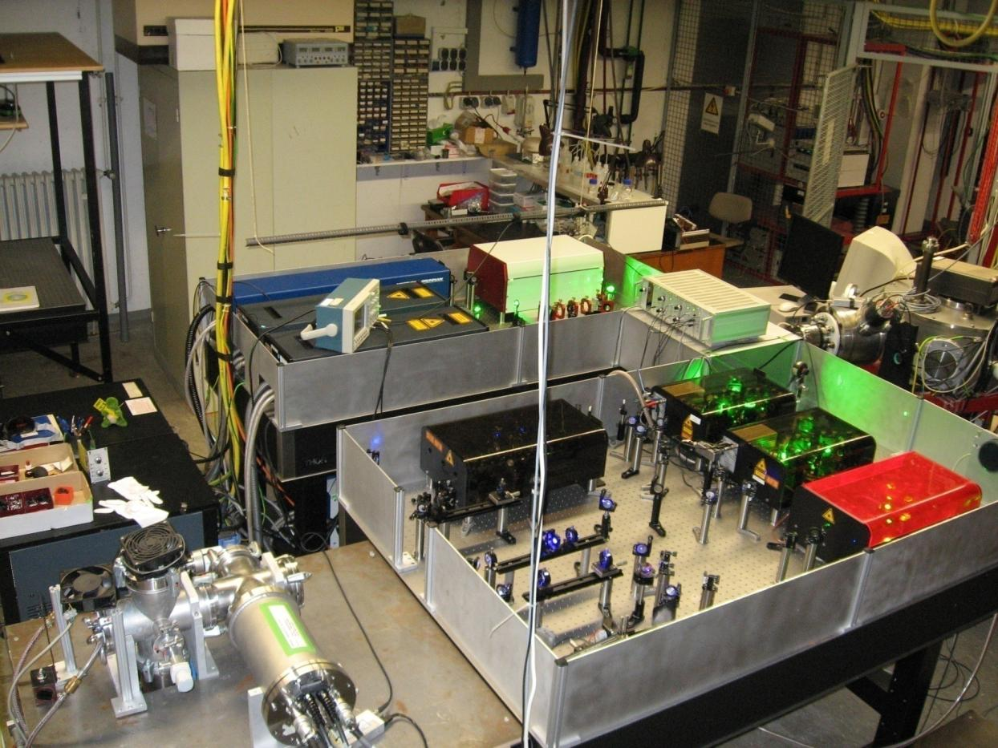
Ti:Sa Laser System at University of Mainz
UMz RISIKO
Mass separator
Pump laser 1064 nm
Pump laser 532 nm
Pump laser 532 nm
Cr:Fo
Ti:Sa 1
FCU
Ti:Sa 2
Wide tuning Ti:Sa
Test Chamber MABU
(Mz Atomic Beam Unit)
Development laser system at University of Mainz
copies at TRIUMF, ORNL, JYFL, CERN & GANIL (under construction)

Slide 15

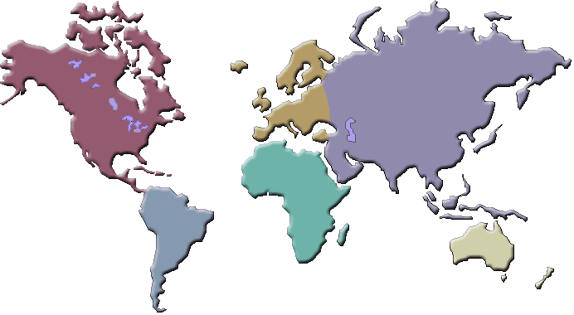
Laser Ion Sources World-Wide
RILIS
FURIOS
LISOL
ISOLDE, Geneva
hot cavity
rep. rate ~10 kHz
dye + ti:sa laser
IGISOL, Jyväskylä
gas cell
rep. rate ~10 kHz
ti:sa laser
Louvain-la-Neuve
gas cell
rep. rate <200Hz
dye laser
TRILIS
TRILIS
TRIUMF, Vancouver
hot cavity
rep. rate 10 kHz
ti:sa laser
off-line
ORNL
Oak Ridge (off-line)
hot cavity
rep. rate ~10 kHz
ti:sa laser
GISELE
RISIKO
TIARA
GANIL, Caen
rep. rate ~10 kHz
ti:sa laser
Mainz (off-line)
hot cavity
rep. rate ~10 kHz
ti:sa laser
Takasaki
hot cavity
rep. rate 300Hz
dye laser

Slide 16
Outline
Introduction
  Myself
  ISOLDE
  RILIS Laser Ion Source
The new Laser System
  Facts
  Comparison of established Dye and new Ti:Sa
Agenda
Summary

Slide 17
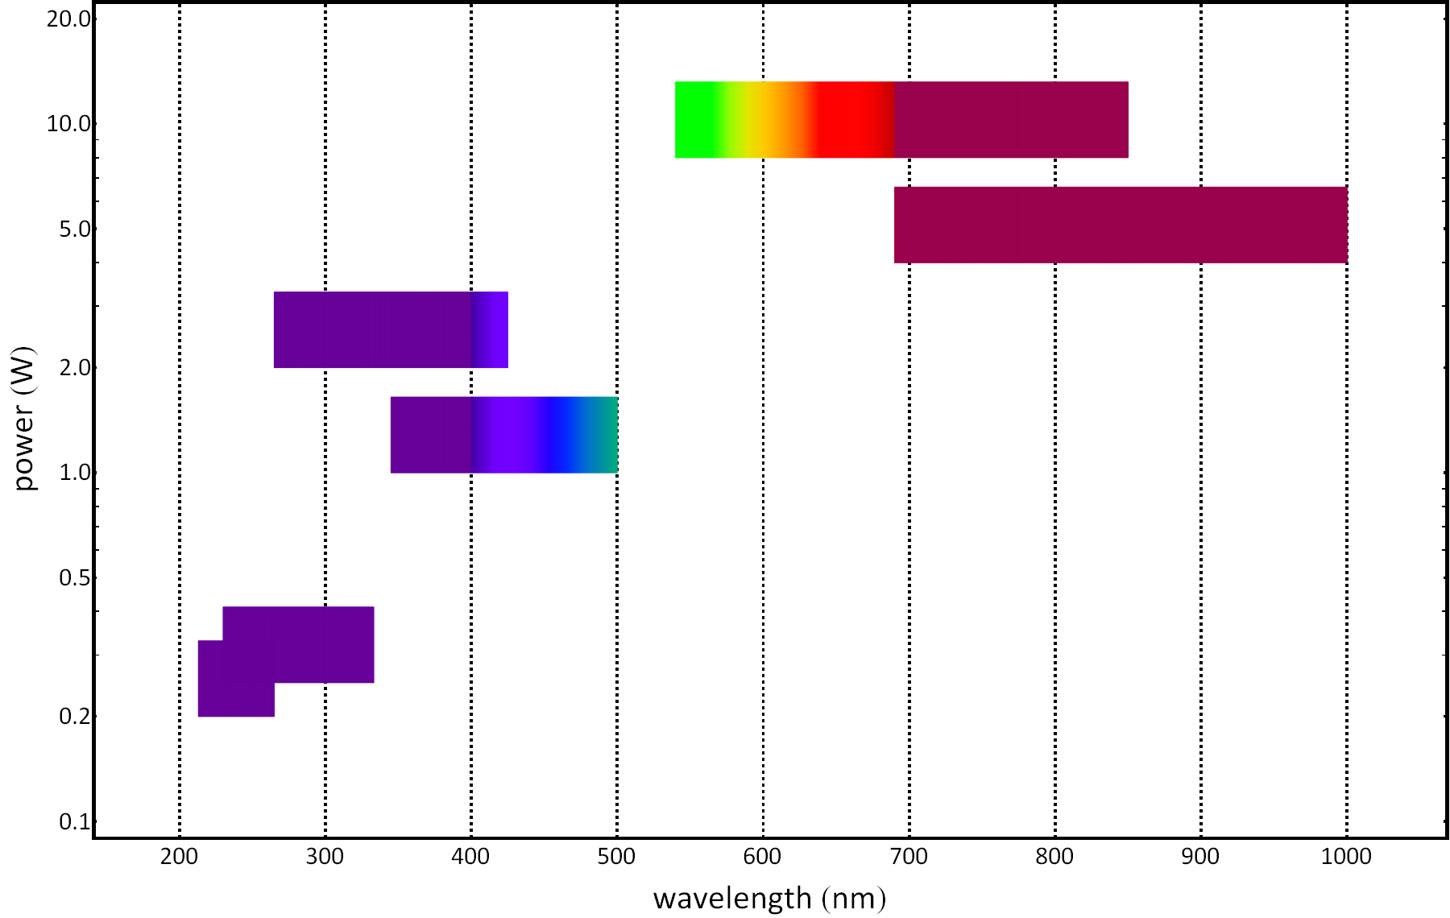
Dye Laser vs. Ti:Sa Laser – Tuning ranges
Dye
Ti:Sa
2x Dye
2x Ti:Sa
3x Ti:Sa
3x Dye
Dye: Green to Red + UV
Ti:Sa: Near IR + Blue

Slide 18
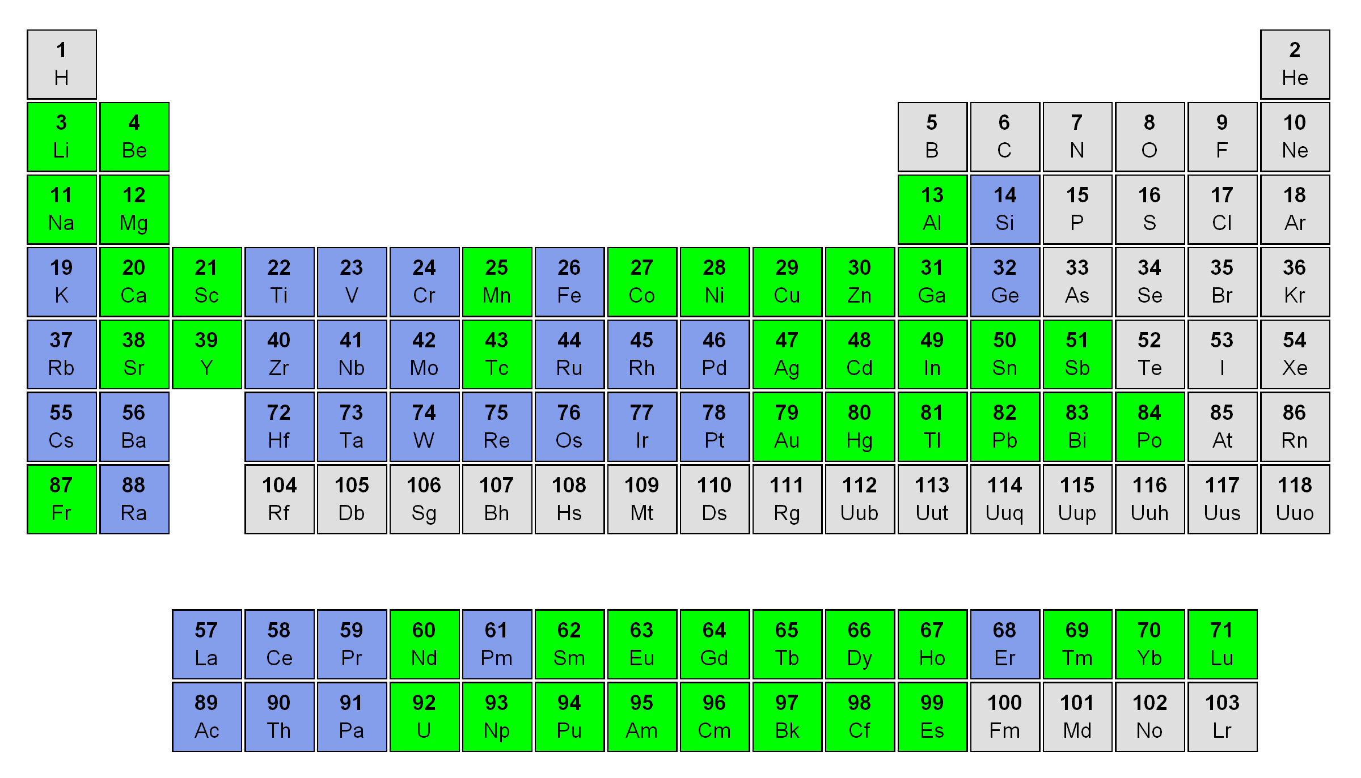
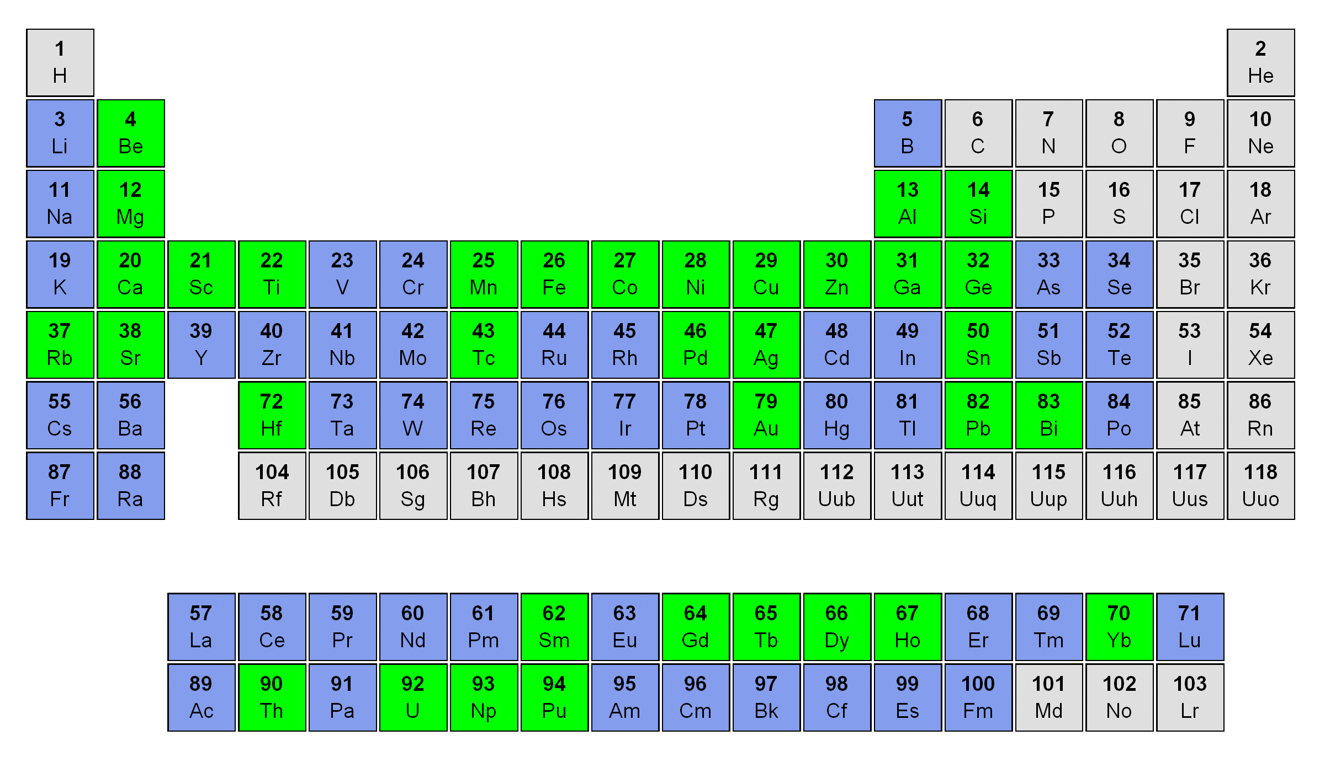
Dye Laser vs. Ti:Sa Laser – Periodic Table of Accessible Elements
Dye laser
46 elements tested
Ti:Sa laser
35 elements tested
Green: successfully tested
Blue: known to be accessible (scheme known but not yet tested )

Slide 19
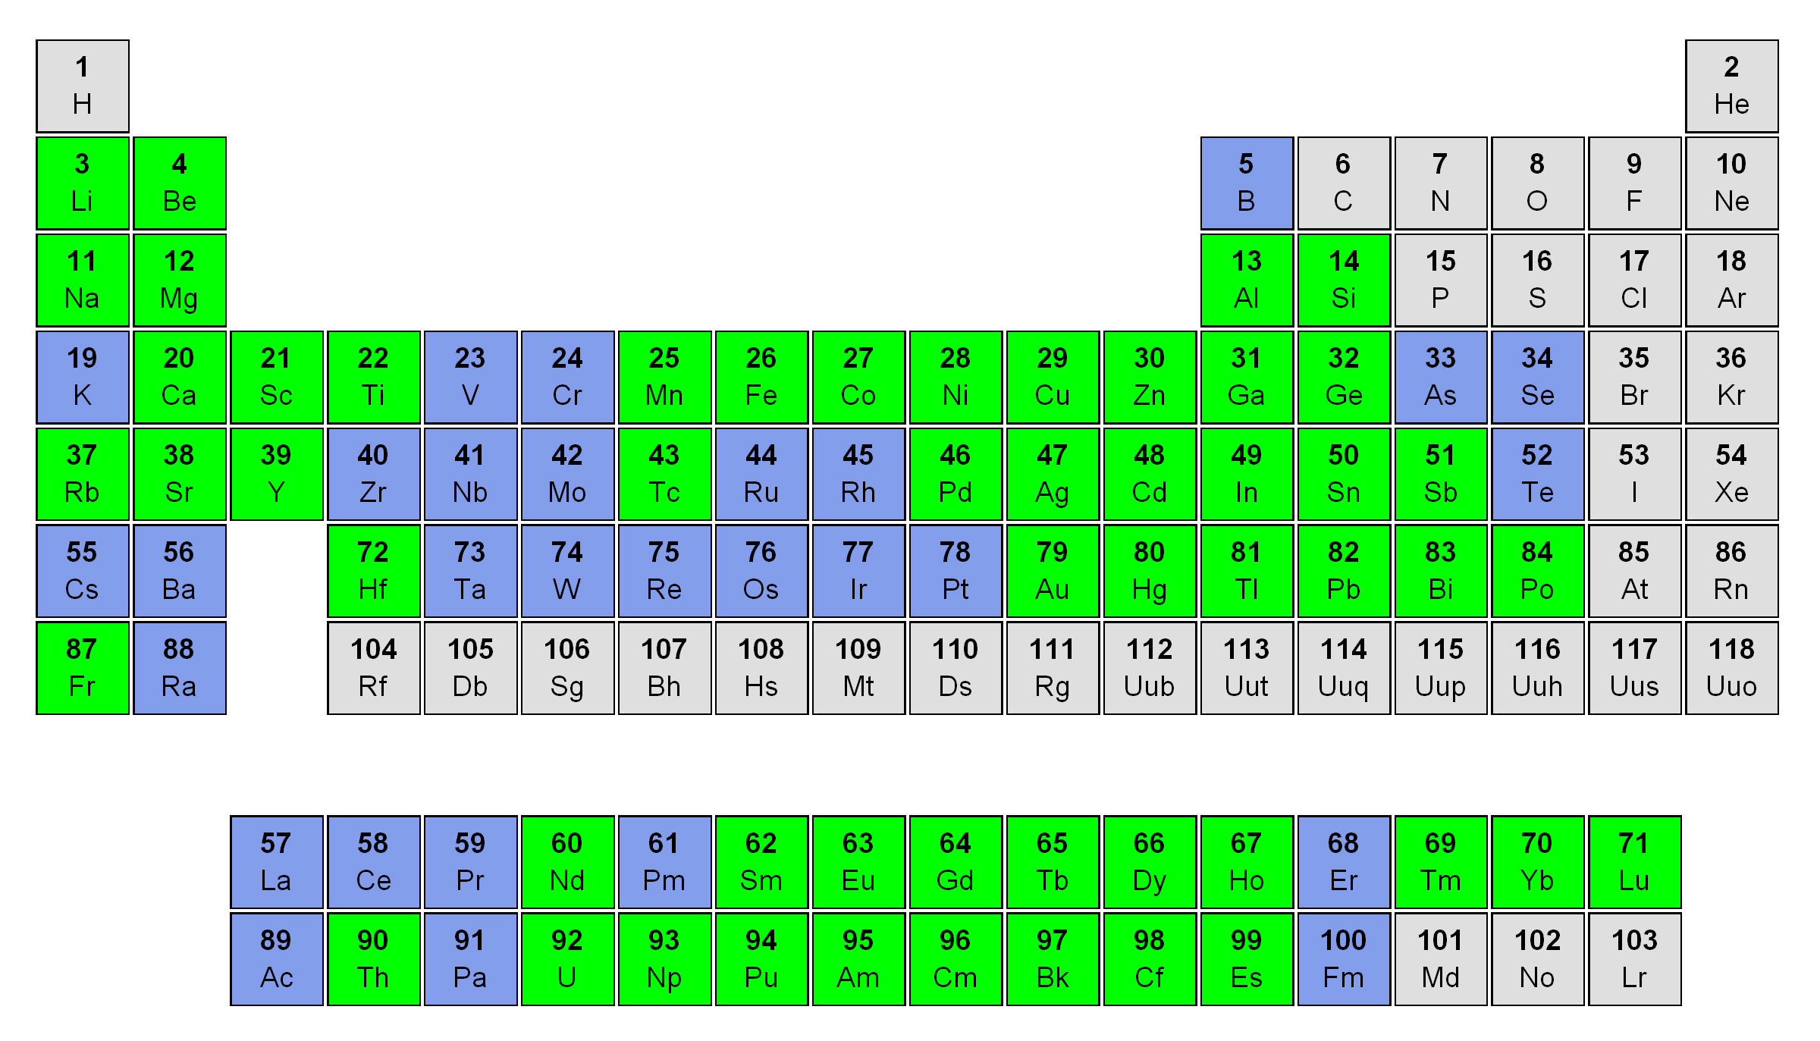
Dye Laser & Ti:Sa Laser – Periodic Table of Accessible Elements
Combined
54 elements tested
Green: successfully tested
Blue: known to be accessible / scheme developed not yet tested
Dye
2x Dye
Ti:Sa
2x Ti:Sa
3x Ti:Sa
3x Dye

Slide 20
Dye Laser & Ti:Sa Laser – Pros and Cons
 | Dye | Ti:Sa | Both
Active Medium | > 10 different dyes | Ti doped sapphire crystal
Tuning range | 540 – 850 nm | 680 – 980 nm | 540 – 980 nm
Power | Up to 8 W | 3- 5 W
Power stability | Decreases during operation | Stable
Switch elements | 2-3 Days | 1 Day | 4 hours
Maintenance | renew dye solutions if decomposed | ~ none
Schemes developed | 46 | 35 | 54
Having two independent laser systems reduces switching time between elements daramatically.

Slide 21
Outline
Introduction
  Myself
  ISOLDE
  RILIS Laser Ion Source
The new Laser System
  Facts
  Comparison of established Dye and new Ti:Sa
Agenda
Summary

Slide 22
Roadmap of RILIS upgrade
October
    first parts are delivered (Crystals, Q-Switches, BiFi)
November
    Pump lasers arrive
    first parts of Ti:Sa are in mechanical workshop in Mainz
December
    Delivery of resonator mirrors and etalons
January
    Prototype of new Ti:Sa is ready to be tested
Winter
    Lasersystem is complete and ready to be tested
Spring
    First off-line laser ions
    Step-wise installation at RILIS laser cabin
First on-line laser ions
Duo-RILIS: two laser systems available for operation with a possibility of quick switch from one element to another
Combination of Dye + Ti:Sa for one ionization scheme
2009
2010
2011

Slide 23
Outline
Introduction
  Myself
  ISOLDE
  RILIS Laser Ion Source
The new Laser System
  Facts
  Comparison of established Dye and new Ti:Sa
Agenda
Summary

Slide 24
Summary
For selective production of Isotopes one needs a Laser Ion Source
To speed up switching between elements, a second laser system is needed
The new system will be a Mainz-Type solid-state Ti:Sapphire system
Ti:Sa & Dye complement one another
First parts arrived

Slide 25



Acknowledgements
CERN, EN department
KTH – Royal Institute of Technology &
Knuth and Alice Wallenberg Foundation
Stockholm, Sweden
University of Mainz, Working group LARISSA
Mainz, Germany
Larissa
BMBF – Bundesministerium für Bildung und Forschung

Slide 26
Thank you.

