Slide 1
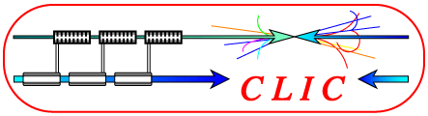


Simulations of
Beam-Beam-Background in a CLIC Detector
André Sailer (PH-LCD & HU Berlin)
Supervisors:
Konrad Elsener (PH-LCD)
Thomas Lohse (HU Berlin)

Slide 2
Content
(Compact Linear Collider)
Beam-Beam-Interaction and Beam-Beam-Background
CLIC Detector Forward Region Elements
Radiation Dose
Background in the Vertex Detector

Slide 3
Compact Linear Collider (CLIC)
See Christian’s Talk

Slide 4
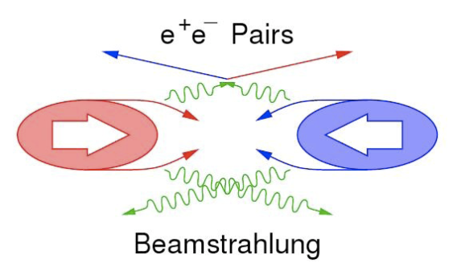
Beam-Beam-Interaction
We want a large Luminosity L
  →Small Beams
Beam Parameters
  Height σ_{y}: 1nm
  Width σ_{x}: 45 nm
  Particles (Bunch charge) N: 3.7x10⁹
But high field density causes Beam-Beam-Interaction
Particles are deflected / pinched
Produce photons (Beamstrahlung)
  Energy of annihilating particles is reduced from nominal value
  Only 30% of Luminosity in top 1%
Photons interact with Particles and/or Field
Photons produce Electron-Positron-pairs

Slide 5
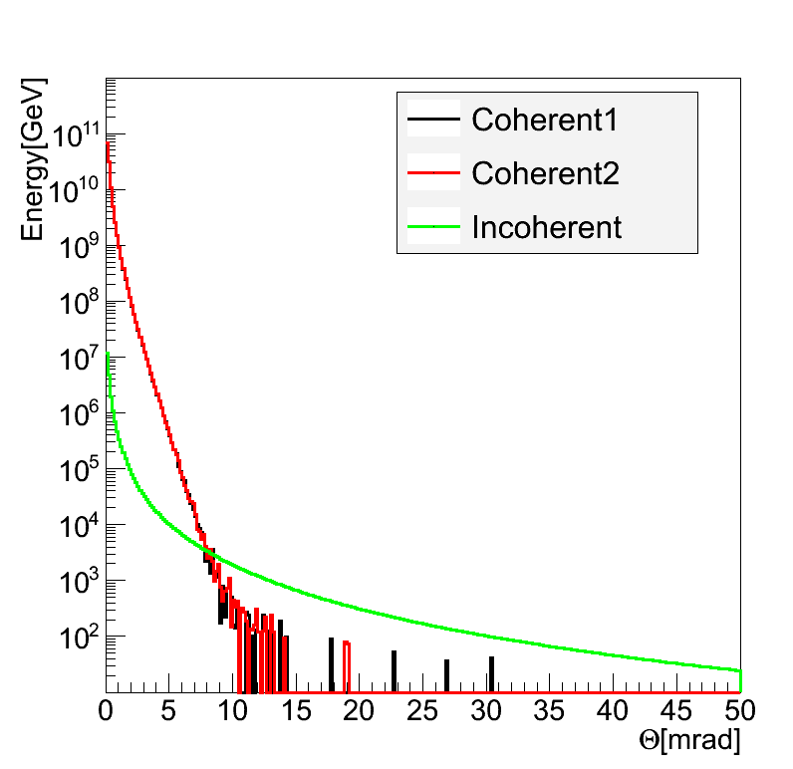
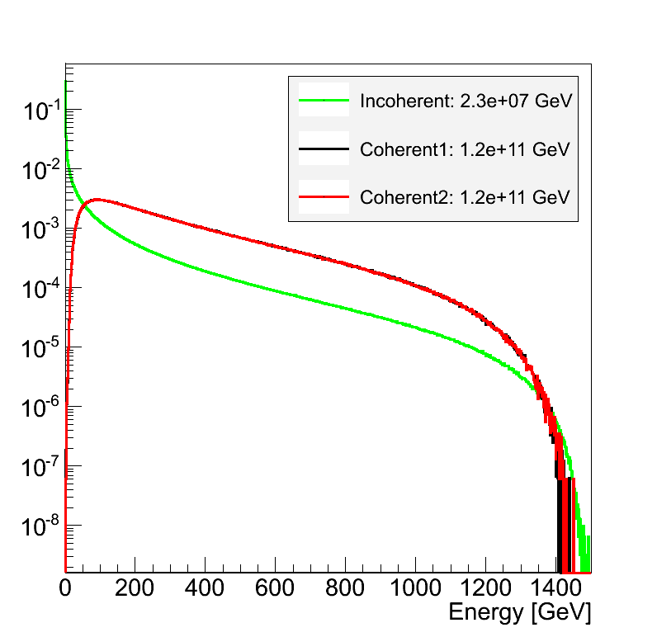
Beam-Beam-Background
Photons interacting with electrons/positrons of the other bunch
  Incoherent Pairs: ~ 350000 per Bunch Crossing
Photons interacting with EM-Field
  Coherent Pairs: ~ 3.8x10⁸ per Bunch Crossing
    A lot of Energy
    But at smaller angle than incoherent Pairs
    Aperture for outgoing beam must be large enough (~10 mrad)
Gamma-Gamma to Hadrons
  About 3 Events per BX
Simulation of Beam-Beam-Interactions are done with Guinea-Pig

Slide 6
CLIC_ILD Detector
Studies based on ILD Detector Concept for the International Linear Collider (ILC)
Using Geant4 based Simulation Software Mokka
A few changes to adapt to CLIC
  Crossing Angle 20 mrad
  More Interaction Length in HCAL
  Vertex Detector moved outside due to Background from Beam-Beam-Interaction
Yoke
Radius:
7 m
Coil
HCal
Ecal→
Tracker
LumiCal
BeamCal
QD0
2.5 m
3.5 m

Slide 7
LumiCal
Silicon-Tungsten (Si-W) Sandwich Calorimeter
Counts Bhabha (e+e-→e+e-) events to measure Luminosity
Centered on Outgoing Beam axis
Inner radius: 10 cm
  Incoherent Pairs
Outer Radius: 25 cm
LumiCal
60 cm
2.5 m
3.5 m
Notes:
Picture of the Detector, or right away close up of the interesting parts, and a table detailing numbers, as well as the numbers for the SID like detector…

Slide 8
BeamCal
BeamCal
(with 10cm graphite)
(?)-Tungsten Sandwich Calorimeter
  Located on outgoing beam pipe
  ~3.5 cm inner radius
    Avoid Coherent Pairs
  Outer radius to complement LumiCal coverage (~20 cm)
Dump for incoherent pairs
  Collision/Luminosity Monitoring
  Dose in Detector: ~10 MGy
Masking against back-scattering particles from post-collision line
Electron Veto for 2-Photon events
60 cm
2.5 m
3.5 m
Side View:
Graphite – (?) - W
Front View

Slide 9
Two Photon Background
σ ≈ 280nb
σ ≈ 4700nb
Electrons at very small angles
  BeamCal
SuSy Signal:
  Smuon, Stau Pair Production
  Signature: Two leptons and missing energy
  Cross Section: few nb

Slide 10
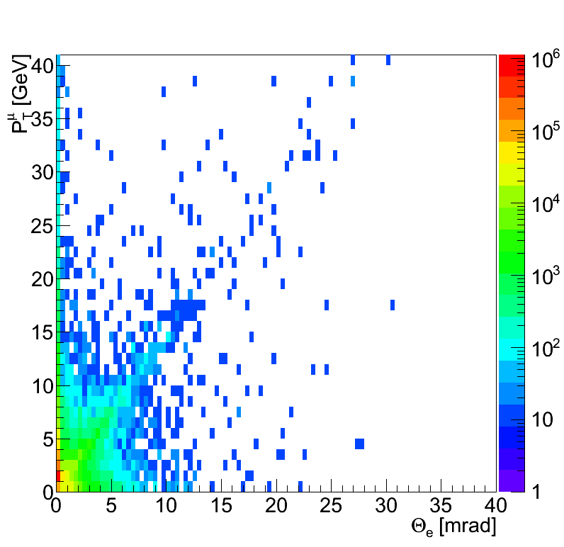
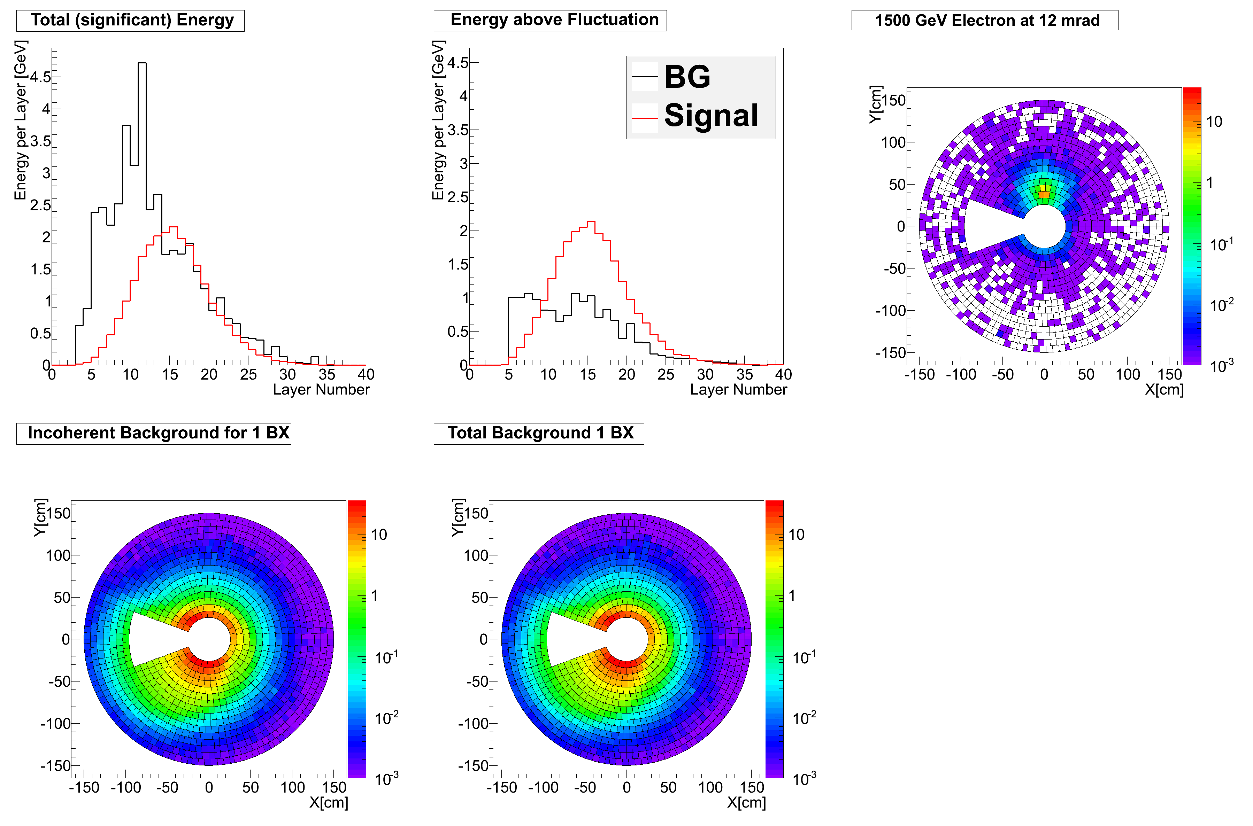
Very Forward Tagging (BeamCal)
PT for Muons and Angles of Electrons for eeµµ
Tag Electrons with angles above ≈ 10 mrad
Electron veto removes Background only, does not remove Signal Events
Large background from incoherent Pairs in BeamCal
Will have pairs from more than 1 BX in BeamCal
Study if Electrons can be recognized above the background
GeV/Cell
GeV/Cell
Deposited Energy integrated over all Layers

Slide 11
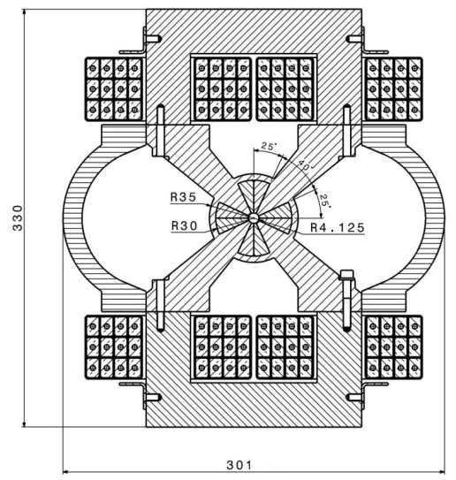
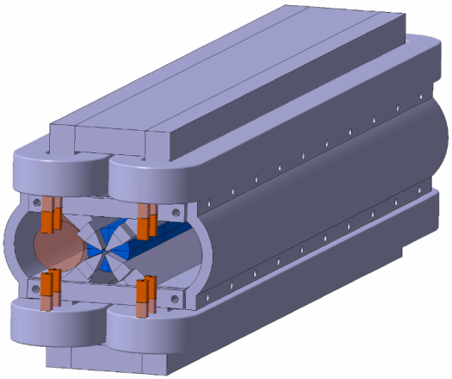
QD0
QD0
R=35mm
Final Focus Quadrupole
Hybrid Magnet for large gradient of 575 T/m
Must be very stable (~0.1 nm) against vibrations
Major issue for integration into detector
Implement more realistic QD0 into Simulation Software to determine energy deposit from background and back-scattering
60 cm
2.5 m
3.5 m
M. Modena, CERN

Slide 12
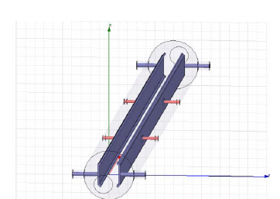
Intra-Train-Feedback
Beam Position Monitor
Detect Offset in outgoing Beam position with Beam Position Monitor (BPM)
Correct with Kicker
“Regain” Luminosity
Has to be very fast
Has to be very close to IP or the Train is through before corrections can be applied
These objects are rather susceptible to radiation
Recent Addition in Simulation
→Study energy deposition from Beam-Beam-Background
Improve shielding if necessary
2.5 m
3.5 m
Kicker
Model of a Strip line kicker: From “Design of a Strip-Line extraction Kicker for CTF3 combiner Ring, I. Rodriguez et al.

Slide 13
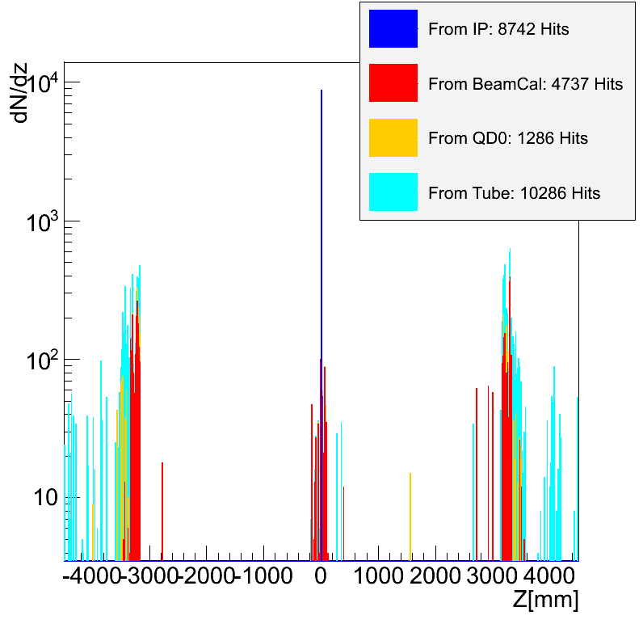
Incoherent Pairs
Incoherent Pairs hit objects in Forward Region
  LumiCal, BeamCal, QD0 (BPM, Kicker)
  Some particles are scattering back into the Vertex Detector (VXD)
Study how changes in the Forward Region affect the Background in the Detector
  Location of BeamCal
  Additional Objects
  Geometry of vacuum tube
Using MC information to identify back scattering surface/origin

Slide 14
Vertex Detector
3 Double Layers
In Z from -125 to +125 mm
R = 31, 46, 60 mm
50 micron Silicon
  Threshold: 3.4 keV
+ Electronics + Support

Slide 15
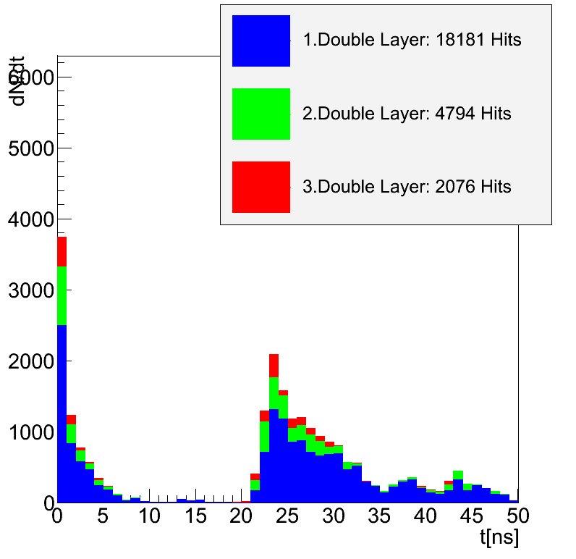
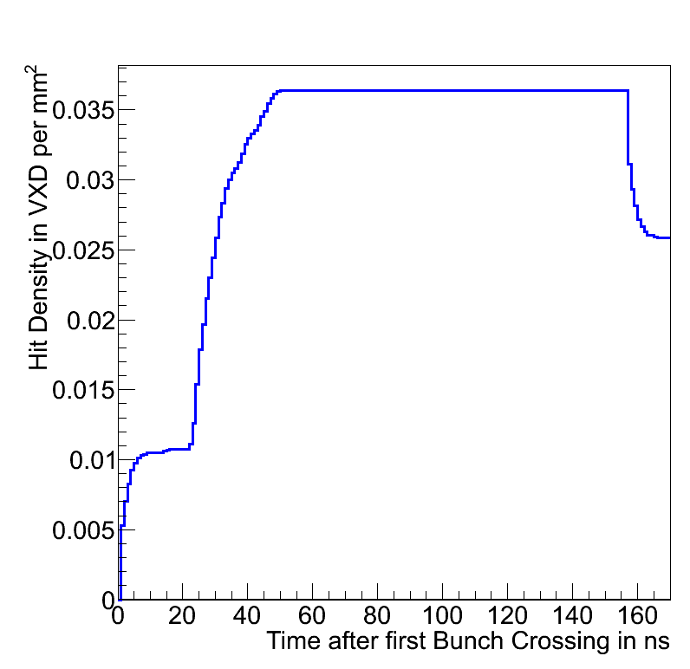
Background in the Vertex Detector
Time separation between direct Hits and back-scattered Hits
  Particles travel ~30cm per ns
Background from several bunch crossings overlap
  1BX every 0.5 ns
Detector is only read out after several bunch crossings
→Reduce back-scattering particles from forward region

Slide 16
Summary
Working on Forward Region for CLIC Detectors
Implement(ed) realistic Forward Region in Simulation
Issues stemming from Electron Positron Pairs from Beam-Beam-Interaction
Studying Background in the Detector
Studying Radiation Dose
  QD0, BPM, Kicker, BeamCal, LumiCal
Studying Energy Deposition in Forward Calorimeters (mostly BeamCal) for Electron Tagging

