Slide 2
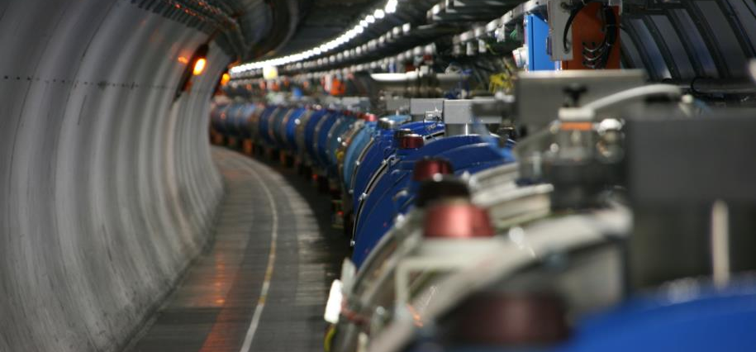
Re-commissioning of the superconducting circuits
Meeting n.7
Mirko Pojer and Matteo Solfaroli
Beams Department
Operation Group

Slide 3

General advancement
Beam screen conditioning done in all sectors: cryo now fully available all over the ring (test on QURC-A of IP8 at the end if time permits)
Some circuits still to be released by QPS, among them few Mains
Main Dipoles released in 6 sectors; one circuit to be powered to 6.5 TeV e.c. today
Main Quadrupoles released in 7 sectors
30/94 IPDs/IPQs fully commissioned
All IPDs PIC2-circuit_quench_via_QPS have been failed by PIC due to missing data: automatic analysis is still not good.
Many tests failed the automatic analysis and have to be manually signed in Acc_testing
PNO.x1 not yet done on IT 600 A: need to change the current and synchronize (we’ll do once all circuits of a powering SS are OK)
PIC-Cryo connection to be tested now that all powering subsectors are available
Cooling water interlock to be tested in all sectors this week (to be agreed with CV)
13 kA calibration to be probably done on Friday

Slide 4
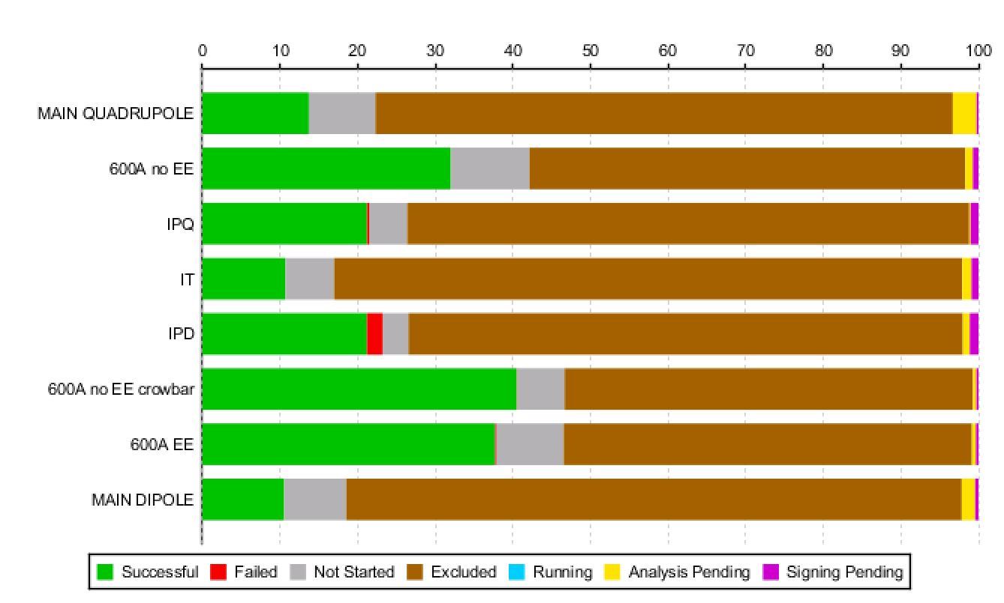
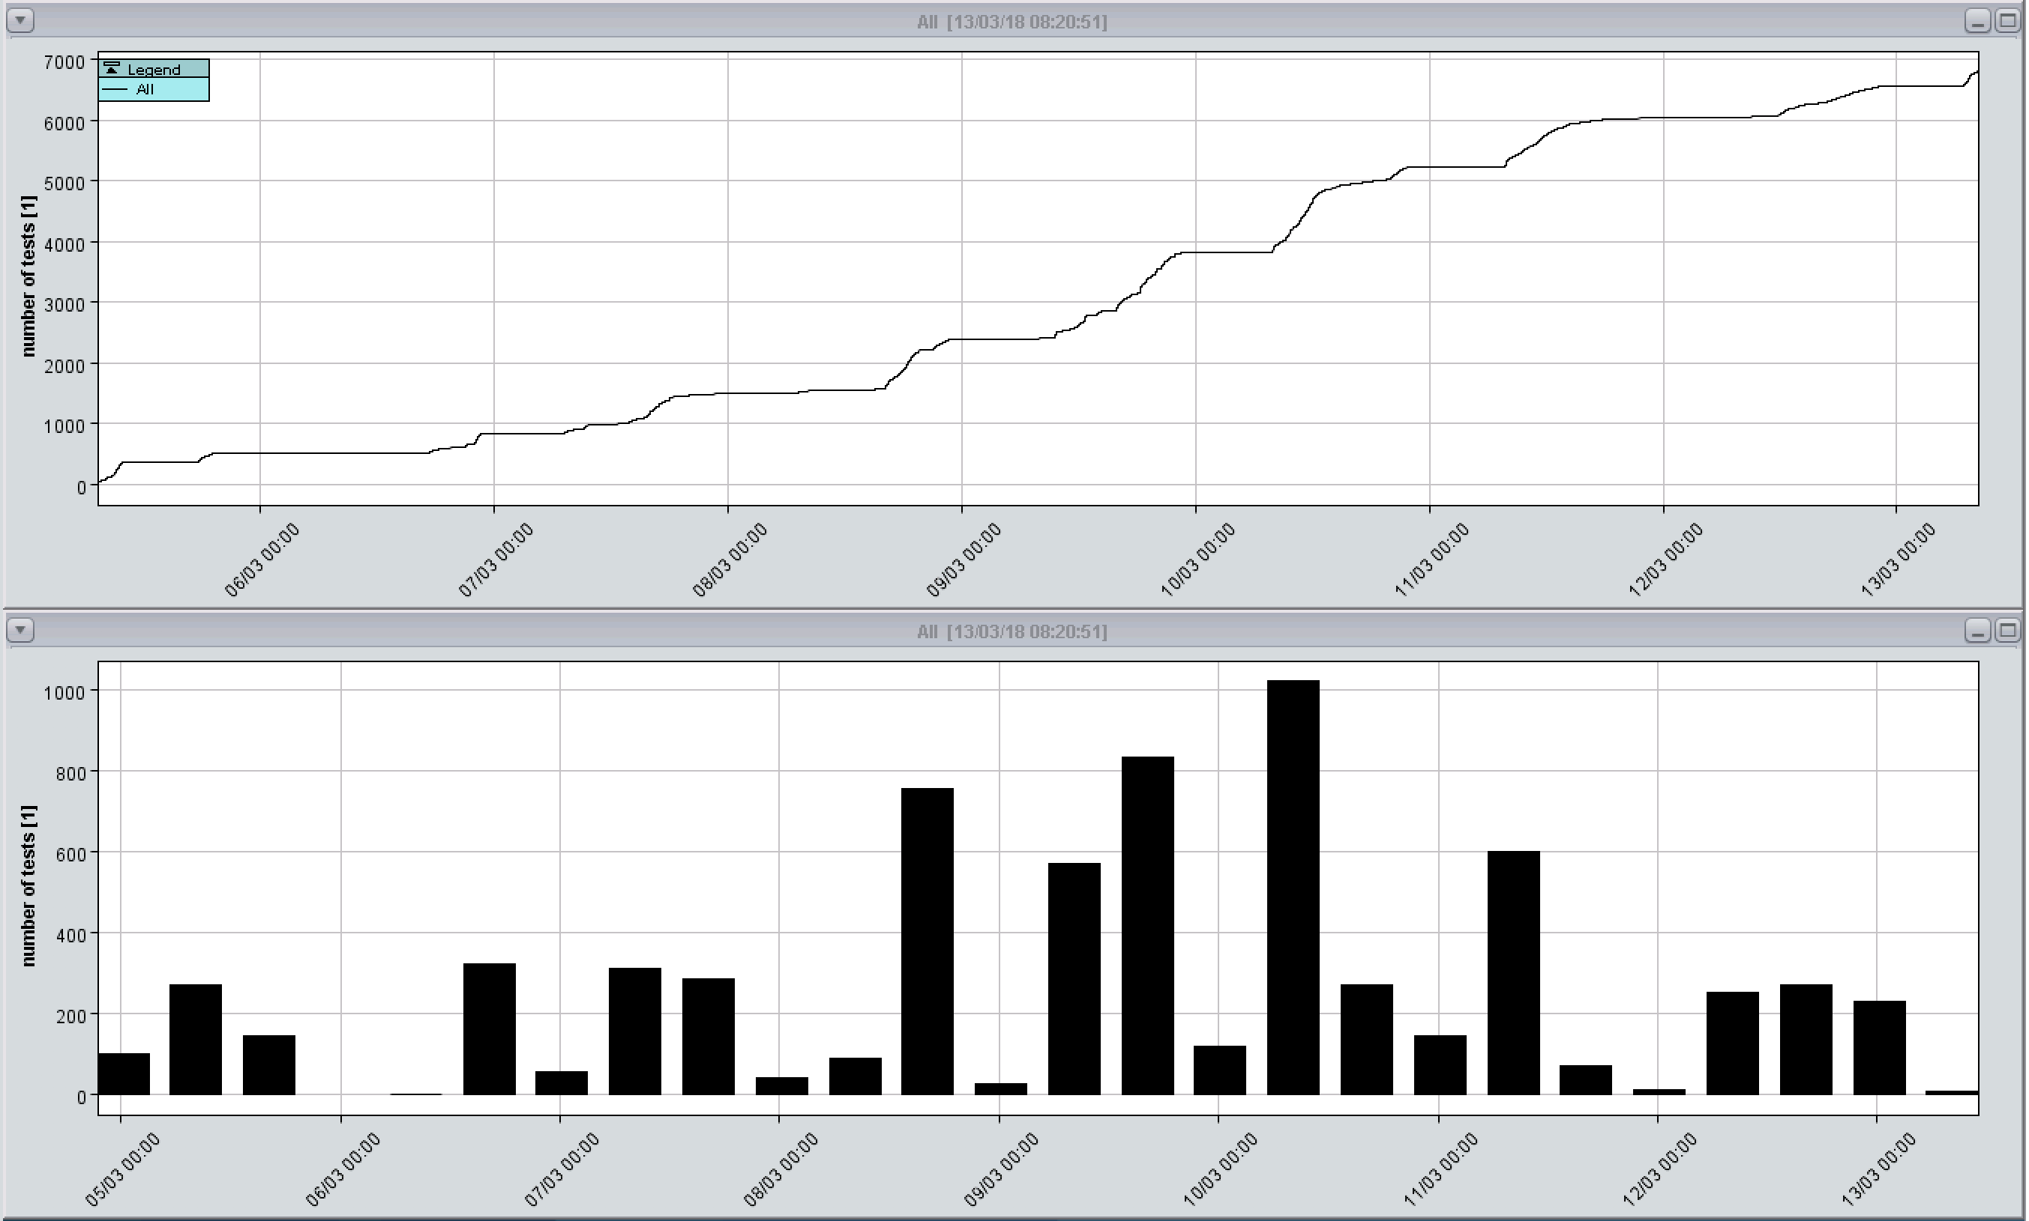
Test status

Slide 5
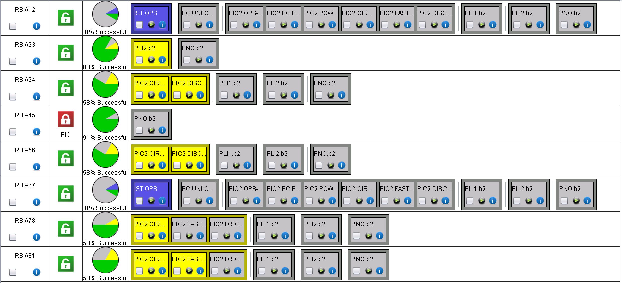
RBs

Slide 6
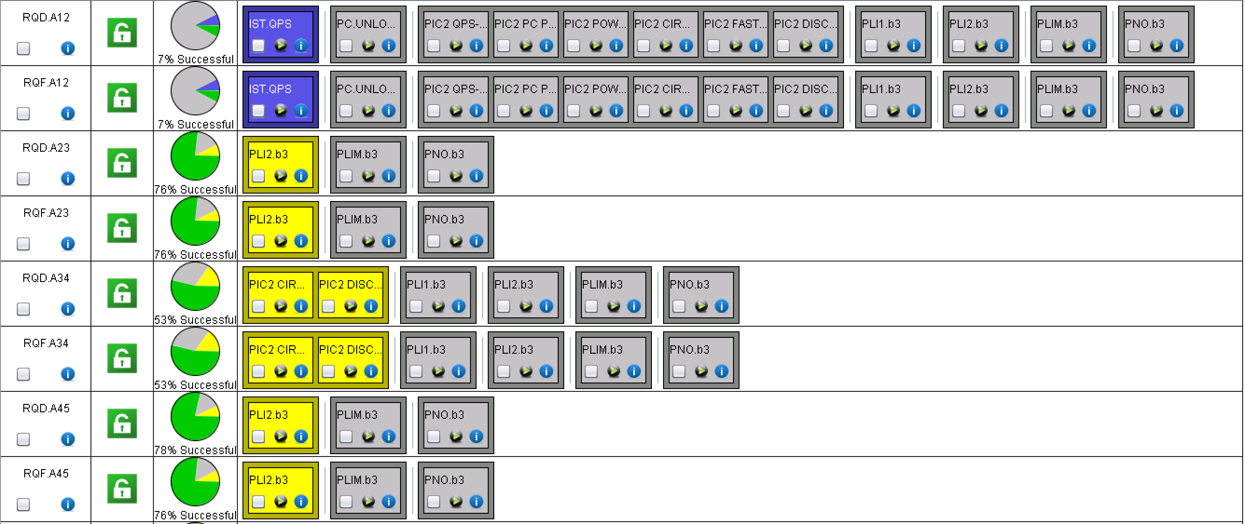
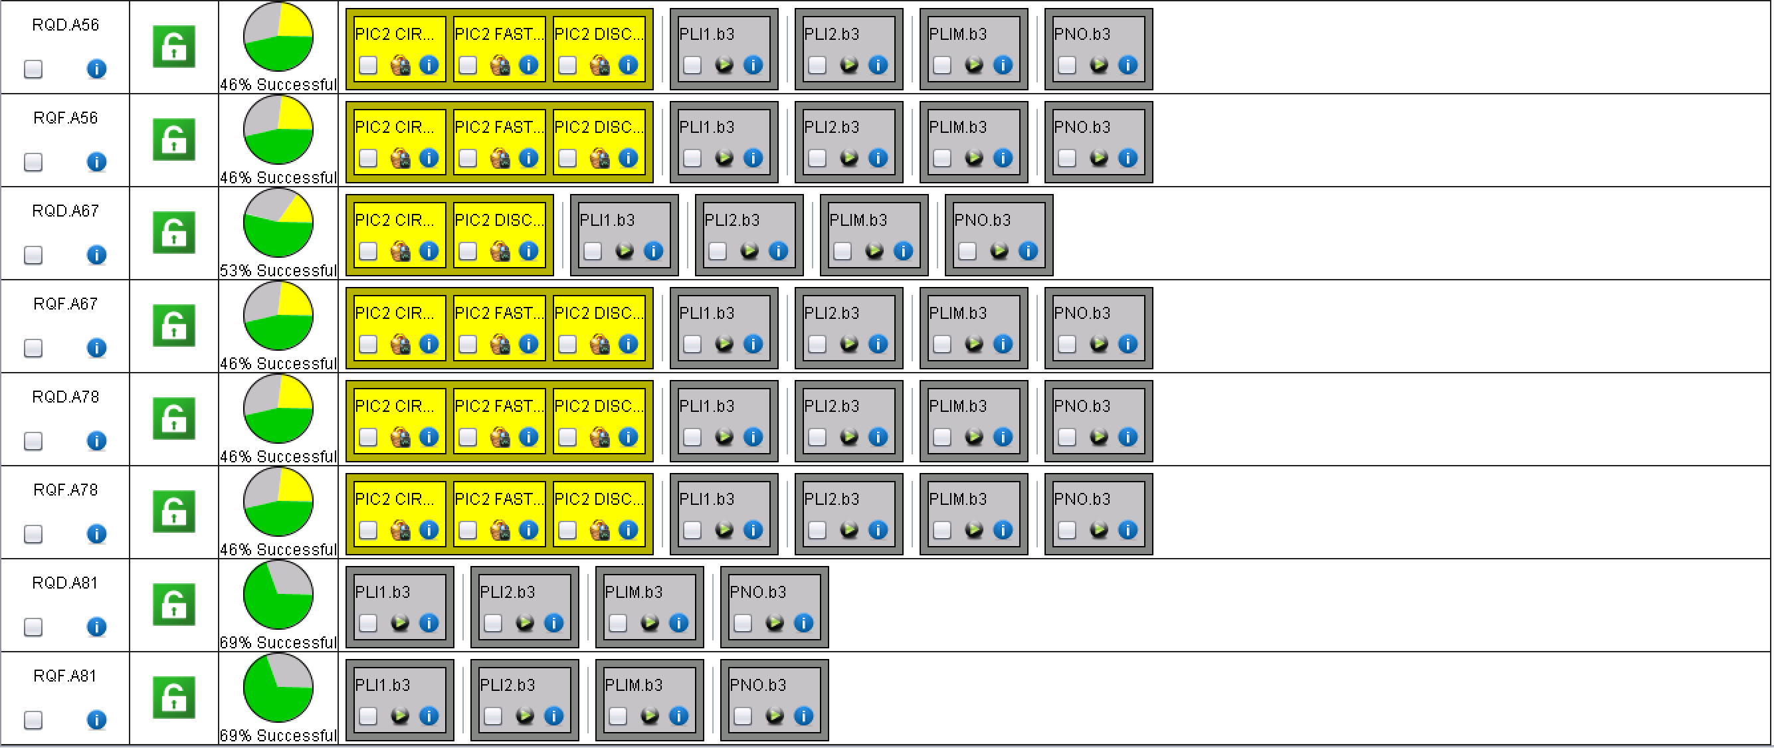
RQD/Fs

Slide 7
EPC interventions
RPLA.30R5.RCBH29.R5B1 | RPLA | LHC | R59 | (r) Valérie Montabonnet | HIGH | 13.03.18 | Solved in Remote
RPHGA.RR13.RQ10.L1B2 | HCRPHGA___ | LHC | RR13 | (r) Valérie Montabonnet |  | 05.03.18
RPHGA.RR13.RQ7.L1B1 | HCRPHGA___ | LHC | RR13 | (r) Valérie Montabonnet |  | 05.03.18
RPHGB.RR13.RQ6.L1B2 | HCRPHGB___ | LHC | RR13 | (r) Valérie Montabonnet |  | 05.03.18
RPHGB.RR57.RQ6.R5B2 | HCRPHGB___ | LHC | RR57 | (r) Julien Chanois |  | 09.03.18
RPMBB.RR77.RQTL9.R7B1 | HCRPMBB___ | LHC | RR77 | (r) Valérie Montabonnet |  | 12.03.18
RPMBB.RR77.RQTL9.R7B2 | HCRPMBB___ | LHC | RR77 | (r) Valérie Montabonnet |  | 12.03.18
RPHGA.UA23.RQ7.L2B1 | HCRPHGA___ | LHC | UA23 | (r) Valérie Montabonnet |  | 09.03.18 | Done
RPMBB.UA23.RCBXV1.L2 | HCRPMBB___ | LHC | UA23 | (r) Valérie Montabonnet | HIGH | 13.03.18 | Water Leak
RPMBB.UA23.RCBXV2.L2 |  |  |  |  |  |  | Water Leak
RPHGA.UA47.RQ8.R4B2 | HCRPHGA___ | LHC | UA47 | (r) Julien Chanois |  | 05.03.18
RPLB.UA47.RCO.A45B1 | RPLB | LHC | UA47 | (r) Julien Chanois |  | 12.03.18
RPLB.UA63.RCO.A56B2 | RPLB | LHC | UA63 | (r) Julien Chanois |  | 12.03.18
RPHGA.UJ67.RQ8.R6B1 | HCRPHGA___ | LHC | UA67 | (r) Julien Chanois |  | 18.01.18
RPHF.UA83.RD1.L8 | RPHF | LHC | UA83 | (r) Julien Chanois |  | 12.03.18 | Done
RPHF.UA83.RD2.L8 | RPHF | LHC | UA83 | (r) Julien Chanois |  | 12.03.18 | Done
RPHGA.UA83.RQ10.L8B1 | HCRPHGA___ | LHC | UA83 | (r) Julien Chanois |  | 11.12.17 | Done
RPHGA.UA83.RQ10.L8B2 | HCRPHGA___ | LHC | UA83 | (r) Julien Chanois |  | 11.12.17 | Done
RPLB.UA87.RCBYH5.R8B2 |  |  |  | (r) Julien Chanois | HIGH | 12.03.18 | Done
RPHGB.UA83.RQ6.L8B2 | HCRPHGB___ | LHC | UA83 | (r) Julien Chanois |  | 18.01.18 | Done
RPLB.UA83.RCO.A78B1 | RPLB | LHC | UA83 | (r) Julien Chanois |  | 12.03.18 | Done
RPLB.UA83.RCO.A78B2 | RPLB | LHC | UA83 | (r) Julien Chanois |  | 12.03.18 | Done

Slide 8
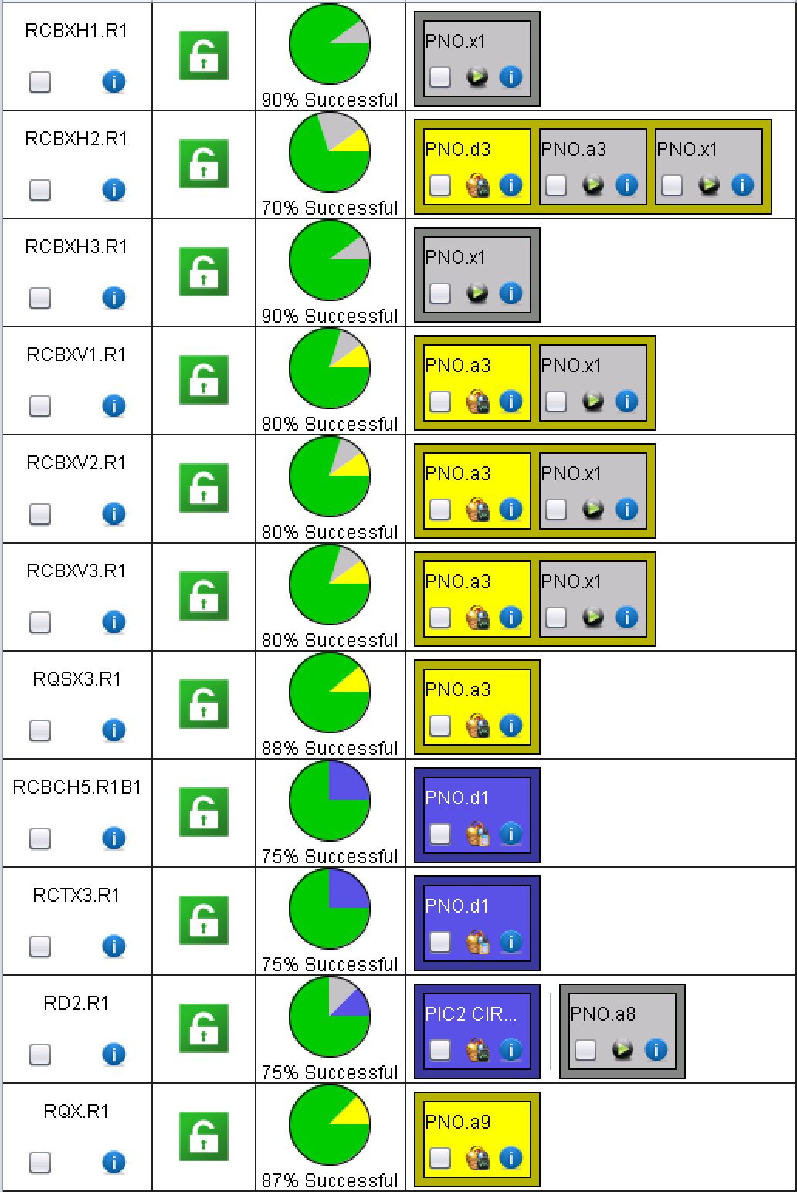
XR1 and LR1
QH analysis to be done

Slide 9
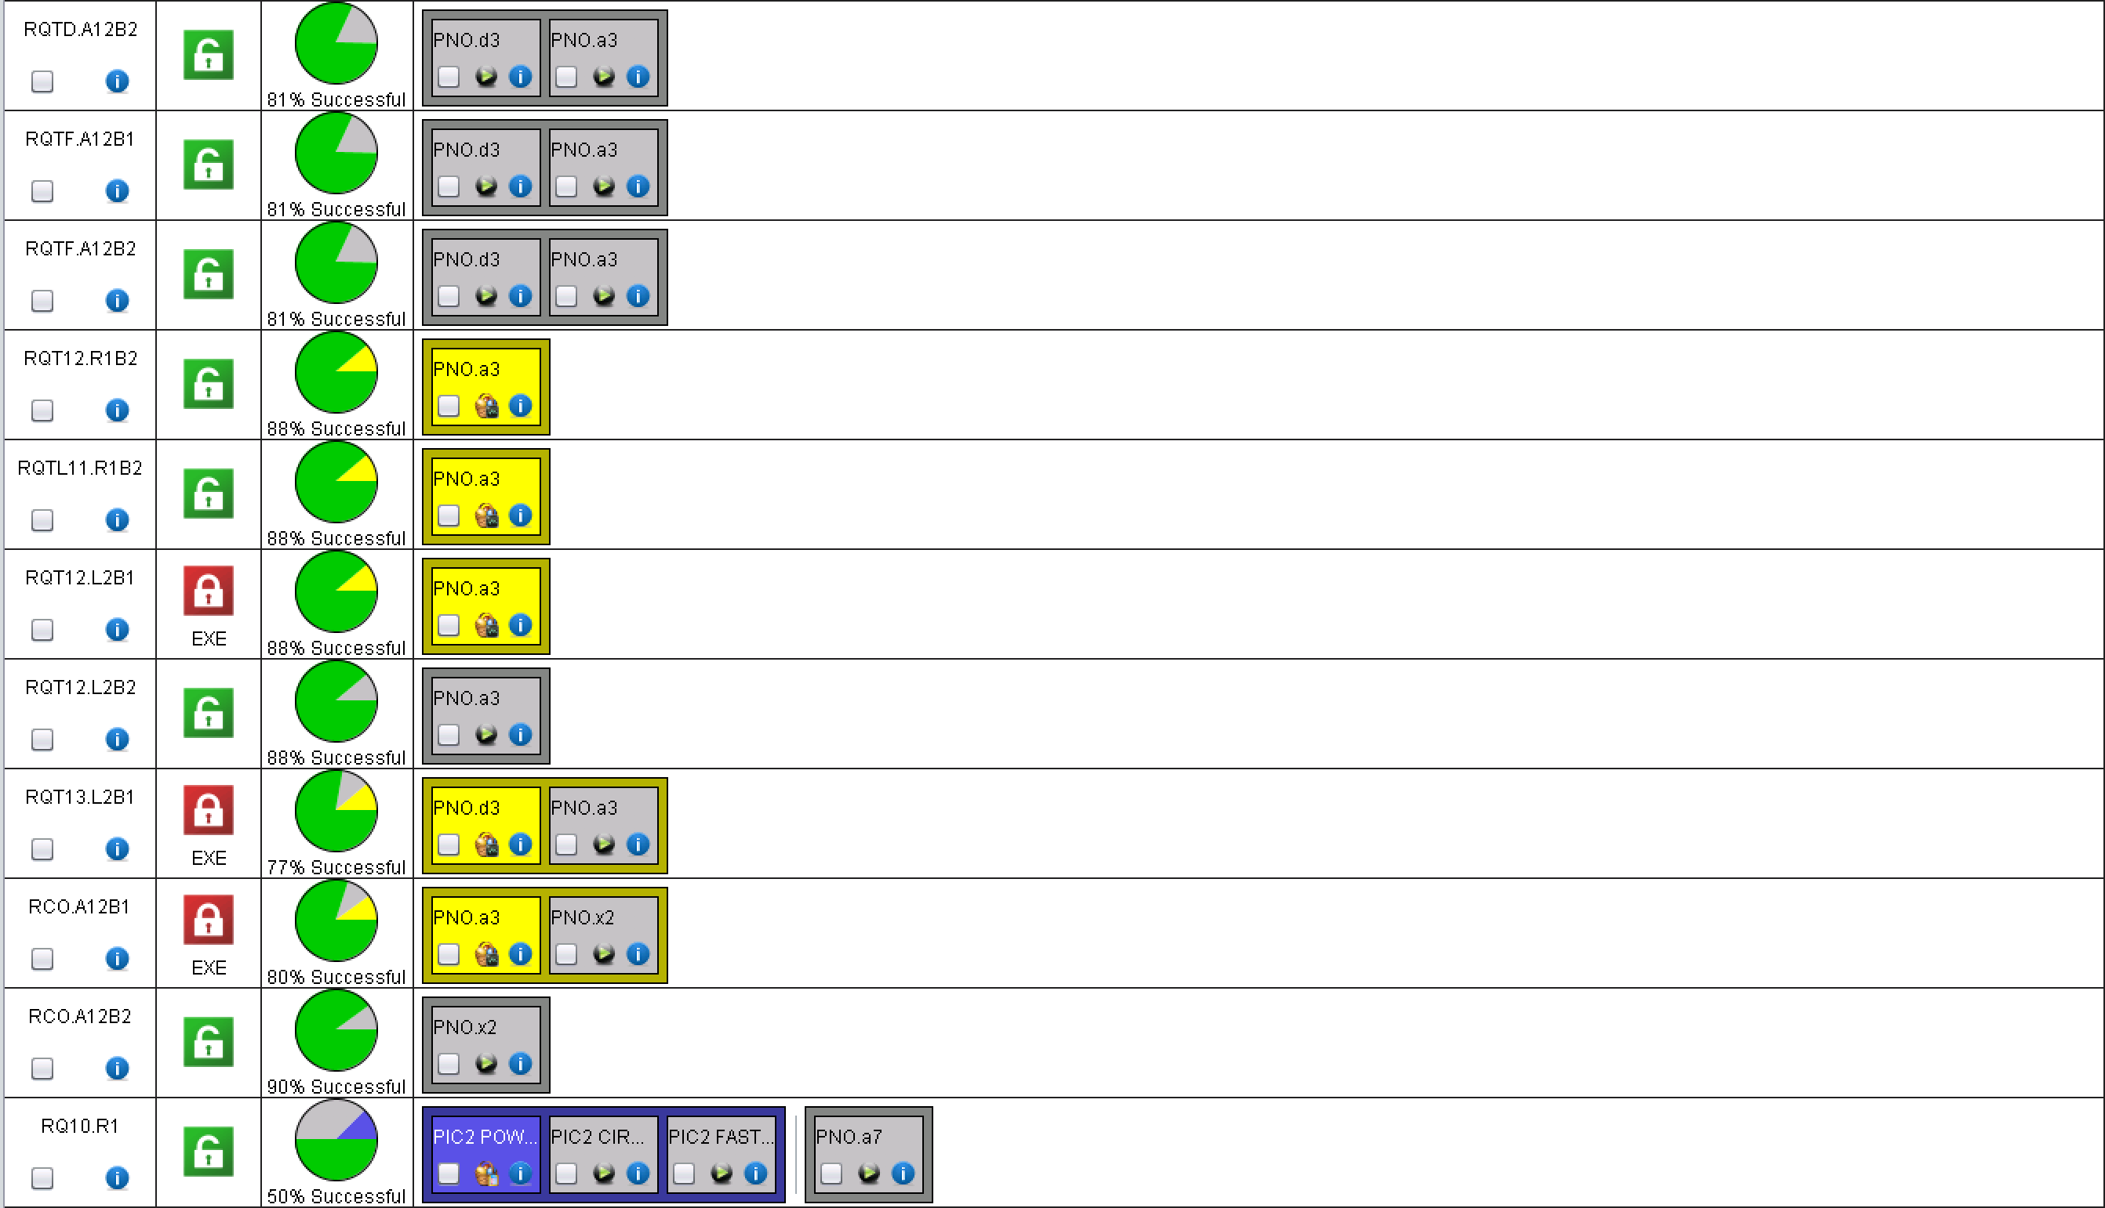
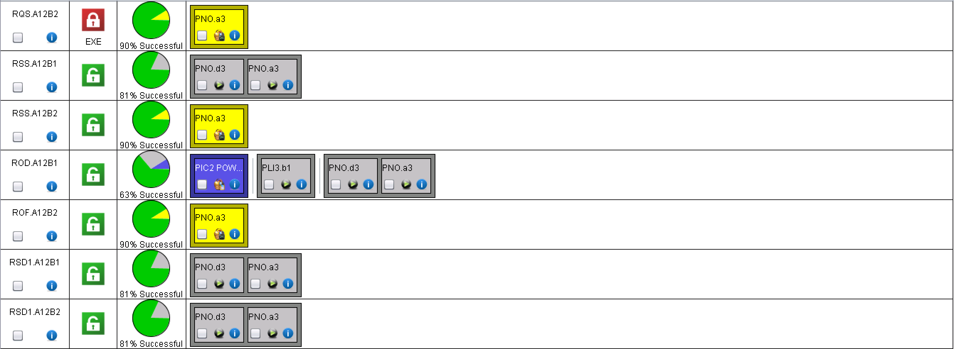
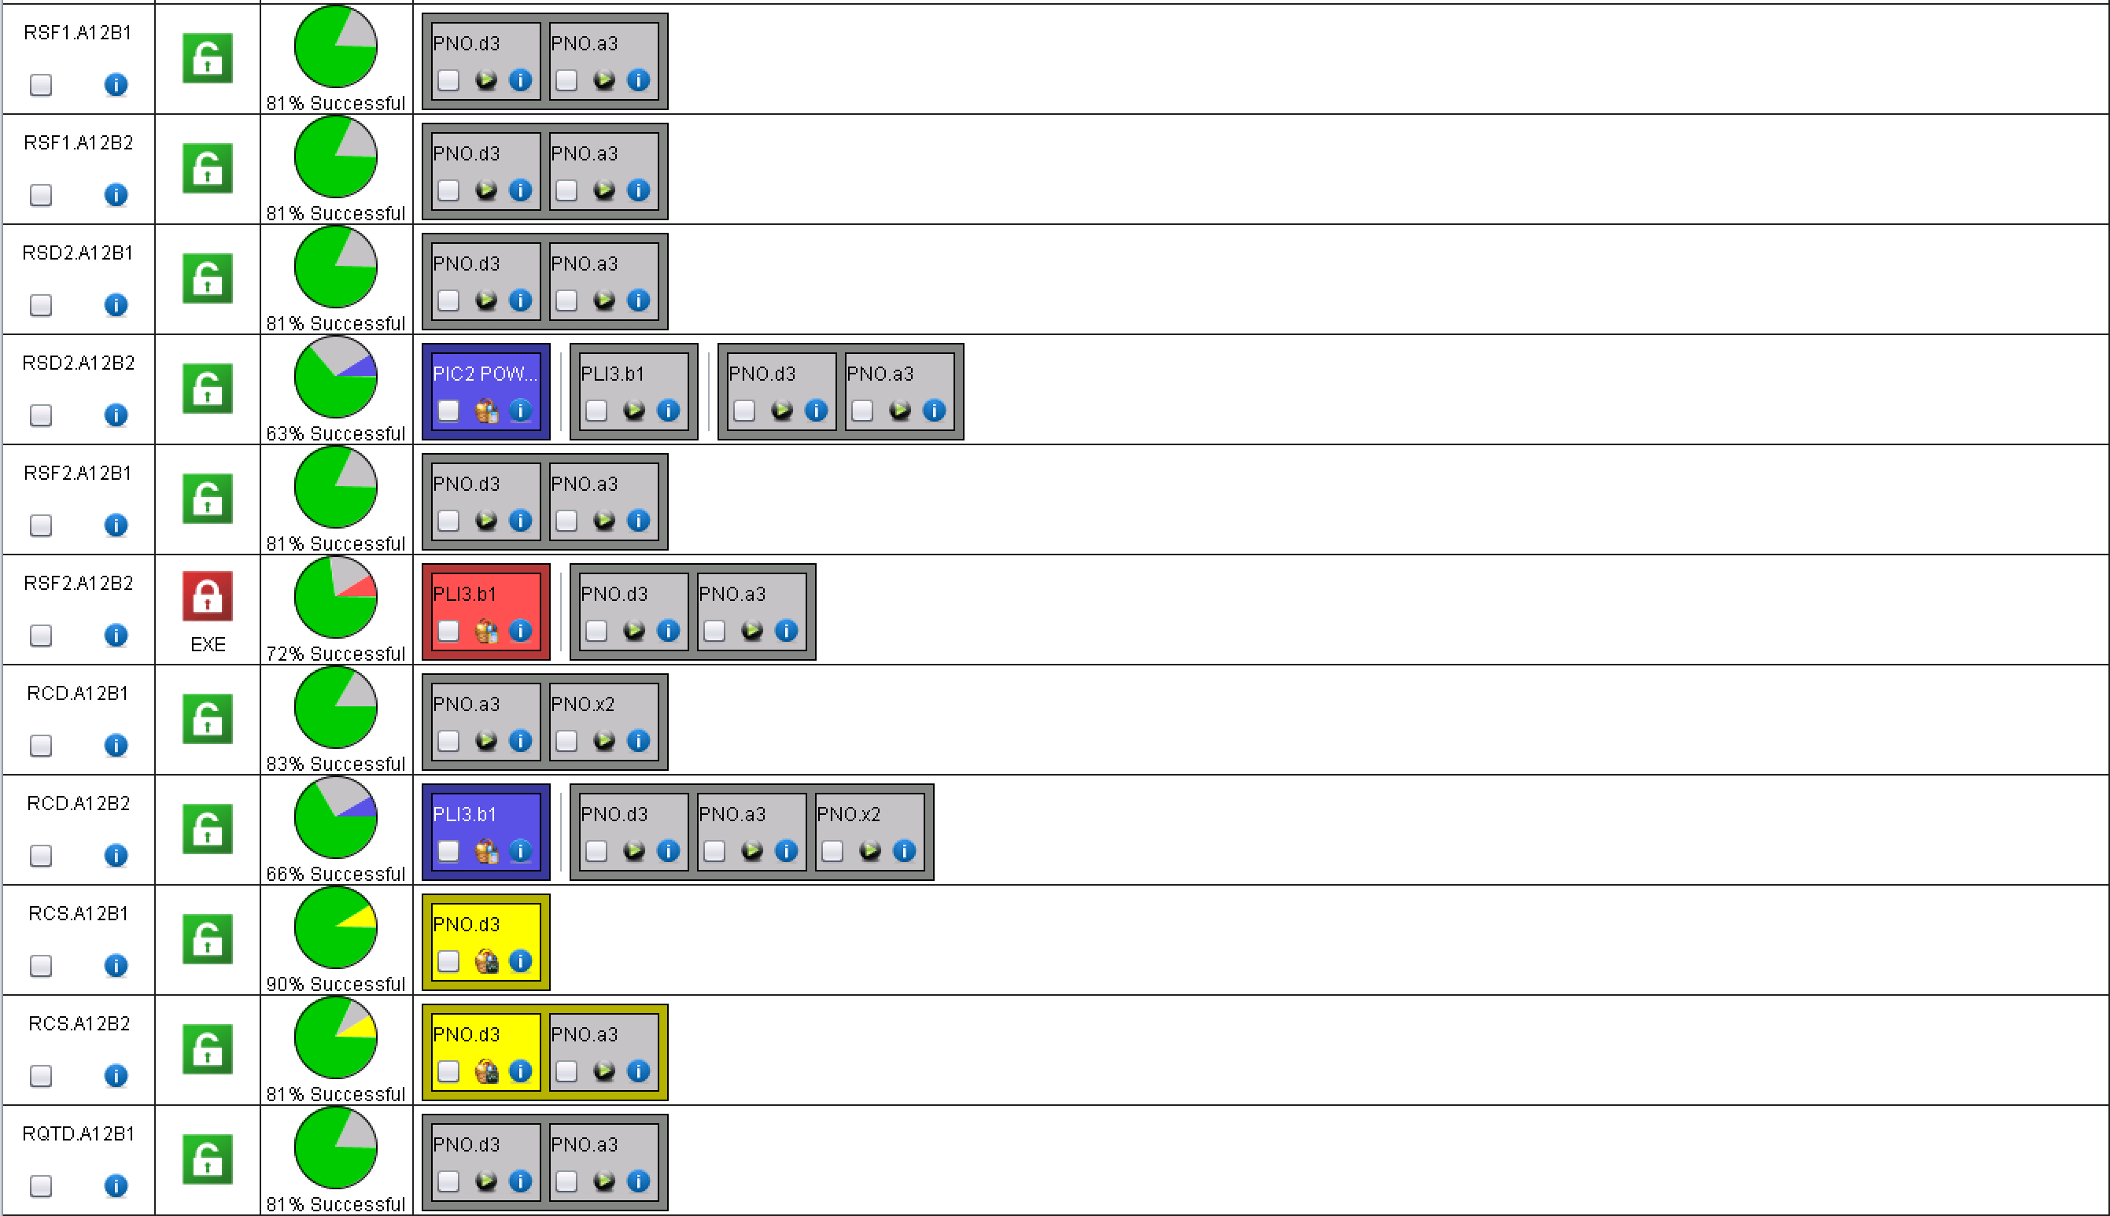
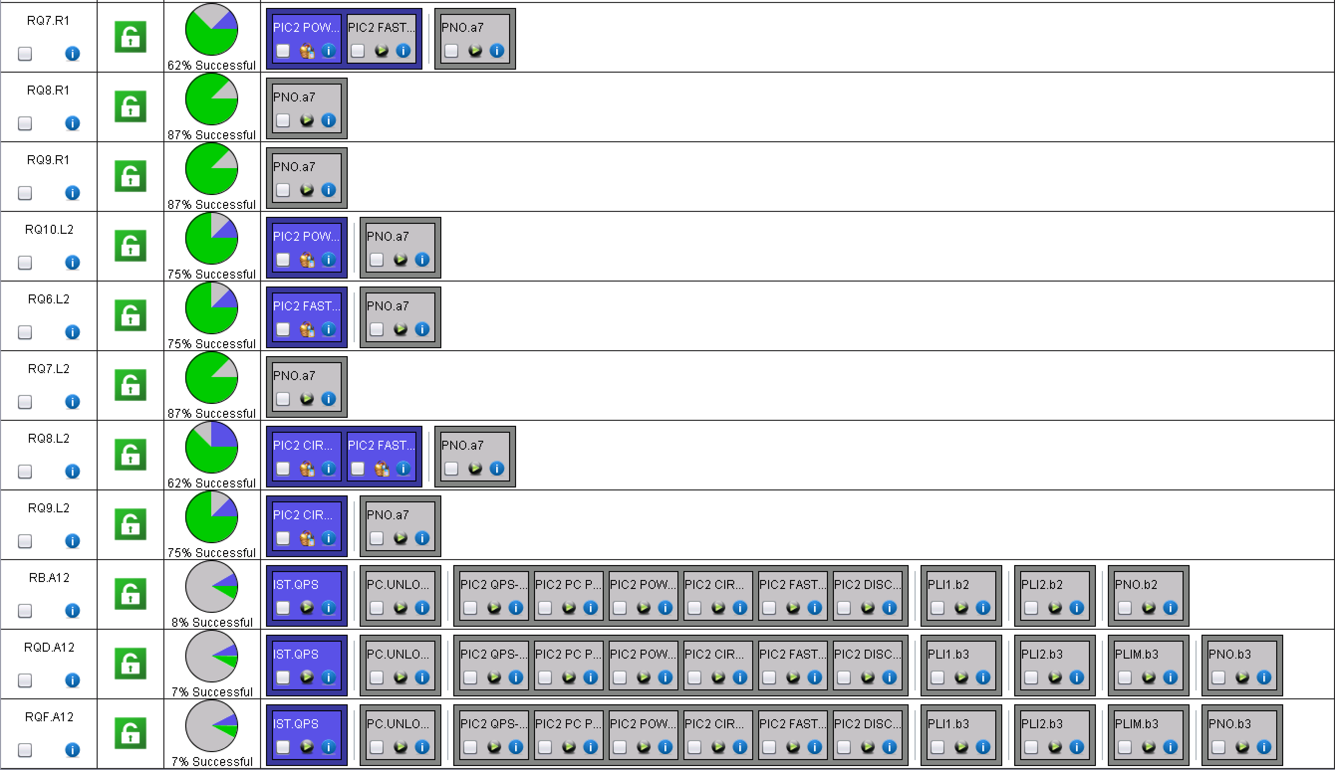
A12

Slide 10
A12 Quench heater test
Summary on QH-firings in RB&RQ.A12 at 500V-charge level, 09/03/2018, 11:30 – 16:00 B. Panev, Z. Charifoulline
  RB-circuit, 154 MBs:
    ✓ 154 x 4 = 616 quench heaters were fired in an automatic way;
    ✓ C30L2 – was not charged during the test, now at 900V;
    ✓ B33L2#4 – jumps on the current, I_HDS_4; considered as the measurement issue (see the next page);
    ✓ All other discharge curves are ok;
    ✓ All magnets are in 900V now;
  Conclusion – Green light for the next step: discharge from 900V.
RQ-circuit, 47 MQs:
  ✓ 47 x 2 = 94 quench heaters were fired;
  ✓ 12R1 – the newly installed QH power supply was not OK; it is replaced and tested by QPS-team;
  ✓ 32L2 – PM Data is not correctly synchronized with QH triggering;
  ✓ All magnets are in 900V now;
  Conclusion – Green light for the next step: discharge from 900V .

Slide 11
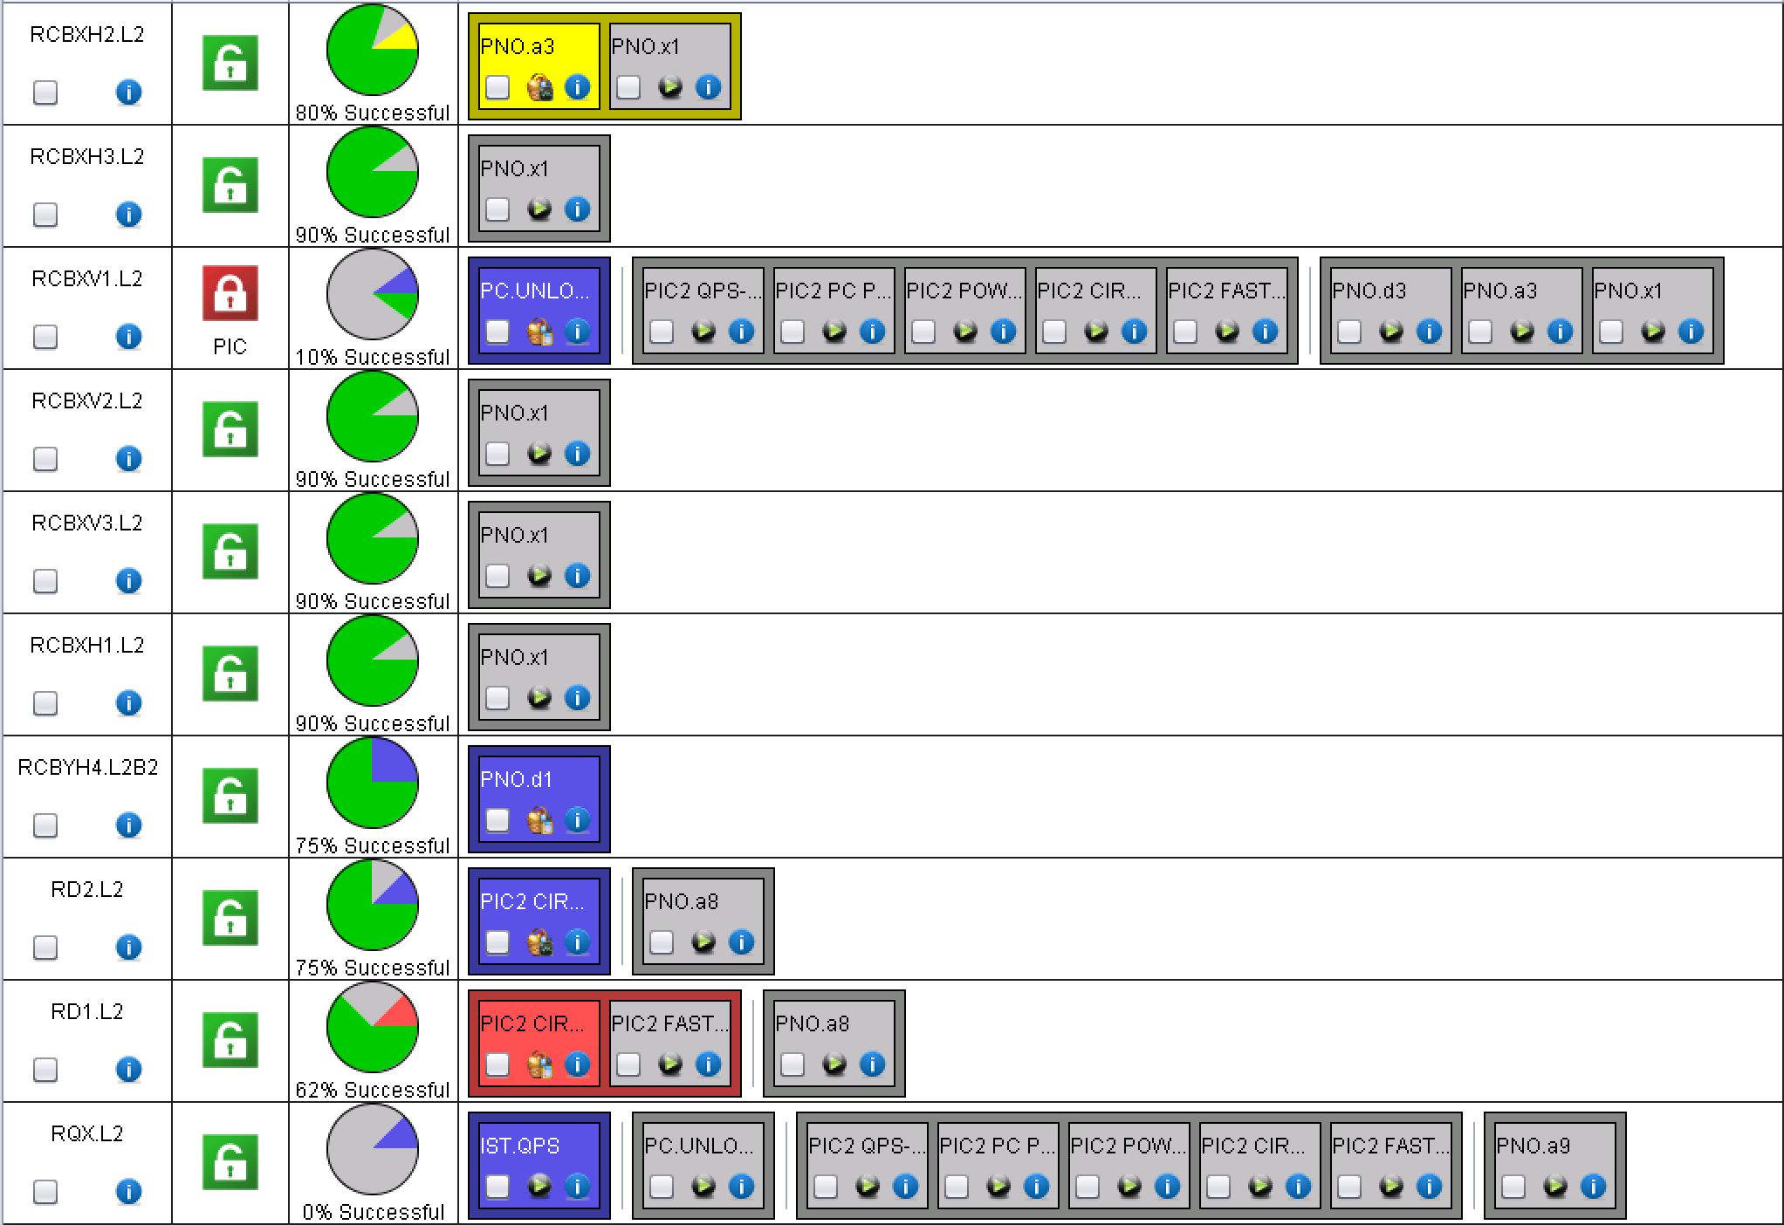
ML2 and XL2
RCBXV1.L2: FGC keeps rebooting – issue not fixed
QH analysis to be re-done

Slide 12
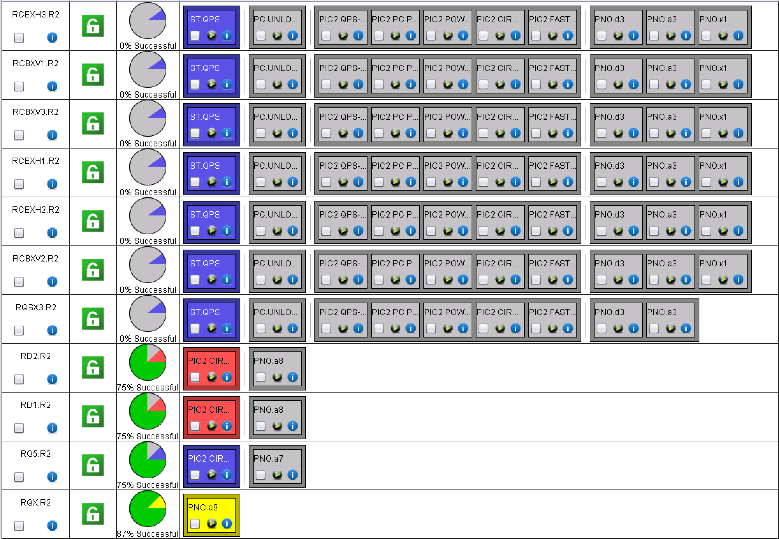
XR2 and MR2
QH analysis to be re-done
QH analysis to be re-done

Slide 13
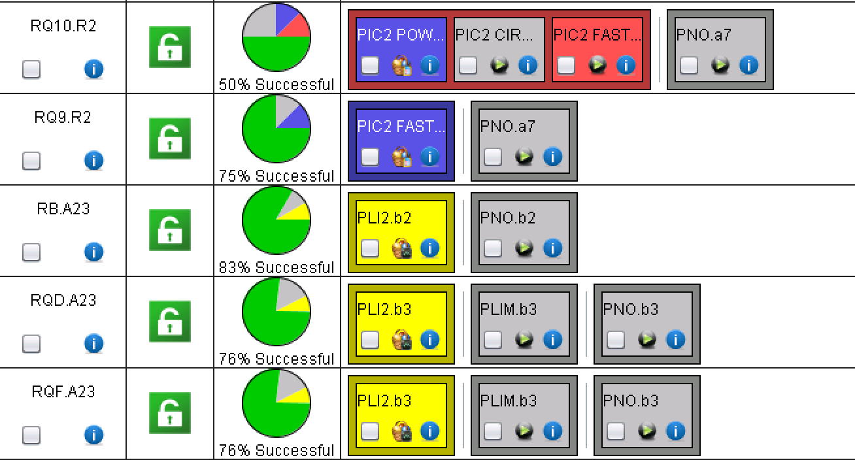
A23
Most of the 600 A circuits released yesterday and ongoing
The rest is done

Slide 14
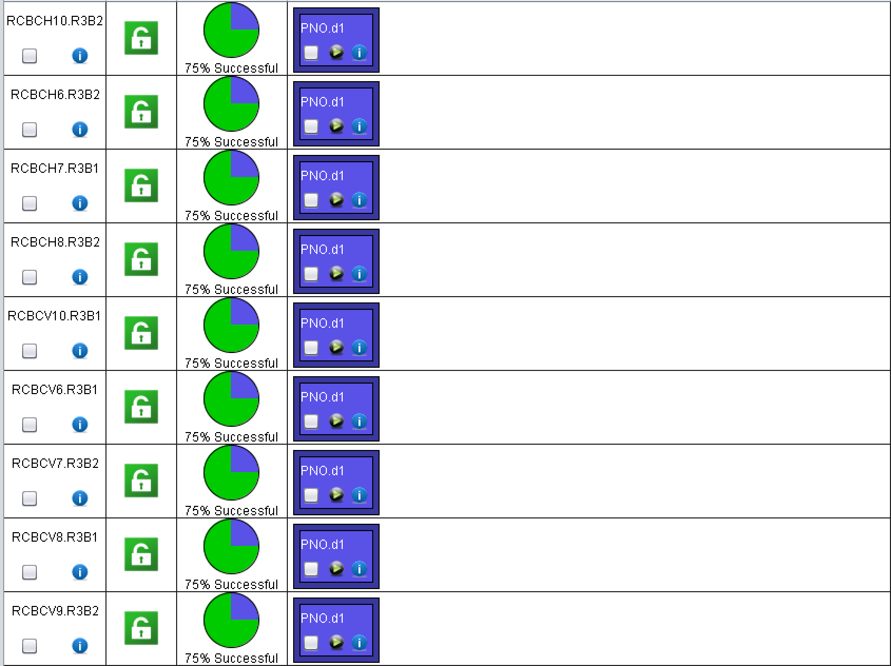
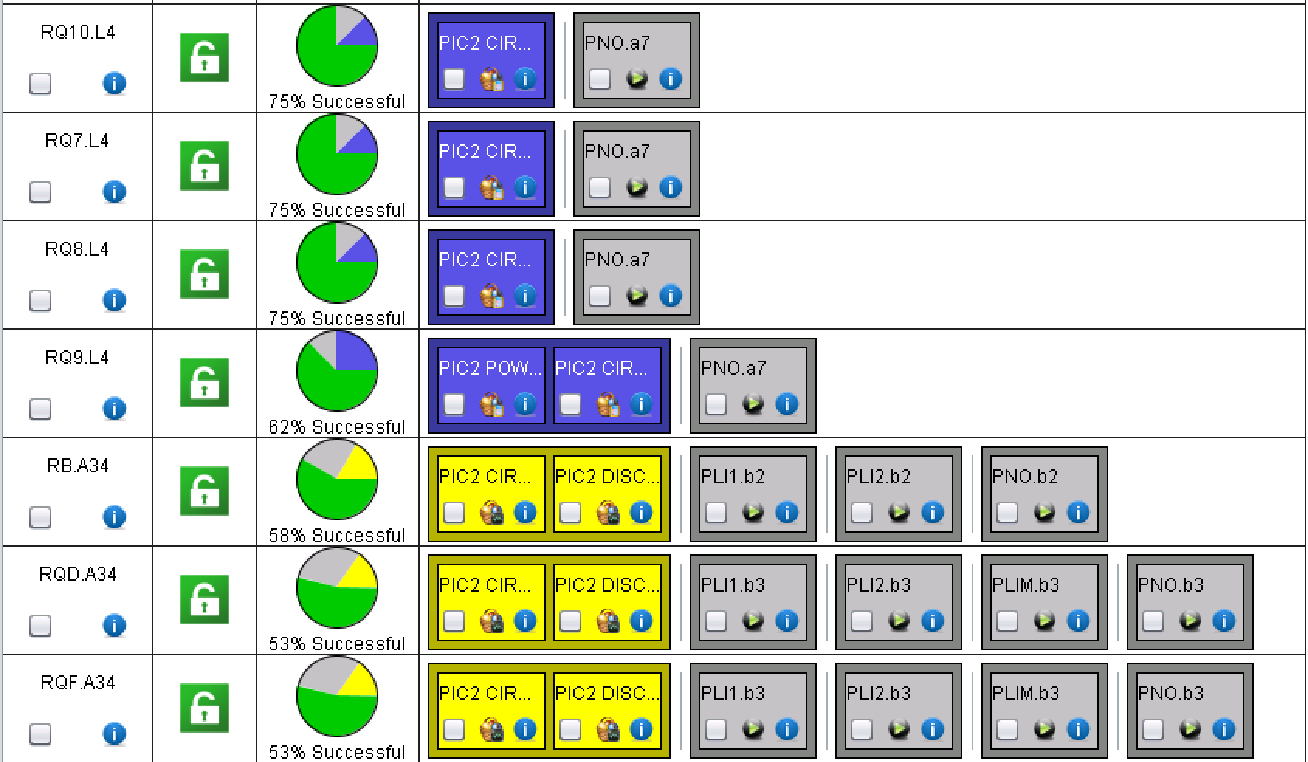
A34

Slide 15
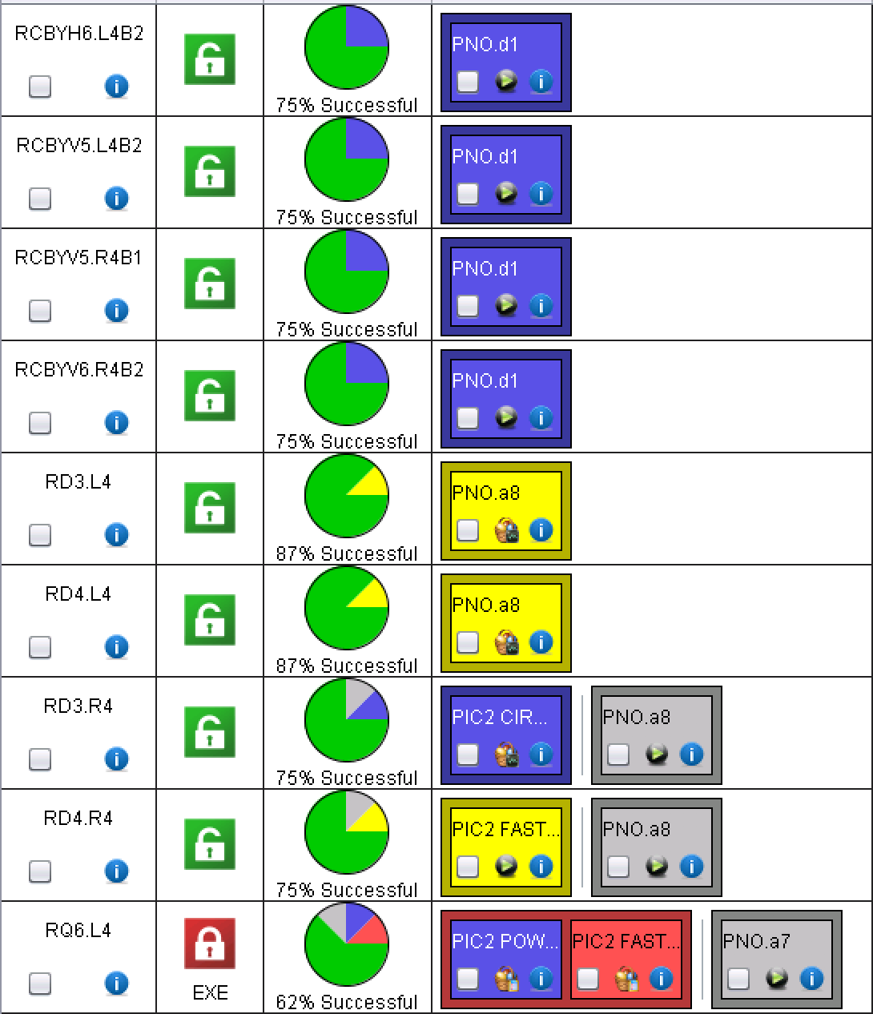
ML4 and MR4
QH analysis to be done

Slide 16
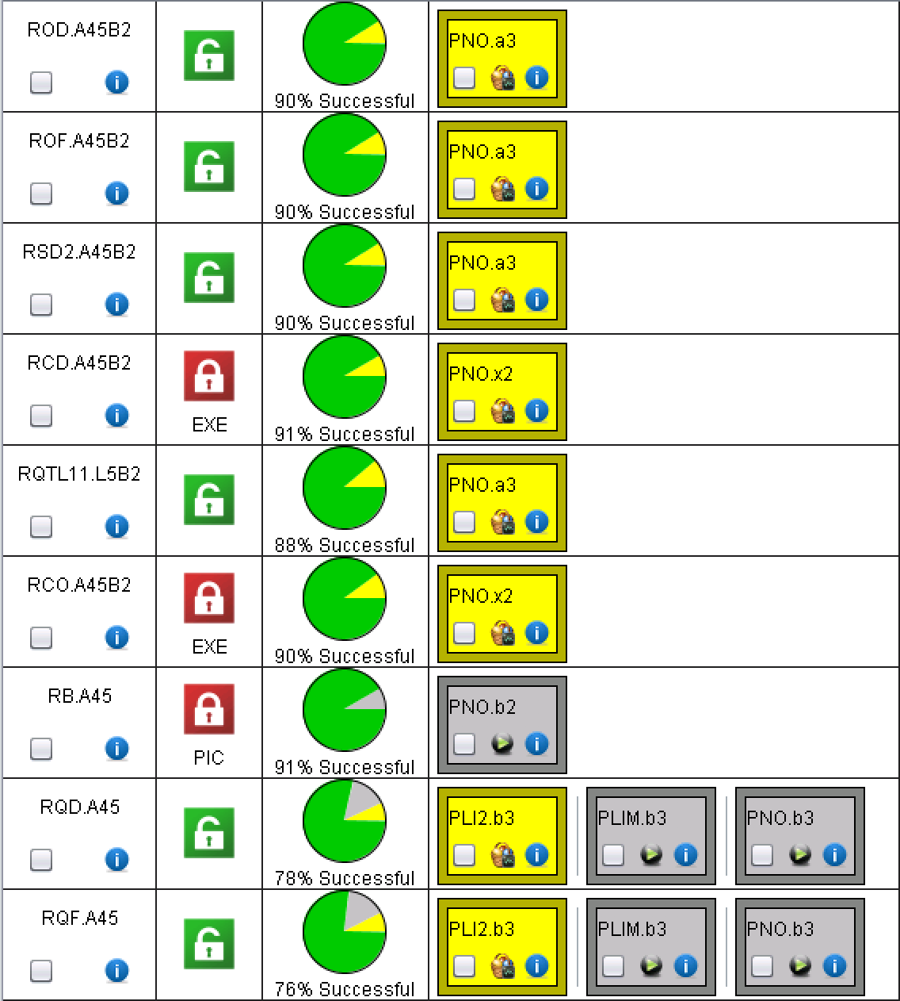
A45
RCD quenched twice
Blocked due to long last test

Slide 17
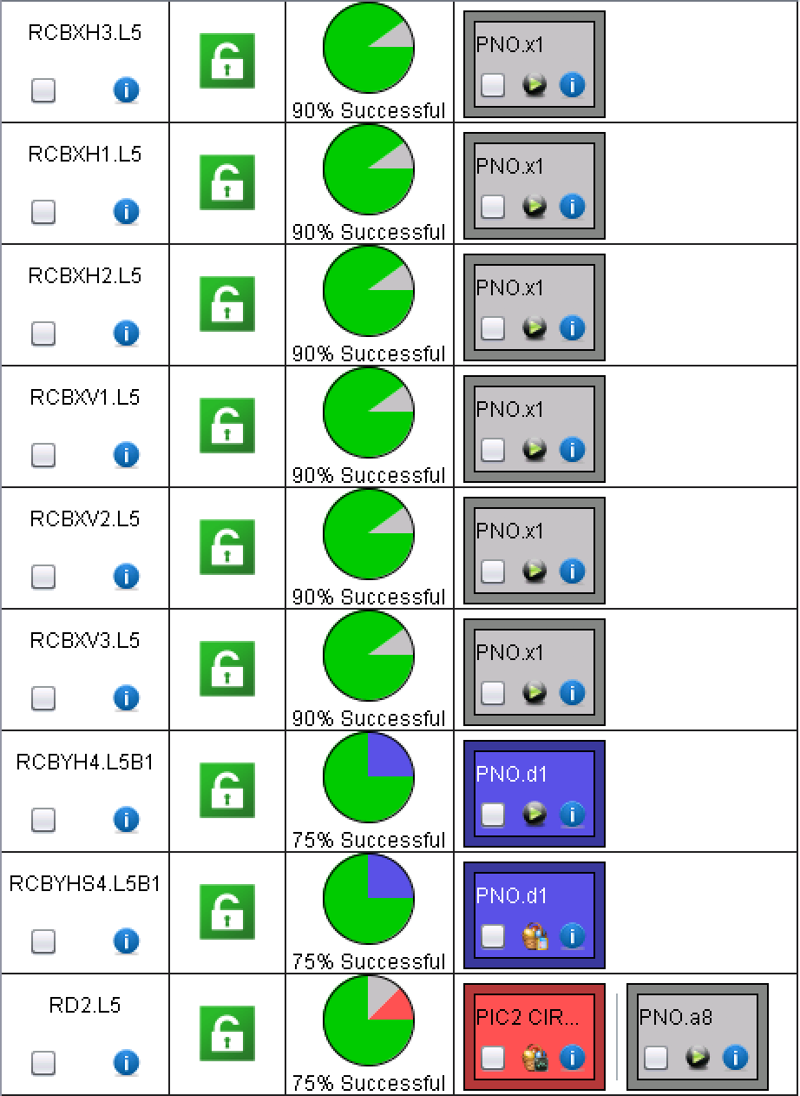
LL5 and XL5
LSA value to be updated: tests today
QH analysis to be re-done

Slide 18
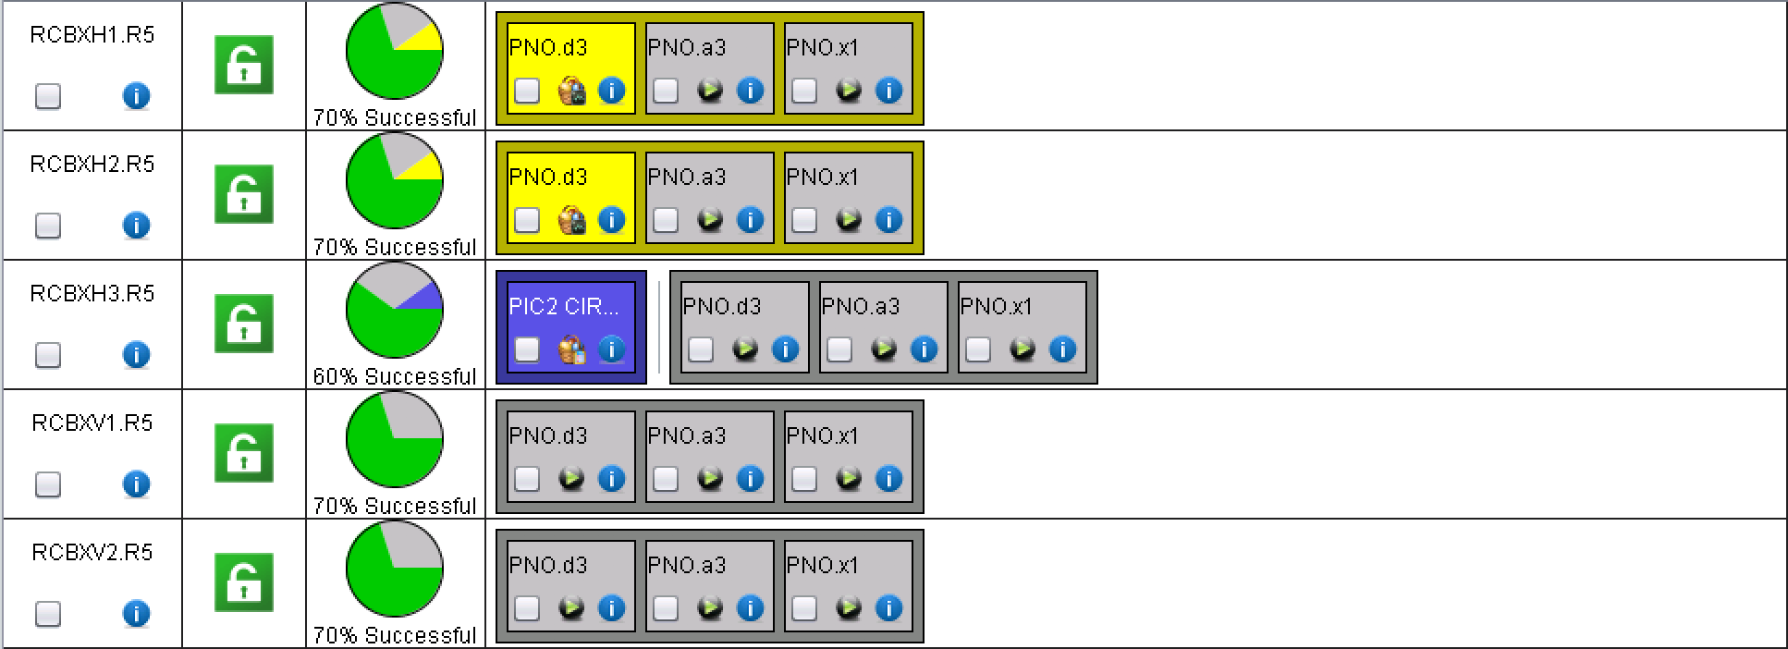
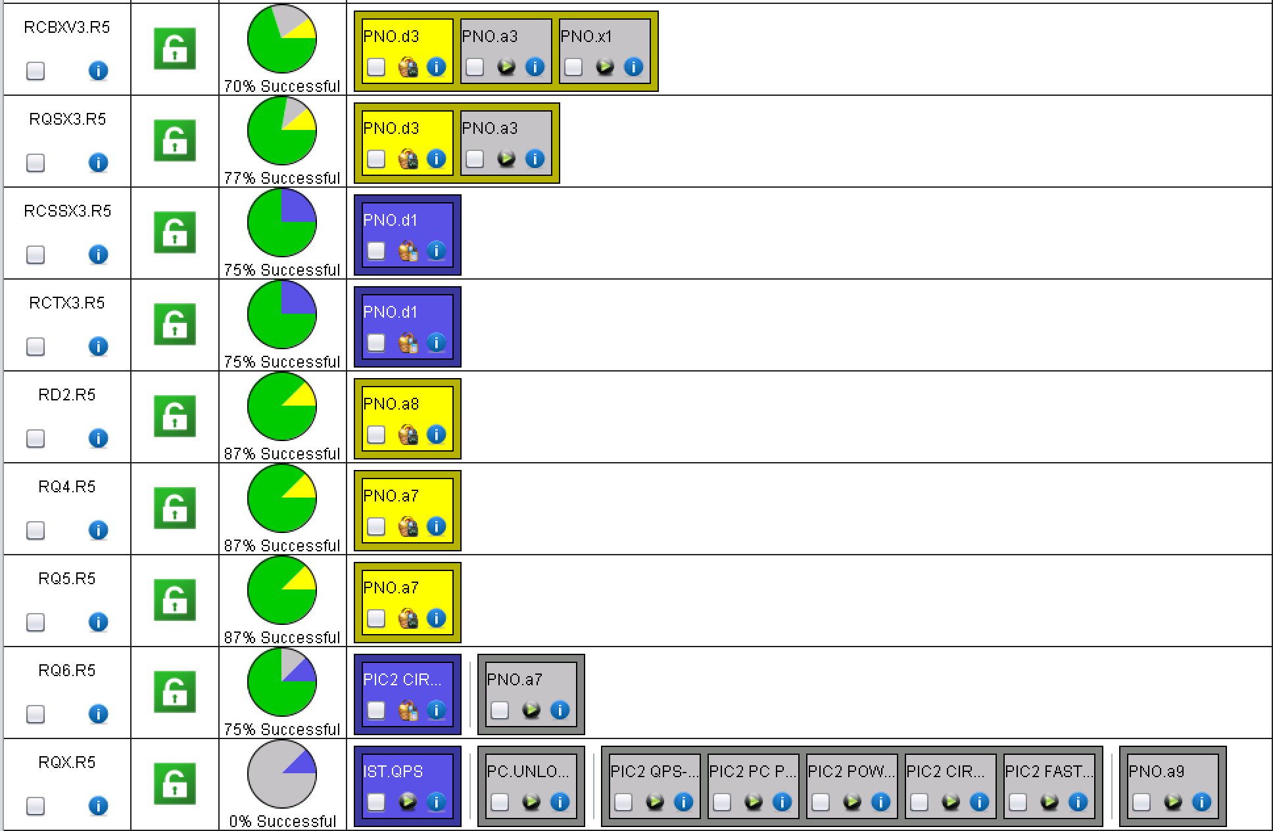
XR5 and LR5

Slide 19
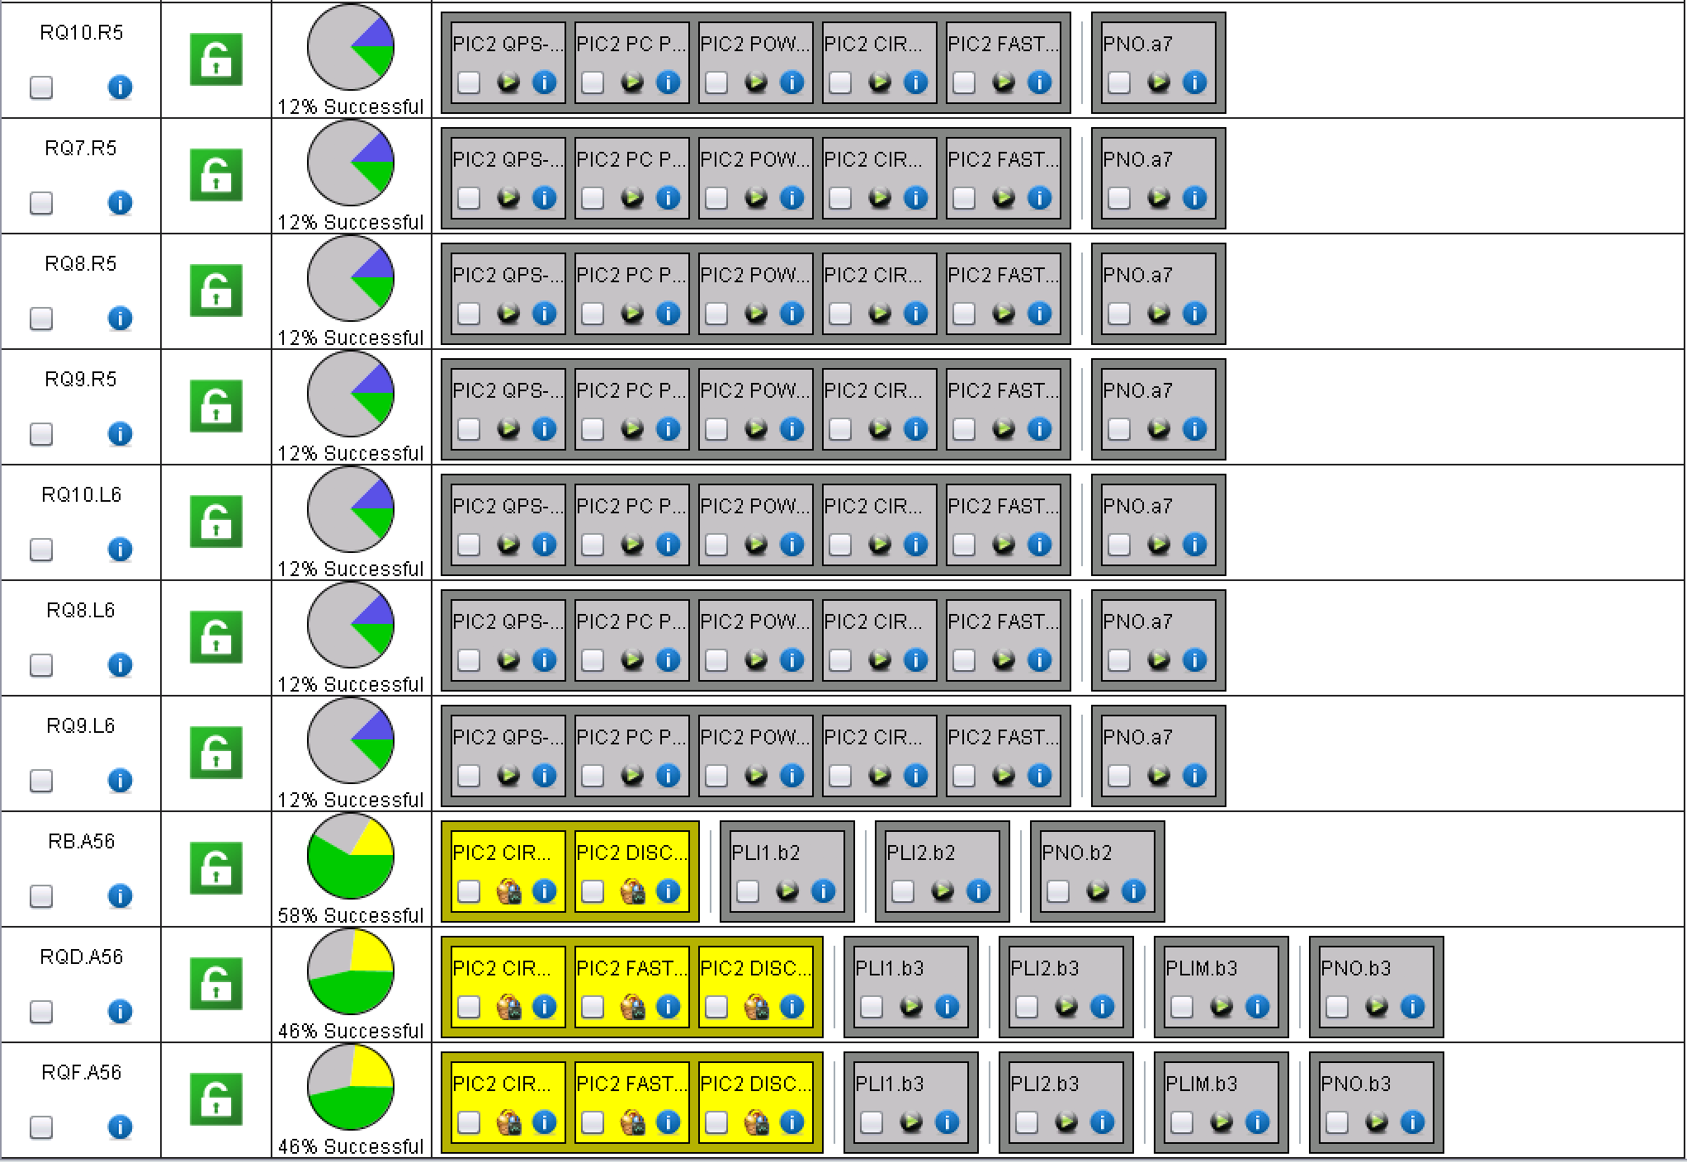
A56
All 600 A circuits released and powering started

Slide 20
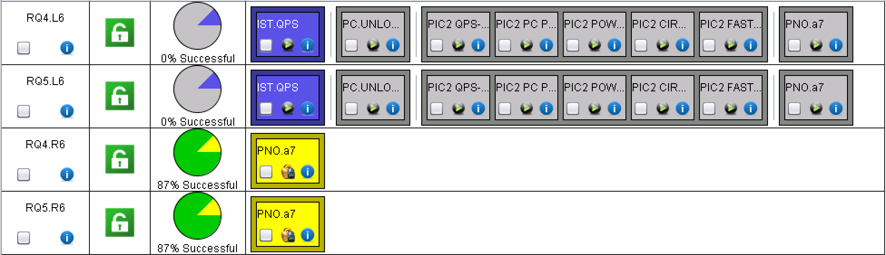
ML6 and MR6

Slide 21
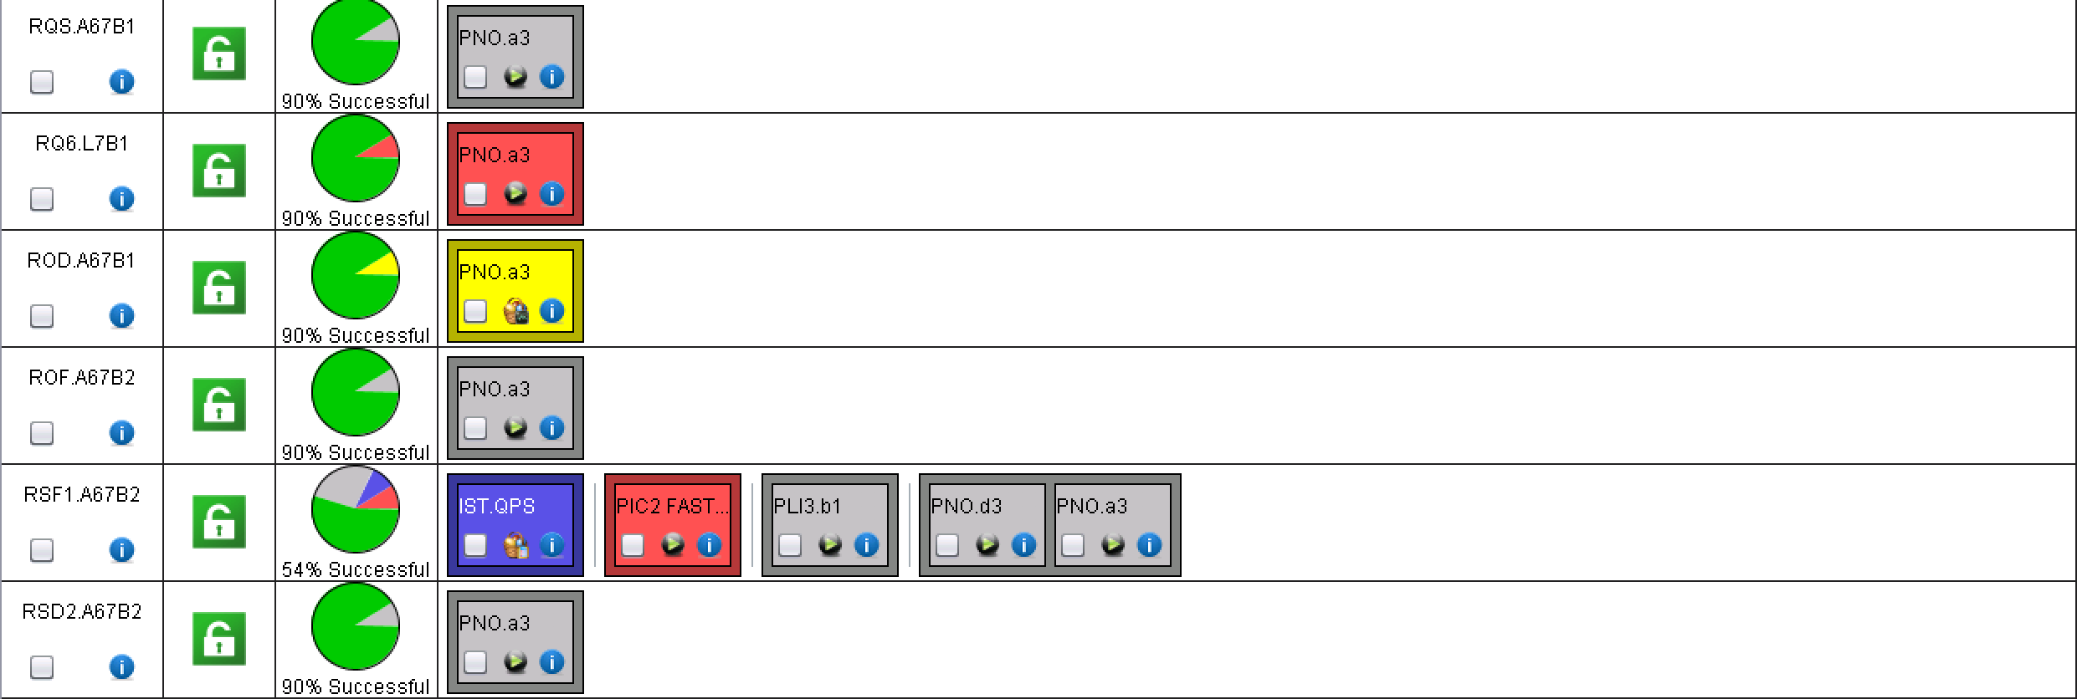
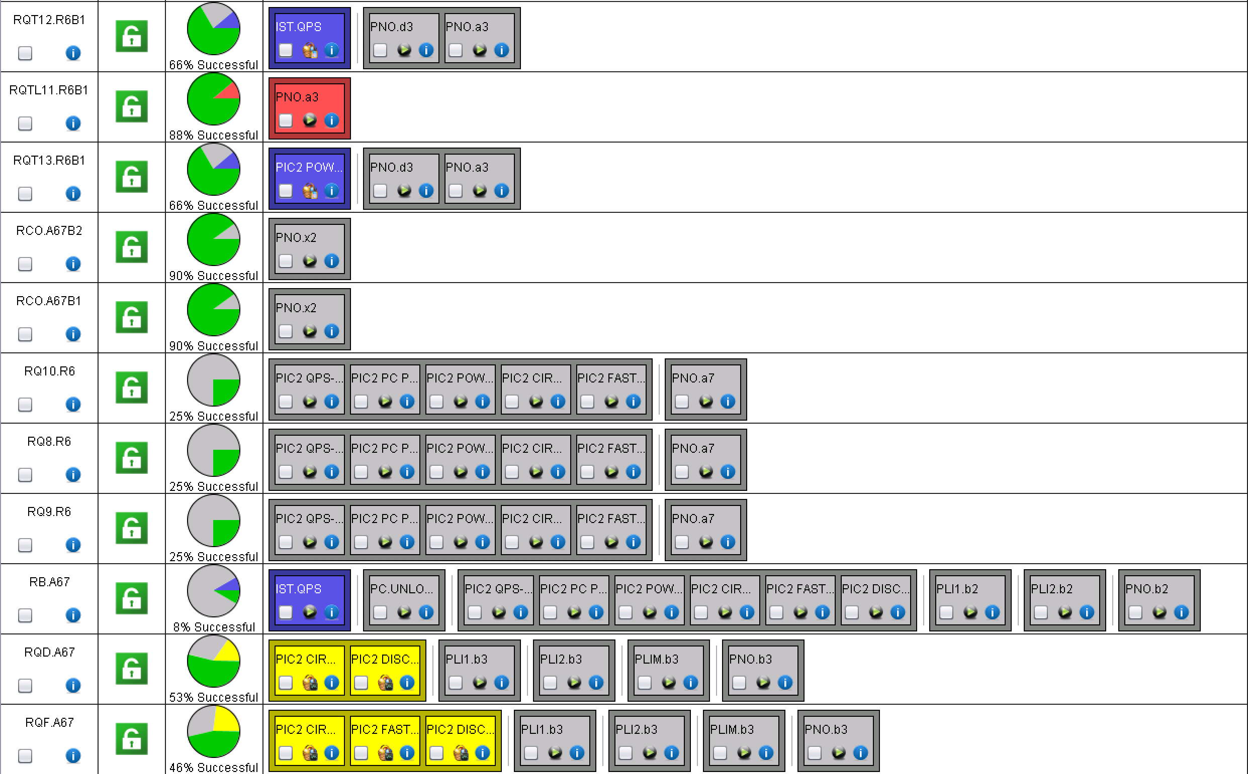
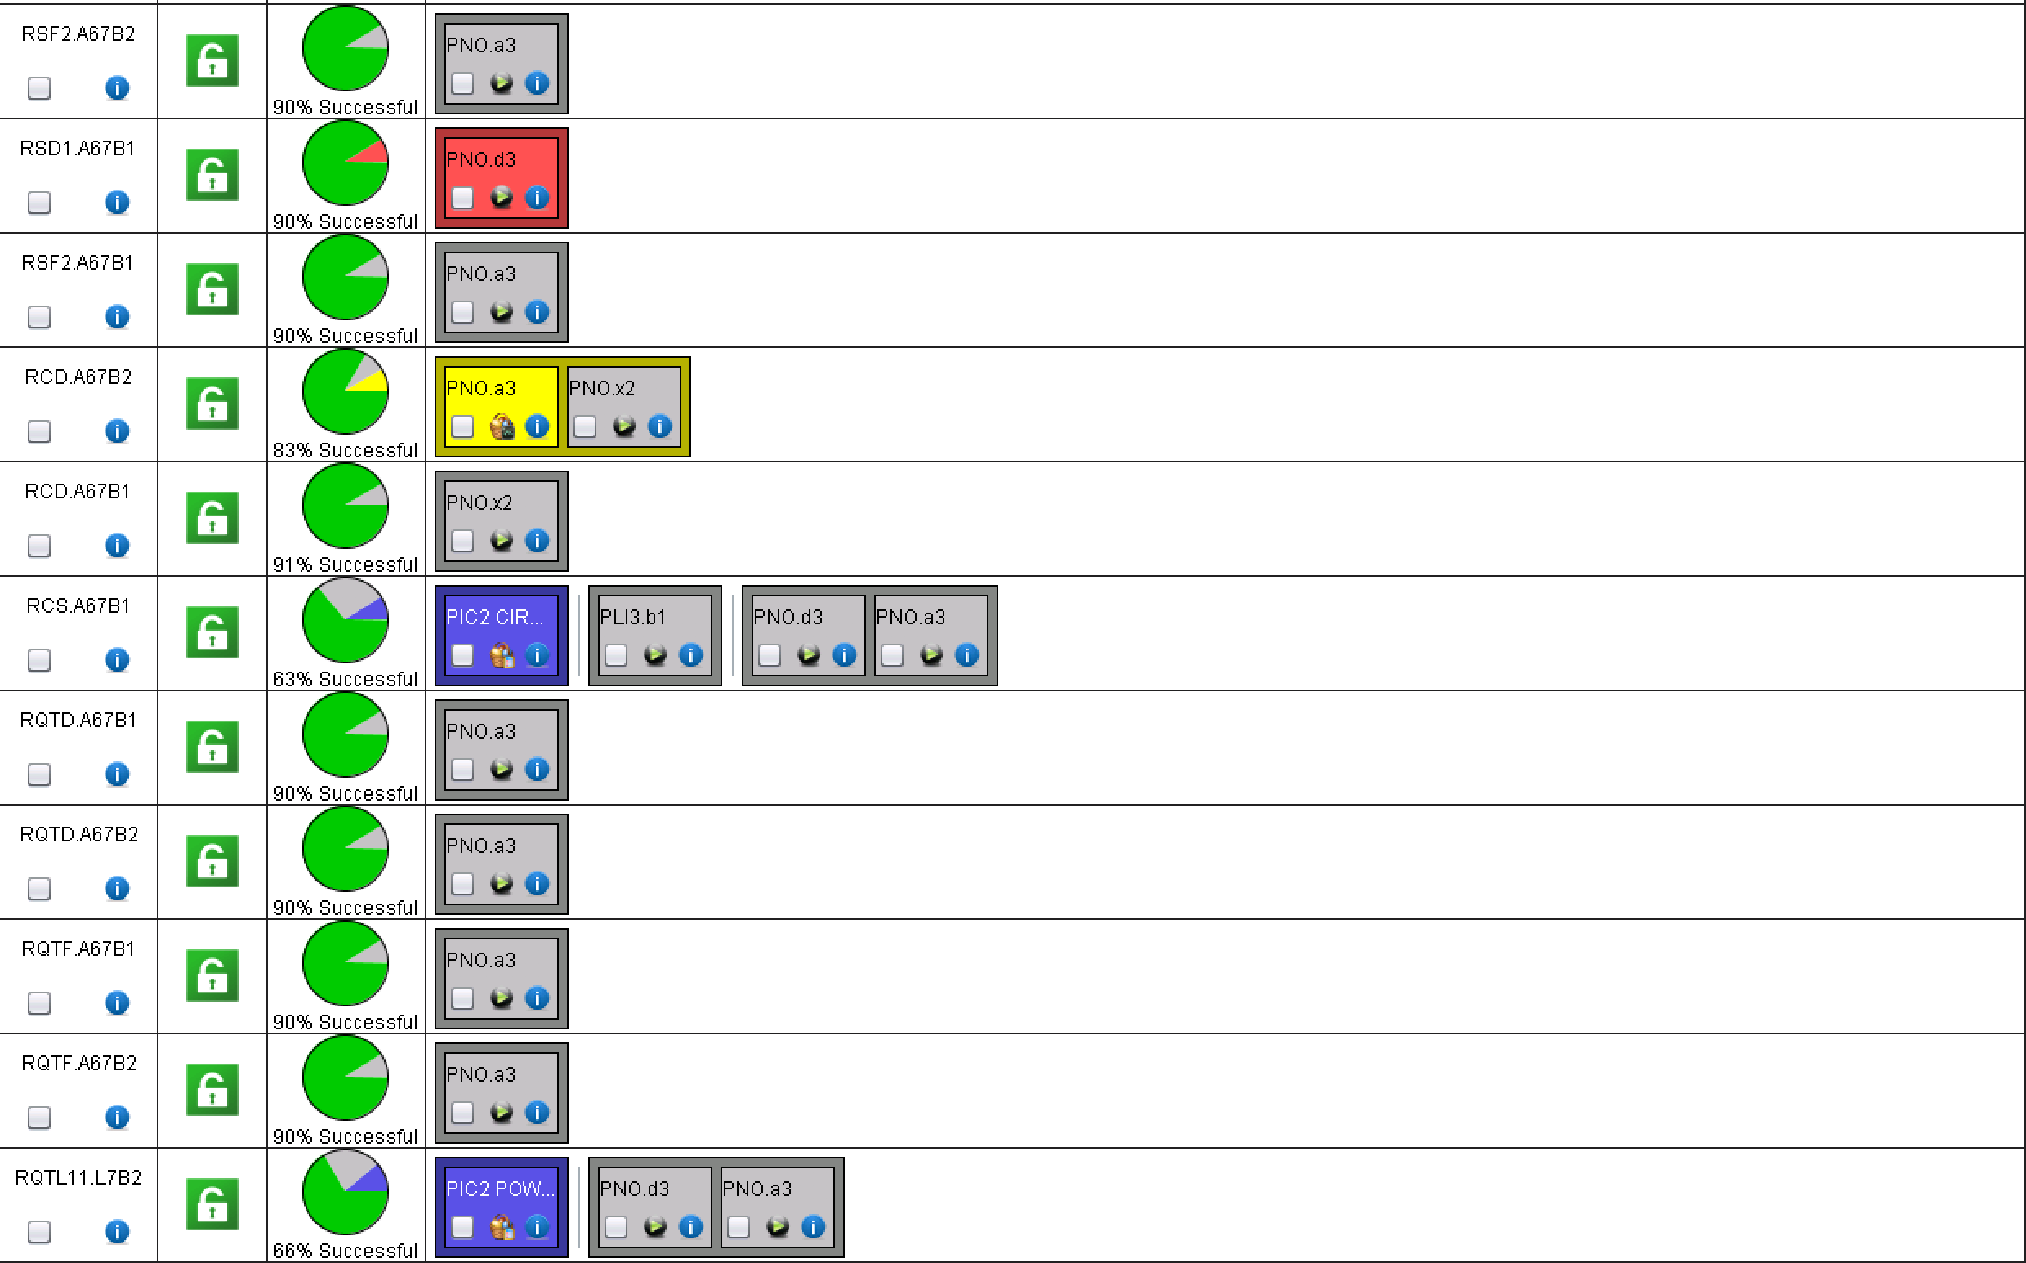
A67

Slide 22
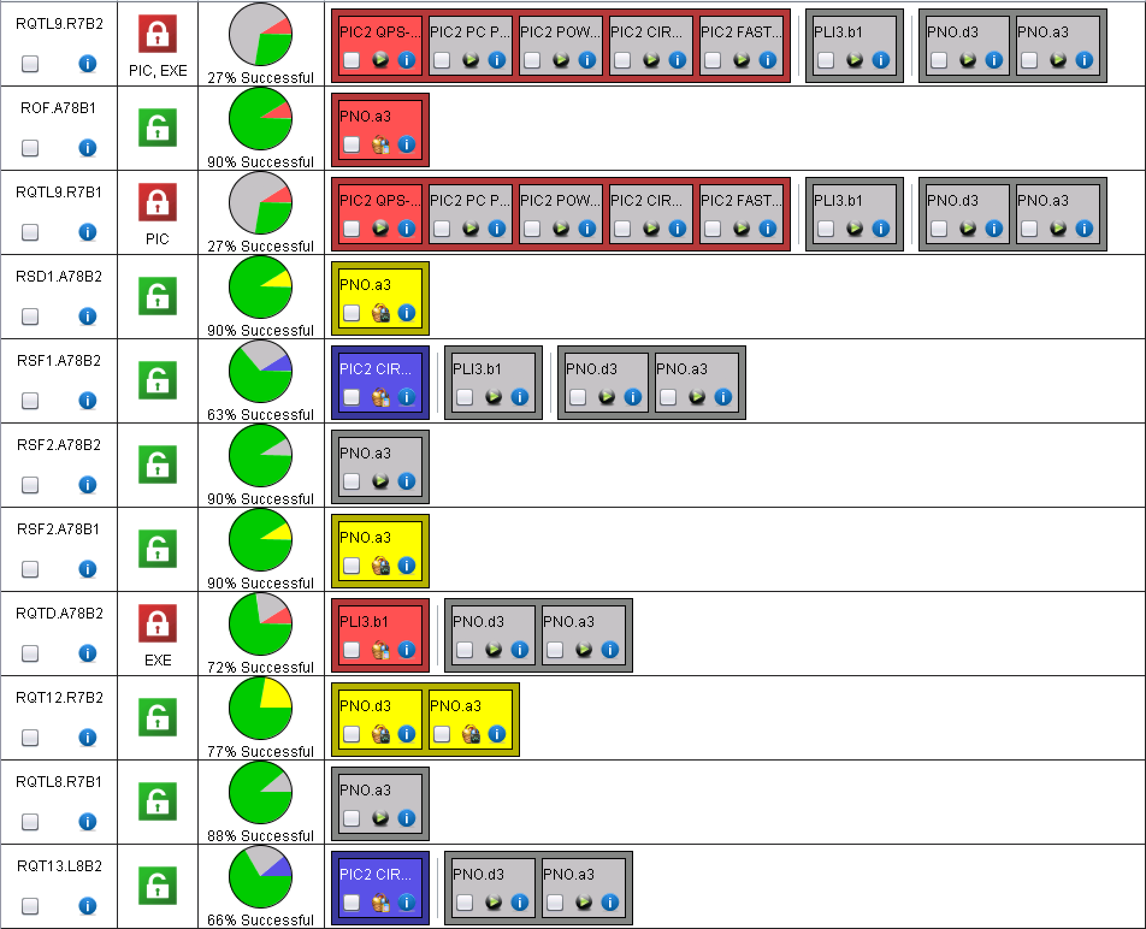
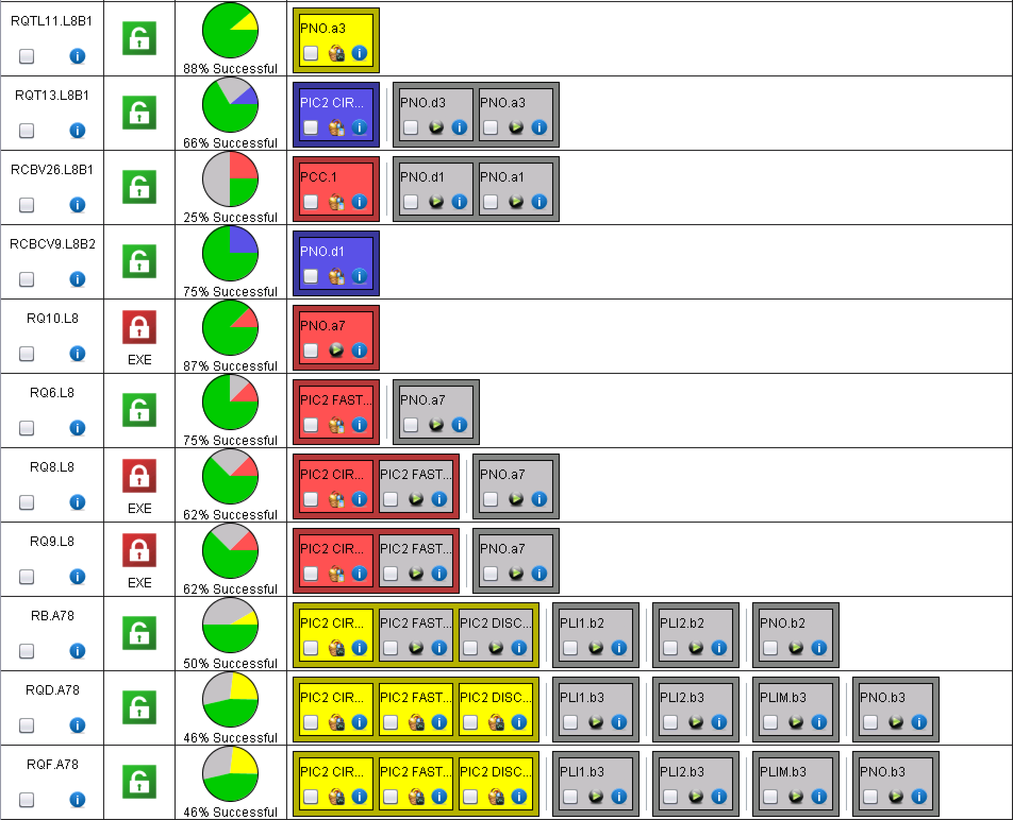
A78

Slide 23
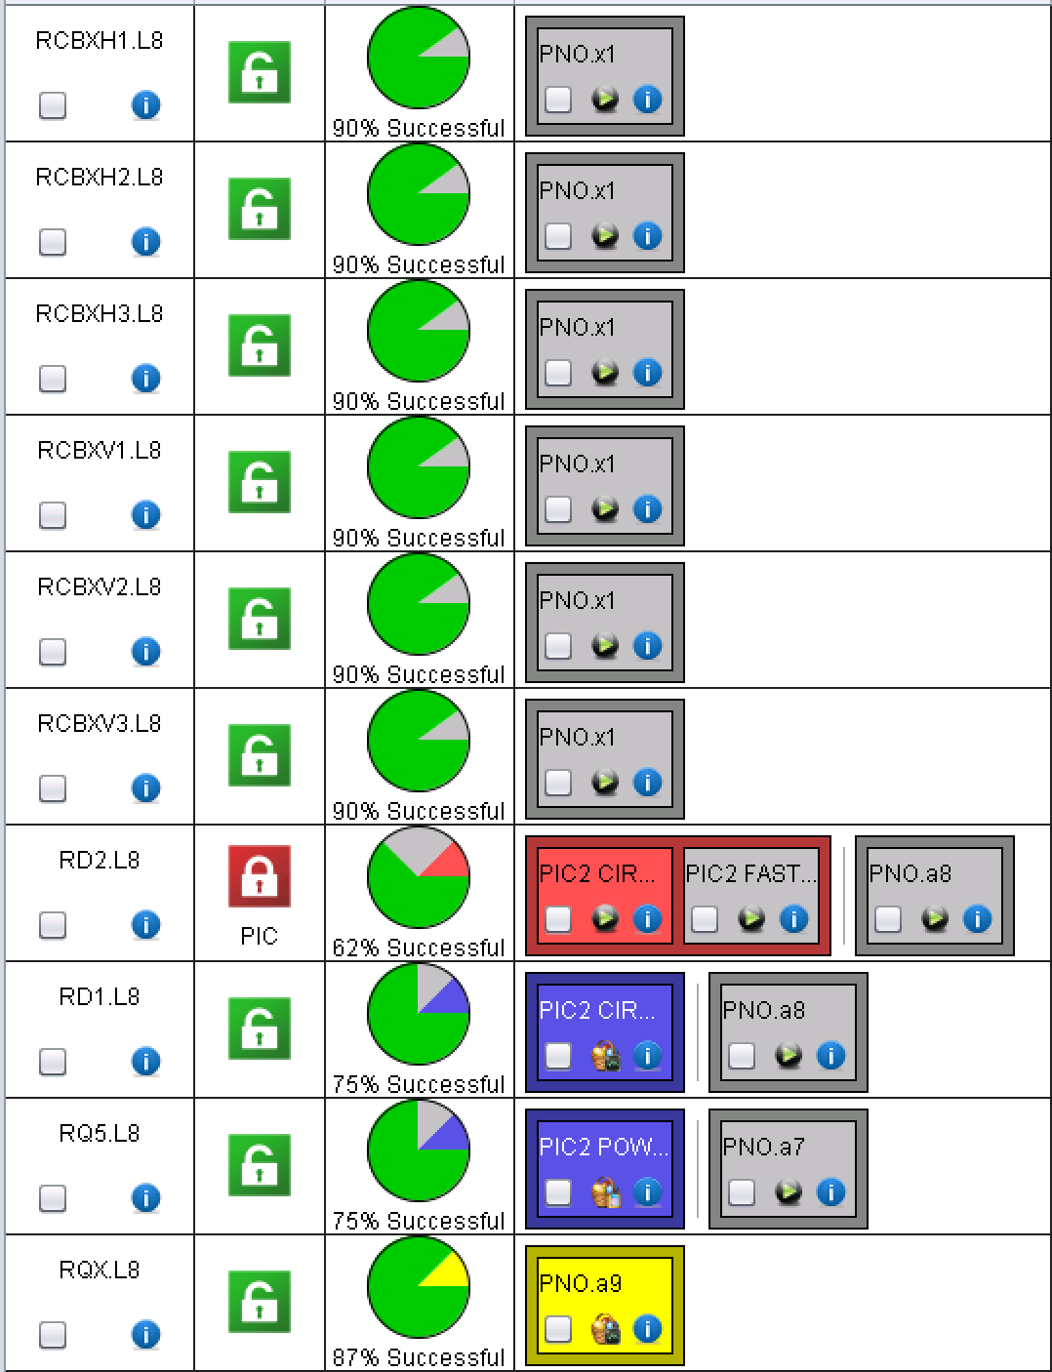
ML8 and XL8
LSA value to be updated: tests today
QH analysis to be re-done
QH analysis to be done

Slide 24
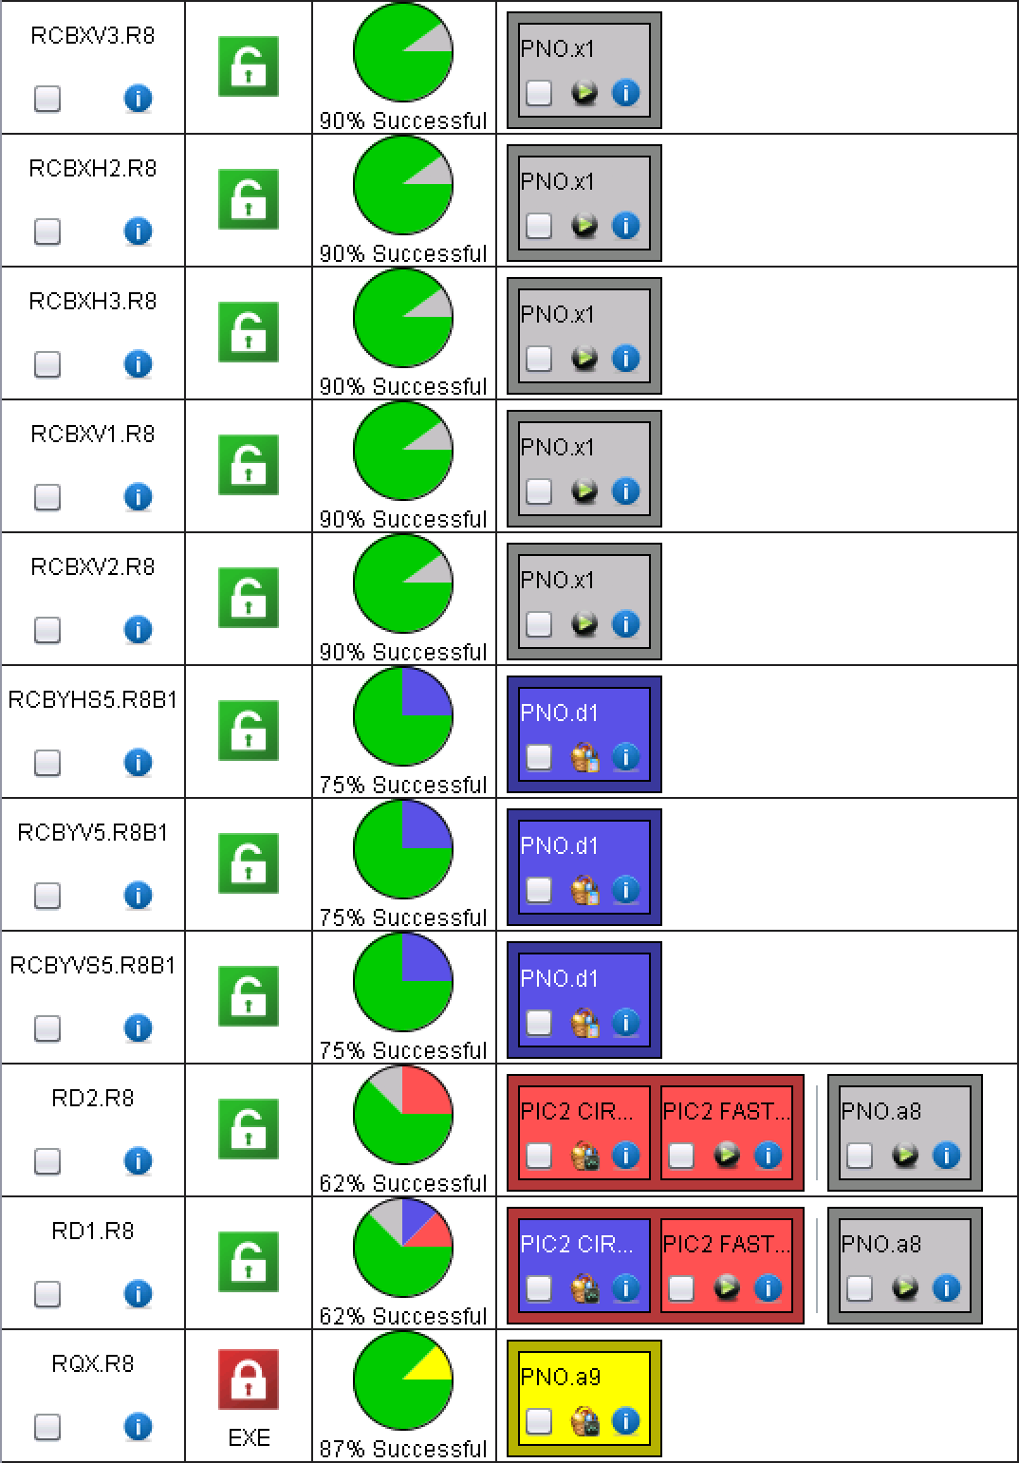
XR8 and MR8
LSA value to be updated: tests today
QH analysis to be re-done
QH analysis to be done

Slide 25
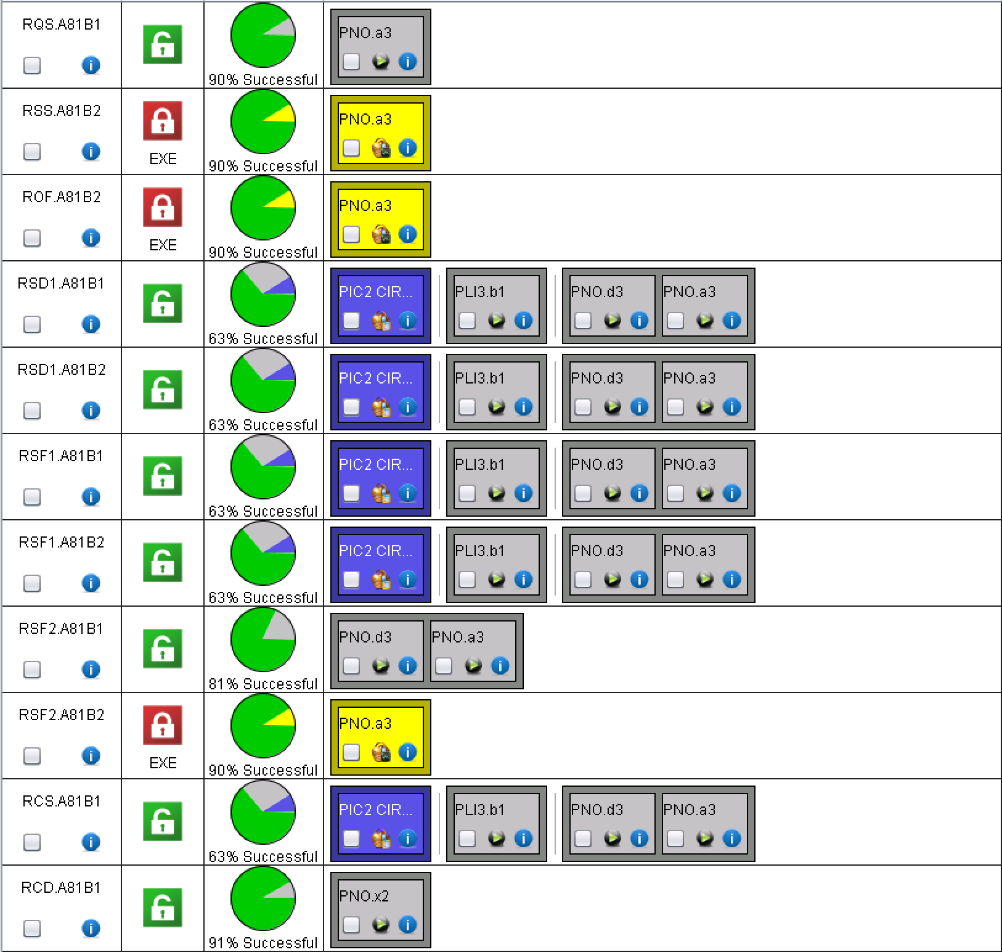
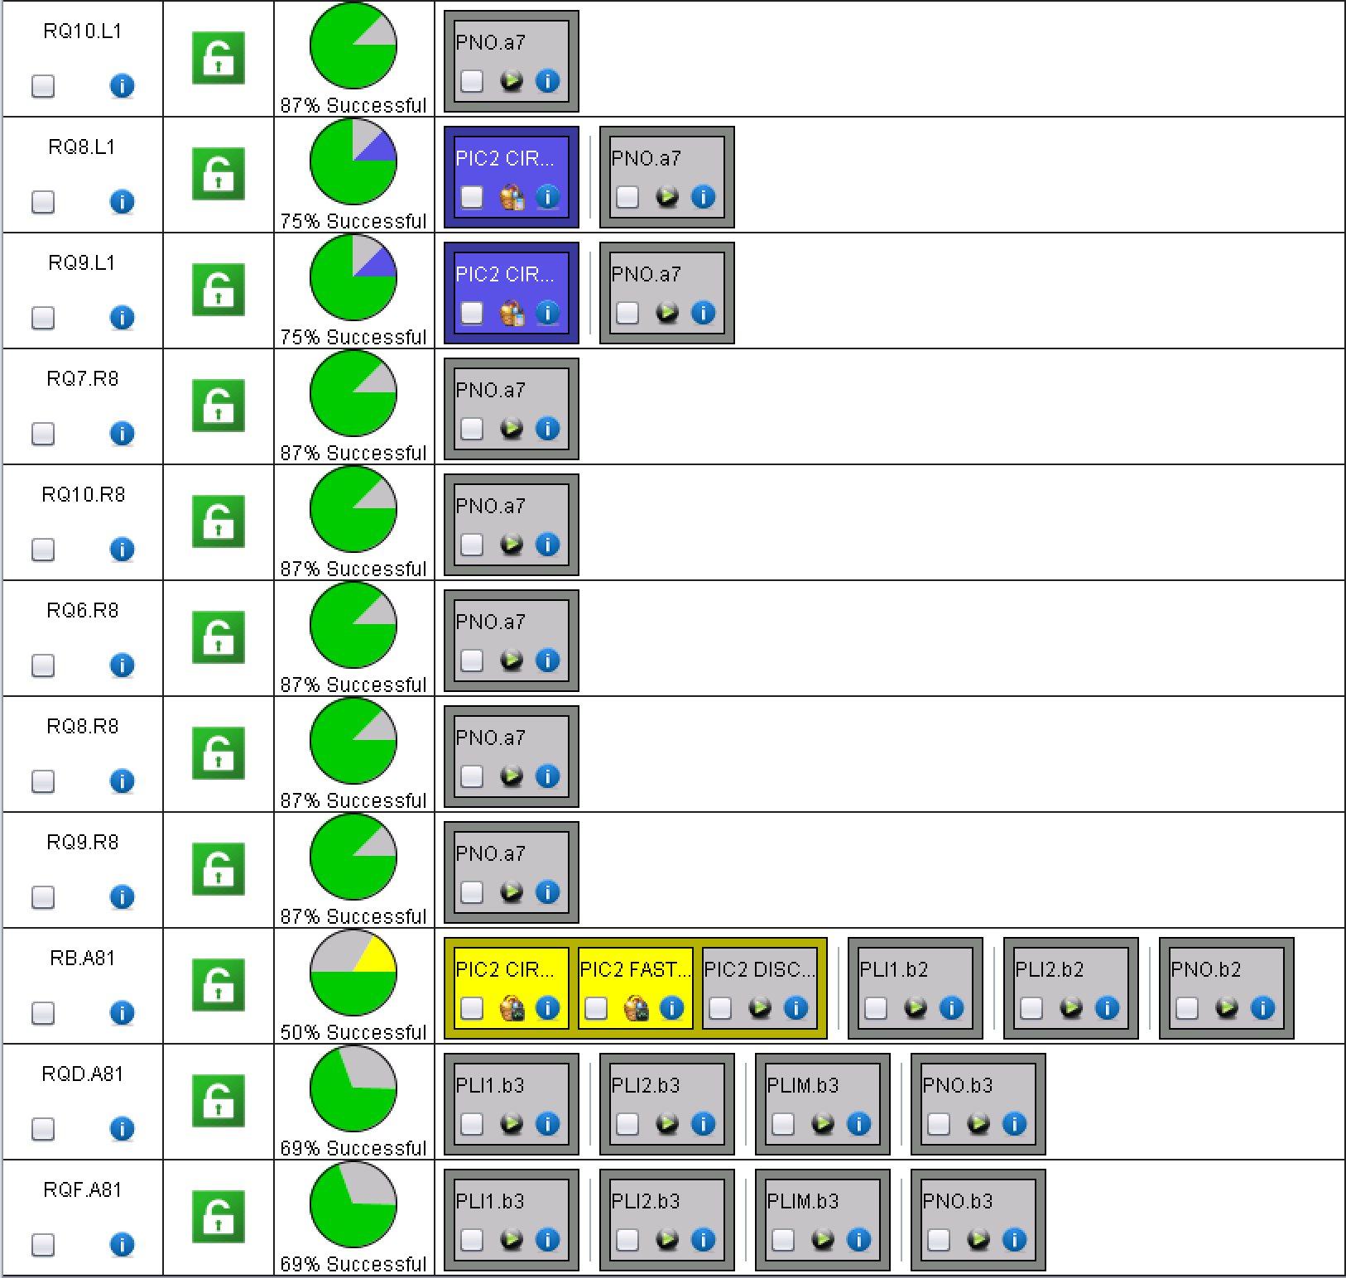
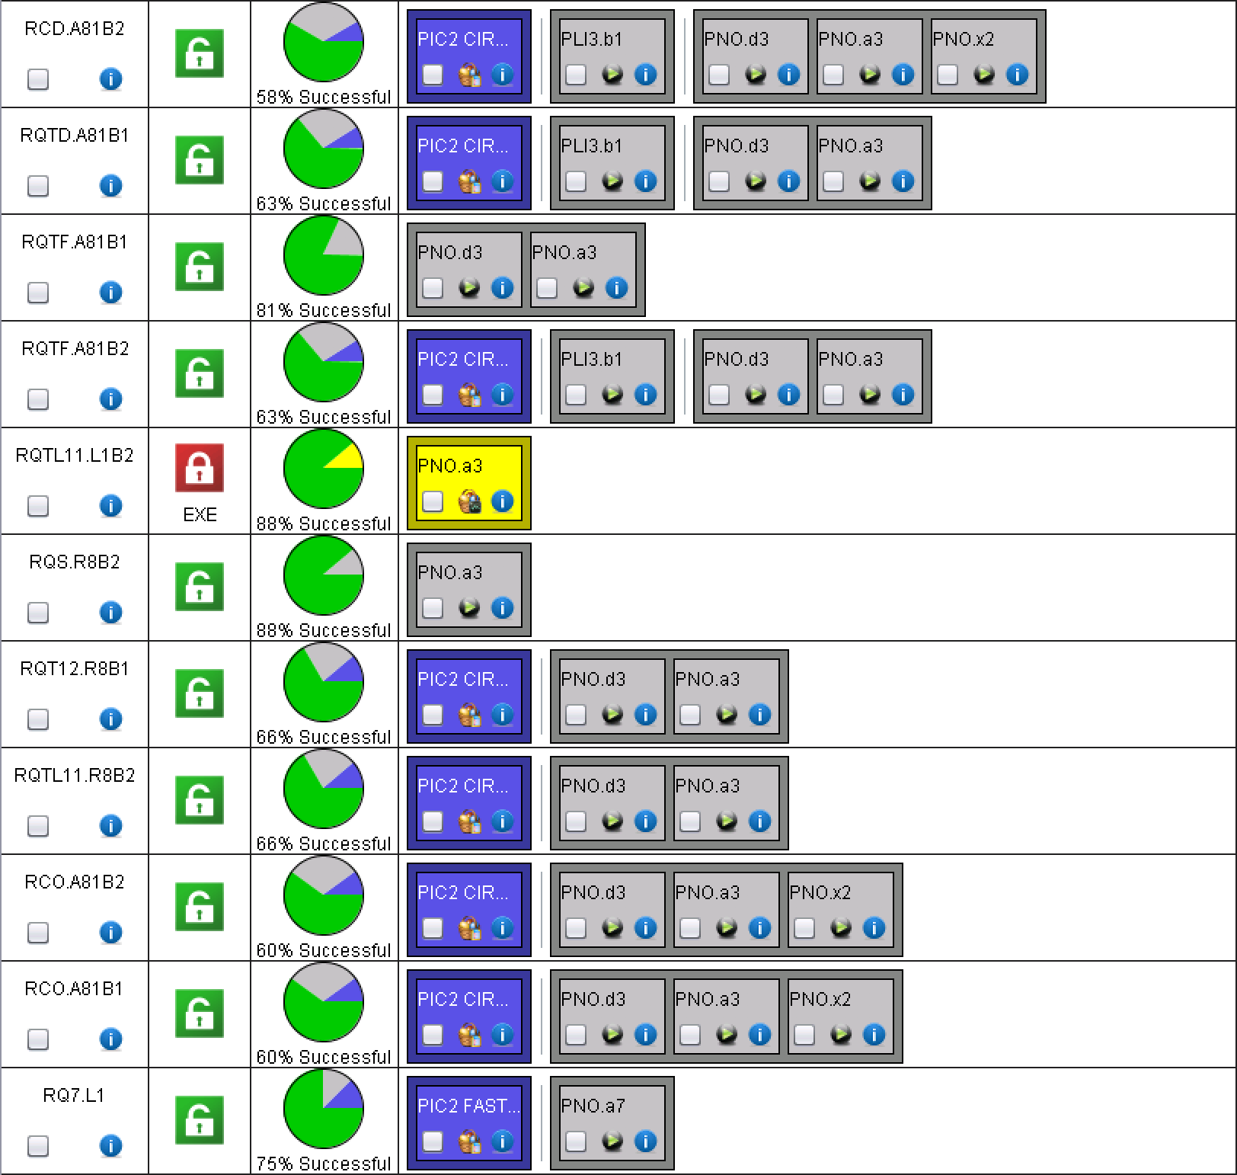
A81

Slide 26
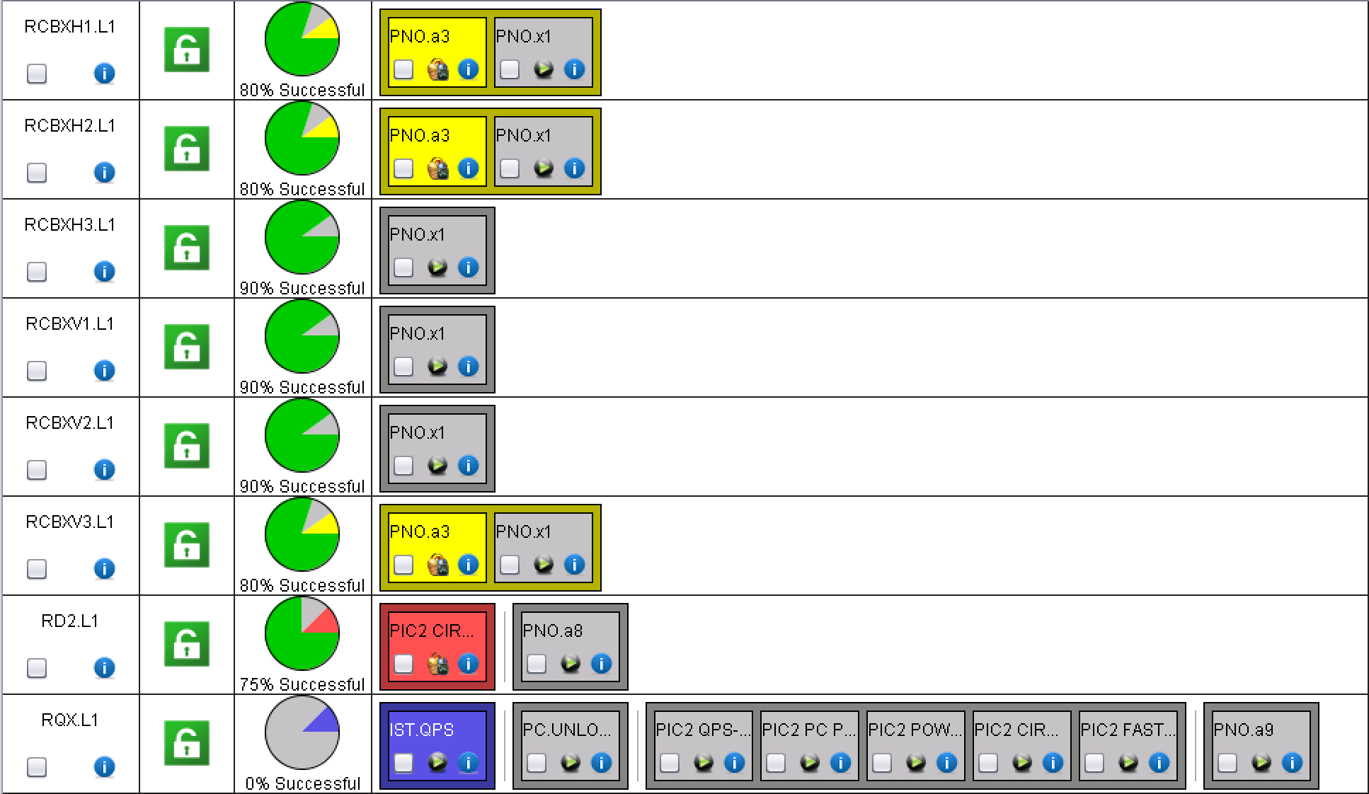
ML1 and XL1
LSA value to be updated: tests today

Slide 27
For the future…

Slide 28
LHC main converter calibration
I would like to ask you to foresee a window of about half a day during hardware commissioning for the calibration of all the LHC main dipole and quadrupole and inner triplet converters.
This can also be done per sector in which case I would require about ½ hour per sector.
This is done by me remotely in coordination with the engineer in charge. It requires the converters to be unlock and OFF, with all faults cleared.
The calibration simulates a current of 13kA in the converter so any interlocks that might trip the converter at that current need to be masked. I will let you evaluate when is the best moment to do it, minimizing the impact on commissioning.
Miguel
To be organized possibly at the end of next week!

Slide 29
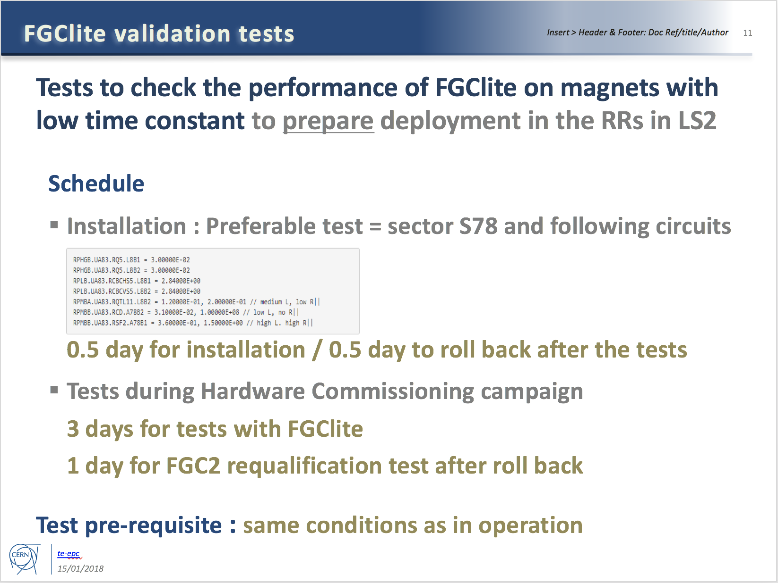
Additional tests required by EPC
To be done after circuit commissioning (if time allows)

Slide 30
Specific Powering Tests – High Priority
# | Description | Test duration * | Period | Cryo
1 | Local (30 m) localisation of shorts in RCS.A78B2, RCO.A78B1, RCO.A78B2 | 2 days | End of the powering tests. | 1.9 K
2 | Global (400 m) localisation of short in RCO.A45B1 | 1 day | Start YETS (DONE) | 1.9 K
3 | Change in EE delay of RB circuits | 0.5 day | During powering tests | 1.9 K
4a | Voltage pick-up of the QPS due to current in the bypass diode | 2 days | Anytime during YETS | <20 K
4b | Heater-induced quench on 2 MB’s | 0.5 day | Start YETS (DONE) | 1.9 K
5 | Quench heaters test in S12 | 0.5 day | End of YETS, during the QPS IST | 1.9 K
6 | Resistance in RQF.A23 and RQD.A78 | 1 day | End of powering tests | 1.9 K
Installation finalized
900 V tests to be done
*: not including the time for installation & removal of equipment

Slide 31
Specific Powering Tests – Medium Priority
# | Description | Test duration * | Period | Cryo
7 | Change in EE delay of RQD/F circuits | 0.5 day | During powering tests | 1.9 K
8 | Resistance in ROD.A56B1 | 1 day | Start of YETS (DONE) | 1.9 K
9 | Internal resistance of 3-6 MB’s | 1 day | Start of YETS or during powering tests | 1.9 K
10 | Investigate degradation of RCBXH/V in IR1/5 | 0.5 day | Start of YETS (DONE) | 1.9 K
System installed in S34
Results of investigations priori to YETS:
Short could not be reproduced in RCO.A45B1 (only few 100kOhms occasionally visible)
2 heater induced quenches performed in S45
Location of increased resistance in ROD identified, segment in question to be bypassed in LS2
None of the 12 RCBXH/V circuits showed any visible degradation after having been cycled many times and after having seen quite a bit of radiation. Final conclusions will be made after the powering test in March 2018.
*: not including the time for installation & removal of equipment

Slide 32
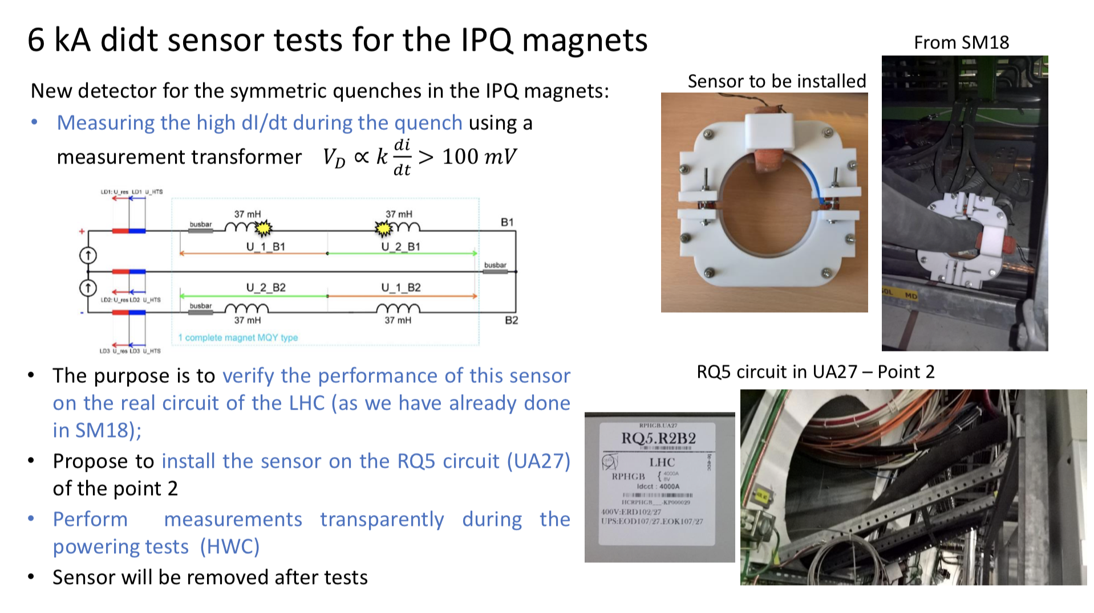
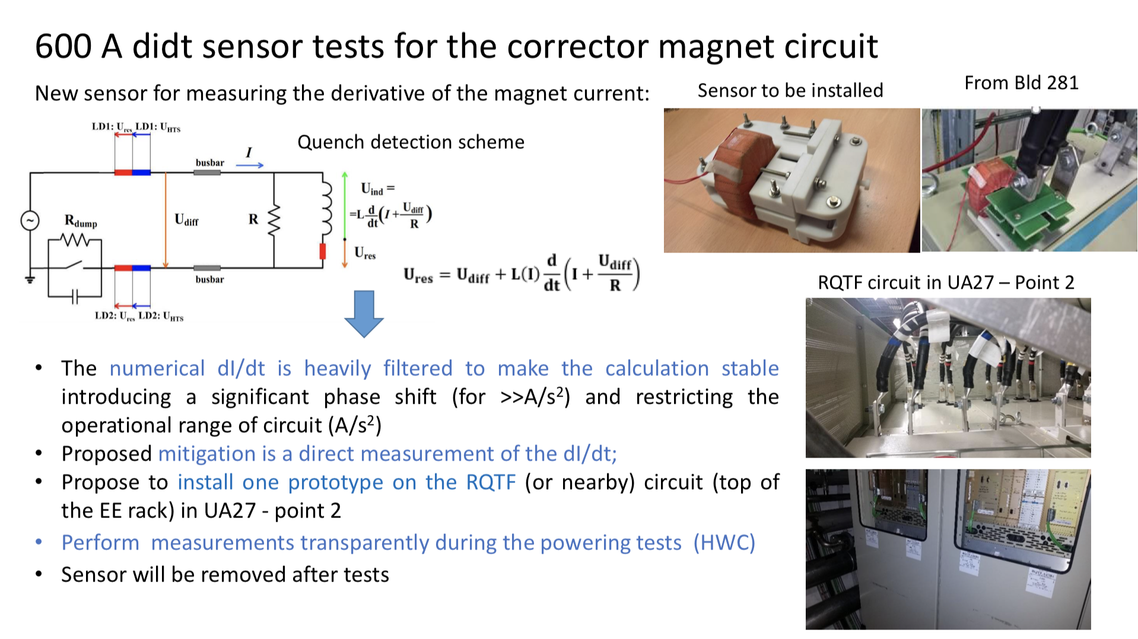
Powering at high current for RQ5.R2 and RCD.A23B1 could be done today

Slide 33
Conical connection check in UA27
Following the problem with the conical connection after LS1, MPE would like to repeat the conical connection measurements in UA27
  System installed before end of YETS
  Measurements parasitically done
  System to be removed at the end of commissioning (condemnation required)

Slide 34
For the future future…
For IPQs: PNO.a7 sometimes fails on Wait PCs to be FAULT_OFF; should probably increase the timeout
For all, but in particular the 600 A: should separate the PNO@training_current from the other tests
For 600 A: should reset the EE automatically after SOF mode
….

Slide 35
Thank you for the attention!

