Slide 1
So, what’s up?

Slide 2
Reguest
WiFi
Outline of the 3 days

Slide 3
At IdeaSquare
Be curious, be open.
Antidiciplinary space. (we’ll casually ask you to act as writers)
Forbidden word: ”…BUT…”

Slide 4
WIFI access
Connect to CERN wifi to register a device
→ Open a browser & follow instructions
Name: TUULI MARIA UTRIAINEN
Be patient!

Slide 5
Outline of the 3 days
Day I – Reframing
Day II – Ideas
Day III - Vision
Working sessions = green
Presentations by YOU = blue
Slides & schedule at:
https://indico.cern.ch/event/713728/timetable/#20180314

Slide 6
Day I – Reframing
Markus: CERN & parallel universes, loosening you up (8:30)
Harri: Intro to IdeaSquare (10:30)
Tuuli: Intro to 3 days (10:45)
Giovanni: CERN Technology deep dive (11:00)
Strangers: During lunch (12:05)
Microcosm visit @ CERN B33 (13:30)
Markus: Who you met during lunch (14:15)
Teams: Present work so far (14:30)
Tuuli: Framing technologies, problems and futures (15:45)
& Entrepreneurial guest (17:30)

Slide 7
Day II – Ideas
Romain: Orientation through movement (8:45)
Tuuli: Scamper (9:45)
Raghu: Sci-fi (10:20)
Geneva: Ethics of Innovation (11:00)
! Team work time (14:00-16:00) !
Tuuli: Solution brainstorm (16:00)
… & Innovation Beer@R1

Slide 8
Day III – Vision
Claudia: Message (9:00)
Teams present visions: Feedback from Markus, Daria (10:00)
! Team work time (11:00-14:00) !
Teams present problem, solution, vision: Feedback from Claudia and Geneva
Wrap up and Clean up!
+ Cosmic Egg Award

Slide 9
- - questionnable photoshopping - -

Slide 10
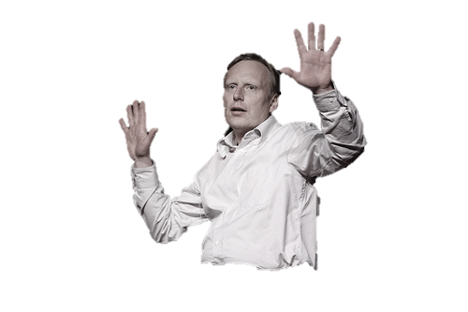
Parallel universes
MARKUS

Slide 11
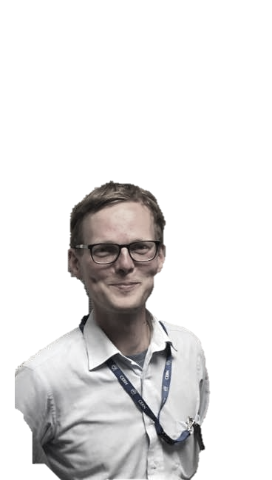
IdeaSquare
HARRI

Slide 12
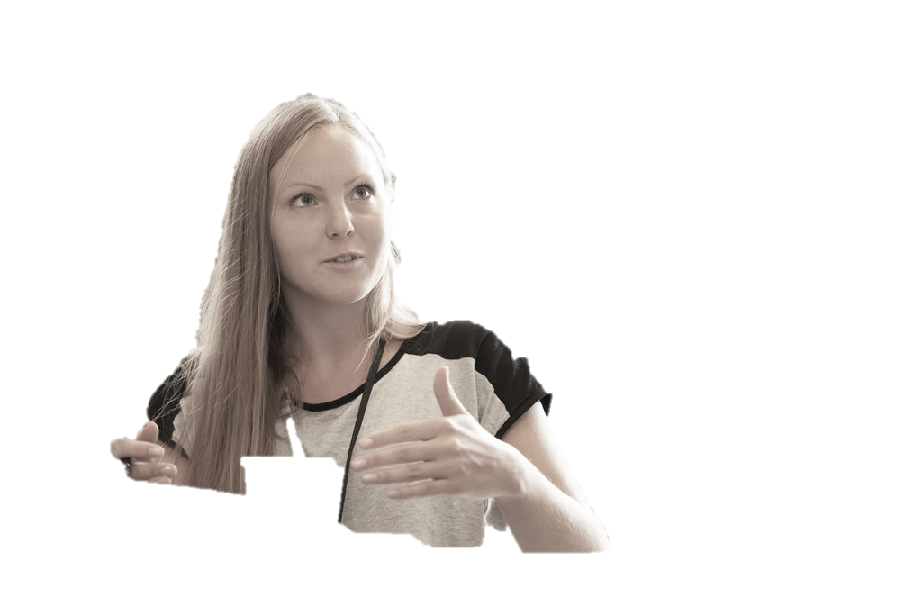
Various topics
TUULI

Slide 13
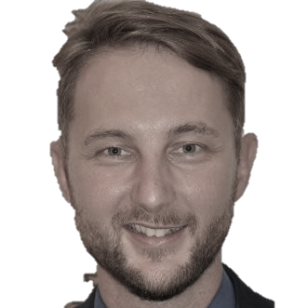
Orientation through
motion
Romain Muller

Slide 14


Ski-fi
RAGHU

Slide 15
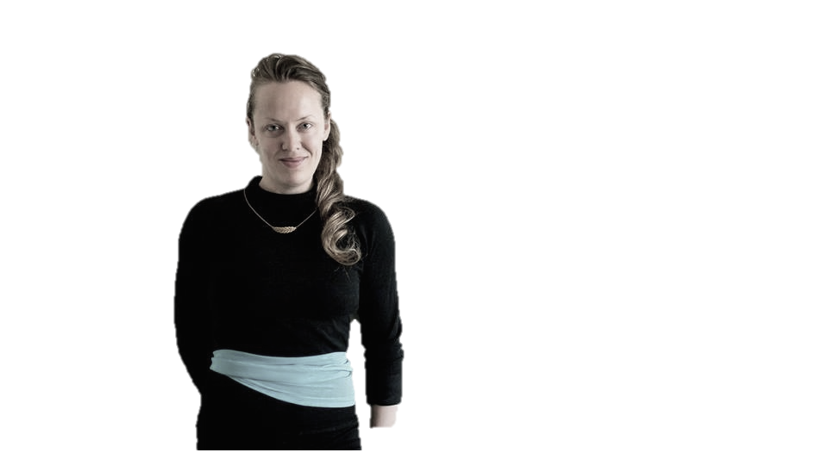
Ethics of Innovation
GENEVA

Slide 16
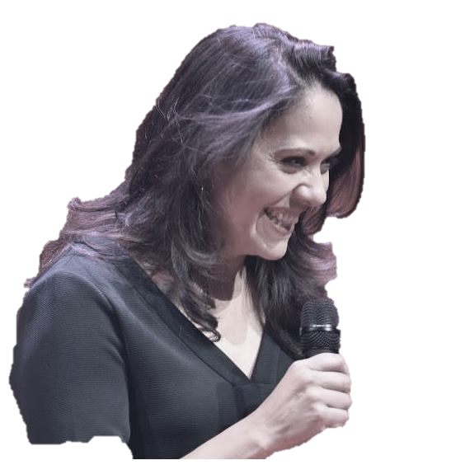
Message
CLAUDIA

Slide 17
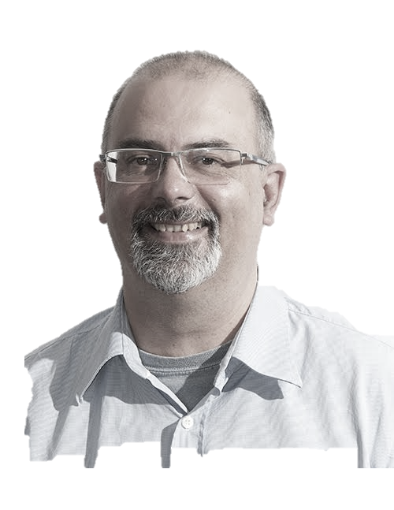
Exponential thinking
PABLO TELLO
POW!

Slide 18
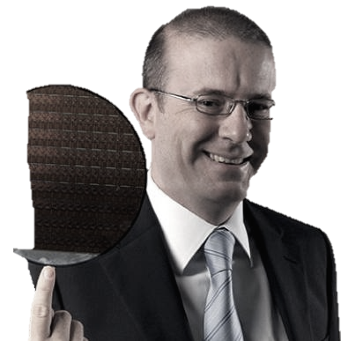
Technology application
GIOVANNI

Slide 19
Before LUNCH…

Slide 20
Talk to Strangers
Introduce yourself and what you are doing at IdeaSquare.
(mention you are a student ;)
Ask about what the person is doing, what they love about it…
see if you can find something in common.
! Write down the name and the experiment !
Invite for sessions:
Thursday afternoon 14-16
Friday 11-14 or presentations at 14 -->
Be ready to report back 14:15

Slide 21
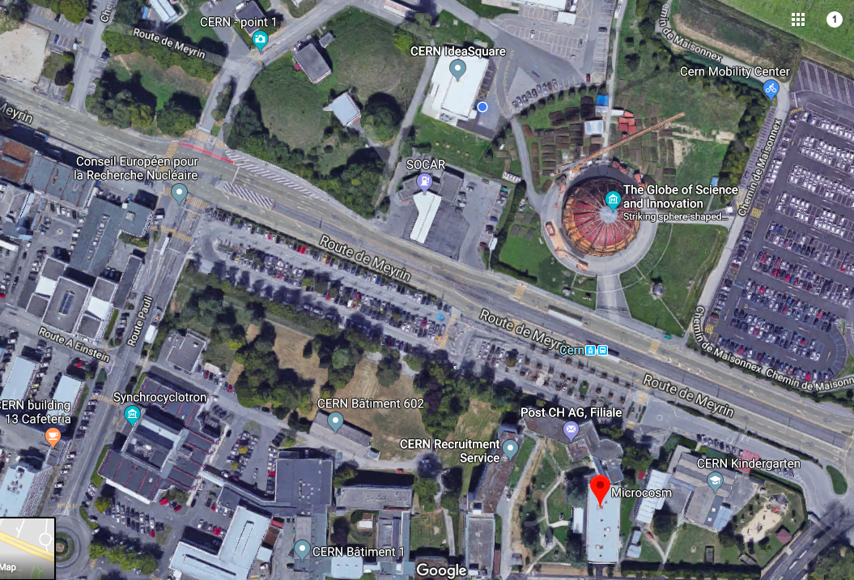
Microcosm →

Slide 22
Cupons!
Water outside!
Don’t get lost!

