Slide 1
IDEAS - - - - -
// SCAMPER // CANVAS
15.3.2018 Tuuli U @ IS

Slide 2
Ideas are building parts for innovation,
raw material.

Slide 3

Solutions
Put up at least 20 ideas.
They will be raw material for your project, go for diversity!
SCAMPER
SCIFI
SOCIAL BEHAVIORS
…
-- smart zone --
-- are you crazy zone --
-- daring zone --

Slide 4
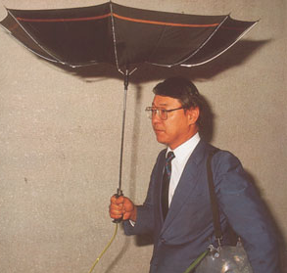

No bad ideas!
No wrong way to ideate!
Start alone.
Use triggers.
Go for diversity and quantity.

Slide 5
Substitute.
Combine.
Adapt.
Modify.
Put to another use.
Eliminate.
Reverse.
SCAMPER

Slide 6

Substitute.
Combine.
Adapt.
Modify.
Put to another use.
Eliminate.
Reverse.
Local plants?
Heating from washing mashene?
Coffee machine as water heater?
SCAMPER
Coffee, tea, coco nespresso bags?
Tint DIY? Compost?
Cold coffee?
Coffee grind powder to pellets?

