Slide 1

The ethics of
innovation

Slide 2
Who are you?

Slide 3
Learning objective:
Identify and challenging invisible assumptions that constrain outside
the box thinking.

Slide 4
Understanding morals v. ethics
Morality
Killing is bad.
Honesty is good.
(Charactised by being ‘bad or good’)
Ethics
Do no harm.
Provide competent
services to clients.
(Characterised as a ‘rule of conduct’)

Slide 5
What are some examples of innovation?
5 minutes in break-out groups

Slide 6
I bet all of your examples of innovation are of things.

Slide 7
Innovation:
The introduction of a new idea, method or device.
- Merriam-Webster dictionary

Slide 8
What are some examples of innovative ideas throughout history?
5 minutes in break-out groups

Slide 9
Mythology 13th-9th BC
Death of truth
21th century
Christianity
1th century
Copernicus
15th century
Newton
16th century
Slavery is wrong
20th century
Enlightenment
18th century
Planck, Maxell, Einstein 20th
century
Renaissance
14th - 17th century
Galileo
15/16th centuries
Islam
7th century
Feminism is a thing
20th century
Buddha, Confucius,
Socrates, Plato, Aristotle
400 – 300 BC

Slide 10
What made these ideas innovative?

Slide 11
What are some of the
biggest challenges that humanity and the planet
face today?

Slide 12
How do you contribute
to them?

Slide 13
What do these challenges
look like in 25 years?

Slide 14
Have you continued to contribute to the problems?

Slide 15
Why?

Slide 16
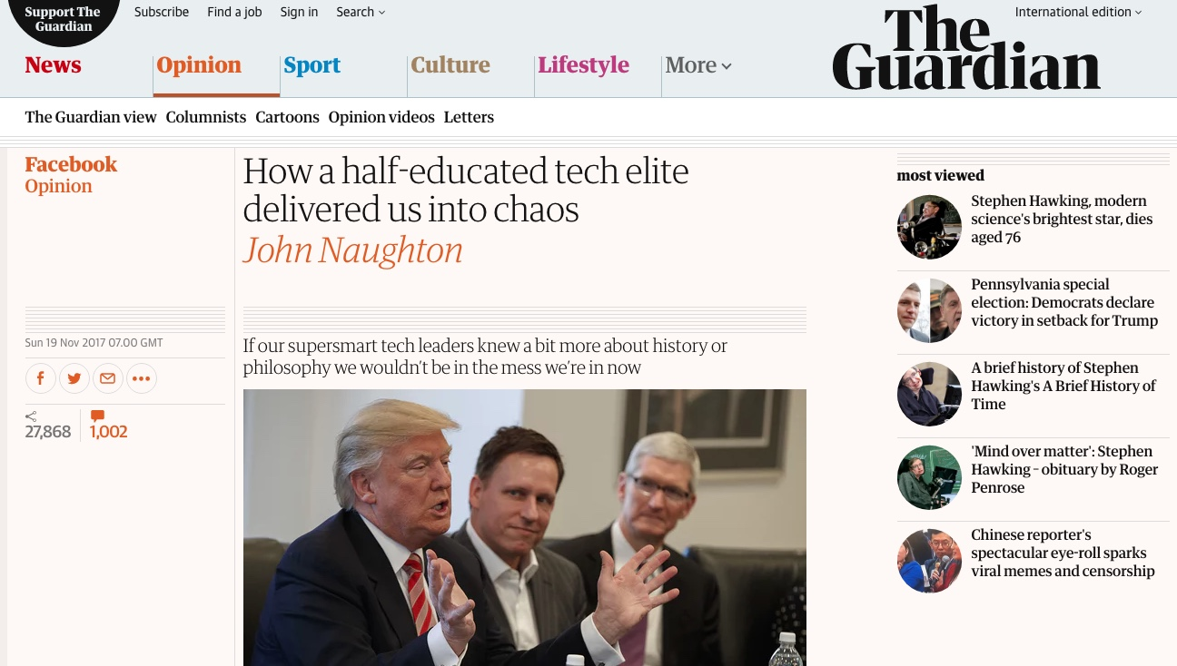

Slide 17
Can you identify some assumptions your current
work is built upon?
5 minutes in break-out groups

Slide 18
“We can’t solve problems by using the same kind of thinking that created them.”

Slide 19
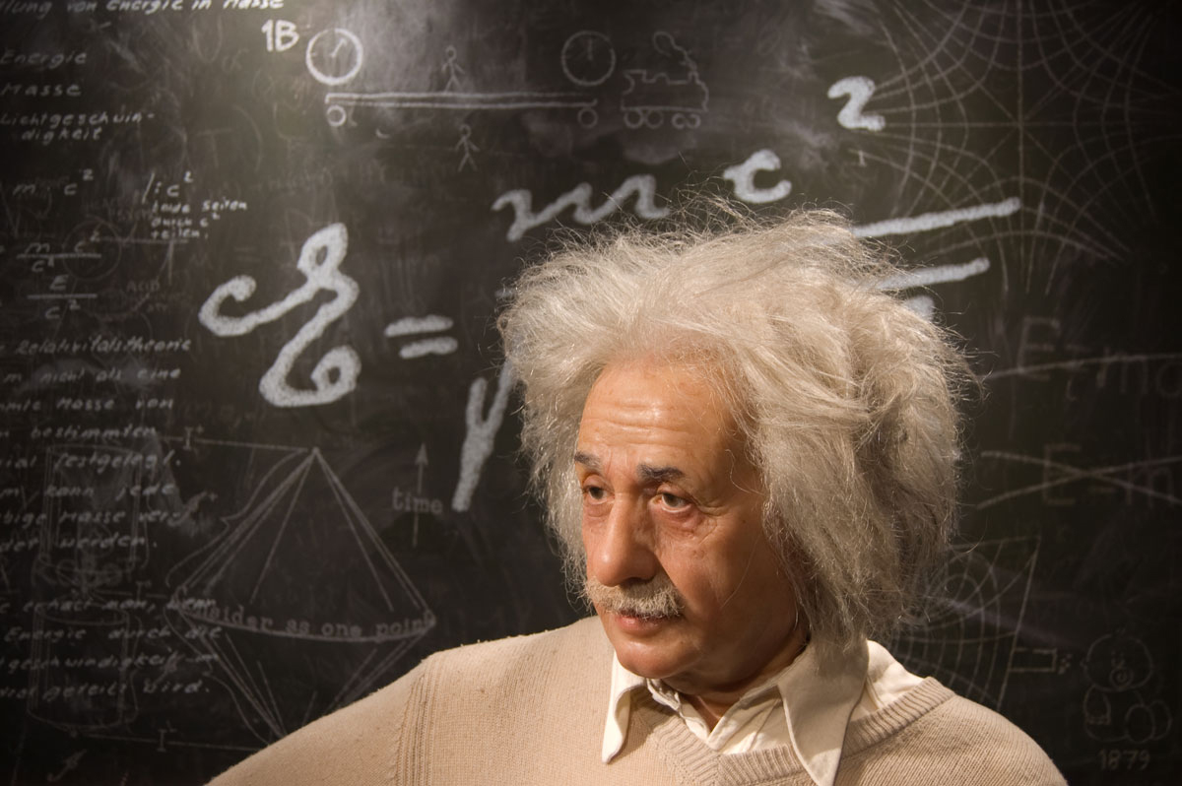

Slide 20
