Slide 1
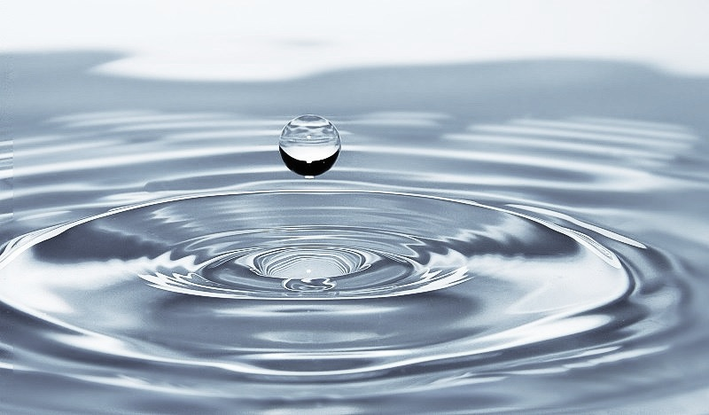
RIPPLE EFFECTS - - - - -
//Beerstorming
15.3.2018 Tuuli U @ IS

Slide 2
BRING YOUR MOST UNLIKELY
AND FAVORITE IDEA (on papers).
2 minutes.
Present – into the box

Slide 3
Ripple effect:
“the continuing and spreading results of an event or action.”

Slide 4
Ripple effect:
“the continuing and spreading results of an event or action.”
Intentional and unintentional effects spread across space and time

Slide 5
Paper recycling in Brazil
Snake farming in India

Slide 6
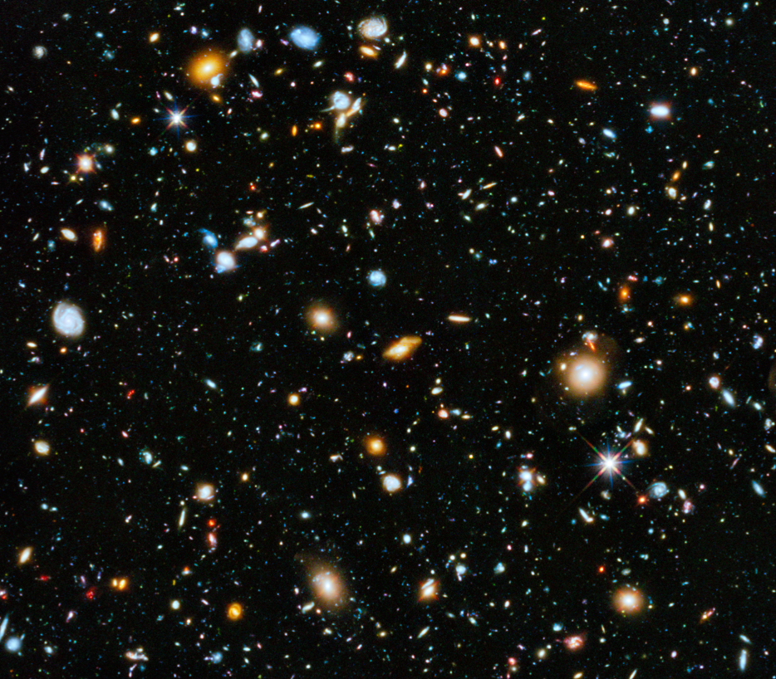
first wave
second wave
third wave

Slide 7
Invention of
bookpress
first wave
second wave
third wave

Slide 8
Spreading propaganda got easier
Invention of
bookpress
Reading got popular
first wave
second wave
third wave

Slide 9
Spreading propaganda got easier
Good light conditions became important for entertainment
Invention of
bookpress
Reading got popular
Eyeglasses became important
first wave
second wave
third wave

Slide 10
Spreading propaganda got easier
Good light conditions became important for entertainment
Cases for glasses a new market
Invention of
bookpress
Reading got popular
Eyeglasses became important
Developments in lens technology gave birth to microscopes..
first wave
second wave
third wave

Slide 11
Photo-synthesis to genome
first wave
second wave
third wave

Slide 12
Skin turns green
Food industry collapses
Photo-synthesis to genome
Sun as source for feeding
first wave
second wave
third wave

Slide 13
Techno racism
Skin turns green
Color schemes of fashion industry
Food industry collapses
Spending time outside increases
Photo-synthesis to genome
Sun as source for feeding
Finns naturally thinner than Brazilians
first wave
“Light restaurants”
second wave
third wave

Slide 14
Techno racism
New forms of social tension
Skin turns green
Color schemes of fashion industry
Food industry collapses
Spending time outside increases
Photo-synthesis to genome
Sun as source for feeding
Office is the cafeteria
Finns naturally thinner than Brazilians
first wave
Menus based on spectrum
“Light restaurants”
second wave
third wave

Slide 15
Desirable?
Techno racism
New forms of social tension
Skin turns green
Color schemes of fashion industry
Food industry collapses
Spending time outside increases
Photo-synthesis to genome
Sun as source for feeding
Office is the cafeteria
Finns naturally thinner than Brazilians
first wave
Menus based on spectrum
“Light restaurants”
second wave
third wave

Slide 16
Generate ripple effects
5ish minutes per wave - go for quantity
Select the most juicy one from 3rd wave.
Present!

Slide 17

SHARE TIME

Slide 18
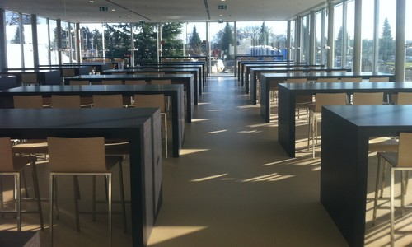
!Beerstorming!

Slide 19
Go for quantity = pitchers
!Beerstorming!

Slide 20
Borrowed from Open space…
The Four Rules state:
1. Whoever come are the right people (invite CERNers to join!)
2. Whatever happens is the only thing that could have
3. Whenever it starts is the right time
4. When it’s over, it’s over
The Law of Two Feet states that:
“If, during the course of the gathering, any person finds themselves in a situation where they are neither learning nor contributing, they can go to some more productive place.”

Slide 21
Bring something you’d like to explore (on paper + pens…)
Question
Solution canvas
Problem
….
Clear definition, brings good outcomes.

Slide 22
Innovation is an inherently inefficient process.
Being effective would imply that you already know precisely what you are doing beforehand.

Slide 23
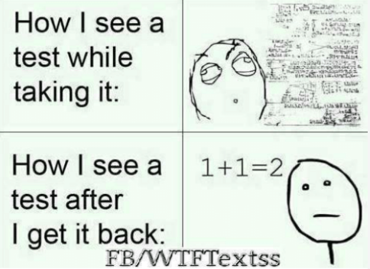

Slide 24
…or Steve Jobs and connecting the dots

Slide 25
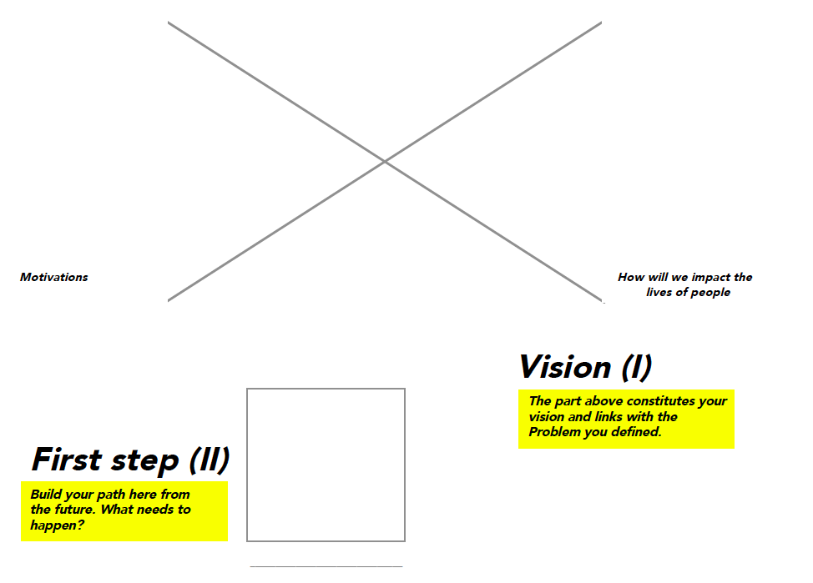
Tomorrow: Vision

Slide 26
!Beerstorming!

