Slide 1
National e-Infrastructure Vision
Dr Anthony Davenport
Accelerator & e-Science Programme Manager
STFC

Slide 2
e-Infrastructure Current position?
Computational Science ‘third leg’ of scientific enquiry, alongside experiment and theory;
Expert users need access to competitive infrastructure to tackle increasingly complex problems: complex simulations and calculations, multi-scale modelling;
Large experiments (e.g. CERN, telescopes, genomics) – need to analyse all the data
Social, medical, health data – analytics plus secure access
New fields now using computational techniques for the first time – large numbers of `non-experts`;

Slide 3
E-Infrastructure as a Research Tool (not a IT system / black box / Tin)
E-Infrastructure is essential for carrying out research in a very wide range of areas
  Optimisation, modelling, simulation, data analysis
  Ubiquitous
  Promoting its use to new research users – better, more cost-effective research
  Underpins other research facilities (e.g. Diamond)
  Underpins most industrial sectors
E-Infrastructure needs regular updating and replacing as technology develops
  Need long-term financial planning

Slide 4
NeI Components
Computers
Data storage systems
  Infrastructure and tools to manage large-scale research data
Software
  operating systems
  applications codes
Networks – Janet and university/institute networks
Digital services, policies and processes:
  Information assurance and governance
  Security
  Allocations, authentication and access
Cloud
  Commercial cloud services
  Academic clouds
  International: EU Open Science Cloud
People – researchers, managers, developers
  Skills and training
NOT JUST HARDWARE!

Slide 5
Not Just Computers
PEOPLE
COMPUTERS
SOFTWARE

Slide 6
The Long term
We are here
Cost
We need to get to here
Time
Cost
Cost
Cost
Capacity
Capacity
Capacity

Slide 7

RESEARCHERS
INDUSTRY
PUBLIC SECTOR
PORTALS
ACCESS MANAGEMENT
JANET NETWORK
JANET NETWORK
Secure
Secure
High Performance Computing
Data Intensive Computing
High-throughput Computing
Software & Data Analytics
JANET NETWORK
National, Regional & Local Service
Providers
Repository & Curation
Services for Data

Slide 8

Enablers & Services
Industry Interactions
  Suppliers
  Users
  Collaborators
Cross RC collaboration
Research Software Engineers
Network
Data Curation
AAAI
Data Storage

Slide 9
RCUK Interactions with BEIS
2015 - Initial discussions with the RC and community leads
Early 2016 – Initial discussions with BEIS through RCUK eIWG
Mid 2016 – Completed a RC wide Business Case
Late 2016 – Received feedback from BIES

Slide 10
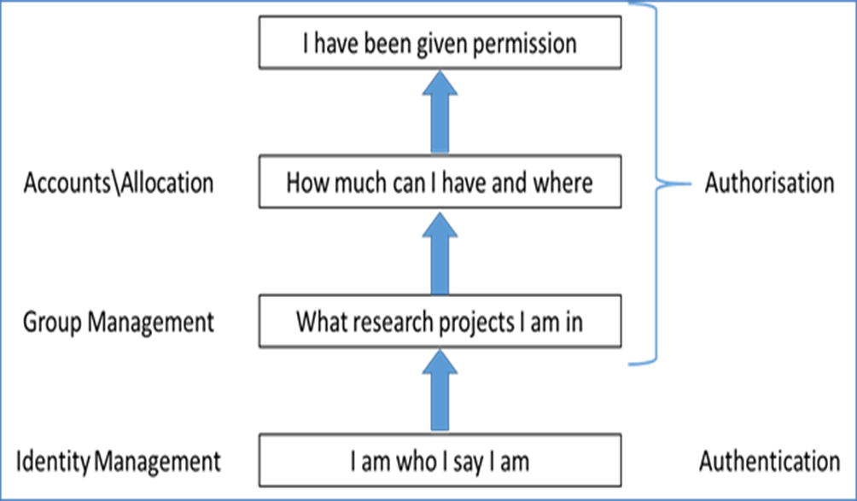
Integrated AAAI
Pilot projects for proof of concept: can we develop a common AAAI system so that users can have a single sign-on?
Interoperability and integration of existing tools

Slide 11
Round 2 with BIES
Took on board BEIS Feedback
Created a shorter and aimed discussion at a higher level
Removed the RC specifics and focused on the vision
Document created and submitted
BEIS invited critical funding Business Cases (on going)

Slide 12
STFC towards the NeI
Recognises the need for an NeI
Is in the strongest position of all the RC’s
Wants to lead the way, collaborating with the other RC’s
‘Towards a UK NeI’ STFC call

Slide 13
Summary
Cross Community and Council work is seen as very important
We understand the constraints on funding and are trying to help where we can
The NeI is a vision towards the future, but will not be easy or quick
All the RC’s are working hard on understanding the needs of the UK research base, and translating it to BEIS

Slide 14
E-Infrastructure Definition
e-Infrastructure is defined as a combination of:
  computer hardware
  data storage hardware
  software tools (operating systems, digital and software libraries, access management systems etc.)
  application software codes
  communications networks
  The personnel associated in the delivery of the above items
and the people and organisational structures needed to support the modern research and innovation landscape. e-Infrastructures function to transform research activities and data into the whole range of research and innovation outputs.

Slide 15
E-Infrastructure Definition Cont.
Data collection aspects of research activities are excluded: the point of generation of data in the first instance (e.g. instruments, observation, experimental set-ups) is research-area-specific in its commissioning and funding, and therefore should be dealt with by the appropriate sector.
Similarly data projects and databases themselves are also excluded. The management of data (access, curation and manipulation) is research-area-specific, and so data resources should be dealt with as assets in their own right by the appropriate sector. The tools used (storage hardware, networks for moving data, software for analysis) would be included as part of the e-infrastructure landscape.
Desktop and departmental compute and storage for the basic needs of a modern researcher, in the form of laptops, work stations and related institutional support is excluded.

Slide 16
Towards the NeI Call
“STFC recognises the importance of a RCUK wide National e-Infrastructure (NeI) and the positive effect that it would have on STFC and the wider UK research community. STFC is keen to take on a leading role in moving towards a NeI, where all areas of UK research can benefit from the combined knowledge and understanding from each other’s areas of expertise. As a direct result, STFC programmes directorate would like to strengthen our position in creating a more joined up computing infrastructure (both in terms of computing hardware as well as software and people).”
“This computing capital call aims to develop STFC’s existing computing infrastructure within the context of moving towards a future NeI. It has become increasingly more important to share expertise and experience across both the RC community as well as through industrial partnerships. Our ambition is to create greater benefits to the Programmes Directorate (PD) science programme, the wider STFC science programme and external stakeholders through creating combined strength in large scale computing.”
“Proposals should aim to: Contain a primary purpose statement on overcoming key challenges in the lead up to the implementation of a NeI;”

